Slide 1
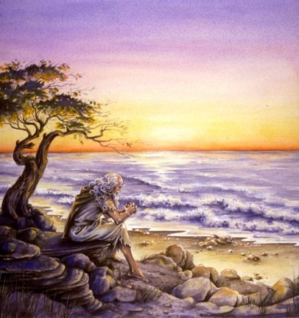
The Book of 1 John
To Download this lesson go to:
http://www.purifiedbyfaith.com/1John/1John.htm
https://revelationillustrated.com/

Slide 2
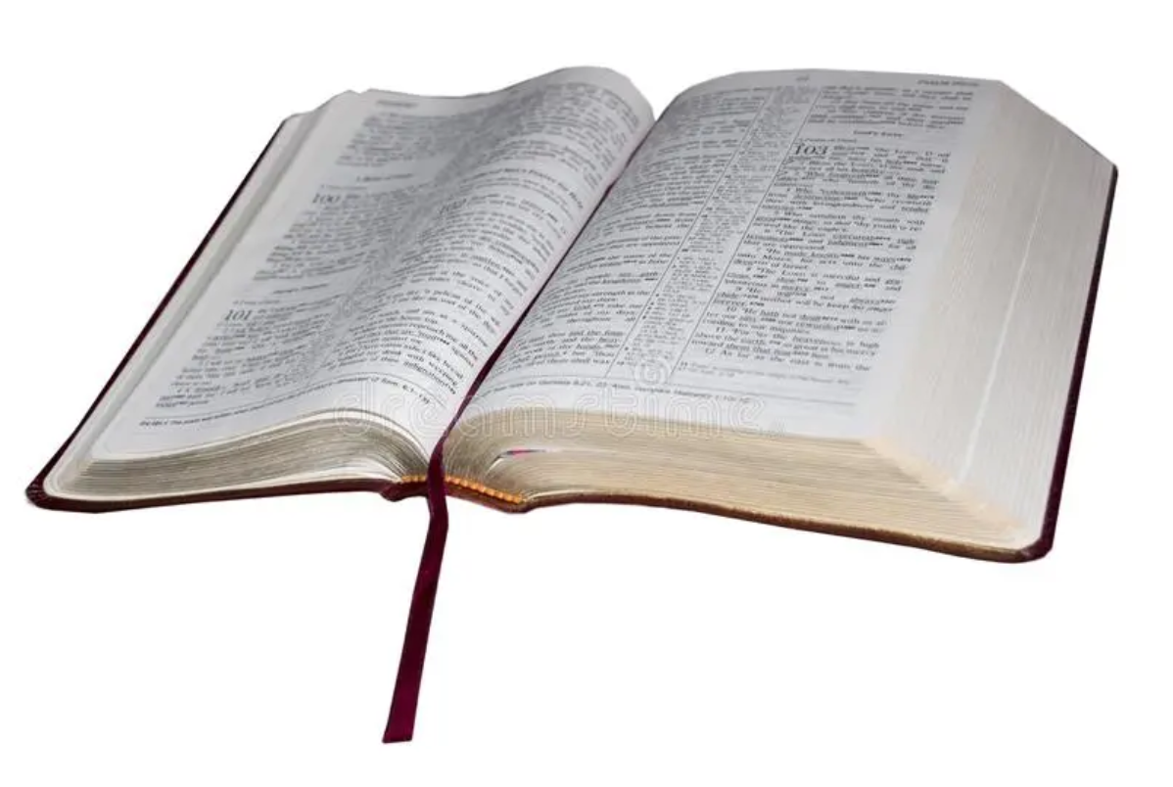
1 John 2:29 – 4:6
The Second Presentation of the Three Tests of FELLOWSHIP WITH GOD: RIGHTEOUSNESS, LOVE and BELIEF in Jesus
To Download this lesson go to:
http://www.purifiedbyfaith.com/1John/1John.htm
http://ullesthorpe.org/bible-owner/

Slide 3

Outline of 1 John
1:1-4 - Prologue: John Introduces the Major Theme of the Letter - FELLOWSHIP WITH GOD
1:5-2:28 - The First Presentation of the Three Tests of FELLOWSHIP WITH GOD: RIGHTEOUSNESS, LOVE and BELIEF in Jesus
2:29-4:6 -The Second Presentation of the Three Tests of FELLOWSHIP WITH GOD: RIGHTEOUSNESS, LOVE and BELIEF in Jesus
4:7-5:21 - The Third Presentation of the Three Tests of FELLOWSHIP WITH GOD: RIGHTEOUSNESS, LOVE and BELIEF in Jesus
Robert Law, The Tests of Life, Third Edition, 1914, p.21-24

Slide 4
2:29-4:6 The Second Presentation of the Three Tests of DIVINE SONSHIP: RIGHTEOUSNESS, LOVE and BELIEF in Jesus
2:29-3:10a - Divine Sonship tested by RIGHTEOUSNESS
God is righteous therefore everyone who “does what is right” is “born of Him” (2:29)
The present status and future hope of the “children of God” (3:1-3)
Divine Sonship is utterly contrary to all sin (3:4-10a)
3:10b-24a - Divine Sonship tested by LOVE
Anyone who does not obey the command to “love one another” is not a child of God (3:10b-11)
Cain as the model of murder and hate - whose example is followed by the world (3:12-15)
Christ as the model of love – whose example we must follow in order to have confidence in our relationship with God (3:16-24a)
3:24b-4:6 - Divine Sonship tested by BELIEF in the Spirit’s Message

Slide 5
1 John 2:29-3:10a Divine Sonship Tested by Righteousness
Instead of viewing the Christian life in terms of fellowship with God, as he did in the first cycle, the apostle now describes the Christian life in terms of divine Sonship.
This characterization of the Christian life is an advance beyond the concept of fellowship. The family relationship is a much closer relationship . . . Family members are not merely companions who are united by common interests and experience. They are bound together by birth.
Donald W. Burdick, The Letters of John, Moody Press, 1985, p.224

Slide 6
1 John 2:29-3:10a Divine Sonship Tested by Righteousness
Just as human children inherit certain characteristics from their parents, so everyone “born of God” (i.e., every true Christian) “inherits” certain divine characteristics from God the Father.
John teaches us that those who inherit these divine characteristics, will show it in their life!
The principle running through this section is “Like father, like son.” He who is a child of the devil manifests the devil’s likeness; he who is a child of God manifests the divine likeness.
Donald W. Burdick, The Letters of John, Moody Press, 1985, p.224

Slide 7
2:29-4:6 The Second Presentation of the Three Tests of FELLOWSHIP WITH GOD: RIGHTEOUSNESS, LOVE and BELIEF in Jesus
2:29-3:10a - Divine Sonship tested by RIGHTEOUSNESS
God is righteous therefore everyone who “does what is right” is “born of Him” (2:29)
The present status and future hope of the “children of God” (3:1-3)
Divine Sonship is utterly contrary to all sin (3:4-10a)
3:10b-24a - Divine Sonship tested by LOVE
Anyone who does not obey the command to “love one another” is not a child of God (3:10b-11)
Cain as the model of murder and hate - whose example is followed by the world (3:12-15)
Christ as the model of love – whose example we must follow in order to have confidence in our relationship with God (3:16-24a)
3:24b-4:6 - Divine Sonship tested by BELIEF in the Spirit’s Message

Slide 8
1 John 2:29 John’s Opening Statement on Divine Sonship
²⁹ If you know that he is righteous, you may be sure that everyone who practices righteousness has been born of him.

Slide 9
When we compare this verse with the first half of the very next verse, we see that “He” / “Him” refers to God the Father:
1 John 3:1a – See what kind of love the Father has given to us, that we should be called children of God…
²⁹ If you know that he is righteous, you may be sure that everyone who practices righteousness has been born of him.
(1 John 2:29)

Slide 10
John says if we know that He (God, the Father) is “righteous”…
²⁹ If you know that he is righteous, you may be sure that everyone who practices righteousness has been born of him.
(1 John 2:29)

Slide 11
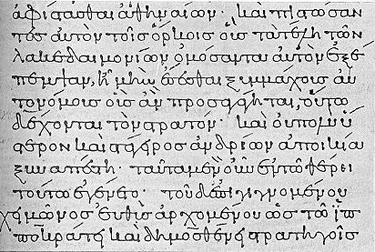
righteous di,kaioj dikaios
The term, dikaios, “righteousness”, refers basically to a standard.
In Greek usage, when applied to human beings, it spoke of a person who observes:
Customs
Legal norms
Laws
In the Septuagint (Greek translation of the Old Testament) God is often described as dikaios, meaning:
God is infallibly consistent in the normative self-determination of His own nature.
God’s actions, His declared standard of right and wrong, and His own nature are ever in perfect harmony
God is always self-consistent: “He cannot deny Himself” (2Timothy 2:13).
Donald W. Burdick, The Letters of John, Moody Press, 1985, p.228

Slide 12
John then compares the Father who “is righteous” to the people who “practice(s) righteousness”. The word translated “practices” (present tense participle of poieo) is a tense in the Greek that indicates that he is not talking about an occasional act of righteousness, but rather a habitual practice of righteousness (Burdick, p. 228; Plummer, p. 69)
²⁹ If you know that he is righteous, you may be sure that everyone who practices righteousness has been born of him.
(1 John 2:29)

Slide 13
John tells us we can be sure that the one who practices righteousness “has been born of Him”. This is a reference to spiritual birth. The word translated “born” (gennao) is in the Greek perfect tense of which indicates that their spiritual birth is an event that was completed in the past, but with results that continue to the present. In other words: The one who is making righteousness the practice of his life has been regenerated in the past, and as a result he is now a child of God who reveals the family trait of righteousness. (Burdick p.229)
²⁹ If you know that he is righteous, you may be sure that everyone who practices righteousness has been born of him.
(1 John 2:29)

Slide 14
born of him evk auvto,j genna,w ek autos gennao
This is the first of ten uses of the verb “to give birth to” (gennao) found in 1 John (2:29; 3:9 [2x]; 4:7; 5:1 [3x], 4, 18 [2x]).
In every case other than 2:29 God is explicitly mentioned as the one by whom those concerned are brought to birth. Therefore the ambiguous expression ‘born of him’ in 2:29 must also be interpreted to mean born of God.
For John, to be “born of God” was something quite distinct from natural human procreation, something that could not be effected by human action or desire, but only by God Himself:
John 1:12-13 - Yet to all who received him, to those who believed in his name, he gave the right to become children of God-- children born not of natural descent, nor of human decision or a husband's will, but born of God. (NIV)
Colin G. Kruse, The Letters of John, The New Pillar Commentary, 2000, pp.90-91

Slide 15
born of him evk auvto,j genna,w ek autos gennao
There are a number of words used in the New Testament that communicate the idea of spiritual birth (or, as it is sometimes called, “regeneration”):
gennao – “to give birth to” (John 1:13; 3:3-8; 1John 2:29; 3:9; 4:7; 5:1, 4, 18)
gennao with anothen - “born again” - (John 3:3, 7)
anagennao - “to bring again to birth” (1 Peter 1:3, 23)
suzoopoieo – “to make alive with” (Eph. 2:5; Col. 2:13)
paliggenesia – “rebirth” (Titus 3:5)
apokueo – “to bear or bring forth” (James 1:18)
New Bible Dictionary, Second Edition, 1982, “Regeneration”, p.1015

Slide 16
born of him evk auvto,j genna,w ek autos gennao
Surveying these terms, we notice that they all indicate a drastic change which may be likened to birth, rebirth, re-creation, or even resurrection.
The effects of sin on human nature are considered to be so serious that, without new birth, the sinner cannot see, let alone enter into, the kingdom of God:
John 3:3 - Jesus answered him, "Truly, truly, I say to you, unless one is born again he cannot see the kingdom of God."
Ephesians 2:5 – [God,] even when we were dead in our trespasses, made us alive together with Christ--by grace you have been saved–
New Bible Dictionary, Second Edition, 1982, “Regeneration”, p.1015

Slide 17
So what does it mean for a person to be “born of God”?
So far we have seen that being born of God:
Happens in a point of time, but with results that continue afterwards
Is something that God does (not man)
Is necessary because of the serious effect that sin has had on our human nature
Results in a radical change that can be likened to new birth or resurrection
Means that the child of God will manifest characteristics of his heavenly Father (such as righteousness)

Slide 18
So what does it mean for a person to be “born of God”?
Before the new birth, sin controlled the man and made him a rebel against God. (Romans 8:8)
After the new birth, the Spirit controls him and directs him towards God. (Romans 8:9)
The born again man is not perfect, he has to grow and progress (1Peter 2:2), but in every department of his personality he is directed towards God.
We may define regeneration as a drastic act on fallen human nature by the Holy Spirit, leading to a change in the person’s whole outlook. He can now be described as a new man who seeks, finds and follows God in Christ (New Bible Dictionary, p. 1015)

Slide 19
In the Greek, two different words are used for “know” in this text:
The first word translated “know” (eidete) means to “know as a fact”.
The second word translated “be sure” (ginoskete) means to “perceive as a logical consequence.”
If you know as fact (eidete) that God is righteous, John says, then you will perceive as a logical consequence (ginoskete) that everyone that doeth righteousness is born of him. (Stott, p. 117)
²⁹ If you know that he is righteous, you may be sure that everyone who practices righteousness has been born of him.
(1 John 2:29)

Slide 20
Pulling together the grammatical analysis of this text, John is saying something like this: 1 John 2:29 - If you know for a fact that all God is and does is in perfect harmony with what is right, then you will correctly conclude that every man who consistently does what is right has been born of God (Expanded Paraphrase)
²⁹ If you know that he is righteous, you may be sure that everyone who practices righteousness has been born of him.
(1 John 2:29)

Slide 21
2:29-4:6 The Second Presentation of the Three Tests of FELLOWSHIP WITH GOD: RIGHTEOUSNESS, LOVE and BELIEF in Jesus
2:29-3:10a - Divine Sonship tested by RIGHTEOUSNESS
God is righteous therefore everyone who “does what is right” is “born of Him” (2:29)
The present status and future hope of the “children of God” (3:1-3)
Divine Sonship is utterly contrary to all sin (3:4-10a)
3:10b-24a - Divine Sonship tested by LOVE
Anyone who does not obey the command to “love one another” is not a child of God (3:10b-11)
Cain as the model of murder and hate - whose example is followed by the world (3:12-15)
Christ as the model of love – whose example we must follow in order to have confidence in our relationship with God (3:16-24a)
3:24b-4:6 - Divine Sonship tested by BELIEF in the Spirit’s Message

Slide 22
1 John 3:1-3 The Present Status and Future Hope of the “Children of God”
¹ See what kind of love the Father has given to us, that we should be called children of God; and so we are. The reason why the world does not know us is that it did not know him. ² Beloved, we are God's children now, and what we will be has not yet appeared; but we know that when he appears we shall be like him, because we shall see him as he is. ³ And everyone who thus hopes in him purifies himself as he is pure.

Slide 23

1 John 3:1-3 The Present Status and Future Hope of the “Children of God”
^{High Level Overview}
https://imgur.com/gallery/kOGmSB0

Slide 24
John tells his readers that their Sonship is evidence of God’s unspeakable love for them.
¹ See what kind of love the Father has given to us, that we should be called children of God; and so we are. The reason why the world does not know us is that it did not know him. ² Beloved, we are God's children now, and what we will be has not yet appeared; but we know that when he appears we shall be like him, because we shall see him as he is. ³ And everyone who thus hopes in him purifies himself as he is pure.
(1 John 3:1-3)

Slide 25
John then describes:
The future effect of Sonship – we will be like Him.
¹ See what kind of love the Father has given to us, that we should be called children of God; and so we are. The reason why the world does not know us is that it did not know him. ² Beloved, we are God's children now, and what we will be has not yet appeared; but we know that when he appears we shall be like him, because we shall see him as he is. ³ And everyone who thus hopes in him purifies himself as he is pure.
(1 John 3:1-3)

Slide 26
John then describes:
The future effect of Sonship – we will be like Him.
The present effect of Sonship: self-purification
¹ See what kind of love the Father has given to us, that we should be called children of God; and so we are. The reason why the world does not know us is that it did not know him. ² Beloved, we are God's children now, and what we will be has not yet appeared; but we know that when he appears we shall be like him, because we shall see him as he is. ³ And everyone who thus hopes in him purifies himself as he is pure.
(1 John 3:1-3)

Slide 27
John opens with an expression of utter amazement at the kind of love God has lavished on us.
¹ See what kind of love the Father has given to us, that we should be called children of God; and so we are. The reason why the world does not know us is that it did not know him. ² Beloved, we are God's children now, and what we will be has not yet appeared; but we know that when he appears we shall be like him, because we shall see him as he is. ³ And everyone who thus hopes in him purifies himself as he is pure.
(1 John 3:1-3)

Slide 28
Love avga,ph agape
Friberg Lexicon:
An attitude of appreciation resulting from a conscious evaluation and choice, used of divine and human love
Burdick (p. 229):
A term that describes the attitude of God towards sinful man.
It is not a strongly emotional word. Instead it describes an attitude in which the intellect and the will are predominant.
God loves the sinner not because He is drawn to him by his lovableness, but because, in spite of man’s unloveliness, God sets His mind and will on seeking man’s highest good
Romans 5:8 - but God shows his love for us in that while we were still sinners, Christ died for us.

Slide 29
The expression of God’s love that John has in mind is this: that we should be called children of God.
¹ See what kind of love the Father has given to us, that we should be called children of God; and so we are. The reason why the world does not know us is that it did not know him. ² Beloved, we are God's children now, and what we will be has not yet appeared; but we know that when he appears we shall be like him, because we shall see him as he is. ³ And everyone who thus hopes in him purifies himself as he is pure.
(1 John 3:1-3)

Slide 30
Not only are believers called God’s children, they actually are His children. (Burdick, p. 231)
¹ See what kind of love the Father has given to us, that we should be called children of God; and so we are. The reason why the world does not know us is that it did not know him. ² Beloved, we are God's children now, and what we will be has not yet appeared; but we know that when he appears we shall be like him, because we shall see him as he is. ³ And everyone who thus hopes in him purifies himself as he is pure.
(1 John 3:1-3)

Slide 31
The reason why the world does not know us…
The word world occurs 23 times in 1 John, and its meaning varies according to the context. Here as in a number of other places, it denotes the unbelieving world. (Kruse, p. 115)
“World” here must depict the unregenerate people who belong to the evil world system (Burdick, p. 231 )
¹ See what kind of love the Father has given to us, that we should be called children of God; and so we are. The reason why the world does not know us is that it did not know him. ² Beloved, we are God's children now, and what we will be has not yet appeared; but we know that when he appears we shall be like him, because we shall see him as he is. ³ And everyone who thus hopes in him purifies himself as he is pure.
(1 John 3:1-3)

Slide 32
The reason why the world does not know us…
To know a person is not only to recognize him, but to understand him, to appreciate him, and to be in friendly relationship with him. . . . Because of the deep gulf between the children of God and the world, no such relationship is possible.
(Burdick, p. 231 )
¹ See what kind of love the Father has given to us, that we should be called children of God; and so we are. The reason why the world does not know us is that it did not know him. ² Beloved, we are God's children now, and what we will be has not yet appeared; but we know that when he appears we shall be like him, because we shall see him as he is. ³ And everyone who thus hopes in him purifies himself as he is pure.
(1 John 3:1-3)

Slide 33
When it says the world did no know “him”, it’s probably referring to Christ:
John 15:18-19 – [Jesus speaking] “If the world hates you, know that it has hated me before it hated you. If you were of the world, the world would love you as its own; but because you are not of the world, but I chose you out of the world, therefore the world hates you.”
¹ See what kind of love the Father has given to us, that we should be called children of God; and so we are. The reason why the world does not know us is that it did not know him. ² Beloved, we are God's children now, and what we will be has not yet appeared; but we know that when he appears we shall be like him, because we shall see him as he is. ³ And everyone who thus hopes in him purifies himself as he is pure.
(1 John 3:1-3)

Slide 34
[In verse 2] John confesses that the exact state and condition of the redeemed in heaven had not yet been revealed to him. (Stott, p.119)
¹ See what kind of love the Father has given to us, that we should be called children of God; and so we are. The reason why the world does not know us is that it did not know him. ² Beloved, we are God's children now, and what we will be has not yet appeared [ = has not yet been made known cf. NIV]; but we know that when he appears we shall be like him, because we shall see him as he is. ³ And everyone who thus hopes in him purifies himself as he is pure.
(1 John 3:1-3)

Slide 35
In the last part of verse 2, John tells his readers that “we know that when he appears, we shall be like him, for we shall see him as he is.”
¹ See what kind of love the Father has given to us, that we should be called children of God; and so we are. The reason why the world does not know us is that it did not know him. ² Beloved, we are God's children now, and what we will be has not yet appeared; but we know that when he appears we shall be like him, because we shall see him as he is. ³ And everyone who thus hopes in him purifies himself as he is pure.
(1 John 3:1-3)

Slide 36
What does seeing Jesus “as He is” have to do with our being “like Him”?
Many scholars (e.g., Bruce, Plummer, Kruse) believe that what John is saying is that the very sight of Jesus (in that day) will make us pure like He is.
Kruse (p. 116) – The sight of him, the author says, will be enough to make us pure like Him (cf. 1Cor 13:12; 2Cor 3:18)
Bruce (p. 87) – If progressive assimilation to the likeness of their Lord results from the present beholding of Him through a glass darkly, to behold Him face to face, to ‘see Him even as He is’, will result in their being perfectly like Him.
Plummer (p. 74) – The sight of God will glorify us

Slide 37
And everyone who thus hopes in him purifies himself…
¹ See what kind of love the Father has given to us, that we should be called children of God; and so we are. The reason why the world does not know us is that it did not know him. ² Beloved, we are God's children now, and what we will be has not yet appeared; but we know that when he appears we shall be like him, because we shall see him as he is. ³ And everyone who thus hopes in him purifies himself as he is pure.
(1 John 3:1-3)

Slide 38
hope - evlpi,j (elpis)
Strong’s Data -
Expectation of good
Joyful and confident expectation of eternal salvation
Burdick (p. 235) –
A clear distinction must be made between the use of “hope” in the New Testament and the common present day use of the term. New Testament hope is confident expectation; it is assurance concerning something yet future. This is far different from the current employment of the term to express a wish or desire that may or may not be realized.

Slide 39
And everyone who thus hopes in him purifies himself…
¹ See what kind of love the Father has given to us, that we should be called children of God; and so we are. The reason why the world does not know us is that it did not know him. ² Beloved, we are God's children now, and what we will be has not yet appeared; but we know that when he appears we shall be like him, because we shall see him as he is. ³ And everyone who thus hopes in him purifies himself as he is pure.
(1 John 3:1-3)

Slide 40
purifies - a`gni,zw (hagnizo)
Kruse (p. 116 ) –
The verb “to purify” (hagnizo) is found only seven times in the NT. It can either have ceremonial or moral connotations.
Ceremonial – John 11:55; Acts 21:24, 26; 24:18
Moral - Jas 4:8; 1Pet 1:22
Moral purification is what it means in the present context where people purify themselves to be pure as Christ is pure.
That it is the moral purity of Christ which the author has in mind is confirmed by what is said in 1 John 3:5 – You know that he appeared to take away sins, and in him there is no sin.

Slide 41
And everyone who thus hopes in him purifies himself…
¹ See what kind of love the Father has given to us, that we should be called children of God; and so we are. The reason why the world does not know us is that it did not know him. ² Beloved, we are God's children now, and what we will be has not yet appeared; but we know that when he appears we shall be like him, because we shall see him as he is. ³ And everyone who thus hopes in him purifies himself as he is pure.
(1 John 3:1-3)

Slide 42
And everyone who thus hopes in him purifies himself…
[It is true that] only the blood of Christ can cleanse us from the stain and guilt of sin (1:7), but we have a part to play in purifying ourselves from its power (Stott, p. 120)
2 Corinthians 7:1b - Let us cleanse ourselves from every defilement of body and spirit, bringing holiness to completion in the fear of God.
1 Timothy 5:22 - Do not be hasty in the laying on of hands, nor take part in the sins of others; keep yourself pure.
James 4:8 - Draw near to God, and he will draw near to you. Cleanse your hands, you sinners, and purify your hearts, you double-minded.
1 Peter 1:22a - Having purified your souls by your obedience to the truth…

Slide 43
The hope of being like Christ in the future expresses itself in an effort to purify oneself to be like Him in the present. (Kruse, p.116)
For to have one’s hope set on Christ implies that He is a constant object of meditation and contemplation; when that is so, the words of Paul come true, that ‘we all, with unveiled face, beholding the glory of the Lord, are being changed into his likeness from one degree of glory to another’. (F. F. Bruce, p. 88)
¹ See what kind of love the Father has given to us, that we should be called children of God; and so we are. The reason why the world does not know us is that it did not know him. ² Beloved, we are God's children now, and what we will be has not yet appeared; but we know that when he appears we shall be like him, because we shall see him as he is. ³ And everyone who thus hopes in him purifies himself as he is pure.
(1 John 3:1-3)

Slide 44
Note John does not say that Christ purifies Himself, for He is, and always has been pure (Burdick, p.235)
¹ See what kind of love the Father has given to us, that we should be called children of God; and so we are. The reason why the world does not know us is that it did not know him. ² Beloved, we are God's children now, and what we will be has not yet appeared; but we know that when he appears we shall be like him, because we shall see him as he is. ³ And everyone who thus hopes in him purifies himself as he is pure.
(1 John 3:1-3)

Slide 45
2:29-4:6 The Second Presentation of the Three Tests of FELLOWSHIP WITH GOD: RIGHTEOUSNESS, LOVE and BELIEF in Jesus
2:29-3:10a - Divine Sonship tested by RIGHTEOUSNESS
God is righteous therefore everyone who “does what is right” is “born of Him” (2:29)
The present status and future hope of the “children of God” (3:1-3)
Divine Sonship is utterly contrary to all sin (3:4-10a)
3:10b-24a - Divine Sonship tested by LOVE
Anyone who does not obey the command to “love one another” is not a child of God (3:10b-11)
Cain as the model of murder and hate - whose example is followed by the world (3:12-15)
Christ as the model of love – whose example we must follow in order to have confidence in our relationship with God (3:16-24a)
3:24b-4:6 - Divine Sonship tested by BELIEF in the Spirit’s Message

Slide 46

Class Discussion Time
https://www.weareteachers.com/moving-beyond-classroom-discussions/

Slide 47
*Class Discussion Time
Roman Catholics (and others who call themselves as “Christians”) have no concept of being saved at a point of time – they tend to see salvation as a gradual lifetime process. How does the Greek grammar in in 1 John 2:29, and the general tenor of much of the New Testament refute this idea?
R.C. Sproul once said that the phrase that captures the essence of Reformed Theology is the little phrase: “Regeneration precedes faith”. Do you agree with that idea? Is there anything in our text today that supports this idea?
Martin Luther used to say that “Justification is by faith alone, but not by faith that is alone.” Do you agree with him? Is there anything in our text today that would speak to this issue?

