Slide 1
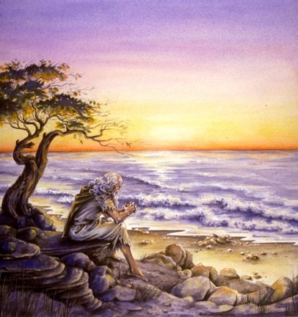
The Book of 1 John
To Download this lesson go to:
http://www.purifiedbyfaith.com/1John/1John.htm
https://revelationillustrated.com/

Slide 2

Outline of 1 John
1:1-4 - Prologue: John Introduces the Major Theme of the Letter - FELLOWSHIP WITH GOD
1:5-2:28 - The First Presentation of the Three Tests of FELLOWSHIP WITH GOD: RIGHTEOUSNESS, LOVE and BELIEF in Jesus
2:29-4:6 -The Second Presentation of the Three Tests of FELLOWSHIP WITH GOD: RIGHTEOUSNESS, LOVE and BELIEF in Jesus
4:7-5:21 - The Third Presentation of the Three Tests of FELLOWSHIP WITH GOD: RIGHTEOUSNESS, LOVE and BELIEF in Jesus
Robert Law, The Tests of Life, Third Edition, 1914, p.21-24

Slide 3
2:29-4:6 The Second Presentation of the Three Tests of DIVINE SONSHIP: RIGHTEOUSNESS, LOVE and BELIEF in Jesus
2:29-3:10a - Divine Sonship tested by RIGHTEOUSNESS
God is righteous therefore everyone who “does what is right” is “born of Him” (2:29)
The present status and future hope of the “children of God” (3:1-3)
Divine Sonship is utterly contrary to all sin (3:4-10a)
3:10b-24a - Divine Sonship tested by LOVE
Anyone who does not obey the command to “love one another” is not a child of God (3:10b-11)
Cain as the model of murder and hate - whose example is followed by the world (3:12-15)
Christ as the model of love – whose example we must follow in order to have confidence in our relationship with God (3:16-24a)
3:24b-4:6 - Divine Sonship tested by BELIEF in the Spirit’s Message

Slide 4
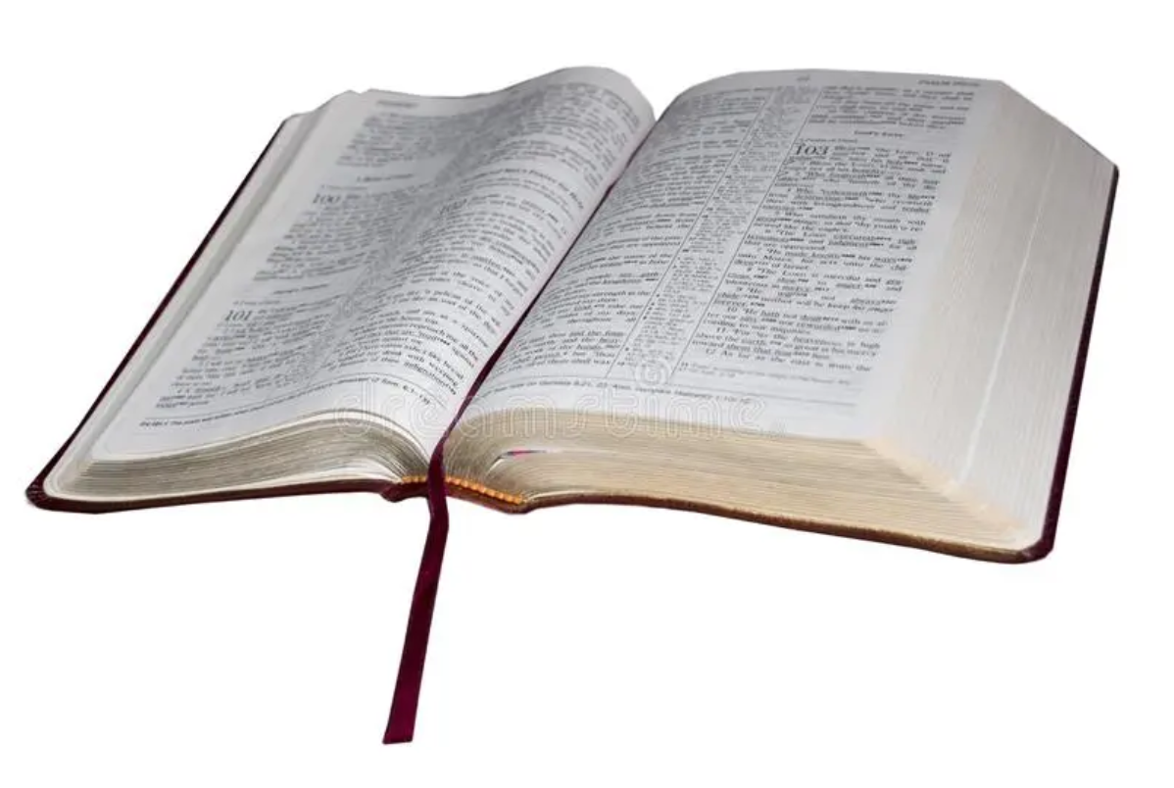
1 John 3:10b-11 Anyone who does not obey the command to “love one another” is not a child of God
¹⁰ whoever does not practice righteousness is not of God, nor is the one who does not love his brother. ¹¹ For this is the message that you have heard from the beginning, that we should love one another.

Slide 5
At this point, without introducing a new sentence, John makes a transition from the subject of righteousness to that of love. (Burdick, p.259)
¹⁰ whoever does not practice righteousness is not of God, nor is the one who does not love his brother. ¹¹ For this is the message that you have heard from the beginning, that we should love one another.
1 John 3:10b-11

Slide 6
As in his first presentation of the love test (1 John 2:7-17) , John focuses on our duty to love other Christians. This is not to say that our love for outsiders is not important. But for the sake of this test, in contrast to the Gnostic false teachers, John focuses on our love for one another.
¹⁰ whoever does not practice righteousness is not of God, nor is the one who does not love his brother. ¹¹ For this is the message that you have heard from the beginning, that we should love one another.
1 John 3:10b-11

Slide 7
In contrast to the Gnostic teaching which was a comparatively late arrival, the command to love was part of the original authoritative message that came from Christ Himself. (Burdick, p. 260-261):
John 15:12-13 – This is my commandment, that you love one another as I have loved you. ¹³ Greater love has no one than this, that someone lay down his life for his friends.
¹⁰ whoever does not practice righteousness is not of God, nor is the one who does not love his brother. ¹¹ For this is the message that you have heard from the beginning, that we should love one another.
1 John 3:10b-11

Slide 8
The gospel does not change. The truth about the person of Christ and about Christian conduct is unalterable. In both doctrine and ethics we must go back to the beginning and inquire what the apostles originally taught and their first converts both had and heard. (Stott, p. 139)
¹⁰ whoever does not practice righteousness is not of God, nor is the one who does not love his brother. ¹¹ For this is the message that you have heard from the beginning, that we should love one another.
1 John 3:10b-11

Slide 9
2:29-4:6 The Second Presentation of the Three Tests of DIVINE SONSHIP: RIGHTEOUSNESS, LOVE and BELIEF in Jesus
2:29-3:10a - Divine Sonship tested by RIGHTEOUSNESS
God is righteous therefore everyone who “does what is right” is “born of Him” (2:29)
The present status and future hope of the “children of God” (3:1-3)
Divine Sonship is utterly contrary to all sin (3:4-10a)
3:10b-24a - Divine Sonship tested by LOVE
Anyone who does not obey the command to “love one another” is not a child of God (3:10b-11)
Cain as the model of murder and hate - whose example is followed by the world (3:12-15)
Christ as the model of love – whose example we must follow in order to have confidence in our relationship with God (3:16-24a)
3:24b-4:6 - Divine Sonship tested by BELIEF in the Spirit’s Message

Slide 10
1 John 3:12-15 Cain as the Model of Murder and Hate - Whose Example is Followed by the World
¹² We should not be like Cain, who was of the evil one and murdered his brother. And why did he murder him? Because his own deeds were evil and his brother's righteous. ¹³ Do not be surprised, brothers, that the world hates you. ¹⁴ We know that we have passed out of death into life, because we love the brothers. Whoever does not love abides in death. ¹⁵ Everyone who hates his brother is a murderer, and you know that no murderer has eternal life abiding in him.

Slide 11

1 John 3:12-15 Cain as the Model of Murder and Hate – Whose Example is Followed by the World
^{High Level Overview}
https://imgur.com/gallery/kOGmSB0

Slide 12
Having exhorted his readers to mutual love, John, by way of contrast, gives two negative examples:
Cain
¹² We should not be like Cain, who was of the evil one and murdered his brother. And why did he murder him? Because his own deeds were evil and his brother's righteous. ¹³ Do not be surprised, brothers, that the world hates you. ¹⁴ We know that we have passed out of death into life, because we love the brothers. Whoever does not love abides in death. ¹⁵ Everyone who hates his brother is a murderer, and you know that no murderer has eternal life abiding in him
(1 John 3:12-15)

Slide 13
Having exhorted his readers to mutual love, John, by way of contrast, gives two negative examples:
Cain
The World
¹² We should not be like Cain, who was of the evil one and murdered his brother. And why did he murder him? Because his own deeds were evil and his brother's righteous. ¹³ Do not be surprised, brothers, that the world hates you. ¹⁴ We know that we have passed out of death into life, because we love the brothers. Whoever does not love abides in death. ¹⁵ Everyone who hates his brother is a murderer, and you know that no murderer has eternal life abiding in him
(1 John 3:12-15)

Slide 14
John then gives the love test –
First with Positive Results:
The Conclusion: We have passed from death to life
The Criterion: We love the brothers
¹² We should not be like Cain, who was of the evil one and murdered his brother. And why did he murder him? Because his own deeds were evil and his brother's righteous. ¹³ Do not be surprised, brothers, that the world hates you. ¹⁴ We know that we have passed out of death into life, because we love the brothers. Whoever does not love abides in death. ¹⁵ Everyone who hates his brother is a murderer, and you know that no murderer has eternal life abiding in him
(1 John 3:12-15)

Slide 15
John then gives the love test –
First with Positive Results:
The Conclusion: We have passed from death to life
The Criterion: We love the brothers
Then with Negative Results:
The Criterion: He does not love
The Conclusion: He remains dead
The Explanation: To hate is murder, and no murderer has eternal life
¹² We should not be like Cain, who was of the evil one and murdered his brother. And why did he murder him? Because his own deeds were evil and his brother's righteous. ¹³ Do not be surprised, brothers, that the world hates you. ¹⁴ We know that we have passed out of death into life, because we love the brothers. Whoever does not love abides in death. ¹⁵ Everyone who hates his brother is a murderer, and you know that no murderer has eternal life abiding in him
(1 John 3:12-15)

Slide 16
In verse 12, John begins by exhorting his readers not to be like Cain. It’s interesting to note that Cain is the only Old Testament character explicitly mentioned in this letter.
¹² We should not be like Cain, who was of the evil one and murdered his brother. And why did he murder him? Because his own deeds were evil and his brother's righteous. ¹³ Do not be surprised, brothers, that the world hates you. ¹⁴ We know that we have passed out of death into life, because we love the brothers. Whoever does not love abides in death. ¹⁵ Everyone who hates his brother is a murderer, and you know that no murderer has eternal life abiding in him.
1 John 3:12-15

Slide 17
[Cain’s] hatred originated in the devil, that wicked one, and issued in murder. (Stott, p.139-140)
Cain, in the murder of his brother, fulfilled the proverb, “Like father, like son”. His attitude was hatred and his act was murder. (Burdick, p.262)
¹² We should not be like Cain, who was of the evil one and murdered his brother. And why did he murder him? Because his own deeds were evil and his brother's righteous. ¹³ Do not be surprised, brothers, that the world hates you. ¹⁴ We know that we have passed out of death into life, because we love the brothers. Whoever does not love abides in death. ¹⁵ Everyone who hates his brother is a murderer, and you know that no murderer has eternal life abiding in him.
1 John 3:12-15

Slide 18
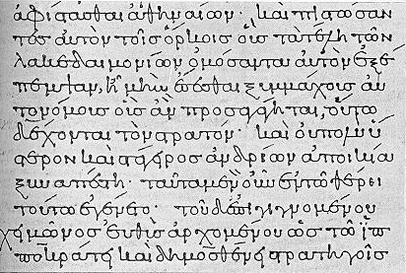
“murdered” sfa,zw sphazo
Strong’s Data:
To slay, slaughter, butcher
To put to death by violence
Burdick, p.262 :
The word for “murder” here is a strong term that originally meant “to cut the throat”. It had come to refer to violent slaughter.
Note: Not all killing is murder:
Romans 13:3-4 – For rulers are not a terror to good conduct, but to bad. Would you have no fear of the one who is in authority? Then do what is good, and you will receive his approval, ⁴ for he is God's servant for your good. But if you do wrong, be afraid, for he does not bear the sword in vain. For he is the servant of God, an avenger who carries out God's wrath on the wrongdoer.

Slide 19
John then discusses the motive for Cain’s act: Cain murdered his brother because his deeds were evil and his brother’s were righteous.
¹² We should not be like Cain, who was of the evil one and murdered his brother. And why did he murder him? Because his own deeds were evil and his brother's righteous. ¹³ Do not be surprised, brothers, that the world hates you. ¹⁴ We know that we have passed out of death into life, because we love the brothers. Whoever does not love abides in death. ¹⁵ Everyone who hates his brother is a murderer, and you know that no murderer has eternal life abiding in him.
1 John 3:12-15

Slide 20
It may be inferred from Gen 4:6-7 that Cain’s offering was not acceptable because he was an evildoer (Kruse, p.133)
Genesis 4:6-7a - The LORD said to Cain, "Why are you angry, and why has your face fallen? If you do well, will you not be accepted?
Proverbs 15:8 - The sacrifice of the wicked is an abomination to the LORD, but the prayer of the upright is acceptable to him.
¹² We should not be like Cain, who was of the evil one and murdered his brother. And why did he murder him? Because his own deeds were evil and his brother's righteous. ¹³ Do not be surprised, brothers, that the world hates you. ¹⁴ We know that we have passed out of death into life, because we love the brothers. Whoever does not love abides in death. ¹⁵ Everyone who hates his brother is a murderer, and you know that no murderer has eternal life abiding in him.
1 John 3:12-15

Slide 21
As far as [the writer of Hebrews] was concerned, what differentiated Abel from Cain was the former’s faith and, presumably, the latter’s lack of it. (Kruse, p.133)
Hebrews 11:4 - By faith Abel offered to God a more acceptable sacrifice than Cain, through which he was commended as righteous, God commending him by accepting his gifts.
¹² We should not be like Cain, who was of the evil one and murdered his brother. And why did he murder him? Because his own deeds were evil and his brother's righteous. ¹³ Do not be surprised, brothers, that the world hates you. ¹⁴ We know that we have passed out of death into life, because we love the brothers. Whoever does not love abides in death. ¹⁵ Everyone who hates his brother is a murderer, and you know that no murderer has eternal life abiding in him.
1 John 3:12-15

Slide 22
The wicked person hates righteousness. It is not that he is jealous of the righteous and wishes that he were like him. Instead it is that the righteousness of the righteous puts the wicked person in a bad light. (Burdick, p.262)
¹² We should not be like Cain, who was of the evil one and murdered his brother. And why did he murder him? Because his own deeds were evil and his brother's righteous. ¹³ Do not be surprised, brothers, that the world hates you. ¹⁴ We know that we have passed out of death into life, because we love the brothers. Whoever does not love abides in death. ¹⁵ Everyone who hates his brother is a murderer, and you know that no murderer has eternal life abiding in him.
1 John 3:12-15

Slide 23
There is a notable parallel between Cain, who hated his brother and murdered him, and the world that hates God’s people. The reason for the hatred is the same in each instance – wickedness cannot tolerate the presence of righteousness. (Burdick, p. 264)
¹² We should not be like Cain, who was of the evil one and murdered his brother. And why did he murder him? Because his own deeds were evil and his brother's righteous. ¹³ Do not be surprised, brothers, that the world hates you. ¹⁴ We know that we have passed out of death into life, because we love the brothers. Whoever does not love abides in death. ¹⁵ Everyone who hates his brother is a murderer, and you know that no murderer has eternal life abiding in him.
1 John 3:12-15

Slide 24
The term [world] is here used . . . to designate the people who are enmeshed in the evil world system, who are members of the devil’s family. (Burdick, p.264)
¹² We should not be like Cain, who was of the evil one and murdered his brother. And why did he murder him? Because his own deeds were evil and his brother's righteous. ¹³ Do not be surprised, brothers, that the world hates you. ¹⁴ We know that we have passed out of death into life, because we love the brothers. Whoever does not love abides in death. ¹⁵ Everyone who hates his brother is a murderer, and you know that no murderer has eternal life abiding in him.
1 John 3:12-15

Slide 25
Following the brief digression in 3:13 with its warning that the readers will be objects of the world’s hatred, in 3:14 [John] returns to the main theme of 3:11-24, that is, mutual love as a mark of true children of God. (Kruse p.135)
¹² We should not be like Cain, who was of the evil one and murdered his brother. And why did he murder him? Because his own deeds were evil and his brother's righteous. ¹³ Do not be surprised, brothers, that the world hates you. ¹⁴ We know that we have passed out of death into life, because we love the brothers. Whoever does not love abides in death. ¹⁵ Everyone who hates his brother is a murderer, and you know that no murderer has eternal life abiding in him.
1 John 3:12-15

Slide 26
we have passed out of death into life…
¹² We should not be like Cain, who was of the evil one and murdered his brother. And why did he murder him? Because his own deeds were evil and his brother's righteous. ¹³ Do not be surprised, brothers, that the world hates you. ¹⁴ We know that we have passed out of death into life, because we love the brothers. Whoever does not love abides in death. ¹⁵ Everyone who hates his brother is a murderer, and you know that no murderer has eternal life abiding in him.
1 John 3:12-15

Slide 27
“we have passed” metabai,nw/ metabaino
Strong’s Data:
To remove
To depart
To pass over from one place to another
Burdick, p.264:
Is used to metaphorically to depict movement from one spiritual sphere, “out of death”, to another spiritual sphere, “into life”.
The perfect tense indicates that the transfer has already occurred at a point in the past, and, as a result, the sphere of life has already been entered.

Slide 28
Becoming a Christian is nothing less than a resurrection or quickening ‘out of’ (ek) spiritual death ‘into’ (eis) eternal life. (Stott, p.141)
John 5:24 - Truly, truly, I say to you, whoever hears my word and believes him who sent me has eternal life. He does not come into judgment, but has passed from death to life.
¹² We should not be like Cain, who was of the evil one and murdered his brother. And why did he murder him? Because his own deeds were evil and his brother's righteous. ¹³ Do not be surprised, brothers, that the world hates you. ¹⁴ We know that we have passed out of death into life, because we love the brothers. Whoever does not love abides in death. ¹⁵ Everyone who hates his brother is a murderer, and you know that no murderer has eternal life abiding in him.
1 John 3:12-15

Slide 29
Therefore: Love for Christians is evidence that one is saved; hatred for Christians reveals that one is still lost. (Burdick, p.264)
¹² We should not be like Cain, who was of the evil one and murdered his brother. And why did he murder him? Because his own deeds were evil and his brother's righteous. ¹³ Do not be surprised, brothers, that the world hates you. ¹⁴ We know that we have passed out of death into life, because we love the brothers. Whoever does not love abides in death. ¹⁵ Everyone who hates his brother is a murderer, and you know that no murderer has eternal life abiding in him.
1 John 3:12-15

Slide 30
As in previous passages (2:10, 3:10) the present tense verb “we love” speaks of the continuing exercise of love, a pattern of life, not merely a momentary flash of affection. (Burdick, p.264)
¹² We should not be like Cain, who was of the evil one and murdered his brother. And why did he murder him? Because his own deeds were evil and his brother's righteous. ¹³ Do not be surprised, brothers, that the world hates you. ¹⁴ We know that we have passed out of death into life, because we love the brothers. Whoever does not love abides in death. ¹⁵ Everyone who hates his brother is a murderer, and you know that no murderer has eternal life abiding in him.
1 John 3:12-15

Slide 31
We know that we have passed out of death into life, because we love the brothers
Stott observes (p.141-142):
Great stress is laid in the NT on love as a preeminent Christian virtue:
The first-fruit of the Spirit:
Galatians 5:22 - But the fruit of the Spirit is love, joy, peace, patience, kindness, goodness, faithfulness…
The sign of the reality of faith:
Galatians 5:6 - For in Christ Jesus neither circumcision nor uncircumcision counts for anything, but only faith working through love.
The greatest of the three abiding Christian graces, which never ends, without which we are nothing:
1 Corinthians 13:2,13 - And if I have prophetic powers, and understand all mysteries and all knowledge, and if I have all faith, so as to remove mountains, but have not love, I am nothing... ¹³ So now faith, hope, and love abide, these three; but the greatest of these is love.

Slide 32
We know that we have passed out of death into life, because we love the brothers
Stott (continued):
True Christians, who have passed from death unto life, will:
Hunger for Christian fellowship.
They will not forsake the assembling of themselves together (Heb 10:25), but will delight to:
Meet Together
Worship Together
Pray Together
Talk Together on Spiritual Topics
Their personal relationship with each other will be marked by unselfish and caring love.

Slide 33
John follows the positive statement of verse 14a with two negative statements in verses 14b-15.
¹² We should not be like Cain, who was of the evil one and murdered his brother. And why did he murder him? Because his own deeds were evil and his brother's righteous. ¹³ Do not be surprised, brothers, that the world hates you. ¹⁴ We know that we have passed out of death into life, because we love the brothers. Whoever does not love abides in death. ¹⁵ Everyone who hates his brother is a murderer, and you know that no murderer has eternal life abiding in him.
1 John 3:12-15

Slide 34
John does not say that the one who does not love dies, but that he remains in death. This means that he existed from birth in the sphere of death, and he continues to stay in that sphere, as opposed to those who love the brothers and have been transferred from death to life. (Burdick, p.265)
Ephesians 2:1 - And you were dead in the trespasses and sins…
¹² We should not be like Cain, who was of the evil one and murdered his brother. And why did he murder him? Because his own deeds were evil and his brother's righteous. ¹³ Do not be surprised, brothers, that the world hates you. ¹⁴ We know that we have passed out of death into life, because we love the brothers. Whoever does not love abides [= remains] in death. ¹⁵ Everyone who hates his brother is a murderer, and you know that no murderer has eternal life abiding in him.
1 John 3:12-15

Slide 35
John puts matters in stark terms. There is no middle ground; not to love is to hate.
(Burdick, p. 265)
¹² We should not be like Cain, who was of the evil one and murdered his brother. And why did he murder him? Because his own deeds were evil and his brother's righteous. ¹³ Do not be surprised, brothers, that the world hates you. ¹⁴ We know that we have passed out of death into life, because we love the brothers. Whoever does not love abides in death. ¹⁵ Everyone who hates his brother is a murderer, and you know that no murderer has eternal life abiding in him.
1 John 3:12-15

Slide 36
Notice that John echoes Jesus in putting hate/anger on a level with murder:
Matthew 5:21-22 - You have heard that it was said to those of old, “You shall not murder; and whoever murders will be liable to judgment. But I say to you that everyone who is angry with his brother will be liable to judgment; whoever insults his brother will be liable to the council; and whoever says, 'You fool!' will be liable to the hell of fire
¹² We should not be like Cain, who was of the evil one and murdered his brother. And why did he murder him? Because his own deeds were evil and his brother's righteous. ¹³ Do not be surprised, brothers, that the world hates you. ¹⁴ We know that we have passed out of death into life, because we love the brothers. Whoever does not love abides in death. ¹⁵ Everyone who hates his brother is a murderer, and you know that no murderer has eternal life abiding in him.
1 John 3:12-15

Slide 37
Hatred is the desire to get rid of someone, whether or not one has the nerve or the occasion to perform the act. (Burdick, p. 265)
¹² We should not be like Cain, who was of the evil one and murdered his brother. And why did he murder him? Because his own deeds were evil and his brother's righteous. ¹³ Do not be surprised, brothers, that the world hates you. ¹⁴ We know that we have passed out of death into life, because we love the brothers. Whoever does not love abides in death. ¹⁵ Everyone who hates his brother is a murderer, and you know that no murderer has eternal life abiding in him.
1 John 3:12-15

Slide 38
The present tense “hates” . . . speaks of continuing action. John does not refer to one who is caught up in a momentary fit of anger toward someone. The one he designates as a murderer is the one who, as a continuing habit, hates his brother. (Burdick, p. 265)
¹² We should not be like Cain, who was of the evil one and murdered his brother. And why did he murder him? Because his own deeds were evil and his brother's righteous. ¹³ Do not be surprised, brothers, that the world hates you. ¹⁴ We know that we have passed out of death into life, because we love the brothers. Whoever does not love abides in death. ¹⁵ Everyone who hates his brother is a murderer, and you know that no murderer has eternal life abiding in him.
1 John 3:12-15

Slide 39
John does not mean that a person who has committed murder can never be saved afterward. Instead, he says that a saved person, by nature, does not commit murder. (Burdick, p. 265)
¹² We should not be like Cain, who was of the evil one and murdered his brother. And why did he murder him? Because his own deeds were evil and his brother's righteous. ¹³ Do not be surprised, brothers, that the world hates you. ¹⁴ We know that we have passed out of death into life, because we love the brothers. Whoever does not love abides in death. ¹⁵ Everyone who hates his brother is a murderer, and you know that no murderer has eternal life abiding in him.
1 John 3:12-15

Slide 40
The Love Test (1 John 3:14-15)
Does he (habitually) love his brother?
Yes
No
Then he has passed from (spiritual) death to (eternal) life.
Then he remains (spiritually) dead.
He, in effect, habitually hates his brother
He is (in principle) a murderer
He does not have eternal life.

Slide 41

Class Discussion Time
https://www.weareteachers.com/moving-beyond-classroom-discussions/

Slide 42
*Class Discussion Time
Commentator Donald Burdick made the following observation about Cain’s motive in murdering his brother:
The wicked person hates righteousness. It is not that he is jealous of the righteous and wishes that he were like him. Instead it is that the righteousness of the righteous puts the wicked person in a bad light.
Do you think Burdick is correct in his assessment of the motivation of unbelievers in this regard? Have you seen an example of this in people in the world that you have observed?
Commentator John Stott gave a description of what it looks like for a Christian to love his fellow believers:
Hunger for Christian fellowship.
They will not forsake the assembling of themselves together (Heb 10:25), but will delight to:
Meet Together
Worship Together
Pray Together
Talk Together on Spiritual Topics
Their personal relationship with each other will be marked by unselfish and caring love.
Do you think this is a good description? Do you see these kinds of attitudes manifested in your own heart?

