Slide 1
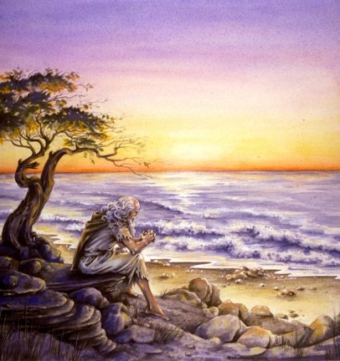
The Book of 1 John
To Download this lesson go to:
http://www.purifiedbyfaith.com/1John/1John.htm
https://revelationillustrated.com/

Slide 2

Outline of 1 John
1:1-4 - Prologue: John Introduces the Major Theme of the Letter - FELLOWSHIP WITH GOD
1:5-2:28 - The First Presentation of the Three Tests of FELLOWSHIP WITH GOD: RIGHTEOUSNESS, LOVE and BELIEF in Jesus
2:29-4:6 -The Second Presentation of the Three Tests of FELLOWSHIP WITH GOD: RIGHTEOUSNESS, LOVE and BELIEF in Jesus
4:7-5:21 - The Third Presentation of the Three Tests of FELLOWSHIP WITH GOD: RIGHTEOUSNESS, LOVE and BELIEF in Jesus
Robert Law, The Tests of Life, Third Edition, 1914, p.21-24

Slide 3
4:7-5:21
The Third Presentation of the Three Tests of FELLOWSHIP WITH GOD:
RIGHTEOUSNESS, LOVE and BELIEF in Jesus
4:7-5:3a – Christian LOVE
  4:7-12 – The Source of LOVE
  4:13-16 – The Synthesis of LOVE and BELIEF– true belief is the vital ground of Christian love
  4:17-5:1 – The Effect and Motives of LOVE
  5:2-3a – The Synthesis of LOVE and RIGHTEOUSNESS – we love God by keeping His commandments
5:3b-21 – Christian BELIEF
  5:3b-4 – The Synthesis of BELIEF and RIGHTEOUSNESS – in belief lies the power of obedience
  5:5-12 – The Contents, Basis, and Issue of Christian BELIEF
  5:13-21 – The Certainties of Christian BELIEF

Slide 4
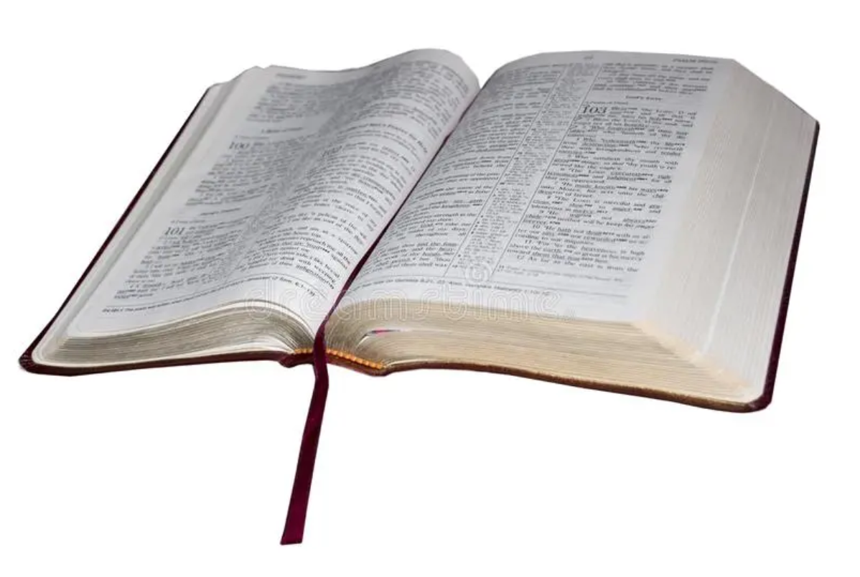
1 John 4:13-16
The Synthesis of LOVE and BELIEF–
True belief is the vital ground of Christian love
¹³ By this we know that we abide in him and he in us, because he has given us of his Spirit. ¹⁴ And we have seen and testify that the Father has sent his Son to be the Savior of the world. ¹⁵ Whoever confesses that Jesus is the Son of God, God abides in him, and he in God. ¹⁶ So we have come to know and to believe the love that God has for us. God is love, and whoever abides in love abides in God, and God abides in him.

Slide 5

1 John 4:13-16
The Synthesis of LOVE and BELIEF
^{High Level Overview}
https://imgur.com/gallery/kOGmSB0

Slide 6
The Synthesis of Belief and Love
The previous two sections have been exhortations:
  A warning not to believe every spirit (4:1-6)
  An appeal to love one another (4:7-12).
These two tests of belief and love are now applied more personally, no longer in exhortation but in affirmation.
The belief and love, which John has been urging upon his readers, are now assumed, and deductions are drawn from them. Furthermore, the relationship of belief and love to each other is pointed out for the first time.
This passage “is the high-watermark of the thought of the epistle” (C.H. Dodd). That “the Father has sent his Son” is not only the chief test of doctrinal orthodoxy but also the supreme evidence of God's love for us and inspiration of our love for our fellow believer.
John R. W. Stott, The Epistles of John – An Introduction and Commentary, Eerdmans, 1979, p.165

Slide 7
God's indwelling is mentioned three times in this paragraph, and what in 4:12 was single (“God abides in us”) is now each time reciprocal:
4:13 - we abide in him and he in us
4:15 - God abides in him, and he in God
4:16 - [he] abides in God, and God abides in him
¹³ By this we know that we abide in him and he in us, because he has given us of his Spirit. ¹⁴ And we have seen and testify that the Father has sent his Son to be the Savior of the world. ¹⁵ Whoever confesses that Jesus is the Son of God, God abides in him, and he in God. ¹⁶ So we have come to know and to believe the love that God has for us. God is love, and whoever abides in love abides in God, and God abides in him.
1 John 4:13-16

Slide 8
To say that someone “abides in God” and that “God abides in them” is another way of saying that they are saved. The present tense verbs (which imply continuing action) in combination with the meaning of the Greek word translated “abides” (“to remain, to stay”) emphasize:
The believer’s continuing perseverance
God’s abiding faithfulness to the believer
¹³ By this we know that we abide in him and he in us, because he has given us of his Spirit. ¹⁴ And we have seen and testify that the Father has sent his Son to be the Savior of the world. ¹⁵ Whoever confesses that Jesus is the Son of God, God abides in him, and he in God. ¹⁶ So we have come to know and to believe the love that God has for us. God is love, and whoever abides in love abides in God, and God abides in him.
1 John 4:13-16

Slide 9
Throughout this letter, the role of the Spirit (as described by John) is to testify to the truth about Jesus as proclaimed by the apostles:
5:6 – And the Spirit is the one who testifies, because the Spirit is the truth.
2:27a – But the anointing [= the Spirit] that you received from Him abides in you, and you have no need that anyone should teach you. But as His anointing teaches you about everything, and is true…
4:2 – By this you know the Spirit of God: every spirit that confesses that Jesus Christ has come in the flesh is from God…
¹³ By this we know that we abide in him and he in us, because he has given us of his Spirit. ¹⁴ And we have seen and testify that the Father has sent his Son to be the Savior of the world. ¹⁵ Whoever confesses that Jesus is the Son of God, God abides in him, and he in God. ¹⁶ So we have come to know and to believe the love that God has for us. God is love, and whoever abides in love abides in God, and God abides in him.
1 John 4:13-16

Slide 10
Here in 4:13-14, John tells us that because we have been given the Spirit, we believe the apostolic testimony concerning the love of God that was powerfully expressed in the sending of His Son to be the Savior of the world, and because we have believed that teaching, we can be assured that we abide in God and God in us.
¹³ By this we know that we abide in him and he in us, because he has given us of his Spirit. ¹⁴ And we have seen and testify that the Father has sent his Son to be the Savior of the world. ¹⁵ Whoever confesses that Jesus is the Son of God, God abides in him, and he in God. ¹⁶ So we have come to know and to believe the love that God has for us. God is love, and whoever abides in love abides in God, and God abides in him.
1 John 4:13-16

Slide 11
Further on in our text, we see two other examples of the Spirit’s work which give us assurance that we remain in God and He remains in us.
¹³ By this we know that we abide in him and he in us, because he has given us of his Spirit. ¹⁴ And we have seen and testify that the Father has sent his Son to be the Savior of the world. ¹⁵ Whoever confesses that Jesus is the Son of God, God abides in him, and he in God. ¹⁶ So we have come to know and to believe the love that God has for us. God is love, and whoever abides in love abides in God, and God abides in him.
1 John 4:13-16

Slide 12
It is by the Spirit that we:
4:15 – Come to confess that Jesus is the Son of God (and thus equal to the Father – cf. John 5:18)
4:16 – Are enabled to love.
The natural man (who does not have the Spirit) can neither believe nor love. In his fallen and unredeemed state he is both blind and selfish.
¹³ By this we know that we abide in him and he in us, because he has given us of his Spirit. ¹⁴ And we have seen and testify that the Father has sent his Son to be the Savior of the world. ¹⁵ Whoever confesses that Jesus is the Son of God, God abides in him, and he in God. ¹⁶ So we have come to know and to believe the love that God has for us. God is love, and whoever abides in love abides in God, and God abides in him.
1 John 4:13-16

Slide 13
And yet, John seems to be indicating that (in our present state) there is a sense in which the Spirit is given in limited measure. He has given us of His Spirit.
¹³ By this we know that we abide in him and he in us, because he has given us of his Spirit. ¹⁴ And we have seen and testify that the Father has sent his Son to be the Savior of the world. ¹⁵ Whoever confesses that Jesus is the Son of God, God abides in him, and he in God. ¹⁶ So we have come to know and to believe the love that God has for us. God is love, and whoever abides in love abides in God, and God abides in him.
1 John 4:13-16

Slide 14
Compare this with John 3:34, which indicates that the Spirit was given without limit to Jesus. By implication, therefore, the Spirit is given to human beings in limited measure because of their finite nature.
¹³ By this we know that we abide in him and he in us, because he has given us of his Spirit. ¹⁴ And we have seen and testify that the Father has sent his Son to be the Savior of the world. ¹⁵ Whoever confesses that Jesus is the Son of God, God abides in him, and he in God. ¹⁶ So we have come to know and to believe the love that God has for us. God is love, and whoever abides in love abides in God, and God abides in him.
1 John 4:13-16

Slide 15
John’s reference to those who “have seen and testify” is similar to 1:1-2 where the reference is to the apostolic witnesses:
1 John 1:1-2 - That which was from the beginning, which we have heard, which we have seen with our eyes, which we looked upon and have touched with our hands, concerning the word of life… we have seen it, and testify to it and proclaim to you the eternal life, which was with the Father and was made manifest to us--
¹³ By this we know that we abide in him and he in us, because he has given us of his Spirit. ¹⁴ And we have seen and testify that the Father has sent his Son to be the Savior of the world. ¹⁵ Whoever confesses that Jesus is the Son of God, God abides in him, and he in God. ¹⁶ So we have come to know and to believe the love that God has for us. God is love, and whoever abides in love abides in God, and God abides in him.
1 John 4:13-16

Slide 16
Therefore “we” in 4:14 is probably a reference to John and his fellow apostles.
A few verses later, however, John uses “we” in a broader sense to include all believers.
¹³ By this we know that we abide in him and he in us, because he has given us of his Spirit. ¹⁴ And we have seen and testify that the Father has sent his Son to be the Savior of the world. ¹⁵ Whoever confesses that Jesus is the Son of God, God abides in him, and he in God. ¹⁶ So we have come to know and to believe the love that God has for us. God is love, and whoever abides in love abides in God, and God abides in him.
1 John 4:13-16

Slide 17
Jesus is “Savior of the world”
¹³ By this we know that we abide in him and he in us, because he has given us of his Spirit. ¹⁴ And we have seen and testify that the Father has sent his Son to be the Savior of the world. ¹⁵ Whoever confesses that Jesus is the Son of God, God abides in him, and he in God. ¹⁶ So we have come to know and to believe the love that God has for us. God is love, and whoever abides in love abides in God, and God abides in him.
1 John 4:13-16

Slide 18
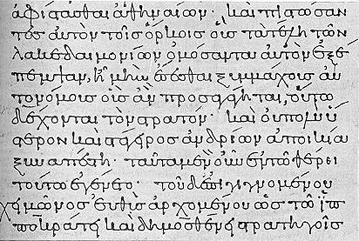
“Savior”- swth,r (soter)
The noun “savior” appears only two times in John’s writings: here (4:14) and in the Gospel of John 4:42:
  They [the Samaritans] said to the woman, “It is no longer because of what you said that we believe, for we have heard for ourselves, and we know that this is indeed the Savior of the world.”
In extra biblical Greek the term was used of pagan gods, of men such as physicians, and of kings or emperors.
Donald W. Burdick, The Letters of John, Moody Press, 1985, p.329

Slide 19
“Savior”- swth,r (soter)
In Scripture, the term “savior” is used of:
  Judges who delivered the Israelites from their enemies:
    Judges 3:9 - But when the people of Israel cried out to the LORD, the LORD raised up a deliverer for the people of Israel, who saved them, Othniel the son of Kenaz, Caleb's younger brother.
  God:
    Isaiah 45:15 - Truly, you are a God who hides himself, O God of Israel, the Savior.
  Christ (16 times in the New Testament)
Here in 4:14 the term is parallel with two earlier statements describing what God has done in sending His Son:
  4:9b – …God sent his only Son into the world, so that we might live through him.
  4:10b – …[God] loved us and sent his Son to be the propitiation for our sins.
In other words, Christ, as our Savior, delivers sinners from the wrath of God.
Donald W. Burdick, The Letters of John, Moody Press, 1985, p.329

Slide 20
“world” ko,smoj (kosmos)
New Testament Usage
The word “world” has a fairly wide range of meanings in the New Testament:
It can refer to the earth (as a planet or a place where men live) and/or all that is in it:
  Acts 17:24 - The God who made the world and everything in it…
  John 1:9 - The true light, which enlightens everyone, was coming into the world.
  Matthew 16:26a - For what will it profit a man if he gains the whole world and forfeits his soul?
The evil world system that Satan has set in opposition to God and/or the unbelieving world of unregenerate humanity:
  2 Corinthians 4:4 - …the god of this world has blinded the minds of the unbelievers, to keep them from seeing the light of the gospel of the glory of Christ, who is the image of God.
  John 15:19 - If you were of the world, the world would love you as its own; but because you are not of the world, but I chose you out of the world, therefore the world hates you. (Joh 15:19 ESV).

Slide 21
“world” ko,smoj (kosmos)
New Testament Usage (continued)
Gentiles as distinguished from Jews:
  Romans 11:12 - Now if [Israel’s] trespass means riches for the world, and if their failure means riches for the Gentiles, how much more will their full inclusion mean!
The human race, people in general, or people without distinction:
  John 8:12 - Again Jesus spoke to them, saying, "I am the light of the world…”
  John 18:20 - Jesus answered him, "I have spoken openly to the world. I have always taught in synagogues and in the temple, where all Jews come together. I have said nothing in secret.”
  Acts 17:6 - "These men [Paul and Silas] who have turned the world upside down have come here also…”

Slide 22
“world” ko,smoj (kosmos)
New Testament Usage (continued)
Because of their theological presuppositions, Arminians often assume that the word “world” – especially as it relates to Christ’s atonement for sinners – means “every man woman and child who ever lived without exception.”
The word “world” can have that meaning in scripture, though it is a very rare. One example of where it has this meaning is in Romans 3:19:
  Now we know that whatever the law says it speaks to those who are under the law, so that every mouth may be stopped, and the whole world may be held accountable to God.
In most places in scripture, taking the word world to mean “every man woman and child without exception” would lead to an absurd understanding of the passage, such as in John 12:18-19:
  The reason why the crowd went to meet [Jesus] was that they heard he had done this sign [raising Lazarus from the dead]. So the Pharisees said to one another, “You see that you are gaining nothing. Look, the world has gone after him.”
  Clearly the meaning here is “people in general”, or “people without distinction”.

Slide 23
“world” ko,smoj (kosmos)
Usage in 1 John (so far)
Within the book of 1 John, we have already seen many of these varied meanings for the word “world”:
People in general or perhaps all people without distinction
  1 John 2:2 - He is the propitiation for our sins, and not for ours only but also for the sins of the whole world.
The evil world system that Satan has set in opposition to God:
  1 John 2:16 - For all that is in the world--the desires of the flesh and the desires of the eyes and pride in possessions--is not from the Father but is from the world.
The unbelieving world (unregenerate humanity)
  1 John 3:13 - Do not be surprised, brothers, that the world hates you.
The earth as a place where people live
  1 John 4:3 - This is the spirit of the antichrist, which you heard was coming and now is in the world already.

Slide 24
In what way is Jesus “the Savior of the world”?
In summary, we have seen:
  Jesus is the Savior, in that he delivers sinners from the wrath of God.
  As Savior of the world, Jesus saves people – but which people?
    Gentiles as distinguished from Jews?
    All people past, present, and future without exception?
    The evil world system (of sinners who oppose God)?
    People from every nation, all men without distinction?

Slide 25
In what way is Jesus “the Savior of the world”?
Gentiles as distinguished from Jews?
  There hardly seems to be any justification for this meaning in the this context.
All people past, present, and future without exception?
  The problem is, if John were saying that Jesus saves all men without exception he would be contradicting what many other Scriptures clearly teach: that there are many men who are not saved from the wrath of God.
    Matthew 7:13 - Enter by the narrow gate. For the gate is wide and the way is easy that leads to destruction, and those who enter by it are many.
  Obviously John is not saying that Jesus saves everyone without exception.

Slide 26
In what way is Jesus “the Savior of the world”?
The evil world system (of sinners who oppose God)?
  This meaning of the word “world” is applicable to this passage.
  After all, Jesus is said to save men from their sins.
  Before Jesus saved us we all were opposed to God:
    Romans 5:10 - For if while we were enemies we were reconciled to God by the death of his Son…
  But at the same time, we must recognize that many who are a part of the evil world system that opposes God will not be saved (see previous section).

Slide 27
In what way is Jesus “the Savior of the world”?
People from every nation, all men without distinction?
  This theme is found throughout John’s writing:
    John 4:42 - They said to the woman, "It is no longer because of what you said that we believe, for we have heard for ourselves, and we know that this is indeed the Savior of the world." Note: this is probably a reference to the fact that Jesus would save Samaritans as well as Jews.
    John 12:32 - And I, when I am lifted up from the earth, will draw all people to myself. Note: this is stated in a context where some Greeks had come and asked to see Jesus, prompting Jesus to speak of a time when he would be “glorified” and draw all [kinds of] men to Himself (i.e., Greeks as well as Jews)
    Revelation 5:9 - And they sang a new song, saying, "Worthy are you to take the scroll and to open its seals, for you were slain, and by your blood you ransomed people for God from every tribe and language and people and nation.
  This meaning of the word “world” seems most applicable in this context.

Slide 28
Christ is the Savior of “the world”, in that He saves men from every nation, “all kinds of men, without distinction”.
¹³ By this we know that we abide in him and he in us, because he has given us of his Spirit. ¹⁴ And we have seen and testify that the Father has sent his Son to be the Savior of the world. ¹⁵ Whoever confesses that Jesus is the Son of God, God abides in him, and he in God. ¹⁶ So we have come to know and to believe the love that God has for us. God is love, and whoever abides in love abides in God, and God abides in him.
1 John 4:13-16

Slide 29
It is clear that the confession here is not merely a statement of theological fact; it is a confession of personal trust. It is in the aorist tense in the Greek, which indicates that John was thinking, not of a continuous confession, but of a single initial confession that introduces a believer into a life of faith in the incarnate Son of God.
¹³ By this we know that we abide in him and he in us, because he has given us of his Spirit. ¹⁴ And we have seen and testify that the Father has sent his Son to be the Savior of the world. ¹⁵ Whoever confesses that Jesus is the Son of God, God abides in him, and he in God. ¹⁶ So we have come to know and to believe the love that God has for us. God is love, and whoever abides in love abides in God, and God abides in him.
1 John 4:13-16

Slide 30
So we have come to know and to believe the love that God has for us…
¹³ By this we know that we abide in him and he in us, because he has given us of his Spirit. ¹⁴ And we have seen and testify that the Father has sent his Son to be the Savior of the world. ¹⁵ Whoever confesses that Jesus is the Son of God, God abides in him, and he in God. ¹⁶ So we have come to know and to believe the love that God has for us. God is love, and whoever abides in love abides in God, and God abides in him.
1 John 4:13-16

Slide 31
“know” - ginw,skw (ginosko)
This verb characteristically speaks of the acquisition of knowledge which is why the ESV translates it as “come to know”.
Donald W. Burdick, The Letters of John, Moody Press, 1985, p.330

Slide 32
“believe” - pisteu,w (pisteuo)
A perfect tense verb (in the Greek), which means that one has believed (in the past) and is now confident (in the present).
Donald W. Burdick, The Letters of John, Moody Press, 1985, p.330

Slide 33
The order in which the two verbs (“know” and “believe”) appear is significant. A knowledge of basic facts must precede belief, for it is necessary to know what is to be believed. Faith must be intelligent or it is sheer gullibility.
¹³ By this we know that we abide in him and he in us, because he has given us of his Spirit. ¹⁴ And we have seen and testify that the Father has sent his Son to be the Savior of the world. ¹⁵ Whoever confesses that Jesus is the Son of God, God abides in him, and he in God. ¹⁶ So we have come to know and to believe the love that God has for us. God is love, and whoever abides in love abides in God, and God abides in him.
1 John 4:13-16

Slide 34
That being said, it’s interesting that the two verbs appear in reverse order in John 6:68-69:
Simon Peter answered him, “Lord, to whom shall we go? You have the words of eternal life, and we have believed, and have come to know, that you are the Holy One of God.“
For it is also true that faith precedes knowledge.
¹³ By this we know that we abide in him and he in us, because he has given us of his Spirit. ¹⁴ And we have seen and testify that the Father has sent his Son to be the Savior of the world. ¹⁵ Whoever confesses that Jesus is the Son of God, God abides in him, and he in God. ¹⁶ So we have come to know and to believe the love that God has for us. God is love, and whoever abides in love abides in God, and God abides in him.
1 John 4:13-16

Slide 35
In spiritual matters, basic facts that are perceived must be received by faith in order for one to go further in knowledge. Advance in knowledge may be blocked by unbelief. So the growth of knowledge and the growth of faith act and react on each other.
¹³ By this we know that we abide in him and he in us, because he has given us of his Spirit. ¹⁴ And we have seen and testify that the Father has sent his Son to be the Savior of the world. ¹⁵ Whoever confesses that Jesus is the Son of God, God abides in him, and he in God. ¹⁶ So we have come to know and to believe the love that God has for us. God is love, and whoever abides in love abides in God, and God abides in him.
1 John 4:13-16

Slide 36
F.F. Bruce points out that the Greek phrase (en hēmin) translated “for us” in the ESV, may more naturally be translated “in us” or “among us”.
¹³ By this we know that we abide in him and he in us, because he has given us of his Spirit. ¹⁴ And we have seen and testify that the Father has sent his Son to be the Savior of the world. ¹⁵ Whoever confesses that Jesus is the Son of God, God abides in him, and he in God. ¹⁶ So we have come to know and to believe the love that God has for us. God is love, and whoever abides in love abides in God, and God abides in him.
1 John 4:13-16

Slide 37
In speaking of “the love that God has in us” [translated “for us” in the ESV] John may mean more than His love for us; that is included, indeed, but the love which God has for His children is poured into their hearts by His Spirit and flows out to others. (Bruce, p.112).
¹³ By this we know that we abide in him and he in us, because he has given us of his Spirit. ¹⁴ And we have seen and testify that the Father has sent his Son to be the Savior of the world. ¹⁵ Whoever confesses that Jesus is the Son of God, God abides in him, and he in God. ¹⁶ So we have come to know and to believe the love that God has for us. God is love, and whoever abides in love abides in God, and God abides in him.
1 John 4:13-16

Slide 38
In other words, John is expressing confidence that God’s love is at work in Christians as they love one another. They have come to know and are now confident that God who is love is dwelling in and loving others through them.
¹³ By this we know that we abide in him and he in us, because he has given us of his Spirit. ¹⁴ And we have seen and testify that the Father has sent his Son to be the Savior of the world. ¹⁵ Whoever confesses that Jesus is the Son of God, God abides in him, and he in God. ¹⁶ So we have come to know and to believe the love that God has for us. God is love, and whoever abides in love abides in God, and God abides in him.
1 John 4:13-16

Slide 39
Pulling all these ideas together, Burdick paraphrases 4:16 as follows: And as for us believers, we have come by experience to know, and we now have confidence in, the love which God has shed abroad in our hearts.
¹³ By this we know that we abide in him and he in us, because he has given us of his Spirit. ¹⁴ And we have seen and testify that the Father has sent his Son to be the Savior of the world. ¹⁵ Whoever confesses that Jesus is the Son of God, God abides in him, and he in God. ¹⁶ So we have come to know and to believe the love that God has for us. God is love, and whoever abides in love abides in God, and God abides in him.
1 John 4:13-16

Slide 40
Since God in His essence is “love”, and since He is the source of “love”, it follows logically that to dwell in love is to dwell in God.
¹³ By this we know that we abide in him and he in us, because he has given us of his Spirit. ¹⁴ And we have seen and testify that the Father has sent his Son to be the Savior of the world. ¹⁵ Whoever confesses that Jesus is the Son of God, God abides in him, and he in God. ¹⁶ So we have come to know and to believe the love that God has for us. God is love, and whoever abides in love abides in God, and God abides in him.
1 John 4:13-16

Slide 41
Paraphrastic Commentary on 1 John 4:7-12 by Donald W. Burdick
(7) Dear friends, we believers are habitually manifesting love to everyone in our fellowship because God enables us to love with spontaneous, self-giving love. Anyone who practices such love is a regenerate child of God and knows God by personal experience. (8) The one whose life is not marked by love has never come to know God. This is true because God in his essence is love. (9) We saw God's love in action among men when God sent His unique Son into this world on the mission of securing eternal life for us. (10) Love consists, not in the fact that we on our part have taken the initiative in loving God. Instead, it is that God was the one who manifested His selfless love toward us by commissioning His Son to be the atoning sacrifice for our sins, to satisfy God's just demands so that His wrath might be averted. (11) Dear friends, since God at Calvary manifested such love toward us, we are under a continuing obligation to show the same kind of selfless love to everyone in our fellowship. (12) God in his essence has never been observed by anyone. If we are manifesting love to the other members of our fellowship, it is God living within us and His selfless love which has come to fruitful maturity.

Slide 42
Paraphrastic Commentary on 1 John 4:13-16 by Donald W. Burdick
(13) This is how we come to know that we are in close relationship with God and that He is dwelling within us: in limited measure, He has imparted His Holy Spirit to us. (14) In addition, we of the apostolic circle have observed-the memory is still very real-and are continuing to bear eyewitness testimony that God the Father commissioned God the Son to make salvation available for the whole world. (15) If anyone publicly and solemnly confesses his faith in the man Jesus as the incarnate Son of God, God is dwelling within him and he is experiencing a close personal relationship with God. (16) And as for us believers, we have come by experience to know, and we now have confidence in, the love which God has shed abroad in our hearts. God in His essence is selfless love, and the person who dwells in the sphere of love actually dwells in God and God dwells within Him.

Slide 43

Class Discussion Time
https://www.weareteachers.com/moving-beyond-classroom-discussions/

Slide 44
*Class Discussion Time
As you have read about the crucial importance of genuine believers loving other believers and reflected on the presence of that otherwise unnatural disposition within your own otherwise sinful heart, do you find comfort and assurance that God really has done a work in you and that you really are in Him and He in you?
In light of the fact that your conformity to the high standard of love set for us 1 John (of God sending his unique Son and Christ dying on our behalf in order to save us) falls far short of what it ought to be, is it a relief to be reminded that, though God has given us of His Spirit, while we live on this earth, we do not (yet) have it in the fullest measure?
Does this make you long for heaven where we will be in the very presence of God and no longer be burdened with a sinful nature in a fallen world?

