Slide 1
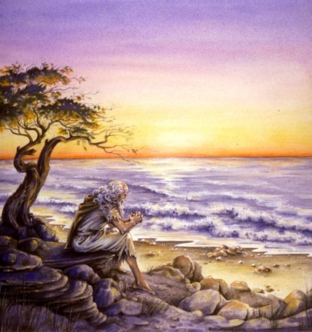
The Book of 1 John
To Download this lesson go to:
http://www.purifiedbyfaith.com/1John/1John.htm
https://revelationillustrated.com/

Slide 2
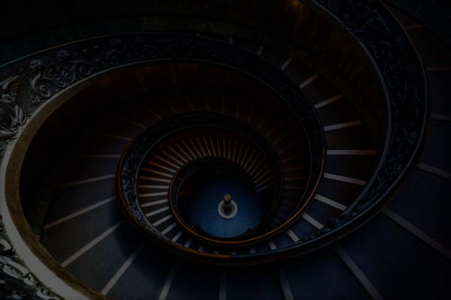
Outline of 1 John
1:1-4 - Prologue: John Introduces the Major Theme of the Letter - FELLOWSHIP WITH GOD
1:5-2:28 - The First Presentation of the Three Tests of FELLOWSHIP WITH GOD: RIGHTEOUSNESS, LOVE and BELIEF in Jesus
2:29-4:6 -The Second Presentation of the Three Tests of FELLOWSHIP WITH GOD: RIGHTEOUSNESS, LOVE and BELIEF in Jesus
4:7-5:21 - The Third Presentation of the Three Tests of FELLOWSHIP WITH GOD: RIGHTEOUSNESS, LOVE and BELIEF in Jesus
Robert Law, The Tests of Life, Third Edition, 1914, p.21-24

Slide 3
4:7-5:21 The Third Presentation of the Three Tests of FELLOWSHIP WITH GOD: RIGHTEOUSNESS, LOVE and BELIEF in Jesus
4:7-5:3a – Christian LOVE
4:7-12 – The Source of LOVE
4:13-16 – The Synthesis of LOVE and BELIEF– true belief is the vital ground of Christian love
4:17-5:1 – The Effect and Motives of LOVE
5:2-3a – The Synthesis of LOVE and RIGHTEOUSNESS – we love God by keeping His commandments
5:3b-21 – Christian BELIEF
5:3b-4 – The Synthesis of BELIEF and RIGHTEOUSNESS – in belief lies the power of obedience
5:5-12 – The Contents, Basis, and Issue of Christian BELIEF
5:13-21 – The Certainties of Christian BELIEF

Slide 4
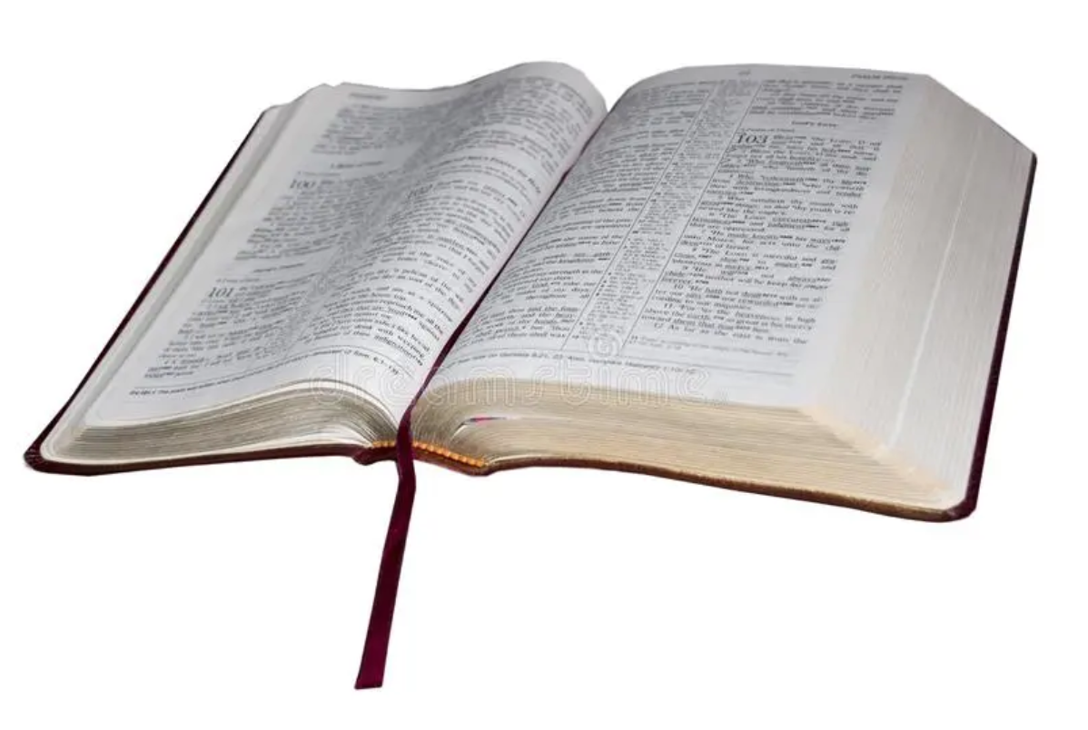
1 John 4:17-5:1 The Effect and Motives of LOVE
¹⁷ By this is love perfected with us, so that we may have confidence for the day of judgment, because as he is so also are we in this world. ¹⁸ There is no fear in love, but perfect love casts out fear. For fear has to do with punishment, and whoever fears has not been perfected in love. ¹⁹ We love because he first loved us. ²⁰ If anyone says, “I love God,” and hates his brother, he is a liar; for he who does not love his brother whom he has seen cannot love God whom he has not seen. ²¹ And this commandment we have from him: whoever loves God must also love his brother. ^{5:1} Everyone who believes that Jesus is the Christ has been born of God, and everyone who loves the Father loves whoever has been born of him.

Slide 5
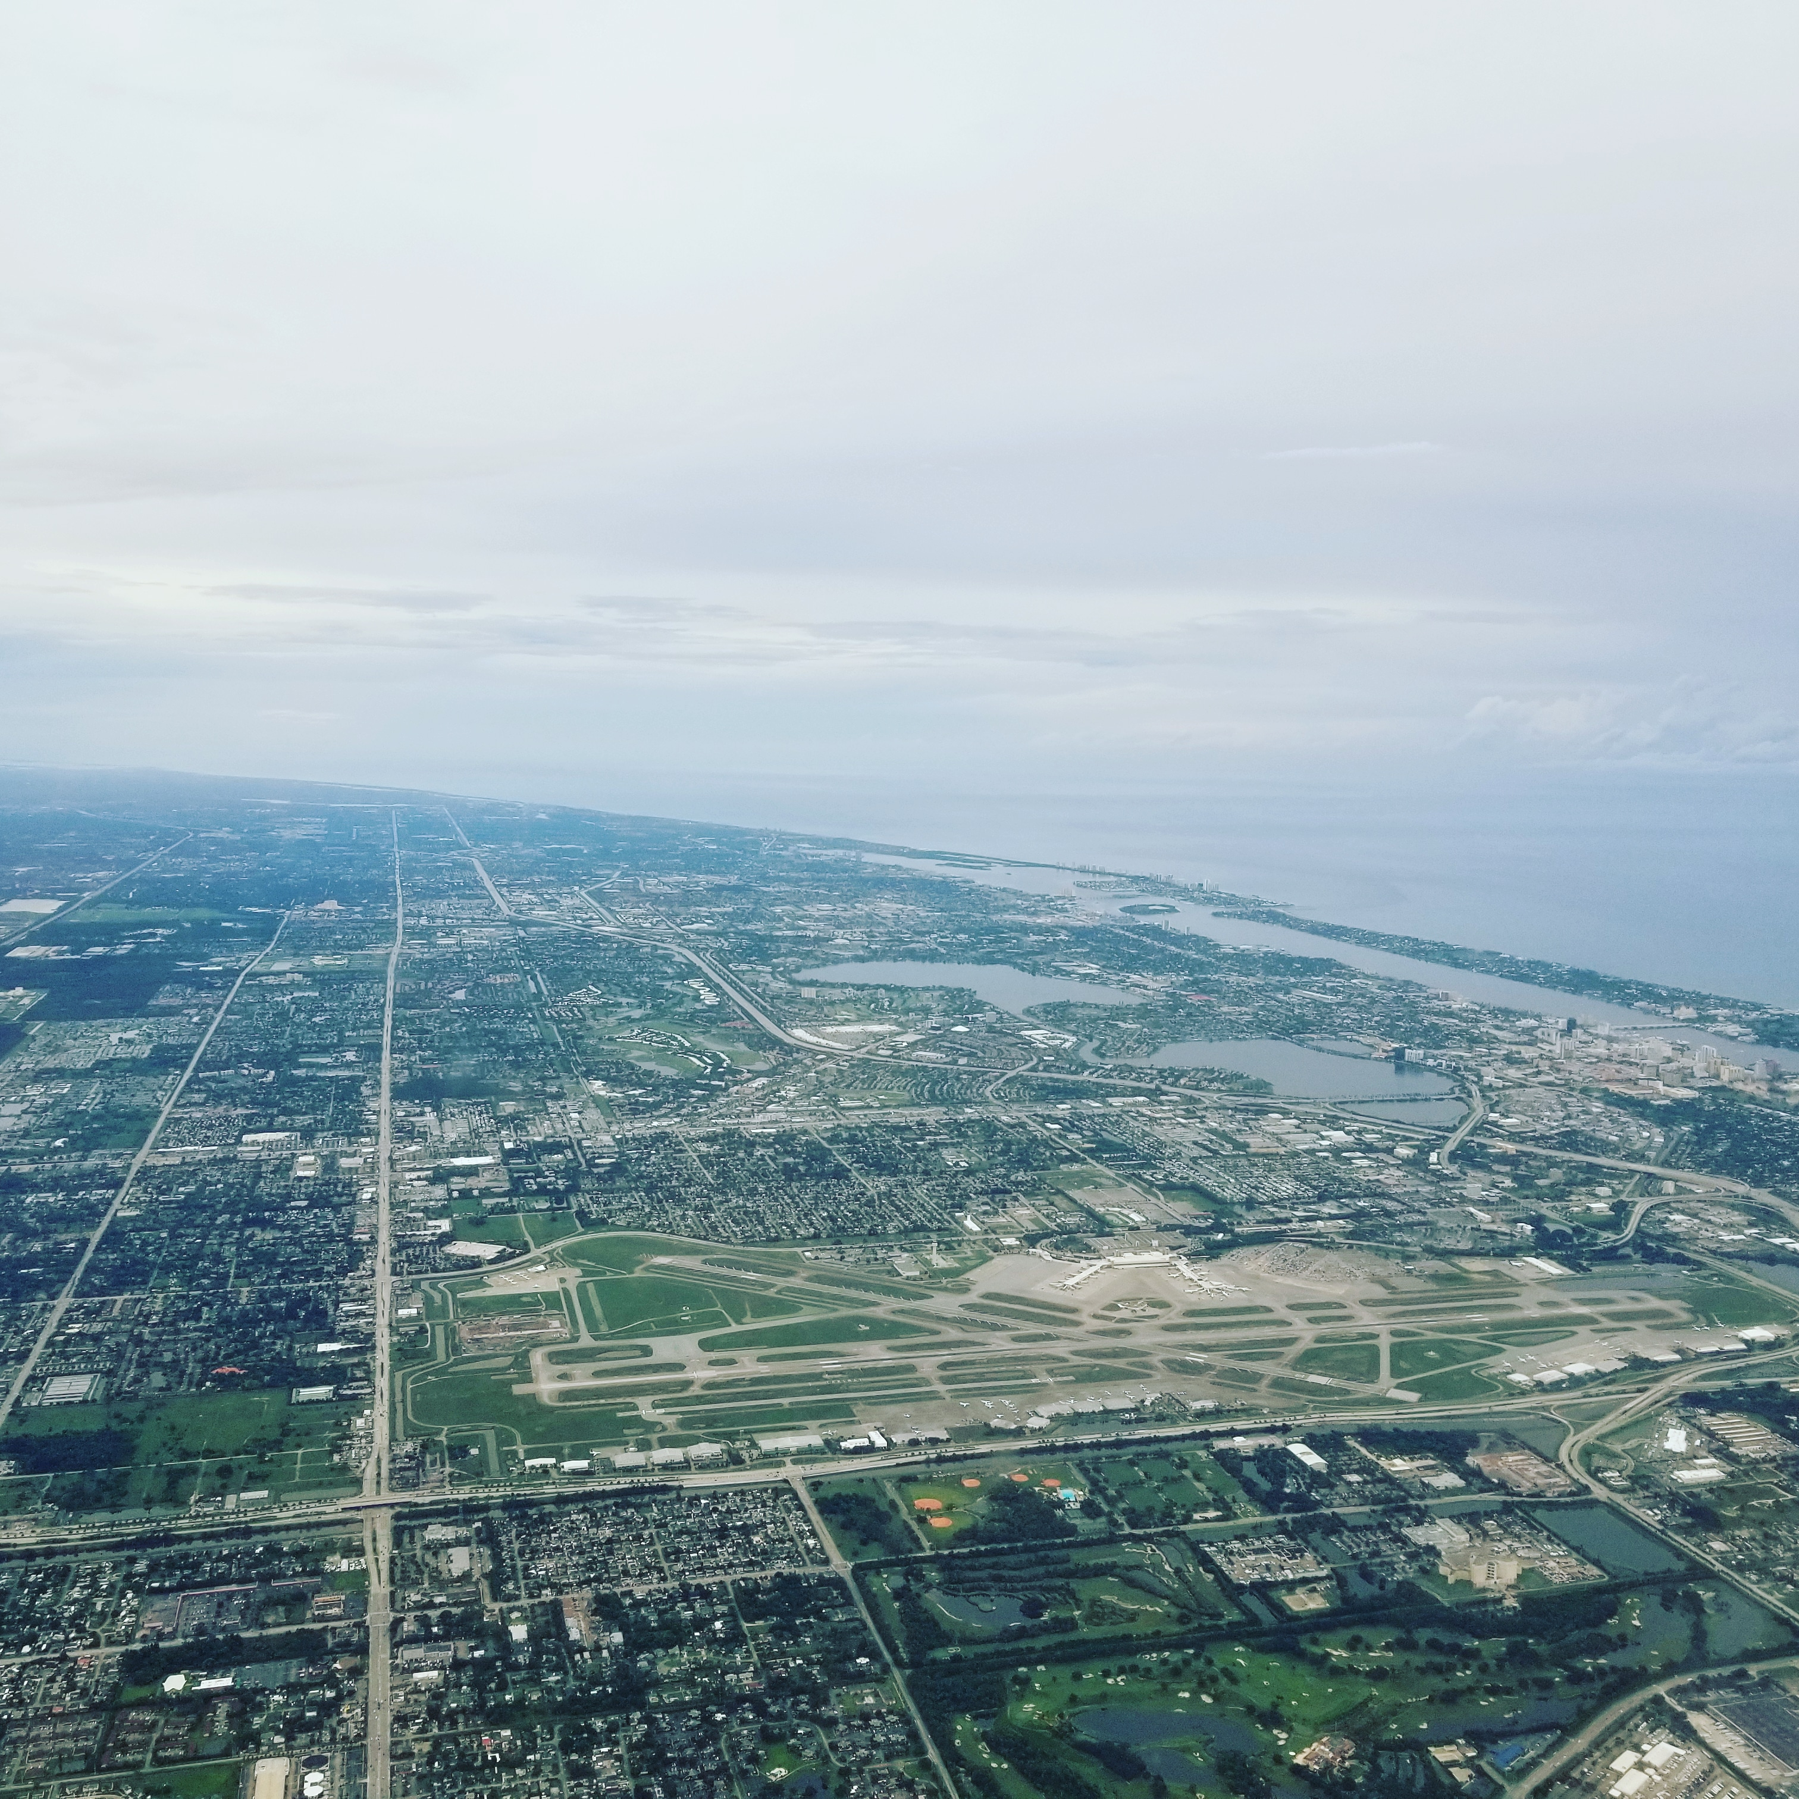
1 John 4:17-5:1 The Effect and Motives of LOVE
^{High Level Overview}
https://imgur.com/gallery/kOGmSB0

Slide 6
The Effect of Love - Genuine love of our Christian brothers drives out fear of eternal punishment and gives us confidence to stand before God in the Day of Judgment.
¹⁷ By this is love perfected with us, so that we may have confidence for the day of judgment, because as he is so also are we in this world. ¹⁸ There is no fear in love, but perfect love casts out fear. For fear has to do with punishment, and whoever fears has not been perfected in love. ¹⁹ We love because he first loved us. ²⁰ If anyone says, "I love God," and hates his brother, he is a liar; for he who does not love his brother whom he has seen cannot love God whom he has not seen. ²¹ And this commandment we have from him: whoever loves God must also love his brother. ^{5:1} Everyone who believes that Jesus is the Christ has been born of God, and everyone who loves the Father loves whoever has been born of him.
1 John 4:17-5:1

Slide 7
The Motive of Love - The necessary association of love for God and love for one’s brother.
¹⁷ By this is love perfected with us, so that we may have confidence for the day of judgment, because as he is so also are we in this world. ¹⁸ There is no fear in love, but perfect love casts out fear. For fear has to do with punishment, and whoever fears has not been perfected in love. ¹⁹ We love because he first loved us. ²⁰ If anyone says, "I love God," and hates his brother, he is a liar; for he who does not love his brother whom he has seen cannot love God whom he has not seen. ²¹ And this commandment we have from him: whoever loves God must also love his brother. ^{5:1} Everyone who believes that Jesus is the Christ has been born of God, and everyone who loves the Father loves whoever has been born of him.
1 John 4:17-5:1

Slide 8
“By this” refers back to the concept of the mutual indwelling in the previous verse:
1 John 4:16b: whoever abides in love abides in God, and God abides in him.
¹⁷ By this is love perfected with us, so that we may have confidence for the day of judgment, because as he is so also are we in this world. ¹⁸ There is no fear in love, but perfect love casts out fear. For fear has to do with punishment, and whoever fears has not been perfected in love. ¹⁹ We love because he first loved us. ²⁰ If anyone says, "I love God," and hates his brother, he is a liar; for he who does not love his brother whom he has seen cannot love God whom he has not seen. ²¹ And this commandment we have from him: whoever loves God must also love his brother. ^{5:1} Everyone who believes that Jesus is the Christ has been born of God, and everyone who loves the Father loves whoever has been born of him.
1 John 4:17-5:1

Slide 9
Likewise, the “love” mentioned here is the love talked about in the previous verse, which God pours into the hearts of His children by His Spirit, and then flows out to others.
¹⁷ By this is love perfected with us, so that we may have confidence for the day of judgment, because as he is so also are we in this world. ¹⁸ There is no fear in love, but perfect love casts out fear. For fear has to do with punishment, and whoever fears has not been perfected in love. ¹⁹ We love because he first loved us. ²⁰ If anyone says, "I love God," and hates his brother, he is a liar; for he who does not love his brother whom he has seen cannot love God whom he has not seen. ²¹ And this commandment we have from him: whoever loves God must also love his brother. ^{5:1} Everyone who believes that Jesus is the Christ has been born of God, and everyone who loves the Father loves whoever has been born of him.
1 John 4:17-5:1

Slide 10
The love which God has shed abroad in our hearts is “perfected”…
¹⁷ By this is love perfected with us, so that we may have confidence for the day of judgment, because as he is so also are we in this world. ¹⁸ There is no fear in love, but perfect love casts out fear. For fear has to do with punishment, and whoever fears has not been perfected in love. ¹⁹ We love because he first loved us. ²⁰ If anyone says, "I love God," and hates his brother, he is a liar; for he who does not love his brother whom he has seen cannot love God whom he has not seen. ²¹ And this commandment we have from him: whoever loves God must also love his brother. ^{5:1} Everyone who believes that Jesus is the Christ has been born of God, and everyone who loves the Father loves whoever has been born of him.
1 John 4:17-5:1

Slide 11
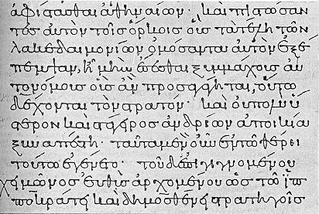
“perfected” - teleio,w (kolasis)
Gingrich:
To complete, finish, accomplish, bring to its goal, perfect
The love which God has shed abroad in our hearts is “perfected” in the sense that it is fully developed and reaches its intended goal when it produces the fruit of loving action towards others.
Colin G. Kruse, The Letters of John, The New Pillar Commentary, 2000, p.168

Slide 12
In my opinion, “with us” (μεθ᾽ ἡμῶν – meth hemon ) would be better translated as “in us” or “among us” (as it is translated in the NIV, for example).
¹⁷ By this is love perfected with among us, so that we may have confidence for the day of judgment, because as he is so also are we in this world. ¹⁸ There is no fear in love, but perfect love casts out fear. For fear has to do with punishment, and whoever fears has not been perfected in love. ¹⁹ We love because he first loved us. ²⁰ If anyone says, "I love God," and hates his brother, he is a liar; for he who does not love his brother whom he has seen cannot love God whom he has not seen. ²¹ And this commandment we have from him: whoever loves God must also love his brother. ^{5:1} Everyone who believes that Jesus is the Christ has been born of God, and everyone who loves the Father loves whoever has been born of him.
1 John 4:17-5:1

Slide 13
So pulling it all together, what John is saying in verse 17 is: It is by this mutual indwelling – us abiding in God and God abiding in us – that love has been brought to fruitful maturity in the Christian community.
¹⁷ By this is love perfected with among us, so that we may have confidence for the day of judgment, because as he is so also are we in this world. ¹⁸ There is no fear in love, but perfect love casts out fear. For fear has to do with punishment, and whoever fears has not been perfected in love. ¹⁹ We love because he first loved us. ²⁰ If anyone says, "I love God," and hates his brother, he is a liar; for he who does not love his brother whom he has seen cannot love God whom he has not seen. ²¹ And this commandment we have from him: whoever loves God must also love his brother. ^{5:1} Everyone who believes that Jesus is the Christ has been born of God, and everyone who loves the Father loves whoever has been born of him.
1 John 4:17-5:1

Slide 14
The “confidence” of which John speaks is an assurance that will enable the believer to stand fearlessly on the judgment day since he has solid evidence that he is regenerated and possesses eternal life.
¹⁷ By this is love perfected with us, so that we may have confidence for the day of judgment, because as he is so also are we in this world. ¹⁸ There is no fear in love, but perfect love casts out fear. For fear has to do with punishment, and whoever fears has not been perfected in love. ¹⁹ We love because he first loved us. ²⁰ If anyone says, "I love God," and hates his brother, he is a liar; for he who does not love his brother whom he has seen cannot love God whom he has not seen. ²¹ And this commandment we have from him: whoever loves God must also love his brother. ^{5:1} Everyone who believes that Jesus is the Christ has been born of God, and everyone who loves the Father loves whoever has been born of him.
1 John 4:17-5:1

Slide 15
1 John 4:17b - …because as he is so also are we in this world.
¹⁷ By this is love perfected with us, so that we may have confidence for the day of judgment, because as he is so also are we in this world. ¹⁸ There is no fear in love, but perfect love casts out fear. For fear has to do with punishment, and whoever fears has not been perfected in love. ¹⁹ We love because he first loved us. ²⁰ If anyone says, "I love God," and hates his brother, he is a liar; for he who does not love his brother whom he has seen cannot love God whom he has not seen. ²¹ And this commandment we have from him: whoever loves God must also love his brother. ^{5:1} Everyone who believes that Jesus is the Christ has been born of God, and everyone who loves the Father loves whoever has been born of him.
1 John 4:17-5:1

Slide 16
1 John 4:17b – “…because as he is so also are we in this world”
“…because” introduces a clause that explains why the believer will have confidence on judgment day: It is because of a certain likeness to Christ.
Believers are like Christ in that they love as He loves:
John calls for a willingness to lay down our lives in love for each other as Christ did (3:16).
Therefore believers who love one another in this world, in the same way that Christ loved His disciples when He was in the world (John 13:1, 34; 15:9, 12), show that they live in God, and therefore they need have no fear as they face the day of judgment.

Slide 17
After pointing out the fruit of love from the positive point of view in verse 17, John next looks at the same subject from the negative side. He turns from “confidence” to its opposite: “fear”.
¹⁷ By this is love perfected with us, so that we may have confidence for the day of judgment, because as he is so also are we in this world. ¹⁸ There is no fear in love, but perfect love casts out fear. For fear has to do with punishment, and whoever fears has not been perfected in love. ¹⁹ We love because he first loved us. ²⁰ If anyone says, "I love God," and hates his brother, he is a liar; for he who does not love his brother whom he has seen cannot love God whom he has not seen. ²¹ And this commandment we have from him: whoever loves God must also love his brother. ^{5:1} Everyone who believes that Jesus is the Christ has been born of God, and everyone who loves the Father loves whoever has been born of him.
1 John 4:17-5:1

Slide 18
In this verse, when it speaks of “fear”, it’s not talking about the proper reverence and respect one should have towards God, but of a dread, servile fear, or terror. “Fear”, in this context, has to do with condemnation.
¹⁷ By this is love perfected with us, so that we may have confidence for the day of judgment, because as he is so also are we in this world. ¹⁸ There is no fear in love, but perfect love casts out fear. For fear has to do with punishment, and whoever fears has not been perfected in love. ¹⁹ We love because he first loved us. ²⁰ If anyone says, "I love God," and hates his brother, he is a liar; for he who does not love his brother whom he has seen cannot love God whom he has not seen. ²¹ And this commandment we have from him: whoever loves God must also love his brother. ^{5:1} Everyone who believes that Jesus is the Christ has been born of God, and everyone who loves the Father loves whoever has been born of him.
1 John 4:17-5:1

Slide 19
“Love” here refers to the love that fellow Christians are to have for one another. So, in other words, John is saying that if we habitually love our brothers, we are giving evidence of salvation and therefore don’t have to fear eternal condemnation.
¹⁷ By this is love perfected with us, so that we may have confidence for the day of judgment, because as he is so also are we in this world. ¹⁸ There is no fear in love, but perfect love casts out fear. For fear has to do with punishment, and whoever fears has not been perfected in love. ¹⁹ We love because he first loved us. ²⁰ If anyone says, "I love God," and hates his brother, he is a liar; for he who does not love his brother whom he has seen cannot love God whom he has not seen. ²¹ And this commandment we have from him: whoever loves God must also love his brother. ^{5:1} Everyone who believes that Jesus is the Christ has been born of God, and everyone who loves the Father loves whoever has been born of him.
1 John 4:17-5:1

Slide 20
“Perfect love” is not flawless love; only God has that. Instead it is love that has become complete (perfect) because it has followed through to the production of loving deeds. Such love has completed its intended course and is fully developed rather than dying in the heart.
¹⁷ By this is love perfected with us, so that we may have confidence for the day of judgment, because as he is so also are we in this world. ¹⁸ There is no fear in love, but perfect love casts out fear. For fear has to do with punishment, and whoever fears has not been perfected in love. ¹⁹ We love because he first loved us. ²⁰ If anyone says, "I love God," and hates his brother, he is a liar; for he who does not love his brother whom he has seen cannot love God whom he has not seen. ²¹ And this commandment we have from him: whoever loves God must also love his brother. ^{5:1} Everyone who believes that Jesus is the Christ has been born of God, and everyone who loves the Father loves whoever has been born of him.
1 John 4:17-5:1

Slide 21
When love has completed its cycle of development and resulted in loving deeds, it removes any fear of judgment day, for it assures us that we are God’s regenerated people.
¹⁷ By this is love perfected with us, so that we may have confidence for the day of judgment, because as he is so also are we in this world. ¹⁸ There is no fear in love, but perfect love casts out fear. For fear has to do with punishment, and whoever fears has not been perfected in love. ¹⁹ We love because he first loved us. ²⁰ If anyone says, "I love God," and hates his brother, he is a liar; for he who does not love his brother whom he has seen cannot love God whom he has not seen. ²¹ And this commandment we have from him: whoever loves God must also love his brother. ^{5:1} Everyone who believes that Jesus is the Christ has been born of God, and everyone who loves the Father loves whoever has been born of him.
1 John 4:17-5:1

Slide 22
“For” explains why “perfect love casts out fear”. It is because fear is, in some way, related to punishment.
¹⁷ By this is love perfected with us, so that we may have confidence for the day of judgment, because as he is so also are we in this world. ¹⁸ There is no fear in love, but perfect love casts out fear. For fear has to do with punishment, and whoever fears has not been perfected in love. ¹⁹ We love because he first loved us. ²⁰ If anyone says, "I love God," and hates his brother, he is a liar; for he who does not love his brother whom he has seen cannot love God whom he has not seen. ²¹ And this commandment we have from him: whoever loves God must also love his brother. ^{5:1} Everyone who believes that Jesus is the Christ has been born of God, and everyone who loves the Father loves whoever has been born of him.
1 John 4:17-5:1

Slide 23
“punishment” - ko,lasij (kolasis)
Strong’s Data:
Correction, punishment, penalty
Kruse:
The word translated “punishment” is found in only one other place in the NT:
Matthew 25:46 - And these will go away into eternal punishment, but the righteous into eternal life.
Punishment there is what God metes out to the unrighteous on the Day of Judgment.
Colin G. Kruse, The Letters of John, The New Pillar Commentary, 2000, p.168

Slide 24
So the punishment John speaks of here, is the punishment that is to be meted out to the unrighteous in the last judgment, and it is fear of this eternal punishment that is driven out by genuine Christian love.
¹⁷ By this is love perfected with us, so that we may have confidence for the day of judgment, because as he is so also are we in this world. ¹⁸ There is no fear in love, but perfect love casts out fear. For fear has to do with punishment, and whoever fears has not been perfected in love. ¹⁹ We love because he first loved us. ²⁰ If anyone says, "I love God," and hates his brother, he is a liar; for he who does not love his brother whom he has seen cannot love God whom he has not seen. ²¹ And this commandment we have from him: whoever loves God must also love his brother. ^{5:1} Everyone who believes that Jesus is the Christ has been born of God, and everyone who loves the Father loves whoever has been born of him.
1 John 4:17-5:1

Slide 25
If a person dreads the thought of judgment day, it may be because his life is not marked by the perfected love that expresses itself in concrete action. In other words, he has no basis for assurance concerning his welfare when judgment day comes.
¹⁷ By this is love perfected with us, so that we may have confidence for the day of judgment, because as he is so also are we in this world. ¹⁸ There is no fear in love, but perfect love casts out fear. For fear has to do with punishment, and whoever fears has not been perfected in love. ¹⁹ We love because he first loved us. ²⁰ If anyone says, "I love God," and hates his brother, he is a liar; for he who does not love his brother whom he has seen cannot love God whom he has not seen. ²¹ And this commandment we have from him: whoever loves God must also love his brother. ^{5:1} Everyone who believes that Jesus is the Christ has been born of God, and everyone who loves the Father loves whoever has been born of him.
1 John 4:17-5:1

Slide 26
As he does so often in this letter, John underscores the connection between our love for God and our love for fellow believers. He begins by reminding his readers that “We love because he first loved us.”
¹⁷ By this is love perfected with us, so that we may have confidence for the day of judgment, because as he is so also are we in this world. ¹⁸ There is no fear in love, but perfect love casts out fear. For fear has to do with punishment, and whoever fears has not been perfected in love. ¹⁹ We love because he first loved us. ²⁰ If anyone says, "I love God," and hates his brother, he is a liar; for he who does not love his brother whom he has seen cannot love God whom he has not seen. ²¹ And this commandment we have from him: whoever loves God must also love his brother. ^{5:1} Everyone who believes that Jesus is the Christ has been born of God, and everyone who loves the Father loves whoever has been born of him.
1 John 4:17-5:1

Slide 27
God showed His love for us by sending His Son as an atoning sacrifice for our sins (4:10). Those who are the beneficiaries of that love, love God in return.
¹⁷ By this is love perfected with us, so that we may have confidence for the day of judgment, because as he is so also are we in this world. ¹⁸ There is no fear in love, but perfect love casts out fear. For fear has to do with punishment, and whoever fears has not been perfected in love. ¹⁹ We love because he first loved us. ²⁰ If anyone says, "I love God," and hates his brother, he is a liar; for he who does not love his brother whom he has seen cannot love God whom he has not seen. ²¹ And this commandment we have from him: whoever loves God must also love his brother. ^{5:1} Everyone who believes that Jesus is the Christ has been born of God, and everyone who loves the Father loves whoever has been born of him.
1 John 4:17-5:1

Slide 28
However, the love relationship believers have with God, if it is real, will manifest itself in their love for Christian brothers and sisters. Because there is such a necessary connection between love for God and love for fellow believers, John goes on: “If anyone says, "I love God," and hates his brother, he is a liar”.
¹⁷ By this is love perfected with us, so that we may have confidence for the day of judgment, because as he is so also are we in this world. ¹⁸ There is no fear in love, but perfect love casts out fear. For fear has to do with punishment, and whoever fears has not been perfected in love. ¹⁹ We love because he first loved us. ²⁰ If anyone says, "I love God," and hates his brother, he is a liar; for he who does not love his brother whom he has seen cannot love God whom he has not seen. ²¹ And this commandment we have from him: whoever loves God must also love his brother. ^{5:1} Everyone who believes that Jesus is the Christ has been born of God, and everyone who loves the Father loves whoever has been born of him.
1 John 4:17-5:1

Slide 29
Here John argues from the lesser to the greater: If people cannot carry out the lesser requirement (to love their fellow believers whom they have seen), they cannot carry out the greater requirement (to love God whom they have not seen).
¹⁷ By this is love perfected with us, so that we may have confidence for the day of judgment, because as he is so also are we in this world. ¹⁸ There is no fear in love, but perfect love casts out fear. For fear has to do with punishment, and whoever fears has not been perfected in love. ¹⁹ We love because he first loved us. ²⁰ If anyone says, "I love God," and hates his brother, he is a liar; for he who does not love his brother whom he has seen cannot love God whom he has not seen. ²¹ And this commandment we have from him: whoever loves God must also love his brother. ^{5:1} Everyone who believes that Jesus is the Christ has been born of God, and everyone who loves the Father loves whoever has been born of him.
1 John 4:17-5:1

Slide 30
1 John 4:20 – God whom he has not seen.
¹⁷ By this is love perfected with us, so that we may have confidence for the day of judgment, because as he is so also are we in this world. ¹⁸ There is no fear in love, but perfect love casts out fear. For fear has to do with punishment, and whoever fears has not been perfected in love. ¹⁹ We love because he first loved us. ²⁰ If anyone says, "I love God," and hates his brother, he is a liar; for he who does not love his brother whom he has seen cannot love God whom he has not seen. ²¹ And this commandment we have from him: whoever loves God must also love his brother. ^{5:1} Everyone who believes that Jesus is the Christ has been born of God, and everyone who loves the Father loves whoever has been born of him.
1 John 4:17-5:1

Slide 31
1 John 4:20 – God whom he has not seen.
When John speaks of God as one whom we have not seen, he is picking up an important theme from the Gospel of John, where the invisibility of God is mentioned again and again:
John 1:18 - No one has ever seen God; the only God, who is at the Father's side, he has made him known.
John 5:37 - And the Father who sent me has himself borne witness about me. His voice you have never heard, his form you have never seen…
John 6:46 - …not that anyone has seen the Father except he who is from God; he has seen the Father.
Here John repeats the point he made in 4:12 of this letter – that claims to know the “unseen” God must be validated by love for fellow believers who can be seen.
Colin G. Kruse, The Letters of John, The New Pillar Commentary, 2000, p.170

Slide 32
In verse 21 John picks up a major theme from the Last Supper discourse in the Gospel of John, where Jesus stresses that His disciples’ love for Him must express itself in obedience to His command that they should love one another (cf. e.g. John 13:34; 14:15; 15:12; 15:17).
¹⁷ By this is love perfected with us, so that we may have confidence for the day of judgment, because as he is so also are we in this world. ¹⁸ There is no fear in love, but perfect love casts out fear. For fear has to do with punishment, and whoever fears has not been perfected in love. ¹⁹ We love because he first loved us. ²⁰ If anyone says, "I love God," and hates his brother, he is a liar; for he who does not love his brother whom he has seen cannot love God whom he has not seen. ²¹ And this commandment we have from him: whoever loves God must also love his brother. ^{5:1} Everyone who believes that Jesus is the Christ has been born of God, and everyone who loves the Father loves whoever has been born of him.
1 John 4:17-5:1

Slide 33
Although 5:1 begins a new chapter, it does not mark a change in thought. John continues to insist, as he does in 4:20-21, that love for God, if it is genuine, will be accompanied by love for fellow believers.
¹⁷ By this is love perfected with us, so that we may have confidence for the day of judgment, because as he is so also are we in this world. ¹⁸ There is no fear in love, but perfect love casts out fear. For fear has to do with punishment, and whoever fears has not been perfected in love. ¹⁹ We love because he first loved us. ²⁰ If anyone says, "I love God," and hates his brother, he is a liar; for he who does not love his brother whom he has seen cannot love God whom he has not seen. ²¹ And this commandment we have from him: whoever loves God must also love his brother. ^{5:1} Everyone who believes that Jesus is the Christ has been born of God, and everyone who loves the Father loves whoever has been born of him.
1 John 4:17-5:1

Slide 34
Notice that John combines the themes of love and belief again in this section as he did earlier in 4:13-16.
¹⁷ By this is love perfected with us, so that we may have confidence for the day of judgment, because as he is so also are we in this world. ¹⁸ There is no fear in love, but perfect love casts out fear. For fear has to do with punishment, and whoever fears has not been perfected in love. ¹⁹ We love because he first loved us. ²⁰ If anyone says, "I love God," and hates his brother, he is a liar; for he who does not love his brother whom he has seen cannot love God whom he has not seen. ²¹ And this commandment we have from him: whoever loves God must also love his brother. ^{5:1} Everyone who believes that Jesus is the Christ has been born of God, and everyone who loves the Father loves whoever has been born of him.
1 John 4:17-5:1

Slide 35
The combination of present tense (“believes”) and perfect tense (“has been born”) is important. It shows clearly that believing is the consequence, not the cause, of new birth. Our present continuing activity of believing is the result, and therefore the evidence, of our past experience of new birth by which we became and remain God’s children.
¹⁷ By this is love perfected with us, so that we may have confidence for the day of judgment, because as he is so also are we in this world. ¹⁸ There is no fear in love, but perfect love casts out fear. For fear has to do with punishment, and whoever fears has not been perfected in love. ¹⁹ We love because he first loved us. ²⁰ If anyone says, "I love God," and hates his brother, he is a liar; for he who does not love his brother whom he has seen cannot love God whom he has not seen. ²¹ And this commandment we have from him: whoever loves God must also love his brother. ^{5:1} Everyone who believes that Jesus is the Christ has been born of God, and everyone who loves the Father loves whoever has been born of him.
1 John 4:17-5:1

Slide 36
This is a metaphor drawn from natural experience, in which a person who loves and respects a father will also love and respect his child.
¹⁷ By this is love perfected with us, so that we may have confidence for the day of judgment, because as he is so also are we in this world. ¹⁸ There is no fear in love, but perfect love casts out fear. For fear has to do with punishment, and whoever fears has not been perfected in love. ¹⁹ We love because he first loved us. ²⁰ If anyone says, "I love God," and hates his brother, he is a liar; for he who does not love his brother whom he has seen cannot love God whom he has not seen. ²¹ And this commandment we have from him: whoever loves God must also love his brother. ^{5:1} Everyone who believes that Jesus is the Christ has been born of God, and everyone who loves the Father loves whoever has been born of him.
1 John 4:17-5:1

Slide 37
4:7-5:21 The Third Presentation of the Three Tests of FELLOWSHIP WITH GOD: RIGHTEOUSNESS, LOVE and BELIEF in Jesus
4:7-5:3a – Christian LOVE
4:7-12 – The Source of LOVE
4:13-16 – The Synthesis of LOVE and BELIEF– true belief is the vital ground of Christian love
4:17-5:1 – The Effect and Motives of LOVE
5:2-3a – The Synthesis of LOVE and RIGHTEOUSNESS – we love God by keeping His commandments
5:3b-21 – Christian BELIEF
5:3b-4 – The Synthesis of BELIEF and RIGHTEOUSNESS – in belief lies the power of obedience
5:5-12 – The Contents, Basis, and Issue of Christian BELIEF
5:13-21 – The Certainties of Christian BELIEF

Slide 38
1 John 5:2-3a The Synthesis of LOVE and RIGHTEOUSNESS – We love God by keeping His commandments
² By this we know that we love the children of God, when we love God and obey his commandments. ^{3a} For this is the love of God, that we keep his commandments.

Slide 39
Having made the point in 5:1 that those who love God also love the children of God, John now explains how people may know that they love the children of God.
² By this we know that we love the children of God, when we love God and obey his commandments. ^{3a} For this is the love of God, that we keep his commandments.
1 John 5:2-3a

Slide 40
Interestingly enough, John here seems to be reversing the approach that he uses elsewhere in the letter. His usual approach is to say that people’s claims to love God are to be tested by the presence or absence of love for fellow believers (e.g. 5:20). But here he does the reverse!
² By this we know that we love the children of God, when we love God and obey his commandments. ^{3a} For this is the love of God, that we keep his commandments.
1 John 5:2-3a

Slide 41
John’s thought almost appears to go in a circle. This is perhaps because as far as he is concerned, the two things involved cannot exist apart from one another: It is as impossible to love the children of God without loving God, as it is to love God without loving His children.
² By this we know that we love the children of God, when we love God and obey his commandments. ^{3a} For this is the love of God, that we keep his commandments.
1 John 5:2-3a

Slide 42
Once again, John speaks of the observable mark of love for God, namely obedience to God’s commands. Whether it is being shown to God or shown to man, “love” is practical and active:
Love for the brethren expresses itself “in deed and in truth”, in sacrificial service (as we saw in 3:18)
Love for God expresses itself in keeping His commandments.
² By this we know that we love the children of God, when we love God and obey his commandments. ^{3a} For this is the love of God, that we keep his commandments.
1 John 5:2-3a

Slide 43
Paraphrastic Commentary on 1 John 4:17-5:3a by Donald W. Burdick
(17) It is by this mutual indwelling - God working in us - that love has been brought to fruitful maturity, so that we will be able to stand fearlessly on judgment day. Such confidence is ours because here in this world we are like Christ in manifesting God-like love. (18) Love and fear are mutually exclusive. Love that has come to fruit-bearing maturity excludes fear, because terror at the prospect of judgment day is punishment in itself. The person who fears that day does not have the assurance of fruit bearing love in his life. (19) We now are manifesting love, because at Calvary He took the initiative and performed a mighty deed of love in our behalf. (20) Suppose someone says, "I love God," and yet he hates a fellow church member. He is not telling the truth, because if he does not show God-like love, for his brother who is visible to him, he cannot love God who is invisible. (21) Furthermore, God has laid down this requirement: One who loves God must also love his brother. (5:1) Everyone who is a believer in Jesus as the divine Christ is a child of God, and anyone who loves God, who is the Father also loves the child who has been born of Him.

Slide 44
Paraphrastic Commentary on 1 John 4:17-5:3a by Donald W. Burdick
(2) This is how we can discover if we love God's children: Do we love God and are we obeying His commands? (3) This is what it is to love God. It is to make it a practice to do what He commands.

Slide 45

Class Discussion Time
https://www.weareteachers.com/moving-beyond-classroom-discussions/

Slide 46
*Class Discussion Time
We live in a day when people, if they believe in God at all, are likely to assume that they are saved and going to heaven. This has not always been the case. In earlier eras, many, perhaps most, people feared they were condemned and going to hell. Thus the comfort of assurance of salvation on the Day of Judgment offered by John in this portion does not tend to have the impact today that it should.
What do you think caused this shift in society’s thinking?
Do you sometimes struggle with a fear that you may not, in fact, be a genuine Christian? If so, based on what we saw in our passage this morning, what remedy should you pursue when you experience those fears?

