Slide 1
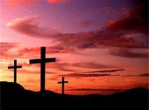
New Covenant Theology

Slide 2
Brief Review
The Bible explicitly refers to the “New Covenant” in a number of passages and builds theology and application on it.
A proper understanding of the New Covenant will help us:
  Do a better job of rightly understanding and applying the Word of God.
  Appreciate and make sense of the unfolding of God’s sovereign plan of redemption as it was progressively revealed in the scriptures.

Slide 3
Overview
What We’re Going to Cover
The Major Covenants in the Bible
How the New Testament Compares and Contrasts the Major Covenants
Questions Raised by New Covenant Theology

Slide 4
Covenants in the Bible

Slide 5
Covenant
Dictionary Definition:
World Book Dictionary - A solemn agreement between two or more persons or groups to do or not do a certain thing

Slide 6
Covenant
Definition of a Covenant between God and Man:
  A covenant is an unchangeable, divinely imposed legal agreement between God and man that stipulates the conditions of their relationship. (Grudem, Systematic Theology p.515)
  A covenant given by God is imposed on men. It is entirely from God. Men have no part in any negotiation over it, but it contains stipulations about their conduct and it may also include penalties for disobedience. (Zaspel and Wells, New Covenant Theology, p.5)

Slide 7
Covenant
A covenant is made between God and a specific person or group of people.
The giving of a covenant often included a solemn ceremony that involved:
  Animal sacrifices
  Pronouncement of curses that would accompany the violation of the covenant

Slide 8
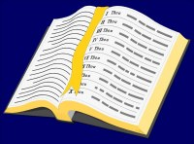
An Example of the
Making of a Covenant
  Genesis 15:1-18 - ¹ After these things the word of the LORD came to Abram in a vision: "Fear not, Abram, I am your shield; your reward shall be very great.” . . . ⁷ And he said to him, "I am the LORD who brought you out from Ur of the Chaldeans to give you this land to possess." ⁸ But he said, "O Lord GOD, how am I to know that I shall possess it?”

Slide 9
An Example of the
Making of a Covenant
  Genesis 15:1-18 (continued) - ⁹ He said to him, "Bring me a heifer three years old, a female goat three years old, a ram three years old, a turtledove, and a young pigeon." ¹⁰ And he brought him all these, cut them in half, and laid each half over against the other. . . ¹¹ And when birds of prey came down on the carcasses, Abram drove them away. ¹² As the sun was going down, a deep sleep fell on Abram. And behold, dreadful and great darkness fell upon him. . . ¹⁷ When the sun had gone down and it was dark, behold, a smoking fire pot and a flaming torch passed between these pieces. ¹⁸ On that day the LORD made a covenant with Abram, saying, “To your offspring I give this land . . .”

Slide 10
Covenant
A covenant was often accompanied by a sign that served as a symbol and future reminder of the covenant.
Two types of covenants:
  Conditional
  Unconditional
  Note: Sometimes a covenant can have both conditional and unconditional aspects to it.

Slide 11
The Major Covenants in the Bible
Noahic (Genesis 9:8-17)
Abrahamic (Genesis 12-17)
Mosaic (Exodus 19-24)
  Often referred to in the New Testament as the “Old Covenant”
Davidic (2Samuel 23:5, Psalm 89:3)
New (Jer.31:31-34 ; Heb.7-13; 2Cor.3:6-18)

Slide 12
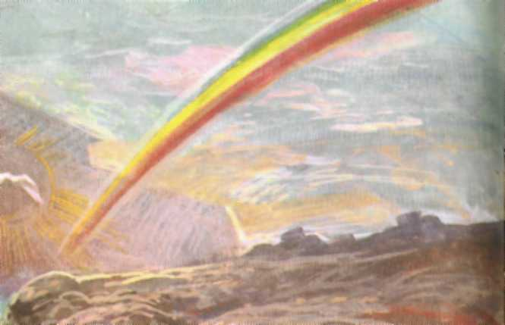
Noahic Covenant
Genesis 9:8-17

Slide 13
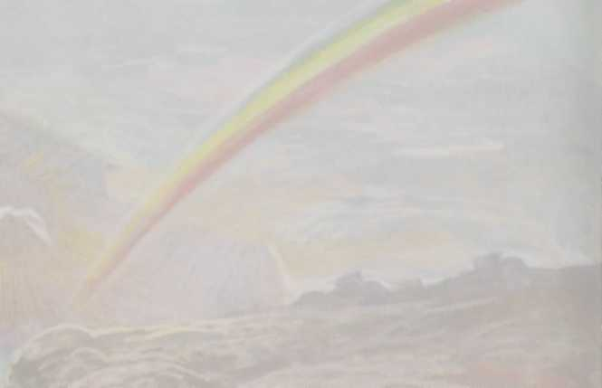
Noahic Covenant
Genesis 9:8-17
Then God said to Noah and to his sons with him, ⁹ “Behold, I establish my covenant with you and your offspring after you, ¹⁰ and with every living creature that is with you, the birds, the livestock, and every beast of the earth with you, as many as came out of the ark; it is for every beast of the earth. ¹¹ I establish my covenant with you, that never again shall all flesh be cut off by the waters of the flood, and never again shall there be a flood to destroy the earth.”

Slide 14
Noahic Covenant
Genesis 9:8-17
¹² And God said, "This is the sign of the covenant that I make between me and you and every living creature that is with you, for all future generations: ¹³ I have set my bow in the cloud, and it shall be a sign of the covenant between me and the earth. ¹⁴ When I bring clouds over the earth and the bow is seen in the clouds, ¹⁵ I will remember my covenant that is between me and you and every living creature of all flesh.

Slide 15
Noahic Covenant
Genesis 9:8-17
“And the waters shall never again become a flood to destroy all flesh. ¹⁶ When the bow is in the clouds, I will see it and remember the everlasting covenant between God and every living creature of all flesh that is on the earth.” ¹⁷ God said to Noah, “This is the sign of the covenant that I have established between me and all flesh that is on the earth.”

Slide 16
Noahic Covenant
Genesis 9:8-17
Description: A divine promise to never again destroy the entire earth and kill all living things with a flood.
Type:
  Unconditional
Made with Whom?
  Noah, his descendants, and every living thing on the earth
Sign:
  Rainbow

Slide 17
Questions
Before this class, were you familiar with the idea of a covenant and how covenants were established in ancient times?
Are you surprised by the fact that the major covenants are so central to the Bible’s message and God’s dealings with man?
Do you think it’s important to have an understanding of covenants (especially the major ones) in order to rightly understand your Bible?

