Slide 1
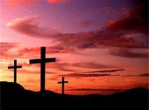
New Covenant Theology

Slide 2
Brief Review
A covenant is a solemn agreement imposed by God on a specific person or group of people.
A covenant was often accompanied by a sign that served as a symbol and future reminder of the covenant.
Two types of covenants:
Conditional
Unconditional
Note: Sometimes a covenant can have both conditional and unconditional aspects to it.

Slide 3
The Major Covenants in the Bible
Noahic (Genesis 9:8-17)
Abrahamic (Genesis 12-17)
Mosaic (Exodus 19-24)
Davidic (2Samuel 23:5, Psalm 89:3)
New (Jer.31:31-34 ; Heb.7-13; 2Cor.3:6-18)

Slide 4
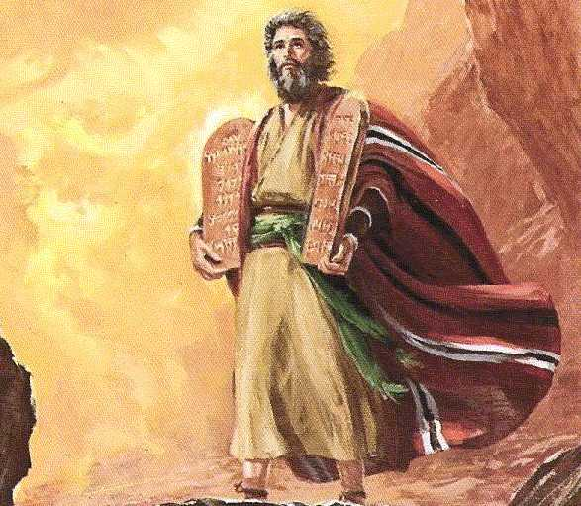
Mosaic Covenant
Exodus 19-24

Slide 5
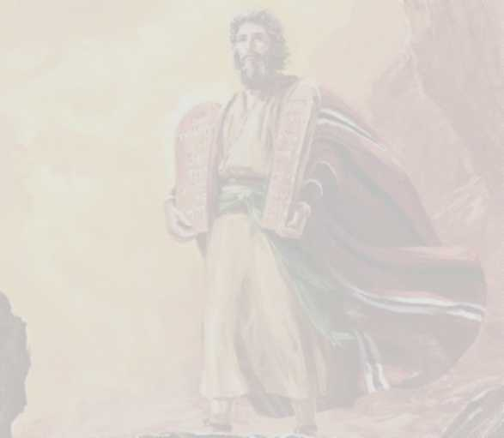

Mosaic Covenant Exodus 19-24
Exodus 19:3-8 – … Moses went up to God. The LORD called to him out of the mountain, saying, "Thus you shall say to the house of Jacob, and tell the people of Israel: ⁴ You yourselves have seen what I did to the Egyptians, and how I bore you on eagles' wings and brought you to myself. ⁵ Now therefore, if you will indeed obey my voice and keep my covenant, you shall be my treasured possession among all peoples, for all the earth is mine; ⁶ and you shall be to me a kingdom of priests and a holy nation. These are the words that you shall speak to the people of Israel." ⁷ So Moses came and called the elders of the people and set before them all these words that the LORD had commanded him. ⁸ All the people answered together and said, "All that the LORD has spoken we will do." And Moses reported the words of the people to the LORD.

Slide 6
Mosaic Covenant Exodus 19-24
Exodus 31:16-17 – And the LORD said to Moses … ¹⁶ “the people of Israel shall keep the Sabbath, observing the Sabbath throughout their generations, as a covenant forever. ¹⁷ It is a sign forever between me and the people of Israel …
Joshua 23:16 – If you transgress the covenant of the LORD your God, which he commanded you, and go and serve other gods and bow down to them. Then the anger of the LORD will be kindled against you, and you shall perish quickly from off the good land that he has given to you.

Slide 7
Mosaic Covenant Exodus 19-24
Description: God’s pledge to treasure and protect the nation of Israel – to be their God and have them as His chosen nation
Type:
Conditional

Slide 8
Mosaic Covenant Exodus 19-24
Made with Whom?
The Nation of Israel
Included regenerate (Heb.11:23-40 ) and unregenerate Jews (Jer.2:8; 4:22)
Heb.11:23ff – By faith Moses… By faith Rahab… Gideon, Barak, Samson, Jephthah, of David and Samuel and the prophets--who through faith conquered kingdoms, enforced justice, obtained promises…
Jer.2:8 – The priests did not say, 'Where is the LORD?' Those who handle the law did not know me; the shepherds transgressed against me; the prophets prophesied by Baal and went after things that do not profit.
Jer.4:22 – For my people are foolish; they know me not; they are stupid children; they have no understanding. They are 'wise'-- in doing evil! But how to do good they know not.
Also applied to Gentiles (non-Jews) living among the Israelites though they were not the primary recipients of the Covenant.
Gentiles could also participate in voluntary aspects of the Mosaic Covenant if they were willing to meet certain requirements.
Num.15:14-16 – And if a stranger is sojourning with you, or anyone is living permanently among you, and he wishes to offer a food offering, with a pleasing aroma to the LORD, he shall do as you do. For the assembly, there shall be one statute for you and for the stranger who sojourns with you, a statute forever throughout your generations. You and the sojourner shall be alike before the LORD. One law and one rule shall be for you and for the stranger who sojourns with you.
See also - Ex. 12:48, 19:6; Lev.18:26; Num.15:30; Deut. 5:14, 14:21

Slide 9
Mosaic Covenant Exodus 19-24
Sign:
The Sabbath

Slide 10
The Ten Commandments and the Mosaic Covenant
The terms of the Mosaic Covenant were summarized in the Ten Commandments that were etched on the tablets of stone for Moses by God on Mount Sinai:
Deuteronomy 4:13 – And He [the Lord] declared to you His covenant, which he commanded you to perform, that is, the Ten Commandments, and He wrote them on two tablets of stone.
The Ten Commandments were given specifically to the Nation of Israel.
Exodus 34:27-28 – And the LORD said to Moses, “Write these words, for in accordance with these words I have made a covenant with you and with Israel.” ²⁸ … And he wrote on the tablets the words of the covenant, the Ten Commandments.

Slide 11
The Law of Moses and the Mosaic Covenant
To Summarize, the Mosaic Covenant was:
Represented by the Sabbath (as the sign of the covenant)
Summarized in the Ten Commandments
Ultimately Embodied in the 600+ Laws Given by Moses:
Deuteronomy 7:12 - And because you listen to these rules and keep and do them, the LORD your God will keep with you the covenant and the steadfast love that he swore to your fathers.

Slide 12
The Law of Moses and the Mosaic Covenant
The Mosaic Covenant with its many laws is often referred to in the Bible as the “law of Moses” or just “the law”.
John 7:23 – If on the Sabbath a man receives circumcision, so that the law of Moses may not be broken, are you angry with me because on the Sabbath I made a man's whole body well?
1 Corinthians 9:20 – To the Jews I became as a Jew, in order to win Jews. To those under the law I became as one under the law (though not being myself under the law) that I might win those under the law.

Slide 13
The Law of Moses and the Mosaic Covenant
The Law of Moses was given exclusively to the nation of Israel.
Psalm 147:19-20 – He declares his word to Jacob, his statutes and rules to Israel. He has not dealt thus with any other nation; they do not know his rules. Praise the LORD!
The Law of Moses was given as a complete unit.
Therefore the Law of Moses had to be kept completely. The Israelites were not allowed to just keep one part and ignore the rest of it!
Galatians 3:10b – Cursed be everyone who does not abide by all things written in the Book of the Law, and do them.
James 2:10 – For whoever keeps the whole law but fails in one point has become accountable for all of it.

Slide 14
The Law of Moses and the Mosaic Covenant
The Law of Moses promised to give (eternal) life to all who would obey it perfectly – but in reality it brought death, because sinful man cannot keep the Law perfectly
The Jews thought (at first) that they would keep the Law:
Exodus 19:7-8 – So Moses came and called the elders of the people and set before them all these words that the LORD had commanded him. All the people answered together and said, "All that the LORD has spoken we will do." And Moses reported the words of the people to the LORD.
They eventually found out that they couldn’t keep the Law
Romans 7:10 – The very commandment that promised life proved to be death to me.

Slide 15
Questions
Does it come as a surprise to you, that, though many of the Old Testament Jews had faith in the promised Messiah, many, perhaps a majority of them, were unbelievers?
Does it come as a surprise to you that the Law of Moses, including the Ten Commandments, and the command to observe the Sabbath were given to the nation of Israel alone?

