Slide 1

New Covenant Theology

Slide 2
The Major Covenants in the Bible
Noahic (Genesis 9:8-17)
Abrahamic (Genesis 12-17)
Mosaic (Exodus 19-24)
Davidic (2Samuel 23:5, Psalm 89:3)
New (Jer.31:31-34 ; Heb.7-13; 2Cor.3:6-18)

Slide 3
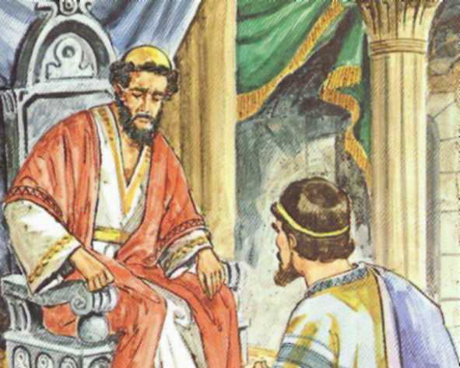
Davidic Covenant
2 Samuel 23:5, Psalm 89:3

Slide 4
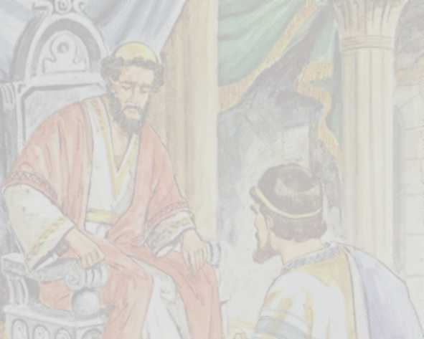

Davidic Covenant 2Samuel 23:5, Psalm 89:3
2 Samuel 7:8,16 – Now, therefore, thus you shall say to my servant David, “Thus says the LORD of hosts: … Your house and your kingdom shall be made sure forever before me. Your throne shall be established forever.”
2 Samuel 23:1,5a – Now these are the last words of David: The oracle of David, the son of Jesse, the oracle of the man who was raised on high, the anointed of the God of Jacob, the sweet psalmist of Israel: … “For does not my house stand so with God? For he has made with me an everlasting covenant, ordered in all things and secure…

Slide 5
Davidic Covenant 2Samuel 23:5, Psalm 89:3
Psalm 89:3-4 – I [the Lord] have made a covenant with my chosen one; I have sworn to David my servant: “I will establish your offspring forever, and build your throne for all generations.”
Psalm 89:30-37 – If [David’s] children forsake my law and do not walk according to my rules, ³¹ if they violate my statutes and do not keep my commandments, ³² then I will punish their transgression with the rod and their iniquity with stripes, ³³ but I will not remove from him my steadfast love or be false to my faithfulness. ³⁴ I will not violate my covenant or alter the word that went forth from my lips. ³⁵ Once for all I have sworn by my holiness; I will not lie to David. ³⁶ His offspring shall endure forever, his throne as long as the sun before me. ³⁷ Like the moon it shall be established forever, a faithful witness in the skies.

Slide 6
Davidic Covenant 2Samuel 23:5, Psalm 89:3
Description: God’s promise that David’s royal lineage will endure forever
Type:
Unconditional – For David, God’s promise of a royal line (fulfilled in Christ, the King of Kings) is unconditional
Conditional – For David’s sons, their privilege to rule was contingent upon them keeping God’s Law
Made with Whom?
David and his descendants
Sign:
?

Slide 7
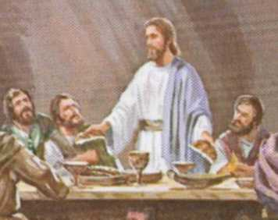
The New Covenant
Jeremiah 31:31-34; Hebrews 7-13;
2 Corinthians 3:6-18

Slide 8
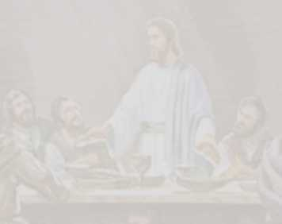
The New Covenant Jer. 31:31-34, Luke 22:20, Heb. 7-13, 2 Cor. 3:6-18
Jeremiah 31:31-34 – Behold, the days are coming, declares the LORD, when I will make a new covenant with the house of Israel and the house of Judah, ³² not like the covenant that I made with their fathers on the day when I took them by the hand to bring them out of the land of Egypt, my covenant that they broke, though I was their husband, declares the LORD. ³³ For this is the covenant that I will make with the house of Israel after those days, declares the LORD: I will put my law within them, and I will write it on their hearts. And I will be their God, and they shall be my people. ³⁴ And no longer shall each one teach his neighbor and each his brother, saying, 'Know the LORD,' for they shall all know me, from the least of them to the greatest, declares the LORD. For I will forgive their iniquity, and I will remember their sin no more.

Slide 9
The New Covenant Jer. 31:31-34, Luke 22:20, Heb. 7-13, 2 Cor. 3:6-18
Luke 22:20b (cf. 1Cor 11:25) – This cup that is poured out for you is the new covenant in my blood.
Hebrews 9:15 – Therefore [Christ] is the mediator of a new covenant, so that those who are called may receive the promised eternal inheritance, since a death has occurred that redeems them from the transgressions committed under the first covenant.
2 Corinthians 3:6-8 – [God] has made us sufficient to be ministers of a new covenant, not of the letter but of the Spirit. For the letter kills, but the Spirit gives life. ⁷ Now if the ministry of death, carved in letters on stone, came with such glory that the Israelites could not gaze at Moses' face because of its glory, which was being brought to an end, ⁸ will not the ministry of the Spirit have even more glory?

Slide 10
The New Covenant Jer. 31:31-34, Luke 22:20, Heb. 7-13, 2 Cor. 3:6-18
Description: God’s promise to redeem His people from their sins and write His law on their hearts, giving them an eternal inheritance.
Type:
Unconditional
Made with Whom?
Genuine believers since the coming of Christ
Sign:
The Lord’s Supper?
1 Corinthians 11:24-25 – And when [the Lord] had given thanks, he broke [the bread], and said, “This is my body which is for you. Do this in remembrance of me.” In the same way also he took the cup, after supper, saying, “This cup is the new covenant in my blood. Do this, as often as you drink it, in remembrance of me.”

Slide 11
The New Covenant
Was established by Jesus’ blood sacrifice on the cross (1 Cor. 11:25)
Includes only regenerate people (those who “know the Lord”) (Jer. 31:31-34)
Is characterized by the Holy Spirit indwelling the hearts of all of God’s people (2 Cor. 3:6) – see also:
Acts 2:17 - "'In the last days, God says, I will pour out my Spirit on all people. Your sons and daughters will prophesy, your young men will see visions, your old men will dream dreams.
2 Corinthians 1:22 – [God] set his seal of ownership on us, and put his Spirit in our hearts as a deposit, guaranteeing what is to come.
1 Corinthians 12:13 - For we were all baptized by one Spirit into one body-- whether Jews or Greeks, slave or free-- and we were all given the one Spirit to drink.

Slide 12
The New Covenant
Includes Jews and Gentiles on an Equal Basis Before God
Ephesians 2:11-18 – Therefore remember that at one time you Gentiles in the flesh, called "the uncircumcision" by what is called the circumcision, which is made in the flesh by hands-- ¹² remember that you were at that time separated from Christ, alienated from the commonwealth of Israel and strangers to the covenants of promise, having no hope and without God in the world. ¹³ But now in Christ Jesus you who once were far off have been brought near by the blood of Christ. ¹⁴ For he himself is our peace, who has made us both one and has broken down in his flesh the dividing wall of hostility ¹⁵ by abolishing the law of commandments expressed in ordinances, that he might create in himself one new man in place of the two, so making peace, ¹⁶ and might reconcile us both to God in one body through the cross, thereby killing the hostility. ¹⁷ And he came and preached peace to you who were far off and peace to those who were near. ¹⁸ For through him we both have access in one Spirit to the Father.

Slide 13
The New Covenant
Believers in the New Covenant Are Under the Law of Christ
1 Corinthians 9:19-21 – For though I am free from all, I have made myself a servant to all, that I might win more of them. ²⁰ To the Jews I became as a Jew, in order to win Jews. To those under the law I became as one under the law (though not being myself under the law) that I might win those under the law. ²¹ To those outside the law I became as one outside the law (not being outside the law of God but under the law of Christ) that I might win those outside the law.
Galatians 6:2 – Bear one another's burdens, and so fulfill the law of Christ.

Slide 14
A New Covenant by any other name…
There are a number of places in scripture (especially in the Old Testament) where the New Covenant is referenced, but the term “new covenant” is not used.
Gentry and Wellum* believe that the New Covenant is referenced in the following passages as a:
Everlasting Covenant (Jer. 32:36-41; 50:2-5; Ezek 37:15-28 (esp. v.26); Isaiah 55:1-5; 61:8-9; Heb 13:20)
Covenant of Peace (Isaiah 54:1-10 (esp. vv.9-10); Ezek 34:20-31 (esp. v.25); 37:15-18 (esp. v.26)
Promise of a new heart and a new spirit (Ezek 11:18-21; 18:30-32; 36:24-32 (esp. v.26) [cf. Isa. 59:21]
New Covenant (Jer. 31:31-34)
*Peter Gentry and Stephen Wellum, Kingdom Through Covenant, Crossway 2012, p.434

Slide 15
A New Covenant by any other name…
Jer. 32:38-41 – And they shall be my people, and I will be their God. ³⁹ I will give them one heart and one way, that they may fear me forever, for their own good and the good of their children after them. ⁴⁰ I will make with them an everlasting covenant, that I will not turn away from doing good to them. And I will put the fear of me in their hearts, that they may not turn from me. ⁴¹ I will rejoice in doing them good, and I will plant them in this land in faithfulness, with all my heart and all my soul.

Slide 16
A New Covenant by any other name…
Isaiah 54:1-10 – “Sing, O barren one, who did not bear; break forth into singing and cry aloud, you who have not been in labor! For the children of the desolate one will be more than the children of her who is married," says the LORD… ³ For you will spread abroad to the right and to the left, and your offspring will possess the nations and will people the desolate cities… ⁷ For a brief moment I deserted you, but with great compassion I will gather you... ¹⁰ For the mountains may depart and the hills be removed, but my steadfast love shall not depart from you, and my covenant of peace shall not be removed," says the LORD, who has compassion on you.
Compare: Galatians 4:22-28 – For it is written that Abraham had two sons, one by a slave woman and one by a free woman. ²³ But the son of the slave was born according to the flesh, while the son of the free woman was born through promise. ²⁴ Now this may be interpreted allegorically: these women are two covenants. One is from Mount Sinai, bearing children for slavery; she is Hagar. ²⁵ Now Hagar is Mount Sinai in Arabia; she corresponds to the present Jerusalem, for she is in slavery with her children. ²⁶ But the Jerusalem above is free, and she is our mother. ²⁷ For it is written, “Rejoice, O barren one who does not bear; break forth and cry aloud, you who are not in labor! For the children of the desolate one will be more than those of the one who has a husband.” ²⁸ Now you, brothers, like Isaac, are children of promise.

Slide 17
A New Covenant by any other name…
Ezekiel 11:19-20 – And I will give them one heart, and a new spirit I will put within them. I will remove the heart of stone from their flesh and give them a heart of flesh, ²⁰ that they may walk in my statutes and keep my rules and obey them. And they shall be my people, and I will be their God.
Ezekiel 36:25-27 – I will sprinkle clean water on you, and you shall be clean from all your uncleannesses, and from all your idols I will cleanse you. ²⁶ And I will give you a new heart, and a new spirit I will put within you. And I will remove the heart of stone from your flesh and give you a heart of flesh. ²⁷ And I will put my Spirit within you, and cause you to walk in my statutes and be careful to obey my rules.
Compare 2Cor. 3:3-6 – You are a letter from Christ delivered by us, written not with ink but with the Spirit of the living God, not on tablets of stone but on tablets of human hearts (literally, “hearts of flesh”)... Not that we are sufficient in ourselves to claim anything as coming from us, but our sufficiency is from God, who has made us sufficient to be ministers of a new covenant, not of the letter but of the Spirit.

Slide 18
Observations by Gentry and Wellum*
Gentry and Wellum* make the following observations about the New Covenant prophesies given in Isaiah, Jeremiah, and Ezekiel:
Between 750 and 550 B.C. …the prophets… announced coming events. Some events would happen fairly soon; others would not happen for some time… Because the people had broken… the Israelite covenant… God would put in place a new covenant in which not only would he be faithful, but his people would be faithful too. (p.434)
Isaiah [for example] excoriate[s] the people for their sins… The Lord has no choice but to fulfill the gravest curses and threats entailed in the covenant in Deut. 28. The final threat is exile. (p.436)
*Peter Gentry and Stephen Wellum, Kingdom Through Covenant, Crossway 2012

Slide 19
Observations by Gentry and Wellum*
Isaiah… [then] looks farther into the future, beyond the judgment of exile to the comfort and consolation of Israel, i.e., bringing them back from exile… the return from the Babylonian exile will be nothing less than a new exodus – indeed a greater exodus! (p.437)
This new exodus is also described by the term “redeem”… Yahweh… will “buy back” his people from exile as he once delivered them from bondage and slavery in Egypt (p.437)
*Peter Gentry and Stephen Wellum, Kingdom Through Covenant, Crossway 2012

Slide 20
Observations by Gentry and Wellum*
The return from exile, however, is not a chronologically single task. The promises of redemption are divided into two distinct events:
Release
Forgiveness
Release refers to bringing the people physically out of exile in Babylon and back to their own land.
Forgiveness entails dealing fully and finally with their sin and the broken covenant… you can take the people out of Babylon, but how do you get Babylon out of the people?
The exile will be over only when God deals with the people’s sin and renews the covenant.
*Peter Gentry and Stephen Wellum, Kingdom Through Covenant, Crossway 2012, p.437-438

Slide 21
Questions
What do you think about the idea of new covenant believers no longer being under the Old Testament Law of Moses, but under Christ’s Law?
Does it make sense to you (insofar as we have looked at them) that the Old Testament texts cited earlier, which do not explicitly use the term “new covenant”, do in fact, refer to the new covenant, though by a different name?

