Slide 1

New Covenant Theology

Slide 2

Questions Raised by New Covenant Theology

Slide 3
Are OT Laws Binding on Christians Today? (Review)
Where We Are in Our Study:
  We are still looking at the first question that I raised concerning New Covenant Theology: Are OT laws binding on Christians today?
  We’ve spent two weeks looking at a passage where Jesus addresses this very issue: the second half of the “Sermon on the Mount” as it is laid out in Matthew 5:17-48.
  Last week I began to present some comments on Matthew 5:17-48 from William Hendriksen, a respected Dutch Reformed Bible scholar who has an opposing viewpoint on this passage.
  This week we will resume looking a Hendriksen’s comments on this passage.

Slide 4
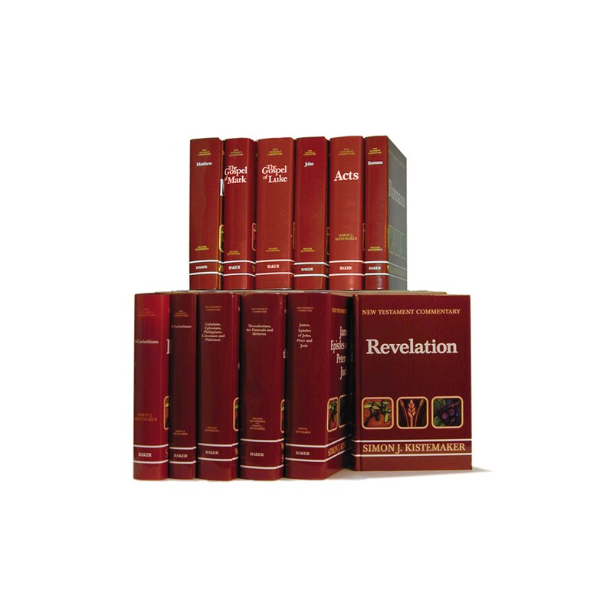
Comments on Mat. 5:17-48 From an Opposing Viewpoint

Slide 5
Review of What I Said About William Hendriksen Last Week
William Hendriksen is a scholar for whom I have a great deal of respect and with whom I agree in many other areas of Biblical teaching.
Hendriksen has written some excellent commentaries on a number of NT books, and has authored a number of other books as well.
Because Hendriksen is Dutch Reformed, he will disagree with a number of things that we believe as Baptists. For example he says in his commentary on Col. 2:11-13 (p.116 and in the footnote):
  The definite implication [of Col. 2:11-13] is that baptism has taken the place of circumcision… Hence the following statement is correct: “Since, then, baptism has come in the place of circumcision, the children should be baptized as heirs of the kingdom of God, and of his Covenant.” (emphasis original)
As a Reformed writer, Hendriksen would also disagree with many of the things that I have been teaching you about New Covenant Theology (NCT). He would see much more continuity between the OT and NT laws than I would.

Slide 6
Review of Hendriksen’s Comments on Mat. 5:17-20
Last week I began by showing you several comments made by Hendriksen on Jesus’ introductory remarks in Mat. 5:17-20 where Jesus tells us that he has not come to abolish the OT scriptures and that not even the smallest part of the OT would go unfulfilled.
In his comments on Mat. 5:17-20, Hendriksen said a couple of things with which we can all agree:
  Christ’s opponents even now had begun to regard him as a destructive revolutionist, an iconoclast who wanted to break every tie with the past… The opponents were wrong. (p.288)
  Not until the universe in its present form disappears will even the smallest part of the Old Testament that requires fulfillment fail to be fulfilled. Every type will be exchanged for its antitype, Every prediction will be verified. The law’s demand will be fully met. (p.291)

Slide 7
Review of Hendriksen’s Comments on Mat. 5:17-20
But then we had to part company with Hendriksen, when he made the following comment:
  [Christ] insists that every commandment of that which is truly God’s moral law – the very law which he is about to discuss in greater detail in 5:21ff – must be kept. Nothing must be annulled or cancelled. (p.292 – emphasis added)
The problem with this comment is that Hendriksen narrows Christ’s statement to saying that only the “moral law” must continue to be kept.
But if we look at what Christ actually said, he tells us that we must keep all of the laws by obeying him and thereby fulfilling what those laws pointed to (cf. Rom. 13:8-10).

Slide 8
Review of Hendriksen’s Comments on Mat. 5:21-48
We then began to look at Hendriksen’s comments on what Jesus says in the body of the Sermon on the Mount.
In this section, Jesus’ cites six examples of OT commands where he follows this pattern:
  He begins by saying: “You have heard that it was said to those of old…”
  Quotes or paraphrases an OT command(s)
  Then says: “But I say to you…” at which point he makes a number of comments concerning that command.
Hendriksen prefers to go with a less common way of translating Jesus’ first phrase. So where almost every mainstream English translation (e.g. ESV, NAS, NET, NIV, NLT, RSV) says something like:
  “You have heard that it was said to the men of long ago…”
Hendriksen (along with the KJV) translates it:
  “You have heard that it was said by the men of long ago…”
And, as Hendriksen sees it, translating that one word as “to” rather than “by” completely changes what we understand Jesus to be saying.

Slide 9
Review of Hendriksen’s Comments on Mat. 5:21-48
I understand Jesus to be quoting the OT law that was given to the ancient Israelites and telling us how we as New Covenant believers are to behave in light of what that law was pointing to.
Hendriksen, on the other hand, understands Jesus to be correcting what was said by the ancient rabbis about the OT laws.
So, going with the majority of modern translations, I would give an expanded paraphrase of Mat. 5:21-22 like this:
  You have heard [in Exodus 20:13] that [Moses] said to the [Israelites] of long ago, 'You shall not murder… But I say to you that [in the New Covenant] everyone who is angry with his brother will be liable to judgment.
Whereas Hendriksen would understand Jesus to be saying something like this:
  You have heard that it was said by the [Rabbis] of long ago, 'You shall not murder… But I say to you that [they didn’t go far enough in their teaching – they should have known better and should have taught that] everyone who is angry with his brother will [also] be liable to judgment.

Slide 10
Review of Hendriksen’s Comments on Mat. 5:21-48
Here are the reasons that Hendriksen gives (p. 296) for his way of understanding of these six examples:
It would be very strange that Jesus, having just affirmed in most emphatic terms that he had not come to set aside the law or the prophets, would now suddenly turn around and do this very thing.
  I agree. I don’t think Jesus is setting aside the law. I think Jesus is showing us how the OT is fulfilled in what he commands.
Had Jesus been referring to what Moses in the law had commanded he would have used different language; for example, “Moses commanded” (Mat. 8:4), or “It is written” (Mat. 4:4, 7, 10; Luke 2:23; 4:4).
  A few verses later in one of the texts Hendriksen cites (Luke 4:4), Jesus uses very similar wording to what he uses in Mat. 5: And Jesus answered him, “It is said, ‘You shall not put the Lord your God to the test.’” (Luke 4:12)
In later Jewish writings such famous rabbans as Hillel and Shammai were called “fathers of antiquity.” The designation “men of long ago” is accordingly an excellent designation for those who had orally interpreted the written Old Testament.
  The book of Hebrews uses very similar language to what Jesus uses in Mat. 5 to describe the giving of scripture: Long ago… God spoke to our fathers by the prophets (Heb. 1:1)

Slide 11
Additional Hendriksen Comments on Mat. 5:21-48
Here are some additional reasons (that we didn’t get to last week) that Hendriksen gives (p. 296) for his way of understanding of these six examples:
  The expression “it was said,” though possible even as a reference to something written, is more readily associated with oral teaching and tradition than with that which was put down in a document.
  It is clear that when Jesus says, “You have heard… but I say” (5:22, 32,34,39,44) he is drawing a contrast between two positions that are sharply opposed. This contrast is clearer when the two opposing clauses are “It was said by the men… but I say,” meaning “They said… but I say,” than if it would be if they were “It was said to the men… but I say,” meaning, “They heard… but I say.”

Slide 12
Additional Hendriksen Comments on Mat. 5:21-48
To summarize:
  By going with an unusual Greek construction in Matthew 5, Hendriksen sees Jesus as commenting on (and correcting) what was said “by the men of long ago” (i.e. some ancient Jewish rabbis).
  Hendriksen offers reasons for going with his interpretation but, though I can see how his interpretation fits in well with his Reformed theology, I do not find any of the reasons that he offers to be compelling!

Slide 13
Additional Hendriksen Comments on Mat. 5:21-48
  I think it makes better sense to understand Jesus as be commenting on (and making additions to) the OT scriptures that were given “to the men of long ago” (i.e. the ancient Israelites).
  Why do I say that?
  As I’ve already pointed out, is the most common way of translating the Greek expression used in these passages.
  It makes Jesus teaching fit together with the numerous other passages of scripture that we have looked at, which say that we are no longer to listen to Moses, but we are to listen to Jesus.
  It makes the examples that Jesus gives fit better with the introduction that he gives in verses 17-20 where he talks about how he is the one who fulfills the OT scriptures.
  It fits better with what the text actually says. Jesus is not quoting false rabbinical teachings about scripture – all the quotations he gives are direct quotations of (or close paraphrases of) scripture.

Slide 14
Additional Hendriksen Comments on Mat. 5:21-48
Here is Hendriksen’s response (p.296) to the last point that I just raised:
  The ancient interpreters, then, in quoting the sixth commandment has said, “Thou shall not kill.” What was wrong with this? Was not this, after all, exactly what God in his law had written on tablets of stone? (Ex. 20:13; Deut. 5:17)?
  On the surface, therefore, it would seem that no fault whatsoever can be found with the manner in which men of long ago had interpreted the sixth commandment. In the present instance what was wrong was not what they had said but what they left unsaid, or at least unemphasized.
Notice he has to read an idea into the text that is not actually there.
Jesus says nothing about what the men of long ago “left unsaid” or “unemphasized”. He simply quotes (or paraphrases) the OT law.

Slide 15
Additional Hendriksen Comments on Mat. 5:21-48
If you want to see an example of what Jesus says when men fail to go far enough in carrying out the commands of scripture, look at what he says to the Pharisees for not going far enough:
  But woe to you Pharisees! For you tithe mint and rue and every herb, and neglect justice and the love of God. These you ought to have done, without neglecting the others. (Luke 11:42)
Furthermore, for the most part, the things Jesus teaches in Mat. 5:21-48 are not things that the rabbis (or anyone else) could have known, because, while the OT laws pointed to the things that Jesus taught, they were never explicitly given (in the OT) until Jesus instituted them here as a part of the New Covenant.

Slide 16
Conclusion on Hendriksen’s Comments (Mat. 5:17-48)
  While Hendriksen is normally a good and trustworthy Biblical scholar, I believe that his Reformed, Covenant of Grace theology blinds him from seeing what Jesus is actually doing in Mat. 5:
  He sees Jesus talking about “God’s moral law”, in a verse where Jesus says he’s talking about all of God’s law.
  He opts to go with a very unusual way of interpreting a Greek construction that makes it appear as though Jesus is correcting some ancient unnamed rabbis, rather than accept the fact that Jesus is actually upgrading and changing the OT law.
  He misses the fact that the things that Jesus adds to the law in Matthew 5 are things that the scriptures never taught, until Jesus added them as a part of the New Covenant.
  His interpretation of Jesus in Mat. 5 would end up making Jesus contradict many other clear NT passages which say that we are no longer to listen to Moses, but we are to listen to Jesus.

Slide 17
Questions?

