Slide 1

New Covenant Theology

Slide 2

Questions Raised by New Covenant Theology

Slide 3
Questions Raised by New Covenant Theology
What are the competing theological systems to New Covenant Theology?
What questions do these competing views raise that we need to evaluate and consider?

Slide 4
Competing Systems to New Covenant Theology
We will look at two major competing theological systems to New Covenant Theology:
  Dispensationalism
  Covenant Theology

Slide 5
Dispensationalism – Brief Review
We saw last time where Dispensationalism sees God as dividing human history into several distinct time periods or “dispensations” (from the Greek word OIKONOMIA – 1Cor 9:17; Eph. 1:10) during which man is tested in respect to obedience to some specific revelation of the will of God.
Although Dispensationalists vary in how many dispensations they claim there are, last week I listed the seven dispensations taught in the notes of the Scofield Reference Bible in order to provide you with an example of the time periods that are commonly believed by dispensationalists. Can you name them?
  Innocence (Before the Fall)
  Conscience (Adam to Noah)
  Government (Noah to Babel)
  Promise (Abraham to Moses)
  Law (Moses to Christ)
  Grace (Pentecost to the Rapture)
  Kingdom (Future Millennial kingdom where Christ rules on earth for a thousand years).

Slide 6
Dispensationalism – Brief Review
Besides the division of Biblical history into distinct time periods (which we believe also, though we would use the term “covenant” rather than “dispensation”), what were some of the other distinctives that dispensationalists hold to?
  When it comes to the fulfillment of prophesy, they do not believe that what is taught in the NT takes precedent over what is said in the OT.
  They believe that many OT prophesies that NT writers say have been fulfilled (spiritually), will have a literal physical fulfillment in the future that the NT writers don’t mention.
  They say that these OT prophecies predict that in the future (during “the Tribulation” and “Millennium”) God is going to reconstitute Israel as a physical nation of believing Jews, who are distinct from the Gentiles – much like it was in OT times.
Which of these dispensational beliefs do you find most troubling? Why do you find it troubling?

Slide 7
Covenant Theology
Covenant Theology views the history of God's dealings with mankind under the framework of three overarching theological covenants:
  The Covenant of Works
  The Covenant of Redemption
  The Covenant of Grace
Unlike the biblical covenants (i.e. covenants that are specifically mentioned in the Bible) that we focused on in our development of New Covenant Theology, the theological covenants of Covenant Theology are never mentioned by name anywhere in scripture.
This is not to say that all the ideas described by these theological covenants are unbiblical or untrue – as we will soon see, many of the ideas described by these theological covenants are, in fact, biblical.
And there is not necessarily anything wrong with creating theological terminology that is not directly used in the Bible to describe a biblical concept – as long as you make sure that the concept you are describing is truly a biblical concept.

Slide 8
Origins of Covenant Theology
Many of the basic teachings of Covenant Theology find are found in seed form in the writings of John Calvin (1509-1564), but the fullest original expression of Covenant Theology is found in the Westminster Confession of Faith (1646).
Since that time, Covenant Theology has been picked up and further developed by Reformed writers down through the years. To name but a few:
  John Owen (1616–1683)
  London Baptist Confession of 1689
  Jonathan Edwards (1703–58)
  Charles Hodge (1797-1878) in his Systematic Theology
  Louis Berkhof (1873-1957) in his Systematic Theology
  William Hendriksen
  Wayne Grudem in his Systematic Theology

Slide 9
The Covenant of Works
Covenant Theology views the arrangement that God had with Adam in the Garden as a “Covenant of Works”.
The Westminster Confession of Faith (Chapter 7 part 2) says concerning this covenant:
  The first covenant made with man was a covenant of works, (Gal 3:12) wherein life was promised to Adam, and in him to his posterity,(Rom 5:12-20;10:5) upon condition of perfect and personal obedience. (Gen 2:17; Gal 3:10)
A couple of things I would point out concerning this statement in the WCF:
  If you look up the references cited, none of them say anything about a “covenant” with Adam.
  Adam was not promised “life”. The only thing promised to Adam was death if he disobeyed God's clear command.
  If you study them in context, you will find that many of the Bible references given have nothing to do with Adam.
  Several of them (Gal. 3:10, 12; Rom 10:5), for example, are texts that teach that those who try to be saved by keeping the Mosaic Law must do so perfectly and, since no one can do that, they will be condemned. Note: Adam was not under the Law of Moses!

Slide 10
The Covenant of Redemption
Covenant Theology calls the specific plan and purpose of God that was agreed upon by the Father, Son, and Holy Spirit in order to secure our redemption “The Covenant of Redemption”.
Note: this particular theological covenant is not mentioned in the Westminster Confession, but it is taught by many other Reformed writers.
For example, Berkhof, in his systematic theology, says this about the so-called “Covenant of Redemption”:
  Scripture clearly points to the fact that the plan of redemption was included in the eternal decree or counsel of God, Eph. 1:4 ff.; 3:11; II Thess. 2:13; II Tim. 1:9; Jas. 2:5; I Pet. 1:2, etc. Now we find that in the economy of redemption there is, in a sense, a division of labor: the Father is the originator, the Son the executor, and the Holy Spirit the applier. This can only be the result of a voluntary agreement among the persons of the Trinity, so that their internal relations assume the form of a covenant life. (p.293)
Although the scriptures do teach that such an agreement exists between the members of the Trinity, there is no reference anywhere in scripture (including the references given by Berkhof) that call this predetermined plan made between the members of the Trinity a “covenant”.

Slide 11
The Covenant of Grace
The Westminster Confession of Faith (Chapter 7 part 3) says concerning this covenant:
  Man, by his fall, having made himself incapable of life by that covenant, the Lord was pleased to make a second, commonly called the Covenant of Grace, whereby He freely offereth unto sinners life and salvation by Jesus Christ, requiring of them faith in Him, that they may be saved; and promising to give unto all those that are ordained unto eternal life His Holy Spirit, to make them willing, and able to believe.
In Covenant Theology, all of the major covenants described in the Bible are merely different “administrations” or “dispensations” of this overarching Covenant of Grace.

Slide 12
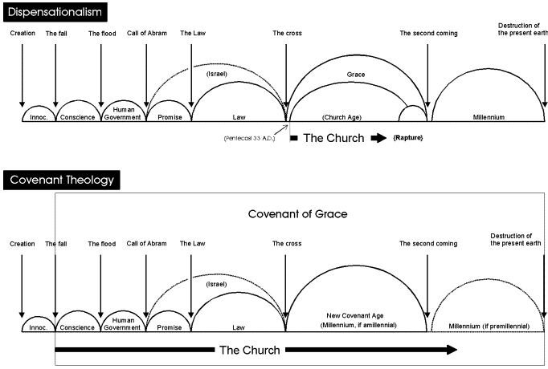
The Covenant of Grace
http://www.biblicalreader.com/prophecy/articles/dis_cov_interp.htm

Slide 13
Problems With Covenant Theology
One problem with Covenant Theology, as we have seen, is that it reads a number of theological ideas into scripture that are not specifically stated.
For example, it claims to see theological “covenants” that the scriptures never mention, but then turns around and refers to the covenants actually given in the Bible as “administrations” or “dispensations”.
But the biggest problem I have with Covenant Theology is that, by viewing all of the biblical covenants as being a part of a bigger “Covenant of Grace”, there is a strong tendency on the part of Covenant theologians to blur the distinctions that exist between the biblical covenants – something the Bible itself is careful not to do.
You will, no doubt, recall that we have already seen this kind of thinking applied to several areas that we covered earlier in this class:
  Tithing – Since tithing took place in earlier “administrations” of the Covenant of Grace (i.e. Abraham tithed, Jacob tithed, Moses prescribed tithing) then it is natural to assume that Cain and Abel must have been required to tithe and that tithing is expected in the final “administration” of the Covenant of Grace (i.e., the New Covenant)
  Sabbath Keeping – The “people of God” were commanded to keep the Sabbath in an earlier “administration” of the Covenant of Grace (i.e. Moses prescribed Sabbath-keeping), therefore it’s natural to assume that God expects men in all “administration” of the Covenant of Grace to “keep the Sabbath”.

Slide 14
Problems With Covenant Theology
What this kind of thinking ultimately leads to is Infant “Baptism”:
Since infants were included in earlier “administrations” of the Covenant of Grace (i.e. circumcision in the Abrahamic and Mosaic administrations) then it is only natural to assume that we should expect to include infants in the final “administration” of the Covenant of Grace (i.e. infant baptism in the New Covenant)
So, following this line of thinking, it seems natural to those attending an Orthodox Presbyterian Church service for the “baptism” of an infant to see the parents being asked:
  Do you acknowledge that, although our children are conceived and born in sin and therefore subject to condemnation, they are holy in Christ, and as members of his church ought to be baptized? (Trinity Hymnal [Confessional Edition], Philadelphia, 1961, p.667 – emphasis added).
To be clear, I realize that not everyone who holds to Covenant Theology believes in infant baptism. But I think that to be consistent in holding to Covenant Theology, you would ultimately have to end up there.

Slide 15
For Next Time…
I encourage you to purchase a Copy of “In Defense of the Decalogue” by Richard Barcellos and read
  Preface
  Introduction
  Chapter 1

Slide 16
Other Questions?

