Slide 1

New Covenant Theology

Slide 2

Questions Raised by New Covenant Theology

Slide 3
Questions Raised by New Covenant Theology
What are the competing theological systems to New Covenant Theology?
What questions do these competing views raise that we need to evaluate and consider?

Slide 4
Competing Systems to New Covenant Theology
Last week we began doing a “side by side” comparison* of the two major competing theological systems to New Covenant Theology:
  Dispensationalism
  Covenant Theology
After each comparison, we discussed the position that we would take in holding New Covenant Theology.
So far we compared the three systems on the following topics:
  Calvinism Versus Arminianism
  Literal Versus Figurative Interpretation of the Bible
  The Use of the Term “Israel” in Scripture
  The Phrase “Israel of God” in Galatians 6:16
  Israel and the Church
This week we continue this process of comparing the three systems on a number of additional topics.
*Much of the material in these slides can be found on http://www.angelfire.com/ca/DeafPreterist/compare.html

Slide 5
Framework for Viewing Human History
Dispensationalism:
  Believes God has divided human history into several distinct time periods or “dispensations” (from the Greek word OIKONOMIA – 1Cor 9:17; Eph. 1:10) during which man is tested in respect to obedience to some specific revelation of the will of God.
Covenant Theology:
  Views the history of God's dealings with mankind under the framework of three overarching theological covenants:
    The Covenant of Works
    The Covenant of Redemption
    The Covenant of Grace
New Covenant Theology:
  Views the history of God's dealings with mankind under the framework of the major Biblical covenants (i.e. covenants that the Bible actually specifies as “covenants”).
  NCT believes that all the major covenants find their ultimate fulfillment in the New Covenant.

Slide 6
The Promised New Covenant of Jer. 31:31-34
"Behold, the days are coming, declares the LORD, when I will make a new covenant with the house of Israel and the house of Judah, not like the covenant that I made with their fathers on the day when I took them by the hand to bring them out of the land of Egypt, my covenant that they broke, though I was their husband, declares the LORD. For this is the covenant that I will make with the house of Israel after those days, declares the LORD: I will put my law within them, and I will write it on their hearts. And I will be their God, and they shall be my people. And no longer shall each one teach his neighbor and each his brother, saying, 'Know the LORD,' for they shall all know me, from the least of them to the greatest, declares the LORD. For I will forgive their iniquity, and I will remember their sin no more."
Dispensationalism:
  Believes that the promise of a “New Covenant” in Jer. 31:31-34 is primarily to the physical descendants of Israel and will ultimately be fulfilled in a future thousand year period (known as “the Millennium”) when Christ will rule on earth and, at which time, they believe physical Israel will have become a believing nation.
Covenant Theology:
  Believes the promise of a “New Covenant” in Jer. 31 is for spiritual Israel, as the NT writers teach.
  CT views the New Covenant as one of several “administrations” under the Covenant of Grace.
New Covenant Theology:
  Believes the New Covenant is fulfilled in the church, which is the new spiritual Israel.
  As stated earlier, NCT believes that all the major covenants find their ultimate fulfillment in this New Covenant.

Slide 7
The Proper Use and Applicability of the OT Law
Dispensationalism:
  Believes that the OT Law has been abolished for the Church. But when the Church is taken away, and God returns to His original people, physical Israel, they will once again be under the OT Law.
Covenant Theology:
  Believes in a three-fold division of the Law:
    The Ceremonial Law, which have been abolished
    The Civil Law, which have been abolished except maybe to give general guidelines as to what is just in government
    The Moral Law is given in the Ten Commandments and is binding on all of God’s people in all ages.
  CT believes the Moral Law continues to have three uses:
    To convict unbelievers of sin and lead them to Christ
    To restrain sin in society
    To instruct Christians in godliness.
New Covenant Theology:
  The OT Law is there to instruct us in the way God dealt with His people in the OT.
  Christ is our new law-giver and by obeying Christ, we fulfill what the OT law ultimately pointed to (Rom.13:8-10).

Slide 8
Determining the Applicability of the OT Law
Dispensationalism:
  Believes OT laws are no longer in effect unless repeated in the NT.
Covenant Theology:
  Believes the OT laws are still in effect unless abrogated in the NT.
New Covenant Theology:
  Believes, as Dispensationalism, that OT laws are no longer in effect unless repeated in the NT.
  But I would add this caveat: OT laws can sometimes be helpful in defining eternal moral principles that are applicable in all ages and therefore binding on us as well.

Slide 9
Eschatology and the Millennium
Dispensationalism:
  Tends to view references to “the Kingdom of God” as references to the a future thousand year period when Christ will rule on earth, a period that they refer to as “the Millennium”.
  Dispensationalist are:
    Always Premillennial (i.e. they believe Christ will return to earth prior to reigning for a thousand years on the earth)
    Usually Pretribulational (i.e. they believe the church will be removed (i.e. “raptured”) from the earth prior to a horrible seven year period of “tribulation” on the earth. They believe this seven year Tribulation is described in the book of Revelation)
Covenant Theology:
  Tends to view references to the “Kingdom of God” as references to the Church, which they believe began immediately after the Fall.
  Those holding to CT are usually Amillennial (believe there is no literal thousand year reign on the earth) or Postmillennial (believe Christ will return after a thousand year period of blessing on the earth); although a few are Premillennial.
New Covenant Theology:
  Same as CT, except they believe the Church began in the NT, rather than immediately after the Fall.

Slide 10
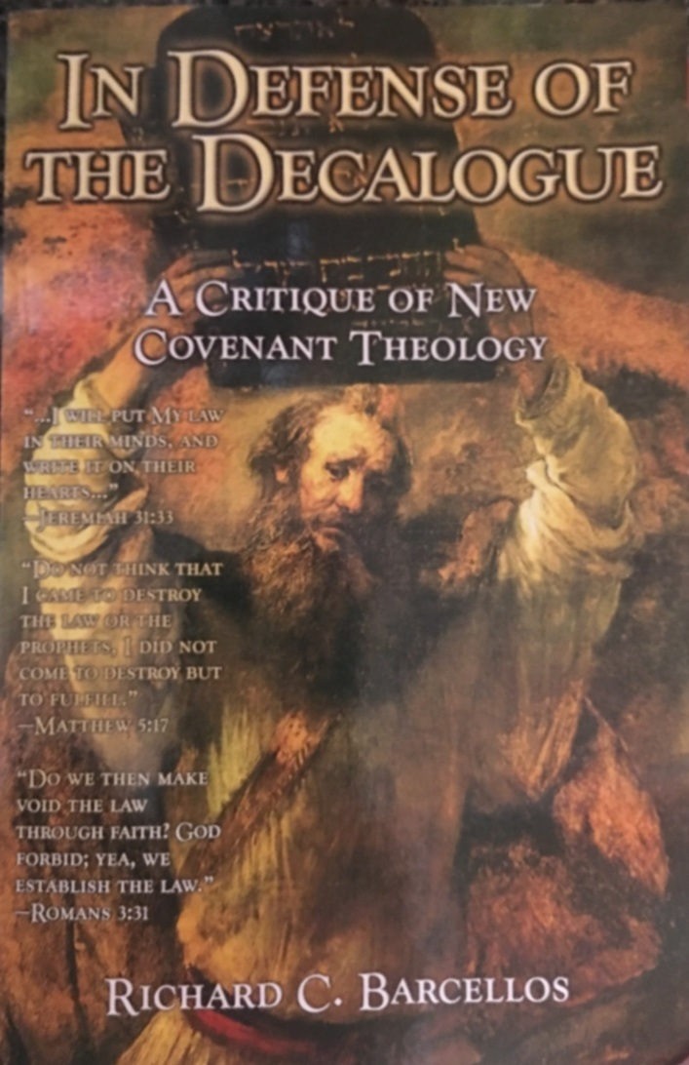

An Examination of Reformed Baptist Arguments Against New Covenant Theology

Slide 11
An Examination of Reformed Baptist Arguments Against New Covenant Theology
Some interesting Observations about the book and its author:
  Barcellos graduated with a Master of Divinity degree from Master’s Seminary (1989)
  Barcellos was awarded a Master of Theology degree by Whitefield Theological Seminary for his critique of New Covenant Theology
  Several esteemed writers and theologians have made commendations in the front of the book, including:
    George W. Knight, III – a Presbyterian author of several books, including an outstanding commentary on the pastoral epistles
    Sam Waldron – who wrote a modern exposition of the 1689 London Baptist Confession
    Fred Zaspel – who has written several books on NCT, complimented Barcellos for advancing the discussion on this topic.

Slide 12
An Examination of Reformed Baptist Arguments Against New Covenant Theology
Preface:
  Describes NCT as seeking to “strike a middle ground” between:
    The stress on continuity and in the traditional Reformed theology
    The radical discontinuity of some older forms of Dispensationalism
  Contends that:
    “Some of the major tenets of NCT are not biblical” (p.7)
    “NCT is troublesome because it produces a reductionistic, myopic, and truncated view of Christian ethics” (p.7)
  Points out that it is somewhat difficult to critique NCT because:
    There is some variation among those who hold to NCT.
    NCT is a relatively new school of thought and there is not yet a definitive work defining the beliefs of NCT.
  Promises to:
    Direct his critique towards things that are in print and on which NCT theologians seem to be in general agreement
    Offer exegetically based answers on the issues discussed

Slide 13
An Examination of Reformed Baptist Arguments Against New Covenant Theology
Introduction:
  Describes NCT as a “movement within conservative, Evangelical, and Calvinistic Baptist circles, which seeks to steer a middle road between traditional Covenant Theology and Dispensational Theology” (p.11).
  Acknowledges that NCT “attempts to base its conclusions on the exegesis of key texts that speak to the issues of continuity and discontinuity in both the Old and New Testaments” (p.11).
  Recognizes that “there are many facets of NCT that all ought to appreciate” (p.12):
    Its high view of scripture
    Its respect for the sovereignty of God in salvation and providence
    Its attempt to understand the nature of and relationship between the various biblical covenants
    Etc.

Slide 14
An Examination of Reformed Baptist Arguments Against New Covenant Theology
Introduction:
  He applauds those who believe in NCT for being “zealous students of the Bible”, but believes that some things about NCT “should disturb us and are worth challenging” (p.13).
  Specifically, in this book, he intends to challenge NCT’s view concerning:
    The Promise of the New Covenant
    The Identity of the Old Covenant
    The Abolition of the Old Covenant
    The Sermon on the Mount
    The Identity of the Moral Law
    Hermeneutical Presuppositions
    Canonics
    Historical Theology

Slide 15
For Next Time…
If you haven’t already done so, I encourage you to download a copy of Barcellos’ book from my website (http://www.purifiedbyfaith.com/) and read Chapter 1 before we meet again next week.

Slide 16
Other Questions?

