Slide 1

New Covenant Theology

Slide 2
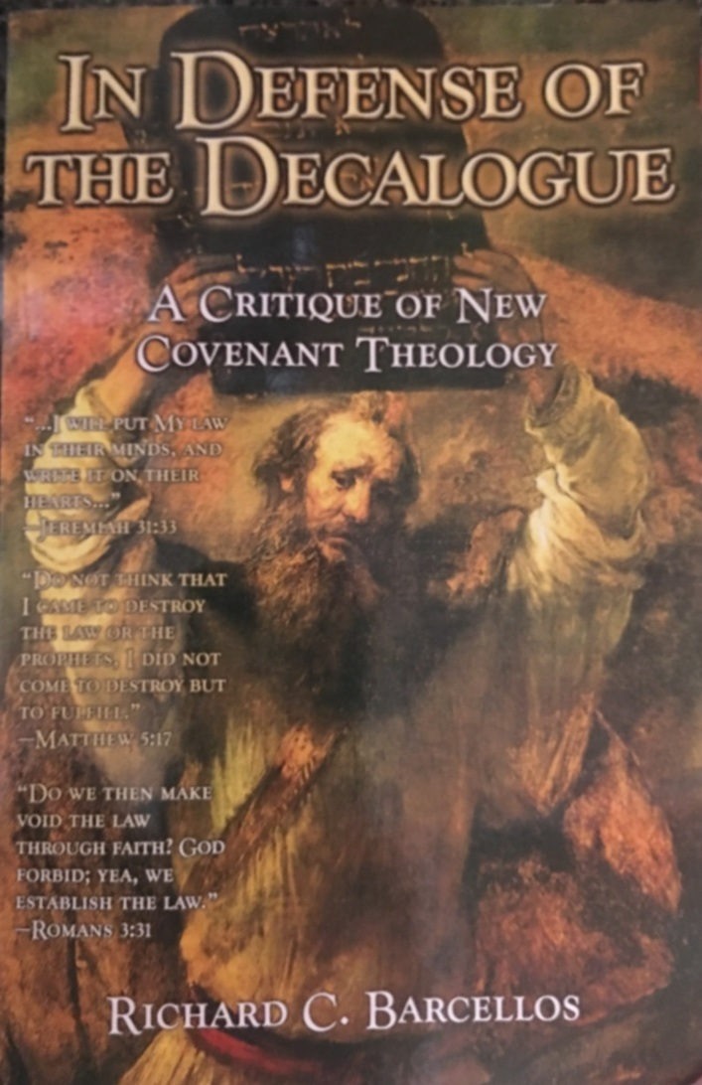

An Examination of Reformed Baptist Arguments Against New Covenant Theology

Slide 3
Chapter 1
NCT and the Promise of the New Covenant
On page 15 we read: “The first area of challenge for New Covenant Theology concerns it central thesis, that the law written on the heart in the New Covenant is decidedly not the same as the law of the Mosaic Covenant.”
"Behold, the days are coming, declares the LORD, when I will make a new covenant with the house of Israel and the house of Judah, not like the covenant that I made with their fathers on the day when I took them by the hand to bring them out of the land of Egypt, my covenant that they broke, though I was their husband, declares the LORD. For this is the covenant that I will make with the house of Israel after those days, declares the LORD: I will put my law within them, and I will write it on their hearts. And I will be their God, and they shall be my people. And no longer shall each one teach his neighbor and each his brother, saying, 'Know the LORD,' for they shall all know me, from the least of them to the greatest, declares the LORD. For I will forgive their iniquity, and I will remember their sin no more."
Barcellos claims: “A careful exegesis of Jeremiah 31:31-34, however severely undercuts the New Covenant Theology position in this regard.” (p.16)

Slide 4
Chapter 1
NCT and the Promise of the New Covenant
  Barcellos then makes a few observations (p.16-17):
  “The law under the New Covenant is God’s law… The phrase ‘my law’ occurs six times in the book of Jeremiah (6:19; 9:13; 16:11; 26:4; 31:33; 44:10)… Whatever this law is, we know that it is not our law but God’s law already revealed to God’s Old Covenant people”
  “The Law of God under the New Covenant will be put on all the beneficiaries of the New Covenant”
  “God is both the author of the law itself and the one who writes it on the heart.”
  Barcellos then concludes (p.17): “These observations provide the exegetical groundwork necessary for identifying the basic fundamental law of God under the New Covenant referred to by Jeremiah. The text of Jeremiah clearly assumes that the law of God under the New Covenant is referring to a law already written at the time of the writing of Jeremiah.”

Slide 5
Chapter 1
NCT and the Promise of the New Covenant
  Here are a few things for us to ponder at this point:
  Barcellos argues that because the phrase “my law ” occurs six times in the book of Jeremiah (6:19; 9:13; 16:11; 26:4; 31:33; 44:10) and in each of those contexts refers to the law “already revealed to God’s Old Covenant people”, then that must be how God intends for us to understand the phrase “my law ” in Jer. 31:33.
  Using this same logic, could we not also argue (as the Dispensationalists do) that since the phrase “the house of Israel and the house of Judah” also occurs six times in the book of Jeremiah (5:11; 11:10; 11:17; 31:27; 31:31; 33:14) and in each of those contexts refers to the northern and southern tribes of the physical descendants of Israel, that must be how God intends for the phrase to be understood in Jer. 31:31?
  And yet, as we have seen, the NT writers view the promised New Covenant as applying to spiritual Israel (2Cor.3; Heb. 8).

Slide 6
Chapter 1
NCT and the Promise of the New Covenant
  Here are a few things for us to ponder at this point:
  Furthermore, though the Israelites in Jeremiah’s day may not have thought about it, is it not possible that a change in covenants (resulting in a change in priesthood) might also result in a change in God’s law for those under that New Covenant?
  Isn’t this, in fact, what the writer of Hebrews tells us in the lead-up to his discussion of the New Covenant prophesied in Jer. 31:31-34?
  For when there is a change in the priesthood, there is necessarily a change in the law as well. (Heb. 7:12)

Slide 7
Chapter 1
NCT and the Promise of the New Covenant
  In reading Barcellos’ book up to this point, you could be forgiven for thinking that he is arguing that “the law” mentioned in Jer. 31:33 is “the law of the Mosaic Covenant… already revealed to God’s Old Covenant people”.
  But when we get to page 18 we find out that what Barcellos actually believes is that “the law” mentioned in Jer. 31:33 refers only to a very small portion of the Law of Moses – i.e., the Ten Commandments written on the tablets of stone by the finger of God:
  “Jeremiah clearly teaches that the Law of God under the New Covenant is a law that was written on stone by God and that will be written on hearts by God.”
  “Exodus 24:12 identifies the ‘tablets of stone’ with ‘the law and commandments I have written’.”
  “In the New International Dictionary of Old Testament Theology and Exegesis, Peter Enns acknowledges that torah [law] refers to the Decalogue [the Ten Commandments] in this text.”

Slide 8
Chapter 1
NCT and the Promise of the New Covenant
  On page 19 Barcellos cites three passages in order to prove that “my law” in Jer. 31:33 = the Ten Commandments:
  And [the Lord] gave to Moses, when he had finished speaking with him on Mount Sinai, the two tablets of the testimony, tablets of stone, written with the finger of God. (Ex. 31:18)
  For this is the covenant that I will make with the house of Israel after those days, declares the LORD: I will put my law within them, and I will write it on their hearts. And I will be their God, and they shall be my people. (Jer. 31:33)
  And you show that you are a letter from Christ delivered by us, written not with ink but with the Spirit of the living God, not on tablets of stone but on tablets of human hearts. (2Cor. 3:3)
After examining these three passages, Barcellos concludes:
  The text of Jeremiah clearly teaches that the basic fundamental law of God under the New Covenant is the Decalogue [i.e. the Ten Commandments].” (p.19-20)
Do the passages cited by Barcellos support the conclusion that he draws from them?

Slide 9
Chapter 1
NCT and the Promise of the New Covenant
  Some further things for us to ponder:
  In 2Cor. 3:3 (one of the passages cited by Barcellos), the Apostle Paul alludes to Jer. 31:33 and contrasts what was written externally on the tablets of stone in Moses’ day with what was written internally on the Corinthians’ hearts in his day:
    And you show that you are a letter from Christ delivered by us, written not with ink but with the Spirit of the living God, not on tablets of stone but on tablets of human hearts. (2Cor. 3:3)
  Barcellos concludes from this verse that since God wrote the the Ten Commandments on the tablets of stone, then he must have also written the Ten Commandments on the hearts of New Covenant believers!
  Given his interpretation of 2Cor. 3:3, what do you think Barcellos would do with what Paul says a few verses later in 2Cor. 3:7-8?
    Now if the ministry of death, carved in letters on stone, came with such glory that the Israelites could not gaze at Moses' face because of its glory, which was being brought to an end, will not the ministry of the Spirit have even more glory? (2Cor 3:7-8)
  Do you think Paul is telling us in 2Cor. 3 that the Spirit carves “the ministry of death” on the hearts of New Covenant believers?

Slide 10
Chapter 1
NCT and the Promise of the New Covenant
  After reaching this conclusion (that “my law” in Jer. 31:33 = the Ten Commandments), Barcellos makes, what I find to be, an interesting comment in a footnote (fn.12 p.20):
  “Some might want to challenge the approach here, which reduces the torah [i.e. the law written on the heart in Jer. 31:33] to the Decalogue [i.e. the Ten Commandments rather than the whole Law of Moses]. However, not reducing the torah to the Decalogue produces the difficulty of answering the question why God would write temporary, ceremonial laws that point to Christ on the hearts of New Covenant people after Christ’s work on the cross abrogated those very laws.”
Barcellos initially argued that the scriptures convinced him that God wrote the Ten Commandments on the hearts of New Covenant believers.
What does Barcellos’ comment in this footnote suggest might be the reason he adopted this view?

Slide 11
Chapter 1
NCT and the Promise of the New Covenant
  What do you think it means for God to put his law within New Covenant believers and write it on their hearts?
  As you answer this question, consider a couple of other OT texts that use a similar phrase:
  The sin of Judah is written with a pen of iron; with a point of diamond it is engraved on the tablet of their heart (Jer. 17:1)
  The mouth of the righteous utters wisdom, and his tongue speaks justice. The law of his God is in his heart; his steps do not slip. (Psalm 37:30-31)
  Listen to me, you who know righteousness, the people in whose heart is my law; fear not the reproach of man, nor be dismayed at their revilings. (Isa. 51:7)

Slide 12
Chapter 1
NCT and the Promise of the New Covenant
  Barcellos spends the remainder of Chapter 1 pointing out what he believes Jer. 31:31-34 does not say:
  “The text does not say that the law of God under the New Covenant consists of a disposition to obey.” (p.20)
  “And, as we have seen, the text does not say that the law of God under the New Covenant consists of a new law.” (p.21)
  “And finally the text does not say the law of God under the New Covenant consists of a heretofore unrevealed, transcendent law. This is completely foreign to the text and the rest of the book of Jeremiah.” (p.23)
The text also does not say that God would someday abrogate animal sacrifices, Jewish dietary laws, Sabbath keeping, and a whole host of other laws. But the fact is, He did!
Just because the text does not say that God would later change His laws doesn’t mean He won’t!

Slide 13
Chapter 1
NCT and the Promise of the New Covenant
Barcellos ends the chapter with this thought: “The standard New Covenant Theology interpretation of Jer. 31:33 puts an unnecessary wedge between the Ten Commandments as a unit and New Covenant ethics. This forces NCT to impose something on the New Testament from the Old Testament that is simply not there.” (p.24)
Do you think this characterization of NCT given by Barcellos at the end of Chapter1 is accurate?

Slide 14
For Next Time…
If you haven’t already done so, I encourage you to download a copy of Barcellos’ book from my website (http://www.purifiedbyfaith.com/) and read Chapter 2 before we meet again next week.

Slide 15

Other Questions?

