Slide 1
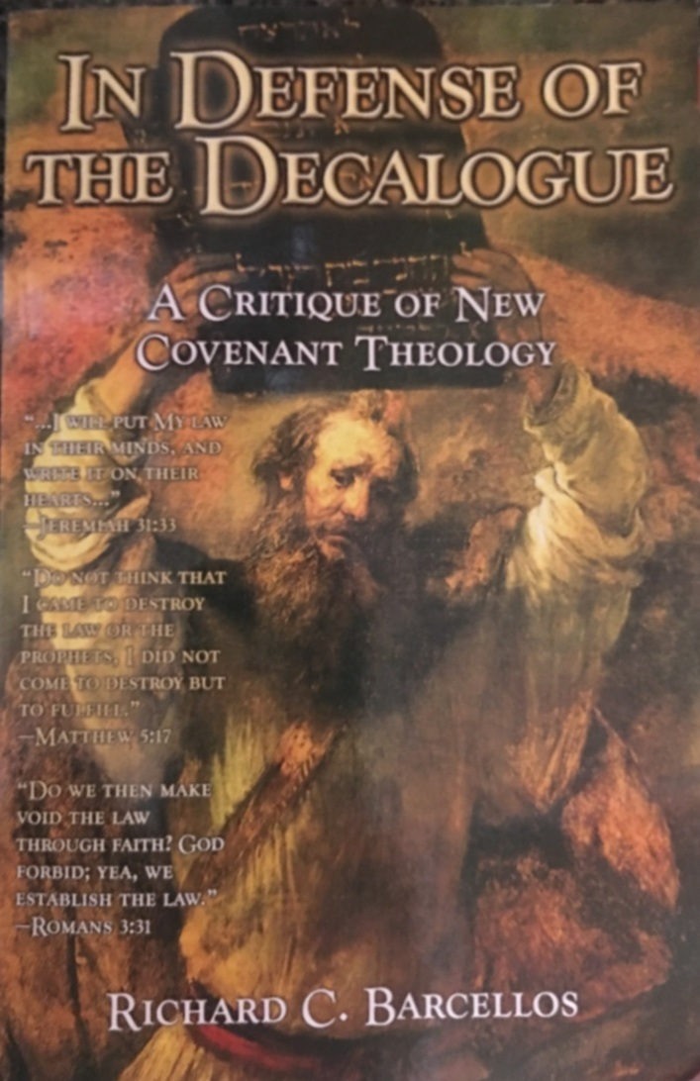

An Examination of Reformed Baptist Arguments Against New Covenant Theology

Slide 2
Chapter 2
NCT and the Identity of the Old Covenant
On page 25 we read: “A second challenge for New Covenant Theology concerns the identity of the Old Covenant. According to New Covenant Theology, the Old Covenant is identified as the Ten Commandments, the Decalogue.”
Barcellos gives several citations from a couple of well known NCT authors (Fred Zaspel and John Reisinger) to document his claim that NCT teaches an exact, one-to-one equation of the Old Covenant and the Ten Commandments.
We will look at a few of these citations in a moment, but those who have been in this class from the beginning will recall that I did not teach that the Ten Commandments = the Old Covenant.
What I did teach is that the Ten Commandments summarized the terms of the Mosaic Covenant.
Consequently, I don’t think that the argument Barcellos makes in the first eight pages of this chapter contradicts what we discussed in class concerning the relationship between the Ten Commandments and the Old Covenant.
For those who weren’t here, let’s briefly review what I said about the Ten Commandments and the Old Covenant earlier in this class.

Slide 3
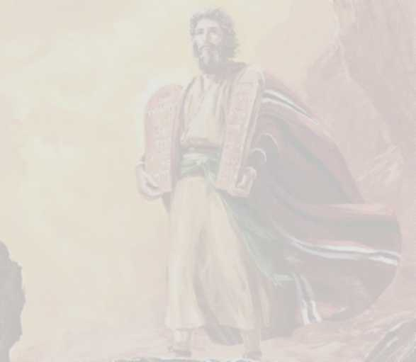
The Ten Commandments and the Mosaic Covenant
The terms of the Mosaic Covenant were summarized in the Ten Commandments that were etched on the tablets of stone for Moses by God on Mount Sinai:
  Deuteronomy 4:13 – And He [the Lord] declared to you His covenant, which he commanded you to perform, that is, the Ten Commandments, and He wrote them on two tablets of stone.
The Ten Commandments were given specifically to the Nation of Israel.
  Exodus 34:27-28 – And the LORD said to Moses, “Write these words, for in accordance with these words I have made a covenant with you and with Israel.” ²⁸ … And he wrote on the tablets the words of the covenant, the Ten Commandments.

Slide 4
The Law of Moses and the Mosaic Covenant
To Summarize, the Mosaic Covenant was:
  Represented by the Sabbath (as the sign of the covenant)
  Summarized in the Ten Commandments
  Ultimately Embodied in the 600+ Laws Given by Moses:
    Deuteronomy 7:12 - And because you listen to these rules and keep and do them, the LORD your God will keep with you the covenant and the steadfast love that he swore to your fathers.

Slide 5
Chapter 2
NCT and the Identity of the Old Covenant
For what it’s worth, I’m not convinced that Barcellos properly understood what Fred Zaspel was saying about the relationship between the Ten Commandments and the Old Covenant.
From what I read, Fred Zaspel seems to hold a similar idea to what I taught in class.
I was able to find the full context* of the citation that Barcellos gives from Zaspel. Here is what Zaspel said:
  “…the terms [of the Old Covenant] are summarized in the Ten Commandments. The Decalogue is the statement of the covenant. Indeed, God Himself says so [in Exodus 34:27-28] ... These ten words to Israel are the covenant; apart from this foundational summary statement (the Decalogue), there is no covenant at all.” (emphasis added)
Do you see any difference between what Zaspel says here and what I taught in class?
Do you think Barcellos’ accurately represents Zaspel’s view when he says Zaspel equates the Ten Commandments to the Old Covenant?
* https://biblicalstudies.org.uk/pdf/ref-rev/06-3/6-3_zaspel.pdf

Slide 6
Chapter 2
NCT and the Identity of the Old Covenant
John Reisinger, on the other hand, apparently did, at one time, equate the Ten Commandments and the Old Covenant in the original printing of his book (in 1989), Tablets of Stone.
But he later changed his view on this (perhaps in response to Barcellos’ criticism in this book which was written in 2001) and openly retracted his earlier statements in a subsequent edition (2004) of Tablets of Stone.

Slide 7
Chapter 2
NCT and the Identity of the Old Covenant
On page 33, Barcellos raises a question: “This brings us to the most important question: Does the Bible view the Ten Commandments as a unit, functioning any other way than as Old Covenant law?”
Barcellos then answers his own question: “We have already seen that Jeremiah 31:33 refers to the Ten Commandments functioning as a unit under the New Covenant. Three NT texts, 2 Cor. 3:3, Eph. 6:2-3, and 1Tim. 1:8-11 also demonstrate that the Ten Commandments do indeed function outside the Old Covenant as a unit”(p.34)
What do you think Barcellos means when he talks about the Ten Commandments “function[ing] outside the Old Covenant as a unit”? What was the “function” of the Ten Commandments in the Old Covenant? And did they function “as a unit”? If so, how?
The function of the Ten Commandments in the Old Covenant was to define the duty of those in that covenant.
They could be said to function as a unit in that all ten commandments were equally binding on the Old Covenant believers.
So in other words, what Barcellos is saying is that all ten of the Ten Commandments (including the command to observe the Sabbath) are still binding on believers in the New Covenant.

Slide 8
Chapter 2
NCT and the Identity of the Old Covenant
On page 34 Barcellos begins what he calls an “exposition” of 2Corinthians 3:3:
    And you show that you are a letter from Christ delivered by us, written not with ink but with the Spirit of the living God, not on tablets of stone but on tablets of human hearts. (2Cor. 3:3)
After giving a brief description of the context in which this verse was written, Barcellos makes the following observations (p.35):
  First, in the context, Paul is obviously talking about the New Covenant as prophesied by Jeremiah”
  Second, Christ is the author of this epistle written on the heart.
  Third, Christ… uses not ink but the Holy Spirit to write on the hearts of men.
  Fourth, the tablets of stone refers to the Ten Commandments…
  Fifth, the tablets of flesh (the heart) refers to the Corinthians
  Sixth, unlike the writing on the tablets of stone under the Old Covenant, which was a ministry of death, the writing on the tablets of hearts under the New Covenant is a ministry of the Spirit which gives life (see verses 6-7).
  Seventh, assuming Paul has Jeremiah’s prophesy in mind, what Christ writes on the heart is the law of God as Promised in Jer. 31:33

Slide 9
Chapter 2
NCT and the Identity of the Old Covenant
So far so good where the seven observations are concerned.
But then on page 36 Barcellos says:
  Paul’s ministry is in fulfillment of OT prophesy. The movement in Paul’s thought is not from one law to no law or to a totally new law, but the same law from stone to heart.
Does this assertion look familiar?
It should, because it’s basically a repeat of what Barcellos argued throughout Chapter 1: that the law that Christ writes on the heart is the Ten Commandments!
To support his idea Barcellos (on page 37) cites two commentaries on 2 Corinthians:
  Philip E Hughes – an Anglican writer
  Geoffrey B. Wilson – a Reformed Baptist writer
From the comments cited, Hughes seems to be arguing that the OT law is not obsolete and that NT believers are still under it: “The establishment of the new covenant, however, implies neither the abrogation nor depreciation of the Mosaic Law…Neither God changes nor his law.”
Wilson, like Barcellos, believes that the law on the heart of New Covenant believers is the Ten Commandments.

Slide 10
Chapter 2
NCT and the Identity of the Old Covenant
Barcellos then concludes (p.38):
  Paul’s understanding of the law of God written on the heart under the New Covenant from 2 Cor. 3 now becomes clear. That law is the Ten Commandments, the fundamental basic law of the Old Covenant.
Did anyone see Barcellos present any new argument in this section beyond the ones that we already refuted in Chapter 1?
I cannot see where Barcellos has done anything in this section to advance the arguments given in Chapter 1, other than to quote a couple of commentaries that agree with him and then make the same argument all over again.
What is the argument that Barcellos makes to “prove” that the law written on the heart in Jer. 31:33 and referenced by Paul in 2 Cor. 3 has to be the Ten Commandments?
Barcellos argues that because Paul in 2 Cor. 3 tells us that the place where the law is “written” has changed (from stones to hearts) but doesn’t specifically say (in 2 Cor. 3 ) that the law written on the hearts of New Covenant believers is different than the laws written on the tablets of stone, that proves that there is no difference between what was written on the stones and what is written on the hearts of New Covenant believers.
Do you see any problems with this argument?

Slide 11
Chapter 2
NCT and the Identity of the Old Covenant
I see a couple of problems with Barcellos’ argument:
  Barcellos is guilty of a classical logical fallacy known as the “argument from silence”: Because Paul didn’t say that the law written on the stones is different from the law written on the hearts of New Covenant believers, then the law written on the hearts must be the same law that was written on the stones!
  Although Paul doesn’t tell us in 2 Cor. 3 that the OT law (written on the stones) is different than the NT law written on the hearts (because it didn’t suit his purpose to do so), he and the other NT writers do tell us in other NT passages that the New Covenant law of Christ is different than the OT law of Moses.

Slide 12
For Next Time…
If you haven’t already done so, I encourage you to read the remainder of Chapter 2 (from page 38-59) before we meet again next week and come prepared to discuss it.

Slide 13

Other Questions?

