Slide 1

New Covenant Theology

Slide 2
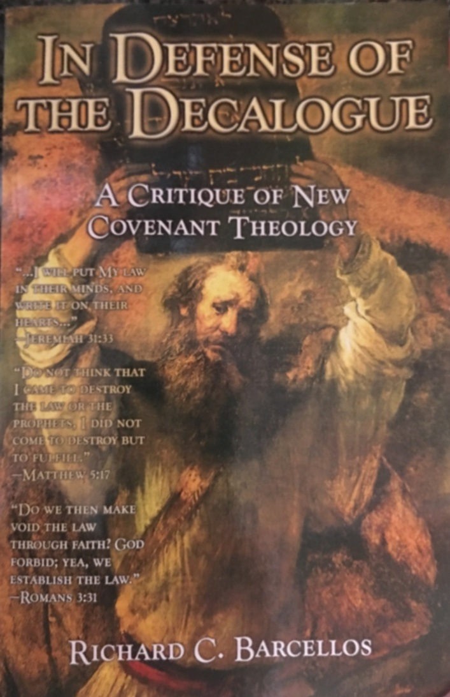

An Examination of Reformed Baptist Arguments Against New Covenant Theology

Slide 3
Chapter 2
NCT and the Identity of the Old Covenant
  Barcellos tells us at the beginning of Chapter 2 that there are three NT texts (2 Cor. 3:3, Eph. 6:2-3, and 1Tim. 1:8-11) that demonstrate that “the Ten Commandments function outside the Old Covenant as a unit”, meaning that all of the Ten Commandments (including the command to observe the Sabbath) are still binding on believers in the New Covenant.
  In 2 Cor. 3:3 Barcellos argues that because Paul draws a contrast between the Law written on the tablets of stone at Mount Sinai and the Law written on the heart of New Covenant believers and doesn’t explicitly say that the law written on the stones is different than the law written on the hearts, then the Law written on the heart must be the Ten Commandments.
  In Eph. 6: 2-3 Barcellos argues that because Paul quotes the fifth commandment when instructing to New Covenant believers to honor their parents and mentions that it is the first commandment with a promise, then Paul must have assumed that the Ten Commandments are an “inseparable unit” and are therefore all ten of them are equally binding on New Covenant believers.

Slide 4
Chapter 2
NCT and the Identity of the Old Covenant
On page 41, Barcellos begins his “Exposition of 1 Tim. 1:8-11”.
But before we look at what Barcellos has to say about this text, I would like for us to examine this text for ourselves in its original context.

Slide 5
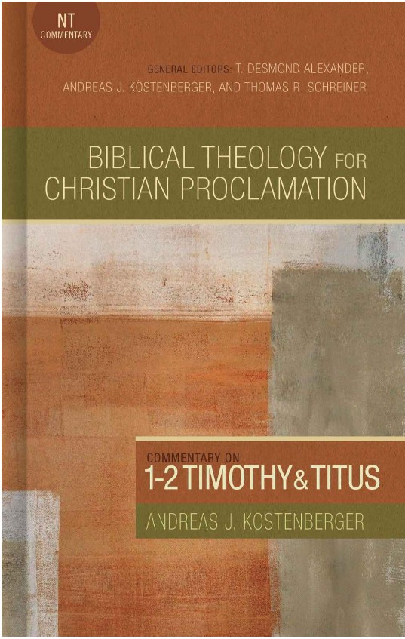
1 Tim. 1:8-11 – Background

Slide 6
1 Tim. 1:8-11 – Background
1 Timothy is a letter written by Paul to Timothy while on his fourth missionary journey (around 62-64 AD).
Paul, having left Timothy at Ephesus while he traveled on to Macedonia, is now writing to give Timothy instructions on how to address a group of false teachers in the church at Ephesus. Paul gets right to the point starting in vs. 3:
  As I urged you when I was leaving for Macedonia, stay on in Ephesus to instruct certain people not to spread false teachings, ⁴ nor to occupy themselves with myths and interminable genealogies. Such things promote useless speculations rather than God's redemptive plan that operates by faith. ⁵ But the aim of our instruction is love that comes from a pure heart, a good conscience, and a sincere faith. ⁶ Some have strayed from these and turned away to empty discussion. ⁷ They want to be teachers of the law, but they do not understand what they are saying or the things they insist on so confidently. (1Tim. 1:3-7 NET)

Slide 7
1 Tim. 1:8-11 – Background
From what we just read, it appears that these false teachers:
  Considered themselves to be “teachers of the law” and were very confident in their false ideas.
  Were using the law to teach a lot of useless and speculative ideas (involving myths and genealogies) that were contrary to the ideas of faith and love as taught in the Gospel.
It is these false teacher’s misuse of the law that prompted Paul to write 1 Tim. 1:8-11:
  ⁸ Now we know that the law is good, if one uses it lawfully, ⁹ understanding this, that the law is not laid down for the just but for the lawless and disobedient, for the ungodly and sinners, for the unholy and profane, for those who strike their fathers and mothers, for murderers, ¹⁰ the sexually immoral, men who practice homosexuality, enslavers, liars, perjurers, and whatever else is contrary to sound doctrine, ¹¹ in accordance with the gospel of the glory of the blessed God with which I have been entrusted.

Slide 8
1 Tim. 1:8-11 – Observations
Paul begins in verse 8 by stating that the law is good, if one uses it lawfully (i.e. properly, legitimately).
In other words, Paul’s problem with the false teachers at Ephesus is not the fact that they were using the Law of Moses.
The Law of Moses came from God and is therefore “good” (cf. Rom 7:12 - So the law is holy, and the commandment is holy and righteous and good).
The problem with the false teachers is that they were evidently misusing the Law of Moses – i.e. they were using the law in a way that God does not intend for it to be used.

Slide 9
1 Tim. 1:8-11 – Observations
In verse 9 Paul tells us that, contrary to what the false teachers were saying, the law wasn’t given to condemn “the just” (i.e., right-living believers).
The law was given by God to convict and condemn ungodly men who think they are righteous but are really not:
  Men like the Israelites, who, before hearing the law, said “All that the LORD has spoken we will do” (Ex. 19:8),
  Men like the Apostle Paul who tells us that, prior to his conversion, “if it had not been for the law, I would not have known sin. For I would not have known what it is to covet if the law had not said, ‘You shall not covet.’ ”(Rom 7:7b)
  And, evidently, men like the false teachers at Ephesus who felt confident that they understood the law, but in reality were using it in a way that was contrary to the Gospel.
This is not to say that there are not principles in the Law that are applicable to believers – e.g., the principle that Paul cited in Eph. 6:2-3.
Even later in this letter Paul applies a cites a principle from the Law (Deut. 25:4) when discussing elder compensation (1 Tim 5:18).
But at this point in the letter, Paul is using the law to condemn the false teachers at Ephesus who thought they understood the law, but didn’t.

Slide 10
1 Tim. 1:8-11 – Observations
In verses 9b – 10, Paul gives a list of vices that characterize the kind of people the Law condemns.
There is an “echo” of the Ten Commandments is this list of vices:
  The beginning of the list focuses on sins against God (just like the first tablet of the Ten Commandments).
  The last part of the list, starting with “those who strike their fathers and mothers”, covers several categories of sin in the same order that they are covered in the fifth though ninth commandments.
And, given that the Ten Commandments are a summary of the OT Laws, it is not altogether surprising that Paul would pattern this list of vices in a way that echoes the Ten Commandments.

Slide 11
1 Tim. 1:8-11 – Observations
But we must note, despite what Barcellos may try to claim:
  Several of the vices in this list are drawn from other places in the Law besides the Ten Commandments:
    Whoever strikes his father or his mother shall be put to death. (Ex. 21:15)
    If a man lies with a male as with a woman, both of them have committed an abomination. (Lev. 20:13)
    If a man is found stealing one of his brothers of the people of Israel, and if he treats him as a slave or sells him, then that thief shall die. (Deut. 24:7)
  Not all the Ten Commandments are represented in this list of vices:
    The tenth commandment is in not represented in this list
    The first four commandments are not as easily correlated to Paul’s list as Barcellos claims they are.

Slide 12
Chapter 2
NCT and the Identity of the Old Covenant
On page 41, Barcellos askes four questions about 1 Tim. 1:8-11 and then spends the remainder of the chapter answering them:
  Why does Paul bring up the issue of the law?
  What is said about the law?
  To whom is Paul referring when he says “the law is not made for a righteous person”?
  What law is Paul referring to in verses 8 through 10?
In answer to the first question, Barcellos correctly observes: He does so to combat the wrong use of the law and set forth its right use. (p.41)
In answer to the second question, Barcellos again correctly observes: The law is both good and can be used lawfully (p.42)
So far, so good.

Slide 13
Chapter 2
NCT and the Identity of the Old Covenant
To whom is Paul referring when he says “the law is not made for a righteous person”?
  Giving frequent citations from other writers, Barcellos tries to argue that the “righteous” (or “just” ESV) person that Paul says the law is not given for can include moral unbelievers.
  He argues, for example, that “The word righteous is used elsewhere in the NT to refer to non-Christians and Christians. For instance… in Phil 3:6… Paul’s own description of his relationship to the Mosaic Law before his conversion” (pp. 43-44).
  Barcellos is right, the word is sometimes used of unbelievers who (falsely) believe themselves to be righteous. But is that how Paul is using the word in this context?

Slide 14
Chapter 2
NCT and the Identity of the Old Covenant
To whom is Paul referring when he says “the law is not made for a righteous person”?
  Barcellos then goes on to say that according to his understanding “Paul is not referring to the law in a soteriological sense… but in an ethical sense… This understanding of the passage makes conformity to the law the responsibility of believers and unbelievers alike”. (p.44)
  Do you think Paul had believers in mind when he says the law is for the “ungodly and sinners, for the unholy and profane, for those who strike their fathers and mothers, for murderers, ¹⁰ the sexually immoral, men who practice homosexuality, enslavers, liars, perjurers, and whatever else is contrary to sound doctrine, ¹¹ in accordance with the gospel”?
  And do you think that Paul would say the Law was not meant be applied to ethical unbelievers who believe themselves to be righteous?

Slide 15
Chapter 2
NCT and the Identity of the Old Covenant
  What law is Paul referring to in verses 8 through 10?
    Giving numerous arguments and frequent citations from other writers, Barcellos ends up concluding on page 56: “It now becomes quite obvious what law Paul was referring to in 1 Timothy 1:8-11… He was referring to the Decalogue in its function of revealing God defined ethical norms for all men”.
    But, as we have seen, while the passage does allude to the Ten Commandments, it excludes some of the Ten Commandments and includes other parts of the Law of Moses that are not in the Ten Commandments.
    So why wouldn’t it be “quite obvious” that Paul has the entire Law of Moses in mind in 1 Timothy 1:8-11? Especially since he calls it “the law” (not the Ten Commandments), a term that he almost always uses to refer to the entire Law of Moses?

Slide 16
For Next Time…
Read Chapter 3 (from pages 61-69) before we meet again next week and come prepared to discuss it.

Slide 17

Other Questions?

