Slide 1

New Covenant Theology

Slide 2
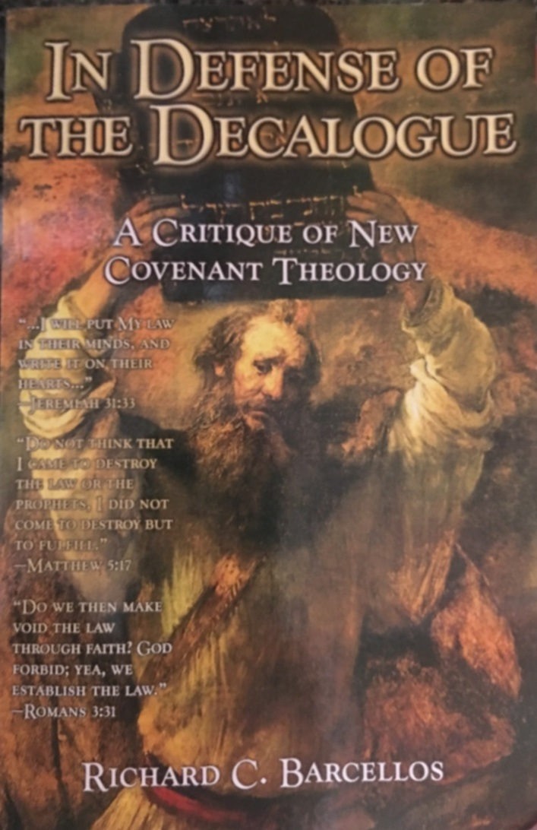

An Examination of Reformed Baptist Arguments Against New Covenant Theology

Slide 3
Chapter 3
NCT and the Abolition of the Old Covenant
  This chapter has a very different feel than the chapters we have covered so far.
Throughout the first two chapters Barcellos seemed to argue, almost relentlessly, that the Ten Commandments are the “moral law” of the OT and all Ten of them are as binding on New Covenant Christians today as they were on the Israelites in the Old Covenant.
  So it comes as a bit of a surprise to hear Barcellos say at the beginning of Chapter 3 that: Hearty agreement must be given when New Covenant theologians argue for the abolition of the Old Covenant. This is clearly the teaching of the Old and New Testaments… The whole Law of Moses, as it functioned under the Old Covenant, has been abolished, including the Ten Commandments. (p.61 – emphasis original)
  What gives? Has Barcellos suddenly changed his mind? Have we been misunderstanding him up to this point?

Slide 4
Chapter 3
NCT and the Abolition of the Old Covenant
  I don’t think Barcellos has changed his mind, nor do I think we’ve been misunderstanding him.
  So why does Barcellos almost sound like he’s changing his mind in this chapter?
  Both Covenant Theologians (like Barcellos) and New Covenant Theologians (like us) recognize that there is both continuity and discontinuity between the Old and New Covenants:
  Covenant Theologians tend to emphasize the continuity between the Old and New Covenants
  As New Covenant Theologians, we tend to emphasize the discontinuity between the Old and New Covenants.

Slide 5
Chapter 3
NCT and the Abolition of the Old Covenant
In Chapters 1 and 2, Barcellos focused on the continuity between the covenants and therefore sounded like the Covenant Theologian that he is.
In this chapter, Barcellos is acknowledging and attempting to deal with areas where he sees discontinuity between the covenants, and this tends to almost make him sound like New Covenant Theologian.
But don’t be fooled - as we have already seen, and will see again in later chapters, Barcellos still sees far more continuity between the covenants than I believe the scriptures teach.

Slide 6
Chapter 3
NCT and the Abolition of the Old Covenant
I will give Barcellos kudos for at least acknowledging that the scriptures clearly teach that there are significant discontinuities between the Old and New Covenant – something that is rather difficult for Covenant Theologians to acknowledge.
But, in my opinion, one of the glaring weaknesses in this chapter, is that, at this point at least, he doesn’t give us any details as to what the discontinuities between the Old and New Covenant actually are.

Slide 7
Chapter 3
NCT and the Abolition of the Old Covenant
For example on page 64, after criticizing how he believes that New Covenant theologians deal with this text, he tells us what he thinks Jesus is teaching in Mat 5:17-20: What Jesus is saying is that the Old Testament is still binding upon His people, but not in the same way it used to be. The OT is still authoritative as far as our sanctification goes, but the coming death of Christ and the inauguration of the New Covenant now condition its application. (emphasis original)
I have no disagreement with what he says here, as far as it goes. But what does he really mean by it?
The OT is still binding on New Covenant Christians, but “not in the same way is used to be.” Okay, so in what way is it now binding? He doesn’t say at this point.
The OT is “still authoritative as far as our sanctification goes,” but the coming of Christ and the New Covenant changes how it does that. Okay, but how? In what way? Again, he doesn’t say.
He then concludes this discussion saying: Casting aside all the difficult questions that arise concerning the specific application of this thesis, it cannot be doubted that the rest of the NT clearly confirms it.
So his interpretation of this text raises “difficult questions,” but he’s not going to answer them right now!

Slide 8
Chapter 3
NCT and the Abolition of the Old Covenant
  Likewise in the conclusion of his examination of Ephesians 2:14-16 on page 66-67 Barcellos tells us: It is very clear from this passage and other explicit statements of the NT that the Old Covenant and its law, as Old Covenant law, has been annulled by Christ’s death.
  Again, as far as the statement goes, I agree. But what does it mean for the Old Covenant Law (which includes the Ten Commandments) to be annulled by Christ’s death “as Old Covenant law”?
  Does it now apply as New Covenant law? Does anything change as it goes through this transition? If so, what?
  Again, he doesn’t say at this point.

Slide 9
Chapter 3
NCT and the Abolition of the Old Covenant
Barcellos examines two Biblical texts in this chapter: Mat 5:17-20 and Eph. 2:14-16
In his discussion of Mat 5:17-20, he levels a number of criticisms at what he perceives to be the NCT handling of this text.
For example, on page 62, Barcellos says: A common understanding of this text goes like this: Jesus is saying that he will make the law null and void for his people and is declaring that they will have nothing to do with the Old Testament law of God because he will fulfill or complete it for them.
You may recall what I (and what most NCT authors that I’m familiar with) have taught on this text is that:
  Jesus tells us that he has not come to set aside the OT scriptures as though they were of no value or importance.
  The purpose of the OT scriptures – and even the commandments within them – was to point to Jesus as the one who fulfills them.
  Jesus then, takes us through a series of six examples, where he shows us how to “keep” the OT commandments by listening to him and doing what he says.

Slide 10
Chapter 3
NCT and the Abolition of the Old Covenant
But I found Barcellos next critique of the NCT to be very curious: Those of this persuasion often say… “We are not under the Law of Moses, but under the law of Christ,” as though Moses and Christ were sworn enemies. This view has many problems.
Does the statement that Barcellos criticizes in the above point look familiar?
To those under the law [i.e., Jews] I became as one under the law (though not being myself under the law [of Moses] ) that I might win those under the law. To those outside the law I became as one outside the law (not being outside the law of God but under the law of Christ) that I might win those outside the law. (1Cor. 9:20-21)

Slide 11
Chapter 3
NCT and the Abolition of the Old Covenant
  On page 62-63, Barcellos goes on to describe the “many problems” with viewing ourselves as “not under the Law of Moses, but under the Law of Christ”:
  First, this view cannot stand up to the context.
    I believe the NCT does a better job of dealing with the context.
  In verse 17, the phrase “the Law or the Prophets” refer to the whole Old Testament…
    I agree.
  In verse 18a, the phrase “till heaven and earth pass away,” refers to the duration of the whole Old Testament’s authority… in verse 18b
    Mat. 5:18 is not talking about the duration of the OT’s authority – it says that “not a dot, will pass from the Law until all is accomplished”, meaning (in the context) that every bit of what the law pointed to will be fulfilled and accomplished by Christ.

Slide 12
Chapter 3
NCT and the Abolition of the Old Covenant
  On page 62-63, Barcellos describes the “many problems” with viewing ourselves as “not under the Law of Moses, but under the Law of Christ”:
  Second, this view assumes a theory of the postponement of the kingdom of Christ that is explicitly disproved by the rest of the NT.
    My view does not assume any such theory of the postponement of the kingdom of Christ.
  Christ’s… Kingdom… was inaugurated at His first coming and… all Christians have been placed [into it].
    I agree.
  Third, this view cannot adequately deal with the pro-law statements of the NT.
    I have no problem with the pro-law statements of the NT. The law is good and perfect at doing what God designed it to do.

Slide 13
Chapter 3
NCT and the Abolition of the Old Covenant
  On page 62-63, Barcellos describes the “many problems” with viewing ourselves as “not under the Law of Moses, but under the Law of Christ”:
  Fourth, this view cannot justify capital punishment as a duty of the civil magistrate.
    I’m not sure what he means by this. But Romans 13, in the NT, speaks to the duty of a civil magistrate to carry out capital punishment.
  Fifth, this view cannot adequately explain 2 Tim. 3:16-17:
    All Scripture is breathed out by God and profitable for teaching, for reproof, for correction, and for training in righteousness, that the man of God may be complete, equipped for every good work.
    I have no problem affirming that the OT scriptures are profitable for doing all the things that this verse affirms.

Slide 14
For Next Time…
Read Chapter 4 (from pages 71-76) before we meet again in four (!) weeks and come prepared to discuss it.
In the meantime, Stephen will be filling in as teacher for the next three weeks.

Slide 15

Other Questions?

