Slide 1

New Covenant Theology

Slide 2
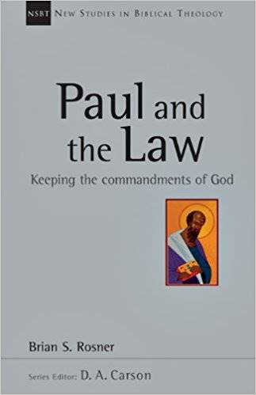
While I was Gone..
  Stephen discussed some of the key ideas found in Brian Rosner’s book, Paul and the Law, namely that the Apostle Paul’s handling of the OT is rather complex and has been a source of much debate and confusion among Biblical scholars.
  Some would even go so far as to say that Paul contradicts himself in his statements about the OT Law (though we know this is not the case!).
  Rosner divided Paul’s statements about the Law into three major categories:
  Repudiation (e.g. 1Cor. 9:20 – I am not under the law)
  Replacement (e.g. 1Cor. 9:21 – I am under the Law of Christ)
  Reappropriation of the Law as Prophesy and as Wisdom (e.g. Eph. 6:2 - "Honor your father and mother" (this is the first commandment with a promise))

Slide 3
While I was Gone..
  The traditional approach that Covenant Theologians (and others) have taken to explain these seemingly contradictory descriptions of the law is to break the law into parts and say the differing descriptions apply to the different parts of the law:
  The Moral Law
  The Ceremonial Law
  The Civil Law
The problem with this explanation is that the scriptures never divide the law in this way. The Bible always views the Law as a whole (cf. James 2:10).
  Rosner explains Paul’s seemingly contradictory descriptions of the law by showing that Paul is describing the different roles served by the law in the Old and New Covenants.
  Did you all find this explanation of Paul’s descriptions of the Law to be helpful?

Slide 4
While I was Gone..
  At the end of his last lesson, Stephen talked about how we could use Rosner’s analysis in applying the OT to our lives.
  He talked about how Paul sometimes applies the OT as wisdom and suggested that we can do the same and went on to suggest as an example that we might apply the OT Sabbath in our lives by wisely recognizing that it’s not a good idea to “burn the candle at both ends”, i.e. work to a point that we never take any time to rest.
  While I affirm (as common sense) the wisdom of setting aside time in our lives for rest, it is important to keep in mind, as Stephen pointed out at the time, such an application would be limited to a personal application and would not be a standard to which you can hold other Christians.
  The only applications of OT wisdom that are binding on other Christians are those areas where the apostles authorize such application in the NT.
  Any further thoughts or discussion?

Slide 5
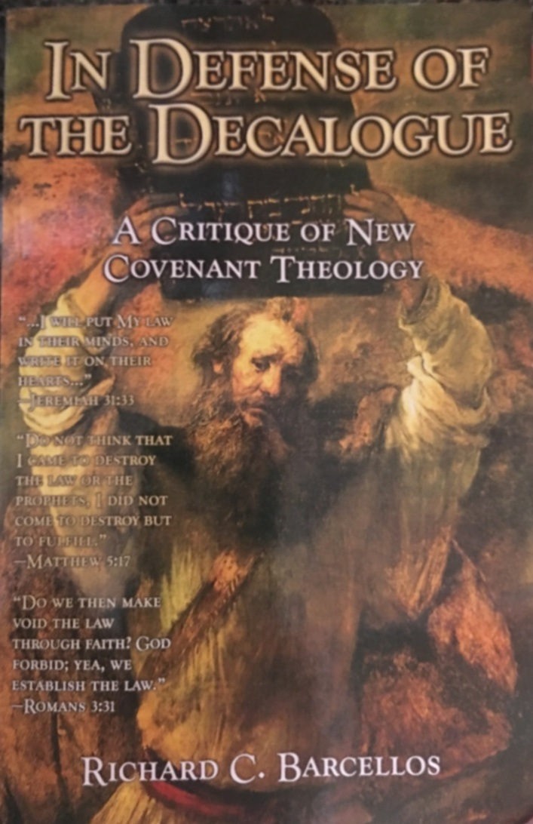

An Examination of Reformed Baptist Arguments Against New Covenant Theology

Slide 6
Chapter 4
NCT and the Sermon on the Mount
  In this chapter, Barcellos takes issue with advocates of NCT who say that in the second half of the Sermon on the Mount, Jesus is making changes to the Law of Moses as he lays down standards for New Covenant believers.
  Barcellos directs most of his criticisms in this regard towards the writings of NCT advocate John Reisinger.
  Before we look further at Barcellos arguments, let’s take a quick look at what we said in this class about the second half of the Sermon on the Mount.

Slide 7
My Analysis of Mat. 5:17-48
What I pointed out about this passage is that:
  Jesus tells us that he has not come to set aside the OT scriptures as though they were of no value or importance.
  The purpose of the OT scriptures – and even the commandments within them – was to point to Jesus as the one who fulfills them.
  Jesus then, takes us through a series of six examples, where he shows us how to “keep” the OT commandments by listening to him and doing what he says.
In each of the six examples Jesus follows the same pattern:
  He begins by saying: “You have heard that it was said to those of old…”
  Quotes or paraphrases an OT command(s)
  Then says: “But I say to you…” at which point he adds to, upgrades, and, in some cases, even does away with the OT command.

Slide 8
Chapter 4
NCT and the Sermon on the Mount
  Barcellos, like most Covenant Theologians, do not see Jesus as making any changes or upgrades to the Law of Moses in Mat. 5:21ff, but rather, they understand Jesus in this passage to be correcting the Pharisee's misunderstanding and misapplication of the Law of Moses.
  Why do you think Covenant Theologians like Barcellos would want to say that Jesus is not changing or upgrading the Law in Mat. 5:21ff, but is criticizing the misuse of the Law by the Pharisees?
  What would you say to a Covenant Theologian to challenge their view of this passage?
  In each example, when Jesus says, “You heard it was said… but I say”, he does not give some false teaching by the Pharisees.
  Instead he gives either a direct quotation, or a very close paraphrase of an OT law and then goes on to upgrade, change, or in some cases eliminate the law altogether.

Slide 9
Chapter 4
NCT and the Sermon on the Mount
  In defending the idea that Jesus is criticizing the Pharisees and not changing the Law, Barcellos only looks at one of Jesus six examples (i.e., Jesus’ second example that extends the prohibition against committing adultery to a prohibition against lust).
  Barcellos asks, “Did an Old Covenant man honor God by committing lust, the type of heart adultery forbidden by Matthew 5:28?” (p.74)
  The answer is, “No, of course not”. But an OT man could lust after a woman and still meet the demands of the national covenant and remain an unpunished member of society, because there were no explicit prohibitions against lust in the OT Law.

Slide 10
Chapter 4
NCT and the Sermon on the Mount
  Barcellos goes on to claim that what Jesus is giving here is not a new teaching. To prove this Barcellos gives two instances where he claims that the OT teaches that lusting after a woman in your heart is adultery:
  The tenth commandment: You shall not covet your … neighbor's wife (Exodus 20:17)
  A statement in Proverbs concerning an adulterous woman: Let not your heart turn aside to her ways; do not stray into her paths, for many a victim has she laid low, and all her slain are a mighty throng. Her house is the way to Sheol, going down to the chambers of death. (Proverbs 7:25-27)
  Do you think that these two OT statements clearly teach that to lust after a woman is to commit adultery with her in your heart ?

Slide 11
Chapter 4
NCT and the Sermon on the Mount
  As I pointed out earlier, Barcellos simplified his task of refuting the NCT claim that in Mat 5:21ff Jesus is changing and upgrading the Law of Moses but only dealing with one of Jesus’ six examples.
  Had Barcellos tried to deal with some of Jesus’ other examples, I believe he would have an even harder time making his point. For example:
  In Mat.5:31-32, Jesus gives much greater restrictions on divorce than were given in the OT law
  In Mat.5:43-48 Jesus ends the OT practice of hating the enemies of God (cf. Psalm 139:21-22; 2Chron. 19:2) and tells instead us to love our enemies.

Slide 12
For Next Time…
Read Chapters 5 and 6 (from pages 77-86) before we meet again and come prepared to discuss it.

Slide 13

Other Questions?

