Slide 1
Biblical parenting
Introduction
Proverbs and Other Texts

Slide 2
Foundational Principles
The Bible is Our Authoritative Guide
Nature of Children
The Role of Parents

Slide 3
Nature of Children
Every child is born with a sinful nature and utterly devoid of wisdom:
  Therefore, just as sin came into the world through one man, and death through sin, and so death spread to all men because all sinned-- (Rom 5:12 ESV)
  Behold, I was brought forth in iniquity, and in sin did my mother conceive me. (Psalm 51:5 ESV)
  The wicked are estranged from the womb; they go astray from birth, speaking lies. (Psalm 58:3 ESV)
  Folly is bound up in the heart of a child, but the rod of discipline drives it far from him. (Proverbs 22:15 ESV)

Slide 4
Nature of Children
Every child is born with a sinful nature and utterly devoid of wisdom:
  A child need not be taught how to lie, to be selfish, or to do wrong; these things come naturally. Every sweet, innocent cuddly baby possesses within his nature the constant temptation to fulfill his strong desire to sin. Under the control of sin, the child is totally self-centered; he wants what he wants when he wants it. A child wants to be fed what and when he wishes, to have the total attention of others, to play always, and generally have his every desire fulfilled without regard for anyone else. (J. Richard Fugate, What the Bible Says About Child Training, p.65)

Slide 5
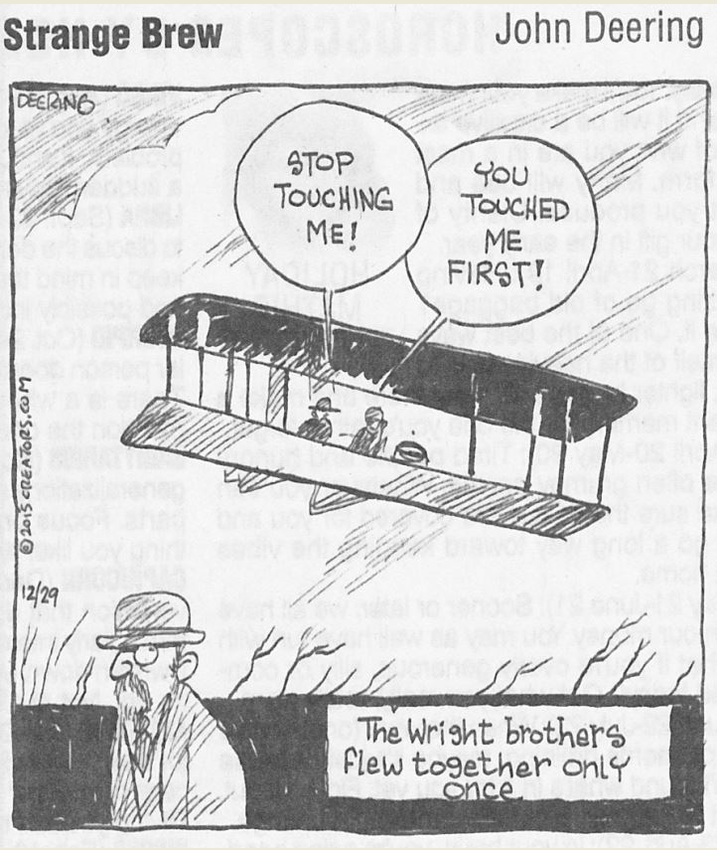
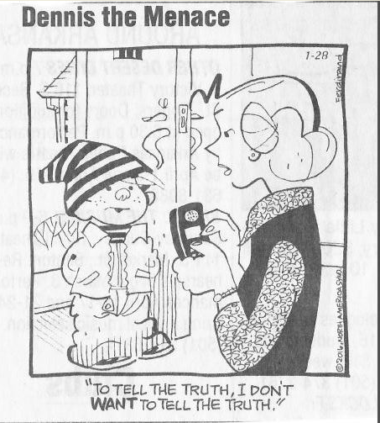
Nature of Children

Slide 6
Nature of Children
Because they are sinful and foolish from birth, children must be restrained by their parents:
  God judged Eli, a priest in the OT, because he did not restrain his sons: And I [God] declare to [Eli] that I am about to punish his house forever, for the iniquity that he knew, because his sons were blaspheming God, and he did not restrain them. Therefore I swear to the house of Eli that the iniquity of Eli's house shall not be atoned for by sacrifice or offering forever." (1Sam. 3:11-14 ESV)
  The rod and reproof give wisdom, but a child left to himself brings shame to his mother. (Proverbs 29:15 ESV)

Slide 7
Nature of Children
  As John MacArthur says, “Children are born sinful, and that sinfulness manifests itself not because of what parents do, but because of what they don’t do.” (cited by Ginger Plowman in Don’t Make Me Count to Three)

Slide 8
The Role of Parents
Parents, your children are a gift from God:
  Behold, children are a heritage from the LORD, the fruit of the womb a reward. Like arrows in the hand of a warrior are the children of one's youth. Blessed is the man who fills his quiver with them! He shall not be put to shame when he speaks with his enemies in the gate (Psalm 127:3-5 ESV)
  In what ways should this verse impact how we think about our children?

Slide 9
The Role of Parents
God expects you to train your children:
  And these words that I command you today shall be on your heart. You shall teach them diligently to your children, and shall talk of them when you sit in your house, and when you walk by the way, and when you lie down, and when you rise. (Deut. 6:6-7 ESV)
  Fathers, do not provoke your children to anger, but bring them up in the discipline and instruction of the Lord. (Eph. 6:4 ESV)
  Train up a child in the way he should go; even when he is old he will not depart from it. (Proverbs 22:6 ESV)

