Slide 1

How to Raise Wise, Godly Children
Training Your Child to Obey
Dealing with Rebellion
Training in Righteousness
Aiming for the Heart

Slide 2
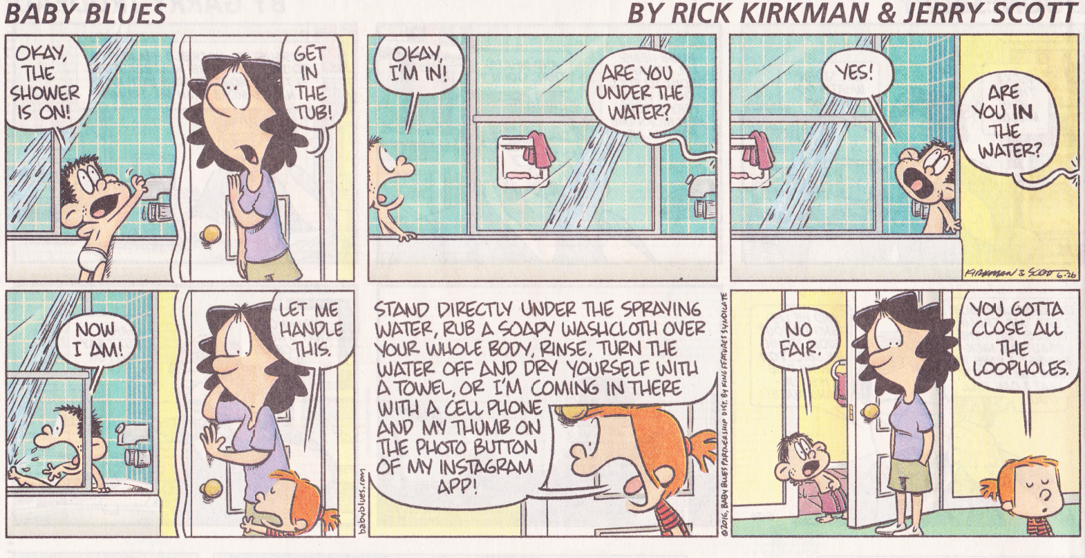

Slide 3
1 Corinthians 13 – the “Love” Chapter
We have been going through 1Cor.13:4-7 and thinking about how to apply the principles taught there to our kids :
  Love waits patiently, love shows kindness. Love does not burn with envy; does not brag – is not inflated with its own importance. It does not behave with ill-mannered impropriety; is not preoccupied with the interests of the self; does not become exasperated into pique [irritation or anger]; does not keep a reckoning up of evil. Love does not take pleasure at wrongdoing but joyfully celebrates the truth. It never tires of support, never loses faith, never exhausts hope, never gives up. (Thiselton translation of 1Cor.13:4-7)

Slide 4
Love does not brag (13:4d)
To praise yourself excessively, speak arrogantly, or behave as a windbag
This includes all forms of desire to gain the applause of others. Love does not seek to win admiration and applause. (Charles Hodge, Commentary on 1 Corinthians)
Does not necessarily preclude us from citing our skills and qualifications in a situation that calls for it (such as on a resume). See, for example, Paul’s citation of his experiences as an apostle in 2Cor.11:
  But I do not think I am in the least inferior to those “super-apostles.” I may not be a trained speaker, but I do have knowledge. We have made this perfectly clear to you in every way. . . Since many are boasting in the way the world does, I too will boast. . . Are they Hebrews? So am I. Are they Israelites? So am I. Are they Abraham's descendants? So am I. Are they servants of Christ? (I am out of my mind to talk like this.) I am more. (2Cor.11:5-6,18,22-23)

Slide 5
Love does not brag (13:4d)
How does this apply to our kids?
  Teach your kids that:
    We all enjoy praise, but we need to be careful about soliciting it.
    Everything we have is from God - What do you have that you did not receive? If then you received it, why do you boast as if you did not receive it? (1Cor. 4:7)
    It’s okay to talk excitedly about things that they have received or things that they are looking forward to, but it’s not okay to boast about them as though those things somehow make them superior to others.
    There’s a place for letting others know that you have skills or abilities to perform a task or have things that others could be helped by.

