Slide 1

How to Raise Children to Become Wise, Responsible, Godly Adults
Training Your Child to Obey
Dealing with Rebellion
Training in Righteousness
Aiming for the Heart

Slide 2
“Tools” for Training in Righteousness
Spanking/Consequences
Teaching/Instructing
Rebuking/Correcting
Developmental Activities
Modeling by Personal Example

Slide 3
Developmental Activities
In the next few weeks we are going to look at three types of developmental activities:
Work
Education
Recreation

Slide 4
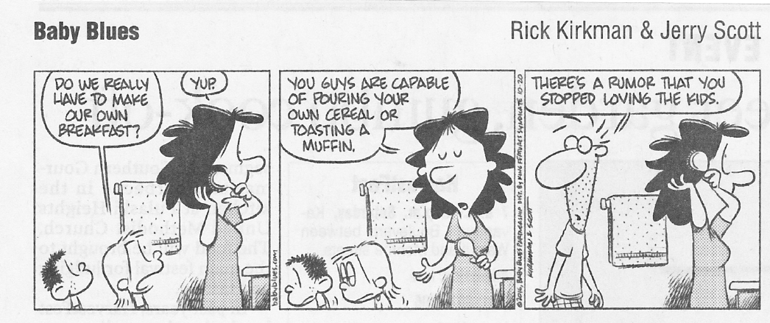
Work

Slide 5
Education
We looked at spiritual education in the earlier section on teaching our kids the Word of God.
In this section we talk briefly about educating our kids in other areas of life.
In these other areas of education, though we’re not directly teaching our kids the Word of God, we should help them understand that ultimately everything in life ties back to a Christian worldview.

Slide 6
Education
Perhaps the first thing that comes to mind when we talk about education is our kids’ schooling.
Parents in our day will generally opt for one of three forms of schooling for their kids:
Home School
Private School
Public School
As Christians, I believe we have the liberty to chose any of these three forms of schooling.
But when making this choice for our kids, we must keep in mind that there are advantages and disadvantages to each of these kinds of schooling.
As a parent, you will need to decide which of these is the best fit for each kid at a given point of time.
Regardless of which of these options you choose, you must always keep in mind that you are the one who is ultimately responsible to make sure that your kids are schooled properly.

Slide 7
Education
What do you see as the advantages and disadvantages of:
Home School?
Private School?
Public School?

