Slide 1

Odds and Ends
Parenting Teenagers
Dealing With Your Kids as Adults
How to Be a Good Grandparent
Learning to Work Well Together With Your Spouse in Raising Your Kids
Going Through a Series of Fictitious Examples

Slide 2
Parenting Teenagers
Most of the principles of biblical parenting apply to any son or daughter who lives under your roof regardless of their age.
But there are some things that change as your kids become older:
If you’re doing your job right, less discipline will be needed as your kids get older.
The amount of control you have in the lives of your kids decreases as they get older.
As your kids become older they will become more self-sufficient and less dependent on you.

Slide 3
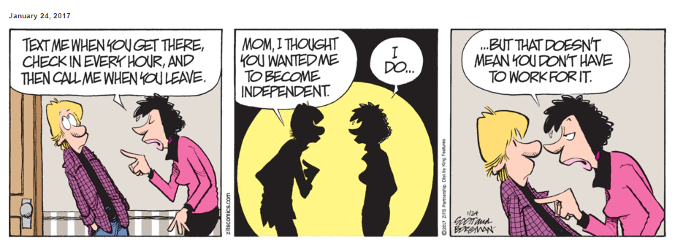
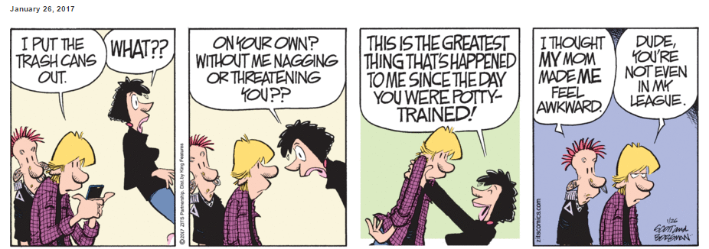
Parenting Teenagers

Slide 4
Parenting Teenagers
The teen years are both exciting and difficult at the same time:
Teens are able to do more things as they get older and therefore have more opportunities.
At the same time teens have a certain amount of insecurity and anxiety over their ability to take on those new responsibilities.

Slide 5
Advice for Raising Teenagers
Teach your teens to fear the Lord. (Proverb 1:7)
Give your teenagers room to fail. Let them make some mistakes and suffer the natural consequences (as long as it’s not dangerous, of course).
Talk with your teens. Discuss tough issues with them (alcohol, drugs, entertainment, dating versus courtship, politics, etc.) Allow them to say what they think or feel about anything without your immediate criticisms or corrections. You don’t have to agree with them, just let them express themselves as with a friend.
Rather than always teaching, ask questions that make them think through their stated opinion to its logical conclusion.

Slide 6
Advice for Raising Teenagers
Don’t be quick to criticize or ridicule everything the world says and produces (even though you’re right). Ask your teens to tell you what they see wrong with a humanistic statement on the news or what’s wrong with the values a particular movie exhibits. In other words, teach them to think for themselves.
Train your teens (especially boys) to become totally self-sufficient from you – economically, physically, and emotionally.
I personally think boys should be doing meaningful work by 12 or 13 years of age – yard work, housework, etc. A teen of 16 or 17 should have the experience of having worked for several bosses, at least over the summers (A young man can learn in a hurry what he doesn’t want to do for a lifetime!)

Slide 7
Advice for Raising Teenagers
Think through with your teen whether or not it’s a good idea for them to go to college (there are other options).
If they are planning to go college, help them think about which colleges are a good choice for them and why.
I personally think it’s a good idea for young person to pay for part or even all of their own college education.
Help them think about what they would like to do as adults:
What are their career plans?
Do they plan to marry and raise a family?

Slide 8
Advice for Raising Teenagers
If your teen (boy or girl) plans to marry and have a family, help them think through the idea of having the Mom stay at home with the kids.
In 1994, a nationwide poll of teenagers* found that:
86% of girls said they expect to work when they are married, only 7% said they expect to stay home.
Among the boys, 58% said they expect their wives to work outside the home. Only 19% expected them to stay home.
* http://www.nytimes.com/1994/07/11/us/poll-of-teen-agers-battle-of-the-sexes-on-roles-in-family.html

Slide 9
Advice for Raising Teenagers
I think it’s a good idea to require teens to do everything they are capable of doing for themselves:
Keeping their room clean and picked up
Doing their own laundry (wash, fold, iron, and put away)
Clean up after themselves (and others)
Helping with home repair and maintenance
I personally think that an older teen should not expect anyone “to take care of him”:
A boy should be able to cook.
A girl should be able to check the oil in the car.
They should both be able to balance a checkbook and manage their own finances.

Slide 10
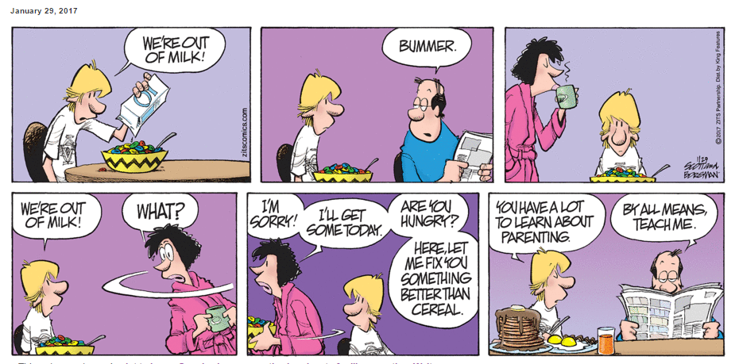
Parenting Teenagers

Slide 11
Questions Concerning My Advice
What do you think about the idea of allowing your teens to fail (as long as it’s not in an area that’s dangerous)?
What do you think about the idea of allowing your teens to express opinions that you don’t agree with and, rather than immediately “jumping down their throat” and giving them your opinion, interacting with them and asking them questions to help them think through their views?
What do you think about the idea of expecting your teens to learn self-sufficiency by taking on responsibilities around the house and even insisting that they get a paying job working for someone else?

