Slide 1


Slide 2
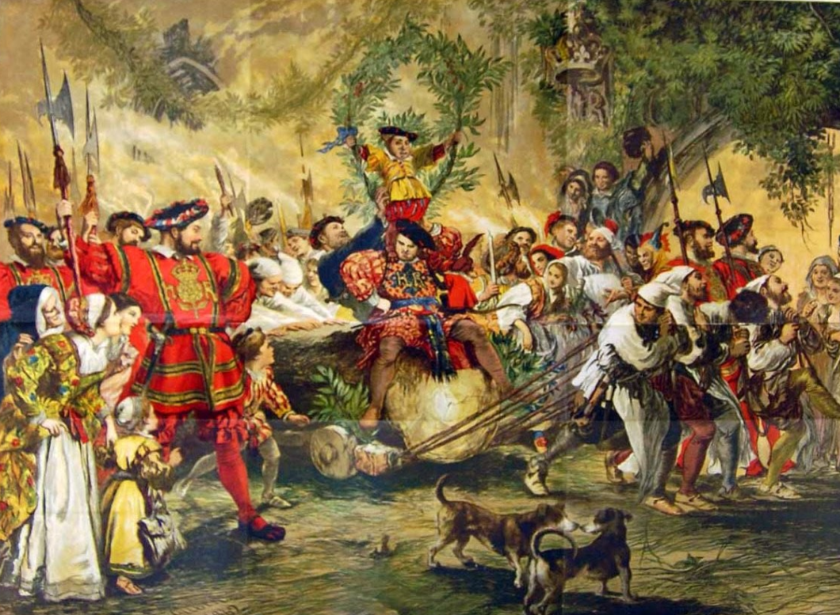
Tudor Christmas Traditions
https://www.historyanswers.co.uk/medieval-renaissance/on-the-12th-day-of-christmas-my-tudor-love-brought-to-me/

Slide 3
Tudor Christmas Traditions
As you know, we have recently been studying the English (and Scottish) Reformation – which began during a period in England known as the Tudor Period – a period that:
  Began with the reign of Henry VII (1485)
  Ended with the death of Elizabeth I (1603).
Besides being the time period in which the Reformation began to take strong root in England, it turns out that the Tudor period was also the time when many of our favorite Christmas traditions were developed.
Carol-singing, present-giving, mulled wine and mince pies were all part of the festive fun – and even Father Christmas and roast turkey have their origins in Tudor England.
https://www.historyextra.com/period/tudor/alison-weir-tudor-christmas-history-advent-calendar-festive-facts-siobhan-clarke/

Slide 4
Tudor Christmas Traditions
And because this is the Sunday that I normally do a special Christmas lesson, I thought this year might be a good time to go back and look at some of those Tudor Christmas traditions.
But before I do that, in order to set the context for how Christmas was celebrated during this period and why this period was so influential in setting some of our present Christmas traditions, I would like to give a brief overview of the different ways Christians have viewed the celebration of Christ’s birth prior the Tudor period – starting with the early church.
https://www.historyextra.com/period/tudor/alison-weir-tudor-christmas-history-advent-calendar-festive-facts-siobhan-clarke/

Slide 5
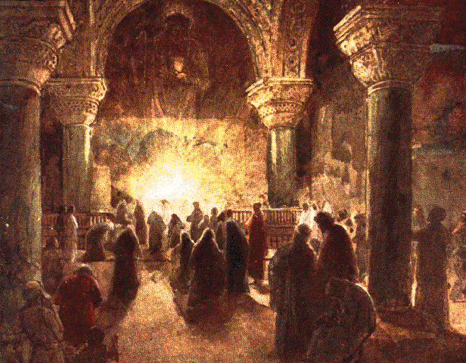
Christmas in the Early Church
https://www.johnsanidopoulos.com/2012/11/continuity-and-change-in-fourth-century.html

Slide 6
Christmas in the Early Church
We are not given a date for the birth of Christ in scripture. And we are not given a command to observe the date.
Where did the December 25th date come from? What is the earliest mention by Christians as to the date of Christmas?
In the early church, there was a difference between the churches in the East and the churches in the West as to when Christmas was celebrated.
As in the Quartodeciman controversy (over when Easter was to be celebrated), the East claimed to have apostolic direction as to when to celebrate the birth of Christ which they did for some time on January 6th (12 days after our Christmas).
Based on notes taken from James White’s 2016 Church History Series; Lesson 21 – Origins of Christmas

Slide 7
Christmas in the Early Church
In the West you begin to see evidence that Christians believed that Christ was born around December 25th as early as the second century:
  Theophilus, Bishop of Caesarea (A.D. 115-181) – “We ought to celebrate the birth-day of our Lord on what day soever the 25th of December shall happen.” (Magdeburgenses, Cent. 2. c. 6. Hospinian, de orign Festorum Chirstianorum)
  Hippolytus of Rome (A.D. 170-240) - “The first coming of our Lord, that in the flesh, in which he was born at Bethlehem, took place eight days before the calends of January [= December 25th], a Wednesday, in the forty-second year of the reign of Augustus, 5500 years from Adam.” (Commentary on Daniel 4:23)
* http://dec25th.info/Objections%20Answered.html

Slide 8
Christmas in the Early Church
Often, when early church fathers gave a rationale for a December 25th date for the birth of Christ, it was based on the traditional dating of the annunciation of the Angel to Mary which was believed to be March 25th (nine months before December 25th).
There is no evidence that early Christians set the date for Christmas for around the same time as the pagan celebrations (that also occurred around the time of the winter solstice) in order to fit in better with the pagans.
It seems inconceivable that the early Christians who suffered so much persecution for faithfully resisting pagan worship would suddenly adopt a pagan holiday on which to celebrate the birth of their Lord.
As Augustine (AD 354-430) put it: “We hold this day holy, not like the pagans because of the birth of the sun, but because of Him who made [the sun].”
*Based on notes taken from James White’s 2016 Church History Series; Lesson 21 – Origins of Christmas

Slide 9
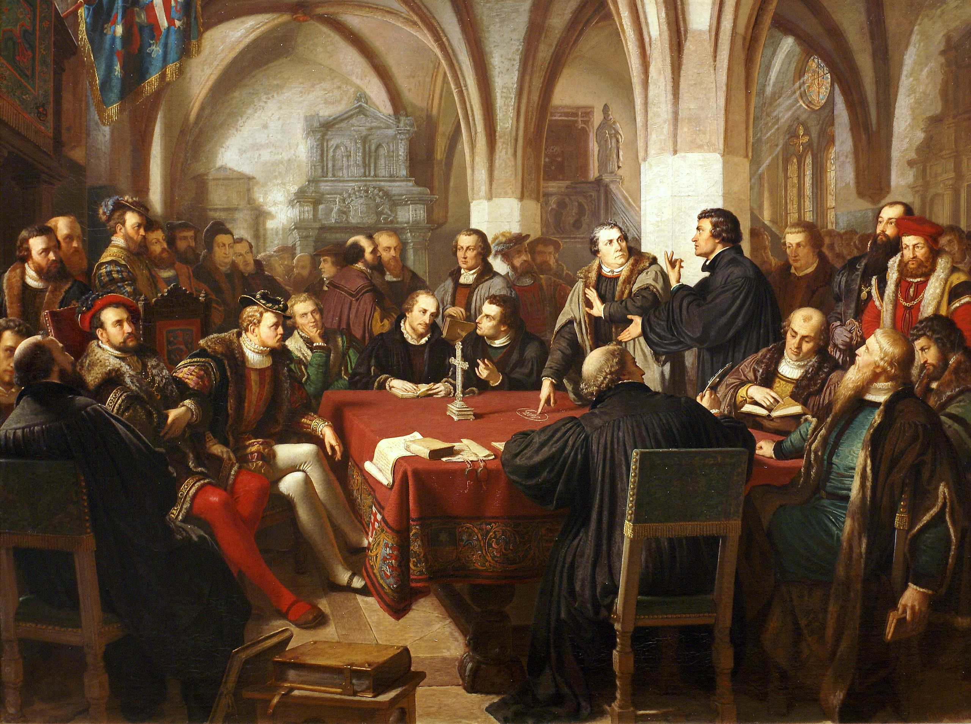
The Reformer’s View of Christmas
https://en.wikipedia.org/wiki/Marburg_Colloquy#/media/File:Religionsgespr%C3%A4ch_zu_Marburg_1529_August_Noack.jpg

Slide 10
The Reformer’s View of Christmas
When it came to celebrating Christmas, leaders of the 16th-century Protestant Reformation were divided on whether followers of Jesus should say “bah humbug” or “joy to the world.”
Among the Reformers, differing views of Christmas stemmed largely from differing views of worship:
  Luther held the “normative principle” — the belief Christians may worship God in any way not forbidden by Scripture
  Zwingli and Calvin held the “regulative principle” — the belief Christians may only worship God in ways commanded by Scripture.
https://www.baptistpress.com/resource-library/news/reformers-disagreement-on-christmas-yields-lessons/

Slide 11
The Reformer’s View of Christmas
Luther delighted in celebrating Christmas. He retained many of the Roman Catholic traditions of Advent and Christmas and may have been among the first people to decorate a Christmas tree with candles.¹
In John Calvin’s Geneva and Ulrich Zwingli’s Zurich, only Sundays were observed as days of worship; the other feast days and saints’ days ordained by Rome were abolished.²
Calvin’s disciple John Knox, who founded the Presbyterian movement in Scotland, followed the same path.¹
Preaching on Christmas Day 1551, a Tuesday, Calvin noted, “I see here today more people than I am accustomed to having at the sermon,” according to Calvin’s Sermons on the Book of Micah translated by Benjamin Wirt Farley.¹
¹ https://www.baptistpress.com/resource-library/news/reformers-disagreement-on-christmas-yields-lessons/
² https://www.deseret.com/2017/12/22/20624542/christmas-after-the-protestant-reformation

Slide 12
The Reformer’s View of Christmas
Then Calvin warned, “When you elevate one day alone for the purpose of worshiping God, you have just turned it into an idol. True, you insist that you have done so for the honor of God, but it is more for the honor of the devil.”
Still, Calvin’s admonition seemed to be a caution rather than a prohibition of Christmas.
In a 1551 letter, Calvin said he “pursued the moderate course in keeping Christ’s birthday.”
Similarly, in a 1555 letter he noted, “A church is not to be despised or condemned because it observes more festival days than the others.”
https://www.baptistpress.com/resource-library/news/reformers-disagreement-on-christmas-yields-lessons/

Slide 13
The Reformer’s View of Christmas
At first, Christmas faced relatively few challenges in England. ¹
When the Anglican Church split with Rome over Henry VIII’s marital issues, it remained relatively Catholic — retaining not only priests, bishops, archbishops and cathedrals but choral music and feast days. ¹
Consequently, many of our Christmas traditions and much of our Christmas music today is from England. ¹
Nearly a century later, the Puritans, who drew theological inspiration from Calvin among other sources, took his view a step further, formally outlawing Christmas in England in 1647. ²
Caution about Christmas in British territories prevailed until the 1800s because of a desire not to return to Roman Catholic practices.²
¹ https://www.deseret.com/2017/12/22/20624542/christmas-after-the-protestant-reformation
² https://www.baptistpress.com/resource-library/news/reformers-disagreement-on-christmas-yields-lessons/

Slide 14
Tudor Christmas Traditions
https://www.historyanswers.co.uk/medieval-renaissance/on-the-12th-day-of-christmas-my-tudor-love-brought-to-me/

Slide 15
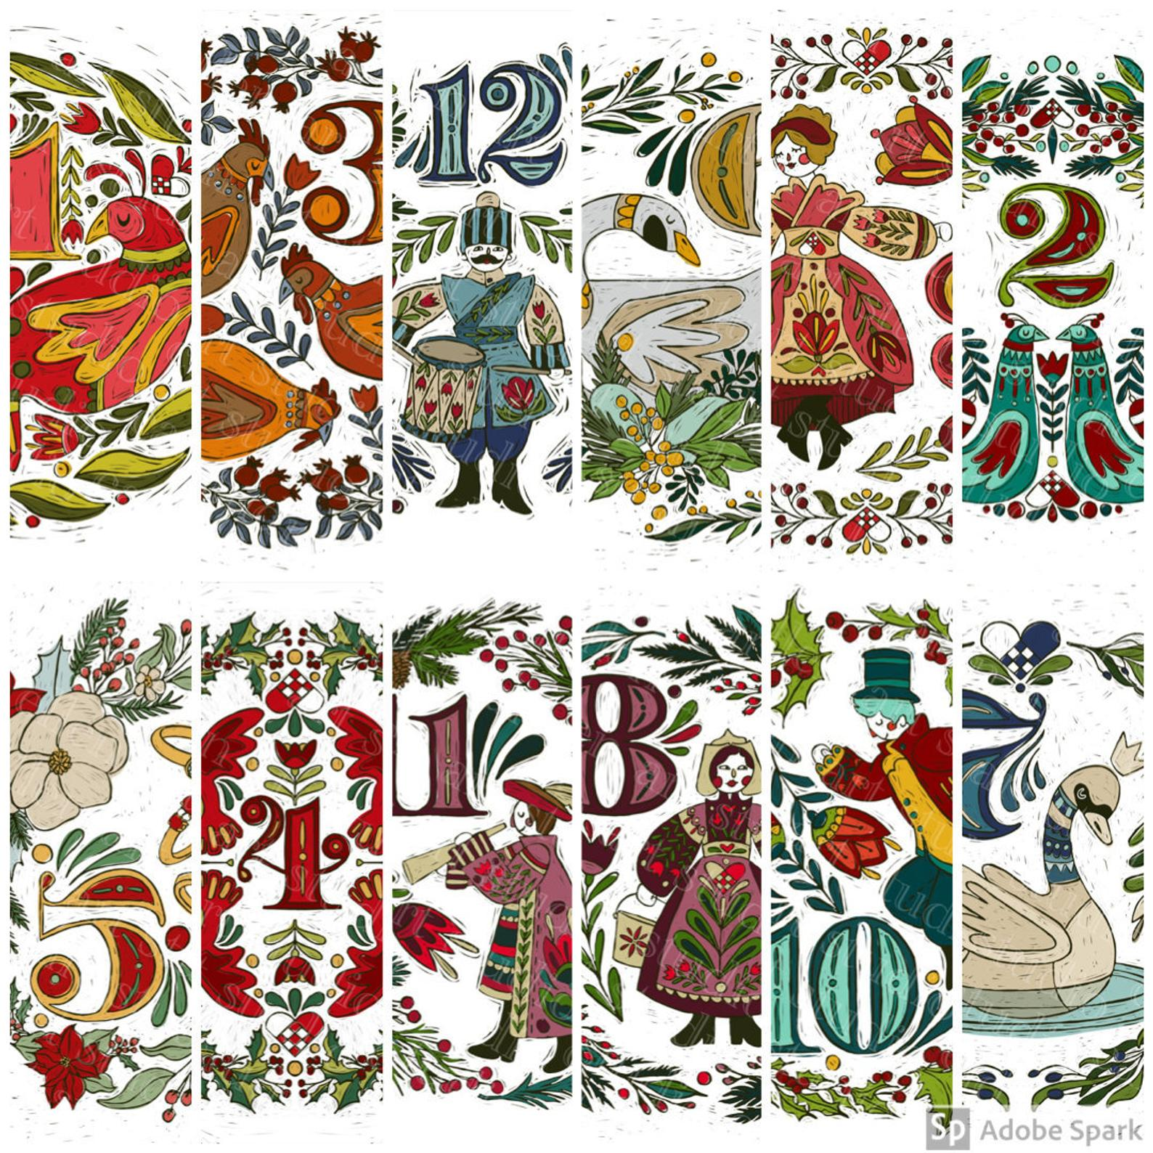
The Twelve Days of Christmas

Slide 16
The Twelve Days of Christmas
For the Tudors, the 40 days before Christmas – sometimes known as “Advent” – was a season of atonement, in which good Christians prepared themselves spiritually for the coming of Christ.
The devout were supposed to do penance and fast – avoiding meat, cheese and eggs.
Then the celebrations began on Christmas Day, and continued for 12 days: from December 25 to January 6.
The three biggest celebrations fell on:
  Christmas Day
  New Year’s
  Epiphany or Twelfth Night on January 6 which honors the arrival of the three kings or three wise men (Magi) to see the baby Jesus.
https://www.historyextra.com/period/tudor/alison-weir-tudor-christmas-history-advent-calendar-festive-facts-siobhan-clarke/

Slide 17
The Twelve Days of Christmas
Though people in Tudor times marked the beginning of the year on March 25 (when they held the Feast of the Annunciation), celebrating and exchanging gifts on January 1 was a holdover from Roman times, when that date was considered the beginning of the year.
All work (except taking care of animals) would stop during the 12-day stretch, as everyone from laborers to noblemen devoted themselves to the enjoyment of the Christmas season.
Work began again on the first Monday after Twelfth Night, known as Plough Monday.
https://www.historyextra.com/period/tudor/alison-weir-tudor-christmas-history-advent-calendar-festive-facts-siobhan-clarke/

Slide 18
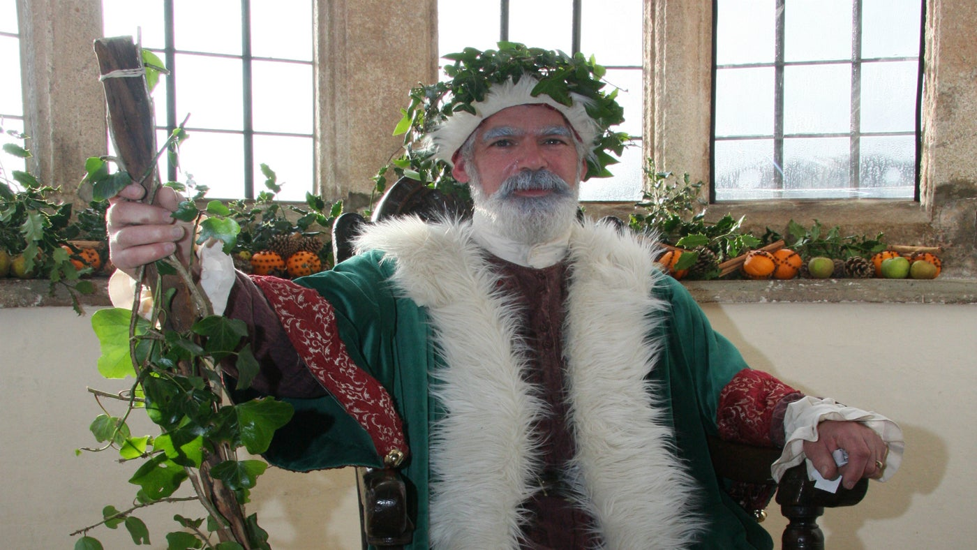
Father Christmas
https://www.bestdaysoutcornwall.co.uk/blog/archives/2016/11

Slide 19
Father Christmas
The tradition of Christmas being personified by one person, such as Father Christmas or Santa Claus, was well established by the Tudor period.
In great households of the Tudor period, the 12 days of feasting, banqueting, pageantry and merrymaking were presided over by a person called the Lord of Misrule.
There was also sometimes a specific character called “Captain Christmas” or “Prince Christmas”, whose role was to ensure that everyone made merry at Yuletide.
A favorite character in Tudor folk plays was called “Father Christmas”. Clad in green, and wearing a grotesque mask and a wig, he would rampage about, shouting and brandishing a great club.
https://www.historyextra.com/period/tudor/alison-weir-tudor-christmas-history-advent-calendar-festive-facts-siobhan-clarke/

Slide 20

The “Kissing Bough”
https://i.pinimg.com/originals/cf/66/9f/cf669f77ae1659f9eed30622769b5992.jpg

Slide 21
The “Kissing Bough”
The Christmas tree tradition as we know it likely began in Germany during the 16th century, but it didn’t become widespread in England until some 300 years later.
Before then, the most popular decoration in people’s houses during the Yuletide season was the kissing bough.
Kissing boughs were woven wooden hoops hung with evergreens like holly and bay leaves and suspended from the ceiling.
Of course, a sprig of mistletoe was a must for any kissing bough.
The tradition of kissing under that parasitic plant goes back as far as ancient Greece, due to mistletoe’s association with fertility.
https://www.history.com/news/christmas-traditions-tudor-england

Slide 22
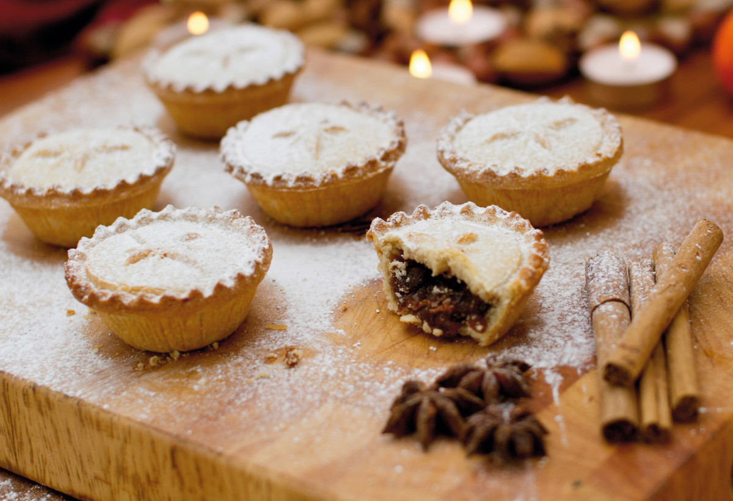
Mince Pies
https://www.history.com/news/christmas-traditions-tudor-england

Slide 23
Mince Pies
After fasting for four weeks, and abstaining from all meat, eggs and cheese, Tudor-era Britons would have been ravenous come Christmas Day.
Mince pies (or “pyes”) were such common fare during the 12 days of celebrations that they were known as Christmas pies.
Stuffed with meat—particularly mutton, which signified the shepherds who visited the infant Jesus—the pies were also made with suet, sugar, spices and dried fruit.
Ideally, they were supposed to contain 13 different ingredients, to symbolize Christ and his 12 apostles.
https://www.history.com/news/christmas-traditions-tudor-england

Slide 24
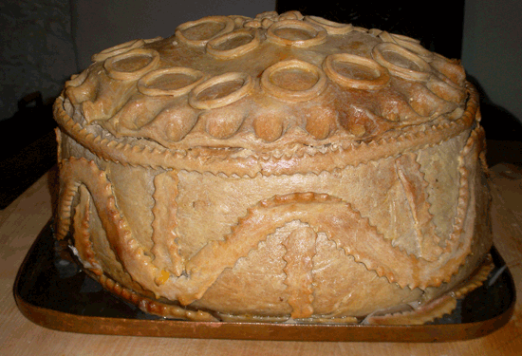
Tudor Christmas Pie
(the Original “Turducken”)
https://www.tudortalkandcatwalk.com/a-tudor-christmas/

Slide 25
Tudor Christmas Pie
The historical record shows the first turkeys arriving in England from the New World in 1526, or right in the middle of Henry VIII’s reign.
Though the most common celebratory fare for Christmas during Tudor times remained the boar’s head, usually displayed on a platter with an apple stuffed into its mouth, wealthier diners could enjoy a particular delicacy of the time: the Tudor Christmas Pie.
This creation, which was not for the faint of heart, consisted of a turkey stuffed with a goose, which was stuffed with a chicken, which was stuffed with a partridge, which was stuffed with a pigeon—all baked inside a pastry “coffin.”
https://www.history.com/news/christmas-traditions-tudor-england

Slide 26
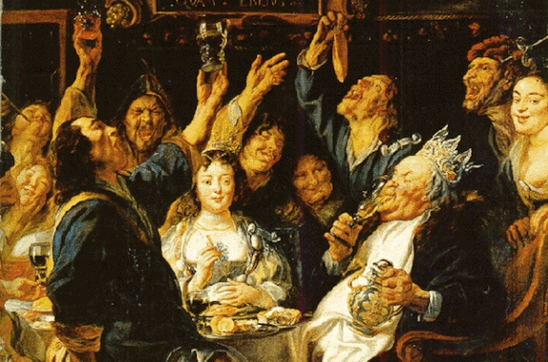
Wassail!
https://www.youtube.com/watch?v=y6Xt5SjHbBA

Slide 27
Wassail!
Today we may recognize the word from classic Christmas carols like “The Wassail Song” and “Here We Come A-Wassailing,” but what did it mean to go wassailing in Tudor times?
During the Christmas season, and particularly on Twelfth Night, groups of people traveled from house to house singing to their neighbors and wishing them good health.
As they did, they passed around the communal wassail bowl, a vessel filled with warm ale, wine or cider mixed with spices and honey.
The word “wassail” is believed to come from the old Anglo-Saxon toast waes hael, meaning “be well” or “be in good health.”
https://www.history.com/news/christmas-traditions-tudor-england

Slide 28
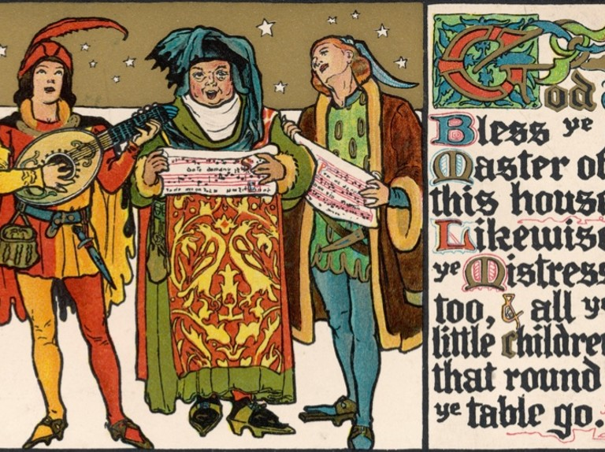
Caroling
https://www.historyextra.com/period/victorian/christmas-carols-history-festive-songs-origins-silent-night/

Slide 29
Caroling
Made popular in Italy in the 13th Century and first recorded in English in 1426, Christmas carols involved dancing as well as singing.
Secular themes such as feasting, hunting and general merry-making became more popular under the Tudors, although carols remained predominantly religious.
Many carols – such as the Coventry Carole, recorded in 1534 – were composed for Mystery Plays, a form of open-air religious theatre that was banned under Henry VIII and restored under Mary I, before eventually declining in popularity sometime around 1600.
16th Century Christmas carols still sung – albeit with revision – today, include “We Wish You a Merry Christmas”, “The First Noel” and “Good King Wenceslaus”.
https://www.historyanswers.co.uk/medieval-renaissance/on-the-12th-day-of-christmas-my-tudor-love-brought-to-me/

Slide 30
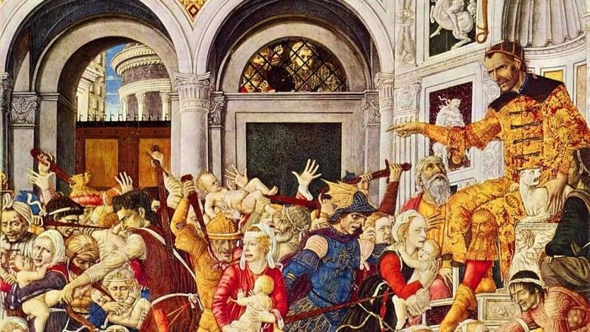
Holy Innocents’ Day
(December 28th)
https://historydaily.org/childermas-children-beaten-december-28

Slide 31
Holy Innocents’ Day
This was in remembrance of King Herod ordering the slaying of all infant boys under two years of age, in an attempt to destroy the infant Christ.
Due to its somber associations, Holy Innocents was a day of fasting for adults, and sometimes, when children woke up, they were whipped – perhaps not too hard – as they lay in bed, to remind them of the suffering of the murdered innocents.
However, for the rest of the day, they were allowed greater license and even permitted to play in church.
It was, essentially, a children’s feast.
https://www.historyextra.com/period/tudor/alison-weir-tudor-christmas-history-advent-calendar-festive-facts-siobhan-clarke/

Slide 32
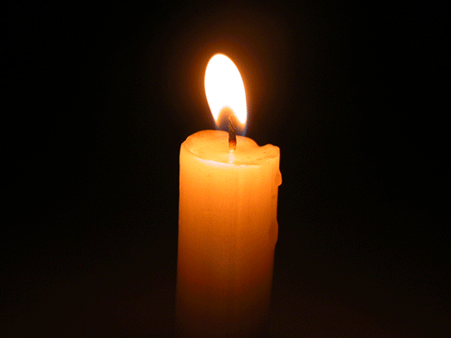
The Coventry Carol
(Sung by King’s College Choir)
Lully, lullay, thou little tiny child, Bye bye, lully, lullay. Thou little tiny child, Bye bye, lully, lullay.
O sisters too, how may we do For to preserve this day This poor youngling for whom we sing, “Bye bye, lully, lullay?”
Herod the king, in his raging, Charged he hath this day His men of might in his own sight All young children to slay.
That woe is me, poor child, for thee And ever mourn and may For thy parting neither say nor sing, “Bye bye, lully, lullay.” (Repeat first verse)
https://www.youtube.com/watch?v=xHkTYpzHNVQ

Slide 33

Class Discussion Time
https://www.weareteachers.com/moving-beyond-classroom-discussions/

Slide 34
*Class Discussion Time
We saw that among the Reformers, differing views of Christmas stemmed largely from differing views of worship:
  Luther held the “normative principle” — the belief Christians may worship God in any way not forbidden by Scripture
  Zwingli and Calvin held the “regulative principle” — the belief Christians may only worship God in ways commanded by Scripture.
Those who lean towards the normative principle tend to cite the principle of Christian liberty: that which is not explicitly forbidden in scripture is allowed.
Those who lean toward the regulative principle tend to cite passages where God condemned those who did not follow his instructions in worship:
  Now Nadab and Abihu, the sons of Aaron, each took his censer and put fire in it and laid incense on it and offered unauthorized fire before the LORD, which he had not commanded them. ² And fire came out from before the LORD and consumed them, and they died before the LORD. (Lev 10:1-2)
Which view do you lean toward? Explain your answer.
Do you have a topic or question that you would like to see us to discuss?

