Slide 1
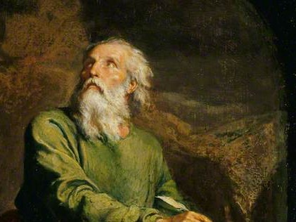
Highlights From the Book of Isaiah
To Download this lesson go to:
http://www.purifiedbyfaith.com/Isaiah/Isaiah.htm
https://www.wikiart.org/en/ernest-meissonier/isaiah

Slide 2
For Unto Us a Child is Born (Isaiah 9:1-7)
When we hear the text of Isaiah 9:6-7, as we so often do at this time of year, we recognize immediately that this is a text about the birth of Jesus.
“For unto us a child is born”, which is echoed in the words of the angels, “For unto you is born this day in the city of David a Savior, who is Christ the Lord.” (Luke 2:11)
What we’re going to do this morning is go back and take a look at this text in its wider context.
We will begin by looking at the section leading up to this prophecy of Isaiah, and then we will look at the actual text of Isaiah 9:6-7 itself.
https://www.desiringgod.org/labs/gloom-to-glory-by-a-great-light

Slide 3
From Gloom to Glory by a Great Light (Isaiah 9:1-2)
¹ But there will be no gloom for her who was in anguish. In the former time he brought into contempt the land of Zebulun and the land of Naphtali, but in the latter time he has made glorious the way of the sea, the land beyond the Jordan, Galilee of the nations. ² The people who walked in darkness have seen a great light; those who dwelt in a land of deep darkness, on them has light shined.
https://www.desiringgod.org/labs/gloom-to-glory-by-a-great-light

Slide 4
¹ But there will be no gloom for her who was in anguish. In the former time he brought into contempt the land of Zebulun and the land of Naphtali, but in the latter time he has made glorious the way of the sea, the land beyond the Jordan, Galilee of the nations.
Isaiah starts off by saying “there will be no gloom for her who was in anguish”.
He is speaking here of the people of Israel, many of whom were in a state of panic and “anguish” because the large and cruel Assyrian army was poised to swoop in and destroy the nation.
Just preceding this verse, at the end of chapter 8, Isaiah has given a vivid description of what it will look like when the nation of Israel collapses:
And they will look to the earth, but behold, distress and darkness, the gloom of anguish. And they will be thrust into thick darkness. (Isa 8:22).
https://www.desiringgod.org/labs/gloom-to-glory-by-a-great-light

Slide 5
¹ But there will be no gloom for her who was in anguish. In the former time he brought into contempt the land of Zebulun and the land of Naphtali, but in the latter time he has made glorious the way of the sea, the land beyond the Jordan, Galilee of the nations.
But as is so often the case in the Old Testament, right after we hear a pronouncement of judgment on the nation of Israel and we’re tempted to think that all is lost, the next word we see, is the word, “but”:
But there will be no gloom for her who was in anguish. In the former time he brought into contempt the land of Zebulun and the land of Naphtali
https://www.desiringgod.org/labs/gloom-to-glory-by-a-great-light

Slide 6
¹ But there will be no gloom for her who was in anguish. In the former time he brought into contempt the land of Zebulun and the land of Naphtali, but in the latter time he has made glorious the way of the sea, the land beyond the Jordan, Galilee of the nations.
“Zebulun and… Naphtali” are the names of two of the sons of Jacob, and the name of the people that descended from them, and then the name of the land that was given to them in the northern part of Israel.
Because of their location, these two territories will be among the first ones taken when the Assyrian army invades from the north.
https://www.desiringgod.org/labs/gloom-to-glory-by-a-great-light

Slide 7
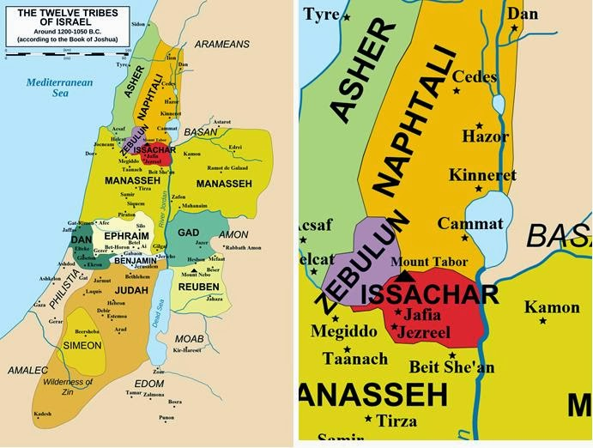
http://baptistbookworm.blogspot.com/2014/01/galilee-under-gentiles.html

Slide 8
¹ But there will be no gloom for her who was in anguish. In the former time he brought into contempt the land of Zebulun and the land of Naphtali, but in the latter time he has made glorious the way of the sea, the land beyond the Jordan, Galilee of the nations.
“In the former time he brought into contempt” – Isaiah is not real specific here as to what time period he is talking about.
But what he wants us to focus on is that:
Formerly there was “gloom” and “contempt”,
But in the end there will be glory
Or, as he says here: “but in the latter time he has made glorious the way of the sea”
https://www.desiringgod.org/labs/gloom-to-glory-by-a-great-light

Slide 9
¹ But there will be no gloom for her who was in anguish. In the former time he brought into contempt the land of Zebulun and the land of Naphtali, but in the latter time he has made glorious the way of the sea, the land beyond the Jordan, Galilee of the nations.
If we want to see the former “gloom” that Isaiah has in mind, it would probably be the event described in 2 Kings 15:29:
In the days of Pekah king of Israel, Tiglath-pileser king of Assyria came and captured Ijon, Abel-beth-maacah, Janoah, Kedesh, Hazor, Gilead, and Galilee, all the land of Naphtali, and he carried the people captive to Assyria. (2 Kings 15:29).
This was an absolutely devastating blow which, no doubt, resulted in great “gloom” and “anguish” among those who were captured.
https://www.desiringgod.org/labs/gloom-to-glory-by-a-great-light

Slide 10
¹ But there will be no gloom for her who was in anguish. In the former time he brought into contempt the land of Zebulun and the land of Naphtali, but in the latter time he has made glorious the way of the sea, the land beyond the Jordan, Galilee of the nations.
But those were the “former” times.
Now comes the “latter time ” for Zebulun and Naphtali. Concerning that part of Israel Isaiah says, “he has made glorious the way of the sea”.
The land of Zebulun and Naphtali were both located around the Sea of Galilee, the area of land just beyond the Jordan.
So, gloom is going to be replaced with glory in “the land beyond the Jordan, Galilee of the nations.”
https://www.desiringgod.org/labs/gloom-to-glory-by-a-great-light

Slide 11
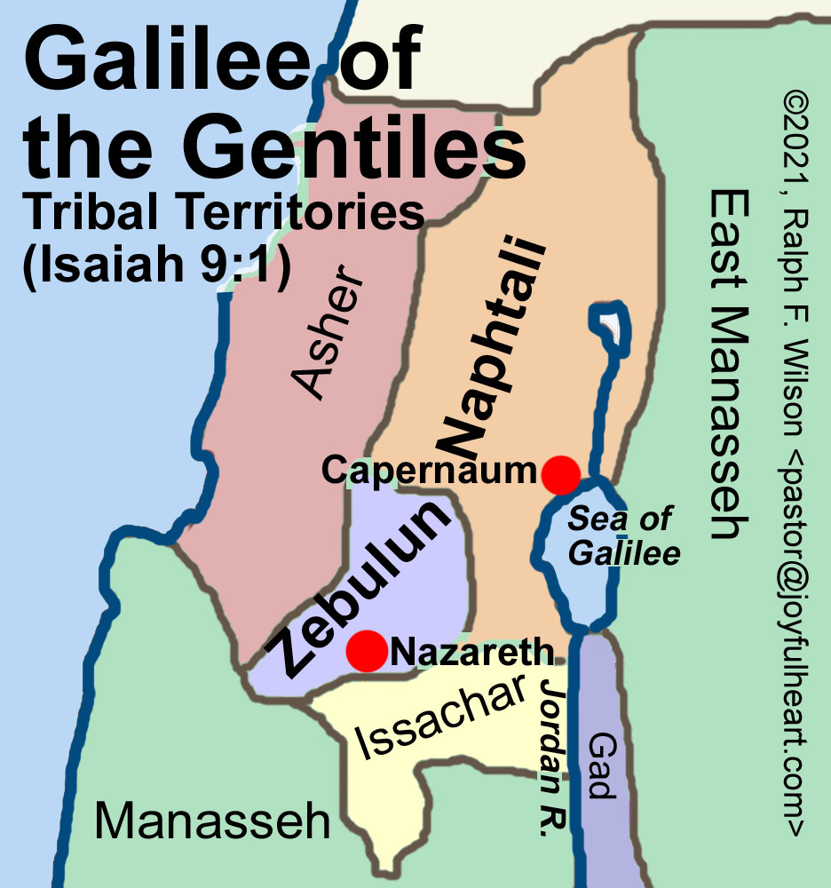
http://www.jesuswalk.com/isaiah/maps/galilee-of-the-gentiles-936x1000x300.jpg

Slide 12
¹ But there will be no gloom for her who was in anguish. In the former time he brought into contempt the land of Zebulun and the land of Naphtali, but in the latter time he has made glorious the way of the sea, the land beyond the Jordan, Galilee of the nations.
What's the reason for calling these two Jewish tribal lands located in and around Galilee, “Galilee of the nations” or, as some translations have it “Galilee of the Gentiles” (see the NKJ, NAS, NIV)?
I suspect it's because these were the lands that bordered on those northern Gentile nations.
And because the borders in those lands were rather porous, there were a lot of Gentiles living in those areas.
And so, when Jesus comes and fulfills this promise of glory for this place, it has implications that he's coming not just for Israel, but for the “nations” (i.e. “Gentiles”) as well.
https://www.desiringgod.org/labs/gloom-to-glory-by-a-great-light

Slide 13
² The people who walked in darkness have seen a great light; those who dwelt in a land of deep darkness, on them has light shined.
Next Isaiah tells us: “The people who walked in darkness have seen a great light”.
The “darkness” here is another way of describing the “gloom” that he was telling us about in verse 1.
These people who (formerly) walked in darkness, “have [now] seen a great light”.
You may recall that the Gospel of Matthew references this very passage.
https://www.desiringgod.org/labs/gloom-to-glory-by-a-great-light

Slide 14
Here’s what Matthew tells us:
Now when [Jesus] heard that John had been arrested, he withdrew into Galilee. And leaving Nazareth he went and lived in Capernaum by the sea, in the territory of Zebulun and Naphtali, so that what was spoken by the prophet Isaiah might be fulfilled: “The land of Zebulun and the land of Naphtali, the way of the sea, beyond the Jordan, Galilee of the Gentiles-- the people dwelling in darkness have seen a great light, and for those dwelling in the region and shadow of death, on them a light has dawned.” From that time Jesus began to preach, saying, “Repent, for the kingdom of heaven is at hand.” (Mat 4:12-17)
https://www.desiringgod.org/labs/gloom-to-glory-by-a-great-light

Slide 15
In other words, Jesus, knowing this prophesy, deliberately chose to go to Galilee, knowing that he was going to be the “light” that was promised and the glory that would be revealed.
And he’s preaching to the people in that region: if you want to be a part of the light, instead of the gloom and darkness then, "Repent, for the kingdom of heaven is at hand.”
https://www.desiringgod.org/labs/gloom-to-glory-by-a-great-light

Slide 16
Yoke Broken, Joy Soaring, Enemies Serving (Isaiah 9:3-5)
³ You have multiplied the nation; you have increased its joy; they rejoice before you as with joy at the harvest, as they are glad when they divide the spoil. ⁴ For the yoke of his burden, and the staff for his shoulder, the rod of his oppressor, you have broken as on the day of Midian. ⁵ For every boot of the tramping warrior in battle tumult and every garment rolled in blood will be burned as fuel for the fire.
https://www.desiringgod.org/labs/gloom-to-glory-by-a-great-light

Slide 17
Yoke Broken, Joy Soaring, Enemies Serving (Isaiah 9:3-5)
We saw how Matthew, in his gospel, cited Isaiah 9:2 to show that Jesus was the promised “light” that would shine through the former “darkness”.
Now we’re going to look at the portion of this text that Matthew didn’t quote.
But Matthew has set us up to interpret the remainder of this text in the light of the gospel, and in the light of the kingdom of Christ, because he told us that Christ is the “glory” that is replacing the “gloom” that's described in verses 1-2.
https://www.desiringgod.org/labs/gloom-to-glory-by-a-great-light

Slide 18
³ You have multiplied the nation; you have increased its joy; they rejoice before you as with joy at the harvest, as they are glad when they divide the spoil.
Verse 3 tells us that as God has become glorious in these northern provinces, he has “multiplied the nation”.
There's a promise that was made to Abram back in Genesis 17:5 :
No longer shall your name be called Abram, but your name shall be Abraham, for I have made you the father of a multitude of nations. (Gen 17:5)
In other words, the people of Israel are going to mysteriously become a “multitude of nations”.
The Apostle Paul interprets that to be the opening of the way to the Gentiles as the Gospel comes and fulfills this Abrahamic promise. (Gal 3:8)
https://www.desiringgod.org/labs/gloom-to-glory-by-a-great-light

Slide 19
³ You have multiplied the nation; you have increased its joy; they rejoice before you as with joy at the harvest, as they are glad when they divide the spoil.
And so, in John 10:16, Jesus tells us:
And I have other sheep that are not of this fold. I must bring them also, and they will listen to my voice. So there will be one flock, one shepherd.
This is a great increase of people beyond the people of ethnic Israel being included in the nation here in Isaiah 9: “You have multiplied the nation”.
Furthermore, God has “increased [the nation’s] joy” and so “they rejoice”.
https://www.desiringgod.org/labs/gloom-to-glory-by-a-great-light

Slide 20
³ You have multiplied the nation; you have increased its joy; they rejoice before you as with joy at the harvest, as they are glad when they divide the spoil.
Isaiah gives two analogies to show what this “joy” is like. “They rejoice before you”:
As with joy at the harvest
As they are glad when they divide the spoil
So, at “harvest”, we're glad because we’ve got enough food. Our needs are met physically by provision.
And we are glad when the enemy has been defeated, and we can “divide the spoil”.
So, there's the gladness of having plenty and the gladness of having victory in war with its fruit of spoil.
https://www.desiringgod.org/labs/gloom-to-glory-by-a-great-light

Slide 21
⁴ For the yoke of his burden, and the staff for his shoulder, the rod of his oppressor, you have broken as on the day of Midian.
Here he gives the reason for this gladness of having victory in war:
God breaks the “yoke” that enemies put on his people.
God breaks the “staff”, that enemies lay on the shoulder of his people.
God breaks the “rod” of the oppressors of his people.
God has broken it.
And that's the that’s the reason they are able to have joy as they divide the spoil.
https://www.desiringgod.org/labs/gloom-to-glory-by-a-great-light

Slide 22
⁴ For the yoke of his burden, and the staff for his shoulder, the rod of his oppressor, you have broken as on the day of Midian.
He has broken the backs of all their enemies “as on the day of Midian”.
What’s that about?
This is referring to the time that Gideon came up against the Midianites in the book of Judges:
And the Midianites … lay along the valley like locusts in abundance, and their camels were without number, as the sand that is on the seashore in abundance. (Jdg 7:12 )
In other words, Gideon was radically outnumbered and of course you remember the story – he reduced his army of 20,000 down to 300, so God would get the glory!
https://www.desiringgod.org/labs/gloom-to-glory-by-a-great-light

Slide 23
⁴ For the yoke of his burden, and the staff for his shoulder, the rod of his oppressor, you have broken as on the day of Midian.
And they cried out, “A sword for the LORD and for Gideon!” …When they blew the 300 trumpets, the LORD set every [Midianite] man's sword against his comrade and against all the army. And the [Midianite] army fled… (Jdg 7:20b-22)
In other words, this this was a stunning victory that only the Lord could have performed and that's the point here in Isaiah 9:4.
You have broken the “yoke”, you've broken the “staff”, you broken the “rod” of all our enemies, and you did it in such a way that only the Lord could have done it - a stunning absolutely miraculous victory.
https://www.desiringgod.org/labs/gloom-to-glory-by-a-great-light

Slide 24
⁵ For every boot of the tramping warrior in battle tumult and every garment rolled in blood will be burned as fuel for the fire.
Now he shows how complete the victory really is:
All the boots and all the garments of the adversaries, that we're just beaten as at Midian “will be burned as fuel for the fire”.
What does that mean?
It means that enemy hasn’t just been defeated. They are super defeated and become useful, even in their death for God's people.
https://www.desiringgod.org/labs/gloom-to-glory-by-a-great-light

Slide 25
God’s Zeal to Enthrone His Son on Earth (Isaiah 9:6-7)
⁶ For to us a child is born, to us a son is given; and the government shall be upon his shoulder, and his name shall be called Wonderful Counselor, Mighty God, Everlasting Father, Prince of Peace. ⁷ Of the increase of his government and of peace there will be no end, on the throne of David and over his kingdom, to establish it and to uphold it with justice and with righteousness from this time forth and forevermore. The zeal of the LORD of hosts will do this.

Slide 26
⁶ For to us a child is born, to us a son is given; and the government shall be upon his shoulder, and his name shall be called Wonderful Counselor, Mighty God, Everlasting Father, Prince of Peace.
We now come to this text that is so rich and familiar to us because of its frequent reference in the Christmas season.
It announces the birth of a baby, and this baby is identified in the context of the prophecy of Isaiah as the birth of a king.
That's what we have to see, first of all, that the basic identity of the person who was being prophesized and described in this text is one who is born to be a king.
And not just any kind of king, but a king who will follow in the line of King David.
https://www.ligonier.org/learn/series/coming-of-the-messiah/the-king-shall-come

Slide 27
⁶ For to us a child is born, to us a son is given; and the government shall be upon his shoulder, and his name shall be called Wonderful Counselor, Mighty God, Everlasting Father, Prince of Peace.
Now, much of the Messianic prophecy of the Old Testament focused on this king who would come, the shepherd King, who would come and rule like David.
And here, in this passage of Isaiah, we hear the announcement of the birth of that promised King: “For to us a child is born, to us a son is given.”
https://www.ligonier.org/learn/series/coming-of-the-messiah/the-king-shall-come

Slide 28
⁶ For to us a child is born, to us a son is given; and the government shall be upon his shoulder, and his name shall be called Wonderful Counselor, Mighty God, Everlasting Father, Prince of Peace.
Notice that this is not simply the joyful announcement of a particular set of parents, where the father and the mother are celebrating the announcement of the impending birth of their baby.
But this is a child that is to be born for the nation: “For to us a child is born, to us a son is given.”
https://www.ligonier.org/learn/series/coming-of-the-messiah/the-king-shall-come

Slide 29
⁶ For to us a child is born, to us a son is given; and the government shall be upon his shoulder, and his name shall be called Wonderful Counselor, Mighty God, Everlasting Father, Prince of Peace.
As we looked at the text leading up to this point, we saw that God had promised that there would be a movement among God's people from “gloom” to “glory”.
And there would be a movement from “darkness” to “light”.
And Jesus is going to be that movement from gloom to glory and darkness to light.
https://www.desiringgod.org/labs/gloom-to-glory-by-a-great-light

Slide 30
⁶ For to us a child is born, to us a son is given; and the government shall be upon his shoulder, and his name shall be called Wonderful Counselor, Mighty God, Everlasting Father, Prince of Peace.
Furthermore, we have seen that there would be a movement from sorrow to joy, great joy.
There would be a movement from oppression under the yoke, and the staff and the rod to freedom as it is broken.
And there would be a movement from oppression to the actual serving of the people of God by the oppressor when his garments and his boots become fuel for them.
https://www.desiringgod.org/labs/gloom-to-glory-by-a-great-light

Slide 31
⁶ For to us a child is born, to us a son is given; and the government shall be upon his shoulder, and his name shall be called Wonderful Counselor, Mighty God, Everlasting Father, Prince of Peace.
And so the question then becomes, okay, what's the replacement for that liberation?
Who will be the ruler now?
And the answer is, the government will not fall upon us.
The government will fall upon the shoulder of one who is now described here.
https://www.desiringgod.org/labs/gloom-to-glory-by-a-great-light

Slide 32
⁶ For to us a child is born, to us a son is given; and the government shall be upon his shoulder, and his name shall be called Wonderful Counselor, Mighty God, Everlasting Father, Prince of Peace.
What we want to notice next is the description given of this child, this king who is to be born.
He is called:
“Wonderful Counselor” – Our king is wise.
“Mighty God” – He is strong.
“Everlasting Father” – He is caring
“Prince of Peace” – He produces peace and all that goes with peace.
https://www.desiringgod.org/labs/gloom-to-glory-by-a-great-light

Slide 33
⁶ For to us a child is born, to us a son is given; and the government shall be upon his shoulder, and his name shall be called Wonderful Counselor, Mighty God, Everlasting Father, Prince of Peace.
So what we have is:
Infinitely wise governance
Infinitely powerful governance
Infinitely caring and loving governance
Leading to glorious peace
I think that's the idea of the four names given to the child that is to be born and govern the world.
https://www.desiringgod.org/labs/gloom-to-glory-by-a-great-light

Slide 34
⁷ Of the increase of his government and of peace there will be no end, on the throne of David and over his kingdom, to establish it and to uphold it with justice and with righteousness from this time forth and forevermore. The zeal of the LORD of hosts will do this.
In this verse, I see six more things said about this king and his government.
First, “Of the increase of his government and of peace there will be no end”.
This means that in the expanse of his government, there will be “peace” with “no end”.
In other words, there are no pockets of rebellion outside his sway in this new world that he's bringing into being.
So that's the first thing – a pervasive government of peace.
https://www.desiringgod.org/labs/gloom-to-glory-by-a-great-light

Slide 35
⁷ Of the increase of his government and of peace there will be no end, on the throne of David and over his kingdom, to establish it and to uphold it with justice and with righteousness from this time forth and forevermore. The zeal of the LORD of hosts will do this.
The second thing is that it fulfills the promises made to king David.
It’s not Caesar's throne that's being established – this is the throne that promised throughout the entire history of Israel.
It’s the fulfillment of all the promises made to David, for example, Jeremiah 23:5:
Behold, the days are coming, declares the LORD, when I will raise up for David a righteous Branch [that’s the Lord Jesus; that's the son born in Isaiah 9:6], and he shall reign as king and deal wisely, and shall execute justice and righteousness in the land.
https://www.desiringgod.org/labs/gloom-to-glory-by-a-great-light

Slide 36
⁷ Of the increase of his government and of peace there will be no end, on the throne of David and over his kingdom, to establish it and to uphold it with justice and with righteousness from this time forth and forevermore. The zeal of the LORD of hosts will do this.
Third, I see here is that this kingdom will be established and sustained by God who will “establish it and to uphold it”.
So, God is the one who is bringing about this government and he promises to establish it and sustain it so that it is firm, you can count on this kingdom, because God will uphold it.
https://www.desiringgod.org/labs/gloom-to-glory-by-a-great-light

Slide 37
⁷ Of the increase of his government and of peace there will be no end, on the throne of David and over his kingdom, to establish it and to uphold it with justice and with righteousness from this time forth and forevermore. The zeal of the LORD of hosts will do this.
Fourth, it will be just.
Justice and righteousness will hold sway in this kingdom there will be no injustice or unrighteousness in this new kingdom.
Fifth, it will last forever.
https://www.desiringgod.org/labs/gloom-to-glory-by-a-great-light

Slide 38
⁷ Of the increase of his government and of peace there will be no end, on the throne of David and over his kingdom, to establish it and to uphold it with justice and with righteousness from this time forth and forevermore. The zeal of the LORD of hosts will do this.
And sixth - one of the most amazing - “zeal” here is the word for “jealousy”.
The zeal or the jealousy of “the LORD of hosts”, “the Lord of armies” will do this.
Will do what?
Will take his son and put him on the throne of David and surround him with a kingdom of people who are included in the love that he has for his son.
https://www.desiringgod.org/labs/gloom-to-glory-by-a-great-light

Slide 39
⁷ Of the increase of his government and of peace there will be no end, on the throne of David and over his kingdom, to establish it and to uphold it with justice and with righteousness from this time forth and forevermore. The zeal of the LORD of hosts will do this.
In other words, infinite zeal, infinite jealousy is behind God's passion to enthrone his son on the throne of the universe which happens to be the throne of David, and from there forever and ever, he will rule with justice and righteousness.
He will uphold it and none will be able to take it down.
It will have no end to its expense or its peace.
And he will be a Wonderful Counselor, Mighty God and everlasting father and a prince of peace.
This is what Jesus was born to achieve.
https://www.desiringgod.org/labs/gloom-to-glory-by-a-great-light

