Slide 1


Slide 2
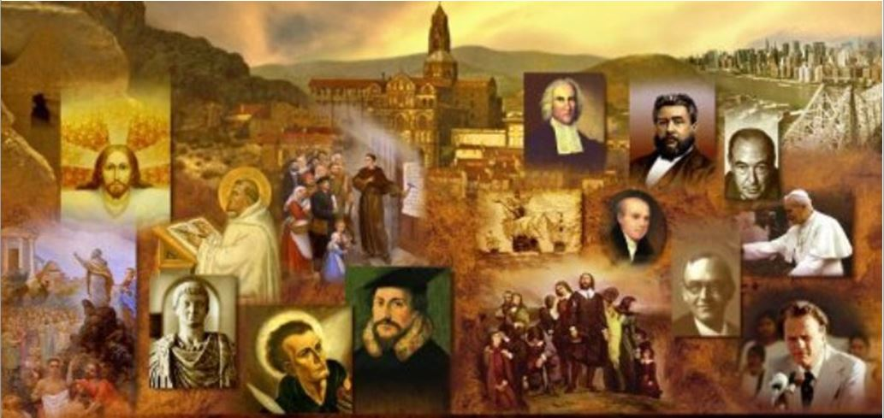
*Why Study Church History?
In most churches today, there is not a big emphasis on church history.
“For most evangelicals today, church history begins with Billy Graham” (James White)
Many Baptists today look at early Church History and say, “Up until the Reformation, they were just a bunch of Catholics and after that they were just a bunch of Lutherans and Presbyterians who would have burned us at the stake or banished us had we lived back then”.
And even though Jesus Christ tells us that “I will build my church, and the gates of hell shall not prevail against it” (Matthew 16:18), our tendency is to think that Christ’s true church was this little tiny group of Baptists that you can hardly find in most time periods until modern times when they could finally come out in the open.
*Much of the material in these introductory slides were drawn from James Whites Church History Series which can be downloaded from sermonaudio.com

Slide 3
Why Study Church History?
To make matters worse, many in our modern world tend to look upon people in ages past with a kind of chronological snobbery.
We think that because we know so much more today than men in the past knew, that there is no value in looking at the things that happened in the past.
In reality, the reason we can know many of the things that we know today is because those who went before us paved the way.
Or, as it is sometimes said, “we stand on the shoulders of giants”. Even if we don’t know their names – we’ve been influenced by them.

Slide 4
Why Study Church History?
There are a fair number of Scriptural examples that seem to show that we need to be reminded of the things that have happened in the past:
When all the nation had finished passing over the Jordan, the LORD said to Joshua, “Take twelve men from the people, from each tribe a man, and command them, saying, “Take twelve stones from here out of the midst of the Jordan…” And Joshua said to them, “…take up each of you a stone upon his shoulder, according to the number of the tribes of the people of Israel, that this may be a sign among you. When your children ask in time to come, ‘What do those stones mean to you?’ then you shall tell them that the waters of the Jordan were cut off before the ark of the covenant of the LORD. When it passed over the Jordan, the waters of the Jordan were cut off. So these stones shall be to the people of Israel a memorial forever.” (Joshua 4:1-7)
Then Samuel took a stone and set it up between Mizpah and Shen and called its name Ebenezer [meaning, “Stone of help”]; for he said, "Till now the LORD has helped us." (1 Samuel 7:12)

Slide 5
Why Study Church History?
There are a fair number of Scriptural examples that seem to show that we need to be reminded of the things that have happened in the past:
For whatever was written in former days was written for our instruction, that through endurance and through the encouragement of the Scriptures we might have hope (Romans 15:4)
Now these things happened to them as an example, but they were written down for our instruction, on whom the end of the ages has come. (1 Corinthians 10:11)
After giving a long list of OT saints who persevered by faith in Hebrews 11, the writer of Hebrews says: Therefore, since we are surrounded by such a great cloud of witnesses, let us throw off everything that hinders and the sin that so easily entangles, and let us run with perseverance the race marked out for us. (Hebrews 12:1 NIV)

Slide 6
Why Study Church History?
So, what is the value of learning about and remembering things that have happened in the history of the church?
We need to be reminded that what God is doing in the world and in history is much bigger than just us.
By looking at what has happened in the past, we can (hopefully) learn from their mistakes.
“Those who fail to learn from history are condemned to repeat it.” (Sir Winston Churchill)
Many of the theological definitions and categories that we take for granted today were forged in earlier controversies in the history of the church.
Church history is often used (by the world or false religions) against as Christians and if we don’t know church history we can be caught flat-footed by those arguments.

Slide 7
Why Study Church History?
So, what is the value of learning about and remembering things that have happened in the history of the church?
If we don’t know church history, we have no appreciation of the thought processes that early Christians went through to develop the theology practices that underlie many of our beliefs and traditions.
Everyone has traditions, whether they admit it or not. The more we understand church history, the more we can understand where our traditions come from and thereby rightly evaluate those traditions.
Church history sort of functions as a mirror that we can hold up to ourselves and gain a wider perspective about what we think we know.

Slide 8
Why Study Church History?
So, what is the value of learning about and remembering things that have happened in the history of the church?
By knowing church history we will be much less likely to be blown about by every wind of doctrine (e.g. the prayer of Jabez). It helps us realize that there is nothing new under the sun.
Warning:
Not everything in church history is overly exciting.
I believe this series on Church History will be applicable to our everyday lives, but not necessarily in the same way that a series on “Child Training” or the “One Another Passages” is.

Slide 9
*Some Other Things You Should Know Before We Begin
Church History is a history of the deeds of the Spirit in and through the men and women in the faith who have gone before us.
That being said, there are episodes in the course of that history in which it is difficult to see the action of the Holy Spirit.
As our narrative unfolds, we will see:
Those who have used the faith of the church for their financial gain, or to increase their personal power.
There will be others who will forget or twist the commandment of love, or will persecute their enemies with a vindictiveness unworthy of the name of Jesus.
At other times, it will appear to many of us that the church has forsaken the biblical faith, making us wonder if such a church can even be called Christian at all!
*Much of the material in these slides were drawn from Gonzalez, Justo L.. The Story of Christianity: Volume 1: The Early Church to the Dawn of the Reformation (pp. 1-6).

Slide 10
*Some Other Things You Should Know Before We Begin
At such points in our narrative, we need to remember two things:
The first of these is that, while this narrative is the history of the deeds of the Spirit, it is the history of the Spirit working through sinners like ourselves! This is clear as early as New Testament times, when Peter, Paul, and the rest are depicted both as people of faith and as sinners.
The second is that it has been through those sinners and that church—and only through them—that the biblical message has come to us. Even in the darkest times in the life of the church, there were those Christians who loved, studied, kept, and copied the scriptures, and thus passed them down to us.
*Much of the material in these slides were drawn from Gonzalez, Justo L.. The Story of Christianity: Volume 1: The Early Church to the Dawn of the Reformation (pp. 1-6).

Slide 11
*Some Other Things You Should Know Before We Begin
What those earlier Christians have passed down to us, however, is more than just the text of scriptures. They have also left the illuminating record of their striving to be faithful witnesses under the most diverse of circumstances:
In times of persecution, some witnessed with their blood, others with their writings, and still others with their loving acceptance of those who had weakened and later repented.
In times when the church was powerful, some sought to witness by employing that power, while others questioned the use of it.
When vast lands until then unknown were opened to European Christians, there were those who rushed to those lands to preach the message of their faith.
*Much of the material in these slides were drawn from Gonzalez, Justo L.. The Story of Christianity: Volume 1: The Early Church to the Dawn of the Reformation (pp. 1-6).

Slide 12
*Some Other Things You Should Know Before We Begin
Like it or not, we are heirs to this host of diverse and even contradictory witnesses.
Some of their actions we may find revolting, and others inspiring. But all of them form part of our history.
All of them, those whose actions we admire as well as those whose actions we despise, brought us to where we are now.
*Much of the material in these slides were drawn from Gonzalez, Justo L.. The Story of Christianity: Volume 1: The Early Church to the Dawn of the Reformation (pp. 1-6).

Slide 13
*Some Other Things You Should Know Before We Begin
Without understanding that past, we are unable to understand ourselves, for in a sense the past still lives in us and influences who we are and how we understand the Christian message.
When we read, for instance, that “the just shall live by faith,” Martin Luther is whispering at our ear how we are to interpret those words—and this is true even for those of us who have never even heard of Martin Luther.
When we hear that “Christ died for our sins,” Anselm of Canterbury sits in the pew with us, even though we may not have the slightest idea who Anselm was.
When we stand, sit, or kneel in church; when we sing a hymn, recite a creed (or refuse to recite one); when we build a church or preach a sermon, a past of which we may not be aware is one of the factors influencing our actions.
*Much of the material in these slides were drawn from Gonzalez, Justo L.. The Story of Christianity: Volume 1: The Early Church to the Dawn of the Reformation (pp. 1-6).

Slide 14
*Some Other Things You Should Know Before We Begin
The notion that we read the New Testament exactly as the early Christians did, without any weight of tradition coloring our interpretation, is an illusion.
It is also a dangerous illusion, for it tends to make us so confident in our interpretation, that we begin to think of our interpretation as the Word of God.
One way we can avoid this danger is to know the past that colors our vision. A person wearing tinted glasses can avoid the conclusion that the entire world is tinted only by being conscious of the glasses themselves.
Likewise, if we are to break free from an undue bondage to tradition, we must begin by understanding what that tradition is, how we came to be where we are, and how particular elements in our past color our view of the present.
It is then that we are free to choose which elements in the past—and in the present—we wish to reject, and which we will affirm.
*Much of the material in these slides were drawn from Gonzalez, Justo L.. The Story of Christianity: Volume 1: The Early Church to the Dawn of the Reformation (pp. 1-6).

