Slide 1


Slide 2
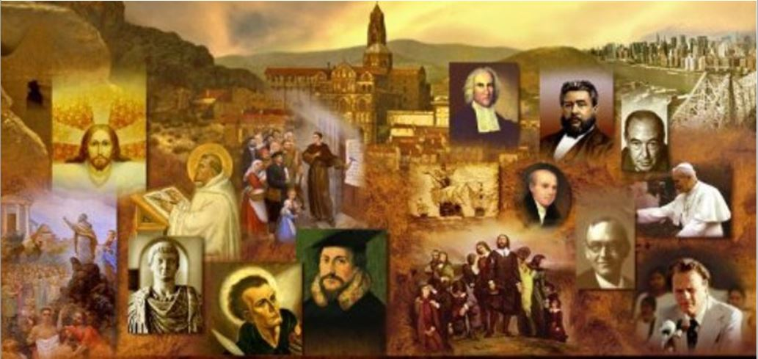
Where Do We Begin?
As you begin a study of church history, you’re faced with a number of questions. For example, is it best to study church history topically or chronologically?
If we begin with the assumption that we will study church history chronologically, the next thing we have to decide is: “When did the church begin?”
If we assume that the church begins with the giving of the Great Commission and the subsequent giving of the Spirit on the Day of Pentecost, we then have to decide: “Where do we want to begin our study?”
One option would be to begin our study by picking up where Luke leaves off in the book of Acts (around AD 62)
Another option would be to look at the events of the early church recorded for us in the Book of Acts itself.
Many church histories that I have read begin with the incarnation and the person of Jesus Christ as the one who established his church.

Slide 3
Where Do We Begin?
But I believe that before we dive into a study of the events that took place in the early church, we need to understand a little about the historical background and setting in which the early church was launched.
I believe we need to familiarize ourselves with the kind of people who made up the early church and the kind of world they faced as they began to carry the gospel into it.

Slide 4
Where Do We Begin?
With these things in mind, I plan to:
  Start by giving a broad overview of the historical and geographical setting in which the NT took place.
  Give a broad overview of the period of church history recorded in the NT, focusing on the historical aspects of what took place during that time.
  I then plan to pick up with the historical events that begin to take place where the book of Acts leaves off (at around AD 62) and move forward from there.

Slide 5
*The Christian Faith is Grounded in History
In those days a decree went out from Caesar Augustus that all the world should be registered. (Luke 2:1)
The Good News (i.e. the Gospel) that Christians have proclaimed throughout the ages is that in the person of Jesus Christ the God and Creator of the Universe entered human history in a unique way in order to secure the salvation of His people.
From the very beginning, the facts of this Christian message were grounded in human history.
History is crucial for understanding not only the life of Jesus, but also the entire biblical message.
A good deal of the Old and New Testament is historical narrative. The Bible tells the story of God’s revelation in the life and history of the people of God.
Without that story, it is impossible to know that revelation.
*Gonzalez, Justo; The Story of Christianity: Vol. 1: The Early Church to the Dawn of the Reformation (p. 1).

Slide 6
*The Christian Faith is Grounded in History
In those days a decree went out from Caesar Augustus that all the world should be registered. (Luke 2:1)
The New Testament writers are quite clear about this:
  The Gospel of Luke tells us that the birth of Jesus took place during the reign of Augustus Caesar, “when Quirinius was governor of Syria” (2:2).
  Earlier in his Gospel Luke places the narrative within the context of Palestinian history, recording that it took place “in the days of Herod, king of Judaea” (1:5).
  The Gospel of Matthew opens with a genealogy that places Jesus within the framework of the history and hopes of Israel, and then goes on to date the birth of Jesus “in the days of Herod the king” (2:1).
  Mark gives less chronological detail, but still does affirm that Jesus began his ministry “in those days”—that is, the days of John the Baptist (1:9).
*Gonzalez, Justo; The Story of Christianity: Vol. 1: The Early Church to the Dawn of the Reformation (p. 1).

Slide 7
*The Christian Faith is Grounded in History
In those days a decree went out from Caesar Augustus that all the world should be registered. (Luke 2:1)
The New Testament writers are quite clear about this:
  The Gospel of John makes it clear that the significance of these events are grounded in One who is stands over and is outside of history by stating that the Word who was made flesh in human history (1:14) is the same Word who “was in the beginning with God” (1:2).
  John makes a similar statement in the opening lines of his first epistle where he says: “that which was from the beginning” is also that “which we have heard, which we have seen with our eyes, which we have looked upon and touched with our hands” (1:1).
*Gonzalez, Justo; The Story of Christianity: Vol. 1: The Early Church to the Dawn of the Reformation (p. 1).

Slide 8
*The Fullness of Time
But when the fullness of time had come, God sent forth his Son, born of woman, born under the law (Galatians 4:4)
The early Christians did not believe that the time and place of the birth of Jesus had been left to chance.
On the contrary, they saw the hand of God preparing for the coming of Jesus:
  In all the events prior to His birth,
  And in all the historical circumstances surrounding His birth.
The same could be said about the birth of the church, which resulted from the work of Jesus.
God had prepared the way so that the disciples, after receiving the power of the Holy Spirit, could be witnesses “in Jerusalem and in all Judea and Samaria and to the ends of the earth” (Acts 1:8).
*Gonzalez, Justo; The Story of Christianity: Vol. 1: The Early Church to the Dawn of the Reformation (p. 13).

Slide 9
*The Fullness of Time
But when the fullness of time had come, God sent forth his Son, born of woman, born under the law (Galatians 4:4)
Therefore, the church was never disconnected from the world around it.
The first Christians were first-century, Palestinian Jews.
Then the faith spread:
  First among other Jews,
  And eventually among Gentiles both within and beyond the borders of the Roman Empire.
*Gonzalez, Justo; The Story of Christianity: Vol. 1: The Early Church to the Dawn of the Reformation (p. 13).

Slide 10
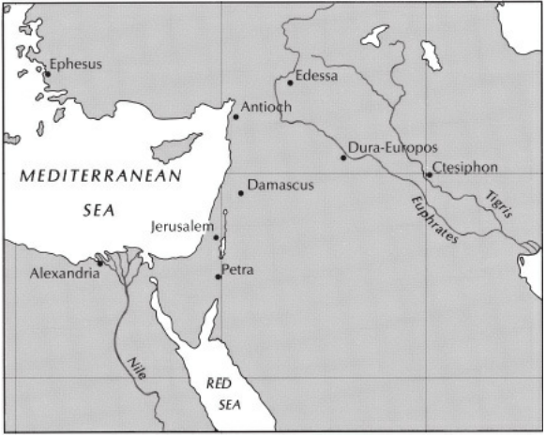
*Palestine – the Birthplace of the Church
*Gonzalez, Justo; The Story of Christianity: Vol. 1: The Early Church to the Dawn of the Reformation (p. 13).

Slide 11
*Palestine – the Birthplace of the Church
Palestine, the land where the church began, had long been a land of fighting and suffering.
In ancient times, this suffering was mostly due to the fact that Palestine was in the middle of several major trade routes that joined Egypt with Mesopotamia, and Asia Minor with Arabia.
As we read the Old Testament, we see that, as empires came and went, they often cast a covetous eye on that narrow strip of land known as Palestine.
For this reason, its inhabitants repeatedly suffered invasion, bondage, and exile.
*Gonzalez, Justo; The Story of Christianity: Vol. 1: The Early Church to the Dawn of the Reformation (p. 13).

Slide 12
*Palestine – the Birthplace of the Church
In the fourth century BC, Alexander the Great, with his Macedonian armies, conquered much of the known world, including Palestine.
Alexander not only conquered the Mediterranean world, but did much to unite and enrich it by spreading the influence of Greek civilization.
As a result of Alexander’s conquests, Greek culture (known as Hellenism) and the Greek language spread throughout the Eastern Mediterranean area.
This unity of culture and language eventually opened the way for Roman conquest and later for the widespread preaching of the Gospel.
*Gonzalez, Justo; The Story of Christianity: Vol. 1: The Early Church to the Dawn of the Reformation (p. 13).

Slide 13
*Palestine – the Birthplace of the Church
But there were many Jews who did not regard Hellenism as a blessing.
Since part of the Hellenistic ideology consisted of equating and mixing the gods of different nations, the Jews saw in it a threat to Israel’s faith in the One God.
In a way, the history of Palestine from the time of Alexander’s conquest to the destruction of Jerusalem in AD 70 may be seen as the constant struggle between Hellenizing pressures on the one hand and Jewish faithfulness to their God and their traditions on the other.
*Gonzalez, Justo; The Story of Christianity: Vol. 1: The Early Church to the Dawn of the Reformation (p. 14).

Slide 14
*Palestine – the Birthplace of the Church
The Romans, who came behind Alexander in their conquest of the Mediterranean world, believed that their calling was to civilize the world around them—which to them meant building and beautifying cities similar to Rome, and placing all of them under Roman rule and guidance. (Note that etymologically the word “civilization” may be understood as “cityfication”.)
Where there were no cities, they built new ones. And where there were ancient cities, they embellished them and erected public buildings in the style of Rome itself.
During the period in which the church was born and the Gospel began to spread throughout the world, the Romans were providentially used by God to establish a period of great world peace, sometimes referred to as The Pax Romana (Latin for "Roman Peace").
This Pax Romana allowed people to freely travel throughout the empire, which in turn facilitated the spread of the Gospel throughout the ancient world.
*Gonzalez, Justo; The Story of Christianity: Vol. 1: The Early Church to the Dawn of the Reformation (p. 15).

Slide 15
*Judaism in Palestine
In general, Roman policies toward the religion and customs of conquered people were rather tolerant.
But the Roman brand of tolerance could not reconcile what appeared to be the obstinacy of the Jews, who insisted on worshiping only their God, and who threatened rebellion at the smallest challenge to their faith.
Following general Roman policy, Herod built the city of Caesarea in honor of the emperor, and he had temples built in Samaria devoted to the worship of Roma and Augustus.
But when he dared place a Roman eagle at the entrance of the Temple in Jerusalem there was an uprising, which he suppressed by force.
His successors followed a similar policy, building new cities and encouraging the immigration of Gentiles.
This led to almost continuous rebellion on the part of the Jews.
*Gonzalez, Justo; The Story of Christianity: Vol. 1: The Early Church to the Dawn of the Reformation; pp.15-16

Slide 16
*Judaism in Palestine
When Jesus was a child there was an uprising against Archelaus, Herod’s son, who had to call in the Roman army.
The Romans then destroyed a city in Galilee near Nazareth, and crucified two thousand Jews. It is to this rebellion that Gamaliel refers in Acts 5:37, as an example of useless revolt.
The radical or Zealot party, a group of Jews who were tenaciously opposed to Roman rule, continued in their efforts to overthrow Roman rule, in spite of the strong actions taken by the Romans against such rebellion.
The Zealots played an important role in the great Jewish rebellion that broke out in AD 66.
Once again the Roman legions were called in, and in the year 70 they took Jerusalem and destroyed the Temple.
Several years later the last stronghold of Jewish resistance, the rock fortress of Massada, was conquered after a heroic defense.
*Gonzalez, Justo; The Story of Christianity: Vol. 1: The Early Church to the Dawn of the Reformation; p.16

Slide 17
*Judaism in Palestine
In the midst of such suffering and changing circumstances, a number of Jewish groups arose during these early years.
Perhaps the best known group, both because the gospels so often refer to it and because later Judaism evolved from it, is the party of the Pharisees:
  They were the party of the people, who did not enjoy the material benefits of Roman rule and Hellenistic civilization.
  To the Pharisees, it was important to be faithful to the Law, and for that reason they studied and debated how the Law was to be applied in every conceivable situation.
  This has led to the charge that they were legalistic. That may be true to a degree. But one must remember that by their emphasis on the Law they sought to make the faith of Israel relevant to everyday situations, and to new circumstances under Roman rule and Hellenizing threats.
  Besides this, they held some doctrines, such as the final Resurrection and the existence of angels, which the more liberal Jews declared to be mere innovations.
*Gonzalez, Justo; The Story of Christianity: Vol. 1: The Early Church to the Dawn of the Reformation; p.16

Slide 18
*Judaism in Palestine
Those more liberal Jews were the Sadducees:
  By and large, they belonged to the Jewish aristocracy, and they were liberal in both politics and religion.
  In matters of religion, their interest centered on the Temple, which they held with the support of the Romans, who in turn found the political liberalism of the Sadducees much to their liking.
  The Sadducees rejected many of the doctrines of the Pharisees as unwarranted innovations.
*Gonzalez, Justo; The Story of Christianity: Vol. 1: The Early Church to the Dawn of the Reformation; p.16

Slide 19
*Judaism in Palestine
There were many other sects and groups within first-century Judaism.
The Zealots have already been mentioned.
Another important group was the Essenes, an ascetic sect to which many attribute the production of the Dead Sea Scrolls.
This group, and probably others like it, sought to obey the Law by withdrawing from the rest of society, and often had a very intense expectation that the end was near.
*Gonzalez, Justo; The Story of Christianity: Vol. 1: The Early Church to the Dawn of the Reformation; p.17

Slide 20
*Judaism in Palestine
While the various Jewish groups had their differences, they all held two things in common:
  Ethical Monotheism
  Eschatological Hope
*Gonzalez, Justo; The Story of Christianity: Vol. 1: The Early Church to the Dawn of the Reformation; p.17

Slide 21
*Judaism in Palestine
Ethical monotheism means that there is only one God, and that this God requires, just as much as proper worship, proper relationships among human beings.
The various parties might disagree as to the exact shape of such relationships, but they all agreed on the need to honor the only God with the whole of life.
Eschatological hope was another common tenet in the faith of Israel. They firmly believed that the day would come when God would intervene in order to restore Israel and fulfill the promise of a Kingdom of peace and justice.
Some thought that they were to speed its coming by the force of arms. Others were convinced that such matters should be left entirely in the hands of God. But all looked to a future when God’s promises would be fulfilled.
*Gonzalez, Justo; The Story of Christianity: Vol. 1: The Early Church to the Dawn of the Reformation; p.17

