Slide 1


Slide 2
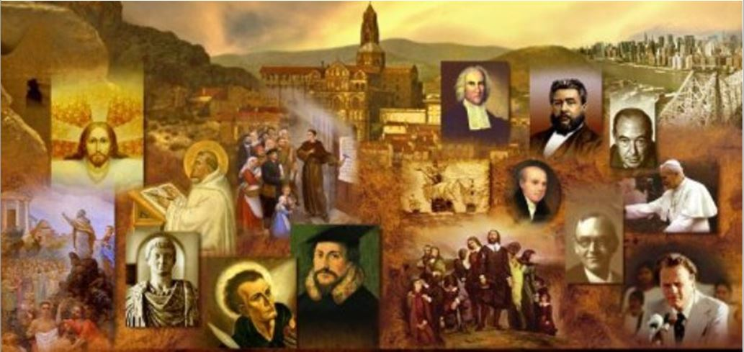
Brief Review
Last week we began looking at a broad overview of the historical and geographical setting in which the NT took place.
We saw that the NT Christian Church was born in a small strip of land on the eastern shore of the Mediterranean know as Palestine.
We saw that, over the centuries, because of its central and strategic location, Palestine was frequently conquered and occupied by larger imperial powers.

Slide 3
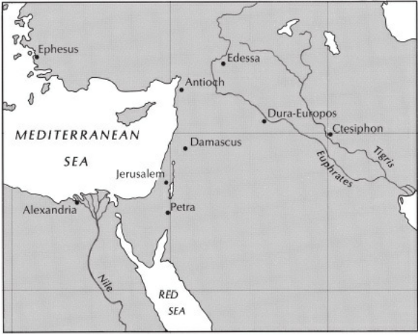
*Palestine – the Birthplace of the Church
*Gonzalez, Justo; The Story of Christianity: Vol. 1: The Early Church to the Dawn of the Reformation (p. 13).

Slide 4
Brief Review
I talked about two earlier conquerors who had a major impact on Palestine during the NT period. Can you name them?
  Alexander the Great of Macedonia (modern day Greece)
  Rome

Slide 5
Judaism in Palestine - Review
I talked about four major Jewish groups living in Palestine during the NT period. Can you name them?
  Pharisees
    Legalistic, but they believed it was important to be faithful to the Law
    Resisted the Hellenistic and Roman pressures to give up their Jewish beliefs.
  Sadducees
    Jewish aristocracy
    Entrusted by Romans with control of the Temple
    Were liberal in both politics and religion.
    Rejected many of the doctrines of the Pharisees as unwarranted innovations.
  Zealots
    Were tenaciously opposed to Roman rule;
    Played an important role in the great Jewish rebellion that broke out in AD 66 and eventually resulted in the Roman destruction of the Temple in AD 70.
  Essenes
    Sought to obey the Law by withdrawing from the rest of society
    Thought to have authored the Dead Sea Scrolls

Slide 6
*Judaism in Palestine
Of all the various Jewish sects, the one group best equipped to survive after the destruction of the Temple were the Pharisees:
  Their roots went back to the time of the Exile, when it was not possible to worship in Jerusalem, and religious life centered on keeping the Law.
  The same was true of the millions of Jews who lived in distant lands in the first century. Not being able to attend worship regularly in the Temple, they developed the synagogue, where the Law and the traditions of Israel were studied, and where the dispersed Jews experienced community and strengthened their resolve to live as the faithful people of God even in dispersion.
  When the Temple was destroyed in 70 CE the Sadducees received a mortal blow, while the theological tradition of the Pharisees continued to bloom into modern Judaism.
*Gonzalez, Justo; The Story of Christianity: Vol. 1: The Early Church to the Dawn of the Reformation; p.17

Slide 7
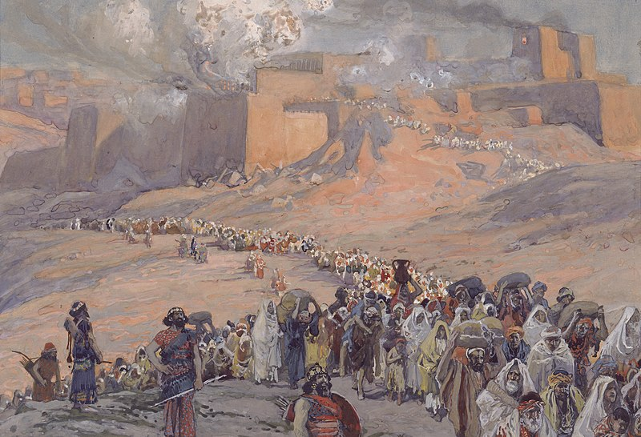
Diaspora Judaism
James, a servant of God and of the Lord Jesus Christ, To the twelve tribes in the Dispersion: Greetings. (James 1:1)
Peter, an apostle of Jesus Christ, To those who are elect exiles of the Dispersion in Pontus, Galatia, Cappadocia, Asia, and Bithynia… (1Peter 1:1)
https://commons.wikimedia.org/wiki/File:Tissot_The_Flight_of_the_Prisoners.jpg

Slide 8
*Diaspora Judaism
For centuries before the birth of Jesus, the number of Jews living outside of Palestine had been increasing.
Dating back to the Old Testament times there were numerous Jews in Persia and Mesopotamia.
In Egypt, they had even built a temple in the seventh century BC, and another five centuries later.
By the time of Jesus, there were sizable Jewish communities in every major city in the Roman Empire.
These Jews, scattered far and wide, but with strong emotional and religious connections with the land of their ancestors, are called the Diaspora or Dispersion.
*Gonzalez, Justo; The Story of Christianity: Vol. 1: The Early Church to the Dawn of the Reformation; p.17

Slide 9
*Diaspora Judaism
Diaspora Judaism is of crucial importance for the history of Christianity, for it was one of the main avenues through which the new faith expanded throughout the Roman Empire.
Furthermore, Diaspora Judaism unwittingly provided the church with the Septuagint: the first Greek Translation of the OT (TaNaK).
For the early church this was the Bible. It took a number of years for the NT Canon, as we know it today, to be fully recognized by all the churches:
  The earliest list of NT books is found in an ancient manuscript known as the Muratorian fragment. The list it contains was originally written in Greek and dates back to the end of the second century (AD 180). The list does not include James or 1 & 2 Peter.
  After that, the first complete list of NT books is found in an ancient document known as Athanatius’ Festal Letter (AD 367).
One of the common traits of Diaspora Judaism was that many of its members had forgotten the language of their ancestors.
For this reason, it was necessary to translate the Hebrew scriptures into languages that the members understood—
  Aramaic in the Eastern wing of the Diaspora
  Greek in its Western wing, within the borders of the Roman Empire.
*Gonzalez, Justo; The Story of Christianity: Vol. 1: The Early Church to the Dawn of the Reformation; p.18

Slide 10
*Diaspora Judaism
Following Alexander’s conquests, Greek had become the common language of the majority of people living in the Mediterranean.
Egyptians, Jews, Cypriots, and even Romans used Greek to communicate with one another.
Therefore, it was natural that when the Jews of the Diaspora began losing their Hebrew they would translate the scriptures into Greek.
This translation originated in Alexandria—the main city in Egypt—and is called the Septuagint, or the Version of the Seventy (or LXX).
It was named this because of an ancient legend that told of seventy Jewish scholars commissioned to translate the scriptures.
The legend was that, after working independently, the scholars translating the TaNaK found that their translations agreed exactly. The obvious purpose of the legend was to legitimize the translation as divinely inspired.
*Gonzalez, Justo; The Story of Christianity: Vol. 1: The Early Church to the Dawn of the Reformation; p.18

Slide 11
*Diaspora Judaism
The Septuagint was of enormous importance to the early church:
  It is the version of scripture quoted by most New Testament authors, and it profoundly influenced the formation of early Christian vocabulary—including the very name of “Christ,” which was the Septuagint word for “Anointed One” or “Messiah.”
  When the early Christians began their missionary spread, they used the Septuagint as a ready-made means of arguing with the more traditional Jews who did not accept their teachings, and also as a means of communicating their message to the Gentiles.
For this and other reasons, the Jewish community produced other versions that were not as readily suitable for Christian use, and, in effect, left the church in sole possession of the Septuagint.
*Gonzalez, Justo; The Story of Christianity: Vol. 1: The Early Church to the Dawn of the Reformation; p.18-19

Slide 12
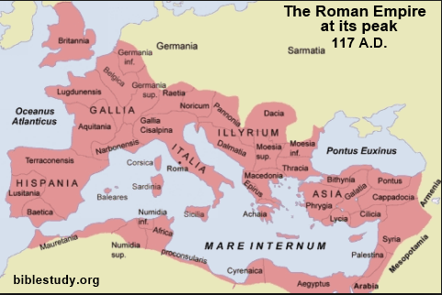
The Greco-Roman World

Slide 13

*The Greco-Roman World
The Roman Empire had a very effective way of dealing with the people that it conquered:
  It would allow the conquered peoples to keep in place many of their laws, customs and religious practices
  While, at the same time, imposing its rule, culture, and pantheon on gods on those conquered people.
Alexander the Great, who preceded Rome, had followed a similar practice.
This method of conquest proved very effective as it allowed first Alexander, and later Rome, to maintain control and influence over a vast number of territories, with a minimum amount of disruption and rebellion.
*Gonzalez, Justo; The Story of Christianity: Vol. 1: The Early Church to the Dawn of the Reformation; p.19

Slide 14
*The Greco-Roman World
The political unity brought about by the Roman Empire allowed the early Christians to travel without having to fear bandits or local wars.
When reading about Paul’s journeys, we see that the greatest threat to shipping at that time was bad weather.
A few decades earlier, an encounter with pirates was much more to be feared than any storm.
In the first century, well-paved and well-guarded roads ran to the most distant provinces—even though most trade and travel took place by water.
Since trade flourished, travel was constant; and in this way Christianity often reached a new region, not through the work of missionaries or preachers, but rather through traveling traders, slaves, and others.
In that sense, the political circumstances in the NT period favored the spread of Christianity.
*Gonzalez, Justo; The Story of Christianity: Vol. 1: The Early Church to the Dawn of the Reformation; p.19-20

Slide 15
*The Greco-Roman World
But other political circumstances were a threat and a challenge to the early Christians.
In order to achieve greater unity, Roman imperial policy sought to impose religious uniformity by two methods:
  Syncretism (the indiscriminate mixing of elements from various religions)
  And emperor worship.
Rome had a vested interest in having its subjects from different lands believe that, although their gods had different names, they were ultimately the same gods.
To the Roman Pantheon (temple of all gods) were added numerous gods from different lands that the Romans conquered.
*Gonzalez, Justo; The Story of Christianity: Vol. 1: The Early Church to the Dawn of the Reformation; p.20

Slide 16
*The Greco-Roman World
The same roads and sea lanes that served Christian missionary expansion were also traveled by people of all sorts of traditions and beliefs.
These traditions and beliefs mingled in the plazas and markets of the cities, to the point that their original form was barely recognizable.
Syncretism became the fashion of the time.
In that atmosphere, Jews and Christians were seen as unbending fanatics who insisted on the sole worship of their One God—an alien cyst that must be removed for the good of society.
*Gonzalez, Justo; The Story of Christianity: Vol. 1: The Early Church to the Dawn of the Reformation; p.20

Slide 17
*The Greco-Roman World
But it was another element in Roman religion that eventually became the reason for persecution.
This was the worship of the ruling emperor.
Roman authorities saw this as a means of unity and a test of loyalty.
To refuse to burn incense before the emperor’s image was a sign of treason or, at the very least, of disloyalty.
When Christians refused to burn incense before the emperor’s image, they did so as a witness to their faith; but the authorities condemned them as disloyal and seditious people.
*Gonzalez, Justo; The Story of Christianity: Vol. 1: The Early Church to the Dawn of the Reformation; p.22

Slide 18
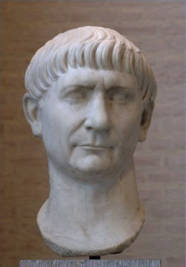
*Pliny the Younger
Writing to the Emperor Trajan
In AD 112, a lawyer, author, and magistrate of Ancient Rome named Pliny the Younger (62–c.113) wrote to the Emperor Trajan for advice on how to deal with Christians in Bithynia.
Trajan (53-117)
*Pliny the Younger, Letters 10.96-97 - http://www.earlychristianwritings.com/text/pliny.html

Slide 19
*Pliny the Younger to the Emperor Trajan
It is my practice, my lord, to refer to you all matters concerning which I am in doubt. For who can better give guidance to my hesitation or inform my ignorance?
I have never participated in trials of Christians. I therefore do not know what offenses it is the practice to punish or investigate, and to what extent. And I have been not a little hesitant as to:
  Whether there should be any distinction on account of age or no difference between the very young and the more mature;
  Whether pardon is to be granted for repentance, or, if a man has once been a Christian, it does him no good to have ceased to be one;
  Whether the name itself, even without offenses, or only the offenses associated with the name are to be punished.
*Pliny the Younger, Letters 10.96-97 - http://www.earlychristianwritings.com/text/pliny.html

Slide 20
*Pliny the Younger to the Emperor Trajan
Meanwhile, in the case of those who were denounced to me as Christians, I have observed the following procedure:
  I interrogated these as to whether they were Christians;
  Those who confessed I interrogated a second and a third time, threatening them with punishment;
  Those who persisted I ordered executed. For I had no doubt that, whatever the nature of their creed, stubbornness and inflexible obstinacy surely deserve to be punished.
  There were others possessed of the same folly; but because they were Roman citizens, I signed an order for them to be transferred to Rome.
*Pliny the Younger, Letters 10.96-97 - http://www.earlychristianwritings.com/text/pliny.html

Slide 21
*Pliny the Younger to the Emperor Trajan
Soon accusations spread, as usually happens, because of the proceedings going on, and several incidents occurred:
  An anonymous document was published containing the names of many persons.
  Those who denied that they were or had been Christians, when they invoked the gods in words dictated by me, offered prayer with incense and wine to your image, which I had ordered to be brought for this purpose together with statues of the gods, and moreover cursed Christ--none of which those who are really Christians, it is said, can be forced to do--these I thought should be discharged.
  Others named by the informer declared that they were Christians, but then denied it, asserting that they had been but had ceased to be, some three years before, others many years, some as much as twenty-five years. They all worshipped your image and the statues of the gods, and cursed Christ.
*Pliny the Younger, Letters 10.96-97 - http://www.earlychristianwritings.com/text/pliny.html

Slide 22
*Pliny the Younger to the Emperor Trajan
They asserted, however, that the sum and substance of their fault or error had been that:
  They were accustomed to meet on a fixed day before dawn and sing responsively a hymn to Christ as to a god,
  And to bind themselves by oath, not to some crime, but not to commit fraud, theft, or adultery, not falsify their trust, nor to refuse to return a trust when called upon to do so.
  When this was over, it was their custom to depart and to assemble again to partake of food--but ordinary and innocent food.
  Even this, they affirmed, they had ceased to do after my edict by which, in accordance with your instructions, I had forbidden political associations.
Accordingly, I judged it all the more necessary to find out what the truth was by torturing two female slaves who were called deaconesses. But I discovered nothing else but depraved, excessive superstition.
*Pliny the Younger, Letters 10.96-97 - http://www.earlychristianwritings.com/text/pliny.html

Slide 23
*Pliny the Younger to the Emperor Trajan
I therefore postponed the investigation and hastened to consult you.
  For the matter seemed to me to warrant consulting you, especially because of the number involved.
  For many persons of every age, every rank, and also of both sexes are and will be endangered.
  For the contagion of this superstition has spread not only to the cities but also to the villages and farms.
But it seems possible to check and cure it.
It is certainly quite clear that the temples, which had been almost deserted, have begun to be frequented, that the established religious rites, long neglected, are being resumed, and that from everywhere sacrificial animals are coming, for which until now very few purchasers could be found.
Hence it is easy to imagine what a multitude of people can be reformed if an opportunity for repentance is afforded.
*Pliny the Younger, Letters 10.96-97 - http://www.earlychristianwritings.com/text/pliny.html

Slide 24
*Emperor Trajan’s Reply to Pliny the Younger
You observed proper procedure, my dear Pliny, in sifting the cases of those who had been denounced to you as Christians.
For it is not possible to lay down any general rule to serve as a kind of fixed standard.
They are not to be sought out; if they are denounced and proved guilty, they are to be punished, with this reservation, that whoever denies that he is a Christian and really proves it--that is, by worshiping our gods--even though he was under suspicion in the past, shall obtain pardon through repentance.
But anonymously posted accusations ought to have no place in any prosecution. For this is both a dangerous kind of precedent and out of keeping with the spirit of our age.
*Pliny the Younger, Letters 10.96-97 - http://www.earlychristianwritings.com/text/pliny.html

