Slide 1


Slide 2
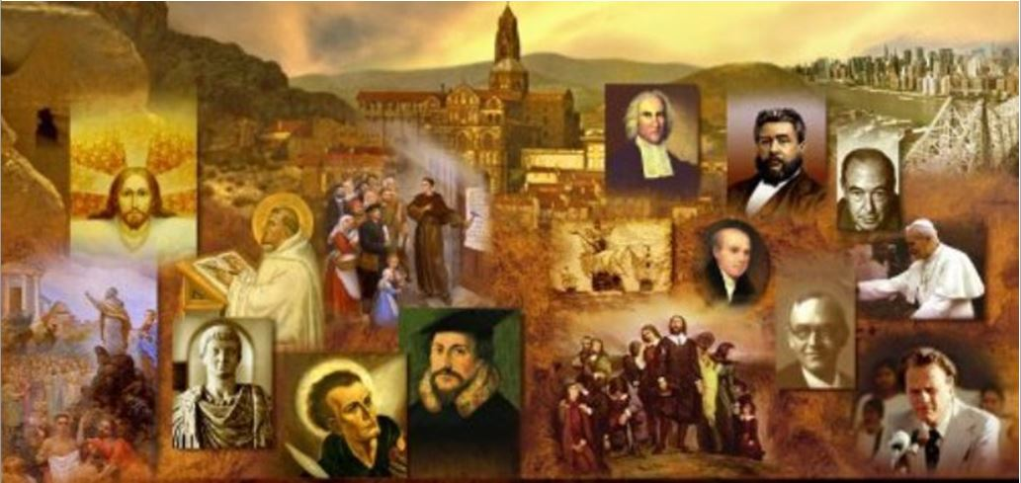
Brief Review
By the time of Jesus, there were sizable Jewish communities in every major city in the Roman Empire.
What was the term used to describe these Jews scattered throughout the Roman world? Give at least one scripture verse where that term is used.
  Diaspora (Greek) or the Dispersion
  James, a servant of God and of the Lord Jesus Christ, To the twelve tribes in the Dispersion: Greetings. (James 1:1)
  Peter, an apostle of Jesus Christ, To those who are elect exiles of the Dispersion in Pontus, Galatia, Cappadocia, Asia, and Bithynia… (1Peter 1:1)

Slide 3
Brief Review
What is the Septuagint?
  It was the first Greek translation of the Hebrew OT (or TaNaK)
  It was the Bible of the early church
Where did the Septuagint get it’s name?
  From the Latin word for seventy.
  References to the Septuagint are often abbreviated as the Roman numeral LXX (seventy)
  It was named this because of an ancient legend that told of seventy Jewish scholars commissioned to translate it.
What is the relationship between the Septuagint and the Jews in the Dispersion?
  When the Jews of the Diaspora began losing their Hebrew they produced the Septuagint so that they could read their scriptures in Greek - the common language of the day.

Slide 4
Brief Review
In what way did Alexander’s previous conquest of the eastern Mediterranean world help the spread of the Gospel during the NT period?
  Established Greek as a common language, allowing the gospel to quickly reach many nations
In what way did the Roman Empire aid in the spread of Christianity?
  The political unity brought about by the Roman Empire (Pax Romana) allowed the early Christians to carry the Gospel from place to place without having to fear bandits or local wars.
In what way did the Romans attempt to hinder the growth of Christianity and why did they do so?
  Jews and Christians were seen as unbending fanatics who insisted on the sole worship of their One God—an alien cyst that must be removed for the good of society.

Slide 5
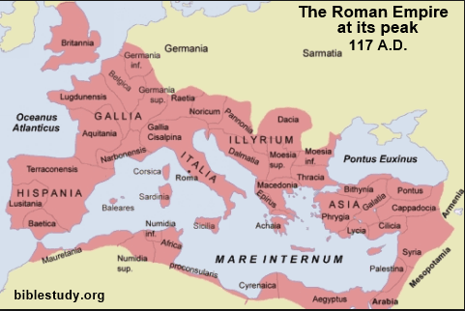
The Roman Empire

Slide 6

*The Roman Empire
At the time of Jesus in the 1st century AD, the Roman Empire controlled the whole of Mediterranean Europe, North Africa and the Middle East.
The Empire was made up of a vast variety of ethnic and religious groups, but there were three main forces held it together:
  A Common Political Loyalty
  A Common Economy
  A Common Intellectual Culture (which included religion and philosophy)
* Needham, Nick. 2,000 Years of Christ's Power Vol. 1: The Age of the Early Church Fathers (Kindle: 282-284)

Slide 7
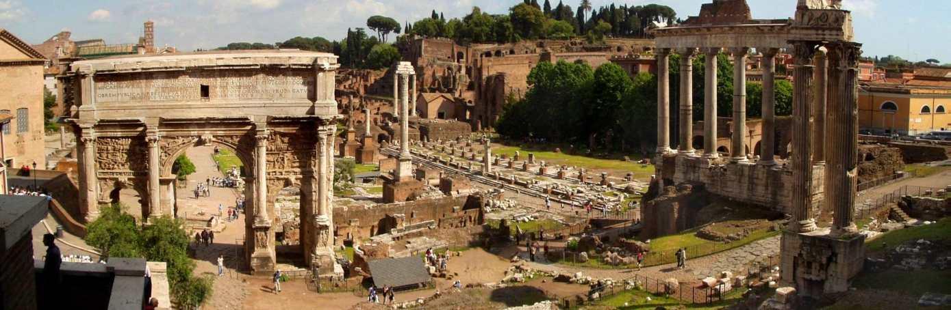
Early Roman Political History
https://en.wikipedia.org/wiki/Roman_Forum

Slide 8
*Early Roman Political History
One man ruled the Empire: the emperor, whose government was based in the capital city of Rome, in central Italy, from which the whole Empire had grown.
The city of Rome was founded in the 8th century BC – the year 753 BC, according to tradition. This was around the same time that the Old Testament prophets Isaiah and Hosea lived.
After two centuries of being governed by kings, in 510 BC a political revolution transformed Rome into a “Republic”, with aristocratic and democratic elements blended in its government, and a deep hostility to monarchy or rule by one man.
Power now rested in the hands of the Senate, a sort of parliament dominated by the upper classes.
* Needham, Nick. 2,000 Years of Christ's Power Vol. 1: The Age of the Early Church Fathers (Kindle: 282-289)

Slide 9
*Early Roman Political History
From the 3rd century BC onward, Rome’s dominion grew steadily, through conflicts and diplomatic alliances, until it stretched across the whole of the Mediterranean world.
And then disaster struck: a series of devastating civil wars in the 1st century BC blew the Republic to fragments, as well as spreading bloodshed and destruction across Europe, North Africa and the Middle East, making it necessary for a single strong ruler to restore order.
* Needham, Nick. 2,000 Years of Christ's Power Vol. 1: The Age of the Early Church Fathers (Kindle: 289-292)

Slide 10
*Early Roman Political History
At first, it seemed that this ruler would be Julius Caesar (born 102 BC) – the most celebrated soldier and politician in Roman history.
However, at the height of his military and political success, Julius was assassinated in 44 BC by a group of Senators who still believed in the Republic; the Republicans were led by Brutus and Cassius, probably the most famous conspirators and assassins of all time.
But the death of Julius Caesar did not restore the Republic. It simply unleashed a fresh series of civil wars.
Julius’s young nephew and adopted son, Octavius Caesar, took up his murdered uncle’s cause, and proved more than equal to the task.
* Needham, Nick. 2,000 Years of Christ's Power Vol. 1: The Age of the Early Church Fathers (Kindle: 292-297)

Slide 11
*Early Roman Political History
After defeating Brutus and Cassius and all other rivals, Octavius assumed supreme power over the Roman world in 31 BC, and in 27 BC the Senate gave him the title Augustus, which means “the exalted one”.
History refers to him by this title. (Our month of August is named after him.)
Augustus was the first and perhaps the greatest of all the Roman emperors; his forty-five years of government restored peace, stability, justice and civilization to a war-torn world.
It is little wonder that grateful millions looked on him as a divine savior sent from heaven.
* Needham, Nick. 2,000 Years of Christ's Power Vol. 1: The Age of the Early Church Fathers (Kindle: 297-301)

Slide 12
*Early Roman Political History
Augustus started out as a ruthless power-seeker who would murder his opponents without any qualms of conscience.
But over time he matured into a wise, moderate, generous ruler, certainly a far more decent and upright character than most of the emperors who came after him.
His reign lasted from 31 BC to AD 14.
Which means he was emperor at the time of Jesus’s birth and is the one mentioned in the Gospel of Luke: In those days a decree went out from Caesar Augustus that all the world should be registered. (Luke 2:1)
It was Augustus who ordered the census which took the Virgin Mary and Joseph on their fateful journey to Bethlehem, where Jesus was born.
* Needham, Nick. 2,000 Years of Christ's Power Vol. 1: The Age of the Early Church Fathers (Kindle: 301-306)

Slide 13
*Early Roman Political History
Augustus was such a successful ruler that the principle of government by a single supreme figure, the emperor, became the established pattern for most of the rest of Rome’s long history.
The Roman Empire depended on the emperor and his armies for maintaining peace and security within the Empire, and also for defending the Empire against aggression from outside, especially from two great enemies:
  The mighty Parthian (Persian) Empire in the east (modern day Iran)
  The Germanic tribes who lived across the Rhine and Danube rivers in the north.
* Needham, Nick. 2,000 Years of Christ's Power Vol. 1: The Age of the Early Church Fathers (Kindle: 306-311)

Slide 14
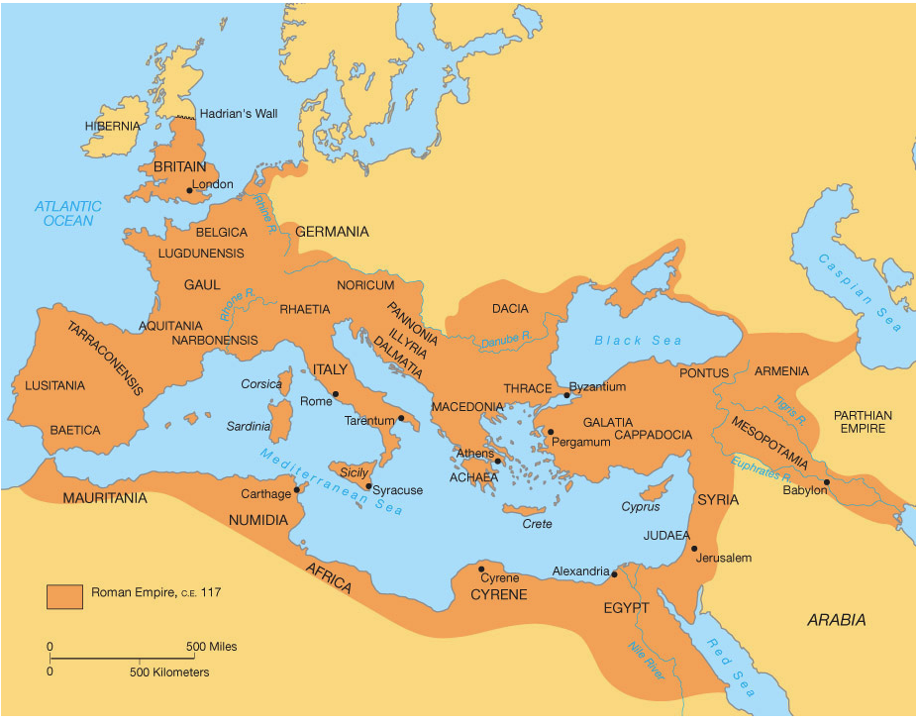
The Roman Empire
https://sljglobal.wikispaces.com/Roman+Geography

Slide 15
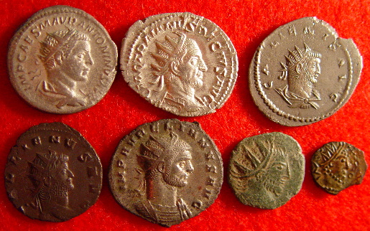
The Roman Economy
https://en.wikipedia.org/wiki/Military_of_ancient_Rome

Slide 16
*The Roman Economy
The sea-coast cities of the Mediterranean, especially the large ones such as Rome itself in the west and Alexandria in the east, depended on trade and commerce for the basic necessities of life.
For example, grain from North Africa fed the population of Rome, and the wines of Italy were exported throughout the Mediterranean.
So a great network of trade bound together the coastal cities of the Empire into a single shared economy.
* Needham, Nick. 2,000 Years of Christ's Power Vol. 1: The Age of the Early Church Fathers (Kindle: 311-314)

Slide 17
*The Roman Economy
One of the early turning points in Rome’s economic fortunes came with the capture of Egypt. After the conquest of Egypt, Rome’s eyes were opened by the world it encountered in the east.
Within a few years of the occupation of Egypt, commercial exchange with India practically exploded.
Trade with ports in India were not, however, limited to products that originated in India.
As recent excavations in Egypt have shown, an array of goods from as far away as Vietnam and Java found their way to the Mediterranean.
* Frankopan, Peter. The Silk Roads: A New History of the World p. 14-16

Slide 18
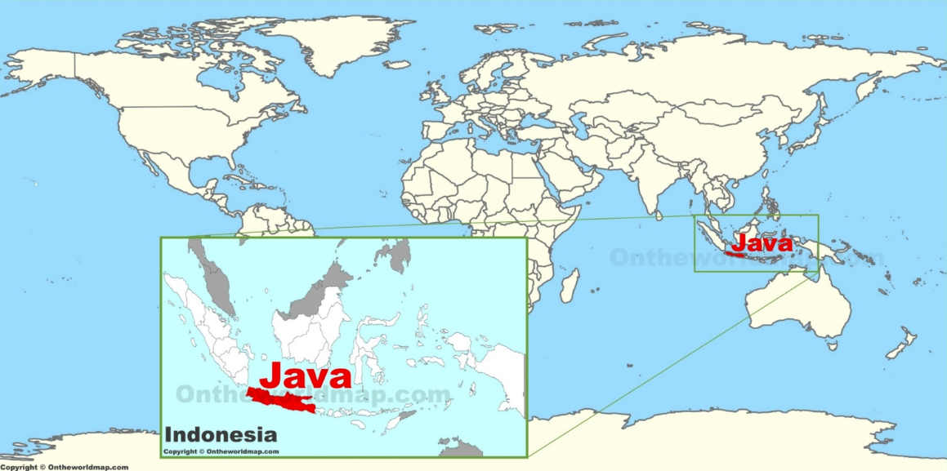
The Roman Empire
http://ontheworldmap.com/indonesia/islands/java/java-on-the-world-map.html

Slide 19
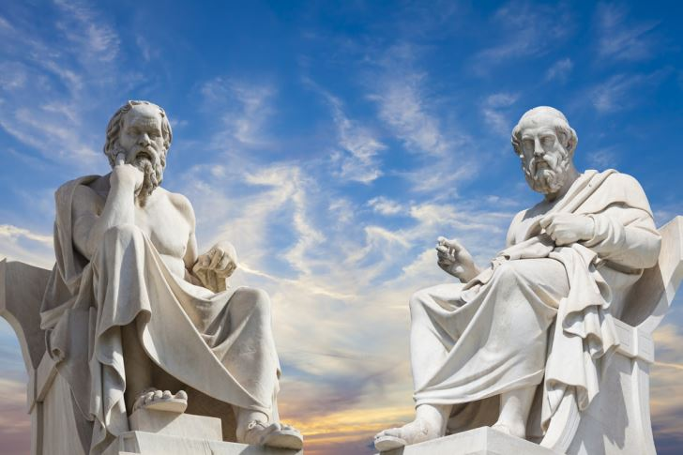
Roman Intellectual Culture

Slide 20
*Roman Intellectual Culture
The dominant culture in the Roman Empire was not Roman but Greek.
At the end of the 4th century BC, the language and values of Greek civilization had spread out from Greece itself across the whole of the Eastern world – the Balkans, Asia Minor, Syria, Persia, Palestine and Egypt – through the amazing conquests of Alexander the Great (336-323 BC), king of the Greek state of Macedonia.
Alexander’s empire broke up after his death, but it left throughout the East an enduring legacy of Hellenism – the term historians use for Greek culture (from the word Hellas (Ἑλλάς), which is the Greek word for “Greece” – cf. Acts 20:2).
* Needham, Nick. 2,000 Years of Christ's Power Vol. 1: The Age of the Early Church Fathers (Kindle: 315-319)

Slide 21
*Roman Intellectual Culture
When the Romans began to gain control of the Eastern world, they came into contact with Hellenism, and found it immensely attractive.
The armies of Rome vanquished the East, but Eastern culture vanquished Rome.
By the 1st century BC, the Greek language, Greek methods of education, Greek art and literature, and Greek philosophy and science had taken root across the entire Roman Empire.
Everyone in the eastern half of the Empire who lived in a city spoke Greek as his first language.
In the western half of the Empire, Latin was the first language, but most educated people would have spoken Greek as their second language.
* Needham, Nick. 2,000 Years of Christ's Power Vol. 1: The Age of the Early Church Fathers (Kindle: 319-323)

Slide 22
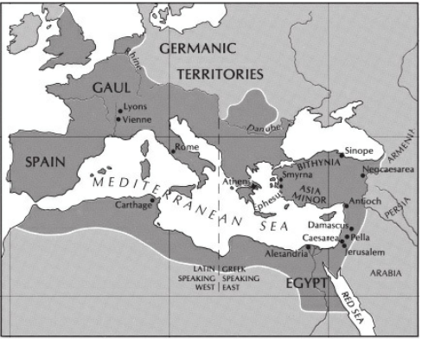
Languages Spoken in the Roman Empire
Latin Speaking West
Greek Speaking East
*Gonzalez, Justo; The Story of Christianity: Vol. 1: The Early Church to the Dawn of the Reformation; p.20

