Slide 1


Slide 2
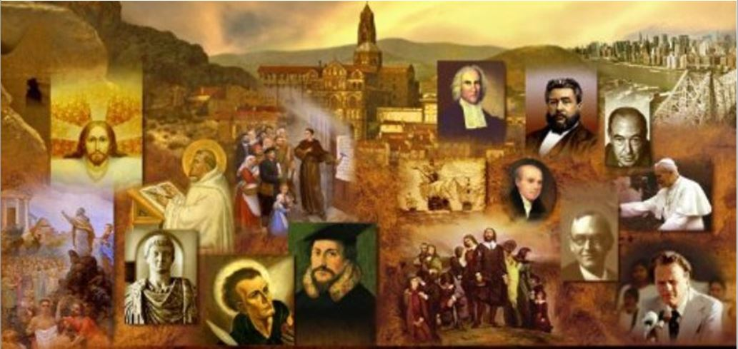
Review
What were the four “schools” of philosophy competing for people’s allegiance at the time of the apostles that we talked about last week?
  Platonism
  Epicureanism
  Stoicism
  Cynicism
Who was Plato’s teacher?
  Socrates
How many of Socrates writings do we have today?
  None. Socrates did not write down any of his ideas all that we know about him, we know because of what others (like Plato) wrote about him.

Slide 3
Review
Who was Plato’s most famous student?
  Aristotle
Plato believed that there were two realities. What were they? Give a brief description of each.
  The ideal, unchanging, eternal realm of God
  The constantly changing world of space and time where we live

Slide 4
Review
What two schools of philosophy that we discussed last week are mentioned in the NT – and where are they mentioned?
  Epicurean and Stoic philosophers are mentioned in Acts 17:17-18 as having interacted with the Apostle Paul when he went to Athens.
The Epicureans taught that pleasure was the supremely desirable quality.
However, they did not define pleasure in terms of physical self-indulgence. How did they define pleasure?
  According to Epicurus, people could achieve true happiness (or pleasure in life) only by a life of quietness, retirement, peace and self-control.

Slide 5
Review
What or who did the Stoics believe was the ultimate cause of all things that happened in history?
  Stoics were basically fatalists who believed that the universe was controlled by a power to which they gave different names – God, Fate, Providence, Reason.
What did the Stoics teach that men must do in order to achieve tranquility?
  Accept what Fate had determined for them and suppress any desires for that which they could not have.
What Christian virtue did Stoics also hold in high regard?
  Stoics called for men to have courage in facing whatever suffering and difficulty that Providence (Fate) had determined that they would face.

Slide 6
Review
How did Cynics view the speculative theories of the academics
  They despised them, believing they had no practical benefit for the individual, but enslaved him with false obligations.
What did Cynics believe concerning such things as wealth, power, sex, and fame?
  They ridiculed luxury and sensual pleasures and idolized poverty.

Slide 7

From Jerusalem to the Ends of the Earth
But you will receive power when the Holy Spirit has come upon you, and you will be my witnesses in Jerusalem and in all Judea and Samaria, and to the end of the earth. (Acts 1:8)
http://wallpaperscristaos.com.br/christianwallpapers/to-the-ends-of-the-earth

Slide 8
*From Jerusalem to the Ends of the Earth
In its first years, Christianity was a religious movement which blossomed exclusively within the confines of Judaism, and revolved around Jerusalem as its spiritual home.
The original followers of Jesus were all Jews, and they had no intention of being anything other than faithful and pious Jews. They continued to worship in the Jerusalem temple, to obey the law of Moses, and to have a negative attitude towards Gentiles.
Yet by the end of the first century, events had transplanted the Church from its original Jewish soil into the Gentile world, where it became an almost exclusively Gentile movement.
This morning we are going to be looking at how this astonishing change took place.
*Needham, Nick. 2,000 Years of Christ's Power Vol. 1: The Age of the Early Church Fathers

Slide 9
*From Jerusalem to the Ends of the Earth
The process of transition began when tensions arose within the early Christian community in Jerusalem between Palestinian Jews, and Jews from a more Hellenistic background.
We find this tension described in Acts 6, where Luke refers to the two parties as, literally, “the Hellenists” and “the Hebrews”.
*Needham, Nick. 2,000 Years of Christ's Power Vol. 1: The Age of the Early Church Fathers

Slide 10
From Jerusalem to the Ends of the Earth
Now in these days when the disciples were increasing in number, a complaint by the Hellenists arose against the Hebrews because their widows were being neglected in the daily distribution. And the twelve summoned the full number of the disciples and said, “It is not right that we should give up preaching the word of God to serve tables. Therefore, brothers, pick out from among you seven men of good repute, full of the Spirit and of wisdom, whom we will appoint to this duty. But we will devote ourselves to prayer and to the ministry of the word.” And what they said pleased the whole gathering, and they chose Stephen, a man full of faith and of the Holy Spirit, and Philip, and Prochorus, and Nicanor, and Timon, and Parmenas, and Nicolaus, a proselyte of Antioch. (Acts 6:1-5)

Slide 11
*From Jerusalem to the Ends of the Earth
Many Jews lived outside Palestine in lands where Hellenistic culture was dominant, such as Egypt and Asia Minor.
So the “Hellenists” of Acts 6 were Jews who had been born in a Hellenistic country and grown up in a Hellenistic culture, speaking Greek as their first language.
These Hellenistic Jews had then either moved into Palestine and settled there, or perhaps were there as pilgrims for the Passover feast.
The chief language spoken in Palestine was Aramaic, not Greek, and Hellenistic Jews would have known little or no Aramaic.
By contrast, the “Hebrews”, were the Jews native to Palestine. They knew some Greek, but Aramaic was their first language.
The Hebrews also had less contact with Hellenistic culture, a culture which some of them despised as Pagan.
*Needham, Nick. 2,000 Years of Christ's Power Vol. 1: The Age of the Early Church Fathers

Slide 12
*From Jerusalem to the Ends of the Earth
This cultural divide between Palestinian and Hellenistic Jews existed before any of them became Christians.
The Palestinian Jews thought of themselves as the true Jews, born and brought up in the Jewish homeland which God had given to their ancestors. They looked on Hellenistic Jews as foreign and corrupted by their contact with Pagan society.
The Hellenistic Jews, on the other hand, tended to think of themselves as being more cultured and civilized than their Palestinian cousins. They regarded the Palestinian Jews as rather narrow-minded, too traditional, and not aware enough of the outside world.
*Needham, Nick. 2,000 Years of Christ's Power Vol. 1: The Age of the Early Church Fathers

Slide 13
*From Jerusalem to the Ends of the Earth
This description of Palestinian and Hellenistic Jews applies only in a general way to what most of them tended to be like. There were exceptions.
The most notable exception was the apostle Paul, who was brought up in the Hellenistic city of Tarsus in Asia Minor, but surpassed even the Palestinian Jews in his intolerant zeal for traditional Judaism, before his Damascus road experience convinced him that Jesus was the Messiah.
*Needham, Nick. 2,000 Years of Christ's Power Vol. 1: The Age of the Early Church Fathers

Slide 14
*From Jerusalem to the Ends of the Earth
As Palestinian and Hellenistic Jews believed the Gospel and became a part of the church, the friction between them continued, despite their common faith in the risen Messiah.
Acts 2:44-45 tells how the early Christian community in Jerusalem cared for its poorer members; the provision of food for Christian widows was part of that system of care, since widows were unable to support themselves economically and depended on others.
However, the Hellenists felt (rightly or wrongly) that the widows from their section of the community were not getting a fair deal.
*Needham, Nick. 2,000 Years of Christ's Power Vol. 1: The Age of the Early Church Fathers

Slide 15
*From Jerusalem to the Ends of the Earth
As we saw in Acts 6, the Hellenists complained that their widows were being overlooked in the distribution of food.
This particular problem was resolved by the appointment of seven men (“deacons”?) whose names are all Greek – an indication that they were elected from the Hellenistic group within the Jesus movement.
But the underlying tensions between Palestinian and Hellenistic believers remained.
*Needham, Nick. 2,000 Years of Christ's Power Vol. 1: The Age of the Early Church Fathers

Slide 16
*From Jerusalem to the Ends of the Earth
The non-traditional attitudes and outlook of the Hellenistic Jewish Christians surfaced in a dangerous way when they began to take a more openly negative, critical stance towards the history and traditions of Israel.
Their spokesman was the Hellenistic “deacon” Stephen, and his lengthy speech recorded in Acts 7 shows us the sort of criticisms that Hellenistic believers could make of Jewish history and tradition.
This provoked and outraged the Jewish authorities, and led to the first great persecution of the Church. Stephen was stoned to death, and many believers were forced to flee from Jerusalem.
*Needham, Nick. 2,000 Years of Christ's Power Vol. 1: The Age of the Early Church Fathers

Slide 17
*From Jerusalem to the Ends of the Earth
This persecution, however, seems mainly to have affected the Hellenistic section of the Church.
The more traditionally minded Palestinian believers, represented by the apostles, were mostly left alone by the Jewish authorities; Luke makes it clear in Acts 8:1 that the apostles were not affected by the persecution.
Ordinary Palestinian believers who were scattered from Jerusalem may have dispersed into other parts of Palestine, and then reassembled in Jerusalem after the trouble had died down, as Acts 11:1-2 seems to indicate.
Hellenistic believers, however, appear to have left Palestine entirely.
*Needham, Nick. 2,000 Years of Christ's Power Vol. 1: The Age of the Early Church Fathers

Slide 18
*From Jerusalem to the Ends of the Earth
From this point onwards the Christian community in Jerusalem was purified of its Hellenistic elements, and became entirely Hebrew and Palestinian in character.
It was led by James, known as “the Lord’s brother” (Gal. 1:19, 2:9), who remained so faithful to Jewish tradition that even unbelieving Jews admired him.
James clearly played a dominant role in the Jerusalem church – see Acts 15 (especially vs. 13ff).
Also known as James the Righteous, he was martyred in AD 62 by the Pharisees.
*Needham, Nick. 2,000 Years of Christ's Power Vol. 1: The Age of the Early Church Fathers

Slide 19
*From Jerusalem to the Ends of the Earth
The scattering of the Hellenistic believers from Palestine was the event which first took the Gospel into the non-Jewish world.
First, the Hellenistic Christians broke through the age-old divide between Jews and Samaritans, as Luke narrates in Acts 8. Philip, one of the Hellenistic “deacons”, was responsible for this bold venture.
The Samaritans were of mixed Jewish and Gentile descent, existing on the borderlands between Judaism and the Gentile world.
*Needham, Nick. 2,000 Years of Christ's Power Vol. 1: The Age of the Early Church Fathers

Slide 20
From Jerusalem to the Ends of the Earth
Now those who were scattered went about preaching the word. Philip went down to the city of Samaria and proclaimed to them the Christ. And the crowds with one accord paid attention to what was being said by Philip when they heard him and saw the signs that he did. For unclean spirits, crying out with a loud voice, came out of many who had them, and many who were paralyzed or lame were healed. So there was much joy in that city… But when they believed Philip as he preached good news about the kingdom of God and the name of Jesus Christ, they were baptized, both men and women… Now when the apostles at Jerusalem heard that Samaria had received the word of God, they sent to them Peter and John, who came down and prayed for them that they might receive the Holy Spirit, for he had not yet fallen on any of them, but they had only been baptized in the name of the Lord Jesus. Then they laid their hands on them and they received the Holy Spirit. (Acts 8:4-8;12;14-17)

Slide 21
*From Jerusalem to the Ends of the Earth
Acts 10 then tells how the centurion Cornelius and his kinsmen became the first Gentile converts in Palestine.
Note that Cornelius is described as a “God-fearer” (Acts 10:2), meaning that prior to his conversion, had already embraced many of the teachings of Judaism.
The first largely Gentile church from a Pagan background was founded outside of Palestine in the Roman province of Syria, in the city of Antioch.
Although Antioch had a big Jewish community, it was basically a vast, throbbing center of Gentile Hellenistic civilization.
Some of the Hellenistic Christian refugees from Jerusalem made their way to Antioch and began preaching the gospel, not only to Jews, but to Pagan Gentiles as well.
*Needham, Nick. 2,000 Years of Christ's Power Vol. 1: The Age of the Early Church Fathers

Slide 22
*From Jerusalem to the Ends of the Earth
Luke records the momentous event in Acts 11:19-21:
  Now those who had been scattered by the persecution in connection with Stephen traveled as far as Phoenicia, Cyprus and Antioch, telling the message only to Jews. Some of them, however, men from Cyprus and Cyrene, went to Antioch and began to speak to Greeks also, telling them the good news about the Lord Jesus. The Lord's hand was with them, and a great number of people believed and turned to the Lord. (Acts 11:19-21 NIV)
In this way the first mainly Gentile church, made up of converts from Paganism, was established in Antioch through the preaching of the scattered Hellenistic believers of Jerusalem.
*Needham, Nick. 2,000 Years of Christ's Power Vol. 1: The Age of the Early Church Fathers

Slide 23
*From Jerusalem to the Ends of the Earth
Acts 11:26 tells us that the term Christian was also first used in Antioch: “And the disciples were first called Christians in Antioch”.
This makes sense, because in a Gentile city like Antioch, where the followers of Jesus were mostly Pagan converts, they would have seemed to the Gentile population to be something other than a Jewish sect.
Prior to this, Christians were still viewed as a sect of Judaism and called themselves by labels such as “followers of the Way” (Acts 9:2, 22:4); their Jewish enemies called them “the sect of the Nazarenes” (Acts 24:5).
By the AD 60s the word “Christian” was widely accepted by all believers in Jesus as a suitable name for themselves: for example, Peter uses the term in 1 Peter 4:16 (which was written around AD 64).
*Needham, Nick. 2,000 Years of Christ's Power Vol. 1: The Age of the Early Church Fathers

Slide 24
*From Jerusalem to the Ends of the Earth
It was from the Gentile church in Antioch that the first organized Christian mission went out, headed by the apostle Paul (Acts 13).
From this point onwards, Paul dominates the events described by Luke in the Book of Acts.
From fanatical Jewish opponent and the foremost persecutor of Jesus’s followers, Paul, through his encounter with the risen Lord on the Damascus road (Acts 9), became Jesus’s most ardent convert and apostle.
*Needham, Nick. 2,000 Years of Christ's Power Vol. 1: The Age of the Early Church Fathers

