Slide 1


Slide 2
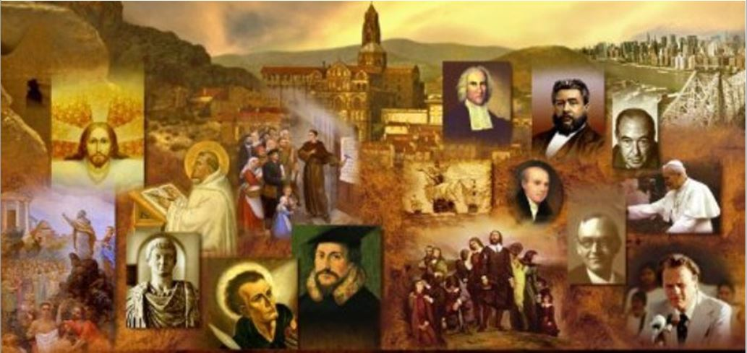
Review
Last time we saw that between the first years of Christianity (around AD 30) and the end of the first century, the church underwent an astonishing ethnic and cultural change. What was that change?
  The original followers of Jesus were all Jews who for some time continued to worship in the Jerusalem temple and follow many of their Jewish customs.
  By the end of the first century, Christianity had become an almost exclusively Gentile movement.

Slide 3
Review
Last time I talked about a tension that existed between two types of Jews in the early church. What are these two groups of Jews called in the NT and what distinguished them from each other?
  “Hebrews” (Palestinian Jews) – grew up in and around Jerusalem speaking mostly Aramaic
  “Hellenists” – born outside of Palestine and grew up in a Hellenistic culture speaking mostly Greek
Where do we see a prominent example of this tension between these two groups described in the NT?
  A disagreement between these two groups over the care of Hellenistic widows is described in Acts 6.

Slide 4
Review
How did the “Hebrews” (Palestinian Jews) see themselves in contrast with the Hellenistic Jews?
  The Palestinian Jews thought of themselves as the true Jews, born and brought up in the Jewish homeland which God had given to their ancestors. They looked on Hellenistic Jews as foreign and corrupted by their contact with Pagan society.
How did the Hellenistic Jews see themselves in contrast with the “Hebrews” (Palestinian Jews)?
  The Hellenistic Jews tended to think of themselves as being more cultured and civilized than their Palestinian cousins. They regarded the Palestinian Jews as rather narrow-minded, too traditional, and not aware enough of the outside world.

Slide 5
Review
When the Jewish authorities began to persecute the early Christians, which of the two Jewish Christian groups (the Hellenists or the Palestinians) seem to have been most affected by it?
  The Hellenistic section of the Church seemed to have been the main target of the persecution – the more traditionally minded Palestinian believers, represented by the apostles, were mostly left alone by the Jewish authorities (Acts 8:1)
What did the Hellenist Christians do as a result of being persecuted by the Jewish authorities in Jerusalem?
  They left Palestine and moved to other areas of the world, carrying the Gospel with them.

Slide 6
Review
What was the first non-Jewish group to receive the gospel and who was it that carried the gospel to them?
  Acts 8 tells us that the Samaritans, who were of mixed Jewish and Gentile descent, heard the gospel from Philip, one of the Hellenist “deacons”.
To what Gentile city did the Hellenistic Christian refugees from Jerusalem carry the Gospel, leading to the establishment of the first largely Gentile church?
  Antioch Syria (Acts 11:19-21)
What distinct role did the city of Antioch play in the spread to the gospel to the rest of the Gentile world?
  It was from Antioch that the first Christian mission went out, headed by the Apostle Paul (Acts 13)

Slide 7
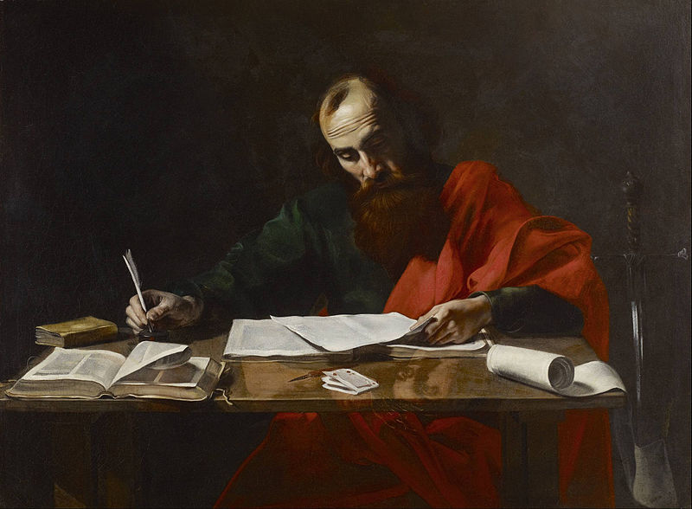
The Apostle Paul
For I am the least of the apostles, unworthy to be called an apostle, because I persecuted the church of God. (1Cor. 15:9).
https://commons.wikimedia.org/wiki/File:Probably_Valentin_de_Boulogne_-_Saint_Paul_Writing_His_Epistles_-_Google_Art_Project.jpg

Slide 8
*The Apostle Paul
No man— other than Jesus, of course— has shaped Christianity more than Saul (or, as Christians came to say, Paul, a name more familiar to the ear of Greek-speaking people). And yet, in the beginning, no one would have seemed a less likely candidate for such a role than Paul.
When Stephen was stoned by his enraged accusers, Saul had stood by giving approval (Acts 7:58 cf. Acts 22:20) .
Soon Saul was leading the charge to drag Christians off to prison (Acts 8:3).
But all that changed one day when Paul was confronted by the Lord outside Damascus. He dropped to the ground blinded by a light when he heard a voice saying: “Saul, Saul, why are you persecuting me?”
Soon after that, Saul became a believer.
So the persecutor of Christians became the persecuted among Christians.
*Shelley, Dr. Bruce L.. Church History in Plain Language: Fourth Edition (p. 21). Thomas Nelson.

Slide 9
*The Apostle Paul
Paul was a leader uniquely qualified to bridge the gap between Jewish and Gentile Christianity.
He was a man of three worlds: Jewish, Greek, and Roman.
Though he had been educated in the strictest Jewish tradition and had studied under the famous rabbi Gamaliel in Jerusalem, Paul spoke Greek fluently and was familiar with Greek thought and literature.
This meant he could express the doctrines and teachings of Jesus, many of which were based on Old Testament beliefs completely foreign to the Gentiles, in ways that the pagan mind could grasp.
In addition, Paul was a Roman citizen, which gave him special freedom of movement, protection in his travels, and access to the higher levels of society. (cf. Acts 22:26-29; 23:27)
*Shelley, Dr. Bruce L.. Church History in Plain Language: Fourth Edition (p. 21). Thomas Nelson.

Slide 10
*The Apostle Paul
It is not necessary for us to review all of Paul’s travels, to which the book of Acts devotes several chapters.
It should suffice to say that, during a number of voyages, first with Barnabas and then with others, Paul took the gospel to
  The island of Cyprus
  To several cities of Asia Minor
  To Greece
  To Rome
  And perhaps—according to a tradition that cannot be confirmed—to Spain.
But to say that Paul took the gospel to those areas is not to imply that he was the first to do so. The letter to the Romans shows that there was already a church in the imperial capital before Paul’s arrival.
*Gonzalez, Justo; The Story of Christianity: Vol. 1: The Early Church to the Dawn of the Reformation; p.33

Slide 11
*The Apostle Paul
Although the New Testament speaks a great deal of Paul and his journeys, there were many others preaching in various regions:
  Barnabas and Mark went to Cyprus (Acts 15:39).
  The Alexandrian Jew Apollos preached in Ephesus and Corinth (Acts 18:24; 19:1).
  The Colossians (and perhaps the Loaodiceans) first heard the Gospel from Epaphras (Col. 1:7-8; 2:1).
  And Paul himself, after complaining that “some preach Christ from envy and rivalry,” rejoiced that Christ was being proclaimed by others (Phil. 1:15,18).
*Gonzalez, Justo; The Story of Christianity: Vol. 1: The Early Church to the Dawn of the Reformation; p.33

Slide 12
*The Apostle Paul
Paul’s greatest and most unique contribution to the shaping of early Christianity was not so much in the actual founding of churches.
Rather, it was in the Letters that he wrote in connection with that activity, since those Letters eventually became part of Christian scripture, and thus have had a decisive and continuing impact on the life and thought of the Christian church.
*Gonzalez, Justo; The Story of Christianity: Vol. 1: The Early Church to the Dawn of the Reformation; p.33

Slide 13
*The Apostle Paul
Paul’s converts were a mixed lot. A few of them were from honorable backgrounds, but the majority were pagans with sordid pasts.
In one of his many letters Paul reminds his readers of their former life: sexually immoral, idolaters, adulterers, homosexuals, thieves, greedy, drunkards, slanderers, and swindlers. (1 Cor. 6:10-11a)
But, says Paul, “You were washed, you were sanctified, you were justified in the name of the Lord Jesus Christ and by the Spirit of our God” (1 Cor. 6: 11, NIV).
What was the best way to instill Christian principles of morality in these churches? That question was at the heart of the continuing tensions between Jewish and Gentile believers in first-century Christianity.
*Shelley, Dr. Bruce L.. Church History in Plain Language: Fourth Edition (p. 22)

Slide 14
*The Apostle Paul
Some of the Palestinian Jews, steeped in traditional Judaism, said, “Unless you are circumcised according to the custom of Moses, you cannot be saved.” (cf. Acts 15:1)
Paul, however, opposed this view. His own experience pointed another way. (Acts 15:2)
Paul tells the Philippians that if a person could gain the righteousness of God by obeying the law, he, as a Jewish Pharisee, would have been the greatest in the kingdom. (Phil. 3:3-10)
But as Paul says in his letter to the Galatians: All who rely on works of the law are under a curse; for it is written, "Cursed be everyone who does not abide by all things written in the Book of the Law, and do them.” Now it is evident that no one is justified before God by the law, for "The righteous shall live by faith." (Gal 3:10-11).
*Shelley, Dr. Bruce L.. Church History in Plain Language: Fourth Edition (p. 22)

Slide 15
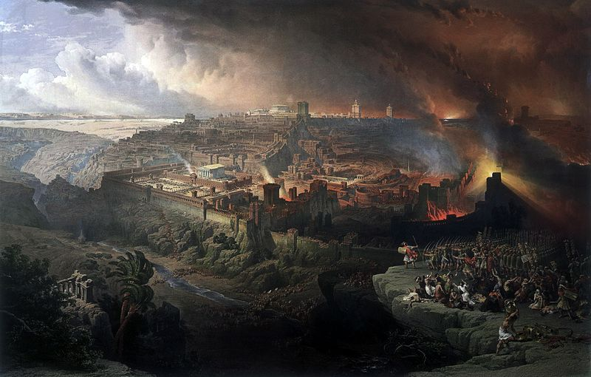
The Decline of Judaism
Israel failed to obtain what it was seeking. The elect obtained it, but the rest were hardened. (Rom 11:7)
https://commons.wikimedia.org/wiki/File:Roberts_Siege_and_Destruction_of_Jerusalem.jpg

Slide 16
*The Decline of Judaism
By that time of Paul’s death (in around AD 64-68), the breach with traditional Judaism was almost complete. Gentile believers:
  Were not circumcised
  Neither knew nor practiced Jewish dietary laws
  And in most areas the Sabbath (seventh day) observance had given way to worship on the first day of the week, the day on which Jesus rose from the dead.
While Paul was gathering Gentile followers throughout the pagan world, the church in Jerusalem continued its strict adherence to Jewish orthodoxy.
*Shelley, Dr. Bruce L.. Church History in Plain Language: Fourth Edition (p. 23)

Slide 17
*The Decline of Judaism
The Jewish persecution of Christians continued during this time:
  In about AD 41, James, the son of Zebedee, long one of Jesus’ closest followers, was murdered by the order of Herod Agrippa I, king of Palestine.
  James’s brother John, “the beloved disciple” who authored five books of the NT, may have then fled Jerusalem.
  Peter was arrested shortly after James’s death, but he escaped and embarked on an extensive missionary journey. He visited Antioch, Corinth, and other cities in Asia Minor. Toward the end of his life he traveled to Rome where he, along with Paul, was caught up in Nero’s persecution and martyred.
  In AD 62 James, “the brother of the Lord,” a devout, law-abiding Jew, who was revered by his followers, was murdered by command of the Jewish high priest. His death left the Jerusalem church leaderless and demoralized.
*Shelley, Dr. Bruce L.. Church History in Plain Language: Fourth Edition (p. 23)

Slide 18
*The Decline of Judaism
Meanwhile, tensions were growing between the Jews and their Roman overlords.
The completion of the Jewish temple in AD 64 put thousands of laborers out of work, adding to the general discontent.
Finally in AD 66 the Jews revolted, signaling their intent by refusing to perform the daily sacrifice for the emperor.
As one account describes it:
  The tragic, bloody war that followed cost more lives than any previous conflict. The Jews held out against overwhelming odds for four years, but they could not withstand the power of Rome. In AD 70 Emperor Vespasian’s forces, led by Titus, broke through the walls of Jerusalem, looted and burned the temple, and carried off the spoils to Rome. The Holy City was totally destroyed. In the reprisals that followed, every synagogue in Palestine was burned to the ground.
*Shelley, Dr. Bruce L.. Church History in Plain Language: Fourth Edition (p. 24)

Slide 19
*The Decline of Judaism
At the start of the Jewish revolt, the Christian Jewish leaders of the Jerusalem church were advised in a vision to flee the city.
Many of the Jews considered the Christian flight from Jerusalem to be an act of treason, and it sealed the fate of the church in the Jewish world.
With the decision to bar Christian Jews from synagogue services some years later, the break was complete.
Any Jew who wished to remain faithful to his religion could not also be a Christian.
The new faith had become and would remain a Gentile movement. The old wineskin was irreparably torn.
*Shelley, Dr. Bruce L.. Church History in Plain Language: Fourth Edition (p. 24)

Slide 20
*The Decline of Judaism
For practical purposes AD 70 and the destruction of Jerusalem mark the end of the apostolic age.
Most of the original apostles were dead, and the churches they had founded had passed into new hands.
Through their tireless activity the Gospel spread throughout the Mediterranean world.
More lasting and resilient than the forces that opposed it, the message of the apostles would endure persecution and opposition, emerging centuries later as the dominant faith of the Roman Empire.
*Shelley, Dr. Bruce L.. Church History in Plain Language: Fourth Edition (p. 24)

Slide 21
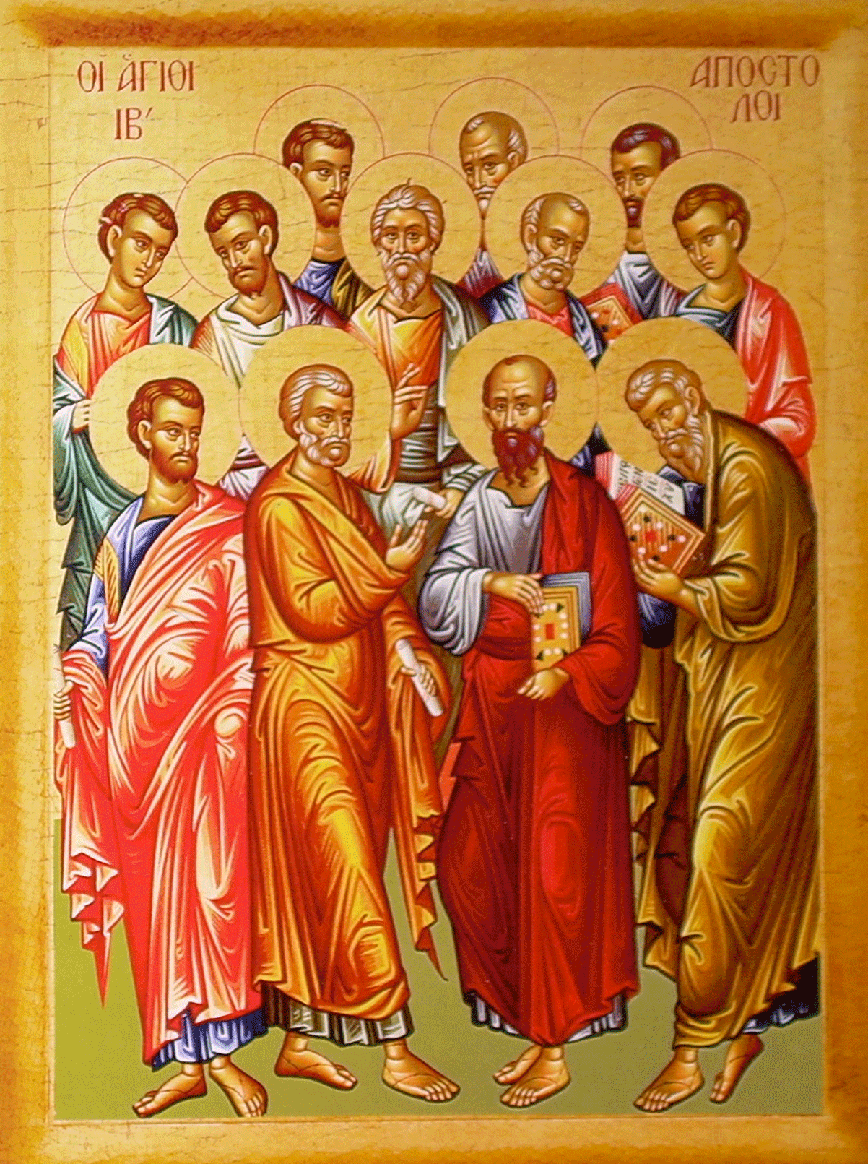
The Apostles:
Facts and Legends
And the wall of the city had twelve foundations, and on them were the twelve names of the twelve apostles of the Lamb. (Rev. 21:14)
https://iconreader.wordpress.com/2010/08/17/how-to-recognize-the-holy-apostles-in-icons

Slide 22
*The Apostles: Facts and Legends
The New Testament tells us very little concerning the career of most of the apostles.
Acts tells of the death of James, the brother of John. But that very book, after following Paul’s career for a number of years, abruptly leaves him while preaching in Rome, awaiting trial.
What became of Paul, Peter, and the other apostles?
*Gonzalez, Justo; The Story of Christianity: Vol. 1: The Early Church to the Dawn of the Reformation; p.36

