Slide 1


Slide 2
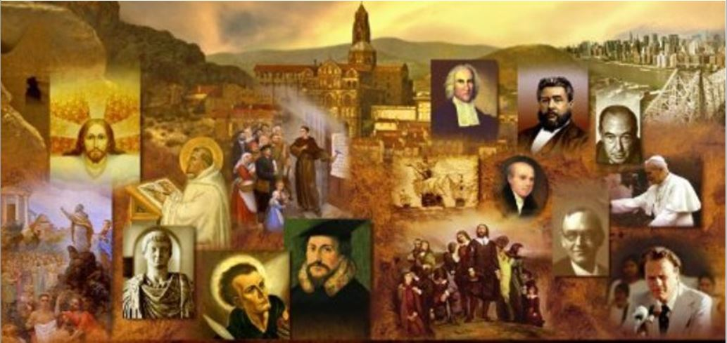
Review
Last time I gave three reasons why the Apostle Paul was uniquely qualified to bridge the gap between Jewish and Gentile Christianity. What were they?
  Paul was a man of three worlds: Jewish, Greek, and Roman:
    He had been educated in the strictest Jewish tradition and had studied under the famous rabbi Gamaliel in Jerusalem. (Acts 22:3)
    He spoke Greek fluently and was familiar with Greek thought and literature. (cf. Acts 17:28)
    He was a Roman citizen, which gave him special freedom of movement, protection in his travels, and access to the higher levels of society. (cf. Acts 22:26-29; 23:27)

Slide 3
Review
We saw how the Apostle Paul carried the Gospel to a number of places throughout the Mediterranean world, as did many other Christians in Paul’s day.
Humanly speaking, what was the Apostle Paul’s other, perhaps most significant, contribution to the formation and shaping of the Christian Church?
  His letters – altogether Paul wrote (at least) 13 of the 27 books of the NT

Slide 4
Review
We have seen that over the course of the first century the Christian church became less and less Jewish and more and more Gentile.
What are some of the ways that Gentile Christians lived differently from the early Jewish Christians in Jerusalem?
  They were not circumcised
  They neither knew nor practiced Jewish dietary laws
  In most areas the Sabbath (seventh day) observance had given way to worship on the first day of the week, the day on which Jesus rose from the dead.

Slide 5
Review
Prior to AD 70, who was the main source of Christian persecution, especially in and around Jerusalem?
  The Jewish authorities
What major event took place in AD 70 that changed everything for Judaism (and Christianity)?
  The Emperor Vespasian’s forces, led by Titus, broke through the walls of Jerusalem, looted and burned the temple, and carried off the spoils to Rome. The remaining Jews were killed or exiled.
What effect did the fall of Jerusalem have on traditional Judaism?
  With their capital and their temple destroyed, the Jews scattered throughout the world were forced to carry on their worship in synagogues.

Slide 6
Review
What effect did the fall of Jerusalem have on Christians?
  Christians lost their “mother church” and their apostolic leaders.
  Many of the Christians living in Jerusalem fled the city in obedience to Jesus’ prophetic warning (Matthew 24:15ff; Luke 21:20-22):
    When you see Jerusalem being surrounded by armies, you will know that its desolation is near. Then let those who are in Judea flee to the mountains, let those in the city get out, and let those in the country not enter the city. For this is the time of punishment in fulfillment of all that has been written. (Luke 21:20-22 NIV)
  Consequently, the Jews came to view Christians as traitors and turncoats, and it sealed the fate of the church in the Jewish world.
  From then on, any Jew who wished to remain faithful to his Judaism could not also be a Christian.

Slide 7
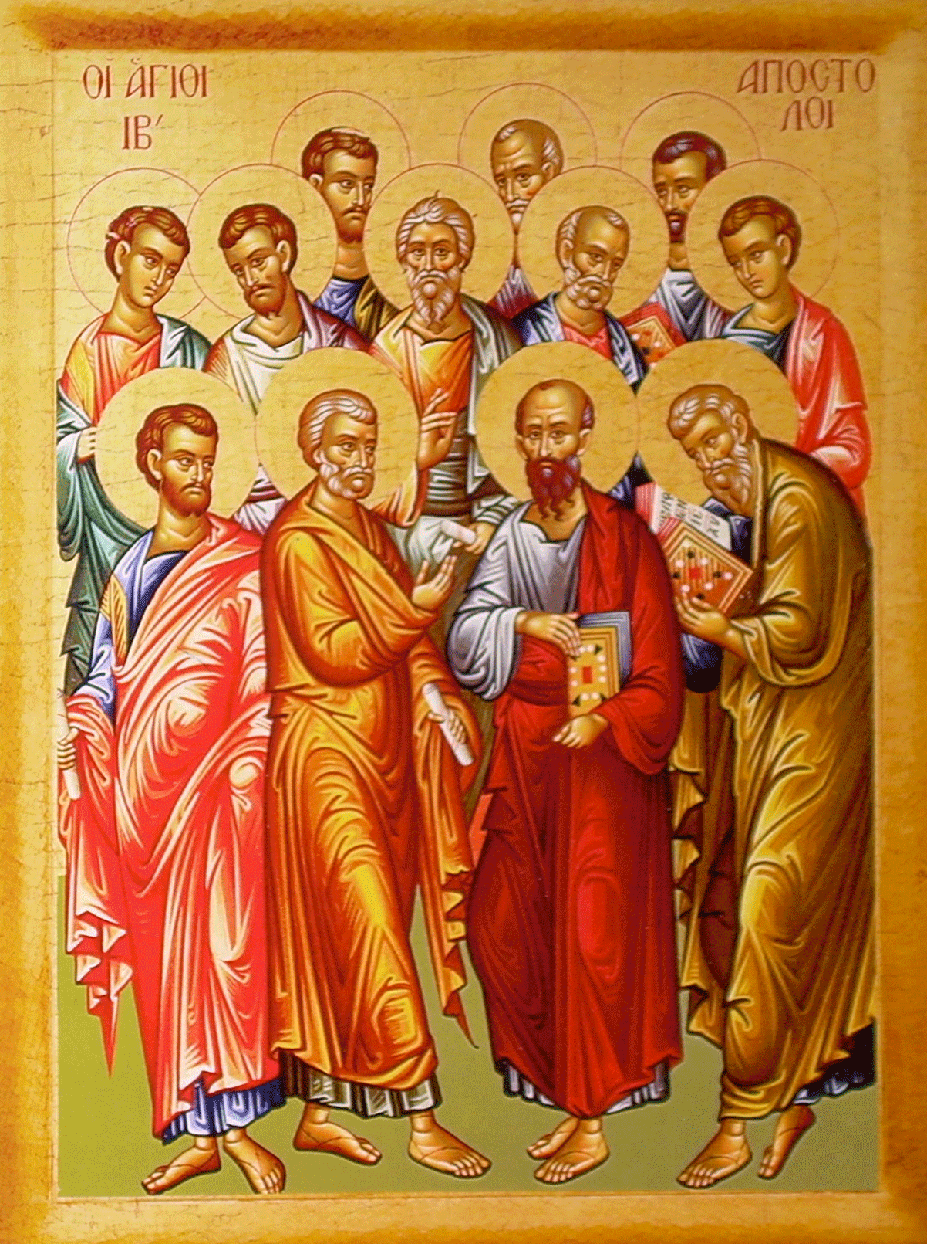
The Apostles:
Facts and Legends
You are… members of the household of God, built on the foundation of the apostles and prophets, Christ Jesus himself being the cornerstone,
(Eph. 2:19-20)
https://iconreader.wordpress.com/2010/08/17/how-to-recognize-the-holy-apostles-in-icons

Slide 8
*The Apostles: Facts and Legends
From an early date, traditions began to appear claiming that one or another of the apostles had preached in a particular region, or had suffered martyrdom in one way or another.
Most of these traditions are nothing more than the result of the desire of a church in a particular city to claim an apostolic origin. Others are more worthy of credit.
Of all these traditions, the most trustworthy is the one that affirms that Peter was in Rome, and that he suffered martyrdom in that city during Nero’s persecution. On these points, several writers of the first and second centuries seem to agree.
*Gonzalez, Justo; The Story of Christianity: Vol. 1: The Early Church to the Dawn of the Reformation; p.36

Slide 9
*The Apostles: Facts and Legends
We are also told that Peter was crucified—according to one version, upside-down—and this seems to be implied by the otherwise obscure words in John 21:18-19:
  [Jesus speaking:] “Truly, truly, I say to you, when you were young, you used to dress yourself and walk wherever you wanted, but when you are old, you will stretch out your hands, and another will dress you and carry you where you do not want to go.” (This he said to show by what kind of death he was to glorify God.) (John 21:18-19)
*Gonzalez, Justo; The Story of Christianity: Vol. 1: The Early Church to the Dawn of the Reformation; p.36

Slide 10
*The Apostles: Facts and Legends
The case of Paul is somewhat more complex.
The book of Acts leaves him while preaching in Rome. Ancient writers agree that he died in Rome—probably beheaded, as befitted a Roman citizen—at the time of Nero.
But others say that he undertook some journeys that are not mentioned in Acts, including one trip to Spain.
Some have tried to combine these two traditions by supposing that Paul went to Spain between the end of Acts and his death at the hands of Nero. But there are chronological difficulties with this view.
At best, all that can be said is that nothing is known for certain between the end of the book of Acts and Paul’s death during the reign of Nero.
*Gonzalez, Justo; The Story of Christianity: Vol. 1: The Early Church to the Dawn of the Reformation; p.36

Slide 11
*The Apostles: Facts and Legends
The task of reconstructing John’s later career is complicated by the frequency with which the name of John appears in early records.
There is an ancient tradition that claims that John was killed in a pot of boiling oil.
But the book of Revelation places John, at about the same time, in exile on the island of Patmos.
Another very trustworthy tradition speaks of John as a teacher at Ephesus, where he died around the year 100.
*Gonzalez, Justo; The Story of Christianity: Vol. 1: The Early Church to the Dawn of the Reformation; p.36

Slide 12
*The Apostles: Facts and Legends
The Christian historian, Eusebius (AD 260-340) gives us two accounts of the martyrdom of the Apostle James (half brother of Christ and author of the book of James):
  An account by the Jewish historian, Josephus (AD 30-100) which says that the high priest Ananus had James stoned to death, but that the people revolted against him as a result.
  An account by an early Christian writer named Hegesippus (AD 100-180) which says that James was noted for his piety and constant prayers in the temple. He was called “camel knees” and was respected by Christians an Jews alike. But that eventually the Jewish leaders threw him down from a pinnacle of the temple and as he still lived, they began to stone him, and then finally he was clubbed to death.
* Eusebius of Caesarea, History of the Church, Book 2, chapter 23

Slide 13
*The Apostles: Facts and Legends
Late in the second century, a development took place that greatly hinders the task of the historian trying to determine what actually happened in the later career of the apostles: churches in every important city began claiming apostolic origins:
  In its rivalry with Rome and Antioch, the church in Alexandria felt the need to have a founder with apostolic connections, and thus the tradition appeared that Saint Mark had founded the church there.
  Likewise, when Constantinople became a capital city in the empire, its church too needed apostolic roots, and thus it was claimed that Philip had preached in Byzantium, the ancient site on which Constantinople was later built.
*Gonzalez, Justo; The Story of Christianity: Vol. 1: The Early Church to the Dawn of the Reformation; p.37

Slide 14
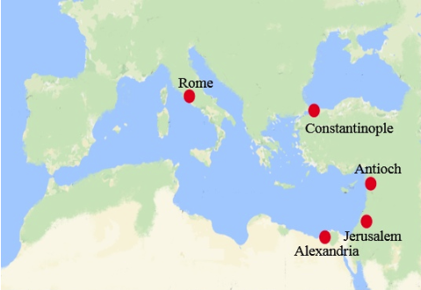
The Apostles: Facts and Legends
https://churchages.net/en/study/the-church-ages-thyatira-the-fourth-age-606-ad-1520-ad

Slide 15
*The Apostles: Facts and Legends
There are other traditions regarding apostolic activities that are worthy of note, if not for their truthfulness, at least for their popularity and their significance for later history.
This is particularly true of the traditions regarding the origins of Christianity in Spain and in India.
Christians in Spain have claimed that their land was evangelized, not only by Paul, but also by James, half brother of our Lord and author of the NT book of James.
*Gonzalez, Justo; The Story of Christianity: Vol. 1: The Early Church to the Dawn of the Reformation; pp.37-38

Slide 16
*The Apostles: Facts and Legends
According to this tradition, James supposedly proclaimed the gospel in parts of Spain, without much success.
On his way back, the Virgin Mary supposedly appeared to him standing on a pillar, and gave him words of encouragement. This is the origin of the Virgen del Pilar, still venerated by many in the Spanish tradition.
*Gonzalez, Justo; The Story of Christianity: Vol. 1: The Early Church to the Dawn of the Reformation; pp.37-38

Slide 17
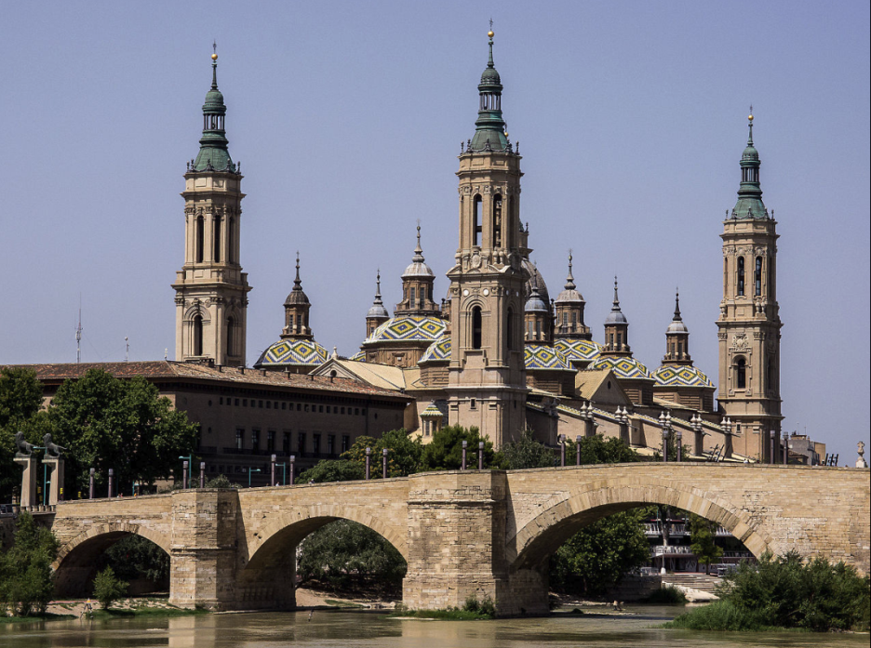
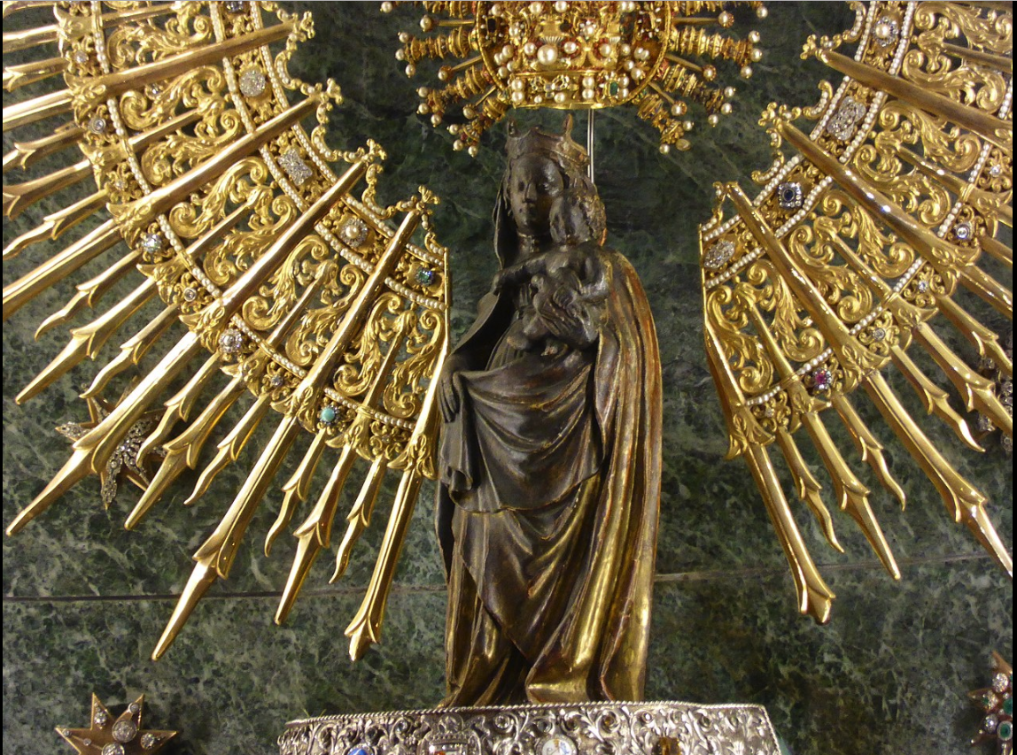
Virgen del Pilar
https://en.wikipedia.org/wiki/Our_Lady_of_the_Pillar

Slide 18
*The Apostles: Facts and Legends
According to this tradition, James supposedly proclaimed the gospel in parts of Spain, without much success.
On his way back, the Virgin Mary supposedly appeared to him standing on a pillar, and gave him words of encouragement. This is the origin of the Virgen del Pilar, still venerated by many in the Spanish tradition.
Then, according to this tradition, James, upon his return to Jerusalem, was beheaded by Herod, and his disciples took his remains back to Compostela in Spain, where they are supposedly buried to this day.
*Gonzalez, Justo; The Story of Christianity: Vol. 1: The Early Church to the Dawn of the Reformation; pp.37-38

Slide 19
*The Apostles: Facts and Legends
This legend has been of great significance for the later history of Spain, for Saint James (in Spanish: “Santiago”) became the patron saint of the nation.
During the wars against the Moors, Santiago was often the battle cry to which various small kingdoms would rally.
At the same time, pilgrimages to the shrine of Saint James in Compostela played an important role both in European religiosity and in the unification of northern Spain.
Thus, although it is highly unlikely that James ever gave any thought to Spain, the legends regarding his visit were very influential in the later history of that country.
*Gonzalez, Justo; The Story of Christianity: Vol. 1: The Early Church to the Dawn of the Reformation; pp.37-38

Slide 20
*The Apostles: Facts and Legends
The tradition that claims Thomas visited India leaves historians somewhat baffled.
This tradition appears for the first time in the Acts of Thomas, a gnostic document which may have been written as early as the end of the second century.
But it is embellished with legendary tales that make the entire account suspicious.
We are told that an Indian king, Gondophares, was seeking an architect to build a palace, and that Thomas, who was no architect, offered himself for the job.
*Gonzalez, Justo; The Story of Christianity: Vol. 1: The Early Church to the Dawn of the Reformation; p. 38

Slide 21
*The Apostles: Facts and Legends
When the king found out that Thomas was giving the money allotted for the construction to the poor of the palace, he had the apostle put in prison.
But then, according to the legend, Gondophares’s brother, Gad, died, came back from the dead, and told his brother of a magnificent heavenly palace that he had seen, which was being built through Thomas’s gifts to the poor.
The king was then converted and baptized, and Thomas moved on to other parts of India, until he eventually died as a martyr.
*Gonzalez, Justo; The Story of Christianity: Vol. 1: The Early Church to the Dawn of the Reformation; p. 38

Slide 22
*The Apostles: Facts and Legends
Historians believe that much in this legend is of questionable authenticity, and have often discarded it as completely as fictitious.
In recent years, however, coins have been found that prove that there was indeed a ruler by that name, and that he had a brother named Gad.
This, coupled with the undeniable antiquity of Christianity in India, and with the fact that, at the time, there was significant trade between India and the Near East, makes it more difficult to reject categorically the possibility that Thomas may have visited that land, and that the story may have been embellished with all kinds of legendary details later.
In any case, it is significant that from a relatively early date there was a church in India, and that this church has long claimed Thomas as its founder.
*Gonzalez, Justo; The Story of Christianity: Vol. 1: The Early Church to the Dawn of the Reformation; p. 38

Slide 23
*The Apostles: Facts and Legends
In conclusion, it is certain that some of the apostles—particularly Peter, John, and Paul—did travel proclaiming the gospel and supervising the churches that had been founded, either by them or by others.
Perhaps other apostles, such as Thomas, did likewise.
But most of the traditions regarding apostolic travels date from a later period, when it was believed that the apostles divided the world among themselves, and when the church in each country or city sought to claim apostolic origins.
In truth, most missionary work was not carried out by the apostles, but rather by the countless and nameless Christians who for different reasons—persecution, business, or missionary calling—traveled from place to place taking the news of the gospel with them.
*Gonzalez, Justo; The Story of Christianity: Vol. 1: The Early Church to the Dawn of the Reformation; pp.38-40

Slide 24
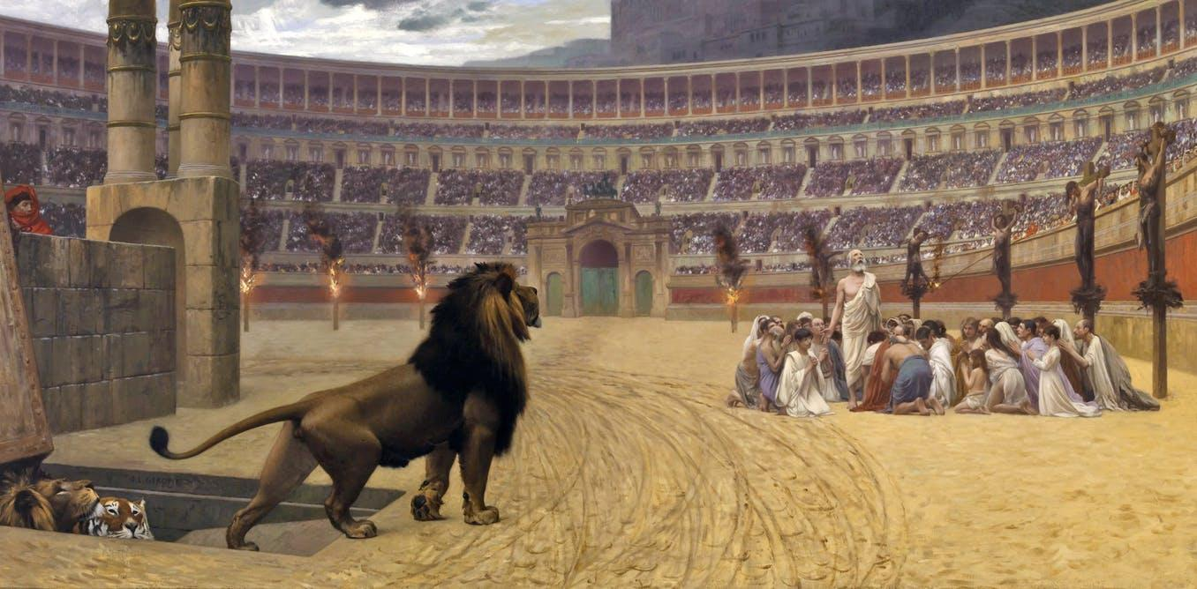
First Conflicts With the State
I know that you have but little power, and yet you have kept my word and have not denied my name
(Rev 3:8)
https://www.sutori.com/story/world-religions-christianity-7ba5

Slide 25
*First Conflicts With the State
From its very beginnings, Christianity was no easy matter:
  The Lord whom Christians served had died on the cross, condemned as a criminal.
  Soon thereafter Stephen was stoned to death following his witness before the Council of the Jews.
  Then James was killed at Herod Agrippa’s order.
  Ever since then, and up to our own days, there have been those who have had to seal their witness with their blood.
We have seen that the earliest persecution of Christians occurred at the hands of the Jewish authorities.
In this section, we will begin exploring the persecution that Christians began to experience at the hand of the Roman authorities.
*Gonzalez, Justo; The Story of Christianity: Vol. 1: The Early Church to the Dawn of the Reformation; p.41

