Slide 1


Slide 2
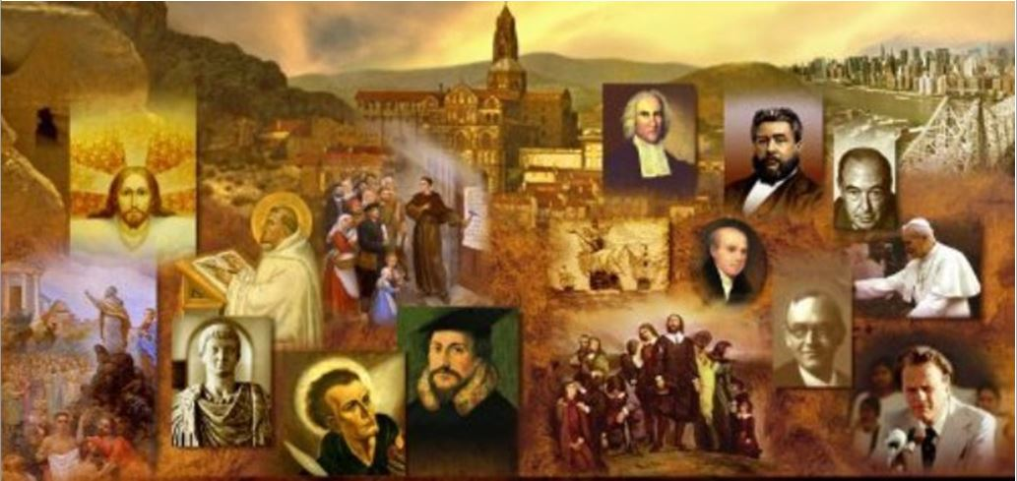
Review
Martin Bucer was a theological giant, but, historically, he has become almost totally eclipsed by whom?
John Calvin
How did John Calvin’s social background compare with Luther’s (financially)?
His background was more “upper class” than Luther’s
What two vocations was Calvin trained for (at his father’s behest) and what languages did he learn in the process?
Priest and then lawyer
Latin, Greek, and Hebrew
What was the original context in which Calvin wrote the Institutes of the Christian Religion?
It was written along with an open letter to Francis I, the Catholic king of France, to defend his persecuted Protestant brothers, and set forth the essence of the Protestant teaching.

Slide 3
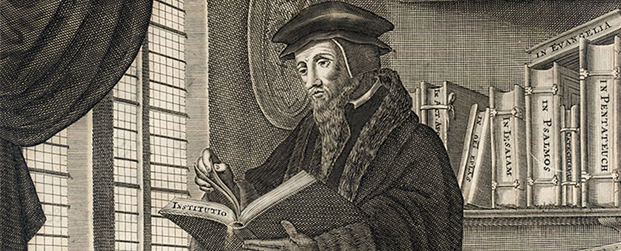
John Calvin’s Theology
https://faculty.wts.edu/posts/why-pastors-should-engage-calvins-institutes-of-the-christian-religion/

Slide 4
John Calvin’s View of the Gospel
The basic theology of the Institutes was the Reformation gospel of salvation by God’s grace alone through faith alone in Christ alone.
Like Luther, Zwingli, and the other Magisterial Reformers, Calvin was a disciple of Augustine, and taught a strongly Augustinian doctrine of humanity’s helpless bondage to sin, and the absolute sovereignty of God’s grace in predestination and salvation.
Many people today associate the doctrine of predestination with Calvin in particular, as if he invented it, but this is a very serious misunderstanding of Church history.
Needham, Nick. 2,000 Years of Christ's Power Vol. 3: Renaissance and Reformation

Slide 5
John Calvin’s View of the Gospel
Most of the great Western theologians of the Middle Ages held a form of Augustinianism, and all the leading Protestant theologians of the Magisterial Reformation stood with Calvin in teaching the doctrine of God’s sovereignty in salvation – because they had all alike drunk deeply from the fountain of Augustine’s writings.
Indeed, many loyal Roman Catholics in the 16th century were convinced Augustinians in their theology.
What divided the Protestant and Roman Catholic Augustinians was their differing views of the Church, and it was in this area that Calvin made his outstanding contribution to the Reformation.
Needham, Nick. 2,000 Years of Christ's Power Vol. 3: Renaissance and Reformation

Slide 6
John Calvin’s View of the Church
Three main views on the Church had come to dominate the minds of those who were living through the upheavals of the Reformation:
The Roman Catholic View
The Lutheran View
The Anabaptist View
Needham, Nick. 2,000 Years of Christ's Power Vol. 3: Renaissance and Reformation

Slide 7
John Calvin’s View of the Church
The Roman Catholic View:
Roman Catholics saw the Church as the outward and visible organization governed by the papacy, in which life-giving grace flowed through the sacraments administered by the Roman Catholic priesthood.
The Church was separate from the state and independent of state control, but entered into partnership with the state in order to create a Christian society.
Needham, Nick. 2,000 Years of Christ's Power Vol. 3: Renaissance and Reformation

Slide 8
John Calvin’s View of the Church
The Lutheran View:
Lutherans defined the Church as the spiritual body of all who were truly united to Christ by personal faith – a body infallibly known to God alone, and thus invisible to human eyes, with Christ alone as its head.
The outward and visible Church of professing Christians and their children was characterized by:
The preaching of the gospel
The administration of the genuine New Testament sacraments of baptism and eucharist,
The church was governed by the state – the Christian king, prince, or city council.
The power of excommunication belonged to the Christian state, not to the Church.
Needham, Nick. 2,000 Years of Christ's Power Vol. 3: Renaissance and Reformation

Slide 9
John Calvin’s View of the Church
The Anabaptist View:
Anabaptists saw the Church as the visible congregational fellowship of the redeemed, made up exclusively of those who had experienced conversion, to which they testified by believers’ baptism and the Lord’s Supper.
It was kept pure by the exercise of Church discipline, ultimately by the power of excommunication which belonged to the local congregation.
The Church was separate from the state, and must never enter into any partnership with the state.
Needham, Nick. 2,000 Years of Christ's Power Vol. 3: Renaissance and Reformation

Slide 10
John Calvin’s View of the Church
Calvin rejected all three views, but borrowed elements from all three in forming his own understanding.
He was not alone in his thinking here; Martin Bucer had already set forth most of what Calvin was to say.
Calvin, however, said it with greater force, and more importantly, was able to put his and Bucer’s ideal into practical effect in Geneva, something Bucer had never managed to achieve in Strasbourg.
But when we talk about Calvin’s view, we should keep in mind that Calvin was building on foundations laid by Bucer.
Needham, Nick. 2,000 Years of Christ's Power Vol. 3: Renaissance and Reformation

Slide 11
John Calvin’s View of the Church
Calvin agreed with Luther that the true Church was the spiritual body of all true believers, infallibly known to God alone.
But he agreed with Rome that the outward visible Church was of supreme practical importance, and must enter into partnership with the state in order to build a Christian society – Calvin accepted the concept of the Christian state.
However, he also agreed with Rome and the Anabaptists that the institutional Church was independent of the state and should not be controlled by it.
And he agreed with the Anabaptists that the power of excommunication belonged to the Church, not to the Christian state and that the Church must exercise a strong internal discipline to ensure that its members were made up of those who professed the true faith and lived a Christian life.
Needham, Nick. 2,000 Years of Christ's Power Vol. 3: Renaissance and Reformation

Slide 12
John Calvin’s View of the Church
This Bucer–Calvin view of Church and state, and the relationship between them, constituted a distinctive and powerful force within the Magisterial Reformation.
It saved most of the Reformed Churches from becoming merely departments of state, politically controlled – the condition into which the “statist” Lutheran Churches had drifted.
In Bucer’s and Calvin’s thought, as in Roman Catholicism, the Church once again stood forth as a divinely ordained, free, independent society, with its own God-given laws and officers.
This time, however, the Church was a Protestant body, with no pope, acknowledging Christ as its only Head, submitting to Scripture alone, and teaching justification by faith alone.
Needham, Nick. 2,000 Years of Christ's Power Vol. 3: Renaissance and Reformation

Slide 13
John Calvin’s View of the Church
Calvin maintained that there were four permanent offices in the New Testament Church: pastor, teacher, elder, and deacon.
The pastors led the public services of worship; their chief duties were expounding the Scriptures to a congregation, administering the two Protestant sacraments of baptism and the Lord’s Supper, and exercising Church discipline together with the elders.
Normally there would only be one pastor, but in larger congregations Calvin was quite happy to see several pastors sharing the work.
The teachers (or “doctors”) were responsible for instructing people in Christian doctrine:
The young who were in school
Those training for the ministry in theology colleges.
The teachers took no part in Church discipline.
Needham, Nick. 2,000 Years of Christ's Power Vol. 3: Renaissance and Reformation

Slide 14
John Calvin’s View of the Church
By contrast with the teachers, the function of the elders was to help the pastors exercise moral discipline within congregations.
All the pastors and elders of all the churches in a recognized district (e.g. a city) would meet as a “consistory”, and together exercise a general spiritual oversight over the affairs of all their churches.
The consistory had the ultimate power of being able to excommunicate for heresy or sinful conduct.
In Calvin’s thinking, then, the oversight of the Church was in the hands of presbyters – pastors, teachers, elders; and all the congregations of a particular region were subject to the authority of all their pastors and elders meeting together as a consistory.
This form of Church government came to be called Presbyterianism.
Needham, Nick. 2,000 Years of Christ's Power Vol. 3: Renaissance and Reformation

Slide 15
John Calvin’s View of the Church
The fourth office of deacons did not share in ruling the Church by teaching or discipline.
Calvin distinguished between two kinds of deacon:
The first type managed the congregation’s funds;
The second type looked after the poor and sick, administering a system of Christian social care (including medical care in hospitals).
All those nominated for any of the four offices of pastor, teacher, elder, and deacon required the approval of a congregation before they could assume their responsibilities within it.
Needham, Nick. 2,000 Years of Christ's Power Vol. 3: Renaissance and Reformation

Slide 16
John Calvin’s View of the Church
Calvin believed that the most scriptural method by which a congregation expressed its approval of candidates for church office was by electing them democratically.
As a result, lay members of Reformed Churches were far more active, and took more responsibility in congregational affairs, than the Lutheran laity did in their state-controlled Churches.
Some historians have argued that we can trace some of the roots of modern democracy back to Calvin’s pattern of Church government.
Certainly Calvin had outlined a system of ecclesiastical organization which would enable the Reformed Churches to function successfully in the most adverse conditions.
He helped to raise up a whole new generation of heroic, pioneering Protestants who did not rely on state support, but could govern themselves and spread their faith even when the political authorities were fiercely hostile.
Needham, Nick. 2,000 Years of Christ's Power Vol. 3: Renaissance and Reformation

Slide 17
John Calvin’s View of Communion
Calvin’s differences with Luther over the doctrine of the Church extended to their views on holy communion.
Building once again on foundations laid by Bucer, Calvin agreed with Zwingli that Christ’s flesh and blood were not physically present in the bread and wine; “This is My body” meant “This signifies My body.”
He also agreed with Zwingli that Luther’s Christology was wrong.
Christ could not be everywhere in His human body, as Luther argued; the risen body of the Savior was in one definite place, heaven, where it would remain until the second coming.
Needham, Nick. 2,000 Years of Christ's Power Vol. 3: Renaissance and Reformation

Slide 18
John Calvin’s View of Communion
However, Calvin agreed with Luther that in the eucharist there was a real reception of Christ’s body and blood.
Unlike Luther, Calvin understood this reception to take place through faith alone, so that only the believer partook of Christ; the unbeliever received only bread and wine.
For Calvin, Christ was present in the Lord’s Supper not physically in the bread and wine (as Luther said), nor in His divine nature alone (as Zwingli said), but in the power of the Holy Spirit.
As the mouths of believers received the sacramental signs (bread and wine), the Spirit fed their souls with the things signified (the body and blood of the crucified and risen Christ).
Needham, Nick. 2,000 Years of Christ's Power Vol. 3: Renaissance and Reformation

Slide 19
John Calvin’s View of Communion
Bucer and Calvin’s non-Zwinglian view of the real eucharistic presence of Christ’s body and blood through the Spirit became the standard Reformed doctrine.
It is found in all the Reformed confessions of faith, including:
The Thirty-Nine Articles of the Church of England (article 28),
The Westminster Confession (chapter 29, section 7),
The 1689 London Baptist Confession (chapter 30, section 7).
Naturally, holding so positive a view of the believer’s communion with Christ in the Lord’s Supper, Calvin argued that the Supper was an integral part of normal Sunday worship.
Hence, he wanted it to be celebrated with great frequency – “at least once a week” (Institutes 4:17:43).
Needham, Nick. 2,000 Years of Christ's Power Vol. 3: Renaissance and Reformation

Slide 20
John Calvin’s View of Communion
Calvin was never able to get his way on this in Geneva, owing mostly to opposition from the city magistrates, who did not want the awesome power of excommunication to receive the high profile which weekly communion would inevitably give it.
However, Calvin’s clearly expressed ideal was that the Lord’s Supper should be celebrated whenever the local church gathered for worship.
Needham, Nick. 2,000 Years of Christ's Power Vol. 3: Renaissance and Reformation

Slide 21
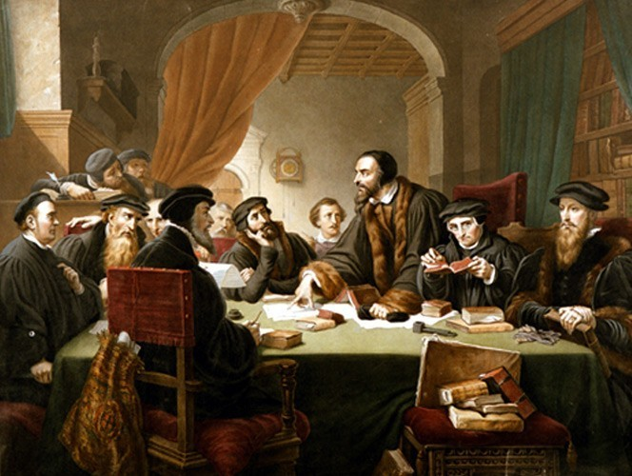
Calvin the Reformer of Geneva 1536-1538
https://www.museeprotestant.org/en/notice/portraits-of-calvin/

Slide 22

Class Discussion Time
https://www.weareteachers.com/moving-beyond-classroom-discussions/

Slide 23
*Class Discussion Time
In Calvin’s ecclesiology, all the pastors and elders of all the churches in a recognized district (e.g. a city) would meet as a “consistory”, and together exercise a general spiritual oversight over the affairs of all their churches.
Assuming that you disagree with this form of ecclesiology, what biblical argument would you make against this kind of arrangement?
Furthermore, Calvin believed that it was the consistory that had the ultimate power of being able to excommunicate for heresy or sinful conduct. Is this biblical? Why or why not?
What are your thoughts on Bucer and Calvin’s non-Zwinglian view – a view later endorsed by nearly all of the Reformed Confessions of faith – that, as the mouths of believers receive the “sacramental signs” (bread and wine), the Spirit “feeds their souls” with the body and blood of the crucified and risen Christ?
Calvin thought the Lord’s Supper should be celebrated at least once a week. What do you think, and why?
Do you have a topic or question that you would like to see us to discuss?

