Slide 1


Slide 2
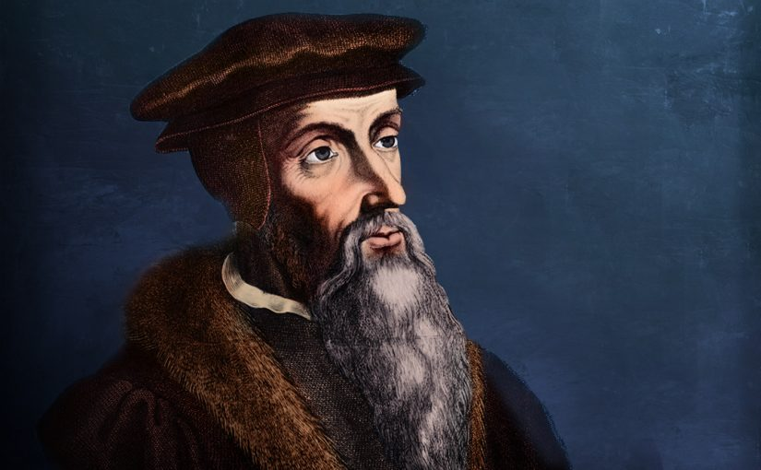
Summary of Calvin’s Achievements
https://www.ets.ac.uk/engage/17-john-calvin/

Slide 3
Summary of Calvin’s Achievements
Calvin produced a great number of important writings during his second period in Geneva.
  He continued to revise and enlarge the Institutes until it reached its final form in 1559.
  He wrote the Genevan Catechism of 1541, a catechism for the Church in Geneva, which had great influence over other Reformed catechisms.
  Calvin wrote commentaries on 24 of the 39 books of the OT and 24 of the 27 books of the NT.
  Many of his sermons, too, were written down by a secretary as Calvin preached them, and were then published, with the result that we sometimes have both a commentary and a series of sermons by Calvin on the same books of the Bible.
  He also produced a host of writings against the various enemies of the Reformed faith.
Needham, Nick. 2,000 Years of Christ's Power Vol. 3: Renaissance and Reformation

Slide 4
Summary of Calvin’s Achievements
Calvin’s work was done against a background of chronic ill-health:
  Arthritis
  Migraine headaches
  Bleeding from the stomach
  Bowel disorders, hemorrhoids
  Inflamed kidneys and kidney stones
  Fever
  Muscle cramps
  Gout
Yet this sick man achieved more in one lifetime than most healthy people could encompass in a hundred.
Needham, Nick. 2,000 Years of Christ's Power Vol. 3: Renaissance and Reformation

Slide 5
Summary of Calvin’s Achievements
Calvin provided the Reformed Churches with a clear, deep, solid theology.
Calvin gave the Reformed movement a pattern of Church government which mobilized the laity and enabled Reformed believers to survive, organize, and flourish despite state opposition and persecution.
He showed the world a city – Geneva – which embodied the Reformed faith and lived it out. The infectious power of Geneva’s example inspired others to reform their communities as Calvin had reformed his.
Needham, Nick. 2,000 Years of Christ's Power Vol. 3: Renaissance and Reformation

Slide 6
Summary of Calvin’s Achievements
Calvin fashioned the Reformed faith into an international movement, with a sense of brotherhood which crossed national boundaries. From Geneva, Calvin kept up a vast correspondence with Reformed leaders throughout Europe, advising, encouraging, exhorting, rebuking.
He made the Reformed faith into the great Protestant “missionary” movement of the 16th century. Geneva was an international training center for Reformed pastors, preachers, theologians and missionaries.
The Genevan Academy, founded by Calvin in 1559 and headed by the psalm-translator Theodore Beza (who was also a distinguished theologian), attracted students from all over Europe.
The Academy began with 162 students; within six years, the number had rocketed to more like 1,600.
Needham, Nick. 2,000 Years of Christ's Power Vol. 3: Renaissance and Reformation

Slide 7
Guest Speaker!
Sermon text:
2 Timothy 1:8-9
https://www.ets.ac.uk/engage/17-john-calvin/

