Slide 1


Slide 2
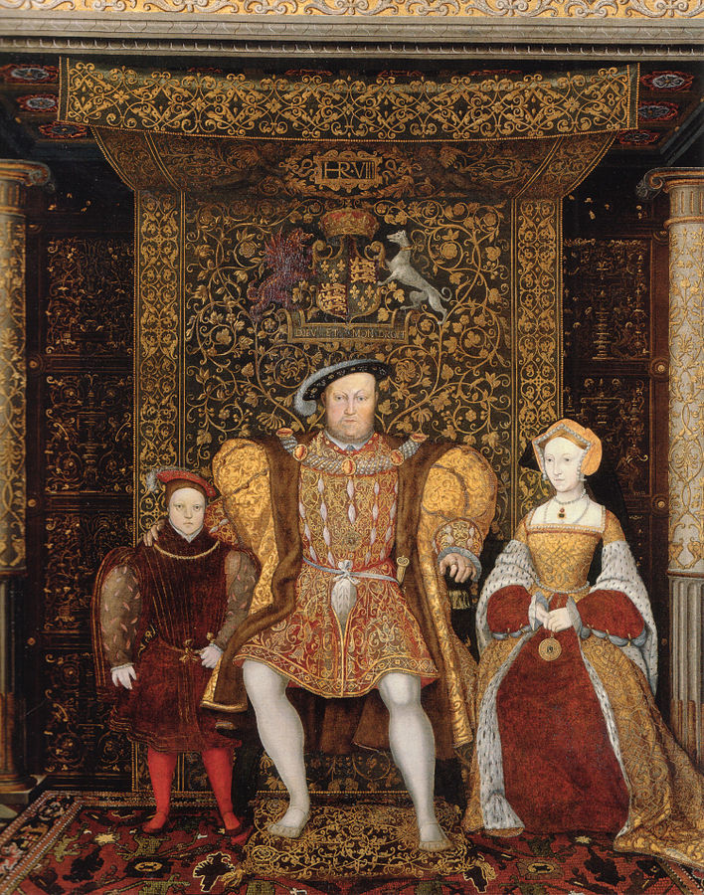
The Dawn of the
English Reformation
https://commons.wikimedia.org/wiki/File:Family_of_Henry_VIII_c_1545_detail.jpg

Slide 3
The Dawn of the English Reformation
The English Reformation began with two strands:
  On the one hand, there was a political Reformation in which the English monarchy under King Henry VIII, threw off its loyalty to Rome.
  On the other hand, there was a spiritual Reformation going on in England for number of years prior to Henry VIII’s break with Rome.
The spiritual Reformation began first, as Lutheran books and ideas began to penetrate England, especially the capital city London.
There was already a thriving Lollard underground movement in London, and these disciples of John Wyclif eagerly seized on the new Lutheran revolt against Rome and made it their own.
Needham, Nick. 2,000 Years of Christ's Power Vol. 3: Renaissance and Reformation

Slide 4
The Dawn of the English Reformation
Old Lollardy and new Protestantism began to merge together in England around the time that William Tyndale’s English New Testament began circulating in 1525-26.
Humanists at Cambridge University also felt attracted to Luther; a group met regularly in the White Horse Inn to discuss the German Reformer’s ideas (the group was nicknamed “Little Germany”).
Among this group were the leaders of the first generation of England’s Protestants: Robert Barnes, Thomas Bilney, Thomas Cranmer, John Frith, and Hugh Latimer, all of whom were eventually burned as martyrs for their Protestant faith.
Needham, Nick. 2,000 Years of Christ's Power Vol. 3: Renaissance and Reformation

Slide 5
https://i2.wp.com/renewaljournal.com/wp-content/uploads/2014/10/tyndale.jpg?ssl=1

Slide 6
William Tyndale
The greatest of the early English Protestants was not a member of the Cambridge group – William Tyndale (1495-1536).
Tyndale was a priest and university-trained linguist (educated at Oxford), whose religious views were at an advanced stage before 1522, under Erasmus’s influence. It is not known exactly when he became a protestant.
Early on, Tyndale conceived it to be his mission to translate the Bible into English from the original Greek and Hebrew, and to give it to the common people as the surest way of overthrowing Roman Catholic error.
Needham, Nick. 2,000 Years of Christ's Power Vol. 3: Renaissance and Reformation

Slide 7
William Tyndale
A contemporary of Tyndale records the famous incident that stiffened Tyndale’s commitment to his mission:
  Master Tyndale happened to be in the company of a learned man, and in communing and disputing with him … the learned man said, we were better without God’s law than the pope’s.
  Master Tyndale, hearing that, answered him, “I defy the pope and all his laws,” and said, “If God spare my life ere many years, I will cause a boy that driveth the plough shall know more of the scripture than thou dost.”
Tyndale began his life’s work in London in 1523; the Protestant merchant, Humphrey Monmouth, acted as his patron.
Opposed, however, by the English Church authorities, Tyndale sailed to the Continent and lived the rest of his life an exile in Germany and the Netherlands.
Needham, Nick. 2,000 Years of Christ's Power Vol. 3: Renaissance and Reformation

Slide 8
William Tyndale
Tyndale’s English New Testament was first published in 1525 at Worms, and thousands of copies were smuggled into England.
This complete English translation soon superseded the old Lollard hand-written fragments.
Tyndale’s translation was a masterpiece.
Working from Erasmus’s Greek text, the Latin Vulgate, and Luther’s German version, Tyndale produced a fresh and original rendering of the New Testament, which formed the basis of virtually all English New Testaments until the 20th century, including the Authorized or King James Version.
Needham, Nick. 2,000 Years of Christ's Power Vol. 3: Renaissance and Reformation

Slide 9
William Tyndale
The subsequent flowering of the English language into its full glory (most famously in Shakespeare) in the reign of Elizabeth I owed much to the inspiration of Tyndale’s New Testament; it would not be going too far to call him the father of modern English.
The English bishops of his own day, however, instantly condemned Tyndale’s work as subversive, and seized and burnt as many copies of his New Testament as they could.
Tyndale translated “church” as “congregation”, “priest” as “senior” (later “elder”), “do penance” as “repent”, “confess” as “acknowledge”, thus ridding the Bible of terms that had acquired a distinctly medieval Catholic flavor.
Tyndale managed to translate the Pentateuch, Jonah, and Joshua to 2 Chronicles into English too, before his death.
Needham, Nick. 2,000 Years of Christ's Power Vol. 3: Renaissance and Reformation

Slide 10
William Tyndale
Tyndale’s theological writings are the most important of any produced by the English Reformers during Henry VIII’s reign.
Three notable works were:
  The Parable of the Wicked Mammon (1528), a lyrical exposition of justification by faith, heavily reliant on Luther
  The Obedience of a Christian Man (1528), which glorifies the doctrine of the absolute authority of kings, soon to be enacted by Henry VIII
  The Practice of Prelates (1530), a vitriolic condemnation of the English Church establishment as morally and spiritually corrupt.
Tyndale also carried on a literary duel with Sir Thomas More, England’s greatest humanist and an increasingly intolerant foe of the Reformation.
Needham, Nick. 2,000 Years of Christ's Power Vol. 3: Renaissance and Reformation

Slide 11
William Tyndale
We learn from More that Tyndale was “a hell-hound in the kennel of the devil”, “a new Judas”, “worse than Sodom and Gomorrah”, “an idolater and devil-worshipper”, and “a beast out of whose brutish beastly mouth cometh a filthy foam” – remarkable accusations when we consider that Tyndale’s unpardonable sin was simply translating the New Testament into English.
Ironically, both More and Tyndale died for their faith, and both at the hands of the same monarch:
  More was executed for treason in July 1535 for opposing Henry VIII’s break with Rome
  An English Catholic spy in the pay of Henry’s government betrayed Tyndale in Antwerp, the Netherlands, in May 1535 – Tyndale was strangled and burnt at the stake at near Brussels in October 1536. His famous last words were, “Lord, open the king of England’s eyes!”
Needham, Nick. 2,000 Years of Christ's Power Vol. 3: Renaissance and Reformation

Slide 12
William Tyndale
Tyndale’s English New Testament was smuggled into England and distributed by a secret Protestant society with Lollard connections, known as “the Christian Brethren”.
Tyndale’s New Testament had to be printed abroad, since no printing press in Catholic England would produce “heretical” works.
Most of the English Protestant literature was published in Cologne, Strasbourg, or Basel, sold at the big book fairs in Frankfurt, smuggled up the river Rhine in barges (the route was patrolled by the inquisition), and shipped to England in bales of cloth.
Here it was unloaded, picked up by distribution agents, and taken to likely buyers in the cities, universities, and monasteries.
Needham, Nick. 2,000 Years of Christ's Power Vol. 3: Renaissance and Reformation

Slide 13
Henry VIII and
England’s Quarrel with Rome
https://www.businessinsider.com/boris-johnson-is-using-the-henry-viii-playbook-on-brexit-macro-hive-2019-11

Slide 14
Henry VIII and England’s Quarrel with Rome
The political Reformation began when the English king, Henry VIII (1509-47), wanted to divorce his wife Catherine of Aragon because of her failure to give him a male heir to the throne.
Catherine was not childless: she had given Henry a daughter, Mary Tudor.
At that time, however, it was not thought safe or proper for a woman to sit on the English throne; a male heir was considered indispensable to the peace of the realm.
There was a real fear that without a son to succeed Henry, England might plunge back into the civil wars from which it had only just emerged under Henry’s father, Henry VII (1485-1509).
Needham, Nick. 2,000 Years of Christ's Power Vol. 3: Renaissance and Reformation

Slide 15
Henry VIII and England’s Quarrel with Rome
Henry began to brood on the possibility that his marriage was cursed by God, because of Catherine having been the wife of Henry’s brother Arthur before Henry married her upon Arthur’s death. ¹
Did the Old Testament not pronounce a curse of childlessness on a man who married his brother’s wife? (cf. Lev 20:21) ¹
But to set Catherine aside, Henry needed to have the marriage dissolved by the pope, Clement VII. ¹
But Catherine was the aunt of Charles V, who at that time had the pope virtually under his thumb, and who had received a plea from his aunt to save her from the dishonor of having her marriage declared illegitimate. ²
Consequently, Clement refused to dissolve the marriage.¹
¹ Needham, Nick. 2,000 Years of Christ's Power Vol. 3: Renaissance and Reformation
² González, Justo L. . The Story of Christianity: Volume 2: The Reformation to the Present Day (p. 88)

Slide 16
Henry VIII and England’s Quarrel with Rome
From that point on, Henry VIII followed a policy that would eventually lead to a break with Rome.
Ancient laws forbidding appeals to Rome were reenacted, putting the clergy more directly under the king’s authority.
He also toyed with the idea of retaining funds that normally went to Rome.
By threatening to do so, he forced the pope to name Cranmer archbishop of Canterbury.
His conflicts with the papacy did not mean, however, that he felt the least sympathy for Protestantism.
As Henry saw matters, what was needed was not a reformation like the one taking place on the Continent, but rather a restoration of the rights of the crown against undue papal intervention.
González, Justo L. . The Story of Christianity: Volume 2: The Reformation to the Present Day (pp. 89-90).

Slide 17
Henry VIII and England’s Quarrel with Rome
The final break took place in 1534, when Parliament, following the dictates of the king, enacted a series of laws:
  Forbidding the payment of contributions to Rome
  Ruling that Henry’s marriage to Catherine was not a true marriage, that therefore Mary was not the legitimate heir to the throne
  Declaring that the king was the “supreme head of the Church of England.”
In order to enforce this last decision, Parliament also declared that any who dared call the king a schismatic or a heretic would be considered guilty of treason.
González, Justo L. . The Story of Christianity: Volume 2: The Reformation to the Present Day (pp. 89-90).

Slide 18
Henry VIII and England’s Quarrel with Rome
Almost all the bishops and clergy submitted to Henry’s and parliament’s ecclesiastical revolution. The handful who remained loyal to Rome were executed.
The victims, as we have seen, included Sir Thomas More, a devout believer in papal supremacy.
Although Henry VIII had broken the English Church’s ties with Rome, he did little to change its doctrine.
Having replaced the pope as head of the Church of England, Henry had no wish to adopt a full-blown Lutheran or Zwinglian theology.
He struck down obstinate Roman Catholics and provocative Protestants with equal severity.
Nevertheless, Protestantism did make some progress in the period 1530-40, largely through the influence of two Thomases: Cranmer and Cromwell.
Needham, Nick. 2,000 Years of Christ's Power Vol. 3: Renaissance and Reformation

Slide 19
Henry VIII and England’s Quarrel with Rome
Thomas Cranmer (1489-1556), a gentle humanist scholar, was a cautious thinker who was moving slowly in the direction of Protestantism.
He supported Henry’s case for divorce; he had become one of Henry’s favorites when he suggested that the universities of Europe should be canvassed for their opinion on whether Henry’s marriage should be dissolved on the grounds of Catherine having been his brother’s wife.
The mixed response lent some credibility to Henry’s case: the European academic establishment, including Roman Catholic universities, failed to give anything like united support to Pope Clement’s opposition to the divorce.
Needham, Nick. 2,000 Years of Christ's Power Vol. 3: Renaissance and Reformation

Slide 20
Henry VIII and England’s Quarrel with Rome
Cranmer became perhaps the only man Henry ever trusted.
Cranmer pronounced Henry’s marriage to Catherine void because it violated Leviticus 20:21, and Henry’s marriage to Anne Boleyn, a lady of the court, was declared lawful in June 1533 (Henry had already married her in secret).
Pope Clement excommunicated Henry, who appealed to an ecumenical Council.
In September Anne gave birth, but not to the desired male heir; her child was a daughter, Elizabeth, the future queen.
Needham, Nick. 2,000 Years of Christ's Power Vol. 3: Renaissance and Reformation

Slide 21
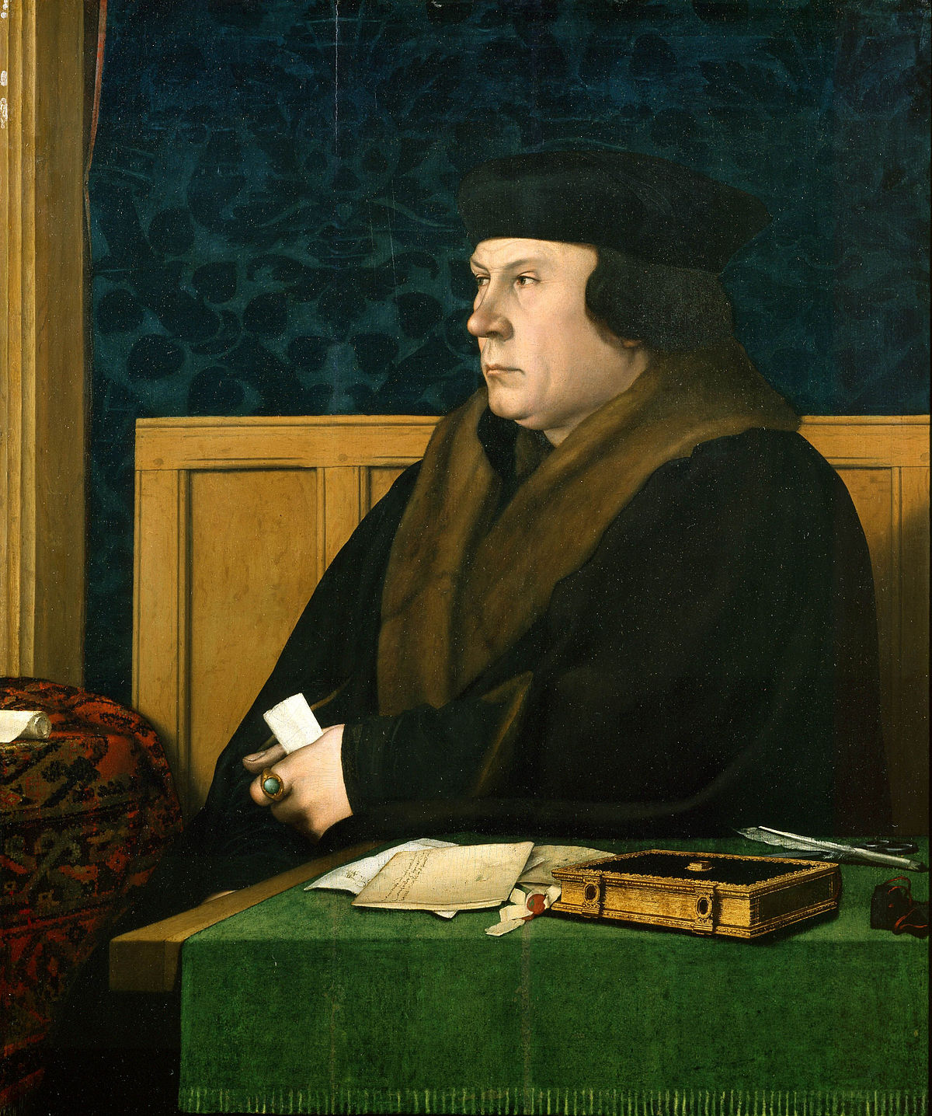
Thomas Cromwell
https://www.wikiwand.com/en/Thomas_Cromwell

Slide 22

Class Discussion Time
https://www.weareteachers.com/moving-beyond-classroom-discussions/

Slide 23
*Class Discussion Time
From last week:
  Do you see any differences in this sermon by Calvin and a sermon that you might hear preached today? If so, what are some of those differences?
  It is often said that the “ink still smudges” on Calvin’s writings – meaning that his writings tend to transcend time and culture and are able to speak to us today every bit as much as his writings would have spoken to those in his own day.
  What characteristics did see in this sermon that might tend to make it “timeless”?
From this week:
  Leviticus 20:21 reads:
    If a man marries his brother's wife, it is an act of impurity; he has dishonored his brother. They will be childless. (NIV)
  Henry VIII (and others) claimed that this scripture prohibited him from marrying his (dead) brother’s former spouse and this ultimately was given as one of the justifications for Henry’s divorce of Catherine. Do you think Henry was correct in his interpretation and application of this verse?
Do you have a topic or question that you would like to see us to discuss?

