Slide 1


Slide 2
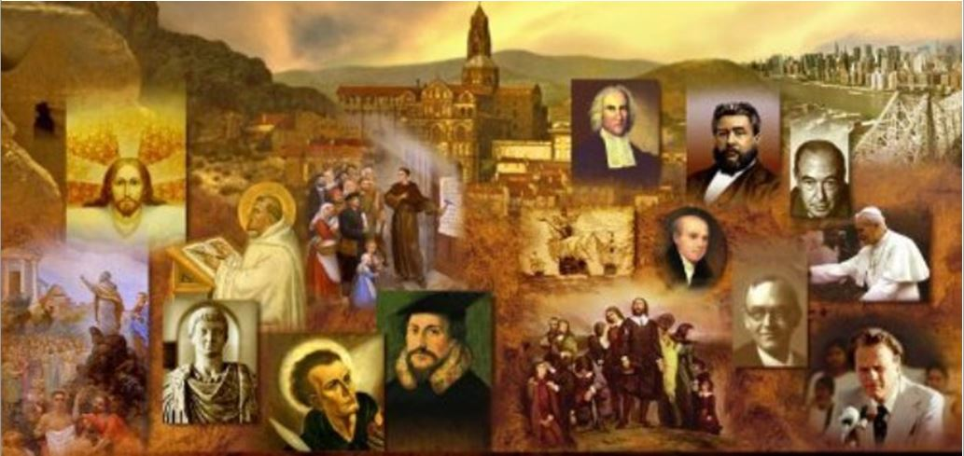
Review
What country on the continent had Scotland traditionally looked to for support in it’s fights against England?
  France
What name was given to those who supported this traditional policy? What name was given to those who favored looking to England for support?
  Francophiles
  Anglophiles
What great reformer had the relationship to Scotland that Luther had to Germany and Calvin had to Geneva?
  John Knox
What eventually happened to John Knox after he joined a group of Protestants holed up in St. Andrews Cathedral?
  He was captured by the French and sold as a galley slave.
  Later he was released and served as a pastor first in England and then Geneva

Slide 3
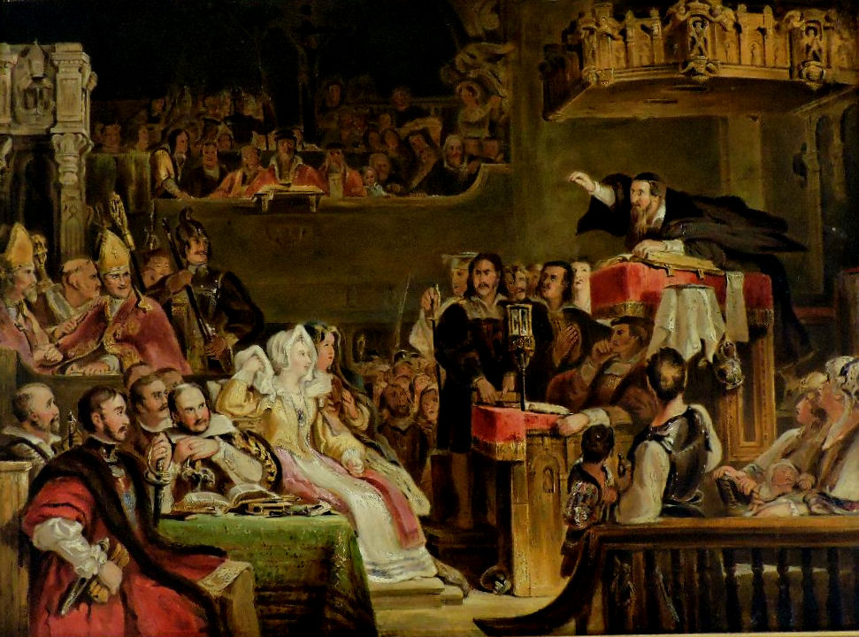
John Knox Returns to Scotland
https://www.artwarefineart.com/gallery/john-knox-preaching-lords-congregation-parish-church-st-andrews-10th-june-1559

Slide 4
John Knox Returns to Scotland
John Knox returned to Scotland May, 1559 at the urgent request of its Protestant leaders.
But a lot had been happening in his native land since his departure for the French galleys in 1547.
Mary of Guise, widow of James V and the mother of the then twelve-year-old Queen Mary Stuart (aka Mary Queen of Scotts), had assumed the regency of Scotland in 1554.
At first she was tolerant of Protestants, because she wanted to win them over to her anti-English, pro-French policy.
Needham, Nick. 2,000 Years of Christ's Power Vol. 3: Renaissance and Reformation

Slide 5
John Knox Returns to Scotland
But there was growing resentment among many Scots at the way Scotland seemed to be becoming a mere French province, especially after young Mary Stuart was married to Prince Francis of France, the heir to the French throne, in April 1558.
This fear of French domination was especially strong among the Scottish Protestants because the government of France was militantly Roman Catholic.
Within this religious and political context, the Protestant members of the Scottish nobility became increasingly determined to secure a Protestant government for their country.
Needham, Nick. 2,000 Years of Christ's Power Vol. 3: Renaissance and Reformation

Slide 6
John Knox Returns to Scotland
On December 3, 1557, the leaders of the Protestant nobility banded together by signing a covenant, in which they pledged themselves to renounce Roman Catholicism as “the Congregation of Satan”, and to promote their freedom to preach and practice according to their Protestant beliefs. ¹
These Protestant nobles called themselves “the Lords of the Congregation of Jesus Christ”. ¹
At first things did not go well for the Scottish Protestants. ²
Mary of Guise requested troops from France in order to crush the Lords of the Congregation. ²
¹ Needham, Nick. 2,000 Years of Christ's Power Vol. 3: Renaissance and Reformation
² González, Justo L. . The Story of Christianity: Volume 2: The Reformation to the Present Day (pp. 96-97)

Slide 7
John Knox Returns to Scotland
The Protestants did achieve some victories over the invaders. But their army, lacking in material resources, could not remain in the field for long. ¹
For a time, the military situation hung doubtfully and dangerously in the balance; only Knox’s phenomenal preaching kept alive the courage and constancy of the Scottish Protestant army. ²
The Protestant army sent repeated appeals to England, arguing that, if the Catholics were able to crush the Protestant rebellion in Scotland, and that kingdom was thus in the hands of the Catholic faction, and closely tied to France, Elizabeth’s crown would be endangered. ¹
Finally, early in 1560, Elizabeth decided to send troops to Scotland. ¹
The English army joined the Scottish Protestants, and a long war seemed inevitable. ¹
¹ González, Justo L. . The Story of Christianity: Volume 2: The Reformation to the Present Day (pp. 96-97)
² Needham, Nick. 2,000 Years of Christ's Power Vol. 3: Renaissance and Reformation

Slide 8
John Knox Returns to Scotland
But then the Mary of Guise died, and the French decided that it was time to sue for peace. ¹
As a result, on July 6, 1560, the Treaty of Edinburgh between England and France brought about the withdrawal of both French and English troops from Scotland. ¹
The immediate aftermath of the Treaty of Edinburgh was the “Reformation Parliament” of July and August 1560. ²
In terms of Scotland’s religious history and cultural identity, this was the most important parliament in the country’s history. ²
¹ González, Justo L. . The Story of Christianity: Volume 2: The Reformation to the Present Day
² Needham, Nick. 2,000 Years of Christ's Power Vol. 3: Renaissance and Reformation

Slide 9
John Knox Returns to Scotland
The parliament approved a new Reformed confession of faith for the national Church.
This was the Scots Confession, drawn up by John Knox and five other leading Reformed men – John Willock, John Winram, John Spottiswoode, John Row, and John Douglas – the six Johns!
It is clearly a Reformed confession: the new Protestant Church of Scotland was to be a Reformed, not a Lutheran body.
The parliament also outlawed the Roman Catholic mass with penalties for its celebration, acknowledged the Reformed preachers as alone competent to administer the sacraments, and abolished all papal jurisdiction over Scotland.
Needham, Nick. 2,000 Years of Christ's Power Vol. 3: Renaissance and Reformation

Slide 10
John Knox Returns to Scotland
The other great document of the Scottish Reformation, the First Book of Discipline, was a comprehensive blueprint for a Protestant society.
It outlined a Presbyterian form of Church polity, which included the popular election of ministers by congregations, elders who were to assist ministers in the exercise of moral discipline, and deacons who were to take charge of the finances of the Church.
The First Book of Discipline also set out a program of relief for the poor on a scale unknown in Western Europe until the coming of the welfare state.
Needham, Nick. 2,000 Years of Christ's Power Vol. 3: Renaissance and Reformation

Slide 11
John Knox Returns to Scotland
A massive educational program was likewise drafted; every parish was to have a school as well as a church. All of this was to be financed by the wealth of the old (Catholic) Church.
Such was Knox’s dream. But it never ended up happening.
The democratic tone of the First Book of Discipline made the nobility uneasy, and most of them preferred to seize the old Church’s assets for themselves rather than for Knox’s utopian program.
Needham, Nick. 2,000 Years of Christ's Power Vol. 3: Renaissance and Reformation

Slide 12
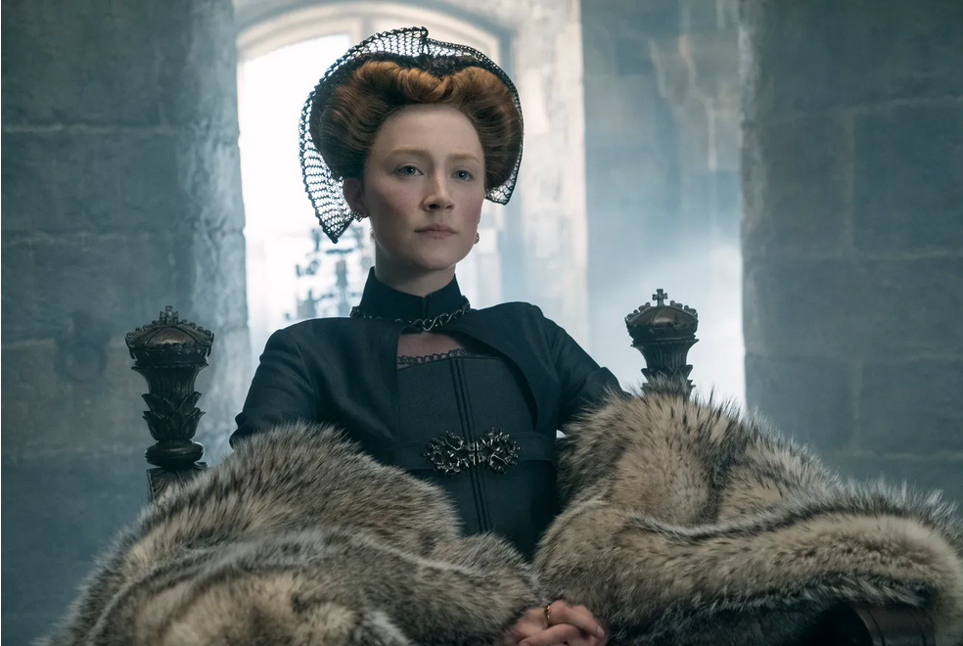
Mary Queen of Scotts Returns
https://www.artwarefineart.com/gallery/john-knox-preaching-lords-congregation-parish-church-st-andrews-10th-june-1559

Slide 13
Mary Queen of Scotts Returns
In the midst of such struggles, the nobles decided to invite Mary Stuart (aka Mary Queen of Scotts) to return to Scotland and claim the throne she had inherited from her father (James V).
Mary had hoped to remain in France as queen of that country, but the death of her husband had deprived her of that honor, and therefore she agreed to the Scottish request.
She arrived in Scotland in 1561.
Although she had never been popular, at first she was content to follow the advice of her illegitimate half-brother James Stuart, earl of Moray, a Protestant leader who prevented her from immediately alienating the other Protestant lords.
González, Justo L. . The Story of Christianity: Volume 2: The Reformation to the Present Day (pp. 96-97)

Slide 14
Mary Queen of Scotts Returns
Mary was young, beautiful, charming, spirited, highly intelligent, well educated in the learning of the French Renaissance. ¹
These qualities won her widespread popularity, and few men (even devout Protestant men) could resist her attractions, with the notable exception of John Knox who viewed her simply and exclusively as an enemy of the Reformation. ¹
From the time of her arrival, Mary insisted on having mass celebrated in her private chapel, and the fiery reformer began preaching against the “idolatry” of the “new Jezebel.” ²
But in the end, Mary Stuart caused her own downfall. ²
She had always dreamed of sitting on the throne of England, and in pursuit of that dream she lost first her own throne and then her life. ²
¹ Needham, Nick. 2,000 Years of Christ's Power Vol. 3: Renaissance and Reformation
² González, Justo L. . The Story of Christianity: Volume 2: The Reformation to the Present Day

Slide 15
Mary Queen of Scotts Returns
In order to strengthen her claim to the English throne, she married her cousin Henry Stuart, Lord Darnley, who also had a distant claim to it.
Moray objected to this marriage and to Mary’s agreement with Spain to uproot Protestantism in her own country, and when his objections went unheeded he rebelled.
Mary then called upon James Hepburn, Lord Bothwell, an able military leader who defeated Moray and forced him to seek refuge in London.
Encouraged by this victory, Mary declared that she would soon sit on the throne in London.
González, Justo L. . The Story of Christianity: Volume 2: The Reformation to the Present Day

Slide 16
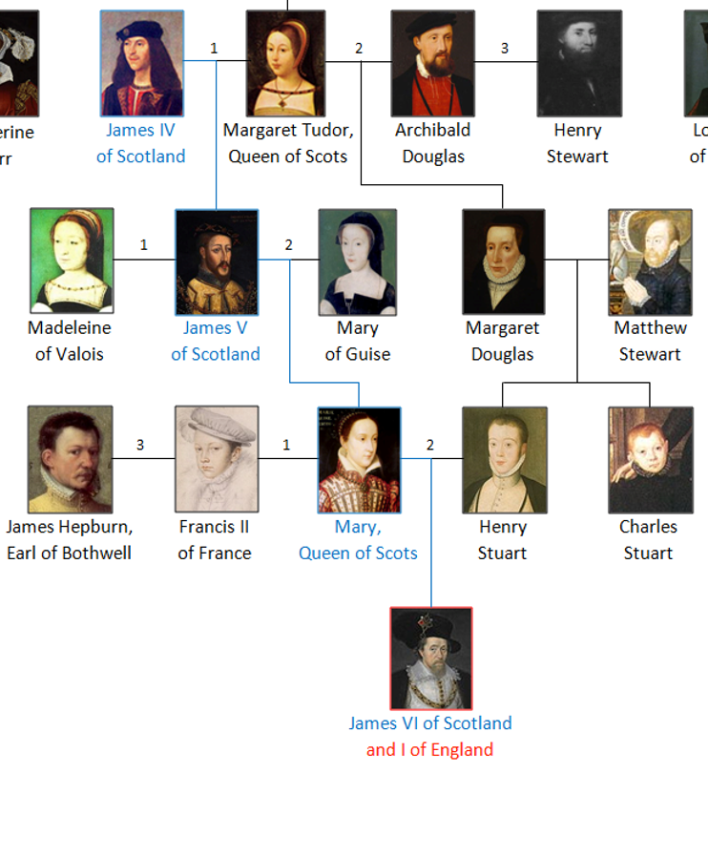
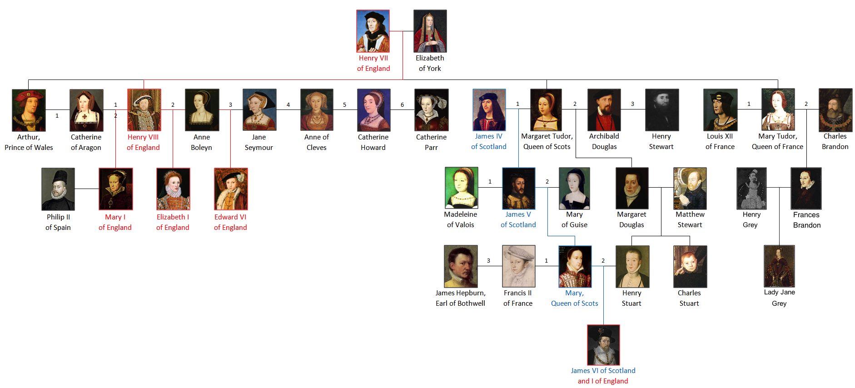
House of Tudor
https://www.wikiwand.com/en/House_of_Tudor

Slide 17
Mary Queen of Scotts Returns
Having lost Moray’s counsel, Mary’s policies became increasingly unwise.
She decided that she had made a mistake in marrying Darnley, and let her feelings be known to Bothwell and others.
Shortly thereafter, Darnley was murdered, and the main suspect was Bothwell.
Bothwell was legally exonerated in a trial in which no witnesses for the prosecution were allowed.
But this did little to allay suspicion, particularly since Mary married Bothwell a few months later.
González, Justo L. . The Story of Christianity: Volume 2: The Reformation to the Present Day

Slide 18
Mary Queen of Scotts Returns
The Scottish lords hated Bothwell, and they soon rebelled.
When the queen sought to quell the rebellion, she discovered that her troops were not willing to support her cause, and she found herself in the hands of the lords.
They convinced her that they had proof of her participation in Darnley’s death, and gave her the choice of either abdicating or being tried for murder.
She abdicated in favor of her one-year-old son James VI, whom she had had with Darnley, and Moray returned from England as to serve as regent of Scotland.
Mary managed to escape and raise an army in support of her cause. But she was defeated by Moray’s troops, and her only recourse was to flee to England and seek refuge under her hated cousin Elizabeth.
González, Justo L. . The Story of Christianity: Volume 2: The Reformation to the Present Day

Slide 19
Mary Queen of Scotts Returns
Romantic imagination has woven many a tale around Mary’s captivity and death, making her a martyr in the hands of a cruel and ambitious cousin.
The truth is that Elizabeth received her with greater courtesy than could be expected for someone who had so long declared her illegitimate in an effort to take possession of her crown.
Although she was a prisoner in the sense that she was not allowed to leave the castle of her residence, there were strict orders that she should be treated as a queen, and she was allowed to choose her own body of thirty servants.
González, Justo L. . The Story of Christianity: Volume 2: The Reformation to the Present Day (pp. 96-97)

Slide 20
Mary Queen of Scotts Returns
But even in prison Mary was a danger to Elizabeth; one Roman Catholic plot after another was formed to topple Elizabeth and replace her with Mary. ¹
When a plot was exposed, in which Mary was implicated in a conspiracy to assassinate Elizabeth, the English queen’s patience was at an end. ¹
So on February 8, 1587, Mary was beheaded for treason. ²
¹ Needham, Nick. 2,000 Years of Christ's Power Vol. 3: Renaissance and Reformation
² https://www.history.com/this-day-in-history/mary-queen-of-scots-beheaded

Slide 21
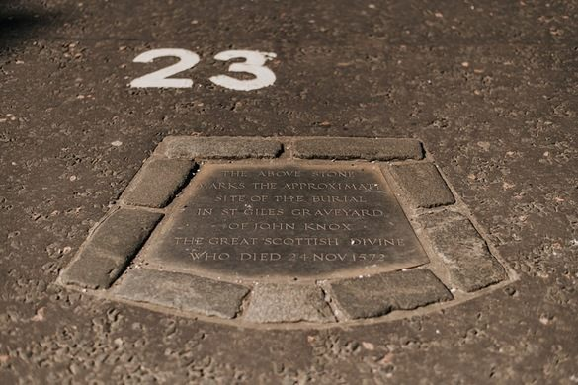
Mary Queen of Scotts Returns
In Scotland, Mary’s exile did not put an end to disputes among the various parties. ¹
Eventually the King’s Party, led by the earl of Morton, triumphed in the civil war. ²
From then until 1580 Morton ruled Scotland with a strong hand; peace and Protestantism were secure under his government. ²
Knox himself was by now a very sick man, having suffered a stroke, and he no longer preached with the power that had once dazzled a nation.
He died on November 24, 1572 and was buried in the churchyard of St Giles Kirk. ²
Morton’s epitaph, spoken at the funeral, was fitting: “There lies one who neither feared nor flattered any flesh.” ²
¹ González, Justo L. . The Story of Christianity: Volume 2: The Reformation to the Present Day
² Needham, Nick. 2,000 Years of Christ's Power Vol. 3: Renaissance and Reformation

Slide 22
Mary Queen of Scotts Returns
Mary’s son, James was anointed King of Scots at the age of thirteen months on July 29, 1567. The sermon at the coronation was preached by John Knox. ¹
James was put under the tutelage of George Buchanan, a Scottish writer and educator, who instilled in him a lifelong passion for literature and learning and sought to turn James into a God-fearing, Protestant king who accepted the limitations of monarchy. ¹
Upon Queen Elizabeth’s death in 1603 he became king of England (James I), Scotland and Ireland. ²
¹ https://www.wikiwand.com/en/James_VI_and_I
² https://www.history.com/this-day-in-history/mary-queen-of-scots-beheaded

Slide 23
Mary Queen of Scotts Returns
The triumph of Protestantism in Scotland through the Reformation Parliament had a profound impact both on Scottish identity and on Anglo-Scottish relationships.
Traditionally, England had been the “Old Enemy” of Scotland since the 13th century, and Scots had in some senses defined themselves as those who existed in this context of hostilities with the English. The Reformation changed all this.
The victory of the Protestant faith over Roman Catholicism in both England and Scotland – and with English help in Scotland – forged a new psychological bond between the two nations.
Not surprisingly, then, Protestant Scotland became a pro-English country. This helped pave the way for the union between their monarchies in 1603, and their parliaments in 1707
¹ https://www.wikiwand.com/en/James_VI_and_I
² https://www.history.com/this-day-in-history/mary-queen-of-scots-beheaded

Slide 24
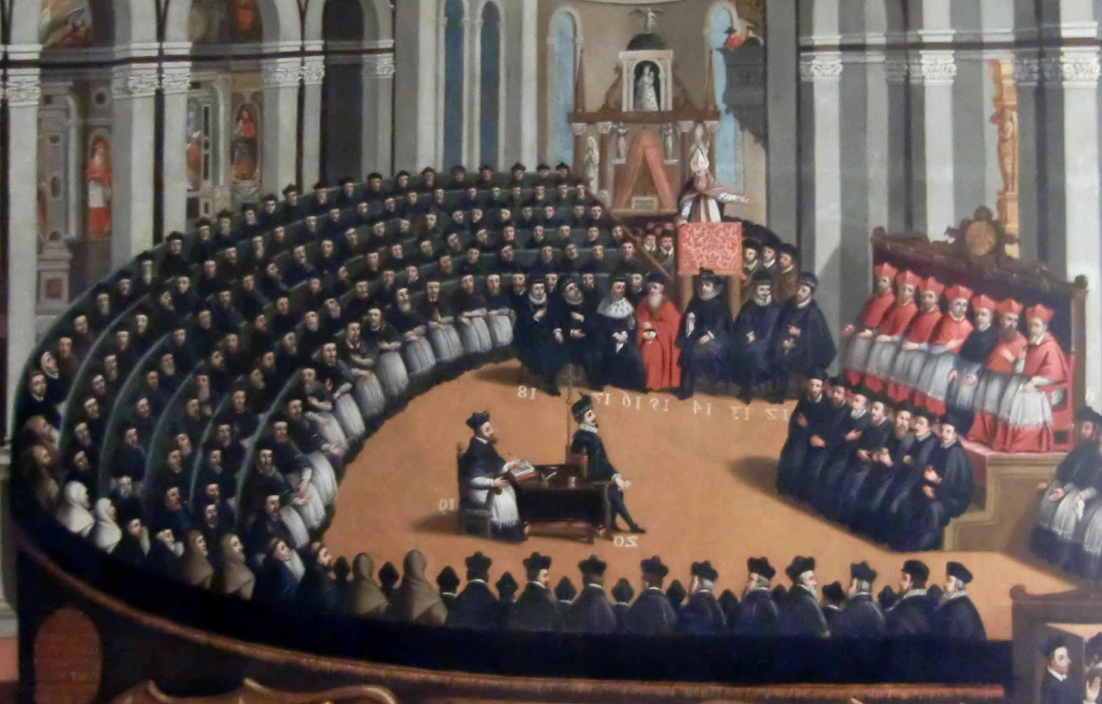
The Catholic Counter-Reformation
https://christianreformedink.wordpress.com/reformed-theology-2/ecclesiology/reformation-events/nine-things-you-should-know-about-the-council-of-trent/

Slide 25

Class Discussion Time
https://www.weareteachers.com/moving-beyond-classroom-discussions/

Slide 26
*Class Discussion Time
John Knox showed great courage and conviction that did much to shape the history of Scotland in his day for good. Knox not only took a strong theological stance, but involved himself in the politics of his day where he preached and applied his theology. Do you see room for this kind of role on the part of preachers/ theologians in our present day? Explain.
Despite John Knox’s positive influence in the history of Scotland, he seems to have lost much of his luster in the eyes of modern Scotts, who built a parking lot over his grave site! Is this, perhaps, a good reminder to us, that what matters in history is not always how succeeding generations view us, but ultimately how God views us?
Do you have a topic or question that you would like to see us to discuss?

