Slide 1


Slide 2
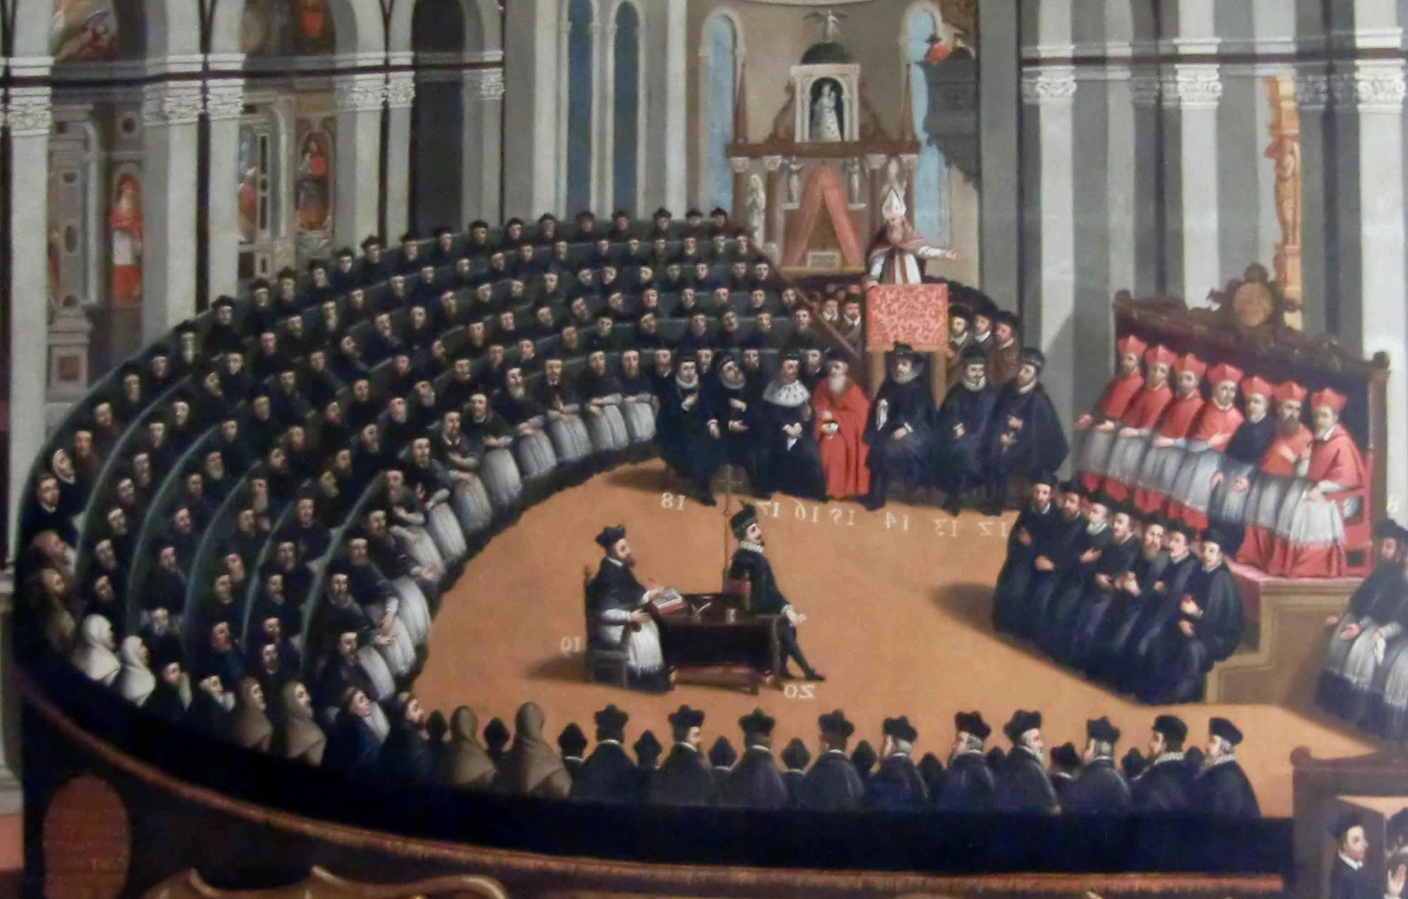
The Catholic Counter-Reformation
https://christianreformedink.wordpress.com/reformed-theology-2/ecclesiology/reformation-events/nine-things-you-should-know-about-the-council-of-trent/

Slide 3
The Catholic Counter-Reformation
How did the Roman Catholic Church respond to the challenge of the Reformers?
It took almost forty years before any clear and committed response became the official Roman policy.
There were many conflicting opinions among those who stayed loyal to Rome.
Even the most traditionally minded Catholics soon realized that simply persecuting Protestants would not solve the problems and abuses in the Church to which the Reformers had pointed.
In this section, we will see how Rome’s ultimate response to the Reformation took shape, and how it affected both the Roman Catholic Church and the religious history of Europe.
Needham, Nick. 2,000 Years of Christ's Power Vol. 3: Renaissance and Reformation

Slide 4
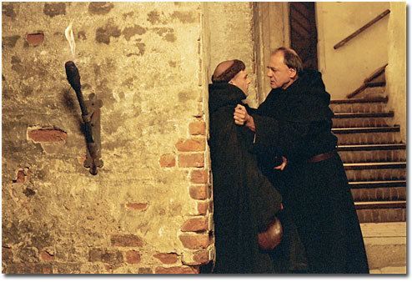
The Catholic Evangelicals
https://deovivendiperchristum.wordpress.com/2013/10/30/johann-von-staupitz-c-1460-1524-on-gods-eternal-predestination/

Slide 5
The Catholic Evangelicals
One Roman Catholic response to the Reformation was to agree with much that Luther, Zwingli, and the other Reformers said, and yet to regret their break with the papacy.
Those who responded in this way worked in the period 1521-41 to reform the Church of Rome from within, towards a more biblical theology and practice, and thus to win back the Protestants into the one true Church.
These Roman Reformers are usually called the Catholic Evangelicals.
We have already met one of these Catholic Evangelicals – Johannes von Staupitz (1460-1524), the young Luther’s spiritual guide.
Staupitz agreed with almost everything Luther said, but after much agonizing he eventually decided not to follow his brilliant pupil in breaking with the papacy.
Needham, Nick. 2,000 Years of Christ's Power Vol. 3: Renaissance and Reformation

Slide 6
The Catholic Evangelicals
The two men drifted painfully apart, and in April 1524, eight months before his death, Staupitz wrote his last letter to his spiritual son, Martin Luther.
He admitted that Luther had achieved a great deal of good: “We owe so much to you, Martin. You have taken us out of the pigsty into the pastures of life.”
But Staupitz went on to criticize the Reformer:
  Having been your forerunner in the holy Evangelical doctrine, I trust that my humble exhortations may have some influence with you. My love for you is unchanged, but you seem to me to condemn many outward things which do not affect a sinner’s justification. Why do you hate monasticism so much, when many monks have lived holy lives? There is nothing that men cannot abuse. I beg you to remember the weak, my dear friend. Do not condemn things which are not important, and which can be sincerely held, although you must of course speak out on matters of faith.
Needham, Nick. 2,000 Years of Christ's Power Vol. 3: Renaissance and Reformation

Slide 7
The Catholic Evangelicals
Luther responded with great sadness to Staupitz’s decision to remain in the Church of Rome:
  I am afraid that you hesitate between Christ and the pope, though they are utterly opposed. You seem to me to be a very different Staupitz from the one who used to preach grace and the cross.
In December 1524 Staupitz died, still within the Church of Rome – an evangelical, but a Catholic one.
Rome was not very grateful for his loyalty; it placed all Staupitz’s writings on the “index of forbidden books” in 1563.
Needham, Nick. 2,000 Years of Christ's Power Vol. 3: Renaissance and Reformation

Slide 8
The Catholic Evangelicals
Staupitz lived and died in Germany, but the great majority of Catholic Evangelicals were based in the Italian cities – Florence, Venice, Padua, Naples, Modena, even Rome itself.
Most of them were upper class laypeople, deeply indebted to Erasmus and Christian humanism, often students of Paul’s letters, and linked with each other by a network of personal friendships.
Women were particularly prominent in the group. The main theological influence on them was Augustine of Hippo; they believed strongly in salvation by grace alone, rooted in divine predestination.
They also read Protestant writings with sympathy, and accepted justification by faith.
Needham, Nick. 2,000 Years of Christ's Power Vol. 3: Renaissance and Reformation

Slide 9
The Catholic Evangelicals
Their foremost leader, Cardinal Gasparo Contarini, had this to say on justification:
  Faith confers a twofold righteousness upon us: first, it confers an inward righteousness belonging to ourselves, together with the love and grace that make us sharers in the divine nature; second, it confers on us the righteousness of Christ, which is given to us by imputation. Our trust should be grounded in Christ’s righteousness conferred on us, and not in the inward holiness and grace that belong to our own souls. This is because our own righteousness is far from complete, far from perfect, and it cannot stop us offending God and constantly sinning in a multitude of matters. By contrast, the righteousness of Christ that is given to us is a true and perfect righteousness; it finds total acceptance in God’s sight. We must therefore lean only upon this, and believe that we are justified before God by virtue of Christ’s righteousness exclusively.
Needham, Nick. 2,000 Years of Christ's Power Vol. 3: Renaissance and Reformation

Slide 10
The Catholic Evangelicals
The chief difference between Catholic Evangelicals and Protestants was that the Catholic Evangelicals combined their views on salvation by grace alone with:
  A continuing belief in the papacy as the divinely ordained head of the visible Church
  Transubstantiation as the only true doctrine of the eucharist.
Their ideal was a reformed evangelical Church of Rome.
Needham, Nick. 2,000 Years of Christ's Power Vol. 3: Renaissance and Reformation

Slide 11
The Catholic Evangelicals
The Catholic Evangelicals could be as bold as the Protestants in condemning abuses in the Church; they expressed their criticisms most forcefully in 1537, in the report of a reform commission set up by Pope Paul III (1534-49).
The report was entitled Consilium de Emendanda Ecclesia (“Consultation on Reforming the Church”).
It was so forthright in its condemnation of the existing state of the Roman Church that the pope refused to publish it.
However, copies of the report “leaked” out and were printed unofficially – especially by Protestants, who claimed that it justified all the criticisms they had made of Rome.
It was so embarrassing that the Roman inquisition finally placed it on the index of forbidden books!
Needham, Nick. 2,000 Years of Christ's Power Vol. 3: Renaissance and Reformation

Slide 12
The Catholic Evangelicals
The most popular writing to emerge from the Catholic Evangelical camp was The Benefits of Christ’s Death, published in Venice in 1543.
Historians are not sure who wrote it; the book was hugely popular among Italian Catholics, selling 40,000 copies by 1549.
It taught a strongly Augustinian theology alongside a Protestant view of justification by faith.
In fact, large parts of the Benefits were simply a translation into Italian of the 1539 edition of Calvin’s Institutes!
The inquisition eventually placed the Benefits on the index of forbidden books.
Needham, Nick. 2,000 Years of Christ's Power Vol. 3: Renaissance and Reformation

Slide 13
The Catholic Evangelicals
The influence of the Catholic Evangelicals on the papacy reached its height in the period 1539-41.
In these three years, leading Roman Catholic and Protestant theologians held a series of meetings, under the authority of Holy Roman Emperor Charles V and backed by Pope Paul III, with the aim of restoring the shattered unity of the Church in Western Europe.
Catholic Evangelicals dominated the Roman delegates at these meetings.
This Roman–Protestant dialogue came closest to success in 1541 at the Colloquy of Regensburg.
Contarini presided over the colloquy; Gropper and Pighius were among the Roman Catholics, and Calvin, Melanchthon, and Bucer among the Protestants.
The two sides managed to produce a common statement on original sin and justification by faith.
Needham, Nick. 2,000 Years of Christ's Power Vol. 3: Renaissance and Reformation

Slide 14
The Catholic Evangelicals
Calvin wrote to William Farel:
  To our delight, they agreed with us without difficulty on original sin. Then followed a discussion about free-will, which was settled according to the opinion of Augustine. In these two points the Catholic delegates do not differ from us. Regarding justification, there were sharper arguments. In the end a formula was drawn up, with corrections agreed on by both sides, which you will certainly accept. When you read the copy of the formula which I include with this letter, you will be amazed, I know, that our opponents came so far over to our views. They have retained the whole truth of our doctrine! There is nothing in the formula which is not found in our writings. I know you will desire an even clearer explanation, and I agree with you on this. But truly, if you think about the men with whom we have reached this agreement, you will realize how much has been achieved.
Needham, Nick. 2,000 Years of Christ's Power Vol. 3: Renaissance and Reformation

Slide 15
The Catholic Evangelicals
However, after these hopeful beginnings, the colloquy broke down completely over the doctrine of the eucharist.
The Catholic Evangelicals insisted on transubstantiation; the Protestants refused to tolerate it, on the basis that it would lead to the idolatrous worship of the communion bread as Christ’s actual body.
The Catholic Evangelicals continued to enjoy a significant degree of popular success, as the sale of The Benefits of Christ’s Death showed, but the failure of the Colloquy of Regensburg marked the end of their official influence in the papal court.
Needham, Nick. 2,000 Years of Christ's Power Vol. 3: Renaissance and Reformation

Slide 16
The Catholic Evangelicals
Many leading Roman Churchmen rejected the joint Roman–Protestant statement on justification by faith as a vile Lutheran heresy; paradoxically, some Protestants, including Luther, rejected it as a compromise with Rome!
In 1541 Pope Paul III removed Contarini from all positions of influence, and the great Catholic Evangelical leader died a year later.
As a result of the Catholic Evangelical failure, Augustinian theology fell into disfavor in Rome.
The way was now clear for a policy of reforming the Church, not in order to win back the Protestants, but in order to make the Church an effective instrument for their extermination.
Needham, Nick. 2,000 Years of Christ's Power Vol. 3: Renaissance and Reformation

Slide 17
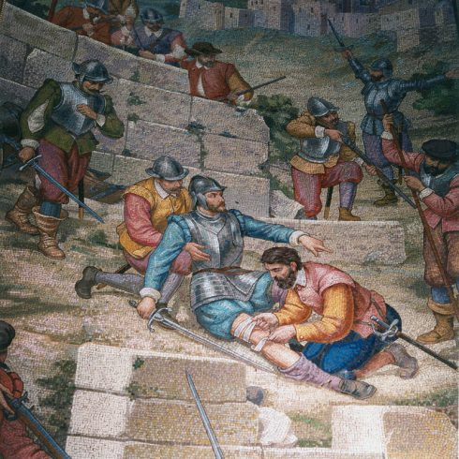
Ignatius Loyola
Father of the Catholic Counter Reformation
https://christianreformedink.wordpress.com/reformed-theology-2/ecclesiology/reformation-events/nine-things-you-should-know-about-the-council-of-trent/

Slide 18
Ignatius Loyola
If Luther gave birth to Protestantism, Ignatius Loyola was the spiritual father of the Catholic Counter-Reformation.
A native of the Basque region of northern Spain where the armies of Islam had never conquered, Loyola belonged to an ancient branch of the Spanish nobility, the Recaldes, direct descendants of the Visigoths.
The Recaldes family had a strong military tradition, and so it was as a soldier that the young and well-educated Loyola began his remarkable life, in the service of the Spanish kings Ferdinand II of Aragon (1479-1516) and his grandson Charles I of Spain (1516-56) – this was the same Charles (Charles V) who became Holy Roman Emperor in 1521.
Needham, Nick. 2,000 Years of Christ's Power Vol. 3: Renaissance and Reformation

Slide 19
Ignatius Loyola
At this stage in his development, Loyola was obsessed with the great medieval tales of knighthood and chivalry; his burning ambition was to become a famous knight.
However, it was not to be. In 1521, one of Loyola’s legs was shattered and crippled in a war between Spain and France, and his military career came to an abrupt end.
As he lay at home recovering from his injury, Loyola’s thoughts turned to religion.
Instead of reading stories of medieval knights, he began to read lives of the saints.
Needham, Nick. 2,000 Years of Christ's Power Vol. 3: Renaissance and Reformation

Slide 20
Ignatius Loyola
But the book that made the deepest impression on him was The Life of our Lord Jesus Christ by the 14th century German writer, Ludolph of Saxony, a Carthusian monk.
This book was the most detailed biography of Christ that had been written in the Middle Ages; it included comments on the different Gospel passages by the early Church fathers and medieval theologians, together with prayers and practical teaching based on each passage.
Needham, Nick. 2,000 Years of Christ's Power Vol. 3: Renaissance and Reformation

Slide 21
Ignatius Loyola
Reading Ludolph’s Life of Christ proved to be the turning point of the young Loyola’s life.
He renounced his worldly ambitions, and vowed that from now on, he would only ever be a spiritual knight in the heavenly service of the Lord Jesus Christ and His mother, the blessed Virgin Mary.
He gave away his knightly costume, put on a hermit’s garb, and went to the Dominican convent in Manresa, north-eastern Spain.
Here, between March 1522 and February 1523, Loyola devoted himself to prayer and harsh ascetic self-discipline.
Needham, Nick. 2,000 Years of Christ's Power Vol. 3: Renaissance and Reformation

Slide 22
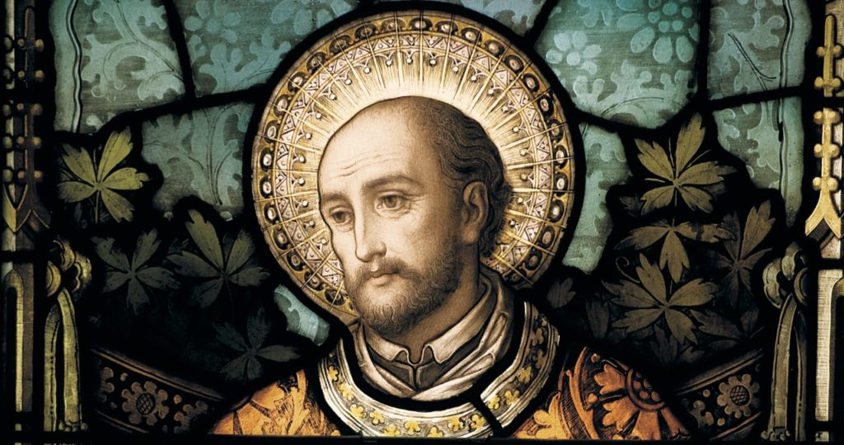
Ignatius Loyola
Founder of the Jesuits
https://christianreformedink.wordpress.com/reformed-theology-2/ecclesiology/reformation-events/nine-things-you-should-know-about-the-council-of-trent/

Slide 23

Class Discussion Time
https://www.weareteachers.com/moving-beyond-classroom-discussions/

Slide 24
*Class Discussion Time
Luther’s spiritual guide Johannes von Staupitz agreed with Luther on the gospel criticized him for leaving the Roman Catholic Church – cautioning Luther that he should not “condemn things which are not important” or things which “do not affect a sinner’s justification”, citing, for example, Luther’s hatred of monasticism. Was Staupitz right about this? Should Luther have heeded his mentor’s advice?
In response to his mentor’s criticisms, Luther expressed disappointment at his former mentor’s allegiance to the pope (and the Roman Catholic hierarchy) – seeing it as inconsistent with a commitment to “grace and the cross”. Is Luther right about this? Is a commitment to following the pope inconsistent with a belief in the gospel?
Likewise, after agreeing on the gospel, the Reformers and Catholic Evangelicals were unable to come together after the Colloquy of Regensburg because of differences over the Eucharist and transubstantiation. Is this an issue worth dividing over?
Do you have a topic or question that you would like to see us to discuss?

