Slide 1


Slide 2
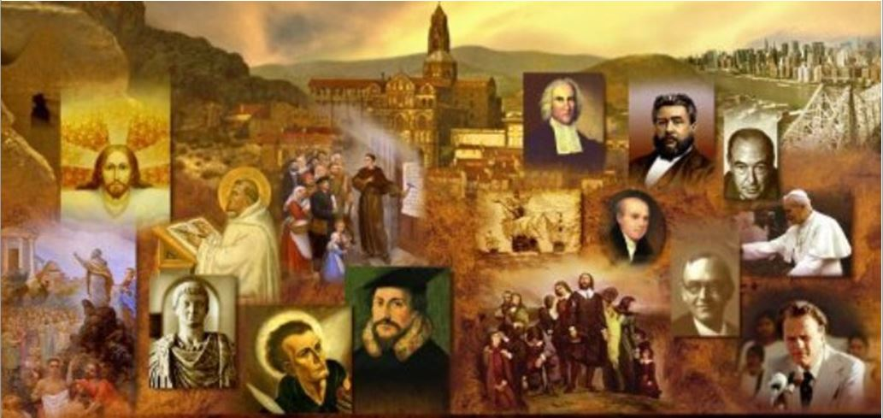
Review
What were the two issues over which the Roman Catholic Evangelicals and the Reformers could never reach agreement?
  The authority of the pope
  Transubstantiation
What did Ignatius Loyola, Father of the Catholic Counter-Reformation, originally aspire to become (career-wise)?
  A famous knight in service of Spain and the Holy Roman empire
What event in Ignatius Loyola’s life providentially prevented him from achieving his original aspiration to become a famous knight and eventually resulted in him wanting to become a spiritual knight in the heavenly service of the Lord Jesus Christ and His mother, the blessed Virgin Mary?
  A knee injury

Slide 3
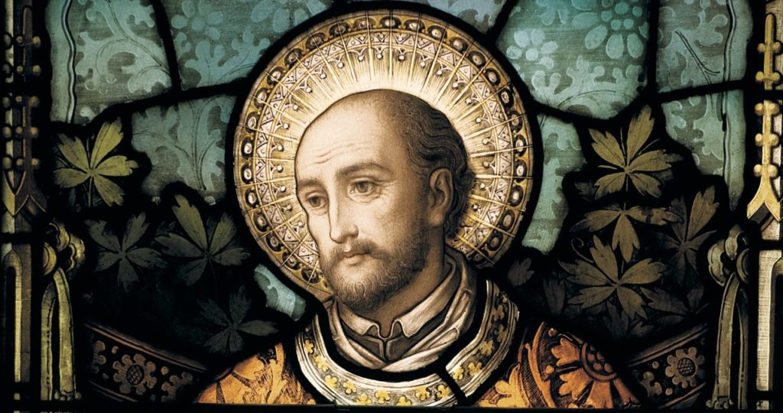
Ignatius Loyola
Founder of the Jesuits
https://christianreformedink.wordpress.com/reformed-theology-2/ecclesiology/reformation-events/nine-things-you-should-know-about-the-council-of-trent/

Slide 4
Ignatius Loyola and the Jesuits
Ignatius Loyola claimed to receive a series of supernatural visions which inspired him to produce one of the most influential religious books ever written: the Spiritual Exercises.
The purpose of the Spiritual Exercises was to bring the soul into total obedience to Christ through total submission to the Roman Church as His one true Church, His Bride, outside of which there was no grace, no Christ, and no salvation.
Loyola believed passionately in the infallibility of the Church of Rome, its exclusive possession of grace through its priesthood and sacraments, and the absolute truth of its traditional scholastic theology.
Needham, Nick. 2,000 Years of Christ's Power Vol. 3: Renaissance and Reformation

Slide 5
Ignatius Loyola and the Jesuits
In Loyola’s mind, faith meant an unquestioning acceptance of all Rome’s teachings; there was no room for criticism, and all dissent was damnable heresy.
The Exercises ended with “Rules for Thinking in Harmony with the Church”, which contained the following famous statement:
  We should leave to one side all personal opinions of our own, and keep our minds prepared and zealous to obey in all things our holy mother, the Catholic Church, the true Bride of Christ our Lord ... To ensure that we enjoy perfect certainty, we should maintain the following attitude: I will believe that something that seems white is actually black, if the Catholic Church proclaims it to be black. For I believe that there is one and the same Spirit who unites Christ our Lord the Husband with the Church His Bride. This Spirit rules and guides our souls for our good; the same Spirit and the same Lord who gave the Ten Commandments guides and rules our holy mother the Church.
Needham, Nick. 2,000 Years of Christ's Power Vol. 3: Renaissance and Reformation

Slide 6
Ignatius Loyola and the Jesuits
Not surprisingly, Loyola did not intend individuals to undertake the Spiritual Exercises on their own.
He required people to practice the Exercises only under the close supervision of a Jesuit spiritual director, someone who had gone through the Exercises himself, and who was himself guided by Loyola’s Directory.
The Directory was a companion volume which gave detailed instructions to spiritual directors on how to lead souls through the Spiritual Exercises.
Needham, Nick. 2,000 Years of Christ's Power Vol. 3: Renaissance and Reformation

Slide 7
Ignatius Loyola and the Jesuits
Loyola studied in various Spanish universities in 1524-28, and then in Paris in 1528-35.
This means that Loyola was a student in Paris at the same time as John Calvin, although there is no record that the two ever met.
During his time in Paris, Loyola collected a group of six disciples, who in 1534 bound themselves together by an oath to go to the Holy Land and work for Christ among the Muslims there.
Loyola and his six disciples gathered in Venice in 1537, intending to sail to the Holy Land, but a war between the Venetians and the Turks prevented them.
So they journeyed instead to Rome, where they became a band of begging preachers.
Needham, Nick. 2,000 Years of Christ's Power Vol. 3: Renaissance and Reformation

Slide 8
Ignatius Loyola and the Jesuits
In 1539 they started calling themselves “the Society of Jesus”, a name Loyola claimed had been revealed to him by Jesus Himself in a vision.
The word “Society” has a military flavor; a modern equivalent would be something like “the Regiment of Jesus”.
More popularly, people were soon calling them Jesuits (the word was first used in Germany as a nickname, and it caught on).
In 1540 Pope Paul III gave the Society official recognition as a new religious order, and Loyola was elected its first leader or “general”.
Needham, Nick. 2,000 Years of Christ's Power Vol. 3: Renaissance and Reformation

Slide 9
Ignatius Loyola and the Jesuits
The rules of the Society, known as the “Constitutions”, were drawn up by Loyola, who believed they were given to him by divine revelation.
The Jesuit Constitutions organized the Society along military lines, reflecting Loyola’s own background.
At the top was the “general” (sometimes referred to as the “black pope” by enemies of the Jesuits), who exercised absolute authority over the rest of the Society.
Under the general were the “provincials”, who governed different regional branches of the Society (e.g. in France or Spain); under the provincials were the “rectors” who controlled local Jesuit groups in towns and cities.
Loyola laid down strict conditions about who could join; they had to be healthy, physically beautiful, intelligent, good at public speaking, and free from the least suspicion of heresy.
Needham, Nick. 2,000 Years of Christ's Power Vol. 3: Renaissance and Reformation

Slide 10
Ignatius Loyola and the Jesuits
Over the next three centuries, Jesuits would be the most zealous advocates of the absolute supremacy of the pope over Church and state.
Loyola laid a powerful stress on education as one of the main tasks of the Society, and in 1551 he founded in Rome the first Jesuit college, which became a model for all the others.
By the 17th century some 400 Jesuit schools and colleges had been established across Western Europe; they were amazingly popular, charging no fees, and using the best educational methods then in existence, with a novel emphasis on physical games and drama.
Needham, Nick. 2,000 Years of Christ's Power Vol. 3: Renaissance and Reformation

Slide 11
Ignatius Loyola and the Jesuits
The Society’s schools were particularly successful in training a whole new generation of devout and committed Roman Catholics.
Jesuits concentrated on educating the sons of Roman Catholic kings and nobles, so that Jesuit teaching and Jesuit ideals would mold the souls of future Roman Catholic rulers.
“Give me a child before he is seven,” the Jesuits boasted, “and he will remain a Catholic for the rest of his life.”
Needham, Nick. 2,000 Years of Christ's Power Vol. 3: Renaissance and Reformation

Slide 12
Ignatius Loyola and the Jesuits
As for the content of Jesuit teaching, the Society’s Constitutions named Aristotle as the supreme guide in philosophy, and Thomas Aquinas in theology.
Because of the blossoming growth and success of the Society, this helped to make Aquinas into the most widely studied theologian in the Roman Catholic Church, a position previously held by Peter Lombard.
However, Loyola did state that on some points Aquinas’s views were not binding, especially the great Italian schoolman’s denial of the immaculate conception of the Virgin Mary.
Needham, Nick. 2,000 Years of Christ's Power Vol. 3: Renaissance and Reformation

Slide 13
Ignatius Loyola and the Jesuits
At first the Society of Jesus was concerned mainly with teaching orthodox Roman Catholic theology within the Church, e.g. to children in schools and to the illiterate, and also with missionary work among Muslims and other unevangelized peoples.
However, in the 1550s, the destruction of Protestantism became another chief purpose of the Society.
Jesuit theologians dedicated themselves to studying, mastering, and overthrowing the works of the Protestant Reformers.
Needham, Nick. 2,000 Years of Christ's Power Vol. 3: Renaissance and Reformation

Slide 14
Ignatius Loyola and the Jesuits
The Jesuits soon became Rome’s mightiest weapon in the war against the Reformation; Protestants feared and hated the so-called “Society of Jesus” more than any other Roman Catholic body.
The papacy sent Jesuit priests into every Roman Catholic nation which had been affected by Protestantism, to win their peoples back to a full allegiance to Rome, usually with great success.
They also went secretly into Protestant nations, to strengthen persecuted Roman Catholic minorities in their faith; Protestant governments put many Jesuits to death, especially in England.
Needham, Nick. 2,000 Years of Christ's Power Vol. 3: Renaissance and Reformation

Slide 15
Ignatius Loyola and the Jesuits
As a striking example of a Jesuit triumph, we can look at the work of Peter Canisius (1521-97) in southern Germany.
Despite Roman Catholic persecution of Protestants, the Reformation still had many followers at grass-roots level in Austria, Bavaria and the smaller German territories that bordered on Switzerland.
Rome continued to fear that the whole of Germany might embrace Protestantism.
Canisius, a native of the Netherlands and one of Loyola’s favorite disciples, turned the spiritual tide in southern Germany decisively back towards Roman Catholicism.
Needham, Nick. 2,000 Years of Christ's Power Vol. 3: Renaissance and Reformation

Slide 16
Ignatius Loyola and the Jesuits
Roman Catholics sometimes call Canisius “the second apostle of Germany”. Beginning in 1549, Canisius worked tirelessly in Austria and Bavaria, preaching, teaching, founding Jesuit schools and colleges, training a new generation of devout and well-educated Roman Catholic priests.
His supreme achievement was his German Catholic Catechism, first published in 1555.
Canisius created a Roman Catholic copy of the Lutheran system of catechizing; it was highly effective – some 130 editions of his Catechism were published.
Canisius’s vigorous labors almost wiped out Protestantism in Austria and Bavaria, and raised up a strong Jesuit-led Roman Catholic influence in Hussite Bohemia.
Needham, Nick. 2,000 Years of Christ's Power Vol. 3: Renaissance and Reformation

Slide 17
Ignatius Loyola and the Jesuits
By Loyola’s death in 1556, the Jesuits had taken root and flourished swiftly in Italy, Spain and Portugal; it grew more slowly in France and southern Germany.
Beyond question, the astonishing discipline, dedication and energy of this “regiment of Jesus” proved to be the single most powerful force in reviving the fortunes of traditional Roman Catholicism.
Needham, Nick. 2,000 Years of Christ's Power Vol. 3: Renaissance and Reformation

Slide 18
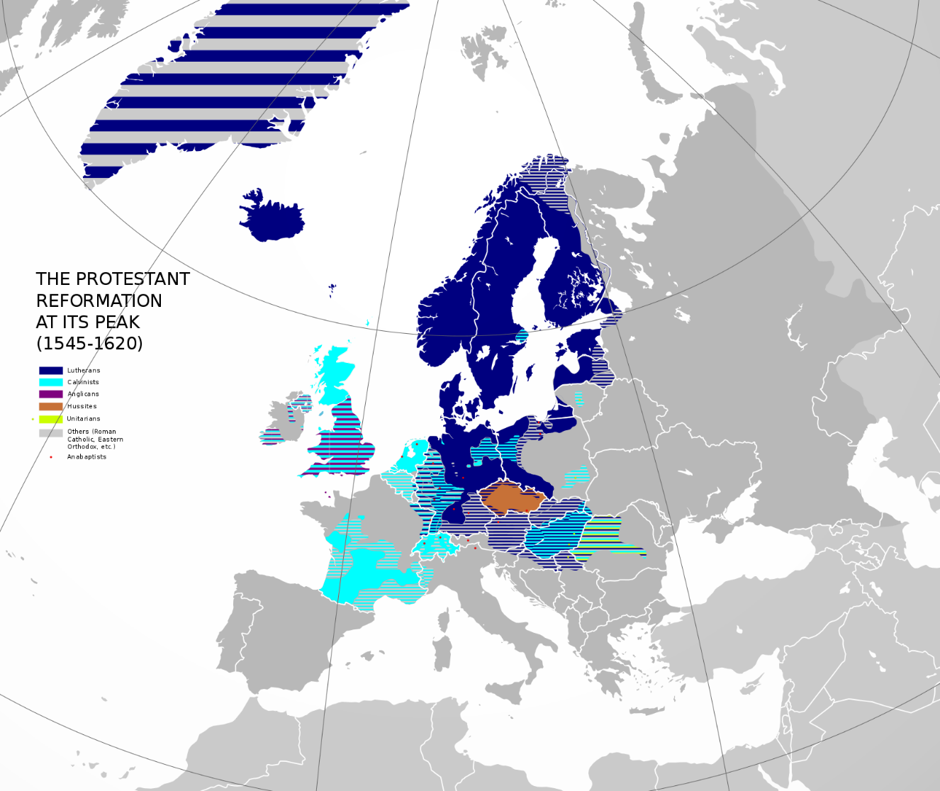
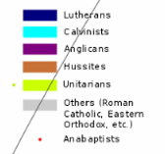
At the Peak of the Protestant Reformation
(1545-1620)
https://www.wikiwand.com/en/Counter-Reformation

Slide 19
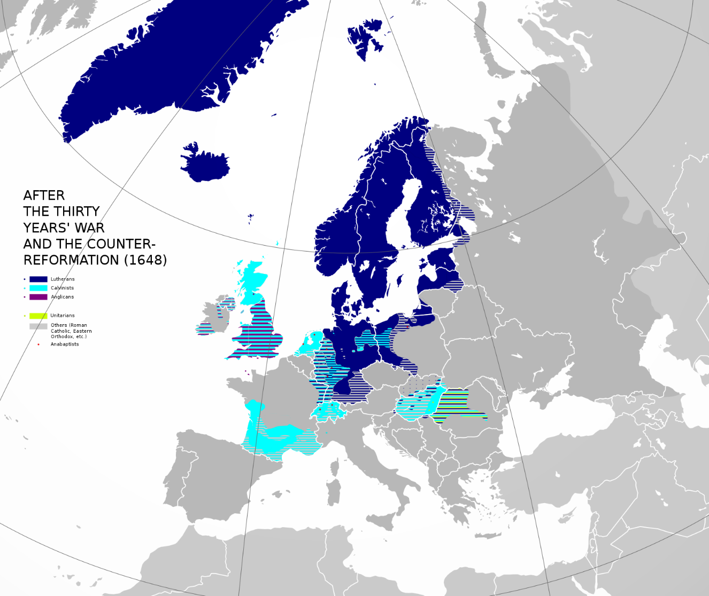

After the Counter-Reformation
(1648)
https://www.wikiwand.com/en/Counter-Reformation

Slide 20
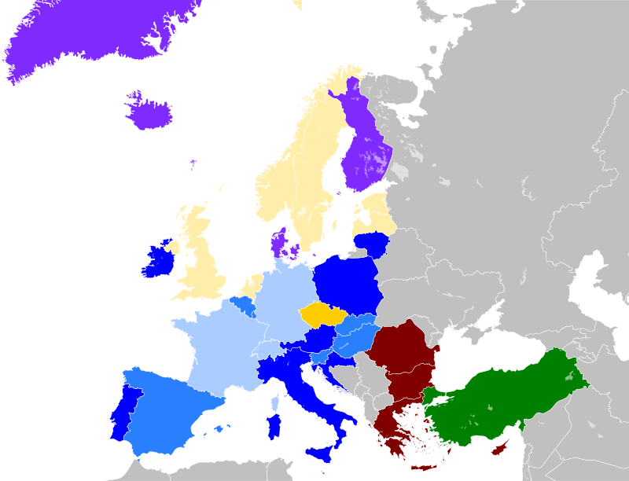
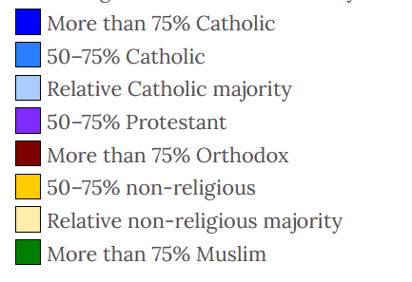
European Religions in 2010
https://www.wikiwand.com/en/Religion_in_Europe

Slide 21


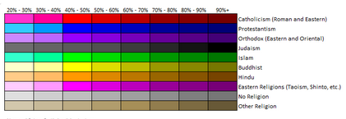
Map of World Religions
https://imgur.com/rzv85dn

Slide 22
Ignatius Loyola and the Jesuits
Sweeping aside the Catholic Evangelicals, Loyola’s spiritual knights taught and spread a new, fiercely anti-Protestant expression of Roman Catholic theology and spirituality throughout Europe.
With one hand, they dealt staggering blows to the Reformation; with the other, they founded orphanages, schools, centers for the care of the poor, houses for reforming prostitutes, and societies for ransoming Christian captives from Muslims.
Jesuits soon stood on the front line of Roman Catholicism at every level, as preachers, educators, chaplains, spiritual guides, and theologians.
Needham, Nick. 2,000 Years of Christ's Power Vol. 3: Renaissance and Reformation

Slide 23
Ignatius Loyola and the Jesuits
Yet at the same time, there was serious opposition to the Jesuits from within the Roman Catholic Church.
Roman Catholic monarchs were sometimes afraid of the Society’s far-flung and powerful international organization.
Many Roman Catholic bishops, and the other religious orders – notably the Dominicans and Franciscans – were jealous of the special favor the Jesuits enjoyed from the papacy.
Augustinian theologians (mostly Dominicans) within the Roman Church disliked Jesuit theology, which had very quickly become marked by a deep hostility to Augustine’s doctrines of sin and grace; and many Roman Catholic moral teachers tried to combat what they believed were the Jesuits’ low and easy-going views of morality.
Needham, Nick. 2,000 Years of Christ's Power Vol. 3: Renaissance and Reformation

Slide 24
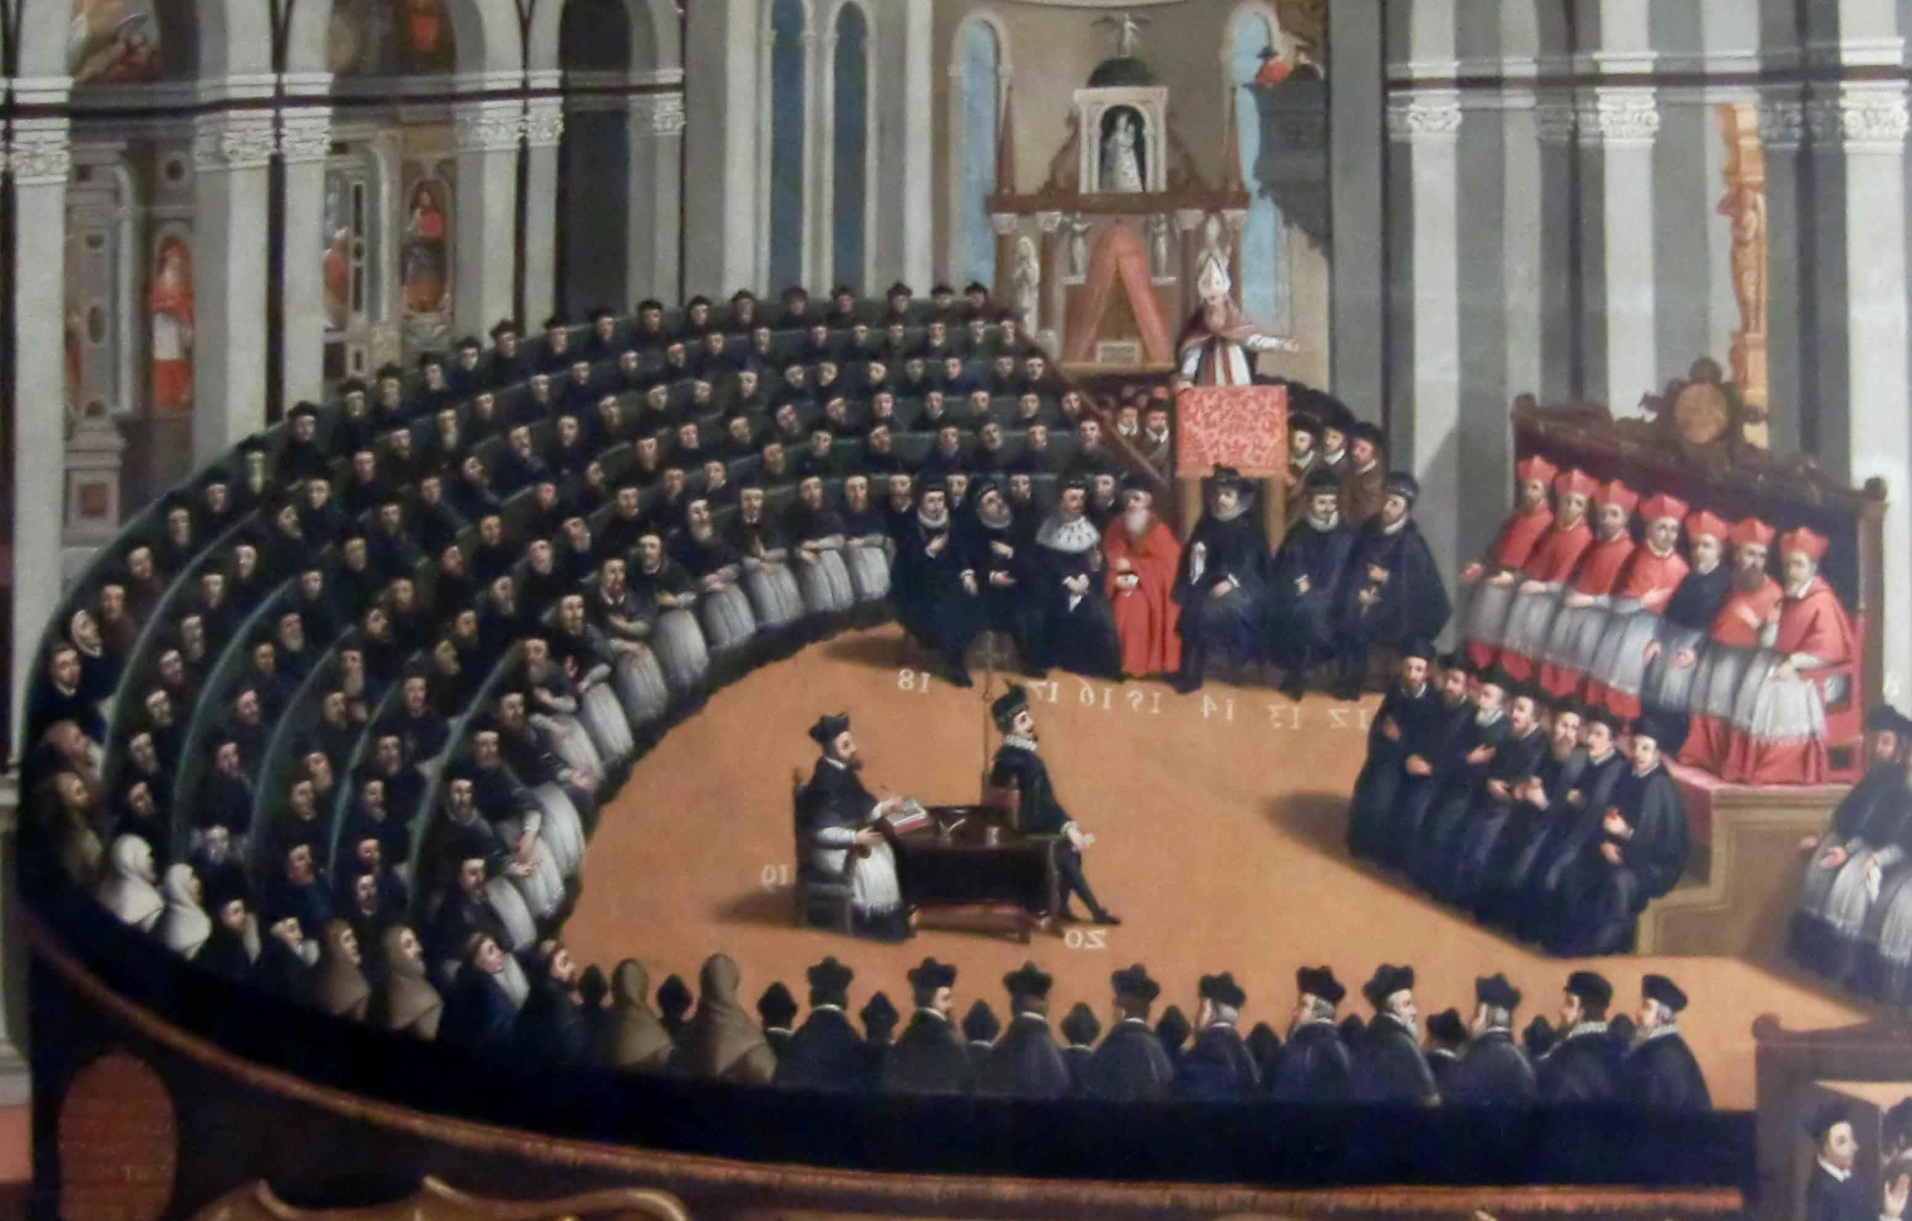
The Council of Trent
https://christianreformedink.wordpress.com/reformed-theology-2/ecclesiology/reformation-events/nine-things-you-should-know-about-the-council-of-trent/

Slide 25

Class Discussion Time
https://www.weareteachers.com/moving-beyond-classroom-discussions/

Slide 26
*Class Discussion Time
The Jesuits boasted, “Give me a child before he is seven, and he will remain a Catholic for the rest of his life.” This is reminiscent of Pro 22:6: Train up a child in the way he should go; even when he is old he will not depart from it. Is there a lesson in this for us?
  How important is it that we win the hearts of our children while they are young?
  How important is it that we protect our children from bad influences while they are young (under the age of seven)? Is it possible to overdo this? Is it a bad idea to raise your kids “in a bubble”?
Can we learn something from the methods used by the Jesuits to “evangelize” a society of people who are opposed to their views?
  Their targeting of young children (see previous questions) and the use of catechisms to counter the catechism’s of their opponents.
  Strong organizational approach to their missionary efforts (set up almost like a military).
  A wholistic approach to meeting human needs in other areas besides religious training (they founded orphanages, schools, centers for the care of the poor, houses for reforming prostitutes, and societies for ransoming Christian captives).
Do you have a topic or question that you would like to see us to discuss?

