Slide 1


Slide 2
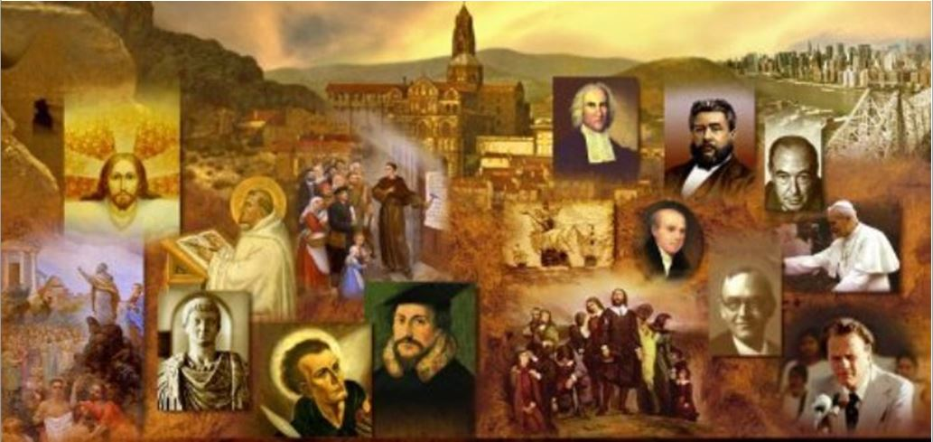
Review
What was the name of the religious order founded by Ignatius Loyola?
  The Society of Jesus (or Jesuits)
At first the Society of Jesus was concerned mainly with teaching orthodox Roman Catholic theology within the Church, e.g. to children in schools and to the illiterate, etc. What became their eventual goal?
  in the 1550s, the destruction of Protestantism became another chief purpose of the Society.
What effect did Canisius, one of Loyola’s favorite disciples, have in Austria, Bavaria, and Bohemia?
  He almost wiped out Protestantism in those countries.

Slide 3
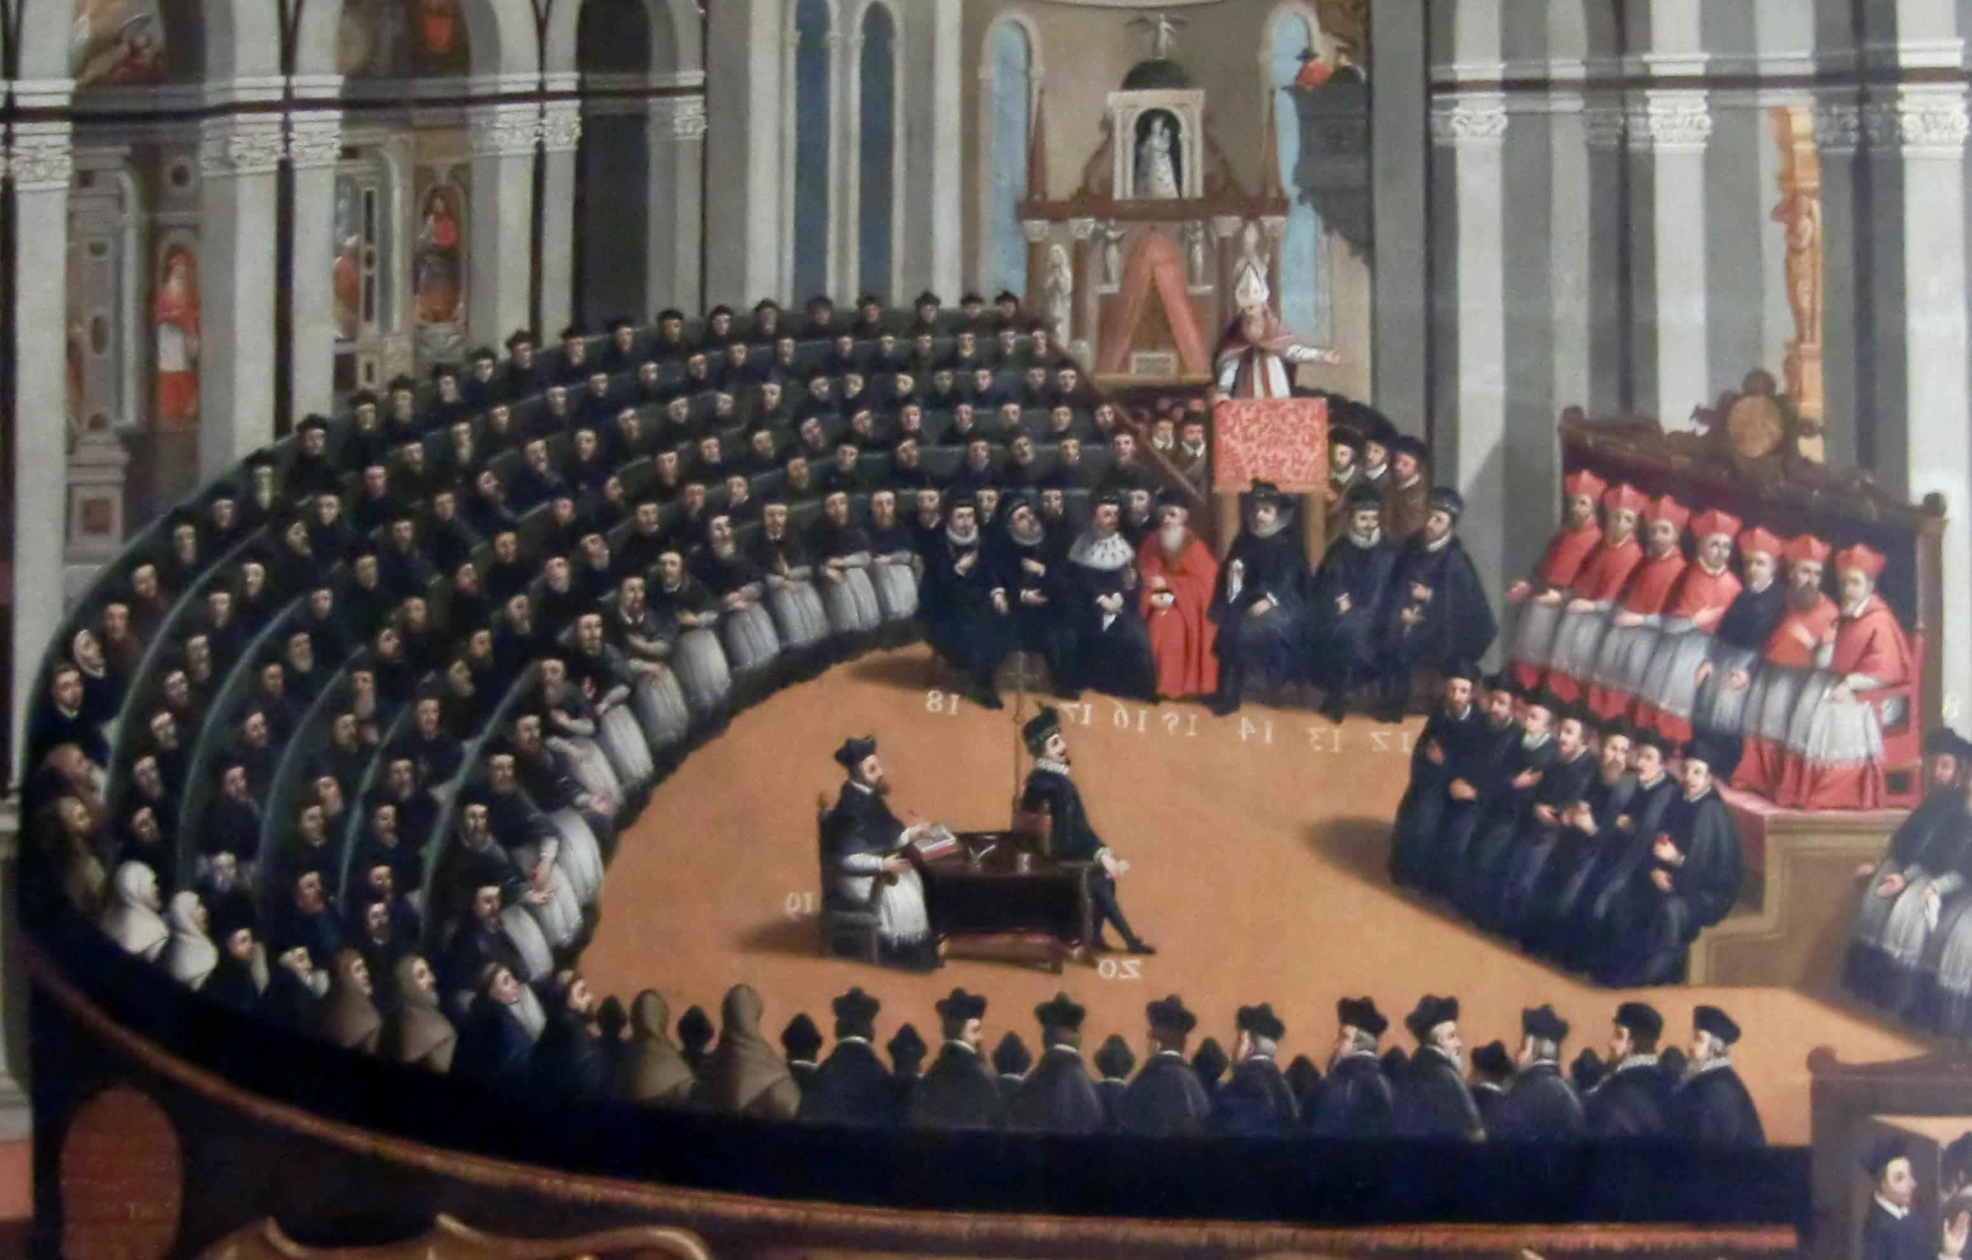
The Council of Trent
https://christianreformedink.wordpress.com/reformed-theology-2/ecclesiology/reformation-events/nine-things-you-should-know-about-the-council-of-trent/

Slide 4
The Council of Trent
In addition to the “Society of Jesus” (aka the Jesuits), the Council of Trent was the second great instrument of the Counter-Reformation.
It met in three stages:
  1545-49
  1551-52
  1562-63
From a Protestant point of view, the period of time covered by Trent stretched from the death of Luther to the death of Calvin.
Needham, Nick. 2,000 Years of Christ's Power Vol. 3: Renaissance and Reformation

Slide 5
The Council of Trent
Trent was supposed to be the ecumenical Council of the whole Western Church for which Luther had called before his break with Rome, and which others had been demanding for years. ¹
Instead, under the influence of the Jesuits, Trent developed into a powerful weapon of the Counter Reformation. ²
From start to finish the council reflected the new militant stance of Rome. ²
Everything the Protestant Reformation stood for was vigorously— one could almost say violently— rejected at Trent. ²
¹ Needham, Nick. 2,000 Years of Christ's Power Vol. 3: Renaissance and Reformation
² Shelley, Dr. Bruce L.. Church History in Plain Language: Fourth Edition

Slide 6
The Council of Trent
The Protestant Reformers emphasized justification by faith alone.
The Council of Trent declared that justification is the result of two causes:
  A righteousness that is external to the disciple but added to our account in the eyes of God
and
  A righteousness that is internal, infused into the disciple.
For Protestants, justification was linked to the event in which a person is given the external righteousness (of Christ) by means of faith at the point of salvation.
Trent emphatically linked justification to a process whereby God imparts righteousness within the disciple during the course of their life.
Shelley, Dr. Bruce L.. Church History in Plain Language: Fourth Edition

Slide 7
The Council of Trent
Luther, Calvin, and Grebel stressed salvation by grace alone.
The council of Trent emphasized grace and human cooperation with God to avoid, in Loyola’s terms, “the poison that destroys freedom.”
“Pray as though everything depended on God alone;” Ignatius advised, “but act as though it depended on you alone whether you will be saved.”
The Protestants taught the religious authority of Scripture alone.
The council of Trent insisted on the supreme teaching office of the Roman Church, popes and bishops, as the essential interpreters of the Bible.
Shelley, Dr. Bruce L.. Church History in Plain Language: Fourth Edition

Slide 8
The Council of Trent
The Council then focused its attention on the sacraments, passing decrees which made any realistic hope of reconciliation with the Protestants impossible.
The delegates reaffirmed with great emphasis the traditional later-medieval theology of the sacraments, declaring them to be seven in number:
  Baptism
  Mass
  Confirmation
  Penance
  Marriage
  Ordination
  Extreme Unction
Needham, Nick. 2,000 Years of Christ's Power Vol. 3: Renaissance and Reformation

Slide 9
The Council of Trent
They set forth the doctrine of transubstantiation in uncompromising language.
They stated the sacrificial nature of the mass.
They affirmed that the cup should be withheld from the laity.
They gave strong expression to the priesthood of the clergy which virtually denied the Protestant understanding of the priesthood of all believers.
They passed anti-Protestant decrees on the invocation of saints, the veneration of relics, purgatory, requiem masses, and indulgences.
Needham, Nick. 2,000 Years of Christ's Power Vol. 3: Renaissance and Reformation

Slide 10
The Council of Trent
The most contentious issue proved to be conflicting views of the authority of bishops in relation to the pope.
Many bishops held that their position came directly from Christ, and was not mediated to them through the pope – a kind of “episcopalian” theory.
The papacy and its supporters, however, maintained that the pope alone has his position directly from Christ, and that all other bishops derive their position from the pope – a view known as “curialism”, after the curia, the name for the papal court.
From Trent onwards, there was a slow, creeping growth of curial views of the papacy throughout the Roman Catholic Church, paving the way at length for the First Vatican Council of 1869-71, at which the pope was declared to be infallible when defining any matter of “faith or morals”.
Needham, Nick. 2,000 Years of Christ's Power Vol. 3: Renaissance and Reformation

Slide 11
The Council of Trent
The Council was dissolved on December 4, 1563, and the collected decrees from all three stages were given official papal sanction on January 24, 1564 by Pius IV.
This was not quite the end of the Council’s work, since before dissolving it set up a commission to reform the way that the mass was celebrated.
In 1570 the commission finished its work and published the Roman Missal (the liturgical textbook for the mass), whose use was made binding throughout the Church; it remained unchanged until the reform movements of the 1960s which resulted in Roman Catholics abandoning Latin and adopting the congregation’s native language for worship.
Needham, Nick. 2,000 Years of Christ's Power Vol. 3: Renaissance and Reformation

Slide 12
The Council of Trent
The Council of Trent was the single greatest landmark of the Catholic Counter-Reformation.
For the next 400 years, Trent’s formulation of Roman Catholic doctrine would be the standard to which Roman Catholics rallied, and against which all alternative visions of Christianity (especially Protestantism, but Eastern Orthodoxy too) would be measured – and found wanting.
Needham, Nick. 2,000 Years of Christ's Power Vol. 3: Renaissance and Reformation

Slide 13
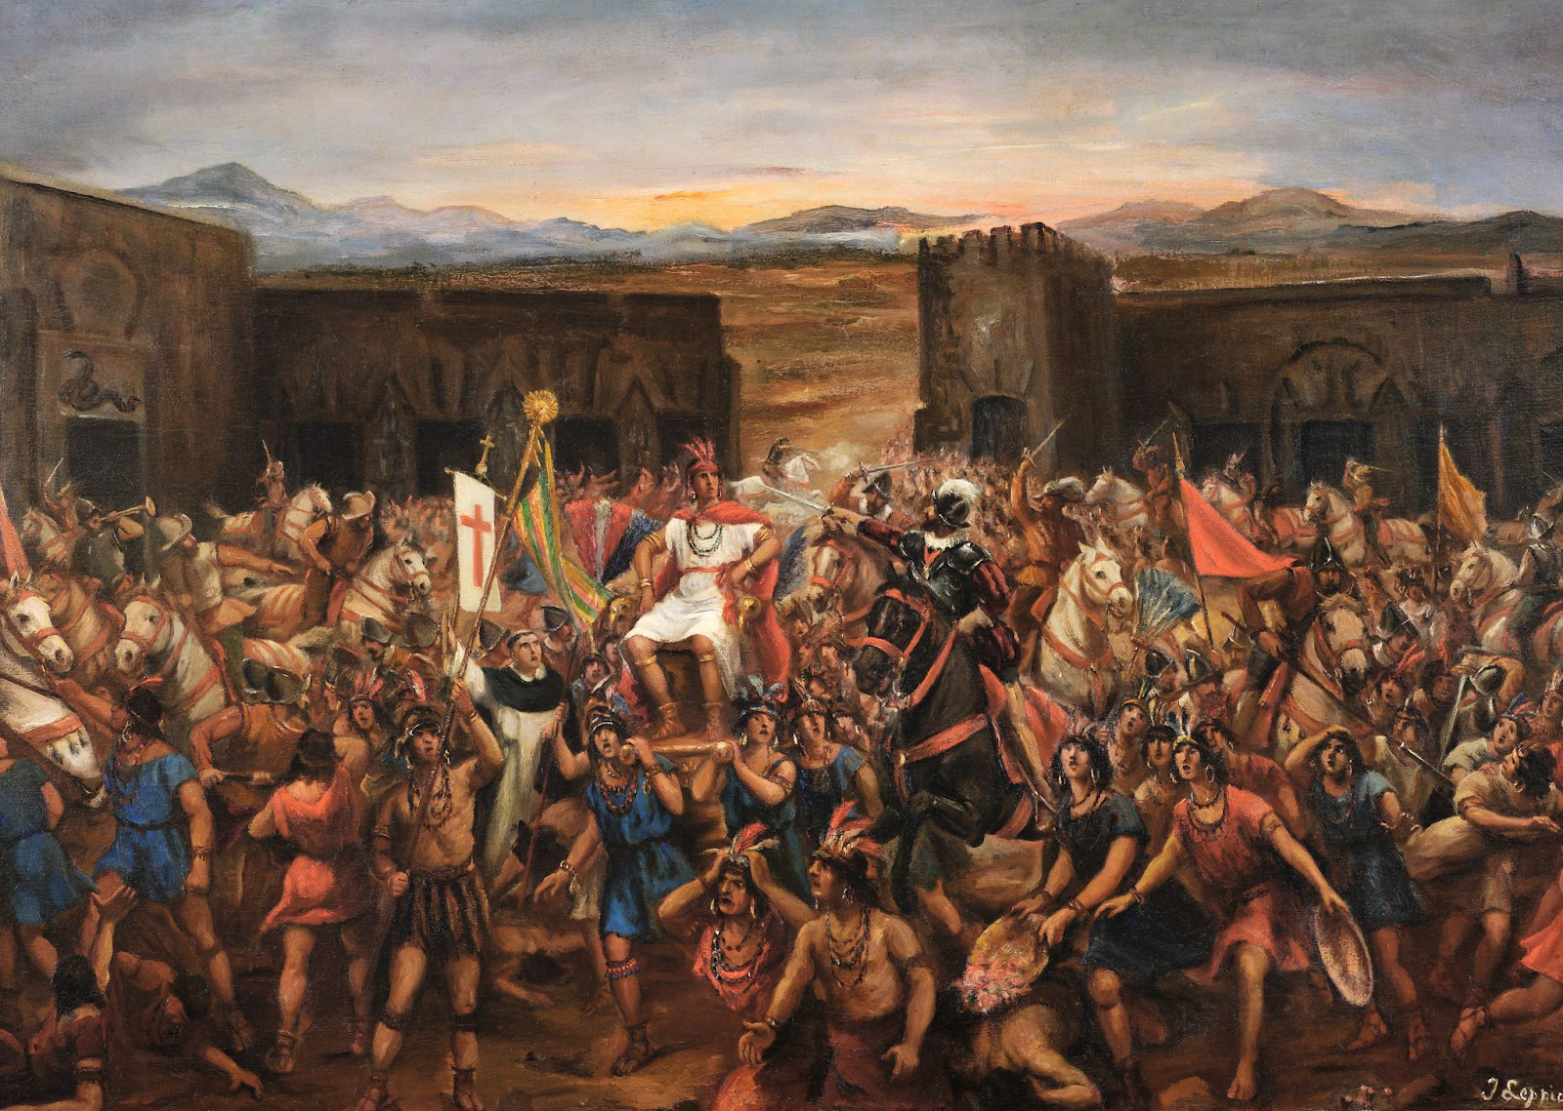
Roman Catholic Expansion Outside Europe
https://www.twcenter.net/forums/content.php?441-Guns-Faith-and-Steel-The-role-of-religion-in-the-Spanish-Conquest-of-South-America-and-post-Colonial-Society

Slide 14
Roman Catholic Expansion Outside Europe
The 16th century witnessed a vast expansion of Roman Catholicism outside Europe as a result of the colonial Empires so rapidly built by Spain and Portugal in the Americas, Africa, and India.
In 1492 the West Indies were discovered by Christopher Columbus, an Italian mariner in the service of the Spanish monarchy.
Altogether Columbus made four voyages (1492-93, 1493-96, 1498-1500, and 1502-04), which opened up the Americas for exploration and colonization by Spain and Portugal, and later by other European powers such as England, France, the Dutch Republic, and Denmark.
Needham, Nick. 2,000 Years of Christ's Power Vol. 3: Renaissance and Reformation

Slide 15
Roman Catholic Expansion Outside Europe
The coast of North America was discovered in 1497 by John Cabot, another Italian but this time in the service of the English king.
America was named after Amerigo Vespucci, an Italian whose explorations and reports of the American coast made the new continent widely known in Europe.
Also in 1497, the Portuguese mariner Vasco da Gama discovered the sea route to India and the East by sailing round the Cape of Good Hope (the extreme southern tip of Africa), which at a stroke made obsolete the whole complicated business of overland caravans to convey Eastern goods to the West.
Needham, Nick. 2,000 Years of Christ's Power Vol. 3: Renaissance and Reformation

Slide 16
Roman Catholic Expansion Outside Europe
To ward off conflict between Spanish and Portuguese forces, in 1493 Pope Alexander VI officially divided up the New World between the two nations.
Spain received Mexico, Peru, and the West Indies, settlements in Columbia and Panama, and outposts in California and Chile.
Portugal received Brazil, West Africa, Mozambique, India, and Ceylon (aka Sri Lanka), parts of the Persian Gulf, and the Malay archipelago south of China
The Philippines, however, were conquered by the Spanish in 1564 and named after King Philip II of Spain.
Mass colonization followed the parceling out of these regions.
Needham, Nick. 2,000 Years of Christ's Power Vol. 3: Renaissance and Reformation

Slide 17

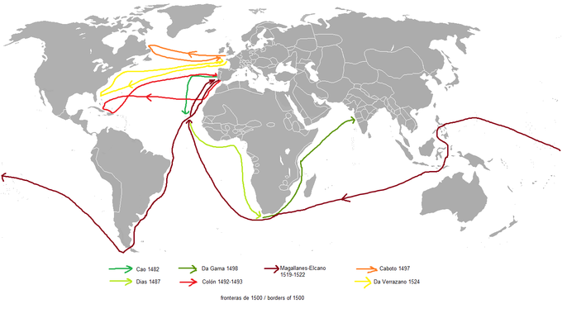
European Expansion
Cao 1482
Da Gama 1498
Magellan-Elcano
1519-1522
Cabot 1497
Dias 1487
Columbus 1492-1493
Da Verrazzano 1524
https://courses.lumenlearning.com/boundless-ushistory/chapter/the-expansion-of-europe/

Slide 18
Roman Catholic Expansion Outside Europe
The Spanish and Portuguese arrived in the Americas as conquering armies first, with the missionaries coming afterwards in their wake.
For the indigenous inhabitants, it was little short of a disaster.
The Spanish and Portuguese armies (“conquistadores”, i.e. conquerors) were half pirates bent on plunder, half crusaders intent on destroying the Paganism of the natives and imposing Roman Catholic Christianity as the “one true faith”.
We should not underestimate this crusading ardor: it was as real as the religious enthusiasm that had taken the medieval Crusaders into the Holy Land to wage war against Islam in the name of Christ.
Needham, Nick. 2,000 Years of Christ's Power Vol. 3: Renaissance and Reformation

Slide 19
Roman Catholic Expansion Outside Europe
With astonishing speed, the European invaders overthrew America’s Aztec and Inca Empires in the early decades of the 16th century.
The Spanish general Hernando Cortes destroyed the Aztec Empire in Mexico in 1519-21; Francisco Pizzaro, another Spaniard, vanquished the Inca Empire in Peru in 1532.
After this abrupt and ruthless conquest, the land was flooded by Dominican and Franciscan missionaries, who shepherded the native Americans into Roman Catholic Christianity through mass baptisms, while the Spanish “crusader” troops destroyed their Pagan idols and temples.
It certainly resulted in the “Christianizing” of the indigenous people and their culture, but often only at surface level.
The old Pagan ways persisted, dressed up in a Christian guise.
Needham, Nick. 2,000 Years of Christ's Power Vol. 3: Renaissance and Reformation

Slide 20
Roman Catholic Expansion Outside Europe
A huge practical problem was the social and political oppression to which the native Americans were subjected by their Spanish masters.
Wherever Spain conquered, the natives in particular districts were given into the power of a colonist, who had the right to tax them and demand their labor, in return for which he was obligated to protect them and Christianize them.
The system produced great injustice, and the native Americans often rebelled, massacring the Dominican and Franciscan missionaries.
This of course provoked savage reprisals and even harsher oppression.
The Spanish settlers regarded the natives as inferior beings, fit only to be ruled by the superior Spanish Christians: a view devoutly upheld by many Spanish theologians.
Needham, Nick. 2,000 Years of Christ's Power Vol. 3: Renaissance and Reformation

Slide 21
Roman Catholic Expansion Outside Europe
Many of the missionaries collaborated in this attitude of European superiority. Some, however, did not.
Bartholomew de Las Casas, a Dominican priest, devoted his life to campaigning for just treatment of native Americans.
He argued strongly against any use of compulsion in evangelism; non-Christian kingdoms had to be respected as legitimate, not seen as mere booty for Christian crusaders, and the only true method of conversion was by peaceful preaching and persuasion and the attractive example of holy living.
One fruit of Las Casas’s struggle was a guarantee in 1542 that the Spanish and the native Americans were to be given equality under the law as fellow human beings.
Strangely, in spite of Las Casas’s enlightened attitude to the native Americans, he did not extend the embrace of human brotherhood to the black Africans shipped to America as slaves.
Needham, Nick. 2,000 Years of Christ's Power Vol. 3: Renaissance and Reformation

Slide 22
Roman Catholic Expansion Outside Europe
In the East, the Jesuits spearheaded the missionary thrust.
The trailblazer was Francis Xavier, a Spanish noble of charming manners and appealing simplicity of character, Ignatius Loyola’s intimate friend.
Xavier headed East to India in 1541, at the request of King John III of Portugal.
Arriving in Goa on the western coast of India in 1542, Xavier dedicated the next ten years to preaching in India, Malaysia, Maluku, and Japan.
Needham, Nick. 2,000 Years of Christ's Power Vol. 3: Renaissance and Reformation

Slide 23
Roman Catholic Expansion Outside Europe
An impulsive man who leapt from one project to the next, Xavier then conceived it as his great mission to evangelize in China, but died before he could penetrate the country.
He left behind him a host of “converts” (through mass-baptisms on what many would now regard as the slenderest evidence of conversion), but more important, the infectious example of a heroic life freely spent in missionary enterprise.
In Roman Catholicism, Xavier is seen as the greatest missionary since the apostles.
His work in Japan certainly paved the way for the phenomenal expansion of Roman Catholic Christianity in that land in the latter half of the 16th century.
Needham, Nick. 2,000 Years of Christ's Power Vol. 3: Renaissance and Reformation

Slide 24
Effects of the Catholic Counter-Reformation
https://christianreformedink.wordpress.com/reformed-theology-2/ecclesiology/reformation-events/nine-things-you-should-know-about-the-council-of-trent/

Slide 25

Class Discussion Time
https://www.weareteachers.com/moving-beyond-classroom-discussions/

Slide 26
*Class Discussion Time
The Council of Trent demonstrates how deeply entrenched the Roman Catholic hierarchy was in opposing the gospel as understood by Protestants. Does this give you a deeper appreciation for why Luther considered reconciliation with Rome an impossible undertaking?
The Spanish conquered the native Americans militarily and then forcibly imposed “Christian” teaching on them. This is obviously wrong. But would it be wrong if they had first conquered and then tried to win the hearts of the native Americans voluntarily?
The Spanish settlers regarded the natives as inferior beings. Besides the fact that this is politically incorrect, what is the Biblical case (please give chapter and verse) for treating natives with the same respect and dignity as the Spanish settlers?
Although all people should be afforded equal respect and dignity, is it wrong to say that some cultures more aligned with Biblical principles than others?
Do you have a topic or question that you would like to see us to discuss?
Notes:
Acts 10:34-35 - So Peter opened his mouth and said: "Truly I understand that God shows no partiality, but in every nation anyone who fears him and does what is right is acceptable to him. (Act 10:34-35)
Acts 17:26 And [God] made from one man every nation of mankind to live on all the face of the earth, having determined allotted periods and the boundaries of their dwelling place (Act 17:26)
James 3:8-9 - no human being can tame the tongue. It is a restless evil, full of deadly poison. With it we bless our Lord and Father, and with it we curse people who are made in the likeness of God. (Jam 3:8-9)

