Slide 1


Slide 2
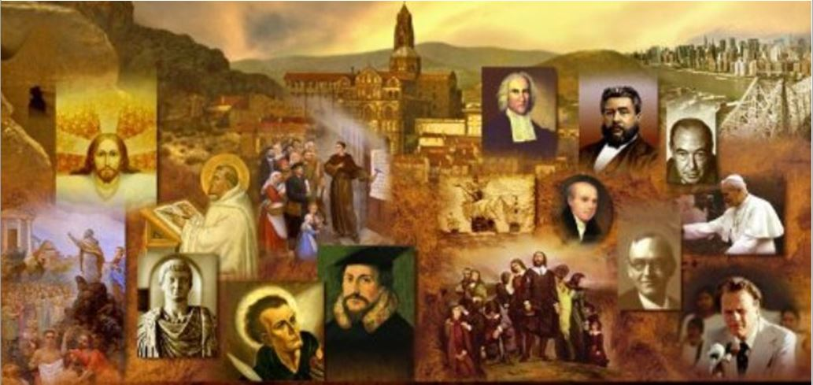
Review
How many years after John Calvin’s death did Theodore Beza serve as primary spiritual leader in Geneva?
  40 years
Beza’s edition of the Greek New Testament served as the key text used by the translators of what well known English translation of the Bible?
  the King James Bible
How did the eminent Dutch scholar Johannes Cocceius view the observance of the Sabbath in the NT period?
  He saw the Sabbath as a distinctively Old Testament ordinance, rooted not in creation but in God’s covenant with Israel at Sinai.
  He argued it was a sign of the coming Messianic kingdom,, just like other ceremonial ordinances; it foreshadowed the spiritual rest that Christ would procure from the laborious existence of sin.

Slide 3
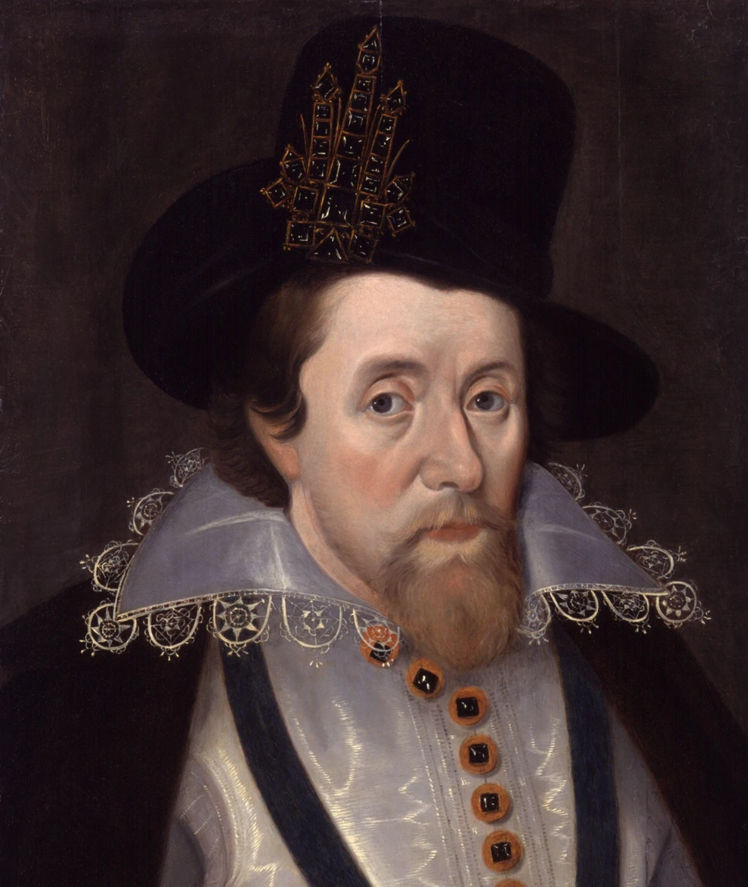
King James
https://reign.fandom.com/wiki/History%27s_King_James_VI_and_I?file=King_James_VI_and_I.jpg

Slide 4
King James
King James, (1566-1625), was king of Scotland (as James VI) from 1567 to 1625 and first Stuart king of England (as James I) from 1603 to 1625.
James was a strong advocate of the “Divine Right of Kings”, and his conflicts with an increasingly self-assertive Parliament set the stage for the rebellion against his successor, Charles I.
James was the only son of Mary, Queen of Scots, and her second husband, Henry Stewart, Lord Darnley.
Eight months after James’s birth his father died when his house was destroyed by an explosion.
After her third marriage, to James Hepburn, 4th earl of Bothwell, Mary was defeated by rebel Scottish lords and abdicated the throne. James, one year old, became king of Scotland on July 24, 1567.
Mary left the kingdom on May 16, 1568, and never saw her son again.
https://www.historyisfun.org/sites/jamestown-chronicles/james_more.html

Slide 5
King James
During his minority James was surrounded by a small band of the great Scottish lords.
Before James was 12, he had taken the Scotish government nominally into his own hands when the earl of Morton was driven from the regency in 1578.
The young king was kept fairly isolated but was given a good education until the age of 14.
He studied Greek, French, and Latin and made good use of a library of classical and religious writings that his tutors, assembled for him.
For several years more, however, James remained the puppet of contending faction leaders.
https://www.britannica.com/biography/James-I-king-of-England-and-Scotland

Slide 6
King James
After falling under the influence of the duke of Lennox, a Roman Catholic who schemed to win back Scotland for the imprisoned Queen Mary, James was kidnapped by William Ruthven, 1st earl of Gowrie, in 1582 and was forced to denounce Lennox.
The following year James escaped from his Protestant captors and began to pursue his own policies as king.
His chief purpose was to gain independence from the Scottish factions and to establish his claim to succeed the childless Elizabeth I upon the throne of England.
Realizing that more was to be gained by cultivating Elizabeth’s goodwill than by allying himself with her enemies, James in 1585–86 made an alliance with England.
He remained true to this policy, even when Elizabeth executed his mother in 1587, he made very little protest.
https://www.britannica.com/biography/James-I-king-of-England-and-Scotland

Slide 7
King James
When Elizabeth died in 1603 she left no direct heir, but declared James as her legitimate successor.
The transition took place without major difficulties, and thus the house of Stuart came to reign over England.
The new king—James I of England, but James VI of Scotland—did not find the government of England an easy matter.
The English always considered him a foreigner. His plans for the union of the two kingdoms—which eventually came about—won him enemies in both Scotland and England.
González, Justo L. . The Story of Christianity: Volume 2: The Reformation to the Present Day

Slide 8
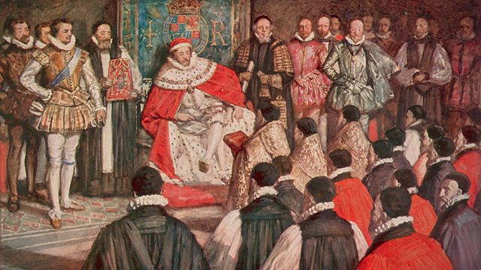
King James and the English Protestants
King James and Puritans at the Hampton Court Conference, 1604
https://www.bbc.co.uk/programmes/b00xln78

Slide 9
King James and the English Protestants
But James’s greatest conflicts were with those Protestants who thought that the Reformation had not progressed sufficiently far enough in England.
These more radical Protestants were given the name Puritans because they insisted on the need to purify the Church through a return to biblical religion.
They opposed many of the traditional elements of worship that the Church of England had retained, such as the use of the cross, certain priestly garments, and the celebration of communion on an altar.
They also insisted on the need for a sober life, guided by the commandments of Scripture, and lacking in luxury and ostentation.
González, Justo L. . The Story of Christianity: Volume 2: The Reformation to the Present Day

Slide 10
King James and the English Protestants
Many insisted on the need to keep the Lord’s Day, devoting it exclusively to religious exercises and to the practice of charity.
They also rejected the Book of Common Prayer and the use of written prayers in general, declaring that such prayers led to insincerity, so that even the Lord’s Prayer, rather than a set of words to be repeated, was to be used as a model for prayer.
They were not absolutely opposed to the use of alcohol, for most of them drank moderately, but they were very critical of drunkenness, particularly among ministers of the Church of England.
They were also very critical of all that they considered licentious—and this included the theater, not only because immorality was often depicted, but also because of the apparent duplicity implicit in acting.
González, Justo L. . The Story of Christianity: Volume 2: The Reformation to the Present Day

Slide 11
King James and the English Protestants
Many Puritans were opposed to bishops. They argued that the episcopacy, at least as it existed in their time, was a later invention, not to be found in the Bible; and that the church ought to look to Scripture as its constitution not only in matters of doctrine, but also in things having to do with its organization and governance.
Still others affirmed that each congregation ought to be independent of all others, and were dubbed “Independents.”
It was mostly from these independents that the forerunners of modern day Baptists arose.
González, Justo L. . The Story of Christianity: Volume 2: The Reformation to the Present Day

Slide 12
King James and the English Protestants
One of the early Puritan leaders was John Smyth (1554–1612), an Anglican priest who decided that Anglicanism had not gone far enough in the process of reformation and established an independent—and therefore illegal—congregation.
As this congregation grew, Smyth and his followers decided to flee to Amsterdam.
There he continued his study of the Bible, and came to the point of refusing to use translations of the Bible in worship, for only the original text had absolute authority.
At church, he would read Scripture in Hebrew or Greek, and translate the text as he preached.
Partly through his study of Scripture, and partly through contact with the Mennonites—whose pacifism and refusal to take oaths he adopted—he eventually became convinced that infant baptism is not valid, and therefore proceeded first to baptize himself with a bucket and a ladle, by pouring water over his head, and then to baptize his followers—for which his critics dubbed him “the self-baptizer.”
González, Justo L. . The Story of Christianity: Volume 2: The Reformation to the Present Day

Slide 13
King James and the English Protestants
The flight of Smyth and his congregation to Amsterdam had been financed by a well-to-do lawyer, Thomas Helwys, who broke ranks with Smyth over the issues of absolute pacifism and the taking of oaths—which Helwys, as a lawyer, considered fundamental to social order.
Helwys and his followers then returned to England, where in 1611 they founded the first Baptist Church on English soil.
Eventually, there was disagreement among Baptists over matters similar to those that divided the strict Calvinists and the Arminians.
Those who took the Arminian position came to be known as General Baptists, for they believed that salvation was generally available to all, in contrast to the “Particular Baptists,” who held that only the predestined would be saved.
González, Justo L. . The Story of Christianity: Volume 2: The Reformation to the Present Day

Slide 14
King James and the English Protestants
Meanwhile, the official (Anglican) church was following a parallel but opposite course.
Elizabeth’s balance had been achieved by establishing a church whose theology was moderately Calvinist, while retaining in its worship and governance all that did not clearly and directly contradict its new theology.
Among the leading theologians of the Church of England there was such appreciation for the beauty of worship as it was then practiced that there was little effort to make it conform to such outside requirements as theology or biblical exegesis.
Soon Puritans began to fear that a vast movement was afoot to return to “Romanism.”
González, Justo L. . The Story of Christianity: Volume 2: The Reformation to the Present Day

Slide 15
King James and the English Protestants
Consequently, as soon as James was proclaimed king, Puritan clergy in the Church of England organized a petition with astonishing swiftness, signed by a thousand ministers, asking James to reform the Church of his new southern kingdom.
The Anglican Church had something like nine thousand clergy, so this petition represented only a small minority of ministers.
Nonetheless, there was no other coalition of opinion in the Church so vocal and well-organized.
To the alarm of Archbishop Whitgift and the other Anglican bishops, James agreed to the conference.
Needham, Nick. 2,000 Years of Christ's Power Vol. 4: The Age of Religious Conflict

Slide 16
King James and the English Protestants
The conference took place at Hampton Court, a royal palace on the river Thames, in January, 1604.
The three-day conference was almost entirely amicable and by the end of the conference, the king had agreed to a list of moderate requests for Anglican reform.
But none of them actually happened.
The reason was the death of Archbishop Whitgift in February, only a month after the conference—and his replacement at James’ command by Richard Bancroft.
With Bancroft as Archbishop of Canterbury, there would never be any reforms, moderate or not; he was the most uncompromising opponent of all things Puritan in the entire Episcopal hierarchy.
Needham, Nick. 2,000 Years of Christ's Power Vol. 4: The Age of Religious Conflict

Slide 17
King James and the English Protestants
Once again, the Puritans were left empty-handed.
Worse, Bancroft immediately imposed a new set of canons on all clergy, requiring them to affirm in the most unqualified terms their acceptance of the doctrine, worship, and government of the Anglican Church
Some hundred Puritans were deposed or driven into exile for refusing.
Needham, Nick. 2,000 Years of Christ's Power Vol. 4: The Age of Religious Conflict

Slide 18
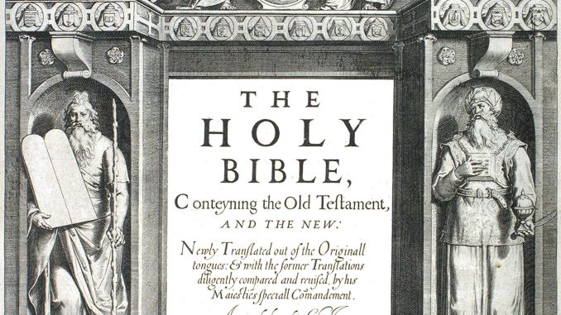
The King James Bible
https://www.mapsofworld.com/on-this-day/may-2-1611-the-king-james-bible-is-published-for-the-first-time/

Slide 19
The King James Bible
James did, however, vigorously pursue one suggestion that emerged unexpectedly from the Hampton Court conference—a suggestion for a new Bible translation.
Up until this point, far and away the most popular English Bible was the Geneva Bible.
Translated by English Protestant exiles in Geneva during Mary Tudor’s reign, the Geneva New Testament appeared in 1557, the complete Bible in 1560.
It was not favored by the Anglican establishment on account of its strongly Puritan marginal notes.
The preferred translation on the part of the Episcopal hierarchy was the Bishops’ Bible of 1568, enforced by convocation, the Anglican clerical governing body, in 1571.
Needham, Nick. 2,000 Years of Christ's Power Vol. 4: The Age of Religious Conflict

Slide 20
The King James Bible
However, it was the Geneva Bible that caught the popular imagination.
The Geneva Bible was the Bible of William Shakespeare, England’s master poet, and it was emphatically the Bible of English Puritans of all types throughout the 16th century.
Between 1560 and 1611, it went through 60 editions. Even after the new translation sponsored by King James appeared in 1611, the Geneva Bible remained popular for another half-century; there were 10 more editions.
John Milton, the well known English poet, was still using Geneva (alongside other translations, including the King James Bible) in the middle decades of the 17th century.
Needham, Nick. 2,000 Years of Christ's Power Vol. 4: The Age of Religious Conflict

Slide 21
The King James Bible
James, then, backed the project for a new translation.
He personally appointed 47 scholars, who met in various committees in Oxford, Cambridge, and Westminster over a three year period (1607–10).
These scholars were not from any single school of thought; James was more concerned, it would seem, about their scholarship than their theology.
  Some of the translators were establishment Anglicans, strongly opposed to all brands of Puritanism, critical even of Calvinism.
  Some were Calvinists but not Puritans
  Some were moderate Puritans.
The King James Bible therefore represented no particular theology, only a broad and general Anglican-style Protestantism.
Needham, Nick. 2,000 Years of Christ's Power Vol. 4: The Age of Religious Conflict

Slide 22
The King James Bible
The completed translation was published in 1611.
All editions of the King James Bible contained the Apocrypha until 1666, when an edition was published without them.
Thereafter, King James Bibles varied—some had the Apocrypha, some did not.
Although the King James Bible is often described as a new translation, and James himself thought of it in those terms, it should be pointed out that in fact the overwhelming bulk of its New Testament derives directly from William Tyndale’s translation of 1526.
Some 80% of the King James New Testament is simply Tyndale.
Needham, Nick. 2,000 Years of Christ's Power Vol. 4: The Age of Religious Conflict

Slide 23
The King James Bible
As the King James Bible eventually supplanted the Geneva Bible in popular use (which it did some time in the second half of the 17th century), this meant that Tyndale’s literary legacy was given a new and enduring lease of life.
No doubt this was not what James intended; but the eventual supremacy of the King James Bible, as the version used throughout the English-speaking Protestant world, and its profound long-term influence on the written and spoken word, meant that James had given Tyndale a place alongside Shakespeare as primary architect of the English language.
Needham, Nick. 2,000 Years of Christ's Power Vol. 4: The Age of Religious Conflict

Slide 24
Other Significant Events in the Reign of King James
https://reign.fandom.com/wiki/History%27s_King_James_VI_and_I?file=King_James_VI_and_I.jpg

Slide 25

Class Discussion Time
https://www.weareteachers.com/moving-beyond-classroom-discussions/

Slide 26
*Class Discussion Time
The Puritans opposed many of the traditional elements of worship that the Church of England had retained, such as the use of the cross, certain priestly garments, and the celebration of communion on an altar. Do you believe they were right to object to such things, or do you consider these things nonessential?
They also rejected the Book of Common Prayer and the use of written prayers in general, declaring that such prayers led to insincerity. Do you agree with this?
They were also very critical of all that they considered licentious—and this included the theater, not only because immorality was often depicted, but also because of the apparent duplicity implicit in acting. What do you think about their thinking on this?
Some of the Puritans believed that each local church congregation ought to be independent of all others, and were dubbed “Independents.” Do you agree with the idea of independent local congregations – or do you think scripture teaches (or perhaps allows for) a hierarchical form of church government?
Do you have a topic or question that you would like to see us to discuss?
Notes:
Acts 10:34-35 - So Peter opened his mouth and said: "Truly I understand that God shows no partiality, but in every nation anyone who fears him and does what is right is acceptable to him. (Act 10:34-35)
Acts 17:26 And [God] made from one man every nation of mankind to live on all the face of the earth, having determined allotted periods and the boundaries of their dwelling place (Act 17:26)
James 3:8-9 - no human being can tame the tongue. It is a restless evil, full of deadly poison. With it we bless our Lord and Father, and with it we curse people who are made in the likeness of God. (Jam 3:8-9)

