Slide 1


Slide 2
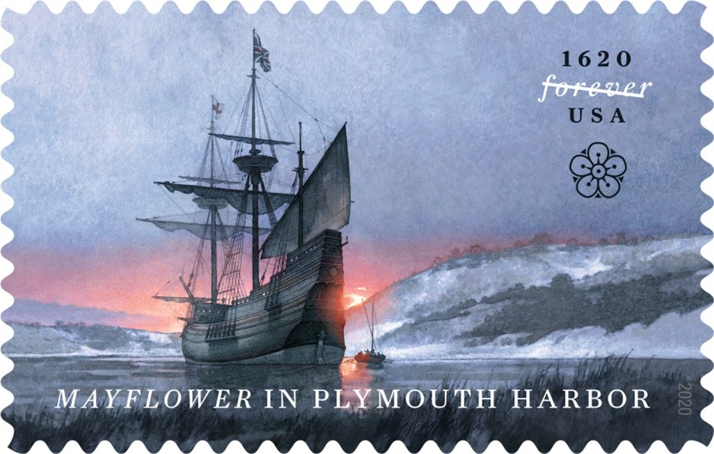
Pilgrims Come to America
https://about.usps.com/newsroom/national-releases/2020/0902ma-usps-celebrates-the-arrival-of-the-mayflower-in-plymouth-harbor-with-forever-stamp.htm

Slide 3
Pilgrims Come to America
After the Hampton Court Conference, seeing little hope that they could reform the Anglican Church, little groups of believers began to meet for worship as they felt the Bible taught them, not according to bishops and prayer books.
They were determined to obey God even if their nation’s leaders were not.
We call this movement Separatism because the groups were intent upon leaving the Church of England to build a separate church.
One of these groups was in the village of Scrooby in northern England.
By 1608 they had moved to Leyden, Holland for safety and freedom of worship.
Shelley, Dr. Bruce L.. Church History in Plain Language: Fourth Edition

Slide 4
Pilgrims Come to America
After ten years in Holland the Scrooby congregation, led by Pastor John Robinson, realized that their children were growing up out of touch with their homeland, forgetting even their native tongue.
But to return to England meant a return to the evil ways of English society.
They had heard of the English colony in Virginia planted in 1607. Perhaps the new continent of America was their answer.
It was a daring thought, full of unknown terrors, but a small number was willing to try.
So they returned to England, where they were joined by another group of like-minded pilgrims.
Shelley, Dr. Bruce L.. Church History in Plain Language: Fourth Edition

Slide 5
Pilgrims Come to America
In September 1620 a company of about a hundred souls set sail from Plymouth, England in a ship called the Mayflower.
In November 1620 the Pilgrim Fathers stepped ashore at what we call Plymouth, Massachusetts.
Ten years later the Massachusetts Bay Company began attracting thousands of frustrated Puritans to Boston and its surrounding towns.
Between 1629 and 1642 some twenty-five thousand Puritans migrated to New England.
Other than in Virginia, the English authorities made no attempt to impose a pattern of religious uniformity in the New World.
Shelley, Dr. Bruce L.. Church History in Plain Language: Fourth Edition

Slide 6
Pilgrims Come to America
The colonies were commercial ventures designed to contribute to the prosperity of a developing English empire.
To be profitable the colonies needed settlers to clear the forests and till the fields.
So the promise of religious toleration provided a powerful incentive to accept the hazards of life in the American colonies.
Quakers came to Pennsylvania, Catholics to Maryland, and Dutch Reformed to New York.
Later came Swedish Lutherans and French Huguenots, English Baptists and Scottish Presbyterians.
Shelley, Dr. Bruce L.. Church History in Plain Language: Fourth Edition

Slide 7
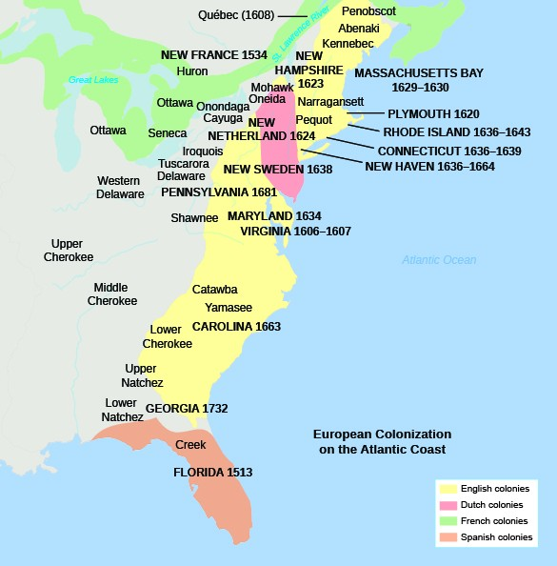
EarlySettlements in New England
https://courses.lumenlearning.com/ushistory1os/chapter/english-settlements-in-america/

Slide 8
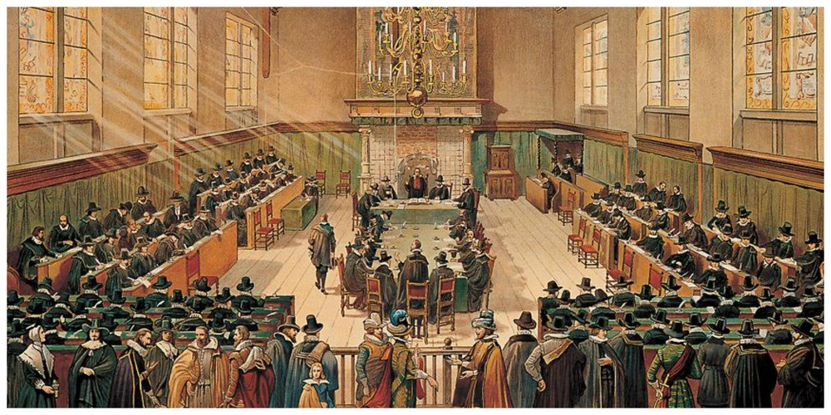
The Origin of the Five Points of Calvinism
https://plymrock.org/pastor-john-robinson-and-the-synod-of-dort/

Slide 9
The Origin of The “Five Points”
To understand how and why the system of theology known to history as Calvinism came to bear this name and to be formulated into five points, one must understand the theological conflict which occurred in Holland during the first quarter of the seventeenth century.
Steele, David; The Five Points of Calvinism Defined Defended and Documented

Slide 10
James Arminius
The story begins with James Arminius, a popular Dutch theologian and pastor, who, having trained under Theodore Beza, he began his career as a Calvinist.
Over time, however, having come under the influence of Dutch humanism and Roman Catholicism, Arminius came to reject many of the teachings of Calvin and Beza regarding the unconditional nature of Biblical predestination.
Predestination, he held, was in fact conditional on human faith: God elected to salvation those whom He foreknew would believe.
Needham, Nick. 2,000 Years of Christ's Power Vol. 4: The Age of Religious Conflict

Slide 11
James Arminius
In 1610, just one year after the death of James Arminius, five articles of faith based on his teachings were drawn up by his followers.
The Arminians, as his followers came to be called, presented these five doctrines to the state of Holland in the form of a “Remonstrance” (i.e. protest).
The Arminian party insisted that the Belgic Confession of Faith and the Heidelberg Catechism (the official expression of the doctrinal position of the Churches of Holland) be changed to conform to the doctrinal views contained in the Remonstrance.
Steele, David; The Five Points of Calvinism Defined Defended and Documented

Slide 12
The “Five Points” of Arminianism
The five articles contained in the Remonstrance can be summarized as follows:
  God elects or reproves on the basis of foreseen faith or unbelief.
  Christ died for all men, although only believers are saved.
  Man is so depraved that divine grace is necessary in order to have faith or to do any good deed.
  But, this grace may be resisted.
  Whether or not all who are truly saved will persevere in their faith is a point which needs further investigation.
The last article was later altered so as to definitely teach the possibility of the truly regenerate believer’s losing his faith and thus losing his salvation.
However, Arminians have not been in agreement on this point – some have held that all who are regenerated by the Spirit of God are eternally secure and can never perish.
Steele, David; The Five Points of Calvinism Defined Defended and Documented

Slide 13
The Synod of Dort
A national Synod was called to meet in Dort in 1618 for the purpose of examining the views of Arminius in the light of Scripture.
The Great Synod was convened by the States-General of Holland on November 13, 1618.
There were 84 members and 18 secular commissioners. Included were 27 delegates from Germany, Switzerland and England.
There were 154 sessions held during the seven months that the Synod met to consider these matters, the last of which was on May 9, 1619.
Steele, David; The Five Points of Calvinism Defined Defended and Documented

Slide 14
The Synod of Dort
The Synod gave very close examination to the “five points” in the Remonstrance, and compared them with the testimony of Scripture.
Ultimately they concluded that the “five points” in the Remonstrance conflicted with the teachings of the Word of God, and therefore they had unanimously rejected them.
Steele, David; The Five Points of Calvinism Defined Defended and Documented

Slide 15
The Synod of Dort
Those participating in the council felt, however, that a mere rejection was not sufficient.
They thought it was also important to set forth the true Calvinistic teaching in relationship to those matters which had been called into question.
And so they did this, embodying the Calvinistic position in five chapters which have ever since been known as “the five points of Calvinism.”
The name Calvinism was derived from the great French reformer, John Calvin (1509-1564), who had done so much in expounding and defending these views.
Steele, David; The Five Points of Calvinism Defined Defended and Documented

Slide 16
The Synod of Dort
No doubt it will seem strange to many in our day that the Synod of Dort rejected as heretical the five doctrines advanced by the Arminians, for these doctrines have gained wide acceptance in the modern Church.
In fact, they are seldom questioned in our generation. But the vast majority of the Protestant theologians of that day took a much different view of the matter.
They maintained that the Bible set forth a system of doctrine quite different from that advocated by the Arminian party.
Steele, David; The Five Points of Calvinism Defined Defended and Documented

Slide 17
The Synod of Dort
Salvation was viewed by the members of the Synod as a work of grace from beginning to end; in no sense did they believe that the sinner saved himself or contributed to his salvation.
Adam’s fall had completely ruined the race. All men were by nature spiritually dead and their wills were in bondage to sin and Satan.
The ability to believe the gospel was itself a gift from God, bestowed only upon those whom He had chosen to be the objects of His unmerited favor.
It was not man, but God, who determined which sinners would be shown mercy and saved.
This, in essence, is what the members of the Synod of Dort understood the Bible to teach.
Steele, David; The Five Points of Calvinism Defined Defended and Documented

Slide 18
The Five Points of Calvinism
Total Depravity
Because of the fall, man is unable of himself to savingly believe the gospel. The sinner is dead, blind, and deaf to the things of God; his heart is deceitful and desperately corrupt. His will is not free, it is in bondage to his evil nature; therefore, he will not--indeed he cannot--choose good over evil in the spiritual realm. Consequently, it takes much more than the Spirit's assistance to bring a sinner to Christ--it takes regeneration by which the Spirit makes the sinner alive and gives him a new nature. Faith is not something man contributes to salvation but is itself a part of God's gift of salvation--it is God's gift to the sinner, not the sinner’s gift to God.
(Genesis 2:15-17, Romans 5:12, Psalm 51:5, 1 Corinthians 2:14, Romans 3:10-18, Jeremiah 17:9, John 6:44, Ephesians 2:1-10)
Steele, David; The Five Points of Calvinism Defined Defended and Documented

Slide 19
The Five Points of Calvinism
Unconditional Election
God's choice of certain individuals unto salvation before the foundation of the world rested solely in His own sovereign will. His choice of particular sinners was not based on any foreseen response or obedience on their part, such as faith, repentance, etc. On the contrary, God gives faith and repentance to each individual whom He selected. These acts are the result, not the cause of God's choice. Election therefore was not determined by or conditioned upon any virtuous quality or act foreseen in man. Those whom God sovereignly elected He brings through the power of the Spirit to a willing acceptance of Christ. Thus God's choice of the sinner, not the sinner’s choice of Christ, is the ultimate cause of salvation.
(Romans 9:10-21, Ephesians 1:4-11, Ephesians 2:4-10, Romans 8:29-30, Acts 11:18, Acts 13:48)
Steele, David; The Five Points of Calvinism Defined Defended and Documented

Slide 20
The Five Points of Calvinism
Limited Atonement
Christ's redeeming work was intended to save the elect only and actually secured salvation for them. His death was a substitutionary endurance of the penalty of sin in the place of certain specified sinners. In addition to putting away the sins of His people, Christ's redemption secured everything necessary for their salvation, including faith which united them to Him. The gift of faith is infallibly applied by the Spirit to all for whom Christ died, thereby guaranteeing their salvation.
(Matthew 1:21, Romans 5:12-21, Romans 3:21-26, Ephesians 2:8-10, Titus 3:5-6, Philippians 1:6, John 10:11-30, John 17:6-12, Romans 8:28-30, John 6:44, Acts 20:28)
Steele, David; The Five Points of Calvinism Defined Defended and Documented

Slide 21
The Five Points of Calvinism
Irresistible Grace
In addition to the outward general call to salvation which is made to everyone who hears the gospel, the Holy Spirit extends to the elect a special inward call that inevitably brings them to salvation. The external call (which is made to all without distinction) can be, and often is, rejected; whereas the internal call (which is made only to the elect) cannot be rejected, it always results in conversion. By means of this special call the Spirit irresistibly draws sinners to Christ. He is not limited in His work of applying salvation by man's will, nor is He dependent upon man's cooperation for success. The Spirit graciously causes the elect sinner to cooperate, to believe, to repent, to come freely and willingly to Christ. God's grace, therefore, is invincible; it never fails to result in the salvation of those to whom it is extended.
(John 3:16, Matthew 22:14, Acts 17:29-31, Matthew 23:37-39, John 6:44, Romans 8:28-30, John 1:12-13, John 3:1-8, Ephesians 2:8-10)
Steele, David; The Five Points of Calvinism Defined Defended and Documented

Slide 22
The Five Points of Calvinism
Perseverance of the Saints
All who were chosen by God, redeemed by Christ, and given faith by the Spirit are eternally saved. They are kept in faith by the power of Almighty God and thus persevere to the end.
(John 3:16, John 6:35-40, John 6:44, Philippians 1:6, Philippians 2:12-13, Jude 24-25, Ephesians 1:13-14, Romans 8:28-30, Romans 8:35-39)
Steele, David; The Five Points of Calvinism Defined Defended and Documented

Slide 23
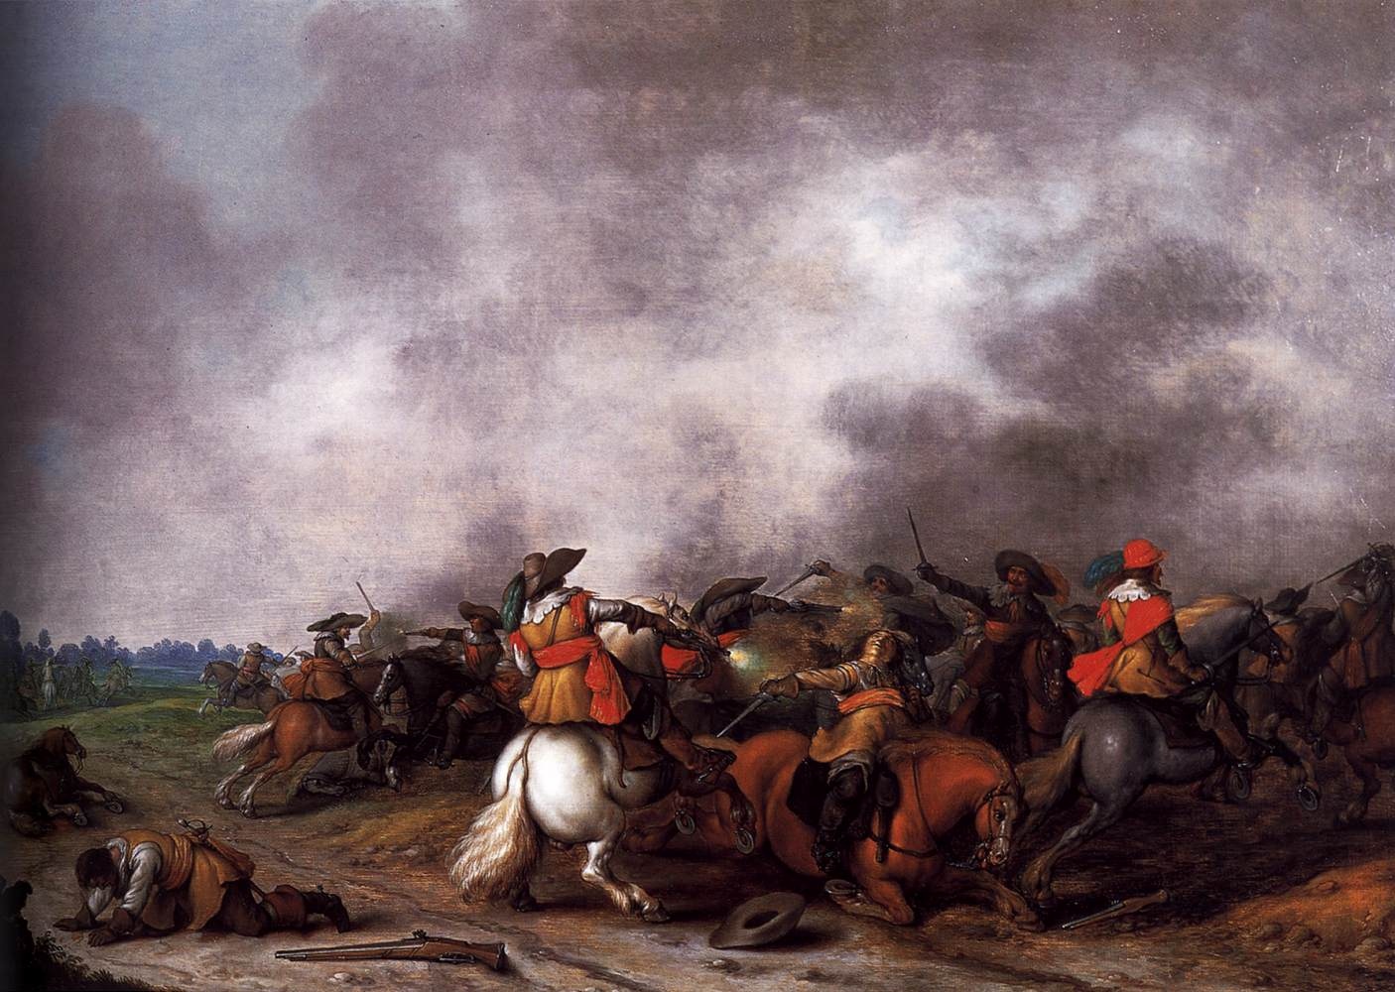
The Thirty Years War
https://www.wikiwand.com/en/Thirty_Years%27_War

Slide 24

Class Discussion Time
https://www.weareteachers.com/moving-beyond-classroom-discussions/

Slide 25
*Class Discussion Time
Do you have any sympathy for any of the points made by the Arminians?
Do you find the five points of Calvinism as explained by the Council of Dort to be persuasive? If so, are there any aspects of “Calvinism” over which you are inclined to have doubts?
While the five points of Calvinism are theological in nature, are there any practical benefits to understanding these doctrines? If so, what are they?
Do you have a topic or question that you would like to see us to discuss?
Notes:
Acts 10:34-35 - So Peter opened his mouth and said: "Truly I understand that God shows no partiality, but in every nation anyone who fears him and does what is right is acceptable to him. (Act 10:34-35)
Acts 17:26 And [God] made from one man every nation of mankind to live on all the face of the earth, having determined allotted periods and the boundaries of their dwelling place (Act 17:26)
James 3:8-9 - no human being can tame the tongue. It is a restless evil, full of deadly poison. With it we bless our Lord and Father, and with it we curse people who are made in the likeness of God. (Jam 3:8-9)

