Slide 1


Slide 2
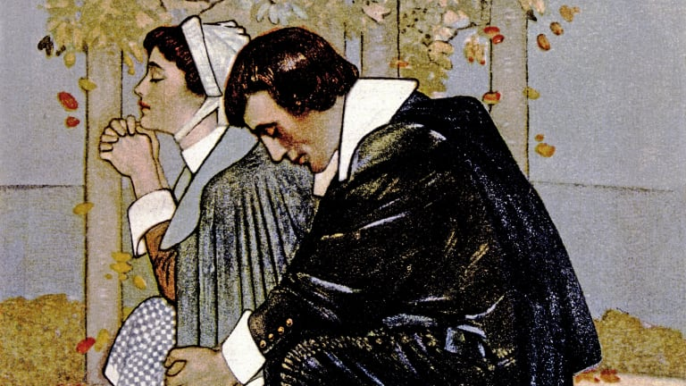
Puritanism
https://www.history.com/topics/colonial-america/puritanism

Slide 3
Puritanism
In 1630 more than four hundred immigrants gathered at Southampton, England, preparing to sail to the New World.
John Cotton, a distinguished minister who would later join them on the other side of the sea, preached a farewell sermon.
His text for the occasion, 2 Samuel 7:10, summed up the spirit of the great adventure:
  Moreover I will appoint a place for my people Israel, and will plant them, that they may dwell in a place of their own, and move no more; neither shall the children of wickedness afflict them any more, as before-time (KJV).
Shelley, Dr. Bruce L.. Church History in Plain Language: Fourth Edition

Slide 4
Puritanism
Cotton declared that like the ancient Israelites these immigrants were God’s chosen people, headed for the land he had promised and prepared.
In this new land they would be able to labor undisturbed for the glory of God.
There you have a snapshot of Puritanism:
  The Bible is the guidebook providing concrete instruction for the believer’s conversion and the construction of a society designed to reinforce a biblical view of the state.
  The church, often pictured analogously to ancient Israel, is also rightly pictured in the Scriptures and should function as the agent for individual and societal reform.
  The society and nation should also be ordered to bolster the purpose of God being played out in history.
Shelley, Dr. Bruce L.. Church History in Plain Language: Fourth Edition

Slide 5
Puritanism
Puritanism endured as a distinct historic movement between 1560 and 1660, providing for Christians of every generation with a model of:
  The Christian faith as a decisive commitment to Jesus Christ
  How that life of the soul expresses itself in the public arena in a nation governed by the truths of the Bible.
The first Puritans had little confidence in traditional religion.
Their plans for a new England arose from a deep conviction that spiritual conversion was crucial to Christianity.
In the mind of the puritans, this rebirth separated them from the mass of mankind and endowed them with the privileges and the duties of the elect of God.
Shelley, Dr. Bruce L.. Church History in Plain Language: Fourth Edition

Slide 6
Puritanism
In its quest to reshape England, the Puritan movement passed through three rather clearly marked periods:
  First, under Queen Elizabeth (1558–1603) it tried to purify the Church of England along the lines of Calvin’s Geneva.
  Second, under James I and Charles I (1603–1642) it resisted the claims of the monarchy and suffered under royal pressures designed to force conformity to a High-Church style Christianity.
  Third, during England’s Civil War and Oliver Cromwell’s rule (1642–1660), Puritans had a chance to shape the national church in England but failed because of their own internal dissensions.
Shelley, Dr. Bruce L.. Church History in Plain Language: Fourth Edition

Slide 7
Puritanism
Under Queen Elizabeth, separation from the Church of England, was considered far too drastic for the vast majority of Puritans. They remained hopeful for some alternative to “schism”.
But all grounds for hope in earthly rulers appeared to vanish in 1625, when Charles I followed his father James to the English throne.
James had his theories about the divine right of kings; Charles was determined to put them into practice.
No law and no parliament would restrain him. To make matters worse in the eyes of the Puritans, his wife, Henrietta Maria, was a French Roman Catholic princess.
Shelley, Dr. Bruce L.. Church History in Plain Language: Fourth Edition

Slide 8
Puritanism
To enforce his will upon the Puritans, Charles found a ready servant in Archbishop William Laud, who believed that God had ordained bishops to govern his church.
Led by the archbishop, an episcopal party arose to resist the Puritans. With the king’s support they reintroduced stained glass windows, crosses—even crucifixes.
They elevated the Communion table and called it an altar and they insisted that worship be conducted according to the Prayer Book and no other.
Shelley, Dr. Bruce L.. Church History in Plain Language: Fourth Edition

Slide 9
Puritanism
Laud’s high-minded and high-handed policy drove some Puritans toward Separatism and others across the Atlantic to America.
Within ten years after Laud became archbishop, twenty towns and churches had sprung up in Massachusetts Bay: in all sixteen thousand people including the four hundred who heard John Cotton’s farewell at Southampton.
The straw that broke the camel’s back came when Charles tried to force his high church brand of Anglican religion upon the Presbyterian Scots.
He insisted that they conduct their worship services from the Book of Common Prayer.
The Scots rose in opposition to the move and to defend their Church, they dared to take up arms against their king.
Shelley, Dr. Bruce L.. Church History in Plain Language: Fourth Edition

Slide 10
Puritanism
To put an army in the field Charles was forced to convene Parliament, which he, like his father, had tried to ignore for over a decade.
Once Parliament assembled, conflicting loyalties led to two parties:
  Royalist Party
  Parliamentary Party.
The Parliamentarians, clearly a majority, were agreed on the broad Puritan principles but were divided over the form of the church.
  On the one hand were Presbyterians
  On the other were Independents (or Congregationalists)
United in their hatred of Archbishop Laud, the Parliamentarians succeeded in bringing him to trial and having him beheaded.
Shelley, Dr. Bruce L.. Church History in Plain Language: Fourth Edition

Slide 11
Puritanism
When Charles tried to punish the Parliamentarian Party leaders for beheading Archbishop Laud, civil war erupted.
The Royalist members of Parliament left London to join the forces defending the king.
This left the remaining Parliamentarian Party (in London) free at last to institute the reform of the Church the Puritans had always wanted.
Shelley, Dr. Bruce L.. Church History in Plain Language: Fourth Edition

Slide 12
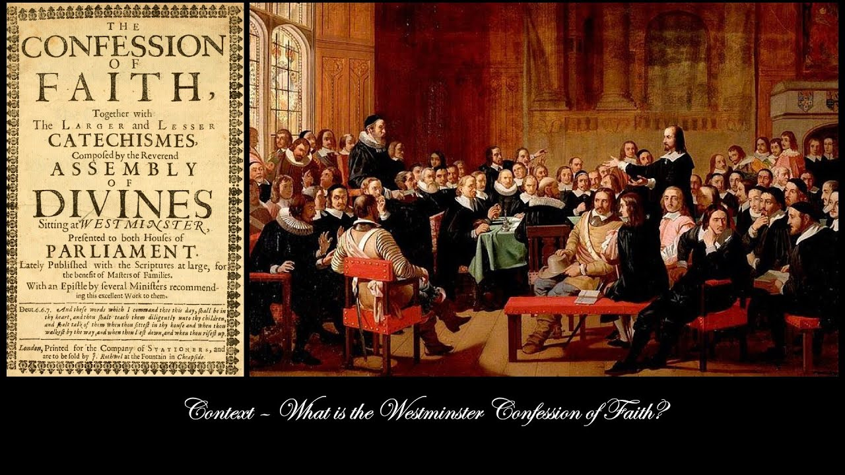
Westminster Confession
https://www.youtube.com/watch?v=vLHrmbdSBMs

Slide 13
Westminster Confession
With the exit of the Royalist Party from Parliament, the Puritans were now free to begin implementing changes in the Anglican Church.
In 1643, the English Parliament called upon “learned, godly and judicious Divines” to meet at Westminster Abbey in order to provide advice on issues of worship, doctrine, government and discipline of the Church of England.
Their meetings, over a period of five years, produced the Westminster Confession of Faith, as well as a Larger Catechism and a Shorter Catechism.
https://www.wikiwand.com/en/Westminster_Confession_of_Faith

Slide 14
Westminster Confession
For more than three hundred years, various churches around the world have adopted the confession and the catechisms as their standards of doctrine, subordinate to the Bible.
The Westminster Confession of Faith was modified and adopted by Congregationalists in England in the form of the Savoy Declaration (1658).
Likewise, the Baptists of England modified the Savoy Declaration to produce the Second London Baptist Confession (1689).
https://www.wikiwand.com/en/Westminster_Confession_of_Faith

Slide 15
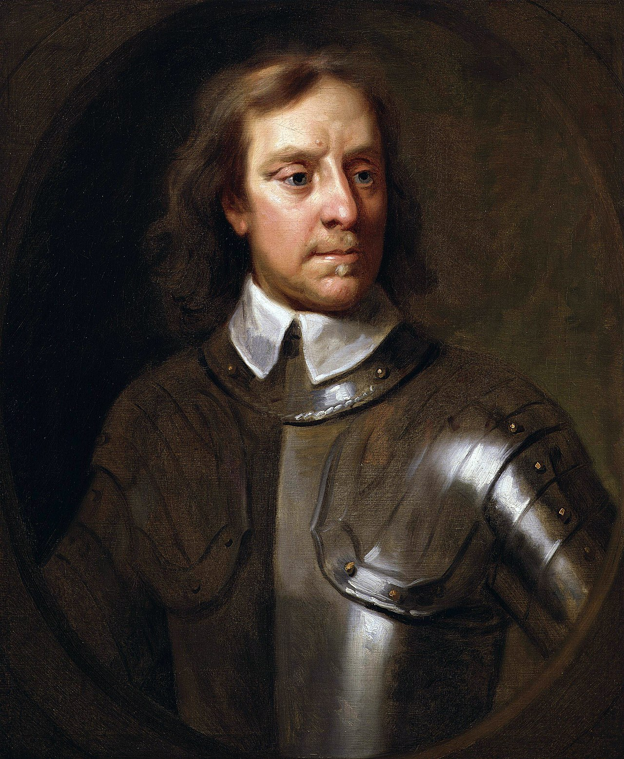
Oliver Cromwell
https://www.wikiwand.com/en/Oliver_Cromwell

Slide 16
Oliver Cromwell
The civil war against Charles I brought forward one of the towering figures of Christian history, a country gentleman named Oliver Cromwell (1599–1658).
As a colonel in the Parliamentary forces he proved to be a military genius.
His regiment, known as Ironsides, was never defeated, in part because Cromwell instilled in his men a sense of discipline and Christian mission.
In their eyes, the war was a Puritan crusade against the enemies of righteousness.
The just end sanctified force as a means. That is why the Army prayed before battles and plunged into conflict singing Christian hymns.
Shelley, Dr. Bruce L.. Church History in Plain Language: Fourth Edition

Slide 17
Oliver Cromwell
By the end of 1646 Cromwell’s Army had forced Charles to surrender.
For the next two years the king tried to play off his enemies against each other: the Scots, the Presbyterians (who controlled Parliament), and the Independents (who dominated the Army).
He succeeded in splitting Parliament and making a secret alliance with the Scots.
But fierce resentment against Charles broke out in the Army, and in 1648 war erupted anew.
Shelley, Dr. Bruce L.. Church History in Plain Language: Fourth Edition

Slide 18
Oliver Cromwell
This time the Army defeated the allies of the king, and the Presbyterians were purged from the House of Commons.
This so-called Rump Parliament, a tool of the Army, created a high court of justice to try the king.
In January 1649 Charles was led to the scaffold in front of the royal palace of Whitehall in London, and, before an assembled throng, he was executed.
It was a brash move, and proved to be a mistake on the part of Puritanism, for it gave the royalists their own martyr.
Centuries of English royal tradition could not be erased, even by the saints of God.
Shelley, Dr. Bruce L.. Church History in Plain Language: Fourth Edition

Slide 19
Oliver Cromwell
Shortly after the king’s execution a portrait appeared, allegedly depicting his last hours.
He was kneeling at a table; on it rested the Bible. The royal crown lay on the floor.
In the king’s right hand was a crown of thorns. His eyes were lifted to a crown of glory above.
The widely distributed picture and its attendant sentiment turned people against Puritanism as no battlefield could.
It changed Charles from a king executed by rebels into the martyr persecuted by fanatics. That is how many Englishmen chose to remember the Puritans.
Shelley, Dr. Bruce L.. Church History in Plain Language: Fourth Edition

Slide 20
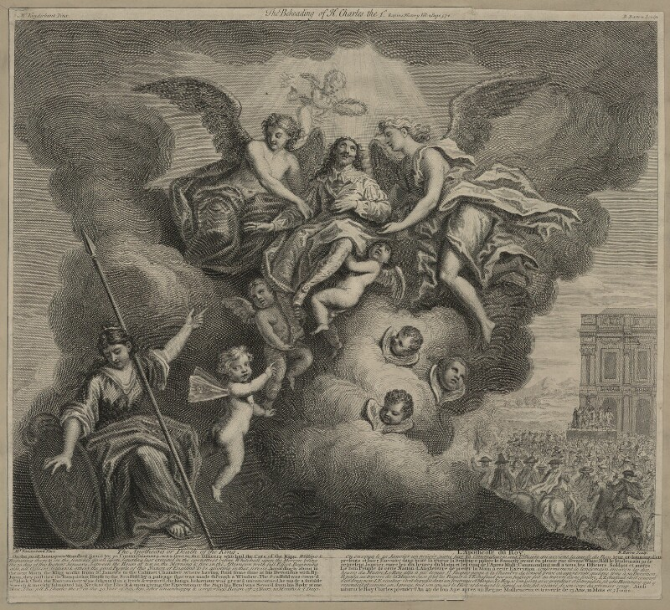
The Apotheosis, or, Death of the King, a 1728 engraving depicting Charles I ascending to heaven after his execution.
https://www.wikiwand.com/en/Execution_of_Charles_I

Slide 21
Oliver Cromwell
For the moment, however, the Army of saints had their say.
After abolishing the House of Lords, the House of Commons proclaimed England a republic: the Commonwealth.
But in 1653 the Army, still distrusting Parliament, overthrew the Commonwealth and set up a form of government called the Protectorate.
Cromwell held the Office of Lord Protector, virtually a military dictator of England.
Shelley, Dr. Bruce L.. Church History in Plain Language: Fourth Edition

Slide 22
Oliver Cromwell
The Lord Protector tried to achieve a religious settlement for the nation by granting liberty to a wide variety of Christian groups now growing on the religious landscape: Presbyterians, Independents, Baptists, Quakers, Levellers, and others.
Unfortunately he found the task impossible, and the last three years of his life were filled with disappointment and trouble.
When he died in 1658 the rule of the saints in old England died with him. Within two years the country welcomed the return of the monarchy, and with the king the office of bishop.
Far across the Atlantic, however, tens of thousands of saints were happily settled in New England where they were devoutly erecting the kingdom of God in the American wilderness.
Shelley, Dr. Bruce L.. Church History in Plain Language: Fourth Edition

Slide 23
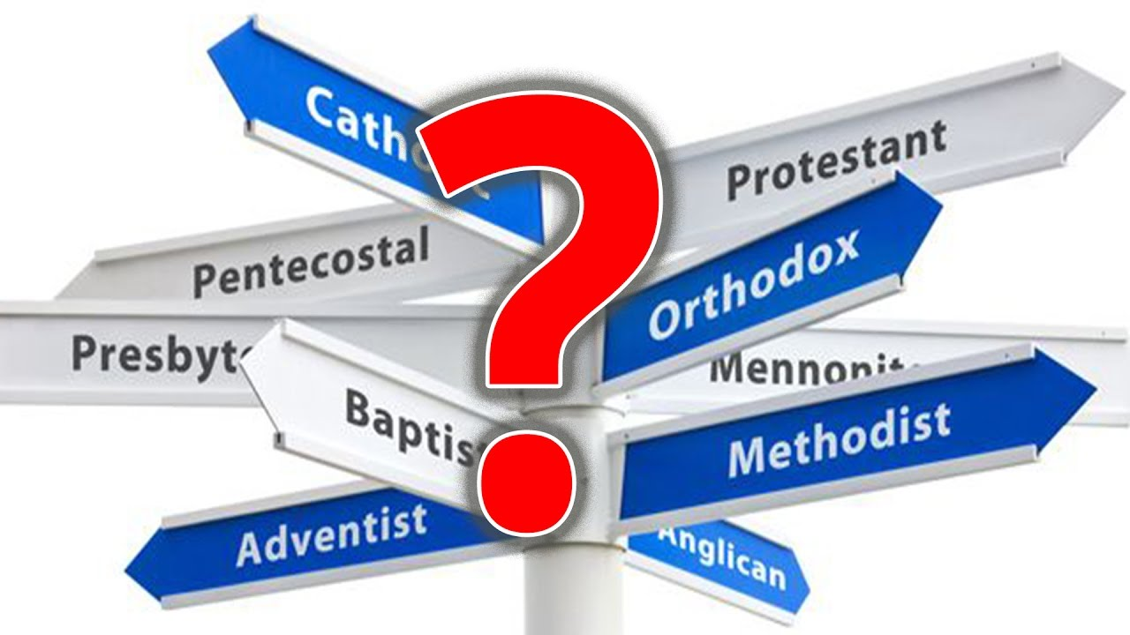
The Birth of Christian Denominations
https://www.youtube.com/watch?v=Nyzy6xilad0

Slide 24

Class Discussion Time
https://www.weareteachers.com/moving-beyond-classroom-discussions/

Slide 25
*Class Discussion Time
What do you think of John Cotton’s applying a passage about Israel and the land God had promised them to the Puritan’s going to America. Do you see a problem using the Bible in this way?
What do you think about the Puritan’s view that Christianity begins with individual salvation, but there is an expected effort on the part saved individuals to bring about changes in society and the nation that glorify God?
Under Queen Elizabeth, and, to some extent, under King James, the Puritan’s primary efforts were to reform the existing government. But under Charles I they gave up hope and decided that they had to work outside, and eventually overthrow, the government.
There are huge practical theological considerations here. Is there a point where Christians can and should work within an existing government? And can a government get to the point where Christians can no longer in good faith work with it, but must either work against it or even work to see it overthrown.
Do you have a topic or question that you would like to see us to discuss?

