Slide 1


Slide 2
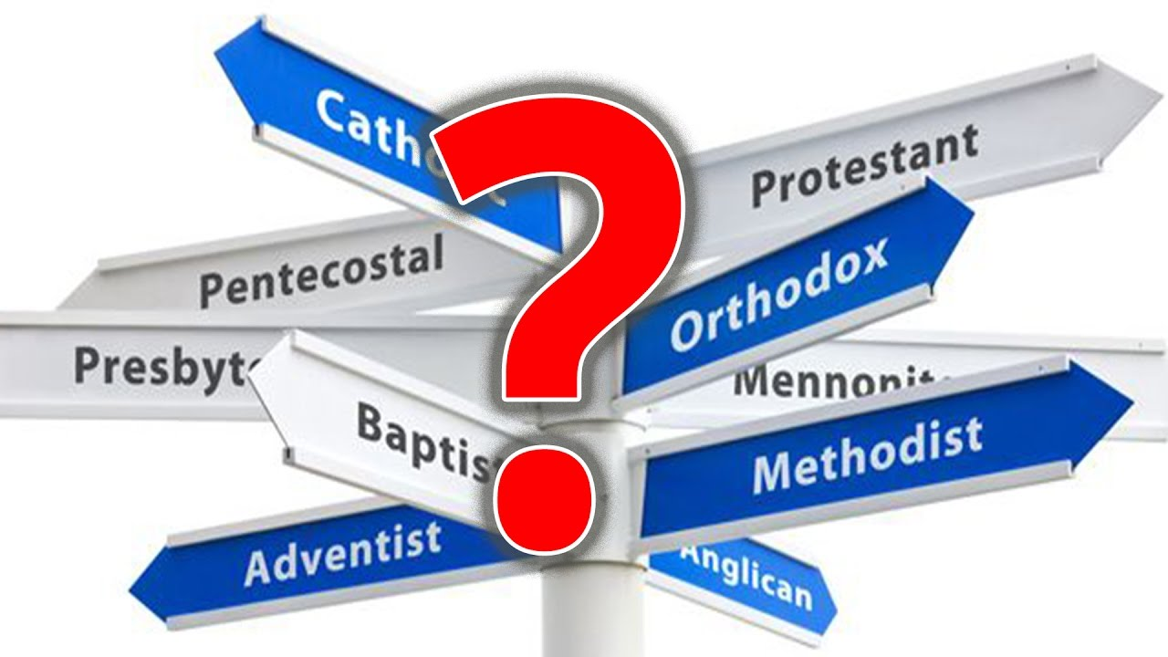
The Birth of Christian Denominations
https://www.youtube.com/watch?v=Nyzy6xilad0

Slide 3
The Birth of Christian Denominations
For decades critics have called denominations “a scandal,” “a blight,” “factionalism,” and “a caste system,” but denominations remain the institutional hallmark of modern Christianity.
Criticism is understandable. Any Christian reading his New Testament senses the difference between the faith of the apostles and the Christianity of our day.
The apostle Paul, for example, speaks of the church as the temple of God, unified in devotion to the Lord Jesus Christ, but we find in our time only a menagerie of cults, sects, denominations, and isms.
We sense deeply that this divided state of Christianity ought not be, but it is.
Why? How did denominations come to be the primary expression of Christianity in modern times?
Shelley, Dr. Bruce L.. Church History in Plain Language: Fourth Edition

Slide 4
The Birth of Christian Denominations
The simple fact is Christians are divided today, in part at least, because they have the freedom to differ.
In earlier centuries they did not.
We may curse denominations or try to ignore them, but they are not going to disappear soon because the cost of their removal is greater than most of us want to pay.
We are shocked by this fruit of modern Christianity, but few of us want to lay the ax at its root.
The Age of the Reformation did not suddenly end and the Age of Reason and Revivals appear overnight as historians’ dates might suggest.
But times do change, and one marked difference between the sixteenth century and the seventeenth was the acceptance of religious differences.
Shelley, Dr. Bruce L.. Church History in Plain Language: Fourth Edition

Slide 5
The Birth of Christian Denominations
We often hear the well-known quote: “I disapprove of what you say, but I will defend to the death your right to say it.”
And most Christians today, even if they cannot identify its source, accept the sentiment of that oft-quoted manifesto.
They accept it not because it is Christian but because it is modern.
The statement has often been attributed to Voltaire (1694–1778), the proud, self-sufficient humanist of the Age of Reason.
It is the kind of thing Martin Luther or Ignatius Loyola would never say, because neither of them believed it.
Shelley, Dr. Bruce L.. Church History in Plain Language: Fourth Edition

Slide 6
The Birth of Christian Denominations
In the light of the Reformation, dissent was neither a Christian virtue nor a human right.
The Reformers were as eager as Catholics to suppress nonconformity.
That was because both camps believed that Christian truth held societies together.
It was an instrument of power. And only one side in a religious conflict had the truth.
The idea that God’s Word could be found on both sides of a battle line was a revolutionary concept that only gained a hearing after both sides fell from exhaustion.
Shelley, Dr. Bruce L.. Church History in Plain Language: Fourth Edition

Slide 7
The Birth of Christian Denominations
The religious diversity of the American colonies, though largely within the Puritan tradition, called for a new understanding of the church. We may call it the denominational theory of the church.
The use of the word denomination to describe a religious group came into vogue about 1740 during the early years of the Evangelical Revival led by John Wesley and George Whitefield.
But the theory itself was hammered out a century before by a group of radical Puritan leaders in England and America.
Shelley, Dr. Bruce L.. Church History in Plain Language: Fourth Edition

Slide 8
The Birth of Christian Denominations
Denominationalism, as originally designed, is the opposite of sectarianism.
A sect claims the authority of Christ for itself alone. It believes that it is the true body of Christ; all truth belongs to it and to no other religious group.
So by definition a sect is exclusive.
The word denomination by contrast was an inclusive term.
It implied that the Christian group called or denominated by a particular name was but one member of a larger group, the church, to which all denominations belong.
Shelley, Dr. Bruce L.. Church History in Plain Language: Fourth Edition

Slide 9
The Birth of Christian Denominations
The denominational theory of the church, then, insists that the true church cannot be identified with any single ecclesiastical structure.
No denomination claims to represent the whole church of Christ.
Each simply constitutes a different form, in worship and organization, of the larger life of the church.
The Reformers had planted the seeds of the denominational theory of the church when they insisted that the true church can never be identified in any exclusive sense with a particular institution.
Shelley, Dr. Bruce L.. Church History in Plain Language: Fourth Edition

Slide 10
The Birth of Christian Denominations
Calvin, in the preface to his Institutes, indicated that it is impossible to draw precise boundaries to the church of Christ.
No one can determine with precision who is numbered among the elect of God.
The Reformers, however, never followed this lead.
When religious dissent arose within a particular area, they tried to suppress it.
They were still convinced that only one religion could exist in one region.
Shelley, Dr. Bruce L.. Church History in Plain Language: Fourth Edition

Slide 11
The Birth of Christian Denominations
The real architects of the denominational theory of the church were the seventeenth-century Independents (Congregationalists) who represented the minority voice at the Westminster Assembly (1642–1649).
The majority at the Assembly held to Presbyterian principles and expressed these convictions classically in the Westminster Confession of Faith and in the Westminster Larger and Shorter Catechisms.
The Independents, however, who held to congregational principles, were keenly aware of the dangers of “dividing the godly Protestant party” in England, so they looked for some way to express Christian unity even when Christians did not agree.
Shelley, Dr. Bruce L.. Church History in Plain Language: Fourth Edition

Slide 12
The Birth of Christian Denominations
These Dissenting Brethren of Westminster articulated the denominational theory of the church in several fundamental truths:
First, considering man’s inability to always see the truth clearly, differences of opinion about the outward form of the church are inevitable.
Second, even though these differences do not involve fundamentals of the faith, they are not matters of indifference. Every Christian is obligated to practice what he believes the Bible teaches.
Third, since no church has a final and full grasp of divine truth, the true church of Christ can never be fully represented by any single ecclesiastical structure.
Finally, the mere fact of separation does not of itself constitute schism. It is possible to be divided at many points and still be united in Christ
Shelley, Dr. Bruce L.. Church History in Plain Language: Fourth Edition

Slide 13
The Birth of Christian Denominations
In other words, the denominational theory of the church looked for Christian unity in a common belief in the foundational principles of the Christian gospel but allowed for diversity in the outward expressions of that personal faith.
This tolerant attitude was not born of doctrinal indifference.
The Independent had no intention of extending Christian unity to all religious professions.
The identity of the “one true church” was restricted to those who shared a common understanding of the core of the Christian faith.
Shelley, Dr. Bruce L.. Church History in Plain Language: Fourth Edition

Slide 14
The Birth of Christian Denominations
This denominational view of the church found only limited acceptance in England where the Church of England retained a favored position – even after the Act of Toleration in 1689 recognized the rights of Presbyterians, Congregationalists, Baptists, and Quakers to worship freely.
In the English colonies of America, however, the denominational theory gained increasing acceptance. It seemed to be God’s answer for the multiplying faiths in the New World.
Few advocates of the denominational view of the church in the seventeenth century envisioned the hundreds of Christian groups included under the umbrella today.
Shelley, Dr. Bruce L.. Church History in Plain Language: Fourth Edition

Slide 15
The Birth of Christian Denominations
They had no intention of reducing the basic beliefs of Christianity to a general feeling of religious sincerity. But they could not control the future.
They simply knew that the traditional bigotry and bloodshed in the name of Christ was not the way forward.
In the end, then, the denominational form of the church has marked the recent centuries of Christian history, not because it is ideal, but because it is better than any alternative the years have offered.
Shelley, Dr. Bruce L.. Church History in Plain Language: Fourth Edition

Slide 16
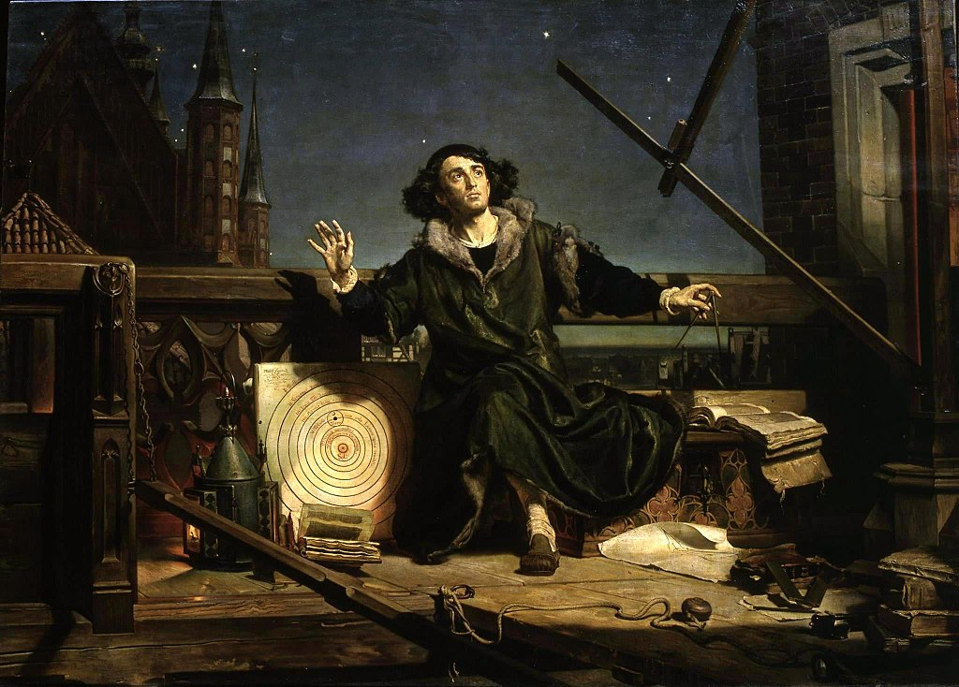
The Age of Reason
Astronomer Copernicus, conversation with God – an 1872 painting by Jan Matejko
https://samdsmith7.wordpress.com/2018/07/03/the-age-of-reason/

Slide 17
The Age of Reason
If Americans believed in saints, Benjamin Franklin would be among them. He exemplified so many virtues Americans have come to admire.
People found him practical, earthy, affable, witty and, above all, tolerant.
A few weeks before he died, Ben responded to an inquiry by President Ezra Stiles of Yale concerning his religious faith. Said Franklin:
As to Jesus of Nazareth . . . I have . . . some doubts as to his Divinity, tho’ it is a question I do not dogmatize upon, having never studied it, and think it needless to busy myself with it now, when I expect soon an opportunity of knowing the truth with less trouble. I see no harm, however, in its being believed, if that belief has the good consequence . . . of making his doctrines more respected and better observed.
Shelley, Dr. Bruce L.. Church History in Plain Language: Fourth Edition

Slide 18
The Age of Reason
Something of the American spirit is there. It is the spirit of Franklin’s time, the Age of Reason.
Questions of dogma seemed unimportant, hardly worth fretting about.
What was immensely more important was behavior.
Do our beliefs make us more tolerant, more respectful of those who differ with us, more responsive to the true spirit of Jesus?
If that hatred of religious bigotry, coupled with a devotion to tolerance of all religious opinions, has a familiar ring, it is because the attitudes of the Age of Reason are not a thing of the past. They live on today in the values of the Western world.
Shelley, Dr. Bruce L.. Church History in Plain Language: Fourth Edition

Slide 19
The Age of Reason
The spirit of the Age of Reason was nothing less than an intellectual revolution, a whole new way of looking at God, the world, and oneself. It was the birth of secularism.
The Middle Ages and the Reformation were centuries of faith in the sense that reason served faith, the mind obeyed authority.
To a Catholic it was church authority, to a Protestant biblical authority, but in either case God’s Word came first, not man’s thoughts. Man’s basic concern in this life was his preparation for the next.
The Age of Reason rejected that. In place of faith it set reason. Man’s primary concern was not the next life, but happiness and fulfillment in this world; and the mind of man, rather than faith, was the best guide to happiness, not emotions, or myths, or superstitions.
Shelley, Dr. Bruce L.. Church History in Plain Language: Fourth Edition

Slide 20
The Age of Reason
The spirit and purpose of the Age of Reason were eloquently expressed by one of its spokesmen, Baron von Holbach, who wrote:
Let us endeavor to disperse those clouds of ignorance, those mists of darkness, which impede Man on his journey, . . . which prevent his marching through life with a firm and steady step. Let us try to inspire him . . . with respect for his own reason—with an inextinguishable love of truth . . . so that he may learn to know himself . . . and no longer be duped by an imagination that has been led astray by authority . . . so that he may learn to base his morals on his own nature, on his own wants, on the real advantage of society . . . so that he may learn to pursue his true happiness, by promoting that of others . . . in short, so that he may become a virtuous and rational being, who cannot fail to become happy.
Shelley, Dr. Bruce L.. Church History in Plain Language: Fourth Edition

Slide 21
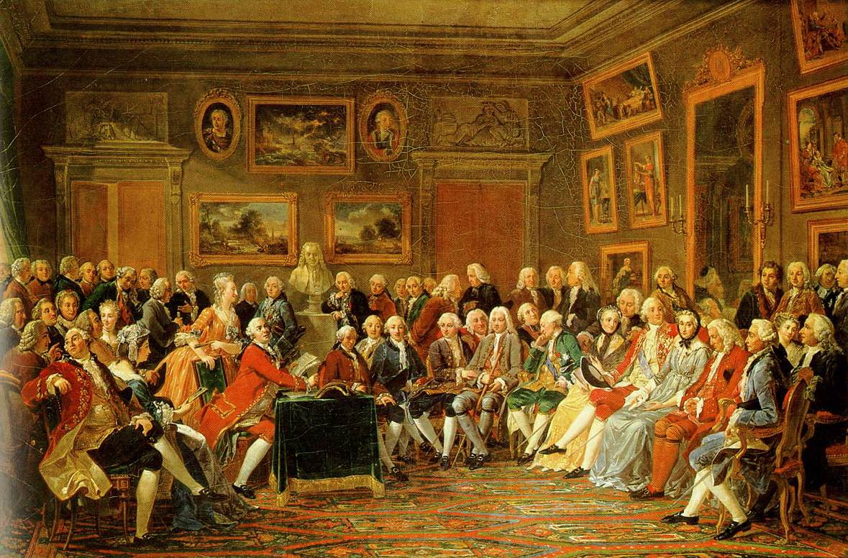
The Enlightenment
In the Salon of Madame Geoffrin in 1755, by Anicet-Charles-Gabriel Lemonnier, 1812.
https://www.wikiwand.com/en/Age_of_Enlightenment

Slide 22

Class Discussion Time
https://www.weareteachers.com/moving-beyond-classroom-discussions/

Slide 23
*Class Discussion Time
In your view, are denominations (i.e. the divisions within the modern church) a blessing, a curse, or a necessary evil? Explain.
I pointed out that the expression (often attributed to Voltaire) – “I disapprove of what you say, but I will defend to the death your right to say it.” is the kind of thing Martin Luther or Ignatius Loyola would never say, because neither of them believed it. Do you believe it? Why or why not?
During the Middle Ages and the Reformation reason served faith, the mind obeyed authority and Man’s basic concern in this life was his preparation for the next.
Most people in our day have rejected that idea. In place of faith they set reason. Man’s primary concern in our day is not the next life, but happiness and fulfillment in this world.
Should our goal today be to have things go back to the way they were? Is that even possible? If not, what should we be trying to do?
Do you have a topic or question that you would like to see us to discuss?

