Slide 1


Slide 2
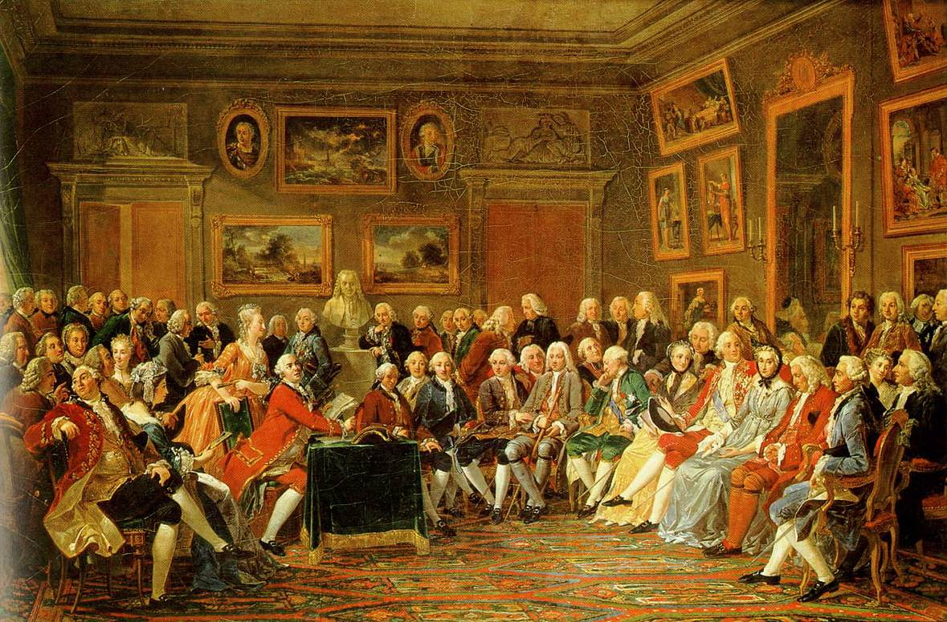
The Enlightenment
In the Salon of Madame Geoffrin in 1755, by Anicet-Charles-Gabriel Lemonnier, 1812.
https://www.wikiwand.com/en/Age_of_Enlightenment

Slide 3
The Enlightenment
The Enlightenment was a European intellectual movement of the 17th and 18th centuries in which ideas concerning God, reason, nature, and humanity were synthesized into a worldview that gained wide assent in the West and that instigated revolutionary developments in art, philosophy, and politics.
Central to Enlightenment thought were the use and celebration of reason, the power by which humans understand the universe and improve their own condition.
https://www.britannica.com/event/Enlightenment-European-history

Slide 4
The Enlightenment
Enlightenment thinkers in Britain, in France and throughout Europe questioned traditional authority and embraced the notion that humanity could be improved through rational change.
The Enlightenment produced numerous books, essays, inventions, scientific discoveries, laws, wars and revolutions.
The American and French Revolutions were directly inspired by Enlightenment ideals and respectively marked the peak of its influence and the beginning of its decline.
The Enlightenment ultimately gave way to 19th-century Romanticism.
https://www.history.com/topics/british-history/enlightenment#section_1

Slide 5
The Enlightenment
The scientific ideas that developed during the Enlightenment sprang from the soil of a new faith in an orderly universe governed by scientific laws.
Modern science arose in the sixteenth and seventeenth centuries and filled men with visions of a new day of knowledge and understanding.
The pioneers of modern science forced men to think in new ways about the universe:
  Copernicus (1473–1543), who insisted that the sun, not the earth, was the center of our universe
  Johann Kepler (1571–1630), who concluded that the sun emitted a magnetic force that moved the planets in their courses
  Galileo Galilei (1564–1642), who made a telescope to examine the planets and proved that the acceleration of falling bodies is constant.
Shelley, Dr. Bruce L.. Church History in Plain Language: Fourth Edition

Slide 6
The Enlightenment
All these discoveries, however, had to be united in one all-embracing principle that would explain the motion of bodies in the heavens and present the universe as one great machine operating according to unalterable laws.
This was the feat of the most illustrious scientist of the Age of Reason, Isaac Newton (1642–1727).
In 1687 Newton published his momentous work, Mathematical Principles of Natural Philosophy, in which all laws of motion, in the heavens and on the earth, were harmonized in a master principle for the universe, the law of gravitation.
Shelley, Dr. Bruce L.. Church History in Plain Language: Fourth Edition

Slide 7
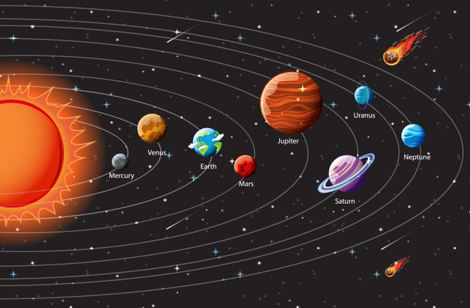
The Wonder of the World Machine
https://www.freepik.com/free-vector/planets-solar-system-infographic_11405689.htm

Slide 8
The Wonder of the World Machine
The reading public of Europe was captivated by the wonder of Newton’s world-machine.
The medieval world of unseen spirits—angels and demons— suddenly seemed less plausible , perhaps even superstitious.
In its place was a sun-centered universe that operated by physical laws explained and justified by mathematics.
In the new model, the sun displaced the earth as the center.
This vast unfolding universe filled some men with dismay.
This sudden access to the mysteries of the universe seemed to magnify the role of human reason.
Shelley, Dr. Bruce L.. Church History in Plain Language: Fourth Edition

Slide 9
The Wonder of the World Machine
Some believed that mankind had been displaced as the crowning apex of creation in the center of God’s world.
Some felt that God had been displaced as well. God seemed less necessary to sustain the world when one observed that the world operated by scientific laws.
Readers today should be reminded that the rise of modern science was absolutely dependent upon Christian convictions and was carried on by minds trained in Christian environments and institutions.
Also worth noting is the re-envisioning of God. In these discussions, God is often pictured as one more actor on the stage and not the majestic Lord overseeing the entire project.
Shelley, Dr. Bruce L.. Church History in Plain Language: Fourth Edition

Slide 10
The Wonder of the World Machine
People began to think that if the universe is a smooth-running machine with all its parts coordinated by one grand design, then all man has to do is think clearly in order to find life’s meaning and true happiness.
This fundamental idea, that man has the ability to find the truth by the use of his senses and reason is what gave rise to the label Age of Reason.
Christianity could scarcely escape the fallout from this intellectual revolution. For 1,200 years Augustine’s ideas had ruled Christendom. Man was an enslaved sinner who needed, above all else, the supernatural grace of God.
To insure the availability of this grace through the Christian church, God had ordained the powers of the state to protect truth and punish error.
Shelley, Dr. Bruce L.. Church History in Plain Language: Fourth Edition

Slide 11
The Wonder of the World Machine
But now intellectuals were arguing something else: Man is no sinner. He is a reasonable creature.
Now man seemed to need common sense more than God’s grace.
At first, during the closing years of the seventeenth century, some believers, especially in England, tried to harmonize reason and faith.
They argued that Christianity is totally reasonable but some truths come by reason and some by revelation:
  Some things, like the existence of God, come by observing the heavens.
  While other things, like the resurrection of Christ, come by the witness of Scripture.
Shelley, Dr. Bruce L.. Church History in Plain Language: Fourth Edition

Slide 12
The Wonder of the World Machine
The best representative of this first generation of Enlightenment thinkers is John Locke (1632–1704).
The highly influential philosopher never minimized the importance of belief. In his Essay Concerning Human Understanding, he not only shows how reason functions; he indicates that the existence of God is “the most obvious truth that reason discovers.”
Closer examination, however, shows that the God Locke had in mind has little in common with the God of the Exodus or of Jesus’ resurrection.
Attempts to rationally justify Christianity sadly often led to a revising of Christianity to what seemed rational at the time.
Shelley, Dr. Bruce L.. Church History in Plain Language: Fourth Edition

Slide 13
The Wonder of the World Machine
A profound ancient Christian wisdom was forgotten.
Christians do not arrive at Christian conviction as the conclusion of a long argument; they believe because they received revelation from the first eye witnesses.
This witness is then powerfully vindicated by the ongoing power of God.
The New Testament is a book of powerfully vindicated testimony of God’s action, not a book of deductive logic.
Reason may serve revelation, but it can never replace revelation.
Shelley, Dr. Bruce L.. Church History in Plain Language: Fourth Edition

Slide 14
The Wonder of the World Machine
At the beginning of the eighteenth century, many in next generation of Enlightenment thinkers felt even fewer obligations to the Christian past, so instead of trying to harmonize nature and Scripture, they simply set aside Scripture.
Many intellectuals began to claim that the parts of the Bible that agree with reason are clearly unnecessary, while the parts of the Bible that contradict reason (miracles, for example) are simply untrue.
This more militant attitude toward the faith was especially evident in France.
Shelley, Dr. Bruce L.. Church History in Plain Language: Fourth Edition

Slide 15
The Wonder of the World Machine
Curiously enough, atheism was not at all fashionable in this “polite society.”
Most of the prominent “infidels” who ridiculed Christianity during the eighteenth century believed in a supreme being but regarded it superstitious to hold that he interfered with the world-machine.
This belief came to be known as deism, a movement especially popular among English speakers.
Deism served as a halfway house on the road to atheism. One could keep the idea of God but dismiss the concept that God would engage or interfere with the world.
Shelley, Dr. Bruce L.. Church History in Plain Language: Fourth Edition

Slide 16
The Wonder of the World Machine
The God of the deists has sometimes been called the watchmaker God: God created the world as a watchmaker makes a watch, and then wound it up and let it run.
And since God was a perfect watchmaker, there was no longer any need for him to interfere with the world.
Hence the deists rejected anything that seemed to be an interference of God with the world, such as miracles or special revelations recorded in the Bible.
The deists believed that their religion was the original religion of man. From it had come, by distortion, all other religions.
These distortions, they claimed, were the work of priests who concocted the theologies, myths, and doctrines of the various religions to enhance their own power.
Shelley, Dr. Bruce L.. Church History in Plain Language: Fourth Edition

Slide 17
The Wonder of the World Machine
The most influential propagandist for deism was Voltaire (1694–1778), who personified the skepticism of the French Enlightenment.
Above all others, Voltaire popularized Newton’s science, fought for personal liberty and freedom of the press, and spread the cult of reason.
He turned out a prodigious number of works: histories, plays, pamphlets, essays, and novels.
He was sickened by what he perceived as the intolerance of organized Christianity.
In his correspondence, estimated at ten thousand letters, he wittily spread the virtues of Enlightenment and scathingly attacked what he perceived to be the abuses of his day.
Shelley, Dr. Bruce L.. Church History in Plain Language: Fourth Edition

Slide 18
The Wonder of the World Machine
Unlike most previous critics of the church, the intellectuals of the 18th-century Enlightenment were not heretics or dissenters who attacked the church in the name of Christ.
These men launched their attack from outside the church.
And they aimed their missiles not at a single point of dogma but at the foundation of all Christian truth.
Their well-publicized purpose was to demolish the church.
Christianity, they insisted, was a pernicious plot designed to turn the earth over to the oppressive powers of a priestly caste.
Revealed religion, they claimed, was nothing less than a scheme to exploit the ignorant.
Shelley, Dr. Bruce L.. Church History in Plain Language: Fourth Edition

Slide 19
The Wonder of the World Machine
Ironically, Christianity’s critics measured Christian behavior by their own human standards of good and evil. But where had these human standards come from?
These critics ignored the fact that standards of good and evil are actually the legacy of Christian teaching.
In the mind of these critics their only goal was truth. “We think that the greatest service to be done to men,” said Diderot, “is to teach them to use their reason, only to hold for truth what they have verified and proved.”
But their standards of “truth” ruled out Christian doctrine from the start.
When the orthodox tried to reason from their basic premises, the infidels only scoffed because they refused to allow arguments drawn from authority or tradition embodied in the Bible or the church.
According to them ,these simply were not “reasonable.”
Shelley, Dr. Bruce L.. Church History in Plain Language: Fourth Edition

Slide 20
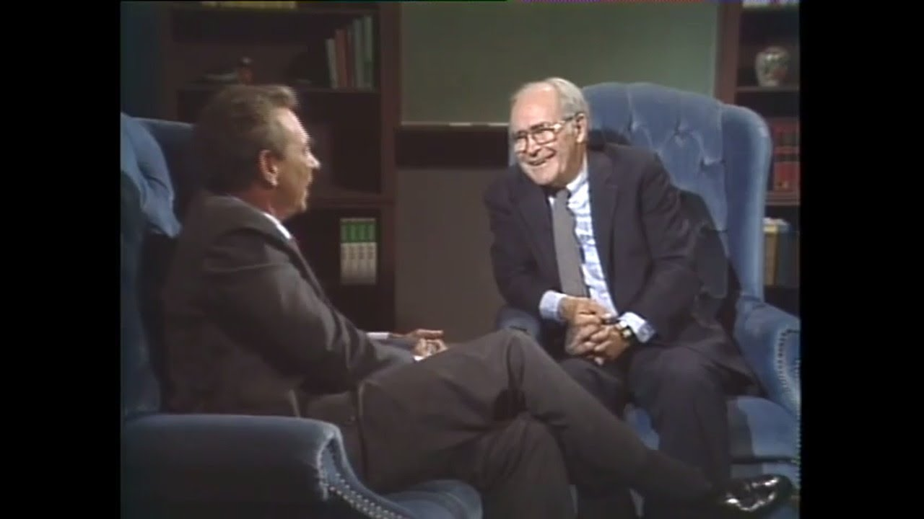
John Gerstner on the Enlightenment
https://www.wikiwand.com/en/Joseph_Butler

Slide 21
John Gerstner on the Enlightenment
“We wrestle not against flesh and blood...” The devil’s struggle against the Christian is so subtle and formidable that it would deceive, if that were possible, the very elect. (cf. Mat. 24:24)
Sometimes the prince of darkness becomes very bold, attacking the church of God not only subtly but by brazen, open, arrogant, direct attacks on the very Word of God.
This describes the so-called Enlightenment of the eighteenth century.
It should be called the Endarklement, because in spite of its many valuable contributions to culture, science, and industry it was crass naturalism denying God and especially His saving revelation.
The Endarklement was a way for man to gain the whole world and lose his soul.
Gerstner, Dr. John H. Handout Church History: Enlightenment - Root and Branch Attack on Reformation Orthodoxy

Slide 22
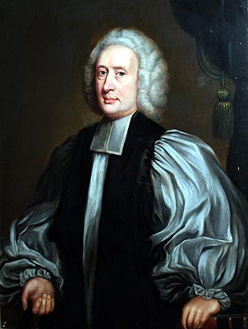
Joseph Butler
Countering the Claims of Deism
https://www.wikiwand.com/en/Joseph_Butler

Slide 23

Class Discussion Time
https://www.weareteachers.com/moving-beyond-classroom-discussions/

Slide 24
*Class Discussion Time
The Fall of man blinds him from being able to see and accept spiritual realities, while still allowing him the ability to see and reason accurately about physical realities. How do you see this playing out in the Enlightenment period?
What do you see as the greatest value of the Enlightenment?
What do you see as the greatest danger of the Enlightenment?
Do you see any effect of Enlightenment thinking in our day? Give specific examples.
Do you have a topic or question that you would like to see us to discuss?

