Slide 1


Slide 2
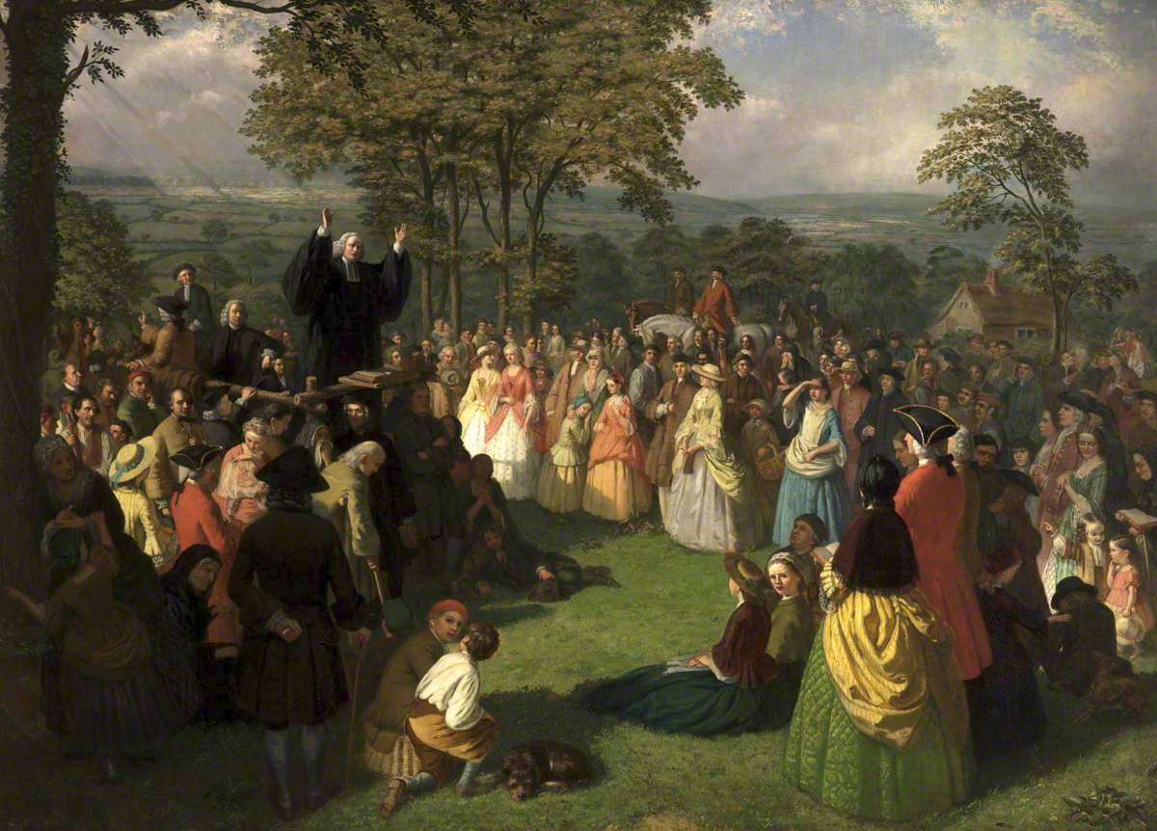
The First Great Awakening
George Whitefield Preaching in Bolton, June 1750
https://allthingsliberty.com/2016/08/great-awakening-american-revolution/

Slide 3
The First Great Awakening
What historians call “the first Great Awakening” can best be described as a revitalization of religious piety that swept through the American colonies between the 1730s and the 1770s.
That revival was part of a much broader movement, an evangelical upsurge taking place simultaneously on the other side of the Atlantic, most notably in England, Scotland, and Germany.
In all these Protestant cultures during the middle decades of the eighteenth century, a new Age of Faith rose to counter the currents of the Age of Enlightenment, to reaffirm the view that being truly religious meant relying on biblical revelation rather than human reason.
https://nationalhumanitiescenter.org/tserve/eighteen/ekeyinfo/grawaken.htm

Slide 4
The First Great Awakening
By the eighteenth century, Christian Europe had wearied of constant religious strife and bloodshed.
Intellectuals embraced the Enlightenment ideal of reason as the ultimate authority.
Theology was made subject to philosophy.
Deism taught that God created the world, subjected it to natural law, and let nature take its course.
This was not the personal God of the Bible; deism was a rejection of revelation in the name of reason.
Rationalism prevailed in the eighteenth century and continues to influence theology today.
Ferguson, Sinclair B.. Church History 101: The Highlights of Twenty Centuries

Slide 5
The First Great Awakening
The Christian pulpit was subverted by the new theology.
The gospel (“the power of God unto salvation”) was replaced by a message of thoughtful moderation and good deeds.
This powerless substitute had little appeal to the masses. They were left to sink down in unbelief, drunkenness, fornication, gambling, and worse.
The church became irrelevant to many people.
No one would have guessed that a great revival was at hand.
Ferguson, Sinclair B.. Church History 101: The Highlights of Twenty Centuries

Slide 6
The First Great Awakening
The earliest manifestations of the American phase of the First Great Awakening appeared among Presbyterians in Pennsylvania and New Jersey.
Led by the Tennent family—Reverend William Tennent, a Scots-Irish immigrant, and his four sons, all clergymen—the Presbyterians not only started religious revivals in those colonies during the 1730s but also established a seminary to train clergymen whose fervid, heartfelt preaching would bring sinners to experience evangelical conversion.
Originally known as “the Log College,” it is better known today as Princeton University.
https://nationalhumanitiescenter.org/tserve/eighteen/ekeyinfo/grawaken.htm

Slide 7
The First Great Awakening
Religious enthusiasm quickly spread from the Presbyterians of the Middle Colonies to the Congregationalists (Puritans) and Baptists of New England.
By the 1740s, the clergymen of these churches were conducting revivals throughout that region, using the same strategy that had contributed to the success of the Tennents.
In emotionally charged sermons, all the more powerful because they were delivered extemporaneously, preachers like Jonathan Edwards evoked vivid, terrifying images of the utter corruption of human nature and the terrors awaiting the unrepentant in hell.
https://nationalhumanitiescenter.org/tserve/eighteen/ekeyinfo/grawaken.htm

Slide 8
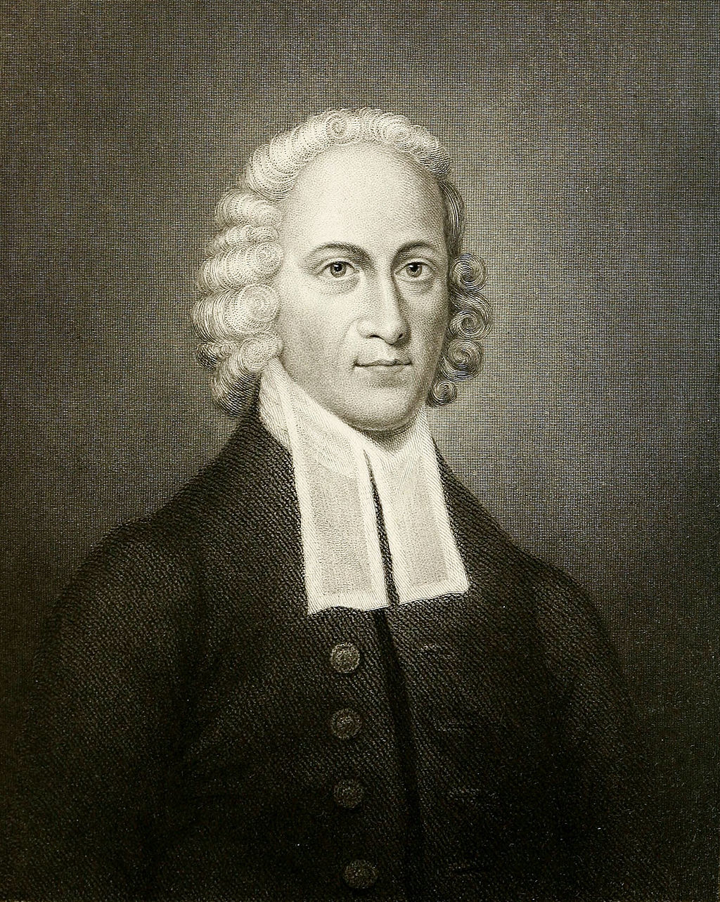
Engraving of Edwards
by R Babson & J Andrews
https://www.wikiwand.com/en/Jonathan_Edwards_(theologian)

Slide 9
The First Great Awakening
In his well known sermon, “Sinners in the Hands of an Angry God,” Edwards described the sinner as a loathsome spider suspended by a slender thread over a pit of seething brimstone.
What was evident in Edwards’s preaching was a shift from a sober religion understood primarily in intellectual terms to one which stressed the “religious affections” – those inward inclinations which dictate how we feel, think, and act; the heart, emotions, and will.
Unfortunately, Edwards’s ministry eventually ended in outward failure.
Tim Grass. SCM Core Text: Modern Church History

Slide 10
The First Great Awakening
Edwards attempted to throw out the Half-Way Covenant in 1750 and revert to the previous practice of requiring all who wanted to receive communion to profess genuine faith, not merely doctrinal knowledge and good moral behavior.
His congregation saw this as threatening the idea of church membership as a cohesive force in society at large and dismissed him.
He spent his remaining years at Stockbridge (130 miles west of Boston), seeking to minister to the Indians but mainly writing and thinking.
Still, by his output he influenced a generation of Evangelicals and did much to set the agenda for American Protestant theology until well into the nineteenth century.
Tim Grass. SCM Core Text: Modern Church History

Slide 11
The First Great Awakening
These early revivals in the northern colonies inspired some converts to become missionaries to the American South.
In the late 1740s, Presbyterian preachers from New York and New Jersey began proselytizing in Virginia.
By the 1750s, some members of a group known as the Separate Baptists moved from New England to North Carolina and quickly extended their influence to surrounding colonies.
By the eve of the American Revolution, their evangelical converts accounted for about ten percent of all southern churchgoers.
https://nationalhumanitiescenter.org/tserve/eighteen/ekeyinfo/grawaken.htm

Slide 12
The First Great Awakening
The year 1735 saw the conversion of George Whitefield, who eventually became the leading preacher of the revival on both sides of the Atlantic. ¹
Although Whitefield had been ordained as a minister in the Church of England, he later allied with other Anglican clergymen who shared his evangelical bent, most notably John and his brother Charles Wesley.²
Whitefield had met John and Charles Wesley in 1732, at a time when they both belonged to a religious society known to history as “the Holy Club” – devout Anglicans, these men set out to pursue holiness by a rigorous discipline or method, and thus were decried as “Methodists.”
Together they led a movement to reform the Church of England which resulted in the founding of the Methodist Church late in the eighteenth century. ²
¹ Ferguson, Sinclair B.. Church History 101: The Highlights of Twenty Centuries
² https://nationalhumanitiescenter.org/tserve/eighteen/ekeyinfo/grawaken.htm

Slide 13
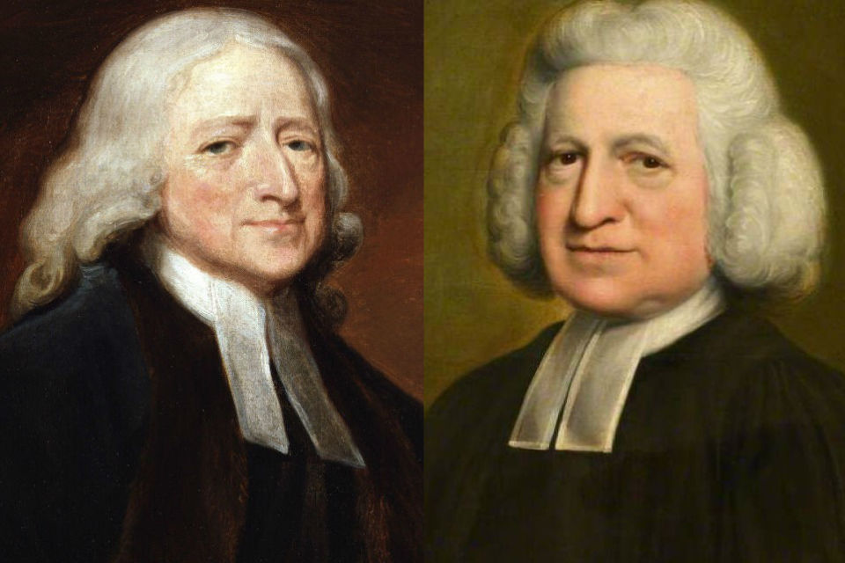
John Wesley and Charles Wesley
https://www.ministrymatters.com/all/entry/6401/the-wesleys-holiness-and-life-in-the-spirit

Slide 14
The First Great Awakening
In October 1735, Wesley, along with his brother Charles, sailed to the American colonies to serve as minister of a newly formed parish in Savannah Georgia.
It was on the voyage to the colonies that the Wesleys first came into contact with Moravian settlers.
At one point in the voyage a storm came up and broke the mast off the ship.
While the English panicked, the Moravians calmly sang hymns and prayed.
This experience led Wesley to believe that the Moravians possessed an inner strength which he lacked.
Ferguson, Sinclair B.. Church History 101: The Highlights of Twenty Centuries

Slide 15
The First Great Awakening
The deeply personal religion that the Moravian pietists practiced heavily influenced Wesley's theology of Methodism.
The Moravians were led by Nicolaus von Zinzendorf who gathered a group of like-minded believers yearning for a more experiential faith than that of the lifeless Lutheranism of eighteenth-century Germany.
Their missionary efforts throughout the world in the eighteenth century were renowned.
Wesley was finally converted at a Moravian meeting in Aldersgate Street, London, in 1738.
Ferguson, Sinclair B.. Church History 101: The Highlights of Twenty Centuries

Slide 16
The First Great Awakening
The preface to Martin Luther’s commentary on Romans was read aloud, and Wesley felt his heart “strangely warmed” as he listened to Luther’s account of the change God works in the heart through faith.¹
Then and there he obtained assurance of salvation and forgiveness of sins.¹
Heralded as “the new birth,” this experiential emphasis became the warp and woof of the Great Awakening and the evangelical preaching, not only of Wesley, but of Whitefield, and others of the era.¹
During his several trips across the Atlantic after 1739, Whitefield preached everywhere in the American colonies, often drawing audiences so large that he was obliged to preach outdoors.²
¹ Ferguson, Sinclair B.. Church History 101: The Highlights of Twenty Centuries
² https://nationalhumanitiescenter.org/tserve/eighteen/ekeyinfo/grawaken.htm

Slide 17
The First Great Awakening
What Whitefield preached was nothing more than what other Calvinists had been proclaiming for centuries—that sinful men and women were totally dependent for salvation on the mercy of a pure, all-powerful God.
But Whitefield—and many American preachers who eagerly imitated his style—presented that message in novel ways.
Gesturing dramatically, sometimes weeping openly or thundering out threats of hellfire-and-brimstone, they turned the sermon into a gripping theatrical performance.
https://nationalhumanitiescenter.org/tserve/eighteen/ekeyinfo/grawaken.htm

Slide 18
The First Great Awakening
Whitefield toured the colonies up and down the Atlantic coast, preaching his message.
In one year, Whitefield covered 5,000 miles in America and preached more than 350 times.
People gathered by the thousands to hear Whitefield speak.
Whitefield preached to common people, slaves and Native Americans. No one was out of reach.
Even Benjamin Franklin, a religious skeptic, was captivated by Whitefield’s sermons, and the two became friends.
Whitefield’s success convinced English colonists to join local churches and reenergized a once-waning Christian faith. But not all looked on with approval.
https://www.history.com/topics/british-history/great-awakening

Slide 19
The First Great Awakening
The Great Awakening aggravated existing conflicts within the Protestant churches, often leading to schisms between supporters of revival, known as "New Lights", and opponents of revival, known as "Old Lights".
Old Lights saw the religious enthusiasm and itinerant preaching unleashed by the Awakening as disruptive to church order, preferring formal worship and a settled, university-educated ministry.
They mocked revivalists as being ignorant, heterodox or con artists.
https://www.wikiwand.com/en/First_Great_Awakening#/CITEREFHeimert1966

Slide 20
The First Great Awakening
New Lights accused Old Lights of being more concerned with social status than with saving souls and even questioned whether some Old Light ministers were even converted.
They also supported itinerant ministers who disregarded parish boundaries.
The Baptists benefited the most from the Great Awakening.
Numerically small before the outbreak of revival, Baptist churches experienced growth during the last half of the 18th century.
https://www.wikiwand.com/en/First_Great_Awakening#/CITEREFHeimert1966

Slide 21
The First Great Awakening
By 1804, there were over 300 Baptist churches in New England.
This growth was primarily due to an influx of former “New Light” Congregationalists who became convinced of Baptist doctrines, such as believer's baptism.
In some cases, entire Separatist congregations accepted Baptist beliefs.
While the Awakening divided many Protestant churches between Old and New Lights, it also unleashed a strong impulse towards interdenominational unity among the various Protestant denominations.
Evangelicals considered the new birth to be “a bond of fellowship that transcended disagreements on fine points of doctrine and polity”, allowing Anglicans, Presbyterians, Congregationalists and others to cooperate across denominational lines.
https://www.wikiwand.com/en/First_Great_Awakening#/CITEREFHeimert1966

Slide 22
The First Great Awakening
The revival also developed the idea of freedom. The convert’s personal experience of grace brought him spiritual freedom.
During the eighteenth century, rationalists and revivalists combined forces on the practical and legal issue of religious freedom against the defenders of state religious establishments.
Their temporary alliance was successful. The birth of the United States of America brought the adoption of the First Amendment of the Constitution, “Congress shall make no law respecting an establishment of religion, or prohibiting the free exercise thereof . . . .”
Shelley, Dr. Bruce L. Church History in Plain Language: Fourth Edition

Slide 23
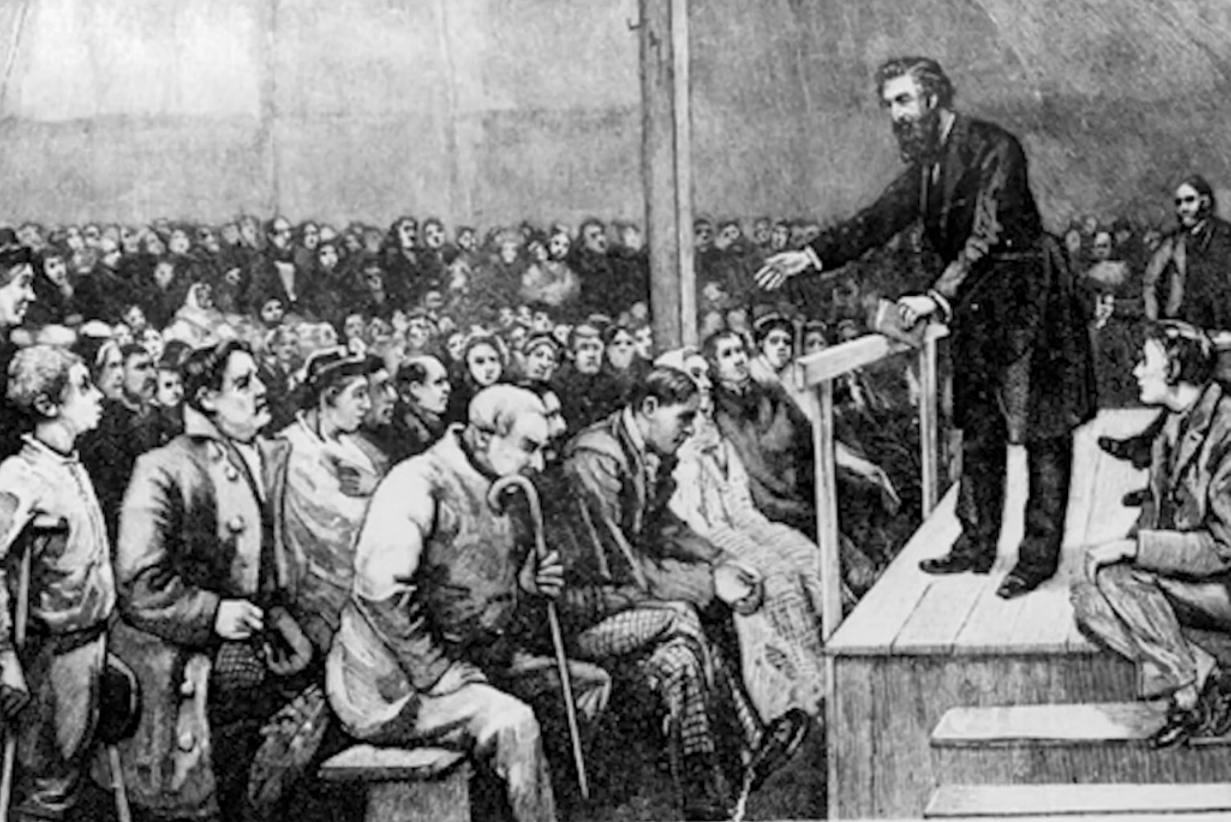
The Second Great Awakening
Charles Finney Preaching in Rochester New York, 1830
https://vimeo.com/349525075

Slide 24

Class Discussion Time
https://www.weareteachers.com/moving-beyond-classroom-discussions/

Slide 25
*Class Discussion Time
The Great Awakening resulted in a major change in the religious and political landscape of America and elsewhere, resulting, no doubt, in many conversions. What caused the great awakening? God? Great preachers? Prayer? A hunger for true religion in the midst of the religious drought that was caused by Enlightenment intellectualism?
John Wesley was a Christian minister for a number of years prior to experiencing genuine salvation. What does this say about the ability or men to be self deceived about their true spiritual state? (cf. Mat. 7:21ff)
The Moravians demonstrated the genuineness of their faith and caused John Wesley to realize his own lack of true faith by their response to a personal crisis. Can our response to a crisis be a valid indicator of our true spiritual state?
Do you have a topic or question that you would like to see us to discuss?

