Slide 1


Slide 2
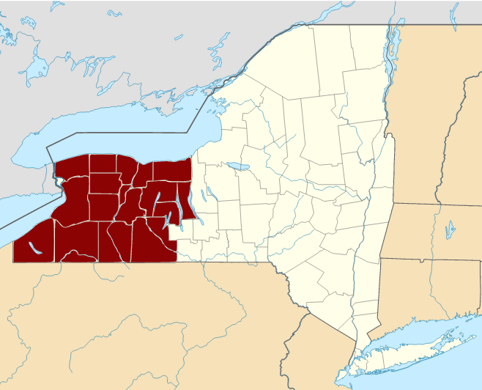
“Burned Over” District in New York
https://courses.lumenlearning.com/boundless-ushistory/chapter/the-second-great-awakening/

Slide 3
“Burned Over” District in New York
The Burned-over District refers to the western and central regions of New York State in the early 19th century, where religious revivals and the formation of new religious movements of the Second Great Awakening took place, to such a great extent that spiritual fervor seemed to set the area on fire.
The term was coined in 1876 by Charles Finney, who argued that the area had been so heavily evangelized as to have no “fuel” (unconverted population) left over to “burn” (convert).
Western New York was still a United States frontier during the early Erie Canal boom, and professional and established clergy were scarce.
https://www.wikiwand.com/en/Burned-over_district

Slide 4
“Burned Over” District in New York
Many of the self-taught people of the Burned-over district were susceptible to enthusiasms of folk religion.
Evangelists won many converts to Protestant sects, such as Congregationalists, Baptists, and Methodists.
Converts in nonconformist sects became part of numerous innovative religious movements, all of which were founded by laypeople during the early 19th century.
https://www.wikiwand.com/en/Burned-over_district

Slide 5
“Burned Over” District in New York
Some of the nonconformist sects from this area included:
  The Mormon movement, which began around 1830.
  The Millerites, who originated around 1834.
    William Miller was a farmer who lived in Low Hampton, New York.
    He preached that the literal Second Coming would occur on October 22, 1844.
    Millerism became extremely popular in western New York state.
    Some of its concepts are still held by church organizations affiliated with Adventism, such as:
      Adventists
      Seventh-day Adventists
      Jehovah's Witnesses
https://www.wikiwand.com/en/Burned-over_district

Slide 6
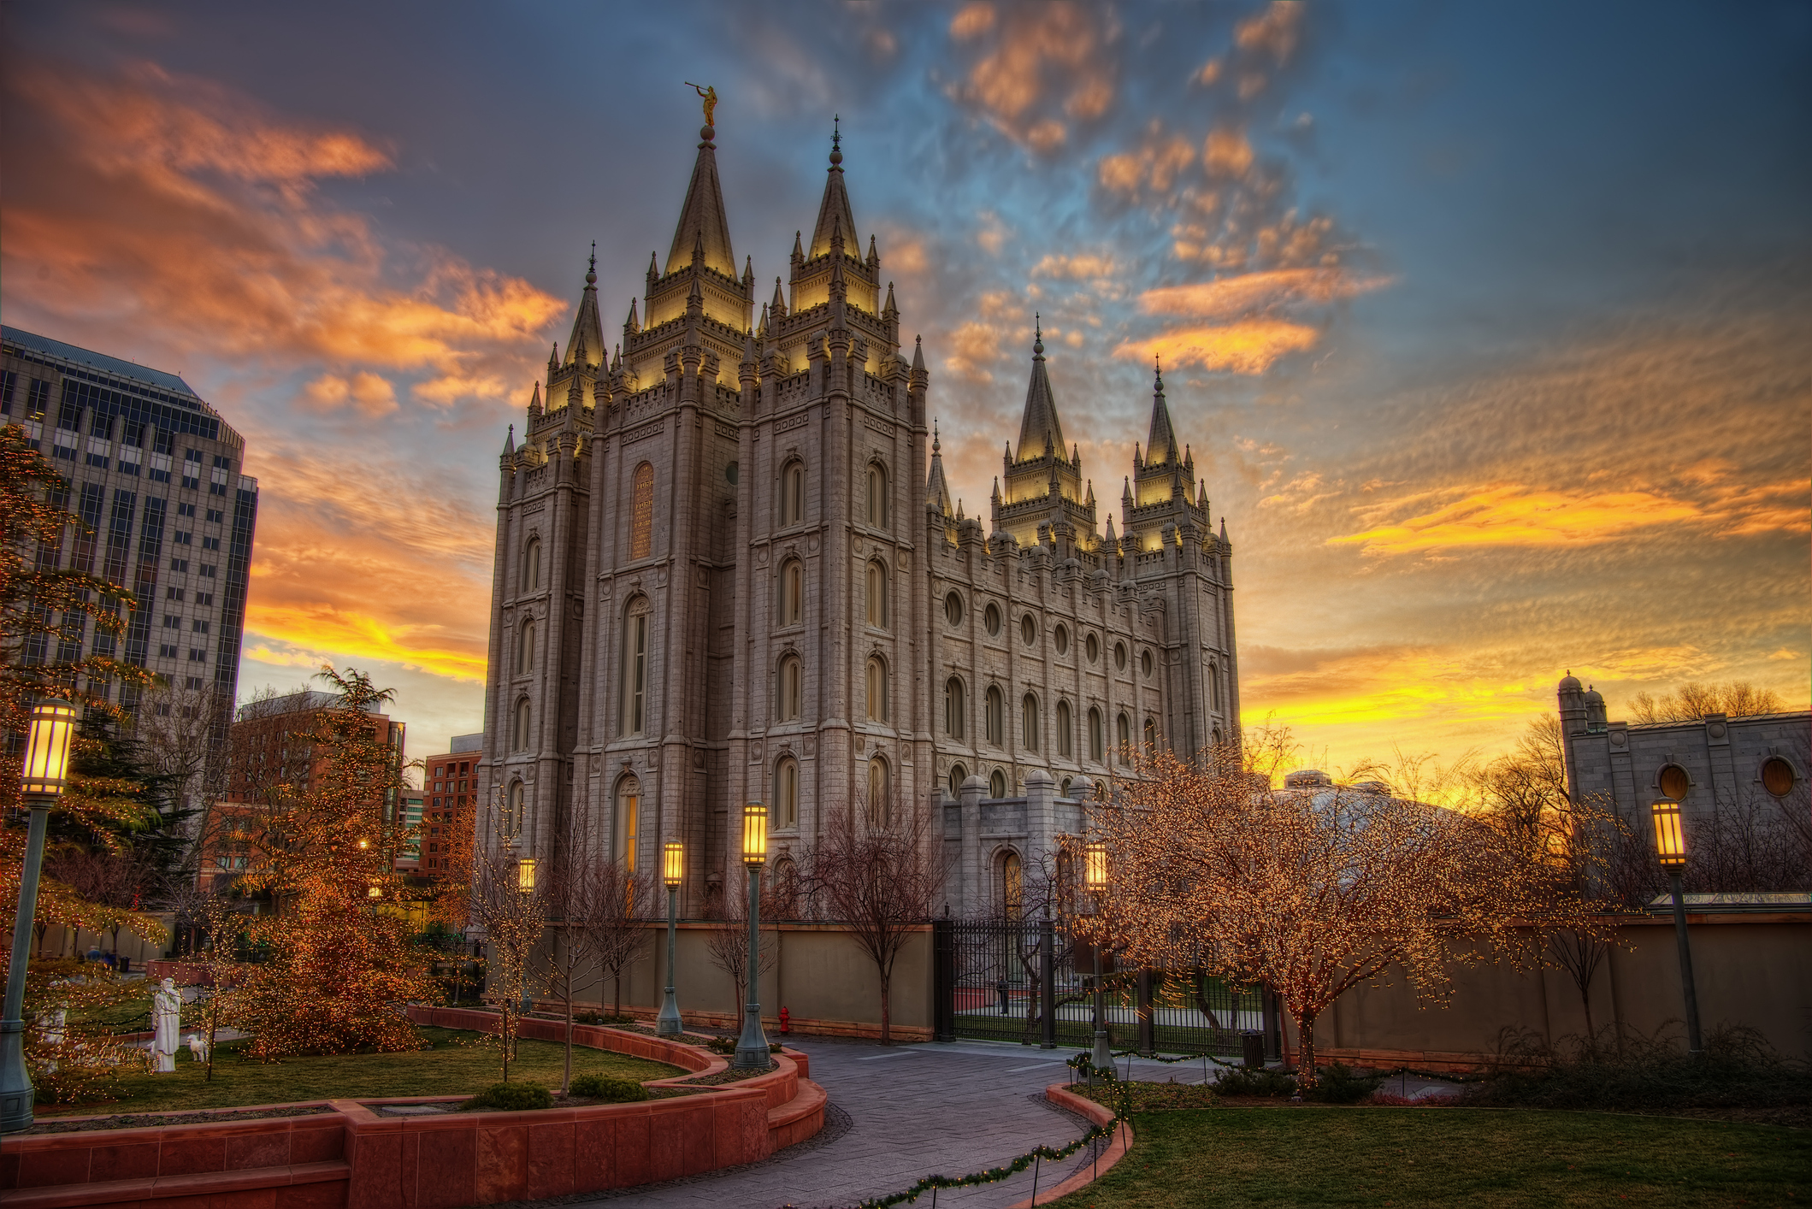
Mormonism
https://washingtonmonthly.com/magazine/november-december-2019/was-i-too-hard-on-the-mormons-nope/

Slide 7
Mormonism
The Mormon church was founded by Joseph Smith (1805–44) in the “Burned-Over District” of upstate New York, in 1830.
Smith claimed to have to been visited by the angel Moroni, who he said told him where to dig up a trove of golden plates or tablets containing the story of the ten lost tribes of Israel. ²
During the late 1820s, Smith claimed that he translated the writing on the golden plates, and in 1830, he published his finding as The Book of Mormon. ¹
On the basis of what he claimed were further revelations, Smith produced additional books which the church also accepts as divinely inspired: Doctrine and Covenants and The Pearl of Great Price. ²
Mormons also claim to believe in the Bible. ¹
¹ https://courses.lumenlearning.com/boundless-ushistory/chapter/the-second-great-awakening/
² Tim Grass. SCM Core Text: Modern Church History

Slide 8
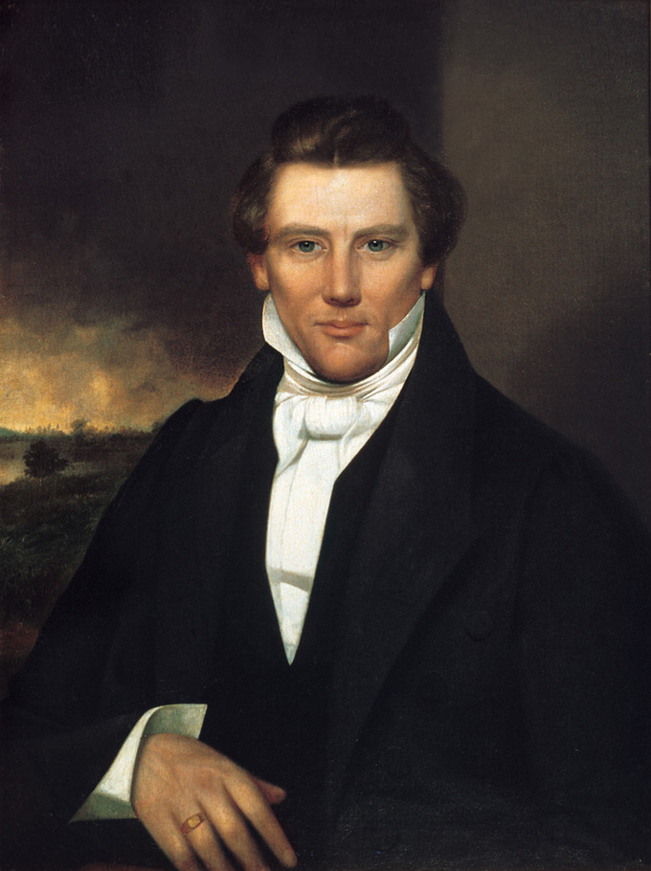
Joseph Smith Jr.
https://courses.lumenlearning.com/boundless-ushistory/chapter/the-second-great-awakening/

Slide 9
Mormonism
In its early decades Mormonism was fiercely opposed by the surrounding society on account of its practice of polygamy and the members’ practice of living in exclusively Mormon settlements and having as little as possible to do with non-Mormons or ‘Gentiles’.
They were thus forced to migrate westwards, seeking land which was not already occupied by others in order to establish a secure habitation.
After Smith was killed by a hostile mob at Nauvoo, Illinois, Brigham Young (1801–77) led the movement and established their headquarters at Salt Lake City in Utah in 1847.
Tim Grass. SCM Core Text: Modern Church History

Slide 10
Mormonism
Utah is the center of Mormon cultural influence, and North America has more Mormons than any other continent, though the majority of Mormons live outside the United States. ¹
Between 1852 and 1890, many Mormons openly practiced “plural marriage”, a form of religious polygamy.¹
Only after polygamy was forbidden in 1890 was Utah admitted to the union, in 1896. ²
Mormons dedicate large amounts of time and resources to serving in their church, and many young Mormons choose to serve a full-time proselytizing mission. ¹
Mormons have a health code that forbids the consumption of alcoholic beverages, tobacco, coffee, tea, and other “addictive” substances. ¹
¹ https://courses.lumenlearning.com/boundless-ushistory/chapter/the-second-great-awakening/
² Tim Grass. SCM Core Text: Modern Church History

Slide 11
Mormonism
Mormons tend to be very family-oriented and have strong connections across generations and with extended family.
Mormons self-identify as Christian, though their beliefs differ from mainstream Christianity.
They believe that Christ’s church was restored through Joseph Smith and is guided by living prophets and apostles.
They have a unique view of cosmology and believe that all people are spirit children of God.
The belief that God speaks to his children and answers their prayers is central to Mormon faith.
https://courses.lumenlearning.com/boundless-ushistory/chapter/the-second-great-awakening/

Slide 12
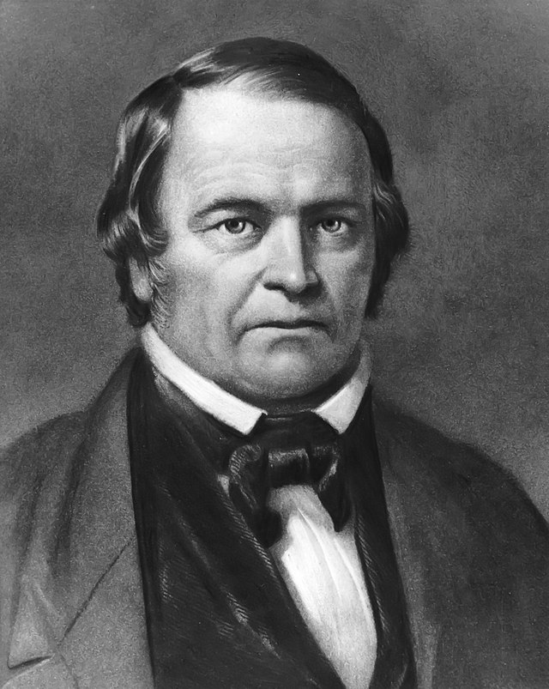
Adventism
William Miller
https://www.wikiwand.com/en/Adventism

Slide 13
Adventism
Adventism is a branch of Protestant Christianity that believes in the imminent Second Coming (or "Second Advent") of Jesus Christ.
It originated in the 1830s in the United States during the Second Great Awakening when Baptist preacher William Miller first publicly shared his belief that the Second Coming would occur at some point between 1843 and 1844.
His followers became known as Millerites. After the Great Disappointment, the Millerite movement split up and was continued by a number of groups that held different doctrines from one another.
These groups, stemming from a common Millerite ancestor, became known collectively as the Adventist movement.
https://www.wikiwand.com/en/Adventism

Slide 14
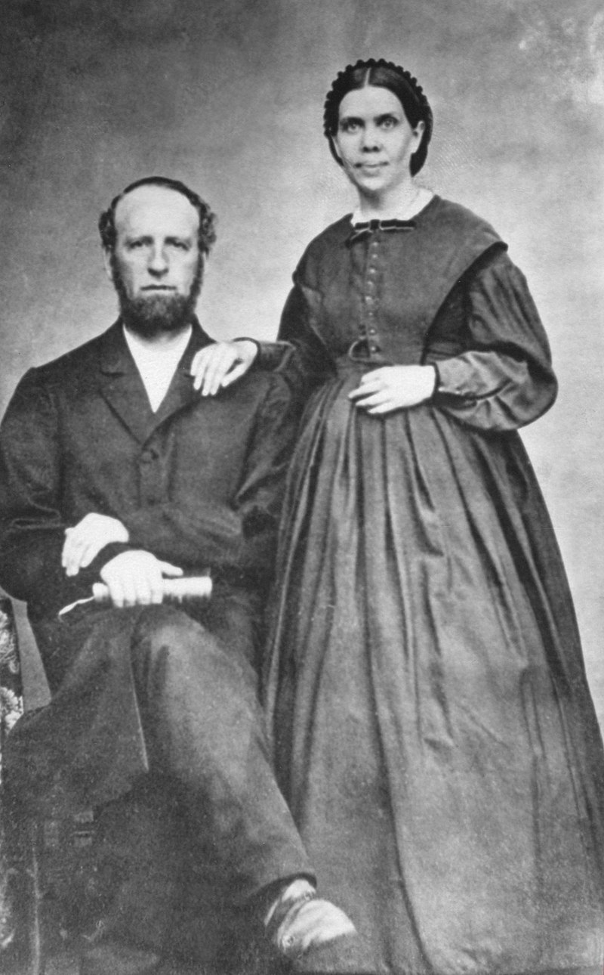
Seventh Day Adventism
James and Ellen White
https://www.wikiwand.com/en/Seventh-day_Adventist_Church

Slide 15
Seventh Day Adventism
The Seventh-day Adventist Church is a Protestant Christian denomination which is distinguished by its observance of Saturday, the seventh day of the week in Christian and Jewish calendars, as the Sabbath, and its emphasis on the imminent Second Coming (advent) of Jesus Christ.
The denomination grew out of the Millerite movement in the United States during the mid-19th century and it was formally established in 1863.
Among its co-founders was Ellen G. White, whose extensive writings are still held in high regard by the church.
Much of the theology of the Seventh-day Adventist Church corresponds to common evangelical Christian teachings, such as the Trinity and the infallibility of Scripture.
https://www.wikiwand.com/en/Seventh-day_Adventist_Church

Slide 16
Seventh Day Adventism
The church is known for its emphasis on diet and health, including adhering to Kosher food laws and advocating vegetarianism.
The Seventh-day Adventist Church is currently “one of the fastest-growing and most widespread churches worldwide”, with a worldwide baptized membership of over 21 million people, and 25 million adherents.
As of May 2007, it was the twelfth-largest religious body in the world, and the sixth-largest highly international religious body.
The church operates over 7,500 schools including over 100 post-secondary institutions, numerous hospitals, and publishing houses worldwide.
https://www.wikiwand.com/en/Seventh-day_Adventist_Church

Slide 17
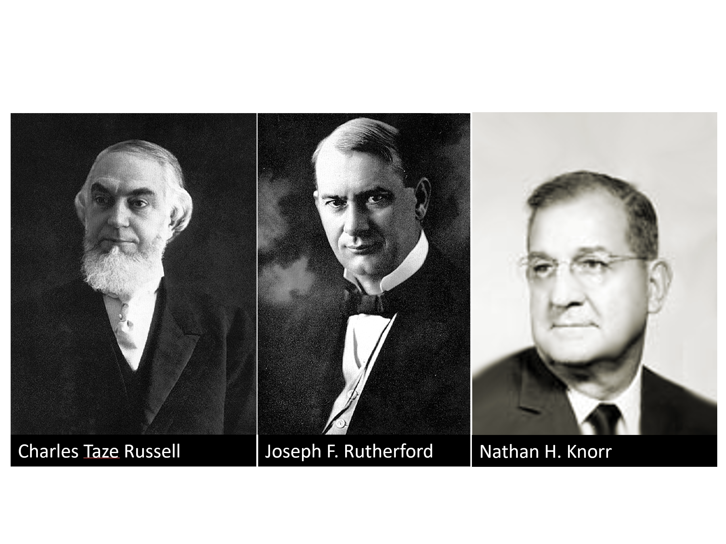
Jehovah Witnesses
https://www.wikiwand.com/en/Jehovah%27s_Witnesses

Slide 18
Jehovah Witnesses
The organization known since 1931 as Jehovah’s Witnesses was founded in Pennsylvania in 1884 by Charles Taze Russell (1852–1916) as the Zion’s Watch Tower Tract Society. ¹
During the course of his ministry, Russell disputed many beliefs of mainstream Christianity including immortality of the soul, hellfire, predestination, the fleshly return of Jesus Christ, the Trinity, and the burning up of the world.²
In 1876, Russell taught that Christ had returned as an invisible spirit being in 1874 inaugurating the “harvest of the Gospel age,” and that 1914 would mark the end of a 2,520 year period called “the Gentile Times,” at which time world society would be replaced by the full establishment of God's kingdom on earth. ²
¹ Tim Grass. SCM Core Text: Modern Church History
² https://www.wikiwand.com/en/Jehovah%27s_Witnesses

Slide 19
Jehovah Witnesses
Russell moved the Watch Tower Society's headquarters to Brooklyn, New York, in 1909, combining printing and corporate offices with a house of worship.
Russell died October 31, 1916, at the age of 64 while returning from a ministerial speaking tour.
In January 1917, the Watch Tower Society's legal representative, Joseph Franklin Rutherford, was elected as its next president.
His election was disputed, and members of the Board of Directors accused him of acting in an autocratic and secretive manner.
The divisions between his supporters and opponents triggered a major turnover of members over the next decade.
² https://www.wikiwand.com/en/Jehovah%27s_Witnesses

Slide 20
Jehovah Witnesses
Significant changes in doctrine and administration were regularly introduced during Rutherford's twenty-five years as president, including the 1920 announcement that the Hebrew patriarchs (such as Abraham and Isaac) would be resurrected in 1925, marking the beginning of Christ's thousand-year earthly Kingdom.
Because of disappointment over the changes and unfulfilled predictions, tens of thousands of defections occurred during the first half of Rutherford's tenure, leading to the formation of several Bible Student organizations independent of the Watch Tower Society, most of which still exist.
² https://www.wikiwand.com/en/Jehovah%27s_Witnesses

Slide 21
Jehovah Witnesses
On July 26, 1931, at a convention in Columbus, Ohio, Rutherford introduced the new name – Jehovah's witnesses – based on Isaiah 43:10: “Ye are my witnesses, saith the Lord…”
In 1932, Rutherford eliminated the system of locally elected elders and in 1938, introduced what he called a “theocratic” (literally, God-ruled) organizational system, under which appointments in congregations worldwide were made from the Brooklyn headquarters.
Nathan Knorr was appointed as third president of the Watch Tower Bible and Tract Society in 1942.
Knorr commissioned a new translation of the Bible, the New World Translation of the Holy Scriptures, the full version of which was released in 1961.
² https://www.wikiwand.com/en/Jehovah%27s_Witnesses

Slide 22
Jehovah Witnesses
From 1966, Witness publications and convention talks built anticipation of the possibility that Christ's thousand-year reign might begin in late 1975 or shortly thereafter.
Membership declined during the late 1970s after expectations for 1975 were proved wrong.
Watch Tower Society literature did not state dogmatically that 1975 would definitely mark the end, but in 1980 the Watch Tower Society admitted its responsibility in building up hope regarding that year.
In 1995, Jehovah's Witnesses abandoned the idea that Armageddon must occur during the lives of the generation that was alive in 1914 and in 2010 changed their teaching on the “generation”.
² https://www.wikiwand.com/en/Jehovah%27s_Witnesses

Slide 23
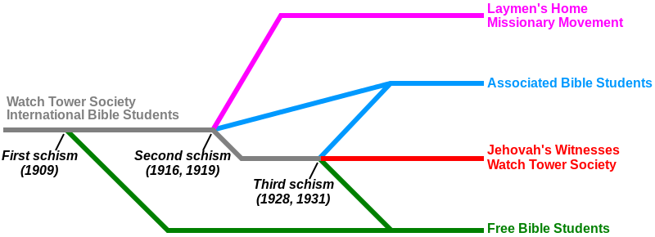
Development of the
Watch Tower Society
https://www.wikiwand.com/en/Bible_Student_movement

Slide 24
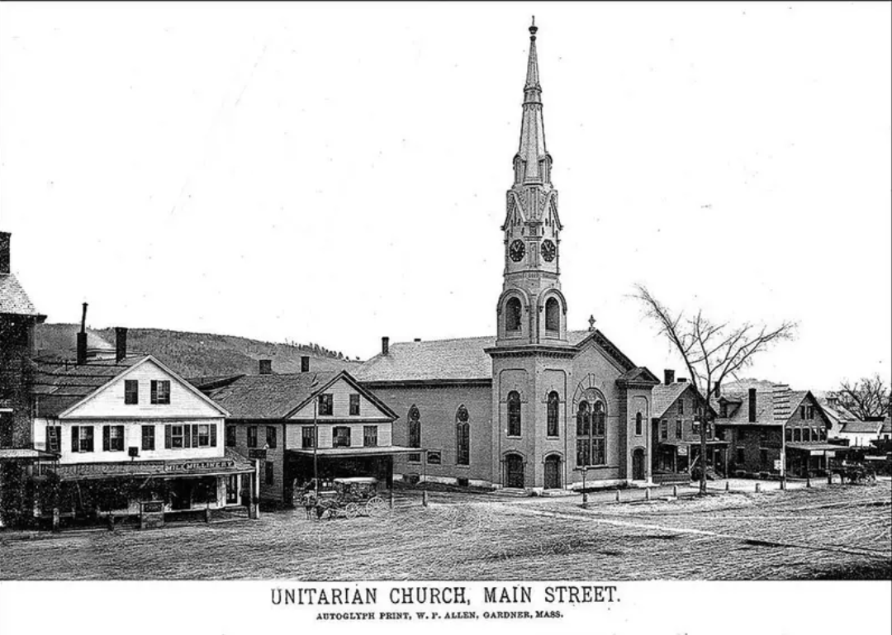
Unitarianism
https://www.christianity.com/church/denominations/what-is-unitarianism-discover-the-history-and-beliefs-of-the-unitarian-church.html

Slide 25

Class Discussion Time
https://www.weareteachers.com/moving-beyond-classroom-discussions/

Slide 26
*Class Discussion Time
Finney theorized that the “Burned Over District” of New York had been so heavily evangelized as to have no “fuel” (unconverted population) left over to “burn” (convert). Do you think there is any truth to his theory? Can an area be over evangelized?
Apart from the sovereignty of God, humanly speaking, why do you think so many false religions would originate in an area that had been so thoroughly evangelized?
Of the things presented today on the origin of several major modern cults, did you learn anything that you found surprising? If so, what?
Do you have a topic or question that you would like to see us to discuss?

