Slide 1


Slide 2
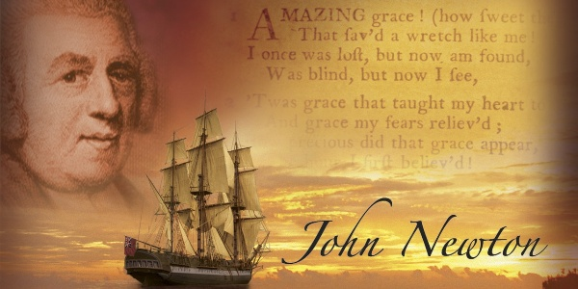
John Newton
https://www.ouramericannetwork.org/story?title=John-Newton-From-Disgrace-to-Amazing-Grace

Slide 3
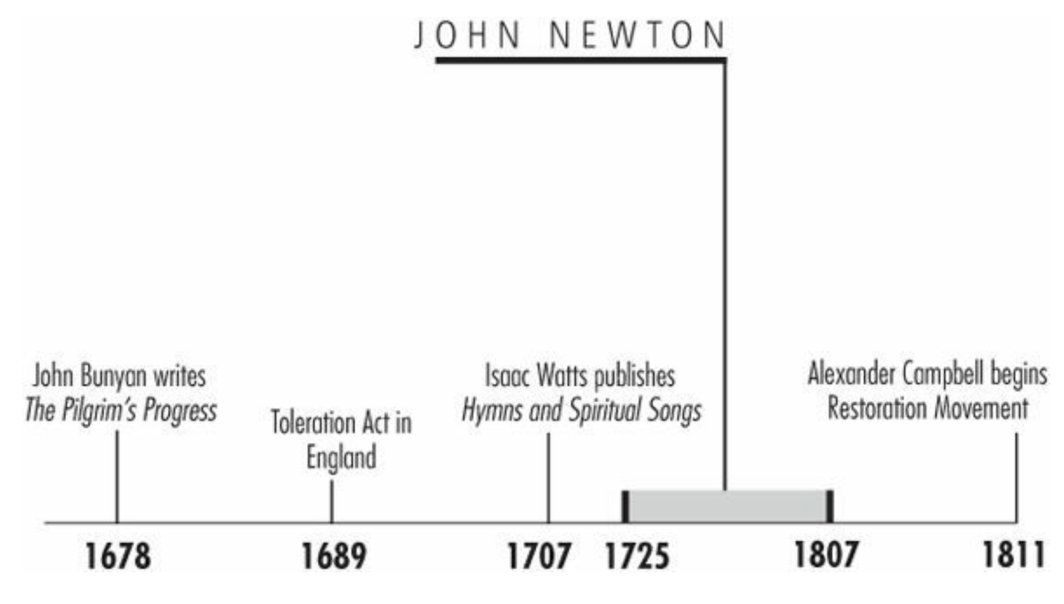
Timeline
Galli, Mark. 131 Christians Everyone Should Know (p. 43).

Slide 4
“Amazing grace, how sweet the sound, that saved a wretch like me.”
It is probably the most famous hymn in history: Amazing grace, how sweet the sound, that saved a wretch like me. I once was lost, but now am found, Was blind but now I see.
Though some today wonder if the word wretch is hyperbole or a bit of dramatic license, John Newton, the song's author, clearly did not.
Galli, Mark. 131 Christians Everyone Should Know (p. 88).

Slide 5
Slave Trader
Newton was nurtured by a Christian mother who taught him the Bible at an early age, but he was raised in his father's image after she died of tuberculosis when Newton was 7.
At age eleven he first went to sea with his father. Newton sailed six voyages before his father retired in 1742.
At that time, Newton's father made plans for him to work at a sugarcane plantation in Jamaica.
Instead, Newton signed on with a merchant ship sailing to the Mediterranean Sea.
https://www.wikiwand.com/en/John_Newton

Slide 6
Slave Trader
In 1743, while going to visit friends, Newton was captured and pressed into the naval service by the Royal Navy. He became a midshipman aboard the HMS Harwich.
At one point Newton tried to desert and was punished in front of the crew of 350. Stripped to the waist and tied to the grating, he received a flogging of eight dozen lashes and was reduced to the rank of a common seaman.
Later, while Harwich was en route to India, he transferred to Pegasus, a slave ship bound for West Africa.
The ship carried goods to Africa and traded them for slaves to be shipped to the colonies in the Caribbean and North America.
https://www.wikiwand.com/en/John_Newton

Slide 7
Slave Trader
Espousing freethinking principles, he remained arrogant and insubordinate, and he lived with moral abandon: “I sinned with a high hand,” he later wrote, “and I made it my study to tempt and seduce others.”
He took up employment with a slave-trader named Clow, who owned a plantation of lemon trees on an island off of west Africa.
But he was treated cruelly by Clow and the slaver's African mistress; soon Newton's clothes turned to rags, and Newton was forced to beg for food to relieve his hunger.
Galli, Mark. 131 Christians Everyone Should Know (pp. 88-89).

Slide 8
Slave Trader
The sluggish sailor was transferred to the service of the captain of the Greyhound, a Liverpool ship, in 1747, and on its homeward journey, the ship was overtaken by an enormous storm.
Newton had been reading Thomas a Kempis's The Imitation of Christ, and was struck by a line about the “uncertain continuance of life.”
He also recalled the passage in Proverbs, “Because I have called and ye have refused,…I also will laugh at your calamity.”
He converted during the storm, though he admitted later, “I cannot consider myself to have been a believer, in the full sense of the word.”
Galli, Mark. 131 Christians Everyone Should Know (pp. 88-89).

Slide 9
Amazing Hymnal
Newton then served as a mate and then as captain of a number of slave ships, hoping as a Christian to restrain the worst excesses of the slave trade, “promoting the life of God in the soul” of both his crew and his African cargo.
After leaving the sea for an office job in 1755, Newton held Bible studies in his Liverpool home.
Influenced by both the Wesleys and George Whitefield, he adopted mild Calvinist views and became increasingly disgusted with the slave trade and his role in it.
He quit, was ordained into the Anglican ministry, and in 1764 took a parish in Olney in Buckinghamshire.
Three years after Newton arrived, poet William Cowper moved to Olney.
Cowper, a skilled poet who experienced bouts of depression, became a lay helper in the small congregation.
Galli, Mark. 131 Christians Everyone Should Know (pp. 89).

Slide 10
Amazing Hymnal
In 1769, Newton began a Thursday evening prayer service. For almost every week's service, he wrote a hymn to be sung to a familiar tune.
Newton challenged Cowper also to write hymns for these meetings, which he did until falling seriously ill in 1773.
Newton later combined 280 of his own hymns with 68 of Cowper's in what was to become the popular Olney Hymns.
Among the well-known hymns in it are “Amazing Grace,” “Glorious Things of Thee Are Spoken,” “How Sweet the Name of Jesus Sounds,” “O for a Closer Walk with God,” and “There Is a Fountain Filled with Blood.”
Galli, Mark. 131 Christians Everyone Should Know (pp. 89).

Slide 11
Amazing Hymnal
In 1787 Newton wrote Thoughts Upon the African Slave Trade to help William Wilberforce's campaign to end the practice— “a business at which my heart now shudders,” he wrote.
Recollection of that chapter in his life never left him, and in his old age, when it was suggested that the increasingly feeble Newton retire, he replied, “I cannot stop. What? Shall the old African blasphemer stop while he can speak?”
Galli, Mark. 131 Christians Everyone Should Know (pp. 89).

Slide 12
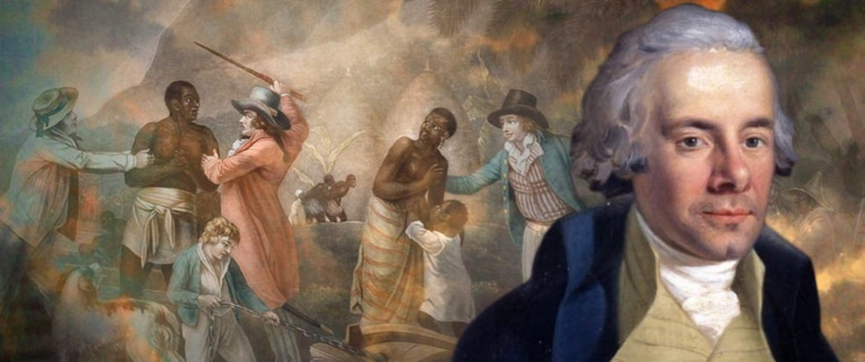
William Wilberforce
ANTISLAVERY POLITICIAN
https://www.adamsmith.org/blog/wilberforce-finally-ended-slavery

Slide 13
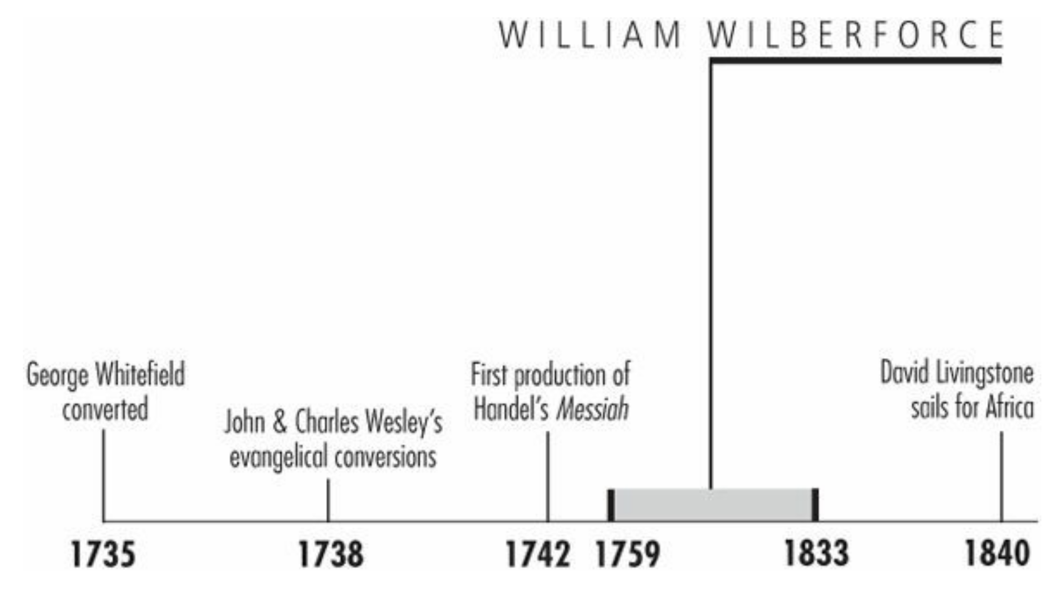
Timeline
Galli, Mark. 131 Christians Everyone Should Know (p. 283).

Slide 14
“So enormous, so dreadful, so irremediable did the [slave] trade's wickedness appear that my own mind was completely made up for abolition. Let the consequences be what they would: I from this time determined that I would never rest until I had effected its abolition.”
Galli, Mark. 131 Christians Everyone Should Know (p. 283-284).

Slide 15
William Wilberforce
Slavery was a common feature of most cultures until roughly 150 years ago.
It still goes on, but in modern times it is against international law and has a minute fraction of the economic status it once held.
Much of this change is due to a man who was born on August 24th, 1759.
William Wilberforce seemed an unlikely champion of social change in his youth, when he was a popular Cambridge student, enjoying gambling, drinking and a hedonistic social life.
Amongst his many friends there was William Pitt, the future Prime Minister.
https://www.adamsmith.org/blog/wilberforce-finally-ended-slavery

Slide 16
William Wilberforce
Inheriting money from his grandfather and uncle, Wilberforce could afford the £8,000 it took to have him elected as a member of parliament for Hull, his birthplace.
His life changed when he converted to evangelical Christianity, and resolved to atone for his rather dissolute past life by making a moral commitment to improving the world.
In particular, he began to campaign against the slave trade, appalled by the cruelty and suffering it involved.
It is estimated that of the approximately 11 million Africans transported into slavery, some 1 in 8 did not survive the journey.
Of the ones who did, many faced lives blighted by hard working conditions and sometimes arbitrary cruelty.
https://www.adamsmith.org/blog/wilberforce-finally-ended-slavery

Slide 17
William Wilberforce
His friend, William Pitt, urged him to take up his campaign in Parliament and in the country, and the “Society for Effecting the Abolition of the Slave Trade” was formed, drawing in other Christian denominations as well as Evangelicals.
Its famous logo of a kneeling slave was designed the Josiah Wedgwood, the celebrated potter, and was inscribed, “Am I not a Man and a Brother?”
Wilberforce made his first major speech on slavery in Parliament in 1789, describing some of the appalling conditions involved in the trade.
The campaign took many years, but gradually accumulated support.
https://www.adamsmith.org/blog/wilberforce-finally-ended-slavery

Slide 18
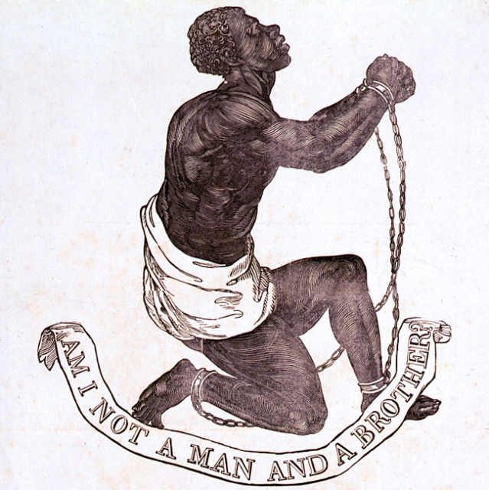
https://www.historiansagainstslavery.org/main/wp-content/uploads/2014/08/1.jpg

Slide 19
William Wilberforce
Wilberforce sometimes had to take time out to cope with an illness, believed to be ulcerative colitis, that flared up occasionally but was alleviated by moderate doses of opium.
Several anti-slavery bills he introduced in the House were defeated, but opinion was changing.
At length, the Prime Minister, Lord Grenville, introduced a bill to stop the use of British ships to carry men as slaves.
It had huge majorities in both houses, and passed into law as the Slave Trades Act in 1807.
Wilberforce wept in Parliament as it passed.
https://www.adamsmith.org/blog/wilberforce-finally-ended-slavery

Slide 20
William Wilberforce
The final hurdle came in 1833, with a bill to abolish slavery itself throughout the British Empire.
On July 26th, on his deathbed, Wilberforce learned that the government had cleared the way to guarantee its passage, and died three days later, his life’s work having been achieved.
The life of William Wilberforce shows that one person, highly motivated and determined, can act to change events.
https://www.adamsmith.org/blog/wilberforce-finally-ended-slavery

Slide 21
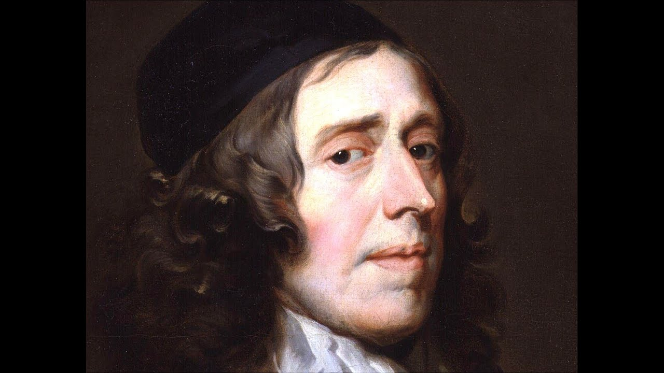
John Owen
https://www.youtube.com/watch?v=qU5b3uzqZMc

Slide 22

Class Discussion Time
https://www.weareteachers.com/moving-beyond-classroom-discussions/

Slide 23
*Class Discussion Time
Do you think getting rid of slavery was a good thing? Why?
Many today believe it was a sin to own a slave. Do you agree? If so, how does this square with
  The numerous regulations in the OT governing slavery.
  The apostle Paul giving extensive instructions to slave owning Christians in Ephesians 6 and other passages (none of which including freeing their slaves).
  Upon conversion, the apostle Paul insisted that a runaway slave (Onesimus) return to his rightful owner (Philemon).
Is there anything about slavery that is sinful? For example:
  Whoever steals a man and sells him, and anyone found in possession of him, shall be put to death. (Exodus 21:16)
  … understanding this, that the law is not laid down for the just but for the lawless and disobedient, for the ungodly and sinners, for the unholy and profane, for those who strike their fathers and mothers, for murderers, the sexually immoral, men who practice homosexuality, enslavers, liars, perjurers, and whatever else is contrary to sound doctrine… (1Tim. 1:9-10)
Do you have a topic or question that you would like to see us to discuss?

