Slide 1


Slide 2
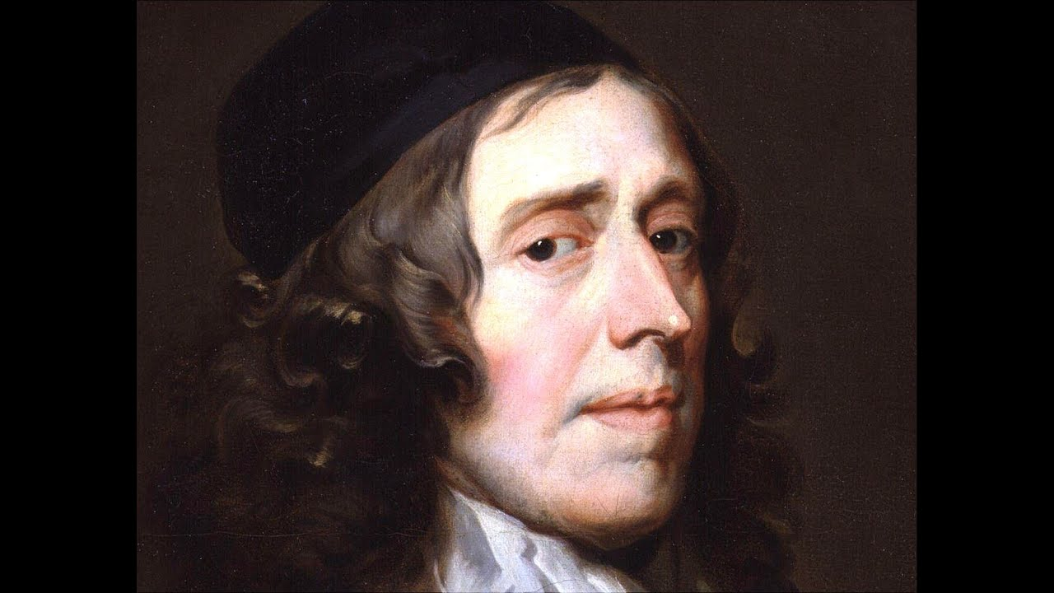
John Owen
https://www.youtube.com/watch?v=qU5b3uzqZMc

Slide 3
John Owen
Owen was by common consent the weightiest Puritan theologian, and many would bracket him with Jonathan Edwards as one of the greatest Reformed theologians of all time.
Born in 1616, he entered Queen’s College, Oxford, at the age of twelve and secured his M.A. in 1635, when he was nineteen.
In his early twenties, conviction of sin threw him into such turmoil that for three months he could scarcely utter a coherent word on anything; but slowly he learned to trust Christ, and so found peace.
In 1637 he became a pastor; in the 1640s he was chaplain to Oliver Cromwell.
https://johnowen.org/about/

Slide 4
John Owen
By 1646, Owen’s views on church government had changed from Presbyterianism to Independent.
He continued, however, to function within the parish system (now controlled by parliament).
His preaching, and the theological writings brought him increasingly into the public eye; as an Independent, he was appreciated by the leaders of the New Model Army.
When Charles I was put to death in 1649, the Rump Parliament chose Owen to preach to them the following day.
Although he did not specifically mention the king’s execution, the sermon was entitled Righteous Zeal Encouraged by Divine Protection.
Needham, Nick. 2,000 Years of Christ's Power Vol. 4: The Age of Religious Conflict

Slide 5
John Owen
In 1651 he was made Dean of Christ Church, Oxford’s largest college. ¹
In 1652 he was given the additional post of Vice-Chancellor of the University, which he then reorganized with conspicuous success. ¹
Owen’s theology filled 24 volumes, 16 on doctrinal or practical divinity, the other eight an exhaustive commentary on Hebrews. ²
One of my favorites is his work defending particular redemption entitled, The Death of Death in the Death of Christ.
After the monarchy was restored in 1660, amidst persecution Owen offered a nationwide leadership to Independents that was crucial in preserving their faith and morale in a dark time. ²
¹ https://johnowen.org/about/
² Needham, Nick. 2,000 Years of Christ's Power Vol. 4: The Age of Religious Conflict

Slide 6
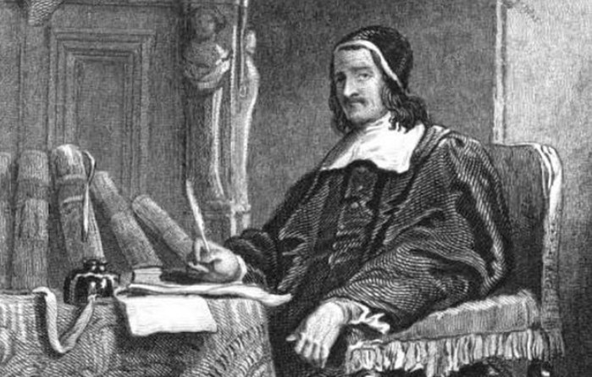
Richard Baxter
MODERATE IN AN AGE OF EXTREMES
https://scriptoriumdaily.com/wp-content/uploads/2019/04/richard-baxter-frontispiece-of-making-light.jpg

Slide 7
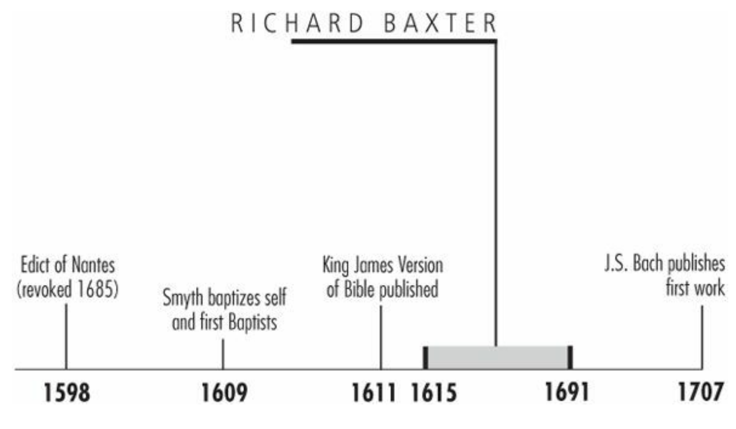
Timeline
Galli, Mark. 131 Christians Everyone Should Know (p. 86).

Slide 8
“I preached…as a dying man to dying men.”
Richard Baxter never received a higher commission than that of parish pastor to loom workers in Kidderminster.
Still, he was the most prominent English churchman of the 1600s.
He was a peacemaker who sought unity among Protestants, and yet he was a highly independent thinker—and at the center of every major controversy in England during his lifetime.
Galli, Mark. 131 Christians Everyone Should Know (p. 86).

Slide 9
Nonconformist Who Sought Unity
Born in Rowton to parents who undervalued education, Baxter was largely self-taught.
He eventually studied at a free school, then at royal court, where he became disgusted at what he saw as frivolity.
He left to study divinity, and at age 23, he was ordained into the Church of England.
Within the Anglican church, Baxter found common ground with the Puritans, a growing faction who opposed the views of the church’s bishops—and was itself breaking into factions.
Galli, Mark. 131 Christians Everyone Should Know (pp. 86-87).

Slide 10
Nonconformist Who Sought Unity
Baxter, for his part, did his best to avoid the disputes between Anglicans, Presbyterians, Congregationalists, and other denominations, even convincing local ministers to cooperate in some pastoral matters. “In necessary things, unity; in doubtful things, liberty; in all things, charity,” he was fond of saying.
The interest in cooperation was not due to a lack of conviction. On the contrary, Baxter was opinionated in his theology, which was not quite Separatist and not quite Conformist.
Among his more than 200 works are long, controversial discourses on doctrine.
Galli, Mark. 131 Christians Everyone Should Know (pp. 86-87).

Slide 11
Persecuted Moderate
Baxter also found himself as a peacemaker during the English Civil Wars.
He believed in monarchy, but a limited one.
He served as a chaplain for the parliamentary army, but then helped to bring about the restoration of the king.
Yet as a moderate, Baxter found himself the target of both extremes.
He was still irritated with the episcopacy in 1660, when he was offered the bishopric of Hereford, so he declined it.
As a result, he was barred from ecclesiastical office and not permitted to return to Kidderminster, nor was he allowed to preach.
Galli, Mark. 131 Christians Everyone Should Know (pp. 87).

Slide 12
Persecuted Moderate
Between 1662 and 1688 (when James II was overthrown), he was persecuted and was imprisoned for 18 months, and he was forced to sell two extensive libraries.
Still, he continued to preach: “I preached as never sure to preach again,” he wrote, “and as a dying man to dying men.”
Baxter became even better known for his prolific writing.
His devotional classic The Saints' Everlasting Rest was one of the most widely read books of the century.
When asked what deviations should be permitted from the Anglican Book of Common Prayer, he created an entirely new one, called Reformed Liturgy, in two weeks.
Galli, Mark. 131 Christians Everyone Should Know (pp. 87).

Slide 13
Persecuted Moderate
His Christian Directory contains over one million words.
His autobiography and his pastoral guide, The Reformed Pastor, are still widely read today.
“The Gospel dieth not when I die: the church dieth not: the praises of God die not: the world dieth not: and perhaps it shall grow better,” he wrote near the end of his life. “It may be that some of the seed that I have sown shall spring up to some benefit of the dark unpeaceable world when I am dead.”
Galli, Mark. 131 Christians Everyone Should Know (pp. 87).

Slide 14
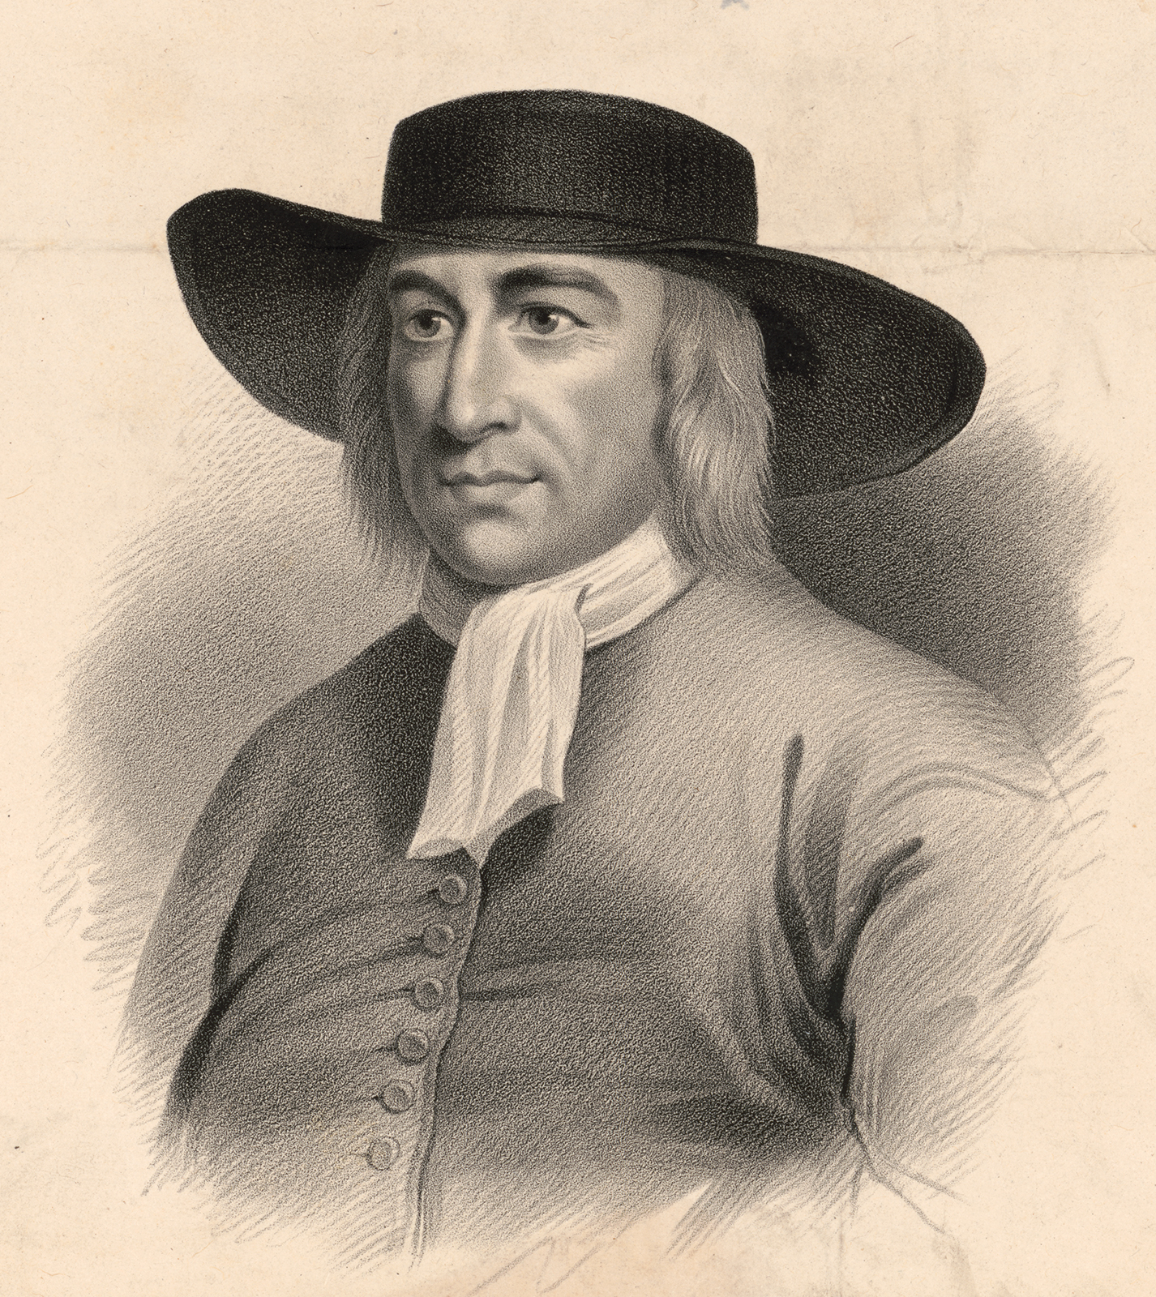
George Fox
First “Friend”
https://www.britannica.com/biography/George-Fox

Slide 15
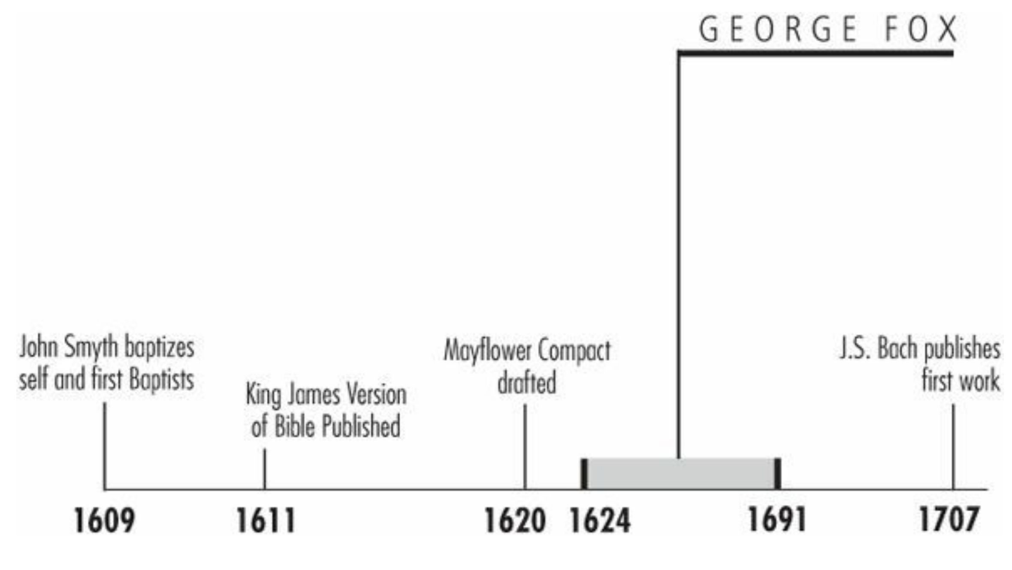
Timeline
Galli, Mark. 131 Christians Everyone Should Know (p. 175).

Slide 16
“These things I did not see by the help of man, nor by the letter…but I saw them in the light of the Lord Jesus Christ, and by his immediate spirit and power, as did the holy men of God by whom the Holy Scriptures were written.”
Galli, Mark. 131 Christians Everyone Should Know (p. 175).

Slide 17
The Inner Light
Fox was born in a small English village, the son of a weaver.
He became a cobbler's apprentice, but, disgusted with the lax morals of his fellow apprentices, he quit and set off on a spiritual journey.
He traveled all over England, attending religious meetings and seeking illumination. He immersed himself in the Bible and wrestled to discover truth.
He eventually came to the conclusion that all sects were wrong and that their worship was a disgrace. Pastors who worked for a salary were nothing but “journeymen.” Hymns, sermons, sacraments, and creeds hindered—rather than helped—people to worship.
Instead, Fox looked to the “inner light” for inspiration.
Galli, Mark. 131 Christians Everyone Should Know (pp. 175-176).

Slide 18
The Inner Light
This inner light, he argued, was in everyone, though it might be very dim in some.
It is not intellect nor natural reason nor morality, but a capacity to recognize and accept God.
It also makes it possible for people to understand and believe the Bible.
Therefore it is through the inner light, first and foremost, that people come to know God.
“These things I did not see by the help of man, nor by the letter,” he concluded, “but I saw them in the light of the Lord Jesus Christ, and by his immediate spirit and power, as did the holy men of God by whom the Holy Scriptures were written.”
Galli, Mark. 131 Christians Everyone Should Know (pp. 175-176).

Slide 19
Persecution and Practice
He was hesitant to share these insights at first, but one day he said he “felt called by the Spirit” to speak out at a Baptist meeting.
The promptings of the Spirit became increasingly frequent; in his journals he regularly writes:
  “At the command of God, I…”
  “I was moved to go….”
In many places, Fox was treated with contempt; he was physically thrown from meetings, beaten, stoned, and jailed.
He spent a total of six years in prison—the first time, for interrupting a preacher who was saying that ultimate truth was found in the Bible.
Other times it was for blasphemy or for conspiring against the government (i.e., for his pacifism).
Galli, Mark. 131 Christians Everyone Should Know (pp. 176).

Slide 20
Persecution and Practice
Still, he gathered followers. They structured their worship so nothing could “get in the way of the Spirit”.
The sacraments were rejected, and the service took place in silence, though any who “felt called” to speak or pray aloud could do so.
People began calling them “quakers” because many would tremble as they were moved by the Spirit, but Fox preferred the term “friends.”
Galli, Mark. 131 Christians Everyone Should Know (pp. 176).

Slide 21
Persecution and Practice
To thwart individualism, Fox emphasized the importance of community and love. Decisions among the Friends were not made by majority vote but by consensus.
If consensus wasn't reached, decisions were postponed until the group as a whole could discern the “leading of the Spirit”.
The Friends also refused to swear oaths or tithes or bow to their betters (they insisted on using the familiar “thou” instead of the respectful “you”).
Like their founder, they were staunch pacifists.
Galli, Mark. 131 Christians Everyone Should Know (pp. 176).

Slide 22
Spreading the Faith
Fox traveled abroad to spread his “gospel of the inner light”. In Scotland, he was accused of sedition. ¹
He went to Ireland, then to the Caribbean and North America; he also made two visits to the Continent. ¹
In both England and America, the Friends were severely persecuted for decades, but the movement continued to grow. ¹
The most famous convert in America was William Penn, founder of Pennsylvania. ¹
Today, there are more than 300,000 Quakers around the world, by some estimates, with the highest percentage in Africa. ²
To date, two U.S. presidents have been Quakers: Herbert Hoover and Richard M. Nixon.²
¹ Galli, Mark. 131 Christians Everyone Should Know (pp. 176-178).
² https://www.history.com/topics/immigration/history-of-quakerism

Slide 23
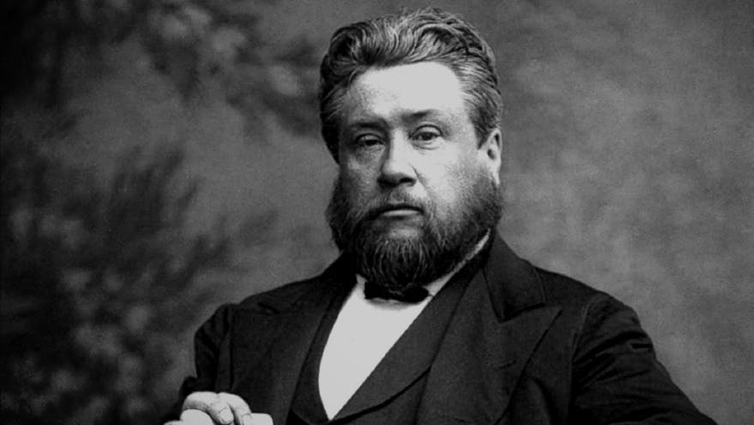
Charles Haddon Spurgeon
The Prince of Preachers
https://www.freechristianresources.org/2008-01/free-spurgeon-devotionals-however-you-want-them

Slide 24

Class Discussion Time
https://www.weareteachers.com/moving-beyond-classroom-discussions/

Slide 25
*Class Discussion Time
After the monarchy was restored in 1660, amidst persecution Owen is said to have offered a nationwide leadership to Independents that was crucial in preserving their faith and morale in a dark time. What do you think that might have looked like? Can you foresee a time in the near future when we might need leaders like this?
Richard Baxter is called a “moderate” in part because he sought to bring unity between opposing sides – not because he lacked strong convictions regarding the issues in dispute, but because he had a strong desire for Christian unity where possible. At one level, this is a good thing. But is it possible to have such a strong a desire for Christian unity that you end up you compromising the truth? At what point do we “cross the line” in seeking compromise?
George Fox once interrupted and disputed with a preacher who taught that the ultimate truth was found in the Bible. George Fox believed that ultimate truth came by means of an “inner light” or “leading of the Spirit” whereby Christians receive extrabiblical revelation from God. Do you agree with him? Would you be comfortable being a member of his church? Why or why not?
What do you think of George Foxe’s idea of churches needing to have a total consensus before making a decision (rather than just a majority)?
Do you have a topic or question that you would like to see us to discuss?

