Slide 1


Slide 2
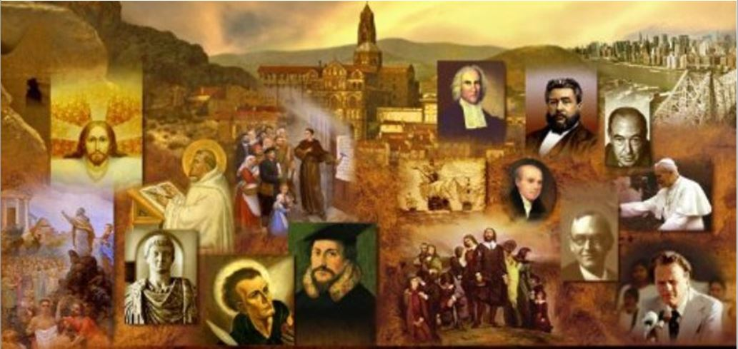
Review
In the letter known as 1 Clement, the writer indicates that the Church at Rome had delayed in responding to a communication from the Church at Corinth. What reason do they give for the delay and why might this be significant for us in dating the letter?
It says they delayed due to the sudden and successive calamitous events which have happened.
If this is a reference to persecution that Roman Church experienced at the hand of the Roman government, then it is likely a reference to the persecution that took place near the end of Domitian’s reign (AD 95), thus enabling us to date the letter to that time.

Slide 3
Review
In an attempt to convince the Corinthians to reinstate their old elders whom they had forcibly removed from office, the writer of 1 Clement uses two types of persuasion – what are they?
“Butter” and “Slap” – Blistering condemnation of their “sedition” followed by praise for their heretofore good conduct and reputation.
1 Clement quotes extensively from both OT and NT
Chapter 4 alone cites a number of OT characters. How many can you name?
Cain and Abel
Jacob and Esau
Joseph (being sold into bondage)
Moses and Pharaoh
Aaron and Miriam
Dathan and Abiram (cf. Numbers 16)
David and Saul

Slide 4
Review
What point is it making in 1 Clement when it says that the Corinthians “fulfilled” that which is written (in Deut. 32:15), “My beloved ate and drink, and was enlarged and became fat, and kicked.”?
Just as the ancient Israelites had rebelled against God after He had poured out numerous blessings on them, so the Corinthians showed a lack of appreciation of all that God had done for them when they rebelled against their previous elders.
1 Clement cites from at least a dozen NT books, including one book, in particular, which did not gain wide acceptance in the early church until a number of years later – due in part, perhaps, to the fact that there is disagreement over who wrote it. What book was that?
The Book of Hebrews

Slide 5
Review
According to 1 Clement, how many offices did the apostles establish within the local church and what were they?
Two: bishops and deacons
What seems to have been the normative expectation in churches at this time (AD 96) concerning the number of bishops/elders in each local church?
A plurality of bishops/elders within each church
How does the letter describe the process by which bishops/elders were appointed within the churches?
In the beginning, the apostles appointed the first elders.
And the apostles then left instructions (i.e. a list of qualifications) by which subsequent elders could be chosen by “other eminent men, with the consent of the whole Church”.

Slide 6
Review
What evidence does 1 Clement give of a belief in the trinity?
The frequent use of “Trinitarian formulas”, much like those in scripture, in which all three members of the trinity are referenced in a way that shows equal power and divinity.
In Chapter 32, 1 Clement affirms the principle of justification by faith alone. Why is this ironic in light of later church history?
Because Roman Catholics believe that the author of this letter, written from the Church at Rome, is the fourth pope; and yet here we see within it a teaching that was anathematized by the Church at Rome some 1400 years later at the Council of Trent!

Slide 7
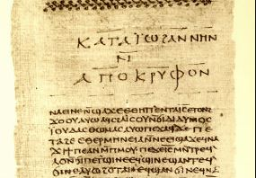
The Didache
https://mymorningmeditations.files.wordpress.com/2013/11/didache_nag_hammadi_codex_ii.jpg

Slide 8
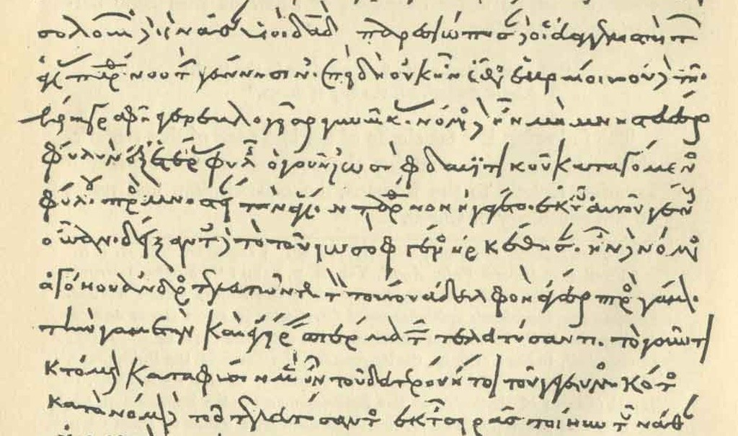
The Didache
http://living-faith.org/2017/11/10/the-didache/

Slide 9
*The Didache
The Didache (Greek for “teaching” – pronounced “did-a-kee”) is the oldest surviving handbook of church discipline, dating from about AD 100.
It originated from Syria, and its full title is The Teaching of the Lord to the Gentiles through the Twelve Apostles – though it is not really written by them.
It is divided into two parts:
Part One concerns doctrinal teaching to be given to Christians, based on a contrast between the “Way of Life” and the “Way of Death”.
Part Two is about various church practices: prayer, fasting, baptism, the Lord’s supper, church leadership, how to handle visiting prophets.
*Needham, Nick. 2,000 Years of Christ's Power Vol. 1: The Age of the Early Church Fathers

Slide 10
*The Didache
The Didache was discovered in 1870s and published in 1883.
Skeptics try to present this as one of the “lost books of the Bible”. They like to point out all the things that are talked about in it, like the deity of Christ. But that wasn’t the purpose of the book. It was a discipline manual.
It’s similar to the book of James – it is intended as a brief summary for someone newly converted out of paganism.
*Based on notes taken from James White’s 2016 Church History Series; Lesson 8 – The DIdache

Slide 11
*The Didache
The translation that I will be using is a revision into modern English based on the J.B. Lightfoot translation*
1:1 There are two ways, one of life and one of death, and there is a great difference between the two ways.
The "Teaching of the Two Ways" has roots in the scripture. See, for example, Deut. 30:15 - See, I have set before you today life and good, death and evil.
1:2 The way of life is this.
1:3 First of all, Love God who made you;
1:4 Secondly, Love your neighbor as you love yourself.
Compare Mark 12:30,31
*http://www.orthodox.cn/patristics/apostolicfathers/didache_en.htm

Slide 12
*The Didache
1:5 Do not do anything to another you would not want to befall yourself.
This negative form of the golden rule corresponds to the positive form found in the synoptic gospels – Mat. 7:12 (cf. Luke 6:31).
Also compare with Tobit 4:15 which reads: “That which you hate, do to no one.”
*http://www.orthodox.cn/patristics/apostolicfathers/didache_en.htm

Slide 13
*The Didache
1:6 Now of these words the doctrine is this.
1:7 Bless those who curse you, pray for your enemies, and fast for those who persecute you;
1:8 For what thanks do you deserve, if you love them that love you? Do not even the Gentiles do the same? But do love those who hate you, and you will not have an enemy.
Pretty much a quote from Matthew 5:44,46.
With the added admonition in verse 1:7 to "fast for those who persecute you" and in 1:8 "you will not have an enemy."
The point of the Didache here seems to be that it is imperative to love, pray, and fast not only for obedience, but to win over the enemy.
*http://www.orthodox.cn/patristics/apostolicfathers/didache_en.htm

Slide 14
*The Didache
1:9 Abstain from fleshly and bodily lusts.
Similar to 1 Peter 2:11, “abstain from the passions of the flesh, which wage war against your soul.”
1:10 If any man give you a blow on your right cheek, turn the other to him also, and you will be flawless;
1:11 If a man compel you to go one mile with him, go two with him;
1:12 If a man take away your cloak, give him also your coat;
1:13 If a man takes away from you that which is your own, do not ask it back, for you are unable to do that.
1:14 Give to every man that asks of you and do not ask it back;
Obviously an extended citation from the Sermon on the Mount – Matthew 5:39-42; Luke 6:29,30
*http://www.orthodox.cn/patristics/apostolicfathers/didache_en.htm

Slide 15
*The Didache
1:15 For the Father desires that gifts be given to all from His own bounties.
1:16 Blessed is he that gives according to the commandment;
1:17 For he is guiltless.
1:18 Woe to him that receives;
1:19 For, if a man in need receives, he is guiltless;
1:20 But he that has no need shall give satisfaction why and wherefore he received;
1:21 And being put in confinement he shall be examined concerning the deeds that he has done, and he shall not come out from there until he has given back the last penny.
1:22 Yea, as touching this also it is said;
1:23 Let your alms sweat in your hands, until you will have learned to whom to give.
These rules about giving and receiving not found in scripture. Seems to have involved some local civil penalties as well.
*http://www.orthodox.cn/patristics/apostolicfathers/didache_en.htm

Slide 16
*The Didache
2:1 And this is the second commandment of the teaching.
2:2 You shall do no murder, you shall not commit adultery, you shall not corrupt boys, you shall not commit fornication, you shall not steal, you shall not deal in magic, you shall do no sorcery, you shall not murder a child by abortion nor kill them when born, you shall not covet your neighbor's goods, you shall not perjure yourself, you shall not bear false witness, you shall not speak evil, you shall not cherish a grudge, you shall not be double-minded nor double-tongued;
Most of the commandments given here reflect biblical teachings, but two things here are new:
"you shall not corrupt boys"
"you shall not murder a child by abortion nor kill them when born."
Apparently these clarifications were necessary because pedophilia, abortion, and infanticide were such common practices in those days, just as in modern times.
*http://www.orthodox.cn/patristics/apostolicfathers/didache_en.htm

Slide 17
*The Didache
2:3 For the double tongue is a snare of death.
2:4 Your word shall not be false or empty, but fulfilled by action.
Reminiscent of James 1:8 which speaks of a double-minded man, unstable in all his ways.
Or maybe James 5:12 – let your "yes" be yes and your "no" be no, so that you may not fall under condemnation.
2:5 You shall not be avaricious nor a plunderer nor a hypocrite nor ill-tempered nor proud.
2:6 You shall not entertain an evil design against your neighbor.
2:7 You shall not hate any man, but some you shall reprove, and for others you shall pray, and others you shall love more than your life.
*http://www.orthodox.cn/patristics/apostolicfathers/didache_en.htm

Slide 18
*The Didache
3:1 My child, flee from every evil and everything that resembles it.
3:2 Do not be angry, for anger leads to murder, nor be jealous nor contentious nor wrathful;
3:3 For of all these things murders are engendered.
3:4 My child, be not lustful, for lust leads to fornication, neither foul-speaking neither with uplifted eyes;
3:5 For of all these things adulteries are engendered.
3:6 My child, do not be a dealer in omens, since it leads to idolatry, nor be an enchanter nor an astrologer nor a magician, neither be willing to look at them;
3:7 For from all these things idolatry is engendered.
Some warnings against sin, anger, lust, adultery, idolatry, and sorcery similar to what you find in a number of NT passages. (cf. Mat 5:21-32; Gal. 5:19-21)
*http://www.orthodox.cn/patristics/apostolicfathers/didache_en.htm

Slide 19
*The Didache
3:8 My child, do not be a liar, since lying leads to theft, neither be avaricious nor glory in vanities.
3:9 For from all these things thefts are engendered.
3:10 My child, do not be a murmurer, since it leads to blasphemy, neither be self-willed nor a thinker of evil thoughts;
3:11 For from all these things blasphemies are engendered.
Warnings against lying, theft, greed, complaining, blasphemy etc. which reflect teachings found in a number of NT passages.
3:12 But be meek, since the meek shall inherit the earth.
Citation of Mat. 5:5.
*http://www.orthodox.cn/patristics/apostolicfathers/didache_en.htm

Slide 20
*The Didache
3:13 Be long-suffering and full of pity and guileless and quiet and kindly and always fearing the words which you have heard.
3:14 You shall not exalt yourself, neither shall you admit boldness into your soul [other translations: “audacious”; “arrogant”; “impertinent”].
3:15 Your soul shall not accompany the lofty, but you shall walk with the righteous and humble.
Admonitions to patience, humility, and the like.
3:16 You shall receive as good the accidents that befall you, knowing that nothing is done without God.
A recognition of God’s sovereignty (even in “accidents”) and that all good things come from God (compare with 1 Cor. 4:7; James 1:17)
*http://www.orthodox.cn/patristics/apostolicfathers/didache_en.htm

Slide 21
*The Didache
Commands pertaining to relationships with other believers:
4:1 My child, you shall remember night and day him that speaks the word of God to you, and your shall honor him as you do the Lord;
4:2 For wherever the Lord speaks, there is the Lord.
4:3 Moreover you shall seek out day by day the persons of the saintly, that you may find rest in their words.
4:4 You shall not make a schism, but you shall pacify them that contend;
4:5 You shall judge righteously; you shall not make a distinction in a person's status or class to reprove him for transgressions.
4:6 You shall not doubt whether a thing shall be or not be. [or “You should not be double-minded whether this should be or not” – Kenneth J. Howell translation]
*http://www.orthodox.cn/patristics/apostolicfathers/didache_en.htm

Slide 22
*The Didache
Commands pertaining to giving:
4:7 Concerning giving, do not be found holding out your hands to receive, but drawing them in.
4:8 If you have ought passing through your hands, you shall give a ransom for your sins.
4:9 You shall not hesitate to give, neither shall you murmur when giving;
4:10 For you shall know who is the good paymaster of your reward.
4:11 You shall not turn away from him that is in need, but shall share with your brother in all things and not say that anything is exclusively your own.
4:12a For if you are fellow-partakers in that which is imperishable, how much more so in the things which are perishable?
*http://www.orthodox.cn/patristics/apostolicfathers/didache_en.htm

Slide 23
*The Didache
Commands pertaining household relationships:
4:12b You shall not withhold your hand from your son or daughter, but from their youth you shall teach them the fear of God.
4:13 You shall not command your bondservant or your handmaid who trust in the same God as yourself when you are in a bitter mood, for fear that by chance they might cease to fear the God who is over both of you;
4:14 For He comes, not to call men with respect of persons, but He comes to those whom the Spirit has prepared.
4:15 But you, servants, shall be subject unto your masters, as to a type of God, in shame and fear.
*http://www.orthodox.cn/patristics/apostolicfathers/didache_en.htm

Slide 24
*The Didache
General Commands Pertaining to the Church:
4:16 You shall hate all hypocrisy, and everything that is not pleasing to the Lord.
4:17 You shall never forsake the commandments of the Lord;
4:18 But shall keep those things which you have received, neither adding to them nor taking away from them.
4:19 You shall confess your transgressions in church and not go to prayer with an evil conscience.
4:20 This is the way of life.
*http://www.orthodox.cn/patristics/apostolicfathers/didache_en.htm

Slide 25
*The Didache
Characteristics of the Way of Death:
5:1 But the way of death is this:
5:2 First of all, it is evil and full of a curse: murders, adulteries, lusts, fornications, thefts, idolatries, magical arts, witchcrafts, plunderings, false witnessings, hypocrisies, doubleness of heart, treachery, pride, malice, stubbornness, covetousness, foul-speaking, jealousy, boldness, exaltation, boastfulness;
5:3 Persecutors of good men, hating truth, loving a lie, not perceiving the reward of righteousness, not adhering to the good nor to righteous judgment, wakeful not for that which is good but for that which is evil;
5:4 From whom gentleness and forbearance stand aloof;
5:5 Loving vain things, pursuing a recompense, not pitying the poor man, not toiling for him that is oppressed with toil, not recognizing Him that made them, murderers of children, corrupters of the creatures of God, turning away from him that is in want, oppressing him that is afflicted, advocates of the wealthy, unjust judges of the poor, altogether sinful.
5:6 May you be delivered, my children, from all these things.
*http://www.orthodox.cn/patristics/apostolicfathers/didache_en.htm

Slide 26
*The Didache
Obedience to the Way of Righteousness:
6:1 Be careful for fear that any man lead you astray from this way of righteousness, for he teaches you apart from God.
6:2 For if you are able to support the whole yoke of the Lord, you shall be flawless;
6:3 But if you are not able, do that which you are able.
*http://www.orthodox.cn/patristics/apostolicfathers/didache_en.htm

