Slide 1


Slide 2
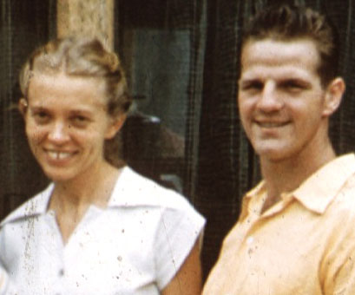
Jim Elliott
https://servantsofgrace.org/suffering-sacrifice-and-the-death-of-jim-elliot/

Slide 3
The Death of Jim Elliot
You might be familiar with Jim Elliot’s most famous quote:
  “He is no fool who gives what he cannot keep to gain that which he cannot lose.”
Elliot is the most known out of five men who were serving as missionaries to the Quichua Indians of Ecuador.
The other four men are Nate Saint, Ed McCully, Roger Youderian, and Peter Fleming.
https://servantsofgrace.org/suffering-sacrifice-and-the-death-of-jim-elliot/

Slide 4
The Death of Jim Elliot
Starting in September, 1955, they began Operation Auca – an effort to make contact with a previously unreached Quichua (Kee-chew-wah) tribe, know as the Auca tribe (aka. Huaoranis , Waoranis, or Waodanis). ¹
They were an isolated tribe known for their violence, against both their own people and outsiders who entered their territory. ¹
On January 8, 1956, after what appeared to be a friendly initial contact with a small group of Auca tribe members, the five men were brutally murdered by a group of Auca warriors. ²
¹ https://www.wikiwand.com/en/Operation_Auca
² https://servantsofgrace.org/suffering-sacrifice-and-the-death-of-jim-elliot/

Slide 5
The Death of Jim Elliot
Despite the tragedy, hundreds of Christians were inspired to become missionaries and thousands were moved to deeper commitment to Christ.
The year after Jim died, his wife Elisabeth wrote Through Gates of Splendor, a widely popular account of the team’s mission and martyrdom.
She writes in the thick of her mourning. Her words come straight from someone who was very involved in the tragic events that unfolded.
https://servantsofgrace.org/suffering-sacrifice-and-the-death-of-jim-elliot/

Slide 6
The Death of Jim Elliot
I especially appreciate the portion of the book in which Elisabeth reflects on her sorrow and God’s sovereignty:
  God is God. I dethrone Him in my heart if I demand that He act in ways that satisfy my idea of justice. It is the same spirit that taunted, “If Thou be the Son of God, come down from the Cross.” There is unbelief, there is even rebellion, in the attitude that says, “God has no right to do this to fine men unless…”
  Those men had long since given themselves without reservation to do the will of God…
  For us widows the question as to why the men who had trusted God to be both shield and defender should be allowed to be speared to death was not one that could be smoothly or finally answered in 1956, nor yet silenced in 1996. God did not answer Job’s questions either. Job was living in a mystery—the mystery of the sovereign purpose of God—and the questions that arose out of the depths of that mystery were answered only by a deeper mystery, that of God Himself.
  Elisabeth Elliot, Through Gates of Splendor (Tyndale, 1981)
https://servantsofgrace.org/suffering-sacrifice-and-the-death-of-jim-elliot/

Slide 7
Growing Up
As a little boy growing up in Portland, Oregon, Jim Elliot listened carefully as visiting missionaries told about life on faraway missions fields.
He asked them questions and dreamed about being a missionary himself some day.
Jim was troubled that so many people in other countries died without knowing about God, and wanted to play a part in carrying the gospel to unreached people in the world.
https://www.christianity.com/church/church-history/timeline/1901-2000/jim-elliot-no-fool-11634862.html

Slide 8
The Long Boat Trip
On February 2, 1952 (at the age of 24), Jim Elliot waved goodbye to his parents and boarded a ship for the 18-day trip from San Pedro, California to Quito (Kee-toe), Ecuador, South America.
He and his missionary partner, Pete Fleming, first spent a year in Quito, Ecuador learning to speak Spanish.
Jim and Pete studied hard to learn the language and fit in.
Their hard work paid off; in six months, both were speaking Spanish well enough to move to Shandia (Shan-dee-ah), Ecuador – a small Quichua (Kee-chew-wah) Indian village to take the place of a retiring missionary.
There they also had to learn the language of the Quichuas.
https://www.christianity.com/church/church-history/timeline/1901-2000/jim-elliot-no-fool-11634862.html

Slide 9
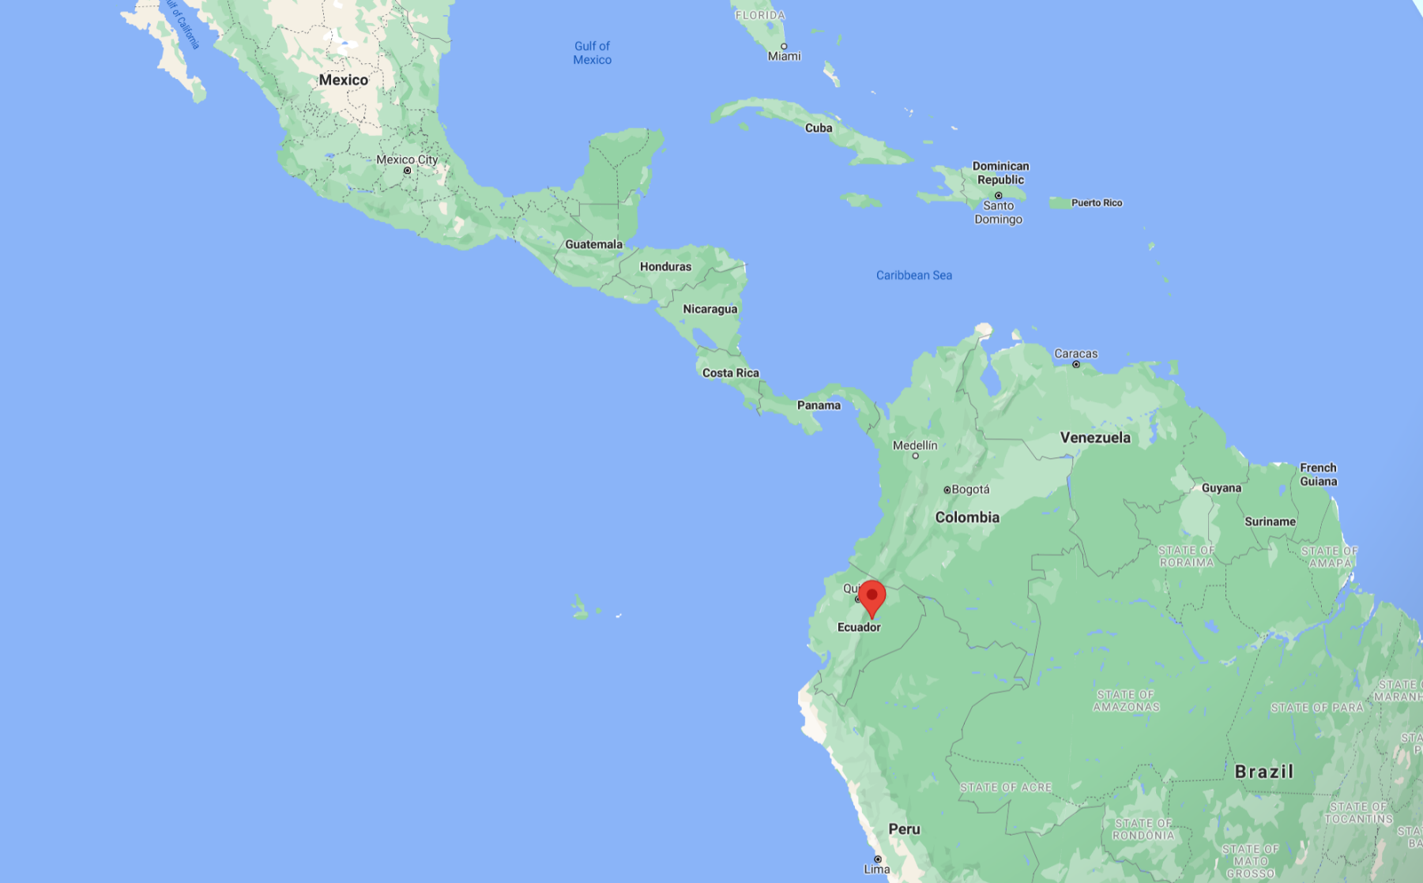
Ecuador

Slide 10
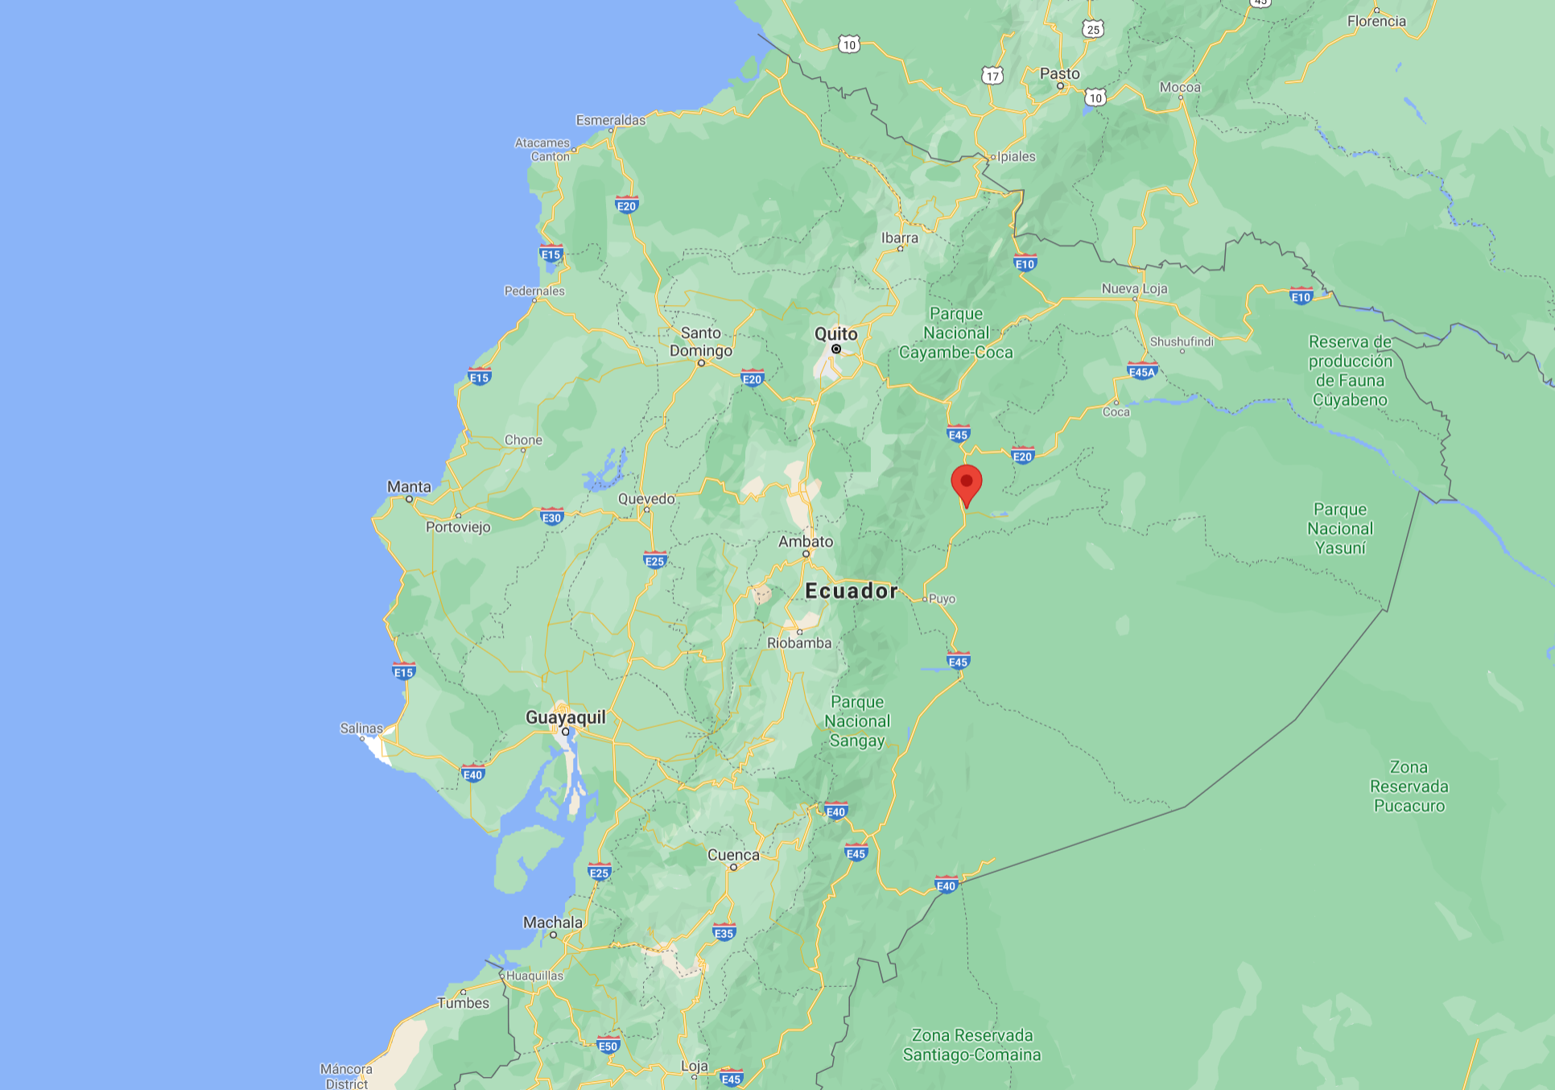
Ecuador
Shandia

Slide 11
Planning to Reach the Aucas
Three years later many Quichuas had become faithful Christians. Jim now began to feel it was time to carry the gospel to the Auca tribe.
The Aucas had killed many Quichuas.
They had also killed several workers at an oil company-drilling site near their territory.
The oil company closed the site because everyone was afraid to work there.
Jim knew the only way the Aucas would ever stop killing was if God changed their heart through the preaching of the gospel.
Jim and the four other Ecuador missionaries began to plan a way to make contact with the Aucas and show that they were friendly.
https://www.christianity.com/church/church-history/timeline/1901-2000/jim-elliot-no-fool-11634862.html

Slide 12
Initial Contact
The first stage of Operation Auca began in September 1955. Saint, McCully, Elliot, and fellow missionary Johnny Keenan decided to initiate contact with the Huaorani and began periodically searching for them by air.
By the end of the month, they had identified several clearings in the jungle.
Meanwhile, Elliot learned several phrases in the language of the Huaorani from Dayuma, a young Huaorani woman who had left her society and become friends with Rachel Saint, a missionary and the sister of Nate Saint.
The missionaries hoped that by regularly giving gifts to the Huaorani and attempting to communicate with them in their language, they would be able to win them over as friends.
https://www.wikiwand.com/en/Operation_Auca

Slide 13
Initial Contact
Because of the difficulty and risk of meeting the Huaorani on the ground, the missionaries chose to drop gifts to the Huaorani by fixed-wing aircraft.
Their drop technique, developed by Nate Saint, involved flying around the drop location in tight circles while lowering the gift from the plane on a rope.
This kept the bundle in roughly the same position as it approached the ground.
On October 6, 1955, Saint made the first drop, releasing a small kettle containing buttons and rock salt.
The gift-giving continued during the following weeks, with the missionaries dropping machetes, ribbons, clothing, pots, and various trinkets.
https://www.wikiwand.com/en/Operation_Auca

Slide 14
Initial Contact
After several visits to the Auca village, which the missionaries called "Terminal City", they observed that the Huaorani seemed excited to receive their gifts.
Encouraged, they began using a loudspeaker to shout simple Huaorani phrases as they circled.
After several more drops, in November the Huaorani began tying gifts for the missionaries to the line after removing the gifts the missionaries gave them.
The men took this as a gesture of friendliness and developed plans for meeting the Huaorani on the ground.
Saint soon identified a 200-yard sandbar along the Curaray River about 4.5 miles from Terminal City that could serve as a runway and camp site, and dubbed it "Palm Beach".
https://www.wikiwand.com/en/Operation_Auca

Slide 15
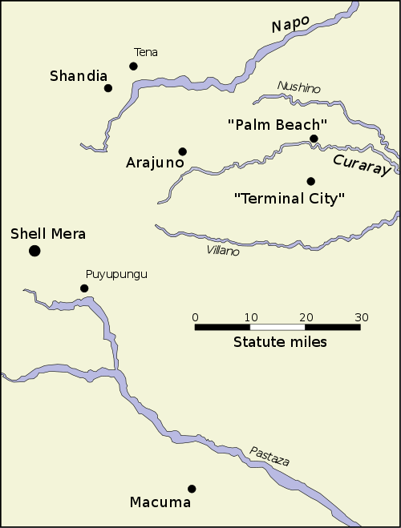
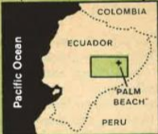
“Operation Auca” Map
https://www.wikiwand.com/en/Operation_Auca

Slide 16
Initial Contact
On December 23, the Flemings, Saints, Elliots and McCullys together made plans to land at Palm Beach and build a camp on January 3, 1956.
They agreed to take weapons, but decided that they would only be used to fire into the air to scare the Huaorani if they attacked.
They decided they would build a sort of tree house that could be assembled upon arrival, and collected gifts, first aid equipment, and language notes.
https://www.wikiwand.com/en/Operation_Auca

Slide 17
Initial Contact
The missionaries were flown in one-by-one and dropped off on the Auca beach.
Nate Saint then flew over the Auca village and called for the Aucas to come to the beach.
After four days, an Auca man and two women appeared.
It was not easy for them to understand each other since the missionaries only knew a few Auca phrases.
They shared a meal with them, and Nate took the Auca man up for a flight in the plane.
https://www.christianity.com/church/church-history/timeline/1901-2000/jim-elliot-no-fool-11634862.html

Slide 18
Initial Contact
The missionaries tried to show sincere friendship and asked them to bring others next time.
For the next two days, the missionaries waited for other Aucas to return.
Finally, on day six, two Auca women walked out of the jungle. Jim and Pete excitedly jumped in the river and waded over to them.
As they got closer, these women did not appear friendly. Jim and Pete almost immediately heard a terrifying cry behind them.
As they turned they saw a group of Auca warriors with their spears raised, ready to throw.
https://www.christianity.com/church/church-history/timeline/1901-2000/jim-elliot-no-fool-11634862.html

Slide 19
Initial Contact
Jim Elliot reached for the gun in his pocket. He had to decide instantly if he should use it. But he realized he couldn’t.
Each of the missionaries had promised they would not kill an Auca who did not know Jesus to save himself from being killed.
Within seconds, the Auca warriors threw their spears, killing all the missionaries: Ed McCully, Roger Youderian, Nate Saint, Pete Fleming and Jim Elliot.
https://www.christianity.com/church/church-history/timeline/1901-2000/jim-elliot-no-fool-11634862.html

Slide 20
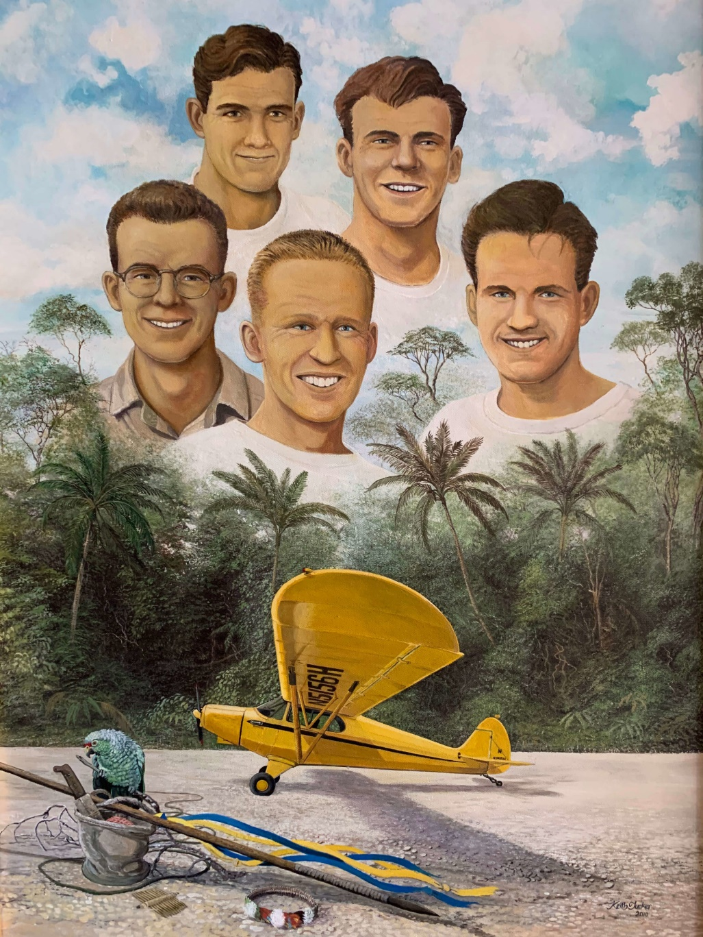
Operation Auca
https://christianhof.org/youderian/

Slide 21
Waiting to Hear
Late in the afternoon of Sunday, January 8, Elisabeth Elliot, Jim's wife, waited by the two-way radio to hear Nate Saint and his wife discuss how things had gone that day.
But there was no call. As evening turned to night, the wives grew worried. They knew the news was not good.
The next morning another missionary pilot flew over the beach to look for the men. He saw only the badly damaged plane on the beach.
News quickly spread around the world about the five missing missionaries.
A United States search team went to the beach, found the missionaries' bodies, and buried them.
https://www.christianity.com/church/church-history/timeline/1901-2000/jim-elliot-no-fool-11634862.html

Slide 22
Aftermath
“Operation Auca” was immediately continued in spite of the loss of the five men.
Johnny Keenan resumed the gift flights so that the Indians would know that the white men had nothing but friendly motives.
The great evil committed by the Waodani against the five men was never held against them by the other missionaries.
They knew that they had killed because they did not know Jesus, and they still wanted to take them the Gospel.
Rachel Saint, Nate Saint’s sister, worked with Dayuma to gather more information about the language.
https://writeforward.wordpress.com/2013/10/28/reaching-the-indians-of-ecuador-missionary-story-part-6/

Slide 23
Aftermath
Eventually, Rachel Saint and Elizabeth Elliot were invited to come and live among the Waodani – something that no one outside the tribe had ever been invited to do.
Like the men who had given their lives trying to reach these people, the women knew the risk they were taking.
But also like the men, they were willing to risk their lives so that the Waodani would have the opportunity to hear the Gospel.
They did go to live with the Waodani, and they were able to finally tell them about Jesus’ dying on the cross for their sins. Some of the tribe came to know Jesus as their Savior, and their kill -or-be-killed way of life eventually came to an end.
https://writeforward.wordpress.com/2013/10/28/reaching-the-indians-of-ecuador-missionary-story-part-6/

Slide 24
Aftermath
Years later, Steve Saint, Nate Saint’s son who grew up among the Waodani after his father was killed at their hands, was able to piece together more of what had really happened on that January day in 1956.
There had been conflict between the man “George”, or Nenkiwi, as his name really was, and some other members of the tribe, and when Nenkiwi and the girl who had visited the beach happened upon a hunting party of some of the men he was arguing with, he lied and said that the missionaries had tried to kill and eat them.
https://writeforward.wordpress.com/2013/10/28/reaching-the-indians-of-ecuador-missionary-story-part-6/

Slide 25
Aftermath
Nenkiwi was known as a troublemaker, and the men didn’t really believe him, but one of the older men, Gikita, told them more lies and kept reminding them about the terrible things that the white men had done to their tribe in the past, fueling their fear and hatred of the white men.
When the other woman who had been visiting the beach returned to find the men making spears in preparation for the attack, she told them they were silly for believing Nenkiwi’s lies and that the white men had not harmed them, but Gikita, the leader of the group, would not let the younger men back down.
The group went back to Palm Beach, where they speared the missionaries.
https://writeforward.wordpress.com/2013/10/28/reaching-the-indians-of-ecuador-missionary-story-part-6/

Slide 26
Aftermath
Years later, as the men who had been involved in the raid told Steve Saint the rest of the story, they were still filled with regret that they had killed those men that day.
As Mincaye, the man who killed Nate Saint, said, “We acted badly, badly, until they brought us God’s carvings. Now, seeing His markings and following His trail, we live happily and in peace.”
This was exactly what the five men had dreamed of and prayed for.
This was why they had been willing to give their lives so that the Waodani could hear the Gospel!
https://writeforward.wordpress.com/2013/10/28/reaching-the-indians-of-ecuador-missionary-story-part-6/

Slide 27
Aftermath
It is natural to hear this story and think of the loss of the lives of five young men as a tragedy, but in reality, it was not a tragedy.
It was God’s plan, carried out for His glory.
The impact of their sacrifice was worldwide – people around the world who heard the story were moved to give their lives to God and live for Him the way that the five men did, and others, like the Waodani, heard the Gospel and were saved.
https://writeforward.wordpress.com/2013/10/28/reaching-the-indians-of-ecuador-missionary-story-part-6/

Slide 28
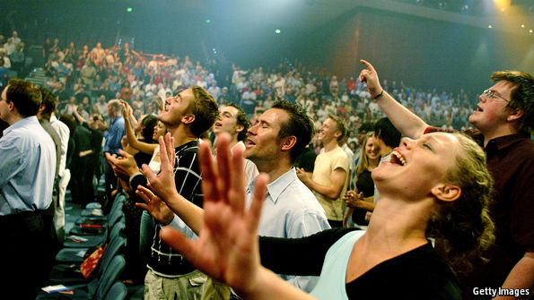
Pentecostalism and the Charismatic Movement
https://www.learnreligions.com/what-is-universalism-700701

Slide 29

Class Discussion Time
https://www.weareteachers.com/moving-beyond-classroom-discussions/

Slide 30
*Class Discussion Time
Can you relate to the intense desire that Jim and his fellow missionaries had to take the risks that they did to reach a known hostile unreached people group?
Jim chose not to use a gun to protect himself when attacked by the Aucas. Why? What would you have done and why?
Jim's wife and daughter went to live with the Aucas after Jim was killed. Can you imagine choosing to live in the Auca village after such tragedy?
Do you agree with and can you relate to Elisabeth’s Elliot’s reflection on the untimely death of her husband when she says “God is God. I dethrone Him in my heart if I demand that He act in ways that satisfy my idea of justice.” Compare this with a typical response that you might tend to have when faced with a similar, or even lesser tragedy in your own life.

