Slide 1


Slide 2
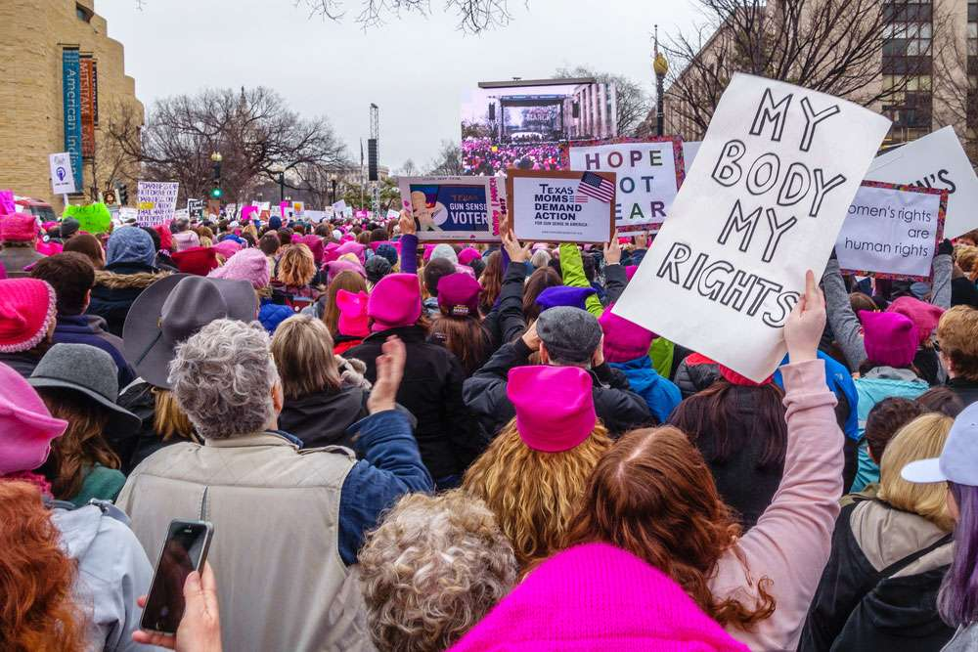
Feminism
https://www.britannica.com/story/feminism-from-ancient-rome-to-the-womens-march

Slide 3
Feminism
Feminism is a belief in the social, economic, and political equality of the sexes.
Throughout most of world history, women were operated in the domestic sphere, while public life was reserved for men.
In medieval Europe, women generally did not own property, go to university, or participate in public life.
Even as late as the early 20th century, women could neither vote nor hold elective office in Europe and in most of the United States.
Women could not conduct business without a male representative, be it father, brother, husband, legal agent, or even son.
https://www.britannica.com/topic/feminism

Slide 4
Early Feminists
In his classic Republic, Plato advocated that women possess “natural capacities” equal to men for governing and defending ancient Greece.
Not everyone agreed with Plato.
On one occasion when the women of ancient Rome staged a massive protest over a law that restricted women’s access to gold and other goods, Roman consul Marcus Porcius Cato argued, “As soon as they begin to be your equals, they will have become your superiors!”
Despite Cato’s fears, the law was repealed.
https://www.history.com/topics/womens-history/feminism-womens-history

Slide 5
Early Feminists
In The Book of the City of Ladies, 15th-century writer Christine de Pizan protested misogyny and the role of women in the Middle Ages.
Years later, during the Enlightenment, writers and philosophers like Margaret Cavendish, the Duchess of Newcastle-upon-Tyne, and Mary Wollstonecraft, author of A Vindication of the Rights of Woman, argued vigorously for greater equality for women.
Abigail Adams, first lady to President John Adams, specifically saw access to education, property and the ballot as critical to women’s equality.
https://www.history.com/topics/womens-history/feminism-womens-history

Slide 6
Modern Feminism
The history of the modern western feminist movement is divided into four "waves".
  The first wave comprised women's suffrage movements of the 19th and early-20th centuries, promoting women's right to vote and to participate in greater numbers in the workplace.
  The second wave, the women's liberation movement, began in the 1960s and campaigned for legal and social equality for women.
  In or around 1992, a third wave was identified, characterized by a focus on individuality and diversity.
  The fourth wave, from around 2012, used social media to combat sexual harassment, and violence against women; it is best known for the Me Too movement.
https://www.wikiwand.com/en/Feminism

Slide 7
First Wave Feminism
At the 1848 Seneca Falls Convention, abolitionists like Elizabeth Cady Stanton and Lucretia Mott boldly proclaimed in their now-famous Declaration of Sentiments that “We hold these truths to be self-evident; that all men and women are created equal.”
Controversially, the feminists demanded “their sacred right to the elective franchise,” or the right to vote.
Many attendees thought voting rights for women were beyond the pale, but were swayed when Frederick Douglass argued that he could not accept the right to vote as a Black man if women could not also claim that right.
When the resolution passed, the women’s suffrage movement began in earnest, and dominated much of feminism for several decades.
https://www.history.com/topics/womens-history/feminism-womens-history

Slide 8
The 19th Amendment: Women’s Right to Vote
Slowly, suffragettes began to claim some successes: In 1893, New Zealand became the first sovereign state giving women the right to vote, followed by Australia in 1902 and Finland in 1906.
In a limited victory, the United Kingdom granted suffrage to women over 30 in 1918.
In the United States, women’s participation in World War I convinced many that they were deserving of equal representation.
In 1920, thanks largely to the work of suffragists like Susan B. Anthony and Carrie Chapman Catt, the 19th Amendment passed, giving women in the U.S. the right to vote.
https://www.history.com/topics/womens-history/feminism-womens-history

Slide 9
Women And Work
Women began to enter the workplace in greater numbers following the Great Depression, when many male breadwinners lost their jobs, forcing women to find “women’s work” in lower paying but more stable careers like housework, teaching and secretarial roles.
During World War II, many women actively participated in the military or found work in industries previously reserved for men, making Rosie the Riveter a feminist icon.
Following the civil rights movement, women sought greater participation in the workplace, with equal pay at the forefront of their efforts
https://www.history.com/topics/womens-history/feminism-womens-history

Slide 10
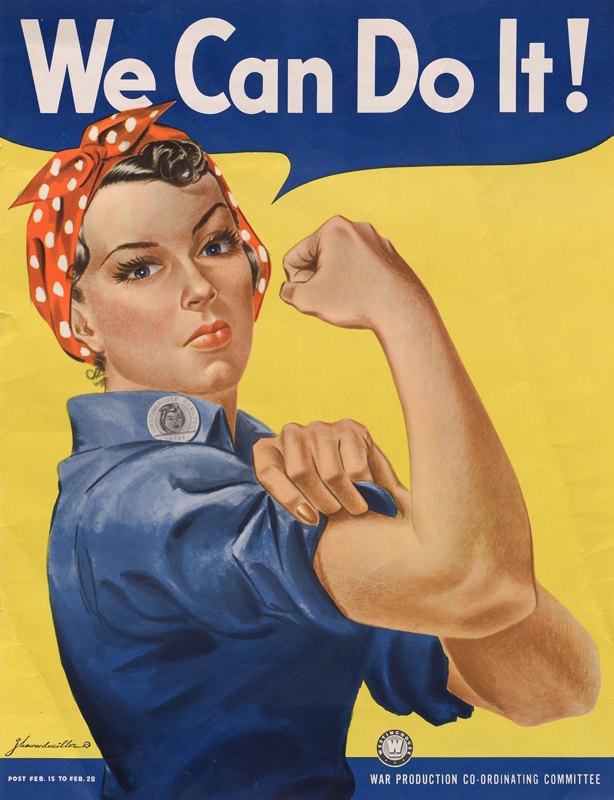
Rosie the Riveter
https://www.britannica.com/topic/Rosie-the-Riveter

Slide 11
Second Wave Feminism
In the 1960s, feminists began pushing into other areas, and with the 1963 publication of The Feminine Mystique, Betty Friedan—who later co-founded the National Organization for Women—argued that women were still relegated to “unfulfilling roles” in homemaking and child care.
By this time, many people had started referring to feminism as “women’s liberation.”
In 1971, feminist Gloria Steinem joined Betty Friedan and Bella Abzug in founding the National Women’s Political Caucus.
https://www.history.com/topics/womens-history/feminism-womens-history

Slide 12
Second Wave Feminism
Steinem’s Ms. Magazine became the first magazine to feature feminism as a subject on its cover in 1976.
The Equal Rights Amendment, which sought legal equality for women and banned discrimination on the basis of sex, was passed by Congress in 1972 (but, following a conservative backlash, was never ratified by enough states to become law).
One year later, feminists celebrated the Supreme Court decision in Roe v. Wade, the landmark ruling that guaranteed a “woman’s right to choose” an abortion.
https://www.history.com/topics/womens-history/feminism-womens-history

Slide 13
Third Wave Feminism
Third-wave feminism began in the United States in the early 1990s and continued until the rise of the fourth wave in the 2010s.
Third-wave feminists embraced individualism in women and diversity and sought to redefine what it meant to be a feminist.
The third wave saw the emergence of new feminist currents and theories, such as intersectionality, sex positivity, vegetarian ecofeminism, transfeminism, and postmodern feminism.
According to feminist scholar Elizabeth Evans, the “confusion surrounding what constitutes third-wave feminism is in some respects its defining feature.”
https://www.wikiwand.com/en/Third-wave_feminism

Slide 14
Fourth Wave Feminism and #MeToo
By the 2010s, feminists pointed to prominent cases of sexual assault and “rape culture” as emblematic of the work still to be done in combating misogyny and ensuring women have equal rights.
The #MeToo movement gained new prominence in October 2017, when the New York Times published a damning investigation into allegations of sexual harassment made against influential film producer Harvey Weinstein.
Many more women came forward with allegations against other powerful men.
https://www.history.com/topics/womens-history/feminism-womens-history

Slide 15
What Do We Make of All This?
Feminism started as a movement that seemed (on the surface) to give women options. Good options.
At the turn of the twentieth century women couldn’t vote, own property, or make independent decisions that many of us take for granted today.
It began as a rising up against male authority and male “oppression of women”.
But the movement wasn’t just about true oppression.
For many first-wave feminists, men were a problem. This attitude led to rebellion.
Reissig, Courtney. The Accidental Feminist: Restoring Our Delight in God's Good Design

Slide 16
What Do We Make of All This?
After the initial issues of first-wave feminism were addressed (such as women securing the right to vote), feminism continued to be defined as personal autonomy and freedom from men.
Feminists continued to rebel against cultural expectations of women.
In the 1950s and 1960s, the rebellion was against the caricature of the “typical” housewife who was happy to stay at home, love and respect her husband, and take care of him and the children.
The outcome of this rebellion was that, beginning in the 1970s, women began entering the workforce in droves, demanding equal pay for work, and seeking purpose and identity outside of a husband and children.
Reissig, Courtney. The Accidental Feminist: Restoring Our Delight in God's Good Design

Slide 17
What Do We Make of All This?
What feminism did through this process was begin to erase the differences between men and women.
In today’s society, the equality of men and women means there are very few differences when it comes to what they can or should do.
If a woman wants to fight in combat, who is to stop her?
If a man wants to be a stay-at-home dad, he’s met with high fives and praise for his progressive living.
If a little girl wants to play on the same football team as her older brothers, we welcome her with open arms.
Now that equality means sameness, it doesn’t matter who’s the leader in a relationship.
Reissig, Courtney. The Accidental Feminist: Restoring Our Delight in God's Good Design

Slide 18
What Do We Make of All This?
But the push for freedom and autonomy didn’t stop there. Next women began to push for sexual freedom and autonomy outside of marriage.
This in turn led to the seminal Roe v. Wade case, effectively legalizing abortion-on-demand in America.
As women in their new found sexual autonomy began to pursue sexual involvement outside of marriage, they were more likely to find themselves in abusive situations, thus giving rise to the felt need for a #Metoo movement.
Reissig, Courtney. The Accidental Feminist: Restoring Our Delight in God's Good Design

Slide 19
What Do We Make of All This?
In summary, modern feminism and all of its recommendations for social action has three main tenets:
  Physical differences apart, men and women are the same. Infant boys and girls are born with virtually the same capacities and if raised identically would develop identically.
  The only reason that men occupy positions of dominance in society is because of the way kids are raised: boys are taught to be mastery oriented and girls are taught to be person oriented. If this stereotyping ceased, leadership would be equally divided between the sexes.
  True human individuality and fulfillment will come only when people view themselves as human repositories of talents and traits, without regard to sex.
https://document.desiringgod.org/recovering-biblical-manhood-and-womanhood-en.pdf?ts=1620230082

Slide 20
What Do the Scriptures Say?
The scriptures teach that men and women are different by virtue of Creation.
Men and women are different because God made them different and intends for men and women to function differently in:
  The Home
  The Church
  Society

Slide 21
What Do the Scriptures Say?
This is not to say that men and women share nothing in common.
Man and woman are named as equally sharing in the “image of God” –
  So God created man in his own image, in the image of God he created him; male and female he created them. (Gen 1:27)
Men and women share equally in their standing before God “in Christ”
  for in Christ Jesus you are all sons of God, through faith… There is neither Jew nor Greek, there is neither slave nor free, there is no male and female, for you are all one in Christ Jesus. (Gal 3:26,28)
  [women] are heirs with [men] of the grace of life, (1Pet 3:1)

Slide 22
Men and Women in the Home
The Word of God commands the man to rule his wife in love and the wife to obey and submit to her husband in respect.
  For the husband is the head of the wife even as Christ is the head of the church… Now as the church submits to Christ, so also wives should submit in everything to their husbands. Husbands, love your wives, as Christ loved the church and gave himself up for her… and let the wife see that she respects her husband. (Eph 5:23-24, 33)
Adam and Eve as the original couple, serve as a prototype for how all men and women are to behave, which is why the Apostle Paul often grounds his commands concerning men and women in creation:
  For man was not made from woman, but woman from man. Neither was man created for woman, but woman for man. (1Cor 11:8-9)

Slide 23
Men and Women in the Home
Scripture teaches that a young woman’s place is working in the home, taking care of her husband and children (a role that feminists vehemently rebel against).
  …and so train the young women to love their husbands and children, to be self-controlled, pure, working at home, kind, and submissive to their own husbands, that the word of God may not be reviled. (Tit 2:4-5).
  So I would have younger widows marry, bear children, manage their households, and give the adversary no occasion for slander. (1Tim. 5:14)
The Word of God refers to the woman as the “weaker vessel” in the marriage relationship:
  husbands, live with your wives in an understanding way, showing honor to the woman as the weaker vessel, since they are heirs with you of the grace of life… (1Pet. 3:7)
  Compare: act like men, be strong. (1Cor. 16:13)

Slide 24
Men and Women in the Home
The Word of God warns women to not make their clothing and jewelry their primary source of beauty. No such warning is ever given to men.
  Do not let your adorning be external--the braiding of hair and the putting on of gold jewelry, or the clothing you wear-- but let your adorning be the hidden person of the heart with the imperishable beauty of a gentle and quiet spirit, which in God's sight is very precious. (1Pet 3:3-4)

Slide 25
Men and Women in the Church
The Scriptures do not permit a woman to teach or exercise authority over men in the church. The teaching is to be done by the men, the women are expected to sit quietly and learn from the men who are teaching.
  Let a woman learn quietly with all submissiveness. I do not permit a woman to teach or to exercise authority over a man; rather, she is to remain quiet. (1Tim. 2:11-12)
Once again the Apostle Paul grounds the above teaching in creation and Adam and Eve as the prototype for all who come after them:
  For Adam was formed first, then Eve; and Adam was not deceived, but the woman was deceived and became a transgressor. (1Tim 2:13-14)

Slide 26
Men and Women in the Church
Scripture does not permit a woman to occupy either of the two church offices: elder/overseer/pastor or deacon.
  an overseer must be above reproach, the husband of one wife… (1Tim 3:2).
  Let deacons each be the husband of one wife (1Tim 3:12)
The Word of God prohibits women from speaking in the church meetings:
  the women should keep silent in the churches. For they are not permitted to speak, but should be in submission, as the Law also says. If there is anything they desire to learn, let them ask their husbands at home. For it is shameful for a woman to speak in church. (1Cor 14:34-35)

Slide 27
Men and Women Society
Some distinctions between how men and women function in society has already been given in passages that we looked at for distinctions between men and women in the home.
  The Word of God views a young woman’s place as working in the home taking care of her husband and children (Titus 2:4-5; 1Tim 5:14).
  Scripture describes women as “the weaker vessel” in the marriage relationship (1Pet 3:7) and characterizes men as “strong” (1Cor 16:13).

Slide 28
Men and Women Society
Jesus taught that marriage is to be between one man and one woman:
  [Jesus] answered, “Have you not read that he who created them from the beginning made them male and female, and said, ‘Therefore a man shall leave his father and his mother and hold fast to his wife, and the two shall become one flesh’?” (Mat 19:4-5)
Another societal distinction that we see in scripture is that it is always assumed that it will be the men who serve as soldiers, or physical protectors of a household or a nation.
  When a strong man, fully armed, guards his own palace, his goods are safe; (Luke 11:21)
  When a man is newly married, he shall not go out with the army or be liable for any other public duty. He shall be free at home one year to be happy with his wife whom he has taken. (Deut 24:5)

Slide 29
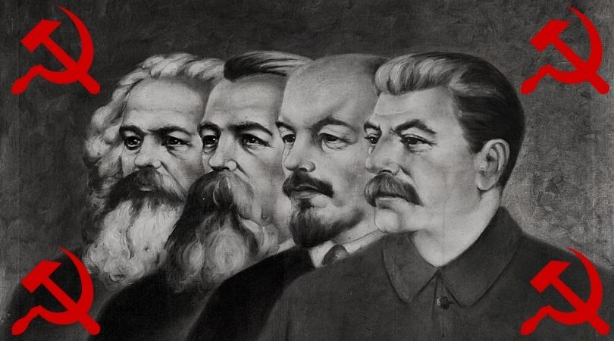
Marxism and Communism
https://www.churchmilitant.com/news/article/marxism-and-the-catholic-church

Slide 30

Class Discussion Time
https://www.weareteachers.com/moving-beyond-classroom-discussions/

Slide 31
*Class Discussion Time
As you listened to the early part of today’s presentation, did you feel a tug of sympathy or agreement with the feminist movement? Is there anything good about the feminist movement? If so, what?
Do you see how ultimately what the feminists are really fighting for is an obliteration of any distinction between the sexes as established in God’s created order?
As I laid out the scriptural case for the distinction between the sexes that we should recognize and honor in the home, church, and society did you agree with what I presented or were there parts of what I said that you have questions about?
Do you agree with the feminists when they say that women who are involved in homemaking and childrearing have been “relegated to an unfulfilling role”?
Do you think it was a good idea to give women the right to vote?

