Slide 1


Slide 2
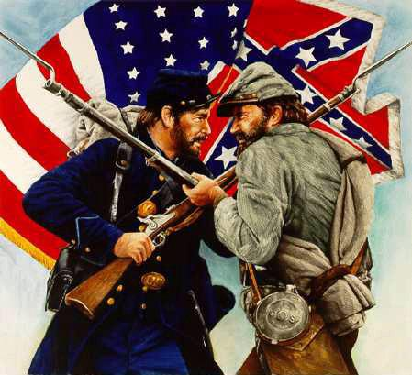
The Civil War
https://www.facebook.com/americancivilwarhistoryhomepage/

Slide 3
Everything You Know About the Civil War Is Wrong
Most of us (including me) attended public schools where we were provided roughly the same instruction regarding the Civil War: Our country was composed of the North, where people opposed slavery, and the South, where slavery was embraced.
Abraham Lincoln rose to the presidency and fought against the South to end slavery and saved the Union.
Like most of my peers, this story seemed plausible enough to me, and after all, it ended happily: Slaves were freed, and the Union remained intact.
Plausible enough until you begin to read some of the literature written at the time of the civil war.
https://medium.com/@jonathanusa/everything-you-know-about-the-civil-war-is-wrong-9e94f0118269

Slide 4
Everything You Know About the Civil War Is Wrong
Consider, for example, that throughout the presidential campaign of 1860, then-candidate Lincoln had all but promised not to interfere with Southern slavery, which he reiterated in his first presidential inaugural address:
  I have no purpose, directly or indirectly, to interfere with the institution of slavery where it exists. I believe I have no lawful right to do so, and I have no inclination to do so.
This seems to run contrary to conventional thinking. Wasn’t Lincoln an abolitionist?
Lincoln promised to enforce fugitive slave laws as president — laws passed by Congress in 1793 and 1850 to provide for the return of slaves who escaped from one state into another state or territory.
https://medium.com/@jonathanusa/everything-you-know-about-the-civil-war-is-wrong-9e94f0118269

Slide 5
Everything You Know About the Civil War Is Wrong
Indeed, Southern secession would have made slavery more precarious without the protection of the Constitution and the Supreme Court.
From a slave property standpoint, staying in the Union made more sense than leaving.
Adding further confusion are the numerous accounts from contemporary newspapers from the North, South, and Europe — all of which tell the tale of a “tariff war,” not the popularly held notion that the Civil War was a “war against slavery.”
But if the war wasn’t over slavery, what was it over? Like most historical events, it’s complicated.
https://medium.com/@jonathanusa/everything-you-know-about-the-civil-war-is-wrong-9e94f0118269

Slide 6
Everything You Know About the Civil War Is Wrong
It’s too easy to assign blame for the Civil War on the South and slavery — and it’s intellectually lazy.
Like many other conflicts, the Civil War was decades in the making and the culmination of unresolved issues between the Northern and Southern states – including, but not limited to slavery.
It finally came to a head during the 1860 presidential campaign and election.
To fully understand the Civil War, we must recognize we are dealing with two separate issues: the cause for secession and the cause of the war.
https://medium.com/@jonathanusa/everything-you-know-about-the-civil-war-is-wrong-9e94f0118269

Slide 7
Secession
In 1860, nearly all federal tax revenue was generated by tariffs — there were no personal or corporate income taxes.
And the Southern states were paying the majority of the tariffs (approximately 80%), and an impending new tariff would nearly triple the taxation rate.
Much of the tax revenues collected from imports in the South went to Northern industrial interests and had been for decades.
The 1860 Republican platform promised more of the same, which further eroded the trust of Southerners.
https://medium.com/@jonathanusa/everything-you-know-about-the-civil-war-is-wrong-9e94f0118269

Slide 8
Secession
In 1828, Congress had passed a tariff of 62%, which applied to nearly all imported goods.
The purpose of the tariff was to protect Northern industries from low-priced imported goods.
But it effectively increased the cost of goods for the South, which relied heavily on imported goods.
At the same time, the tariff reduced the amount of British goods sold to the South, effectively making it more difficult for the British to pay for Southern cotton.
https://medium.com/@jonathanusa/everything-you-know-about-the-civil-war-is-wrong-9e94f0118269

Slide 9
Secession
It’s no wonder the South would refer to the Tariff of 1828 as the “Tariff of Abominations.”
The government of South Carolina declared the tariffs of 1828 and 1832 unconstitutional and therefore unenforceable, creating a precarious situation between the state and the federal government.
President Andrew Jackson refused to accept South Carolina’s defiance.
Without the Compromise Tariff of 1833, it’s likely that South Carolina would have moved to secede from the Union.
https://medium.com/@jonathanusa/everything-you-know-about-the-civil-war-is-wrong-9e94f0118269

Slide 10
Secession
Crisis was averted, but tensions between the North and the South were just beginning.
More tariffs in 1842 and 1857 along with the Fugitive Slave Act of 1850 and the Dred Scott Supreme Court decision (1857) further divided the country.
In May of 1860, the House of Representatives passed the Morrill Tariff bill, the 12th of 17 planks in the platform of the incoming Republican Party — and a priority for the soon-to-be-elected new president.
Charles Dickens, from his journal All the Year Round, observed, “The last grievance of the South was the Morrill tariff, passed as an election bribe to the State of Pennsylvania, imposing, among other things, a duty of no less than fifty per cent on the importation of pig iron, in which that State is especially interested.”
https://medium.com/@jonathanusa/everything-you-know-about-the-civil-war-is-wrong-9e94f0118269

Slide 11
Secession
Soon after, the United States elected its first “sectionalist” president, Abraham Lincoln. And the rupture of the Union was finally at hand.
On December 20, 1860, South Carolina voted unanimously to secede. Mississippi, Alabama, Florida, and Louisiana soon followed, and before Lincoln’s inauguration, Texas and Georgia were added to the list.
At the outset of the war, Lincoln called on volunteers from all states to “put down the rebellion.” Refusing to bear arms against their Southern brethren, Virginia, North Carolina, Arkansas, and Tennessee seceded.
Of the 11 seceding states, only six cited slavery as the primary cause for leaving the Union.
https://medium.com/@jonathanusa/everything-you-know-about-the-civil-war-is-wrong-9e94f0118269

Slide 12
Saving the Union
While in his inaugural address, Lincoln promised not “to interfere with the institution of slavery,” he also argued, “no State upon its own mere motion can lawfully get out of the Union.” Then he threw down the gauntlet against rebellion:
  In doing this there needs to be no bloodshed or violence, and there shall be none unless it be forced upon the national authority. The power confided to me will be used to hold, occupy, and possess the property and places belonging to the Government and to collect the duties and imposts; but beyond what may be necessary for these objects, there will be no invasion, no using of force against or among the people anywhere.
https://medium.com/@jonathanusa/everything-you-know-about-the-civil-war-is-wrong-9e94f0118269

Slide 13
Saving the Union
Lincoln argued that secession was legally and constitutionally impossible, a view that stood in stark contrast to his stated beliefs while a member of Congress just 12 years earlier.
In an 1848 speech in the House of Representatives regarding the war with Mexico, Lincoln argued in favor of secession:
  Any people anywhere, being inclined and having the power, have the right to rise up and shake off the existing government, and form a new one that suits them better. This is a most valuable, a most sacred right — a right which, we hope and believe, is to liberate the world. Nor is this right confined to cases in which the whole people of an existing government may choose to exercise it. Any portion of such people that can may revolutionize, and make their own of so much of the territory as they inhabit.
https://medium.com/@jonathanusa/everything-you-know-about-the-civil-war-is-wrong-9e94f0118269

Slide 14
Saving the Union
Perhaps his views changed between his time in Congress and becoming president.
But it’s doubtful given his involvement in the creation of the state of West Virginia during the Civil War, which provided his party additional electoral votes and congressional representation — an act Lincoln’s own attorney general believed was unconstitutional.
It seems that Lincoln wasn’t opposed to secession if it served his political purposes.
But now as president of a divided country, he was facing a challenge of potentially dire economic consequences.
Had the Southern states been allowed to leave the Union, they would have taken with them millions in tax revenues.
https://medium.com/@jonathanusa/everything-you-know-about-the-civil-war-is-wrong-9e94f0118269

Slide 15
Saving the Union
After the first states seceded, many in the Northern press expressed opposition to war with the South.
Writing in the New York Tribune, Horace Greeley declared, “We hope never to live in a republic where one section is pinned to the residue by bayonets.”
Many of Lincoln’s advisers also recommended against any action that might lead to a war with the South.
Even Lincoln’s top Army commander wanted nothing to do with war. “Let the wayward sisters depart in peace,” urged Gen. Winfield Scott.
Secretary of State William Seward also advised the new president to let the rebellious states go and avoid actions that could upset the states of the upper South.
https://medium.com/@jonathanusa/everything-you-know-about-the-civil-war-is-wrong-9e94f0118269

Slide 16
Saving the Union
But before long, Northern newspaper editors did the math and realized what secession meant for Northern enterprises.
In addition to the loss of tax revenue, the South’s free trade position would’ve had dire consequences for Northern ports.
The Daily Chicago Times foretold the impending economic disaster:
  At one single blow our foreign commerce must be reduced to less than one-half what it now is. Our coastwise trade would pass into other hands. One-half of our shipping would lie idle at our wharves. We should lose our trade with the South, with all of its immense profits. Our manufactories would be in utter ruins. Let the South adopt the free-trade system, or that of a tariff for revenue, and these results would likely follow.
https://medium.com/@jonathanusa/everything-you-know-about-the-civil-war-is-wrong-9e94f0118269

Slide 17
Saving the Union
And consider this dire warning from the New York Evening Post in March of 1862:
  That either the revenue from duties must be collected in the ports of the rebel states, or the port must be closed to importations from abroad, is generally admitted. If neither of these things be done, our revenue laws are substantially repealed; the sources which supply our treasury will be dried up; we shall have no money to carry on the government; the nation will become bankrupt before the next crop of corn is ripe.
In the British journal, All the Year Round, Charles Dickens observed, “Union means so many millions a year lost to the South; secession means the loss of the same millions to the North. The love of money is the root of this as of many other evils.”
https://medium.com/@jonathanusa/everything-you-know-about-the-civil-war-is-wrong-9e94f0118269

Slide 18
Saving the Union
Meanwhile, hundreds of commercial importers in New York and Boston refused to pay duties on imported goods unless the same were collected at Southern ports.
This was after the state of New York considered leaving the Union and joining “our aggrieved brethren of the Slave States.”
Meanwhile, the South was moving forward to organize as a new nation.
On February 8, 1861, the Confederate States of America (CSA) was formed and inaugurated Jefferson Davis as its president.
https://medium.com/@jonathanusa/everything-you-know-about-the-civil-war-is-wrong-9e94f0118269

Slide 19
Saving the Union
There was, it seemed, no way to remedy the secession issue and its associated financial stress on the North — except by forcing the South to rejoin the Union.
But the last thing the Confederacy wanted was a war.
In fact, soon after Jefferson Davis became the first president of the CSA, he dispatched a commission to Washington, D.C., to negotiate a treaty and an offer to pay for all federal property in the South.
But Lincoln refused to meet, believing acknowledgment would discredit his position that secession was illegal.
And that thinking also thwarted the final attempt to resolve the dilemma through peaceful means.
https://medium.com/@jonathanusa/everything-you-know-about-the-civil-war-is-wrong-9e94f0118269

Slide 20
The War Begins
Viewing the Civil War as a crusade to end slavery is simply not correct; abolitionists never accounted for more than a sizable minority in the North.
The cause of war in 1861 wasn’t slavery. It was about the loss of millions in tax revenues.
In reality, it wasn’t even a Civil War.
The Confederate states had no aspirations to rule the Union any more than George Washington sought control over Great Britain in 1776.
In both the American Revolutionary War and the Civil War, independence was the goal.
https://medium.com/@jonathanusa/everything-you-know-about-the-civil-war-is-wrong-9e94f0118269

Slide 21
The War Begins
The idea that the Civil War was some sort of a morality play about freeing Southern slaves is an ideological distortion that obfuscates many of the atrocities that occurred during and after the war.
But if we accept the idea that Lincoln was waging war to free the slaves, it helps justify the loss of over 600,000 American lives.
Not to mention the financial cost of the war, which many historians believe could have been avoided.
After all, this wasn’t the first time a U.S. president faced the issue of secession.
From all outward accounts, Lincoln wanted a war with the South — some might say he needed it.
https://medium.com/@jonathanusa/everything-you-know-about-the-civil-war-is-wrong-9e94f0118269

Slide 22
The Reality of the War
Losses to the Army in significant battles had the Union mired in a bloody quagmire.
Moreover, Britain and France were considering support for the Confederacy by recognizing it as a sovereign country, which could have solidified secession and put Lincoln’s forces at risk of having to fight against Confederate allies from Europe.
Until September 1862, the stated purpose of the war had been to preserve the Union.
By issuing the Emancipation Proclamation on January 1, 1863, Lincoln sought to change the focus of the war.
But the Emancipation Proclamation freed no one. Not a single slave:
  All persons held as slaves within any State or designated part of a State, the people whereof shall then be in rebellion against the United States, shall be then, thenceforward, and forever free.
https://medium.com/@jonathanusa/everything-you-know-about-the-civil-war-is-wrong-9e94f0118269

Slide 23
The Reality of the War
The states “in rebellion,” from which the slaves were granted freedom was the southern states over which Lincoln had no control.
Nor did Lincoln have the power to free the slaves in the Union. That would require a Constitutional amendment, which wouldn’t occur until after the Civil War.
In 1865, the 13th Amendment abolished slavery.
Indeed, this was a last-ditch effort to incapacitate the Confederate Army.
Lincoln hoped that it would entice Southern slaves to leave and join the ranks of the Union Army, depleting the Confederacy’s labor force that was sorely needed to wage war against the Union.
https://medium.com/@jonathanusa/everything-you-know-about-the-civil-war-is-wrong-9e94f0118269

Slide 24
The Reality of the War
Woodrow Wilson, writing in History of the American People, proposed, “It was necessary to put the South at a moral disadvantage by transforming the contest from a war waged against states fighting for their independence into a war waged against states fighting for the maintenance and extension of slavery.”
Prior to the proclamation, Lincoln confessed to New York Tribune editor Horace Greeley, “My paramount object in this struggle is to save the Union, and is not either to save or destroy slavery. If I could save the Union without freeing any slave I would do it, and if I could save it by freeing all the slaves I would do it; and if I could save it by freeing some and leaving others alone I would also do that.”
https://medium.com/@jonathanusa/everything-you-know-about-the-civil-war-is-wrong-9e94f0118269

Slide 25
The Myth of Lincoln
A remarkable number of popular beliefs about the Civil War fail critical scrutiny.
Not just the causes of secession and the war but many other elements of the period.
For all that has been written about Lincoln, so few texts accurately portray his presidency.
Reading Lincoln’s own words quickly dismantles the legend:
  I am not, nor ever have been, in favor of bringing about in any way the social and political equality of the white and black races, that I am not nor ever have been in favor of making voters or jurors of negroes, nor of qualifying them to hold office, nor to intermarry with white people; and I will say in addition to this that there is a physical difference between the white and black races which I believe will forever forbid the two races living together on terms of social and political equality.
https://medium.com/@jonathanusa/everything-you-know-about-the-civil-war-is-wrong-9e94f0118269

Slide 26
The Myth of Lincoln
While denying the charge that he was an abolitionist at a presidential debate, Lincoln expressed his views about the “black race,” all of whom he thought should be sent back to Africa or to an island in the Caribbean.
In his speech on the Dred Scott decision:
  I have said that the separation of the races is the only perfect preventive of amalgamation. I have no right to say all the members of the Republican party are in favor of this, nor to say that as a party they are in favor of it. There is nothing in their platform directly on the subject. But I can say a very large proportion of its members are for it, and that the chief plank in their platform — opposition to the spread of slavery — is most favorable to that separation. Such separation, if ever effected at all, must be effected by colonization.
https://medium.com/@jonathanusa/everything-you-know-about-the-civil-war-is-wrong-9e94f0118269

Slide 27
The Myth of Lincoln
While any reasonable person today would find these remarks abhorrent and bigoted, it was not outside the popular thinking of the period.
In fact, the idea of the colonization of Black people was so popular that Lincoln proposed it as an amendment to the Constitution in his second annual message to Congress in 1862.
Colonization was a staple of Lincoln’s speeches and public comments from 1854 until about 1863.
Lincoln’s views on race contrast sharply with his modern era image as the “Great Emancipator.”
Indeed, his public remarks, which are well-documented, indicate he had little regard for Black people.
https://medium.com/@jonathanusa/everything-you-know-about-the-civil-war-is-wrong-9e94f0118269

Slide 28
The Myth of Lincoln
And this is where the myth of the sympathetic North begins to unravel.
While there was a strong abolitionist movement in the North, it was so small that Lincoln and other politicians didn’t associate themselves with it.
Most white Northerners treated Black people with disdain, discrimination, and violence during the period leading up to the Civil War.
Black people were not allowed to vote, marry, or use the judicial system.
As Alexis de Tocqueville observed in Democracy in America, “The prejudice of the race appears to be stronger in the States which have abolished slavery, than in those where it still exists; and nowhere is it so intolerant as in those States where servitude has never been known.”
https://medium.com/@jonathanusa/everything-you-know-about-the-civil-war-is-wrong-9e94f0118269

Slide 29
How a Myth Becomes “Fact”
Prior to his assassination, Lincoln was often depicted in contemporary media as cowardly, devious, grotesque, and animal-like.
During his presidency and for many years after his death, he was the object of much scorn and derision.
It’s not difficult to understand why.
He started a war without the consent of Congress, had men conscripted into fighting the war, suspended habeas corpus, had cities burned, imprisoned political enemies, and had dissenting newspapers shut down and the owners imprisoned.
https://medium.com/@jonathanusa/everything-you-know-about-the-civil-war-is-wrong-9e94f0118269

Slide 30
How a Myth Becomes “Fact”
In the wake of Lincoln’s legend, the Republican Party controlled national politics and set the national tone for almost three-quarters of a century following the Civil War, winning 16 of 18 presidential elections.
Most texts about the Civil War and biographies of Abraham Lincoln gloss over his shortcomings, suggesting the ends somehow justify the means.
But as historians continue to excavate Lincoln’s life and times, with each unturned stone, another fable is tarnished and truth revealed.
https://medium.com/@jonathanusa/everything-you-know-about-the-civil-war-is-wrong-9e94f0118269

Slide 31
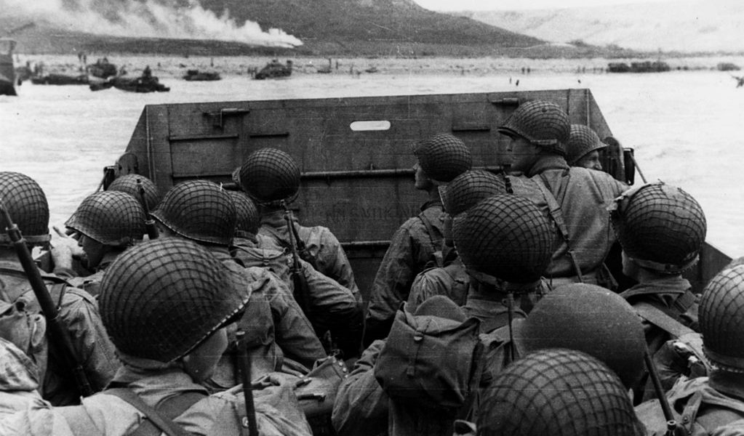
World Wars One and Two
https://www.liberty.edu/champion/2020/01/opinion-wwiii-would-not-look-like-the-first-two-world-wars/

Slide 32

Class Discussion Time
https://www.weareteachers.com/moving-beyond-classroom-discussions/

Slide 33
*Class Discussion Time
Did the material presented this morning change your outlook on the Civil War or Abraham Lincoln? If so, in what way?
We have seen a number of Christians who opposed slavery and sought to abolish it (e.g. William Wilberforce). And yet there were many Christians who fought on the side of the Confederacy where slavery was prevalent. Robert E. Lee, for example, was an Episcopalian who was strongly evangelical in his views and accepted the Bible as the infallible Word of God. Do you believe it was wrong to be a slave owner in the time of the Civil War? If so, what scriptures would you cite to support your case?
Do you believe it would have been wrong to require a runaway slave to return to his master in that day? If so, are you aware that the apostle Paul did that very thing, which is how we got the book of Philemon?
Do you think society is better off not having slavery? Consider what Paul says in 1Cor. 7:20-21 – Each one should remain in the condition in which he was called. Were you a slave when called? Do not be concerned about it. (But if you can gain your freedom, avail yourself of the opportunity.)

