Slide 1


Slide 2
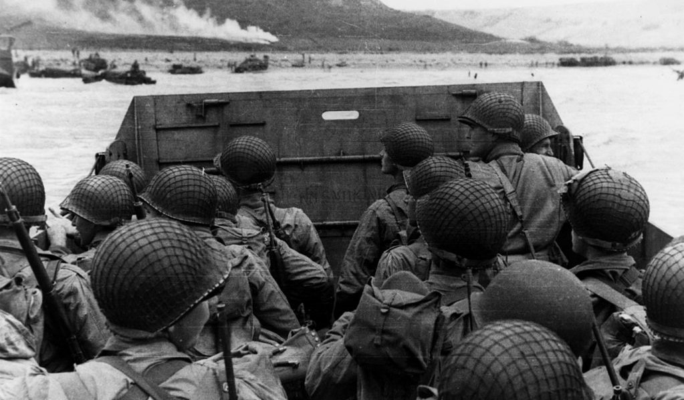
World Wars One and Two
https://www.liberty.edu/champion/2020/01/opinion-wwiii-would-not-look-like-the-first-two-world-wars/

Slide 3
World War One
If we could go back in time and prevent one event in modern history from happening, what would it be?
The answer given by Andrew Roberts of Prager University is World War I.
If there had been no World War I, there would have been:
  No Russian Revolution
  No World War II
  No Holocaust
  No Cold War
And that doesn’t even consider the millions who died in the war itself.
https://www.prageru.com/video/wwi-the-war-that-changed-everything

Slide 4
World War One
Following the end of the Napoleonic Wars in 1815, Europe experienced an unprecedented period of economic growth.
Brought about by the Industrial Revolution, this new prosperity spawned rapid developments in science, medicine, art, and political philosophy.
The future of civilization never looked brighter. And then, suddenly, it all went up in flames.
The fuse was lit in June 1914, in a street in Sarajevo, Bosnia.
It was there that Archduke Franz Ferdinand, the heir to the Austro-Hungarian empire, was assassinated by a Serbian nationalist.
It should have been no more than a sad footnote in history. Instead, it changed history.
https://www.prageru.com/video/wwi-the-war-that-changed-everything

Slide 5
World War One
Austria-Hungary, seeking to avenge the Archduke’s murder, declared war on Serbia. But before taking this drastic step, it asked for—and received—a blessing from its powerful ally, Germany.
Serbia, knowing that it had no chance against Austria-Hungary, called on its ally, Russia, to defend it. Russia agreed.
To strengthen its hand, Russia solicited French support should war break out. France, ever suspicious of German intentions, assented.
Germany then made a pre-emptive move to take France out of the war. The German command, having long planned this war, invaded France through neutral Belgium.
This prompted Britain to join France against Germany. Suddenly, the entire continent was engulfed in war.
https://www.prageru.com/video/wwi-the-war-that-changed-everything

Slide 6
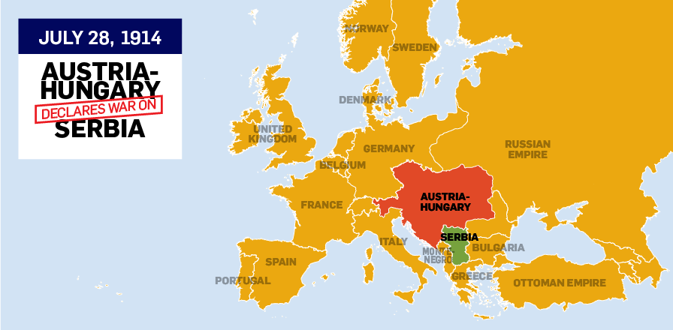
The Start of World War I
https://www.ctvnews.ca/mobile/canada/first-world-war-the-story-of-the-great-war-in-maps

Slide 7
World War One
The key player was Germany.
Their strategy was to punch through Belgium and France and capture Paris before the French had time to react.
This was the so-called Schlieffen Plan, named after the German general who conceived it.
With France conquered, they would turn their attention to Russia.
That Germany thought it would actually work comes down to one man, Germany’s leader, Kaiser Wilhelm II.
The Emperor of Germany from 1888 until his forced abdication in 1918, Wilhelm was a profoundly unpleasant, unstable and vicious personality.
By 1914, he believed that Germany should not only dominate Europe, but the entire world.
https://www.prageru.com/video/wwi-the-war-that-changed-everything

Slide 8
World War One
Had the Schlieffen Plan worked, Germany most certainly would have dominated the world.
But it didn’t work.
The British and the French put up stiff resistance in the west. Russia did the same in the east. The losses incurred by all sides were immediate—and appalling.
The widespread use, for the first time, of barbed wire, machine guns, tanks, and, worst of all, poison gas turned the fields of France and the steppes of Russia into vast cemeteries.
By 1917, the war was at a stalemate.
Who knows how long it would have stayed that way if the United States had not been drawn in?
https://www.prageru.com/video/wwi-the-war-that-changed-everything

Slide 9
World War One
Ironically, President Woodrow Wilson had been elected largely because he promised to keep America out of “Europe’s War.”
His attitude changed when Germany attacked American merchant ships in the Atlantic.
The final straw was the infamous Zimmerman Telegram in which Germany promised to give Mexico, in exchange for its military support, much of the American southwest, including Texas.
The infusion of American manpower and weaponry allowed the Allies to take the initiative.
https://www.prageru.com/video/wwi-the-war-that-changed-everything

Slide 10
World War One
The war finally ended in November of 1918. Sixteen million people—soldiers and civilians—were dead.
  3 million Russians
  2.5 million Germans
  1.7 million French
  1 million British
  117,000 Americans
Russia was now in the hands of Vladimir Lenin and the Bolsheviks.
France and Britain were physically and morally shattered.
Germany, forced into a humiliating surrender treaty at Versailles, would soon be further decimated by runaway inflation that destroyed what was left of its economy.
Meanwhile, the United States retreated into isolationism.
https://www.prageru.com/video/wwi-the-war-that-changed-everything

Slide 11
World War One
It was a pause, not a peace.
The stage was being set for a new and very much worse disaster—a second World War, one that would lead to three times the deaths of the first one.
It would be instigated by a madman who had fought for the Kaiser and shared the same dream of world domination.
Had it not been for WWI, we would have never heard of him.
https://www.prageru.com/video/wwi-the-war-that-changed-everything

Slide 12
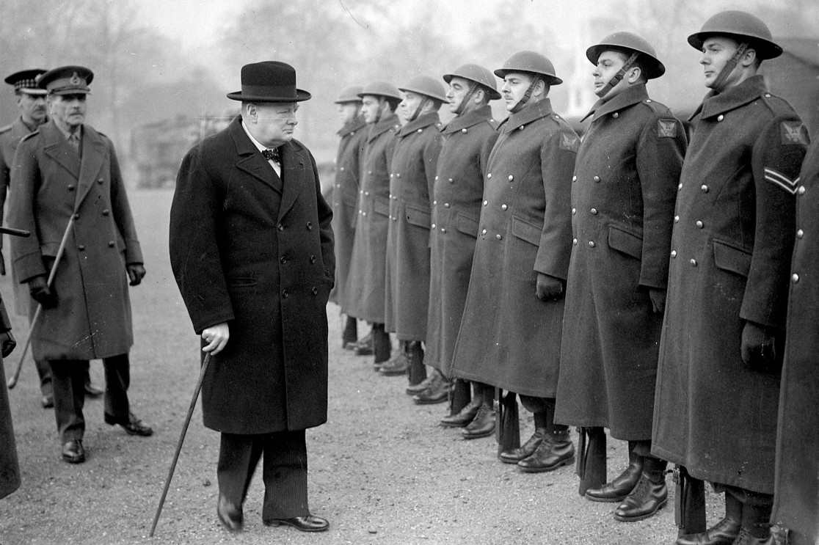
The Man Who Saved the Free World
https://nypost.com/2020/04/25/winston-churchills-words-are-giving-hope-during-the-pandemic/?hcb=1

Slide 13
The Man Who Saved the Free World
In May 1940, Adolf Hitler and his Nazi war machine were sweeping across the European continent. The future of the free world hung in the balance.
An isolationist-leaning United States was an ocean away. There was one man who stood between Hitler’s seemingly invincible army and crushing defeat.
That one man was Winston Churchill.
He was born on November 30, 1874. Though we think of him as the quintessential Englishman, he was actually half American.
His mother, Jennie, was the daughter of a wealthy New York stock speculator.
His father, Lord Randolph Churchill, was of English nobility and a major political figure.
https://www.prageru.com/video/churchill-the-man-who-saved-the-free-world

Slide 14
The Man Who Saved the Free World
From his early school days, Churchill recognized the power of words.
Throughout his life, he used them with consummate skill. They never let him down.
He first made a name for himself as a war correspondent in the 1890s, covering conflicts in Cuba, Northern India, the Sudan, and South Africa.
Though he never abandoned journalism, and became one the greatest historians of his age, Churchill used his family connections and his own fame to launch himself into politics.
His confident manner and matchless oratory marked him as a natural leader.
https://www.prageru.com/video/churchill-the-man-who-saved-the-free-world

Slide 15
The Man Who Saved the Free World
1914 and World War I found him in the key position of First Lord of the Admiralty where he did much to modernize Britain’s navy.
In 1915, Churchill thought he could bring a speedy end to the war by opening a new front in Turkey, which he perceived as the weak link in the German alliance against the allies.
This led to the infamous Gallipoli campaign.
Badly underestimating the fighting strength of the Turks, thousands of British, Australian and New Zealand soldiers were killed in battles that proved to be every bit as indecisive and bloody as the campaigns on Europe’s Western front.
Churchill took the blame.
This was perhaps the low point of his life.
https://www.prageru.com/video/churchill-the-man-who-saved-the-free-world

Slide 16
The Man Who Saved the Free World
Dismissed from the war cabinet, five months later he enlisted in the army, where he saw action in France.
He rose again in British politics throughout the 1920s, making money—as he always did—through his writing and speaking.
As Adolph Hitler took power in Germany in the 1930s, Churchill was one of the first and certainly the loudest voice in England sounding the alarm.
But it was an alarm few in England wanted to hear.
The English had been traumatized, as had all of Europe, by the shocking amount of death and destruction of the First World War.
No one wanted to face the possibility that it could happen again.
https://www.prageru.com/video/churchill-the-man-who-saved-the-free-world

Slide 17
The Man Who Saved the Free World
Churchill, however, saw that a new confrontation with Germany was inevitable.
And when the inevitable arrived with the stunning German attack on France in May 1940, a desperate nation turned to him. He was ready.
His weapons were his pen, his voice and his words. “I have nothing to offer but blood, toil, tears and sweat,” he told the House of Commons in his first speech as Prime Minister.
Things quickly turned from bad to worse.
France collapsed, Belgium surrendered, and a quarter of a million British soldiers barely managed to escape from Dunkirk.
https://www.prageru.com/video/churchill-the-man-who-saved-the-free-world

Slide 18
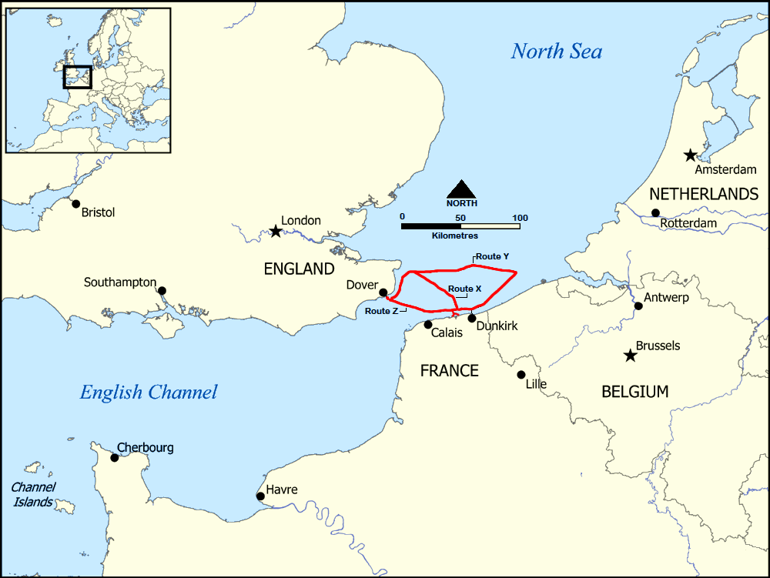
Dunkirk Evacuation
https://commons.wikimedia.org/wiki/File:Dunkirk_Evacuation_shipping_routes.png

Slide 19
The Man Who Saved the Free World
Even as the war news moved from dangerous to desperate to disastrous, Churchill never wavered.
In speech after speech, he infused the British with the spirit to fight on against Hitler’s monstrous tyranny.
“We shall not flag or fail,” he said after Dunkirk. “We shall go on to the end. We shall defend our island, whatever the cost may be…we shall never surrender.”
The point about Churchill in 1940 is not that he stopped a German invasion, but that he stopped the British Government making peace.
If Churchill had not been Prime Minister, the pro-appeasement foreign secretary Lord Halifax would have been.
https://www.prageru.com/video/churchill-the-man-who-saved-the-free-world

Slide 20
The Man Who Saved the Free World
We know that Halifax was open to negotiating with Hitler.
We’d be mistaken to assume that the German Fuhrer’s terms would not have been reasonable; they would probably have been very reasonable, as Hitler wanted to fight a one-front war against Russia.
And an agreement with Britain would have allowed him to do just that.
Churchill made this impossible.
Had he not rallied the British people in the face of defeat after defeat, preventing Hitler from concentrating his full efforts on Russia, the entire history of the free world would have been much different. And, undoubtedly, much darker.
https://www.prageru.com/video/churchill-the-man-who-saved-the-free-world

Slide 21
The Man Who Saved the Free World
Because of Churchill’s efforts and the marvelous resilience of the British people, the United States had an unsinkable “aircraft carrier” —Britain— from which to mount the liberation of the European continent in June of 1944.
For this and so much more, free people everywhere can thank the greatest man of his age—Winston Churchill.
https://www.prageru.com/video/churchill-the-man-who-saved-the-free-world

Slide 22
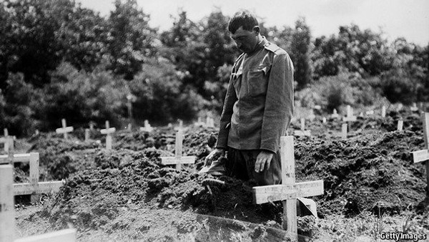
WWI’s Impact on Christianity
https://www.economist.com/erasmus/2014/05/06/from-godlessness-to-ruthlessness

Slide 23
WWI’s Impact on Christianity
While nearly the entire world was touched by the conflict, the First World War greatly impacted the Christian community.
The war made its mark on at least three aspects of the Christian experience with lasting effects.
  The war triggered a paradigm shift in the Christian worldview and “end of time prophecy.”
  Postmillennialism waned among western Protestants.
  Premillennialism started to become popular.
https://www.baptistpress.com/resource-library/news/first-person-wwis-impact-on-christians/

Slide 24
Paradigm Shift in “End of Time Prophecy.”
For hundreds of years Christians had read the book of Revelation with its frightening images of the Apocalypse.
World War I provided a firsthand look at a real-life apocalyptic world.
While many Christian theologians believed the Apocalypse was more allegorical than literal, the Four Horseman of the Apocalypse seemed to come alive during the conflict and its aftermath.
War, famine, disease and death occurred on a worldwide stage and on a scale that truly was unprecedented.
https://www.baptistpress.com/resource-library/news/first-person-wwis-impact-on-christians/

Slide 25
Paradigm Shift in “End of Time Prophecy.”
The war and its destruction marked the beginning of a fundamental shift in the Christian worldview.
After the war and over time, Christians felt less positive about their standing in the world and began to express some pessimism about world affairs.
The war launched a new interest in “end of time prophecy” that peaked in the latter half of the 20th century as the new millennium neared.
https://www.baptistpress.com/resource-library/news/first-person-wwis-impact-on-christians/

Slide 26
Postmillennialism Waned Among Protestants
In the years before World War I, western Protestants largely promoted a view of eschatology called postmillennialism.
Postmillennialists believed that Christian teaching and societal reforms would foster a time of increased Gospel success called the millennium prior to Christ’s return.
The triumph of the Gospel would then usher in responsible human governments promoting peace and prosperity.
Human society, postmillennialists believed, was going to improve.
https://www.baptistpress.com/resource-library/news/first-person-wwis-impact-on-christians/

Slide 27
Postmillennialism Waned Among Protestants
Postmillennialists dominated the 19th century abolition and social reform movements popular among many Christians of that century (and into the 20th century as well).
Although they viewed many of the social reform movements as incomplete since they had no Gospel element, even prominent Southern Baptists like B.H. Carroll (1843-1914) endorsed postmillennialism.
As the horrors of World War I unfolded and uncertainty set in after the conflict, many Christians began to question the idea that human society would get better.
https://www.baptistpress.com/resource-library/news/first-person-wwis-impact-on-christians/

Slide 28
Postmillennialism Waned Among Protestants
Therefore, the First World War marked the beginning of postmillennialism’s decline.
Some still adhered to it after the conflict, but a Second World War, the holocaust and a Cold War with the threat of nuclear destruction led most Western Christians to abandon postmillennialism.
Human reform had not stemmed the collective evils of the 20th century.
https://www.baptistpress.com/resource-library/news/first-person-wwis-impact-on-christians/

Slide 29
Premillennialism Started to Become Popular
While the First World War began to discredit postmillennialism, the war gave new impetus to a premillennial view of the end times popularized earlier by John Nelson Darby and C.I. Scofield.
Premillennialists rejected the belief that the world would get better before Christ returned.
They saw in the war proof that human society without Christ was in fact getting worse.
Pessimistic about human affairs, they believed that Christ would return soon to redeem the elect from an evil world.
https://www.baptistpress.com/resource-library/news/first-person-wwis-impact-on-christians/

Slide 30
Premillennialism Started to Become Popular
Like postmillennialists and amillennialists, premillennialists did not speak with one voice.
Some premillennialists held that Christ would collect His own in a rapture before His second coming while others thought believers would have to endure a period of tribulation before Christ’s return.
Yet all premillennialists believed the world’s slide into anarchy and evil would not be fully or finally reversed before Christ’s second coming.
World War I seemed to offer a contemporary glimpse into the future trauma awaiting the world.
This outlook has continued to the present time throughout most of the Christian world.
https://www.baptistpress.com/resource-library/news/first-person-wwis-impact-on-christians/

Slide 31
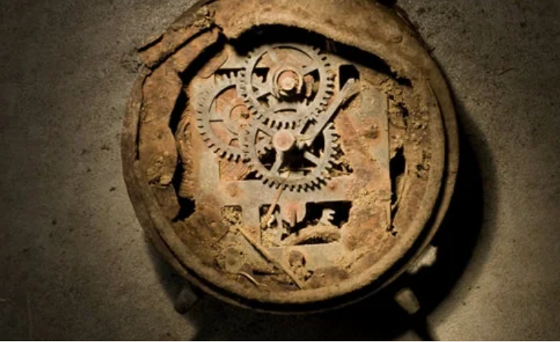
Belief in Millions of Years
https://answersingenesis.org/theory-of-evolution/millions-of-years/where-did-the-idea-of-millions-of-years-come-from/

Slide 32

Class Discussion Time
https://www.weareteachers.com/moving-beyond-classroom-discussions/

Slide 33
*Class Discussion Time
The massive change in Christian eschatology brought about by two major world wars illustrates that, whether we are aware of it or not, our theology is often heavily influenced by what is going on in the world around us. Is that a good thing? Why or why not? And, if not, how can you guard against this?
While Christians must recognize that our primary responsibility to this world is preaching the gospel and making disciples (Mat. 28:18-20), do Christians have a responsibility, where they are able to do so, to speak out against the evils in our world and nation (like the OT prophets often did, or in the NT, John the Baptist in publicly condemning Herod – Mat. 14:3-4) and work to make this world a better place for our neighbors, children, and grandchildren as a part of our responsibility to love our neighbor?
To ask it another way, Jesus commanded us to pray that God’s will be done on earth as it is in heaven (Mat. 6:10). Is that just something that we pray will happen, or should we attempt to make it happen in whatever way we can within our sphere of influence?

