Slide 1


Slide 2
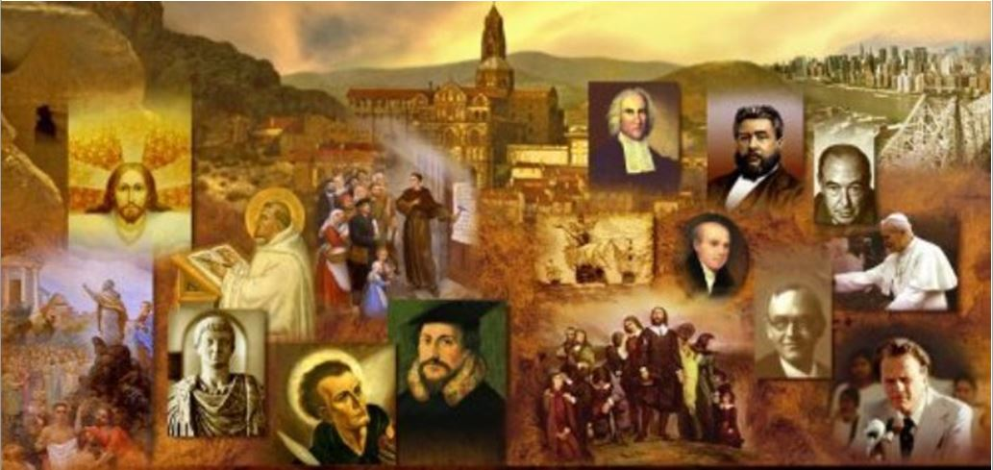
Review
Papias (AD 60–163) was bishop of the church in Hierapolis in Phrygia, Asia Minor.
Most of Papias’ writings (dated at around AD 110-130) have been lost except for some brief excerpts that we find in the works of whom?
  Irenaeus (writing in AD 180) and Eusebius (writing in AD 320).
What are the two claims Eusebius tells us were made by Papias that we sometimes find cited in the introduction to the Gospels of Matthew and Mark in our study Bibles?
  That Matthew’s Gospel was originally written in Aramaic
  That Peter was the source for Mark’s Gospel

Slide 3
Review
The Shepherd of Hermas was written in Rome around the middle of the second century. It was said to be the work of a Christian prophet named Hermas and was very popular for centuries.
Describe what you remember about the content of the Shepherd of Hermas.
  In this book, Hermas describes a series of revelations that he claims to have received from two heavenly figures: an old woman and an angel dressed as a shepherd.
  The book contains five visions, twelve commandments, and ten parables.
What was a major concern that is raised in the book concerning baptism?
  Whether Christians can be forgiven for committing serious sins after baptism. Hermas has heard from “certain teachers” that there can be no forgiveness of serious sins after one’s baptism. The angel tells him that serious post-baptismal sin can be forgiven - but only once.

Slide 4
Review
According to Justin Martyr (AD 100-165), what activities took place in the church worship service held in his day?
  The Reading and Expounding of Scripture,
  Prayer
  The celebration of the Lord’s supper.
What church activity is noticeably absent from Justin’s description?
  Singing
For the most part, when the early church did sing, what was it that they sang?
  The Psalms of the Old Testament, and some of the poetic parts of the New Testament (e.g. the Virgin Mary’s praise of God in Luke 1:46-55).
  It was probably not until the 4th century that the singing of hymns written by ordinary Christians began to become common.

Slide 5
Review
According to Theodoret of Cyrrhus (AD 393-457) how did the early church view the use of musical instruments in church?
  The early Church looked on musical instruments as being part of Jewish or Pagan worship, but not part of the apostolic tradition of Christian worship.
What was the posture of early church attendees during their worship service?
  They would stand for the entire service.
  The Western Church only began to introduce pews (fixed seats in the main part of the church building) in the 14th century – quite a late development.
  The Eastern Church never introduced pews into Eastern church buildings.

Slide 6
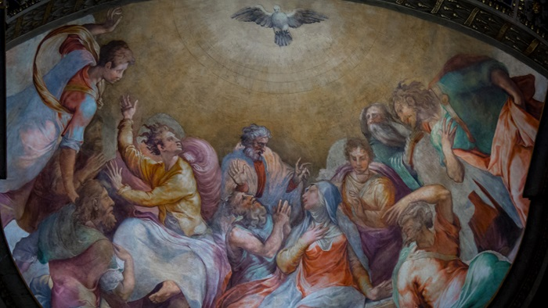
Worship in the Early Church
(Continued)
https://www.christianitytoday.com/history/issues/issue-37/worship-in-early-church-did-you-know.html

Slide 7
*Worship in the Early Church
Nick Needham outlines a fairly typical church service in the second century (A.D. 101-200), based on descriptions and instructions found in the early Church fathers.
The service took place on Sunday and lasted about three hours in total, with the typical posture being standing throughout. There were no musical instruments, and the Lord’s Supper was observed every week.
Their Service was divided into two parts.
* Needham, Nick. 2,000 Years of Christ's Power Vol. 1: The Age of the Early Church Fathers

Slide 8
Part 1: Service of the Word
Opening greeting by bishop and response by the congregation – Often, the bishop would say “The Lord be with you” and the congregation would respond, “And with your spirit.”
Old Testament Scripture reading – Usually read or chanted by a deacon.
Psalm or hymn
New Testament Scripture reading – This first NT reading was from any NT book outside the gospels.
Psalm or hymn
New Testament Scripture reading – From one of the four gospels.
Sermon – Delivered by the bishop, while seated.
Dismissal of all but baptized believers
* Needham, Nick. 2,000 Years of Christ's Power Vol. 1: The Age of the Early Church Fathers

Slide 9
Part 2: The Eucharist
Congregational prayers
  The prayer leader—the bishop in the West; senior deacon in the East—would announce the first topic.
  The congregation prayed silently for a while.
  Then the leader summed up the petitions with his own spoken prayer.
  Then he would do the same pattern again with a new topic. This was a lengthy part of the service.
  Early Christian art suggests that a typical posture from praying was standing, looking heavenward, with arms outstretched and palms up.
* Needham, Nick. 2,000 Years of Christ's Power Vol. 1: The Age of the Early Church Fathers

Slide 10
Part 2: The Eucharist
The Lord’s Supper
  The bishop offered a greeting. The congregation responded
  There was a “kiss of peace” (men to men, women to women);
  Offertory - Church members brought their own small loaf of bread and flask of wine from home; the deacons took these and spread them out on the Lord’s table, emptying the flasks of wine into one large silver cup.
  The bishop and the congregation engaged in a liturgical “dialogue” with each other;
  The bishop led the congregation in prayer;
  The bishop and the deacons broke the bread and distributed the cup to the congregation.
  Something would be said to each member as he or she received the elements (e.g., “The bread of heaven in Christ Jesus,” with the response of “Amen.”)
  Unconsumed bread and wine would be taken home by church members to use for celebrating communion at home during the weekdays.
Benediction – e.g., “Depart in peace,” spoken by the deacon
* Needham, Nick. 2,000 Years of Christ's Power Vol. 1: The Age of the Early Church Fathers

Slide 11
*Some Surprising Things About
Worship in the Early Church
For many modern Christians, two aspects of this early Church worship will stand out as quite striking:
  The first is the fact that the early Church did not allow unbelievers to be present when the congregation prayed (and received the Lord’s Supper).
  This was because, in early Church thinking, the congregation at prayer was participating by the Holy Spirit in the glorified Christ’s own heavenly ministry of prayer.
  This was something in which unbelievers could not share, for they lacked the Spirit.
* Needham, Nick. 2,000 Years of Christ's Power Vol. 1: The Age of the Early Church Fathers

Slide 12
*Some Surprising Things About
Worship in the Early Church
For many modern Christians, two aspects of this early Church worship will stand out as quite striking:
  The second is the way that all church members brought their own bread and wine to be used in communion.
  The early Christians attached great significance to this provision of the communion bread and wine by every church member: it was the whole church offering itself to God, as together all its members presented to Him the fruits of His creation.
  When the deacons placed the loaves and wine on the Lord’s table, they were (in a symbolic sense) laying the congregation itself on the table through its gifts, thus consecrating the people to Christ.
  As the great early Church father Augustine told his people at communion, “There you are, on the table; there you are, in the cup.”
* Needham, Nick. 2,000 Years of Christ's Power Vol. 1: The Age of the Early Church Fathers

Slide 13
*The Use of Liturgy in the Early Church
The use of “liturgy” – fixed, written prayers and exhortations to be read out by the bishop and congregation – is found from a very early date in Christian worship.
The oldest known example of a church’s liturgy for holy communion occurs in the writings of Hippolytus (AD 170-235). He was a presbyter in the church at Rome who later died a martyr’s death.
Hippolytus’s Church Order contains the communion liturgy from the church in Rome.
* Needham, Nick. 2,000 Years of Christ's Power Vol. 1: The Age of the Early Church Fathers

Slide 14
*The Use of Liturgy in the Early Church
After the deacons collected the bread and wine brought by the congregation, the bishop and congregation recited the following dialogue and prayer:
  Bishop: The Lord be with you.
  Congregation: And with your spirit.
  Bishop: Lift up your hearts.
  Congregation: We lift them to the Lord.
  Bishop: Let us give thanks to the Lord.
  Congregation: It is fitting and right.
* Needham, Nick. 2,000 Years of Christ's Power Vol. 1: The Age of the Early Church Fathers

Slide 15
*The Use of Liturgy in the Early Church
After the deacons collected the bread and wine brought by the congregation, the bishop and congregation recited the following dialogue and prayer:
  Bishop: We thank You, O God, through Your beloved Servant Jesus Christ, whom You have sent to us at the end of days as Savior, Redeemer, and Messenger of Your plan, the Logos who comes from You, through whom You have created the cosmos, whom You chose to send down from heaven into the womb of the Virgin, and in her body He became flesh, and was revealed as Your Son, born of the Holy Spirit and the Virgin. To carry out Your plan and make a sanctified people for You, He stretched out His hands [on the cross] when He suffered, so that everyone who trusts in You might be released from suffering.
* Needham, Nick. 2,000 Years of Christ's Power Vol. 1: The Age of the Early Church Fathers

Slide 16
*The Use of Liturgy in the Early Church
After the deacons collected the bread and wine brought by the congregation, the bishop and congregation recited the following dialogue and prayer:
  Bishop: When by His own sovereignty He yielded Himself to suffering, to loose death’s bonds and break the devil’s chains, to trample hell under His feet and shed His light on the righteous, to set up the boundary and manifest the resurrection, He took a loaf, gave thanks and said, “Take, eat, this is My body given for You.” Likewise He took the cup and said, “This is My blood which is outpoured for you. In doing this, you are remembering Me.”
* Needham, Nick. 2,000 Years of Christ's Power Vol. 1: The Age of the Early Church Fathers

Slide 17
*The Use of Liturgy in the Early Church
After the deacons collected the bread and wine brought by the congregation, the bishop and congregation recited the following dialogue and prayer:
  Bishop: Remembering, therefore, His death and resurrection, we offer to You the loaf and the cup, thanking You that You have favored us to stand in Your presence and serve You as priests. We pray that You will send down Your Holy Spirit on this offering of the church. Make it a single offering, and grant to all Your sanctified people who eat and drink that we may be filled with the Holy Spirit and nourished in our faith in the truth, that we may praise You and glorify You through Your Servant Jesus Christ, through whom be glory and honor to You in Your Church, now and for ever. Amen.
* Needham, Nick. 2,000 Years of Christ's Power Vol. 1: The Age of the Early Church Fathers

Slide 18
*Early Church Annual Calendar
Christian worship revolved around Sunday, or “the Lord’s day” as the early Church called it – the day on which the Lord Jesus had risen from the dead.
However, this weekly pattern of worship followed a yearly pattern which revolved around Easter.
Easter was the Christian equivalent of the Jewish Passover. Christ had died at the same time that the Passover lamb was sacrificed; so Christians celebrated their Savior's death at Easter, when Jews were celebrating the Passover.
* Needham, Nick. 2,000 Years of Christ's Power Vol. 1: The Age of the Early Church Fathers

Slide 19
*Early Church Annual Calendar
The churches of Asia Minor observed Easter on the precise day of Passover, the fourteenth of Nisan (in the Hebrew calendar), which was not necessarily a Sunday.
But the churches of Palestine, Alexandria and Rome always observed Easter on a Sunday, the one that fell just after the fourteenth of Nisan.
This caused a serious controversy in the 2nd century, the Quartodeciman controversy (from the Latin word for “fourteenth”), but at the Council of Nicaea in the 4th century the custom of observing Easter on Sunday triumphed.
* Needham, Nick. 2,000 Years of Christ's Power Vol. 1: The Age of the Early Church Fathers

Slide 20
*The Agape (Love) Feast
A worship custom which was a part of church life in these early centuries, but is not mentioned in the detailed description of early church worship given by Justin Martyr (AD 100-165), was the “agape (love) feast”.
  Tertullian (AD 160-220), the great 3rd century theologian, describes the agape feast as a communal meal, which begins with prayer, followed by people eating and drinking, the singing of hymns, and a closing prayer. (Apology 39) He does not connect this event with the bread and wine of the Eucharist.
  Hippolytus (AD 170-235) tells us that the agape feast consisted of a meal that was taken by believers at someone's house or in the church and was presided over by a church officer – normally the bishop. (Apostolic Tradition 26.5)
* https://www.biblestudytools.com/dictionaries/bakers-evangelical-dictionary/love-feast.html

Slide 21
*The Agape (Love) Feast
Some will try to argue that the agape feast in the early church was always done in conjunction with the Lord's Supper.
But neither Tertullian nor Hippolytus mention the Lord’s Supper in their detailed descriptions of the agape feast, and the citations from the church fathers that I have seen given to support this connection between the Lord’s Supper and the agape feast seem rather weak:
  Ignatius (AD 35-108) in his letter to the Smyrneans (Chapter 8) says, “It is not lawful apart from the bishop either to baptize or to hold a love-feast [agape].” Some see “love-feast” here as a reference to the Lord’s Supper done in conjunction with a meal.
  The Didache (AD 100) after giving instructions concerning the taking of the Eucharist (Lord’s Supper) says, “But after you are filled, give thanks…” which some see as implying that there must have been a meal associated with the taking of the Lord’s Supper.
* http://earlychurch.com/LoveFeast.html

Slide 22
*The Agape (Love) Feast
In the 1 Corinthians 11:17-22 we do see an example of a New Testament church that celebrated the Lord’s Supper in conjunction with a meal (though we’re not told whether they called that meal a “love feast”). But in that passage the Apostle Paul takes them to task for what they were doing because the wealthy members of the church body were eating in excess while the poor members went hungry.
In Jude 12 it mentions the practice of a “love feast” in which “certain ungodly people” (cf. vs. 4) shamelessly participated when they should have been excluded. But there is nothing in this text to indicate whether or not they partook of the Lord’s Supper as a part of this feast.
In Acts 2:46 it tells us that “day by day” the early Christians attended the temple together and “breaking bread in their homes, they received their food with glad and generous hearts”. “Breaking bread” here would seem to refer to eating a meal. Some commentaries see this as a reference to the Lord’s Supper, possibly in conjunction with a meal – perhaps a “love feast”? But there is really not enough information here to know for sure.
* Needham, Nick. 2,000 Years of Christ's Power Vol. 1: The Age of the Early Church Fathers

Slide 23
*The Agape (Love) Feast
In conclusion, we see a number of indications that it was common for churches in the first few centuries to have a communal meal called a “love feast” that was usually overseen by a bishop and involved singing and prayer, and, in some cases, it might have included a celebration of the Lord’s Supper, but we can’t say for sure that it always did.
These “love feasts” continued as a part of early church worship into the 5th century, when it began to fade into disuse. Between the sixth and eighth centuries it vanished altogether.
* Needham, Nick. 2,000 Years of Christ's Power Vol. 1: The Age of the Early Church Fathers

Slide 24
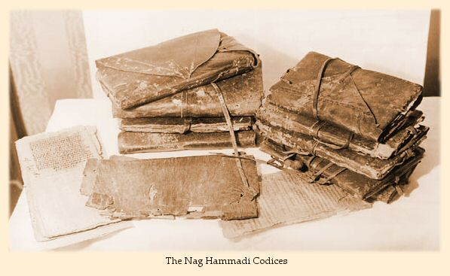
Gnosticism
http://jewishchristianlit.com/Texts/nagHam.html

